Slide 1
Artist’s Resale Rights in South Africa

Slide 2
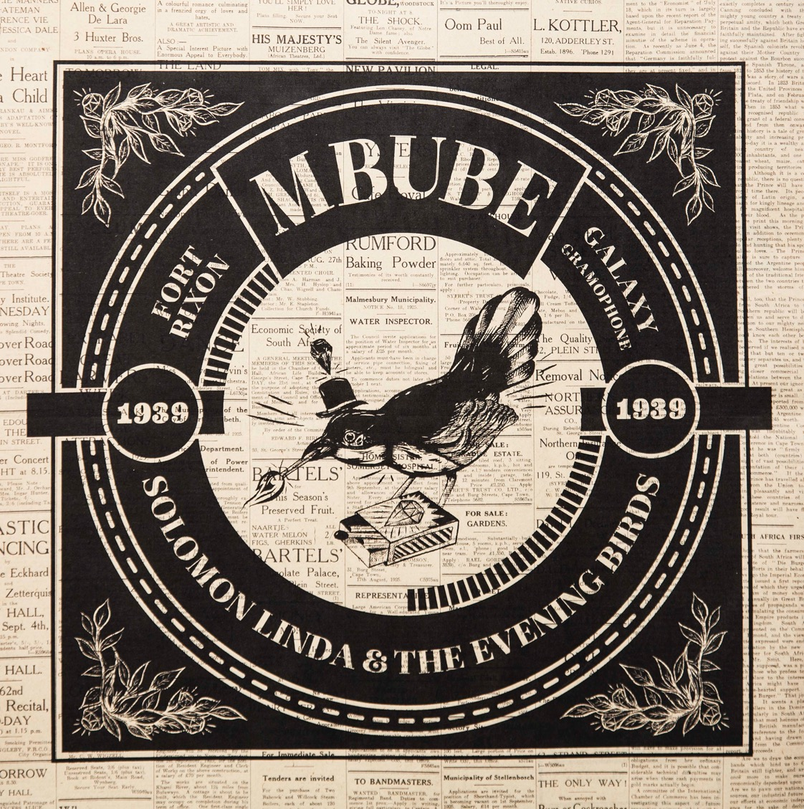
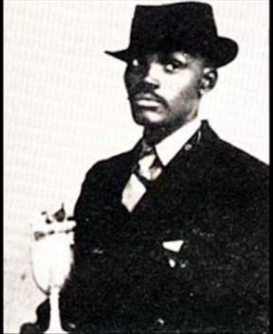

Slide 3
History of rights and royalty abuse in most art forms, often on racial lines (Solomon Linda case)
No legislative framework in South Africa
Royalty structures in some art forms - music and literature.
Strong, established secondary market

Slide 4
Aspire Art Auctions launches in 2016
Successful inaugural auctions in Johannesburg and Cape Town
Skillset focused on primary and secondary markets in SA - historic, modern and contemporary art
From the outset committed to sustainability – supporting the industry
Motivated by wish to improve economic conditions of artists in SA and help keep them making art.
Redress and inequality in SA art

Slide 5
Aspire introduces Artist’s Resale Rights effective immediately from its inaugural auction in Johannesburg in 2016
Sliding scale of royalties on European model
Only to living artists, not to estates – estates and heirs often a difficult legal terrain
Aspire absorbs the total cost of the undertaking, unlike major metropolitan markets
Commitment to growing and sustaining the market as a leader in the field
Not enough in itself to sustain the market, but if others follow there is critical mass for artists and the whole art world

Slide 6
16 living artists benefit from inaugural auction, 33 from second auction, around 26 stand to benefit from most recent auction
Equitable wealth distribution in the market – no framework economically for the system, so must self-regulate
In some countries, payment of royalties attracts tax incentives. No existing tax implications exist in SA due to a lack of legislative framework.

Slide 7
Louis Maqhubela
b. 1939 South Africa
Exiled King
conté on paper
130.5 cm x 95 cm
Estimates: R 60 000 – 80 000
Sold for: R 300 000 (hammer)

Slide 8
Artist’s support: “your e-mail was like a whisper from the 'Old Ones' - a grand affirmation of ethical market practice, goodwill and generosity that really made my day” SA exiled artist, Louis Maqhubela.

