Slide 1

DEBT RELIEF POLICY
Engagement with the Portfolio Committee on Trade and Industry with respect to policy on debt relief
National Treasury, 30 May 2017

Slide 2
PART 1: INTRODUCTION

Slide 3
Background
Last week (24 May) NT presented some perspectives on the dti proposals for debt relief
NT supports the PCs drive for stronger relief for overindebted South Africans, and welcomes the opportunity to engage on the proposed Debt Relief Policy
In general NT supports dti proposals, especially:
  The principle that rules governing debt relief should be strict and clear to limit potential for moral hazard and abuse
  Improving the regulatory and enforcement capability of the NCR in line with regulator powers under twin peaks, esp. “internal” enforcement and settlement agreements
  Stronger action to be taken against reckless lending
  Urgent legal certainty for application of the in duplum rule
  Improvements to the the DC framework to better support low-income workers
  Wide consultation to include the range of effected government departments

Slide 4
RECAP: Main recommendation on debt relief
Propose we facilitate the voluntary extinguishing of debt by banks and credit providers for the poorest of the poor, for indigents / NINAs
  also need to deal with non-bank lenders (retailers, micro-lenders)
This will need careful engagement on:
  The aggregate level of the write-off: what is fair to the industry but will help the poorest South Africans? Who will bear the cost of this across banks and non-banks?
  The maximum level of debt per person to be written off?
  What about debt that has already been on-sold to debt collectors – must reach these
  To get consumer behaviour right and prevent moral hazard, should we require co-payments by the borrower?
  How can we change behaviour over the long term and incentivise savings?
  Will need to consider the extent that government can share in this cost, minimise the burden on the fiscus
  This process CANNOT threaten the stability of the system, and MUST NOT lead to relieved persons being again indebted in 6 months time

Slide 5
Summary of PC issues and questions
In addition to points/questions of clarity, the PC raised a number of issues and questions in relation to the NT presentation, summarised as:
  Banks are already making accounting provisions for losses (5-7%), debt relief must exceed this
  NCA is already powerful and may not be optimally used, especially wrt reckless lending
  Fragrant abuses in debt collection noted, which lie outside scope of the NCA
  What will be the costs to the economy and the sector of debt relief?
  Noted that there are international case studies of various forms of debt extinguishing, and reminded that South Africa has never before gone this route
  What are the potential constitutional challenges to the current proposals?
  It was agreed that the need for relief must be balanced against the need for financial stability, but that systemic risk cannot be an excuse for “doing nothing” (or too little)

Slide 6
Summary of requests for further information
In beginning to map out a way forward, the PC made the following requests of NT:
Long term deliverables
  Legal Opinion: The Committee requested an opinion on the constitutionality of ‘expropriating’ financial assets. We are requesting this from senior legal counsel.
  Analysis on the solvency and stability implications of the debt forgiveness. The Committee requested NT outline what the systemic implications would be for debt forgiveness. This analysis will include the first round effects on financial institutions, second round effects (like the implications of failures of retail financing companies on banks), as well as an assessment of future lending behaviour.
  A sense of what the industry view is. The committee asked for a sense of what the industry view is on the proposals. This may possible involve many stakeholders beyond the narrow banking sector.
Immediate deliverables
  Outlining how we intend on engaging with various stakeholders (like the Department of Justice)
  For NT to share their experience with the public sector audit of garnishee orders (outlined in Annex F of the 2017 Budget)

Slide 7
PART 2: A COORDINATED APPROACH TO OVERINDEBTEDNESS

Slide 8
Overindebtedness crisis escalated to Cabinet
Government is concerned about the very high levels of household debt and over-indebtedness. Thus, in addition to broader financial sector regulatory reforms, an immediate set of comprehensive steps is necessary to deal with the problem of present and future household over-indebtedness
Cabinet (December 2013)
Primary concern for Government as the employer is the high indebtedness of Public Service Employees …the need is to relieve and/or rescue Public Service employees from the debilitating over-indebtedness and minimize the risk of recurrence
  DPSA (January 2015)

Slide 9
Co-ordinated intra-Government response
With so many Government agencies involved, an Oversight Committee was established to design and implement steps to help those already indebted and prevent those from becoming indebted in future
Comprised DOJ, SARB, FSB and the NCR and co-chaired by NT and dti
Committee has stopped meeting owing to far progression of projects
NT has excellent relationship with DOJ: involved in Debt Collectors Amendment Bill and Courts of Laws Amendment Act (to Magistrates Court Act)
Insolvency Bill being revived…
Continue to meet as and when required

Slide 10
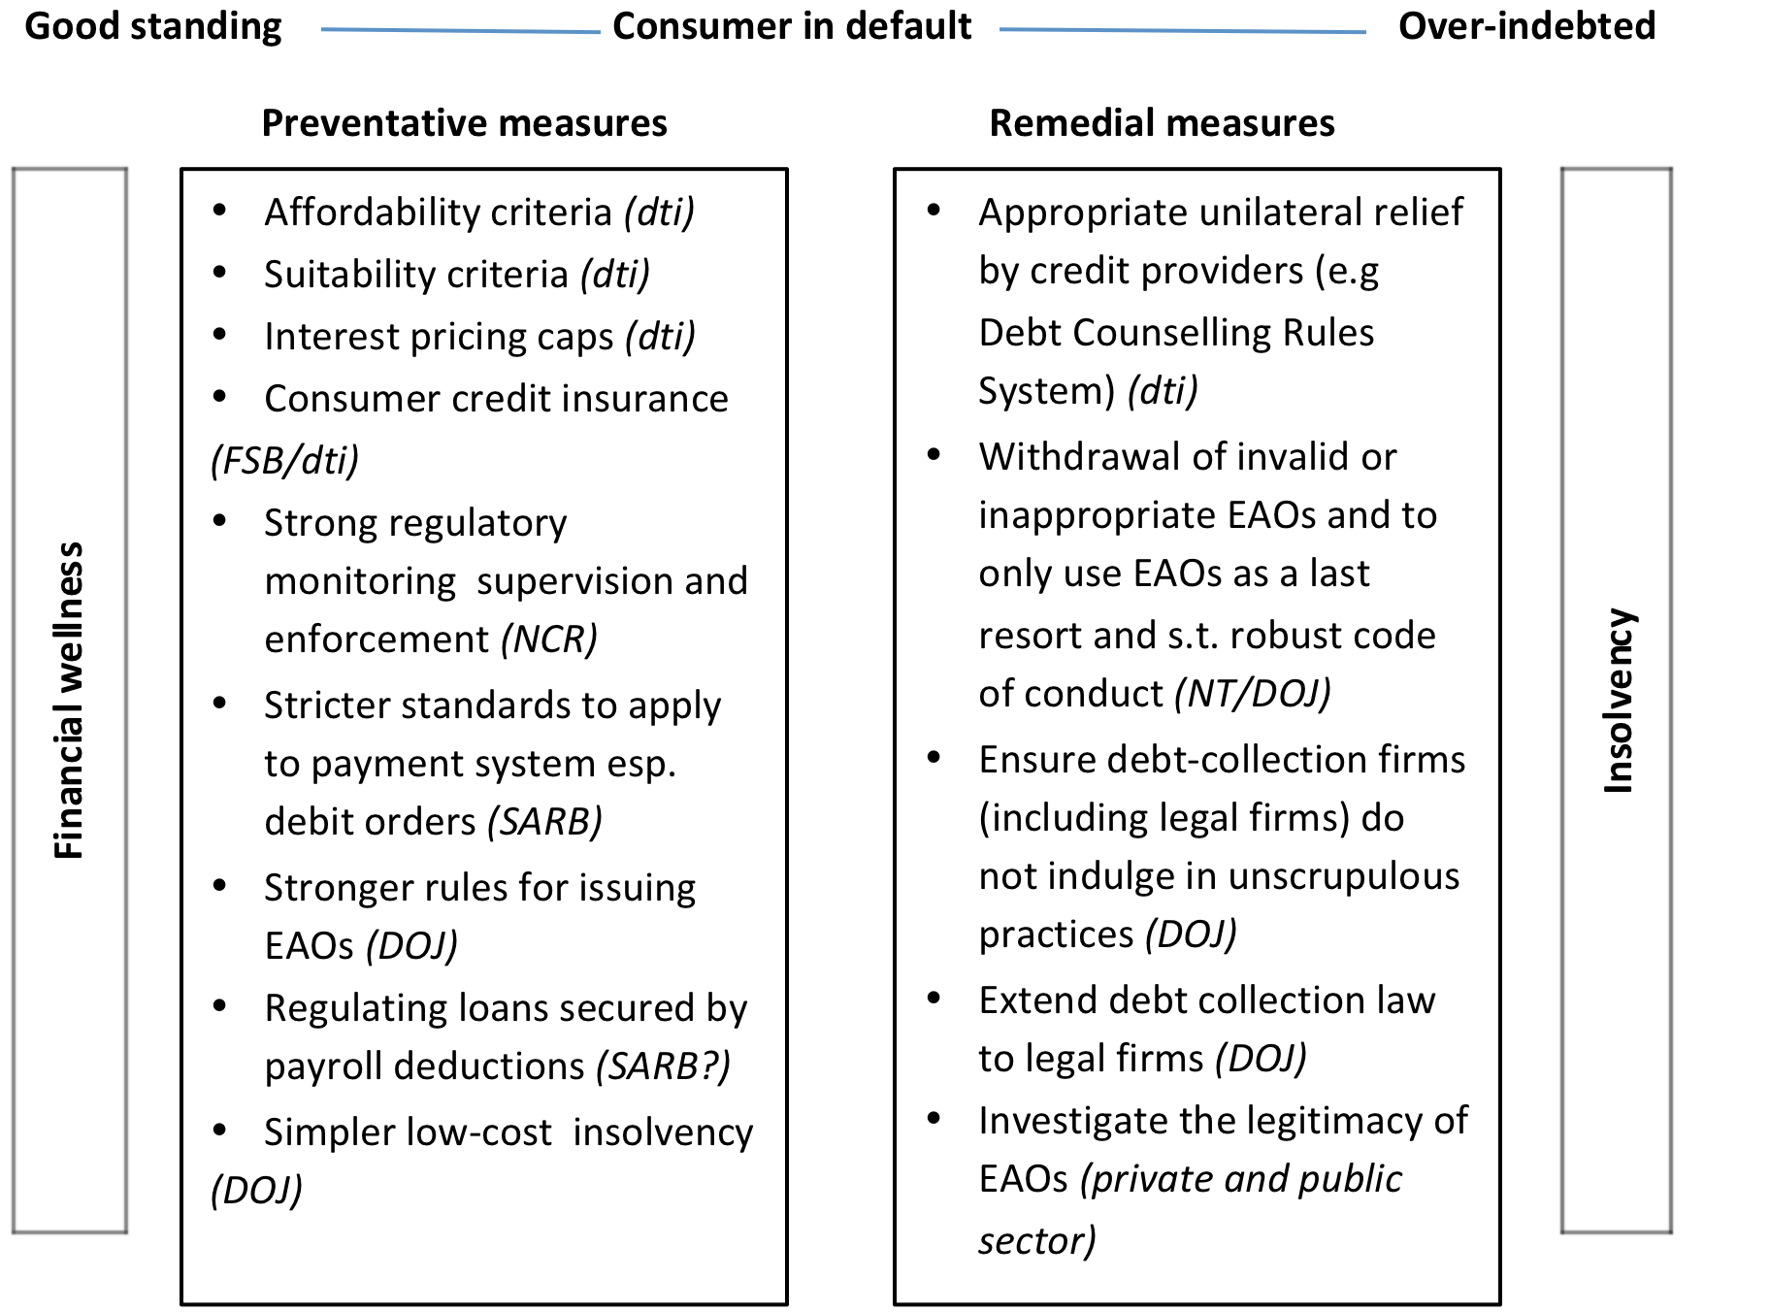
Cabinet approved measures aimed at assisting over-indebted households

Slide 11
PART 3: TAKING RESPONSIBILITY –
EMOLUMENTS ATTACHMENT (GARNISHEE) ORDERS
SOLUTION FOR GOVERNMENT

Slide 12
Extreme abuse of EAOs necessitated extreme action
Garnishees orders: “outright preying on the vulnerabilities of low income and working people”.
  Minister of Trade and Industry (August 2012)
“We are concerned by the abuse of emolument attachment orders that has left many workers without money to live on after they have serviced their debts every month. .. all employers, including the public sector, can play a role and assist their workers to manage their finances and to interrogate all emolument attachment or garnishee orders to ensure that they have been properly issued. “
  Minister of Finance (February 2013)
“The Minister of Finance will also take steps to encourage employers to assist their over- indebted employees by investigating employees’ emolument attachment orders for validity” … Public sector employers will be expected to lead by example.
Cabinet (December 2013)
In June 2013: 15.95% of employees in national departments had EAOs (one or more, sometime up to 14) against their salaries; 11% in provincial departments and 6.7% in the formal private sector
  Law Clinic of the University of Pretoria (January 2015)

Slide 13
The action plan
In December 2013 Cabinet expressed concern about the high levels of household over-indebtedness and authorised the Ministers of Finance and Trade and Industry to take measures to assist over-indebted households and also prevent them from becoming over-indebted in the future
One of the measures identified was to address unlawful Emolument Attachment Orders (EAOs)
Government, through the National Treasury, appointed service provider Q LINK Holdings (Pty) Ltd for two years to:
  Investigate EAOs granted against public servants and deducted from their salaries via PERSAL and address any abuse; and
  Implement an on-going solution for managing EAOs to ensure that no illegally-issued EAOs are enforced against public servants.
The solution was implemented in July 2016

Slide 14
Positioning of the EAO Project
This project fits in with the Department of Public Service and Administration: Public Service Employee Debt Relief Programme, which aims to address of the high level of public servants indebtedness.
The project consists of three components:
  Escalating existing financial wellness management initiatives under the direction and auspices of DPSA
  Filtering and reviewing PERSAL (i.e. payroll) deductions in respect of EAOs, address abuse and implement an on-going solution for the management of EAOs
  Implementing financial-based interventions for debt relief and rescue. A service provider has been appointed under the auspices of DPSA to develop a viable framework on financial intervention to reduce the burden of indebtedness on public servants.

Slide 15
Scope of work
The Terms of Reference define the scope of work as:
Investigating the extent to which public servants have been served with EAOs (other than those for maintenance and child support)
Investigating the legitimacy and validity of the EAOs that have been served against the employees
Scrutinising all irregularities on EAOs and challenging vendors who exploit the system by stopping further deductions, where necessary, and arranging refunds for money that has been unlawfully deducted
Ensuring that each EAO receives a repayment plan, in order to ensure that vendors do not abuse the system by deducting more than the amount stipulated on the repayment plans or exceed the term stipulated
Negotiating reduced instalments in court on behalf of the employees, where necessary.

Slide 16
Role players
Government Departments: to assist Q LINK when approached to obtain the original EAO that was served if it cannot be obtained
NT and Financial Systems (PERSAL): provide the EAO deduction data of all Government employees to Q LINK on a monthly basis via a predefined interface
Q LINK: implement the on-going solution for the management of EAOs; working with University of Pretoria’s Law Clinic to produce comprehensive reports outlining the extent and abuse of EAOs within government

Slide 17
Q LINK’s fees
Section 65 (J)(10) of the Magistrates’ Courts Act 32 of 1944 (the Act) allows that an employer may recover a commission of up to 5 per cent of all amounts deducted and payable to credit providers in respect of services rendered in terms of EAOs
The Q LINK contract stipulates that the 5 per cent deduction that government could have recovered under the Act would be forfeited to the service provider
The total cost of the project is therefore 5 per cent (inclusive of VAT) of the value of each EAO instalment as a monthly administration fee. There are no additional fees/charges to government
It is important to highlight that the 5 per cent commission is effectively paid by the judgement creditor, not the employee or the employer

Slide 18
Headline results
The reporting period is from July 2016 to March 2017
For period July 2016 to March 2017 the following have been realised:
  Saving of R142 713 935 to employees
  Decrease in the number of deductions from 114 371 in July 2016 to 84 356 in March 2017 (a decrease of 26%)
Of this total:
  Sec 65J Emolument Attachment Orders: Numbers reduced from 99 472 to 71 521; Value reduced from R52 117 158 to R35 606 083
  Sec 74 Administration Orders: Numbers reduced from 14 899 to 12 835; Value reduced from R12 355 348 to R10 714 671

Slide 19
Nature of terminations
REFERENCE | DEFINITION
Balance Depleted | Correct amount claimed in EAO has been paid in full.
Consent to Stop | Collector informed Q LINK that EAO has been paid in full. (Take-on balance was excessive)
Excessive Fees | Collection fees charged by collector are in excess of the MCA Regulations.
Excessive Interest | Interest claimed by the collector is more than allowed as per the NCA Regulations.
Fraud & Other | Deductions stopped based on fraudulent activity, or any other irregularities not answered by the collector.
In Duplum | Amounts claimed by the collector exceeds that allowed by the NCA.
Jurisdiction of EAO | EAO was issued out of a court without the necessary Jurisdiction over the Employer.
Outlier Amount | Judgement Debt claimed by the Administrator is more that what is allowed according to the Act (Sec 74 MCA).
Reinstatement Termination | Further amounts are claimed by the collector, should the amount claimed be more than what Act's allowed to be paid, the request is terminated.

Slide 20
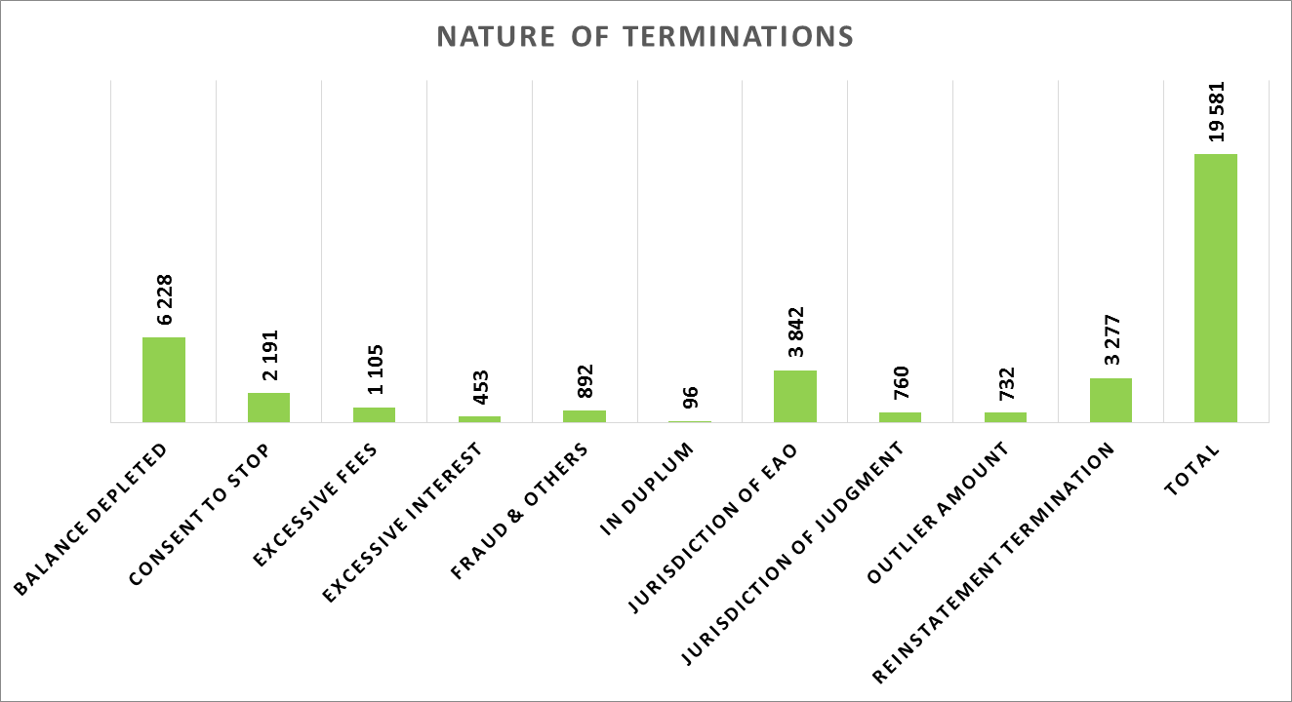
Nature of Terminations - July 2016 to March 2017

Slide 21
Case study: Refunds due to employees
Identified refunds to Government employees to the amount of R767036 at just one of the credit providers
Credit provider participated and agreed to refund the aforementioned amount to Government employees.
Believe similar refunds can be forthcoming from other debt collectors.
Q LINK designed and piloted a refund process to government employees within the insurance industry
Exploring this process to facilitate refunds to Government employees

Slide 22
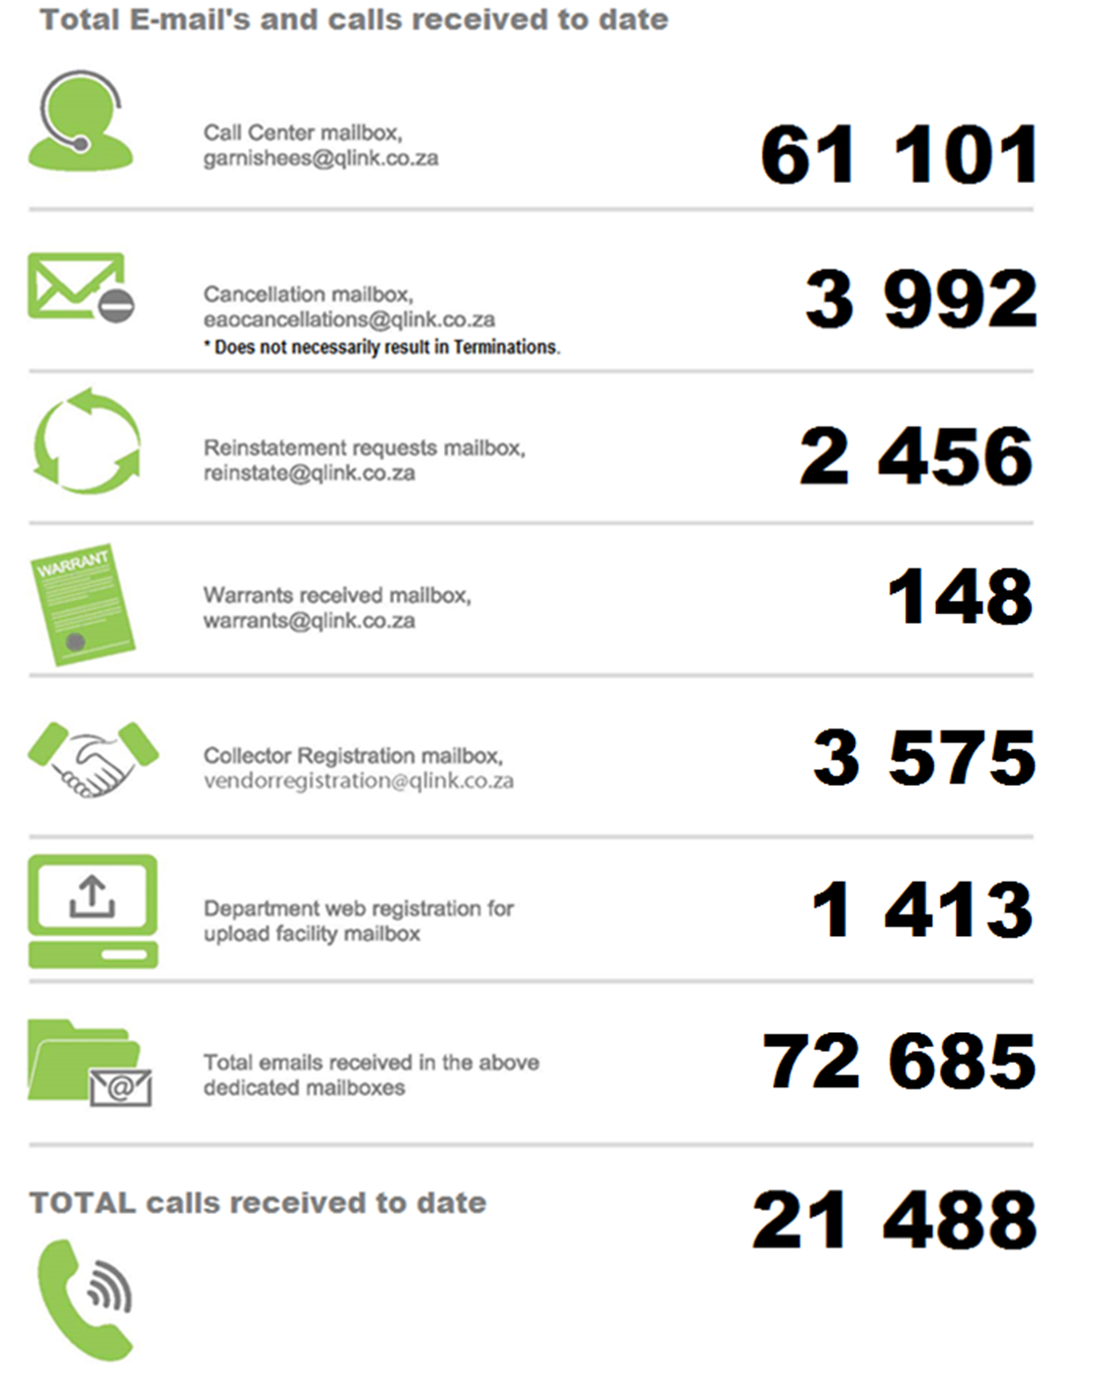
Email and call center statistics

Slide 23
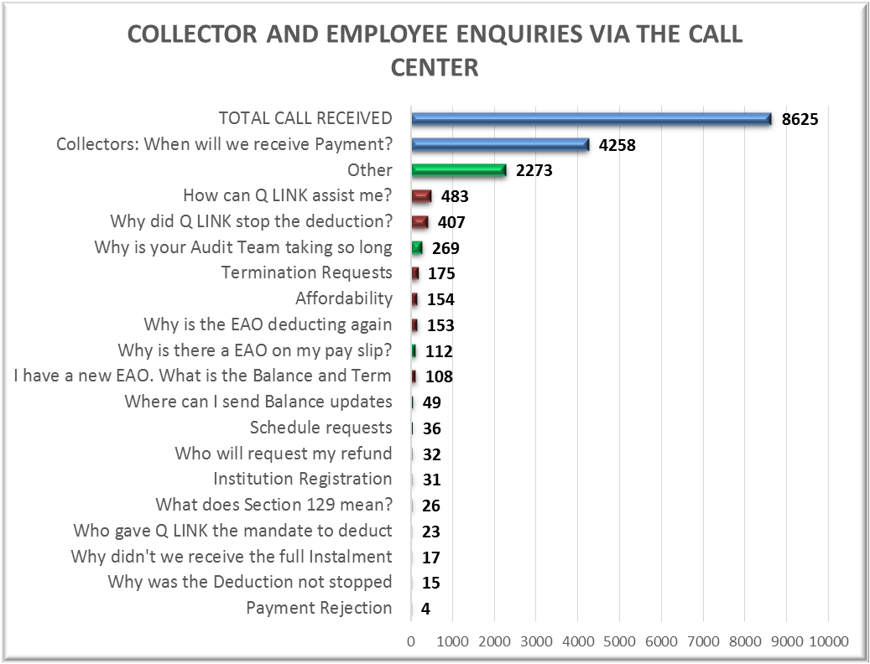
Call Center Stats and Enquiries

Slide 24
Highest 10 Collectors based on Q1

Slide 25
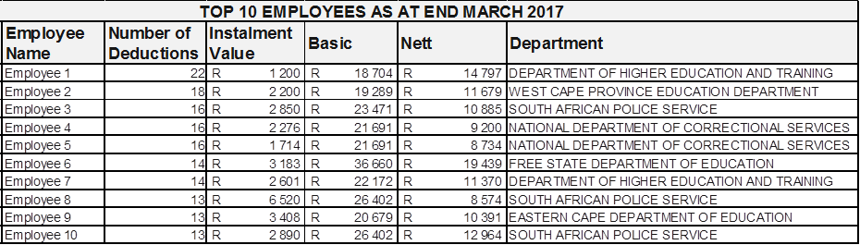
Employees with the largest collection exposure

Slide 26
Top 10 departments with the largest collection exposure
Departments with the largest collection exposure
Top 10 departments make up around 63% of total deduction

Slide 27
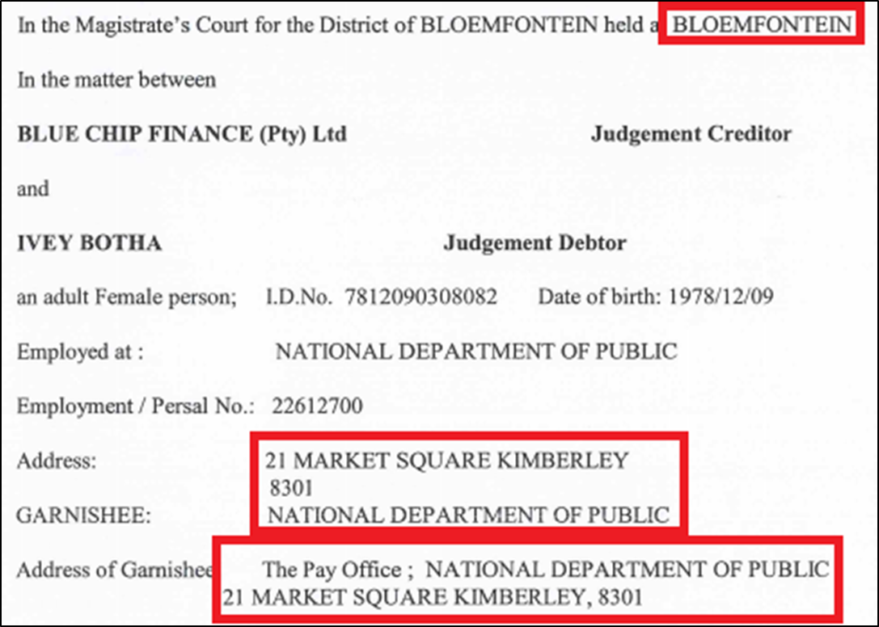
Case study: Jurisdiction of EAOs

Slide 28
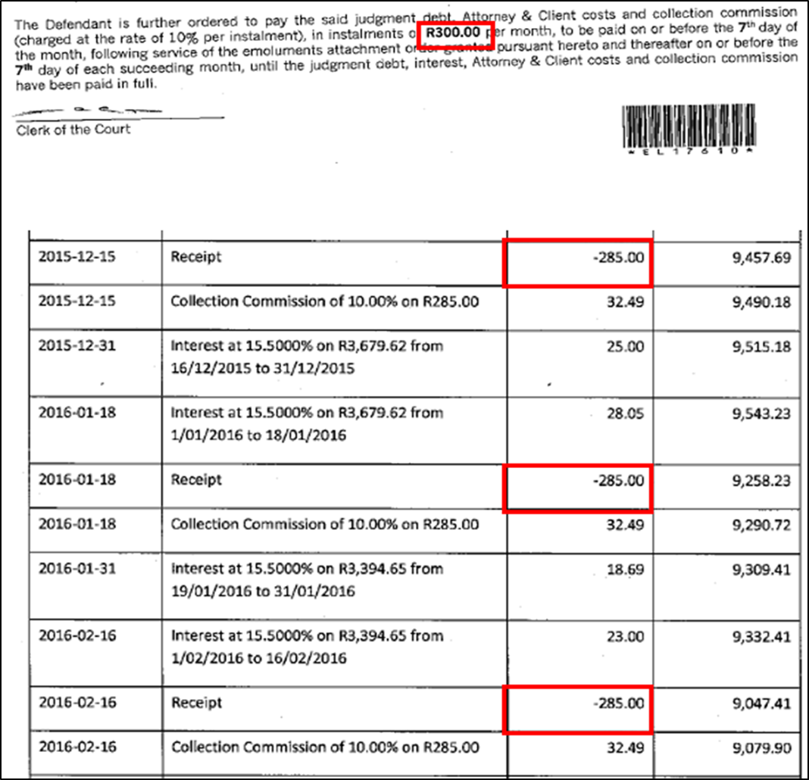
Case study: Misallocation of 5%

Slide 29
Current legal focus
Fraudulent EAOs
  Case numbers don’t exist (OR)
  Those for which there are court files, files were allocated to completely different parties
Deregistered collectors
  Deregistration means they no longer exist in the eyes of the law and therefore cannot trade in their entities’ name

Slide 30
What is the PC wanting to achieve?
Who should benefit from this plan?
  Poorest of the poor – NINAs – YES, but others…?
  Low income, no assets?
  Low income, low assets?
  Other?
  Feasability of debt forgiveness programme in SA highlights:
    Different borrower circumstances taking into account at least income and assets/liab
    And different public policy objectives e.g. only the poorest of the poor for social “protection” or heavily strained workers (like miners) to support economic recovery? US support of teachers gave incentive to stay in teaching
    Imply that different relief mechanisms may be suitable e.g. writing off vs. restructuring, of just loans or debt in general, against collateral or not
    For SA, should be once off and ongoing
    Each must be spelled out

Slide 31
In conclusion
Coordinated action is necessary, given the range of Government agencies and stakeholders involved
Consider mapping out for a typical South African the debt “chain” to check have plugged all the gaps
Systematic monitoring and evaluation of interventions critical – what is working, what is not working? Are we seeing the right outcomes?
Proposed way forward:
  NT to return with more information, as requested by PC on 24 May; propose first step come with options for the parameters of the solution (under guidance of PC) - 9 June? Data can then be collected to see preliminary impact
  NT and dti to engage on a joint action plan. Need to deal with both banks and non-banks, including micro-lenders, and debt collectors. Will require more detailed impact assessment
  NT to continue to support the dti in taking steps to strengthen the regulatory framework for the regulation of credit providers, sharing the experiences of twin peaks in developing best-of-breed regulators, aiming towards improved efficiencies and effectiveness across the system

