Slide 1
NATIONAL PORTFOLIO COMMITTEE
PRESENTATION CHIEF DIRECTOR: Dr LYNDON BOUAH

Slide 2
Budget 2016 / 2017
Provincial Compliance: Mass Participation and Sport Development Grant
Province |  | 2016/17 Adjusted budget R'000
 | % | R'000
Allocation: |  | R 52 965
Conditions:
1. Employment of permanent staff | 5.15% | R 2 732
2. Branding |  | R 566
3. District and provincial Academies |  | R 4 242
This allocation must be used for the established and development of district and provincial academies framework and guidelines from SRSA:
- Administration | 5% | R 212
-Training: Talent identification and scouting, coaching, medical and scientific service, life skills and counselling | 20% | R 848
- Resourcing of district and provincial academies | 40% | R 1 697
- Athlete support as documented in the academy framework | 35% | R 1 485
4. Provincial Sports Councils/Confederation |  | R 2 119
Provinces may transfer funds allocated to provincial sports councils/confederation provided there: - a prior transfer plan has been included in the approved provincial business plan - a service level agreement or memorandum of agreement, between the provincial department and the provincial sport councils/confederations is in place and expenditure and performance monitoring mechanisms of the provincial sports council

Slide 3
Budget conti’
5. School Sport |  | R 22 284 | *
- Province to ring fence | 127% | R 12 711 559
-Support: Training of educators and school sport volunteers | 107% | R 1 201 866
- Purchase equipment/ attire for schools below quintal 3 identified through participation in leagues | 100% | R 1 118 600
- Deliver district and provincial competitions | 65% | R 2 909 938
- Support the implementation of sport focus schools | 0% | R 0
- Remunerate circuit coordinators who coordinate and support the delivery of school sport programmes and monitor and evaluate at a local level. | 99% | R 1 655 658
- Support school sport structures | 92% | R 1 031 683
- Administration costs | 99% | R 555 171,66
- Employment | 97% | R 1 099 633,00
6. Siyadlala Community Sport |  | R 10 440 | *
- Province to ring fence | 98% | R 2 941 102
- Sport and recreation events | 124% | R 3 649 732
- Purchase of equipment | 100% | R 979 999
- Purchase attire | 90% | R 589 408
- Minister's outreach programme | 31% | R 101 311
- Training | 100% | R 979 391
- Administration cost | 118% | R 771 607
- Employment | 44% | R 426 976

Slide 4
Budget conti’
7. Club Development |  | R 10 607 | *
Portion of grant to ring-fenced for club development:
- Training | 15% | R 1 591 750
- Tournaments and league fixture | 50% | R 5 303 500
- Purchase equipment and attire | 25% | R 2 651 750
- Administration cost | 10% | R 1 060 000
8. Provincial Programmes |  | R 2 632
Provincial specific programmes that are implemented must be in line with the main purpose of the grant
 |  | R 52 890
 |  | R 75
School Sport | line 19 includes employment | R 1 100 | *
Siyadlala | line 29 includes employment | R 427 | *
Club Development | line 38 includes employment | R 1 205 | *

Slide 5
Budget for 2017/2018
WESTERN CAPE CONDITIONAL GRANT FINANCIAL ALLOCATION 2017/2018
Total Allocation | 100% | R 52 707 000
Employment of Permanent Staff | 6% | R 3 162 420
Administration | 3% | R 1 581 210
Branding | 1% | R 527 070
Provincial Sports Councils/Confederation | 3% | R 1 581 210
Provincial Programmes | 3% | R 1 581 210
School Sport | 38% | R 20 028 660 | School Sport
Delivery of Teams |  |  | Ring Renced | R 10 000 000
Balance after deductions |  |  | 100% | R 10 028 660
Training of Educators and Volunteers |  |  | 10% | R 1 002 866
Purchase of Equipment and/Attire |  |  | 20% | R 2 005 732
District and Provincial Competitions |  |  | 40% | R 4 011 464
Remuneration of Circuit Coordinators |  |  | 15% | R 1 504 299
Support to School Sport Structures |  |  | 15% | R 1 504 299
Community Sport Siyadlala | 17% | R 8 960 190 | Siyadlala
National Youth Camps |  |  | Ring Renced | R 3 000 000
Balance after deductions |  |  | 100% | R 5 960 190
for tournament support eg transport and catering |  |  | 20% | R 1 192 038
For organising and implementation |  |  | 30% | R 1 788 057
Purchase of Equipment |  |  | 15% | R 894 029
Purchase of Attire |  |  | 10% | R 596 019
Minister's outreach programme |  |  | 5% | R 298 010
Training |  |  | 20% | R 1 192 038
Community Sport CDP | 18% | R 9 487 260 | Club Development
to support clubs that are participating in Rural Sport Development Programme |  |  | 20% | R 1 897 452
Training for sport administration, team management, coaching or technical officiating |  |  | 20% | R 1 897 452
Purchase of Equipment and/Attire |  |  | 25% | R 2 371 815
Leagues |  |  | 35% | R 3 320 541
District and Provincial Academies | 11% | R 5 797 770
Training |  |  | 10% | R 579 777
Resourcing of district and provincial acadmies |  |  | 40% | R 2 319 108
Athlete support |  |  | 35% | R 2 029 220
Sport Focus Schools |  |  | 5% | R 289 889
Remuneration for services rendered by specialist personnel (sport scientists, psychologists etc) |  |  | 10% | R 579 777

Slide 6
Definition of an Academy
According to the National Sport and Recreation White Paper:
“An academy system refers to a range
of institutions in SA that will be part of a
national unified approach with the
main target of developing sporting
talent at different levels.”

Slide 7
Objective
The overall objective of the academy system is to develop talented athletes through the provision of sport science and medical services and provide
training opportunities to athletes, coaches,
administrators and technical staff in line with a
coordinated national plan (White Paper of SA 2012).
This will assist in addressing the demographics of our national teams by accelerating the development of
talented athletes from the disadvantaged groups
(White Paper of SA 2012).

Slide 8
ACADEMIES
1.Western Cape Sport Academy DCAS Head Office | 2. Eden District Sport Academy De Jager Sport Complex
3. West Coast District Academy Saldanha Sport Complex | 4. Cape Winelands District Academy Dal Josaphat
5. Central Karoo Academy Rustden Sports Complex | 6. Overberg District Academy Bredasdorp Sport Complex
7. Metro Academy Venue to be identified with City of Cape Town

Slide 9
Budget Breakdown for Academies
Conditional Grant
2012/2013 R 1,433,000
2013/2014 R 1,950,550
2014/2015 R 2,625,705
2015/16 R 4,457, 068
2016/17 R 4, 242, 000
2017/18 R 5 797, 770

Slide 10
Conditional Grant – Sport Council
For 2016/2017, R 2 118 600.00 was transferred to the Western Cape Sport Confederation.
Funds were allocated in support of project implementation for the Six district sport councils.
The spreadsheet in the next slide will display how the funding was allocated.

Slide 11
Conditional Grant – Sport Council – 2016/2017
Cape Winelands District Sport Council | 200 000
Cape Town District Sport Council | 210 000
West Coast District Sport Council | 170 000
Central Karoo District Sport Council | 170 000
Overberg District Sport Council | 170 000
Eden District Sport Council | 230 000
Western Cape Provincial Sport Confederation (WCPSC) | 368 600
Disability Sport Western Cape (DISWEC) | 500 000
Western Cape Farmworkers | 100 000
TOTAL
R2 118 600

Slide 12
Conditional Grant – Sport Council 2017/2018
Cape Winelands District Sport Council | 95 000
Cape Town District Sport Council | 95 000
West Coast District Sport Council | 95 000
Central Karoo District Sport Council | 95 000
Overberg District Sport Council | 95 000
Eden District Sport Council | 95 000
Western Cape Provincial Sport Confederation (WCPSC) | 471 210
Disability Sport Western Cape (DISWEC) | 220 000
Western Cape Farmworkers | 50 000
Western Cape Federations | 270 000
 | 1 581 210

Slide 13
Conditional Grant – School Sport
School Sport Development
Link with academies (sport focus schools)
Support the SRSA Ministerial Bursary Programme (via academies)
Promote synergy with respective federations and sport councils through the WC Provincial Sport Confederation.
Promote Indigenous Games School Sport disciplines
Promote and facilitate talent identification
Develop a pathway for further development of learners who are talented in Sport.
School Sport Programmes
Intra-school & Inter-school sport leagues (support to WCED)
Code specific coach development
Promote synergy with respective federations and sport councils through the WC Provincial Sport Confederation (SS structures to link with federation structures)
Support to district-based selected representative teams
Next – level participation: Province-based selected representative teams to compete at provincial and national level

Slide 14
Budget for Attire and Equipment for 2017/2018
School Sport
Purchase Equipment and Attire | 20% | R 2 005 732
TOTAL | 20% | R 2 005 732

Slide 15
Conditional Grant - Siyadlala
PROGRAMMES
Youth Camps (30 Sept to 7 October 2017)
- Olympiad system for recruitment at schools (grades 9 – 11).
- 250 Participants from across the Province
Indigenous Games
- Hub participation, 6 District Events, 1 Provincial Trial and attend a National Festival. 24 – 29 September 2017
Golden Games
- Hub participation and 6 District Events.
Big Walks
- Hub participation and 6 District Events 1 October 2017

Slide 16
Conditional Grant - Siyadlala
PROGRAMMES
Move for Health Day
- Mandatory National Campaign from SRSA – 12 May 2017
Nelson Mandela Day
- Mandatory National Campaign from SRSA – 18 July 2017
National Recreation Day
- Mandatory National Campaign from SRSA – 6 October 2017
National Sport Week
- Mandatory National Campaign from SRSA – 6-12 November 2017
Ministerial Outreach Programme
- Usually happens in the week of the National Minister’s Budget speech.

Slide 17
Conditional Grant - Siyadlala
TRAINING
Coaching: Targeting IG structure fraternity and Centre Coaches
Sport Administration: Targeting IG structure fraternity and Centre Coaches
Clinics: Targeting IG structure fraternity and Centre Coaches
Early Childshood Development Skills: Targeting Centre coaches
Organise and Develop Sport Events: Targeting IG structure fraternity and Centre Coaches
Team Skills Development Training: Targeting Team Western Cape

Slide 18
Conditional Grant - Siyadlala
EQUIPMENT AND ATTIRE
Hubs
The hubs need equipment to render its activities effectively and efficiently
IG Structures and Clubs
Codes need equipment for training and playing purposes
Coaches Uniform
The coaches at the centres need uniform for identity and professional outlook.
Provincial Team(s)
The Provincial Teams must be in uniform when representing the province.

Slide 19
Budget for Attire and Equipment for 2017/2018
Community Sport Siyadlala
Purchase Equipment | 15% | R 894,028.50
Purchase Attire | 10% | R 596,019.00
TOTAL | 25% | R 1 490 047.50

Slide 20
Conditional Grant – Club Development Programme
The Club Development Programme (CDP) will service 250 clubs (inclusive of rural and farm clubs) in 2017/18 through transportation, capacity building, support to leagues and provision of equipment and attire.

Slide 21
Conditional Grant – Club Development Programme
Sport Codes
The Big Five
Football, Netball, Rugby, Cricket & Athletics
11 Core Group
Hockey, Swimming, Tennis, Table Tennis, Basketball, Gymnastics, Softball, Volleyball, Goalball, Boxing & Chess

Slide 22
Conditional Grant – Club Development Programme
Type of Support offered to clubs:
The DCAS Club Development Programme supports 2 divisions within a club (meaning: 1 junior and 1 senior division)
Within the 3 year on the programme, clubs should receive the following:
Transport support to league matches
Access to Capacity Building courses;
At least one of the following: Basic sport equipment/basic playing attire/tracksuits, depending on the needs analysis done by the Regional Coordinator.

Slide 23
Club Development – 2016/2017
Areas/ Municipalities present:
Municipality | Number of clubs | Municipality | Number of clubs
Beaufort West | 6 | Drakenstein | 18
Bergrivier | 12 | George | 15
Bitou | 7 | Hessequa | 7
Breedevalley | 12 | Kannaland | 3
Cape Agulhas | 7 | Knysna | 5
Cederberg | 5 | Laingsburg | 4
City of Cape Town | 105 | Langeberg | 7
Total of 213 Clubs

Slide 24
Club Development – 2016/2017
Areas/ Municipalities present:
Municipality | Number of clubs | Municipality | Number of clubs
Matzikama | 3 | Swartland | 4
Mossel Bay | 10 | Swellendam | 4
Oudtshoorn | 11 | Theewaterskloof | 10
Overstrand | 5 | Witzenberg | 4
Prince Albert | 3
Saldanha Bay | 23
Stellenbosch | 10
Total of 87 Clubs

Slide 25
National Rural Sport Development
280 athletes participated in Polokwane during July 2017
Athletes from the Central Karoo and Cape Winelands Districts
First time it was held

Slide 26
Budget for Attire and Equipment for 2017/2018
Club Development Programme
Purchase Equipment and Attire | 25% | R 2 371 815
25% | 25% | R 2 371 815

Slide 27
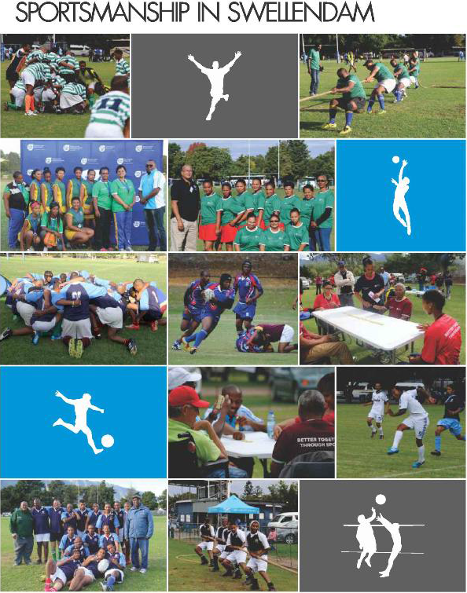
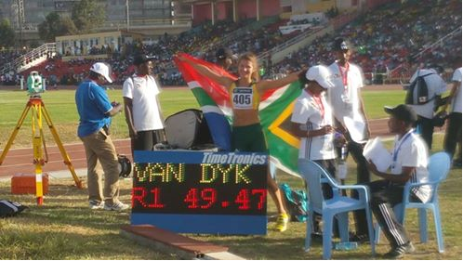
Club Development Programme
Success Stories
Shane Overmeyer of
Bishop Lavis Table Tennis (SA Champion 2016)
Farmworkers Sports Day
Jo- Ann Van Dyk (African Youth Record Javelin)

Slide 28
Conditional Grant – Provincial Programmes
Projects:
Move for Health – 12 May 2017
67 Minutes for Nelson Mandela Day – 18 July 2017
Knysna Oyster Festival - 6 – 16 July 2017
Nelson Mandela Sport and Cultural Day
Alcohol Harms Reduction Programmes
27 Nelson Mandela Race – February 2018
Ministerial Projects
Support to Western Cape Structures

Slide 29
MIG AND SRSA PROJECTS
The total number of projects 114 projects.
Total MIG Projects costs R 575 138 856m
Direct SRSA MIG projects 3
Beaufort West R 15 000 000.
Cederberg R 7 600 000.
Swellendam R 7 000 000.
TOTAL R 29 600 000.
Direct SRSA MIG projects 2
    Bitou R 13 000 000.
    Langeberg R 15 000 000.

Slide 30
SCOPE OF WORK
Sport Fields (Cricket, Football, Rugby, Etc)
Outdoor Gyms
Netball Courts
Swimming Pools
Community Centres
Tennis Courts
Sewerage Connections
High Mast Lights

Slide 31
PROJECTS OVERVIEW 2016/2017

Slide 32
EXPENDITURE OVERVIEW 2016/2017

