Slide 1
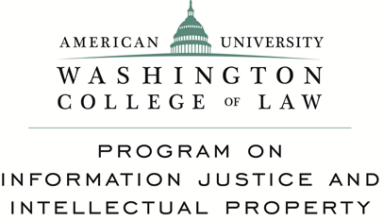
Fair Use in the Digital Environment
Sean Flynn, American University Washington College of Law
(CC) (BY)

Slide 2
17 USC 107
[T]he fair use of a copyrighted work . . . for purposes such as criticism, comment, news reporting, teaching (including multiple copies for classroom use), scholarship, or research, is not an infringement of copyright. In determining whether the use made of a work in any particular case is a fair use the factors to be considered shall include:
the purpose and character of the use, . . .
the nature of the copyrighted work;
3. the amount and substantiality of the portion used . . .; and
4. the effect of the use upon the potential market for or value of the copyrighted work.

Slide 3
12 General exceptions from protection of literary and musical works
Copyright shall not be infringed by any fair dealing with a literary or musical work-
for the purposes of research or private study by, or the personal or private use of, the person using the work;
(b) for the purposes of criticism or review of that work or of another work; or
(c) for the purpose of reporting current events-
(i) in a newspaper, magazine or similar periodical; or
(ii) by means of broadcasting or in a cinematograph film;

Slide 4
Open fair use/Dealing:
Philippines 1997
Sri Lanka 2003
Singapore 2006 (“fair dealing”)
Taiwan 2007 (Civil law)
Israel 2007
Malaysia 2012 (“fair dealing”)
Korea 2013 (Civil law)
China (proposed – “other use”)

Slide 5
TAIWAN
Copyright Act (2007-07011) – article 65
Fair use of a work shall not constitute infringement on economic rights in the work.
In determining whether the exploitation of a work complies with the [ ] conditions of fair use, all circumstances shall be taken into account, and in particular the following facts shall be noted as the basis for determination:
(1)The purposes and nature of the exploitation, including whether such exploitation is of a commercial nature or is for nonprofit educational purposes.
(2) The nature of the work.
(3) The amount and substantiality of the portion exploited in relation to the work as a whole.
(4) Effect of the exploitation on the work's current and potential market value.

Slide 6
Examples of Fair Use (USA):
Time Shifting (VCR)
Software reverse engineering
Plagiarism detection
Library digitization to enable text mining and research
Media monitoring
Internet thumbnails

Slide 7
Openness Score: High v. Middle Income Nations

Slide 8
R&D Spending by Software Firms in Countries With and Without Fair Use
Source: Thomson Reuters Datastream
Notes:
NOTE: These are annual average (mean) research and development expenditures in U.S. dollars. This is based on a sample of 44,940 observations from firms in 63 countries.
Good example is Cloud storage in the US. Cartoon networks 2008. Josh Lerner found $1.3 I increased venture capital investment in could storage industry in 2.5 years after the decision.

Slide 9
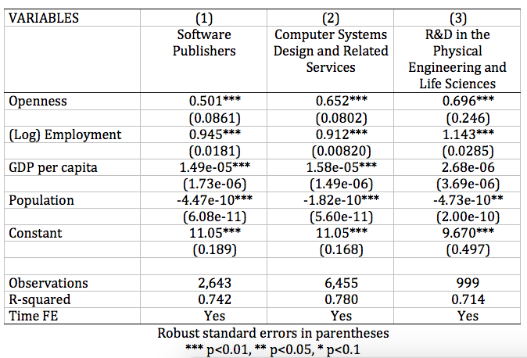
Openness Increases Computer and R&D Firm Revenue

Slide 10
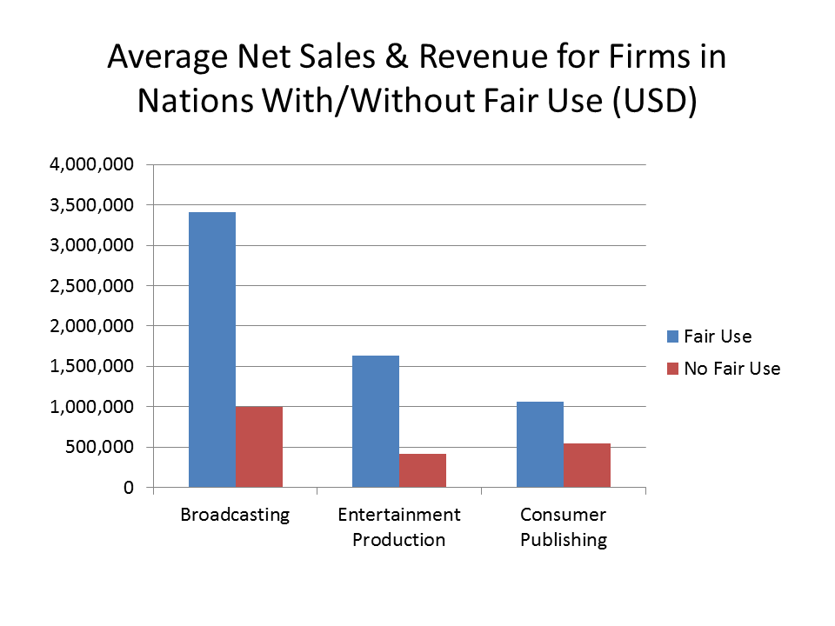
By Mike Palmedo

Slide 11
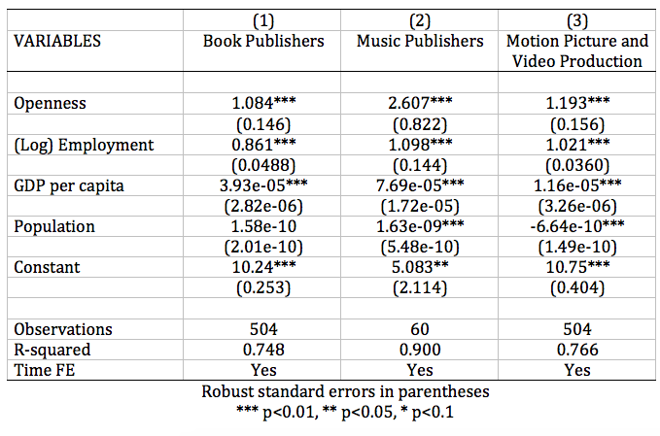
Traditional Copyright Industries Benefit from Openness

Slide 12
Openness is Highly Correlated with “H-Index” Score

Slide 13
Interests
Myths
Creators
Authors
Innovators
Consumers
Human rights
Free Expression
Economy
Piracy
Free for all
Litigation
Harm to publishers
Youtube Giveaway
Unpredictability

Slide 14
Sflynn@wcl.american.edu Director, AUWCL LLM in IP

