Slide 1
Presentation to the Standing Committee on Finance
27 June 2017

Slide 2
Contents
Purpose
Introductory Remarks
Strategy and Strategic Pillars
Implementation Plan and Risks
2017/2018 YTD Financial Performance
Debt Maturities
Q & A

Slide 3
Purpose
To provide the Standing Committee on Finance (“SCOF”) with a high level presentation on the following:
  Strategy and Strategic Pillars;
  Implementation plan and risks;
  2017/2018 YTD Financial Performance; and
  Debt Maturities.

Slide 4
Introductory Remarks
The Board and management have been working with independent aviation experts to refocus and refine the Long-Term Turnaround Strategy (LTTS) and this included developing a 5-Year Corporate and Turnaround Plan (the Plan)
The Plan is based on the primary strategic objective, which is: “To transform SAA into a financially sustainable aviation group”
The Plan further articulates five strategic pillars, such being the key areas of focus over the planning period.
This presentation provides the details on the above.

Slide 5
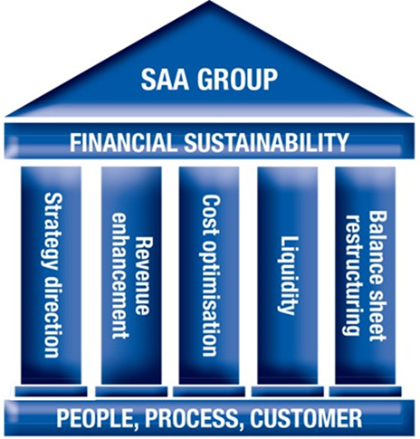
Strategic Objective
To transform SAA into a financially sustainable aviation Group.
Strategic Pillars
Strategy direction;
Revenue Enhancement;
Cost Optimisation;
Liquidity; and
Balance sheet restructuring

Slide 6
Strategic Direction
The LTTS review highlighted the following:
  Appropriate but limited implementation;
  Bureaucratic decision making processes and limited analytical tools to support decision making;
  Debt weight increase from 1% to 4% of group revenue; and
  Limited aviation skills and performance based rewards.
The key strategic focus areas:
  Strategic context clarity _ Financial sustainability;
  Redefine the competitive advantage _ Enhance JNB as a hub and increase the catchment area;
  Strategic choice and operating model _ Position SAA as Regional Network Carrier (focused on domestic/regional catchment and selected
  long-haul markets); and
  Optimise airline group co-ordination_ improve synergies

Slide 7
Strategic Direction…con’td
The key tenets of the strategy:
  Remedial action on certain high loss-making routes;
  Explore opportunistic flying to improve aircraft utilization;
  Improve labour productivity; and
  Renegotiate onerous agreements and return conditions on the leases of the freighters and wide-body aircraft.

Slide 8
Revenue Enhancement
Network and revenue enhancement initiatives are forecasted to increase the revenue by about R13.624 billion over a five-year period.
Initiatives include:
  Network and schedule changes;
  Hub Bypass;
  Step-up acceptance;
  Pricing segmentation;
  Spillage mitigation;
  Targeted demand steering;
  Fare class optimisation; and
  Leverage Star Alliance and codeshare partnerships.

Slide 9
Cost Optimisation
The cost optimisation initiatives is expected to yield R10.104 billion over a period of five years and these includes:
  Aircraft lease;
  Maintenance;
  Sales and distribution;
  Fuel;
  Product;
  Ground handling; and
  Facilities and information technology.

Slide 10
Liquidity and Balance Sheet
The liquidity and balance sheet initiatives are aimed at addressing the liquidity challenges and a weak financial position and these include:
  Recapitalisation;
  Cash management including a cash conservation office;
  Renegotiating existing funding agreements;
  Improved management of overheads; and
  Implementation of a risk based budgeting process.

Slide 11
Implementation Plan and Risks
The implementation will encompass the following:
  Establish a special Turnaround Committee, chaired by the CEO and made up of few members of EXCO . The Committee will meet twice weekly to review any internal and/or external blockages in implementing the plan.
  Implementation plan including the dashboard for monitoring is in place; and
  Enhanced capacity within the Commercial Division.
The key risks to the implementation include:
  Key assumption on recapitalisation not materialising;
  High vacancy rate at leadership and critical positions;
  Counterparty contracts;
  Deterioration of the macro-economic conditions; and
  Adverse movement in jet fuel, interest and currency
  exchange rates.

Slide 12
YTD Financial Performance _ May 2017

Slide 13
Debt Maturities
Maturing Loans .
Engagement with Lenders.

Slide 14
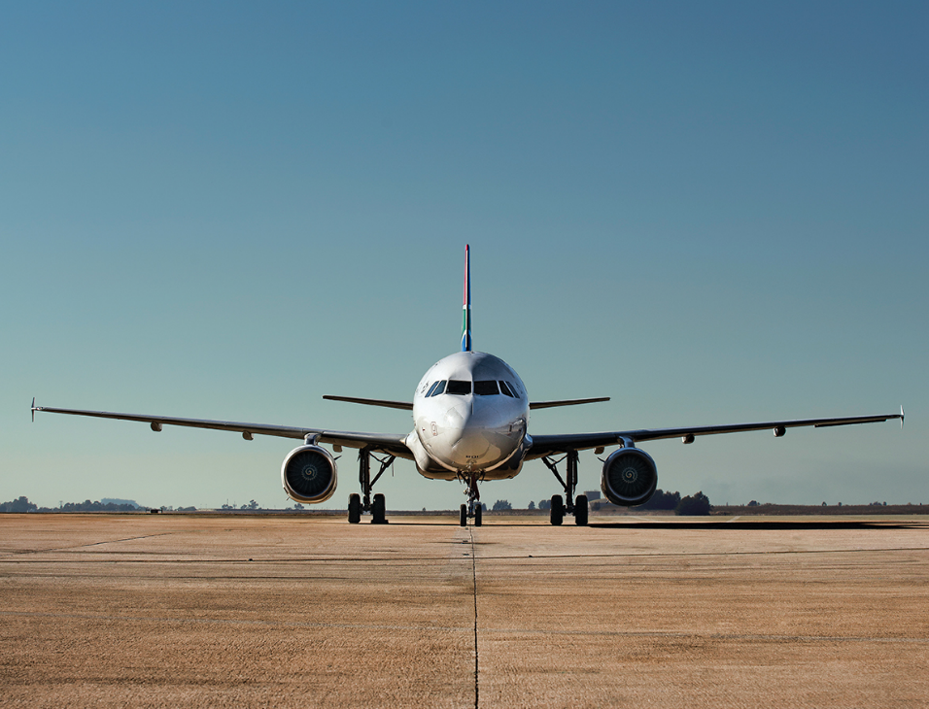
The Flight Plan has been filed.
Ready to take off
Questions?

