Slide 1
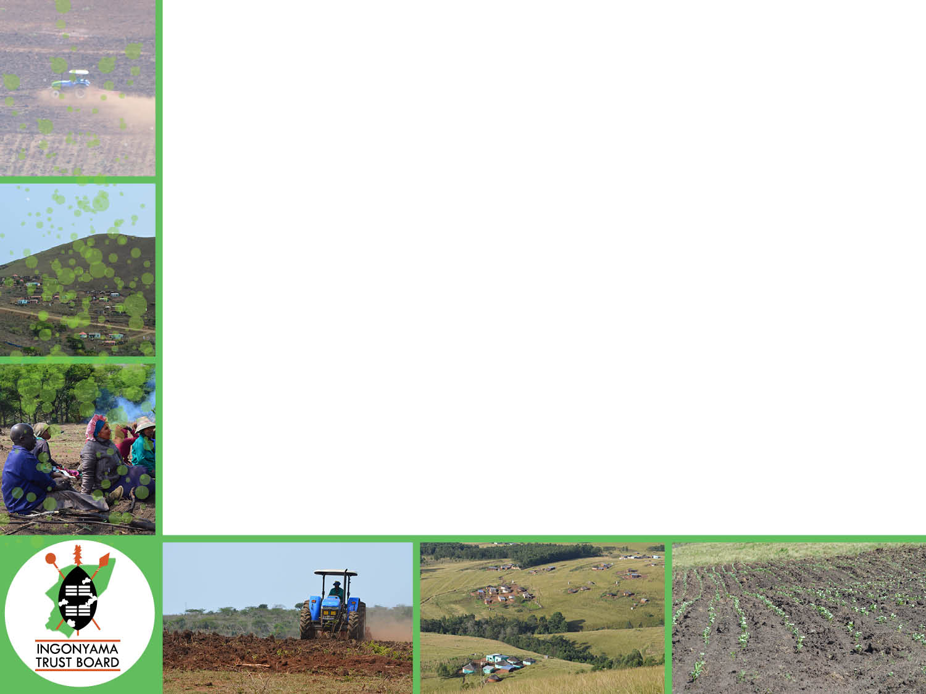
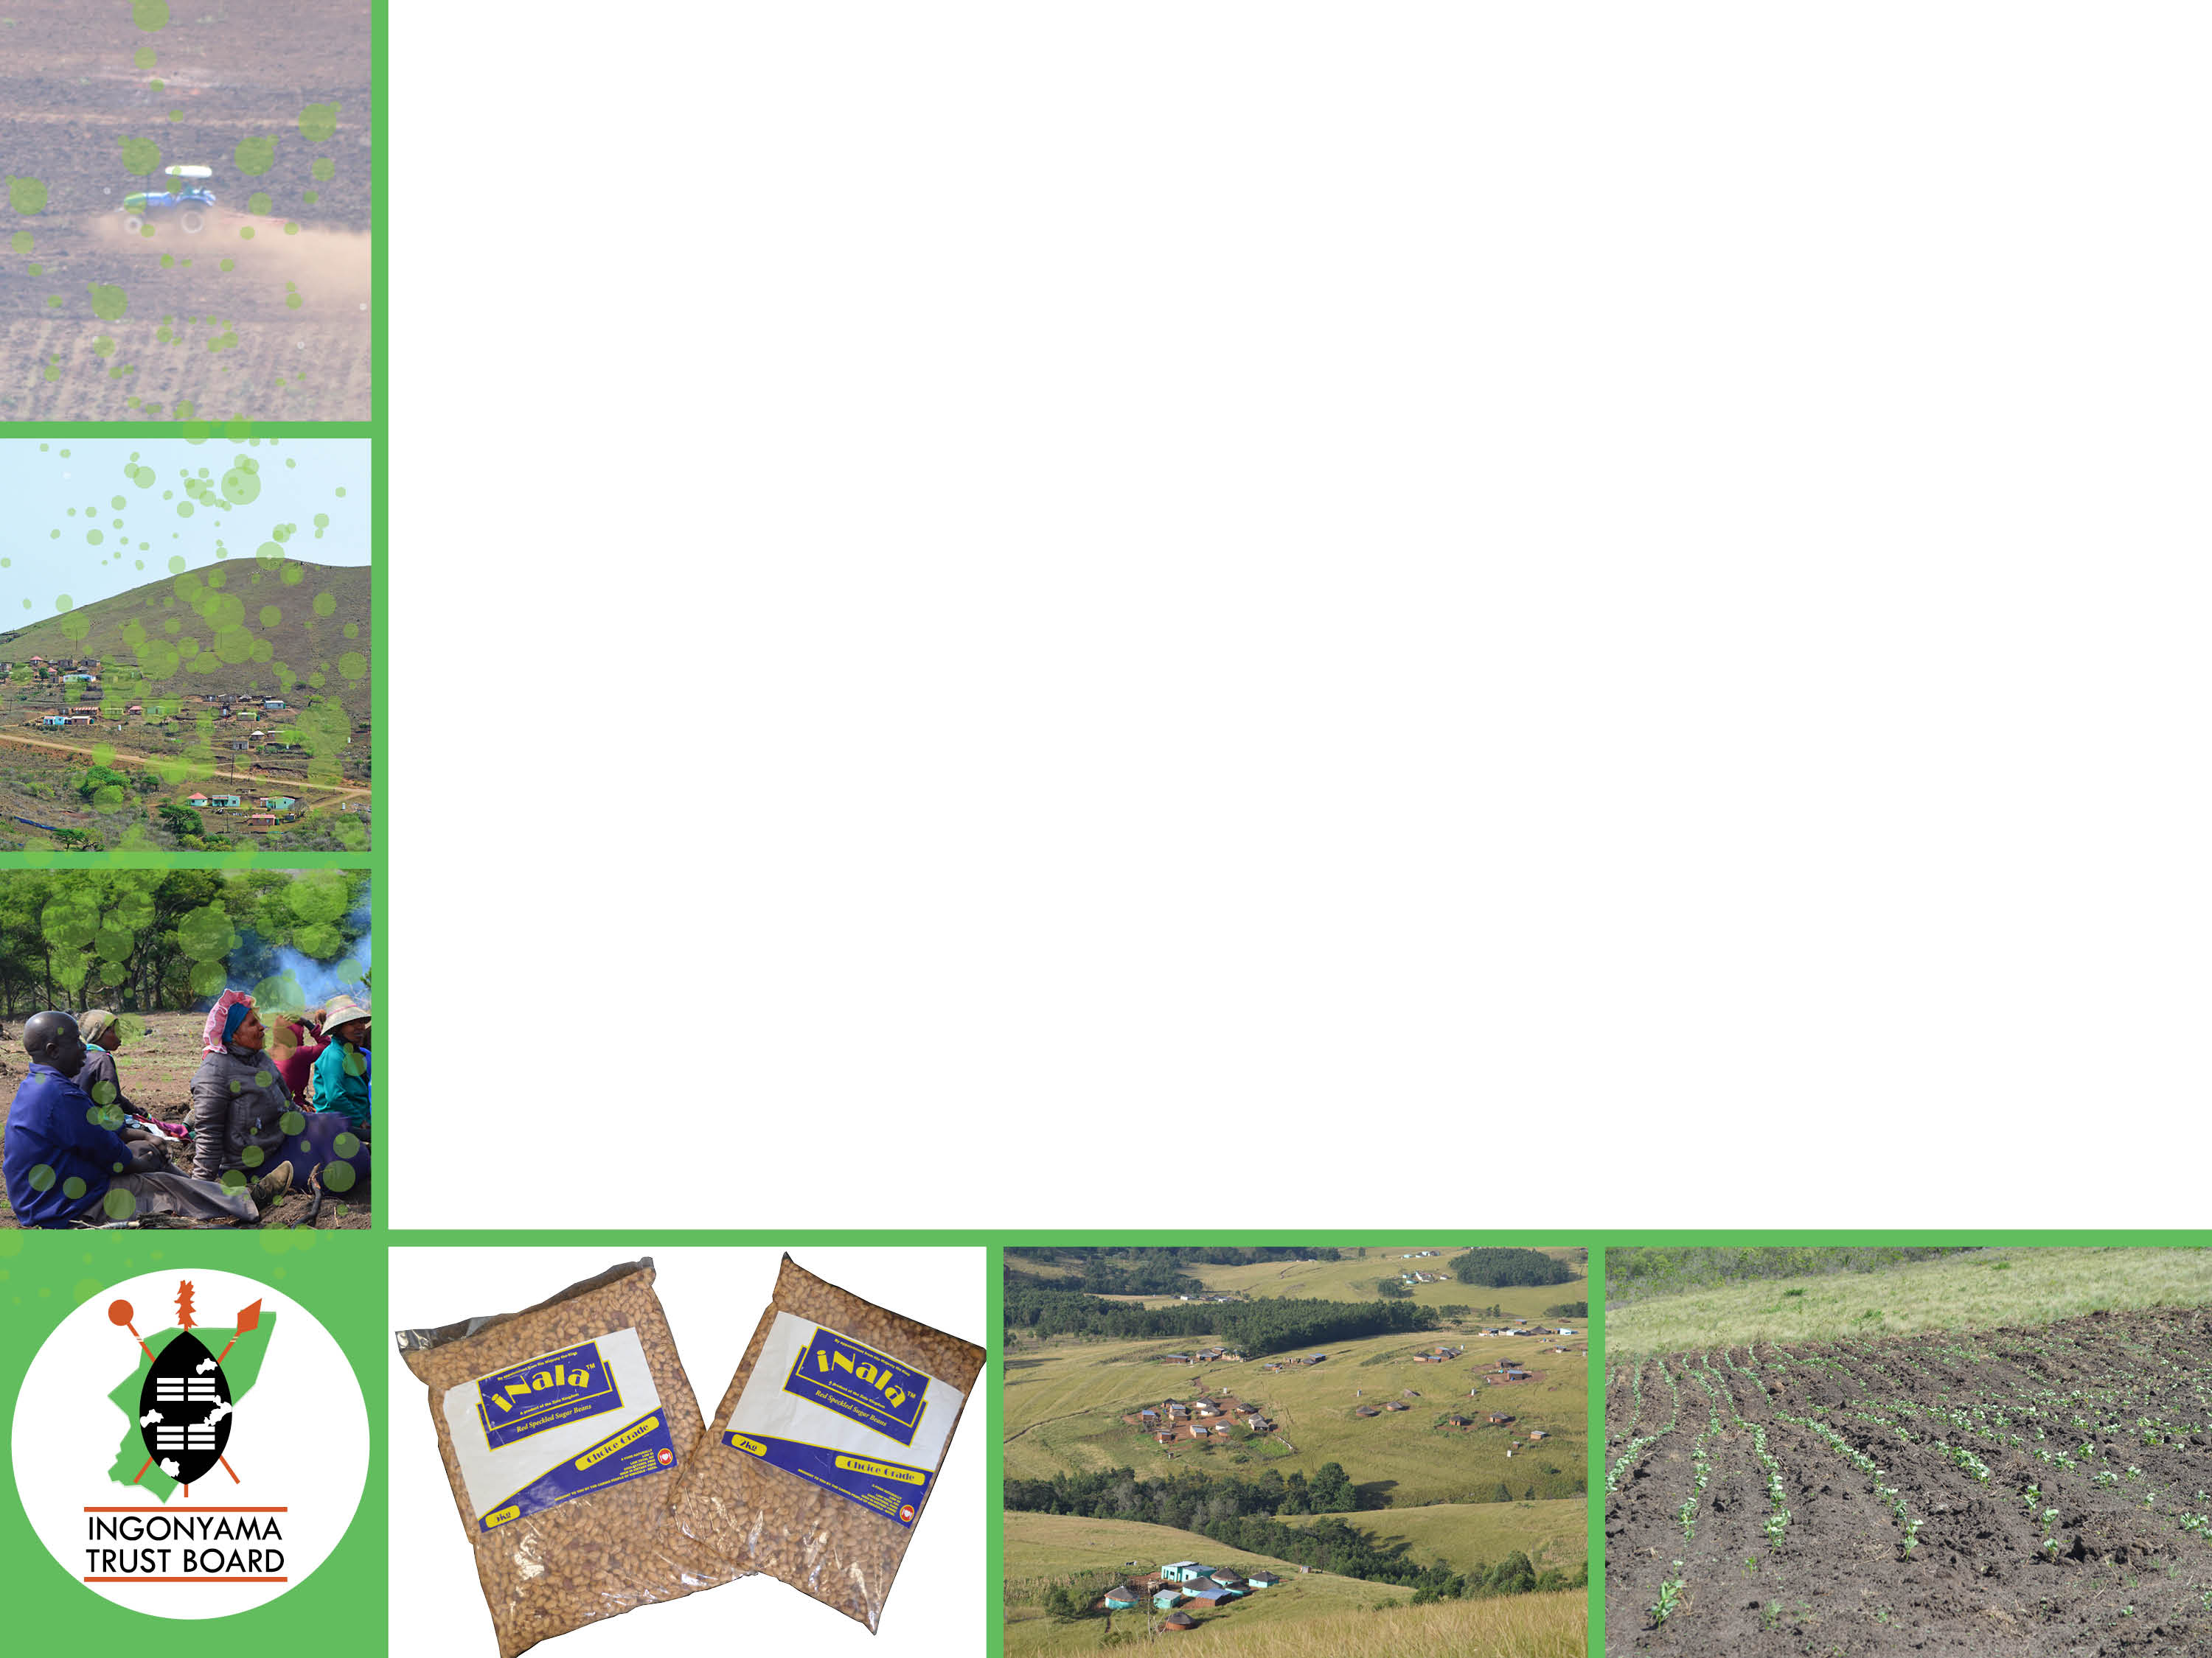
INGONYAMA TRUST BOARD’S 4th QUARTER PERFORMANCE AND FINANCIAL REPORT: 2016 – 2017 FINANCIAL YEAR
PRESENTATION TO THE PARLIAMENT PORTFOLIO COMMITTEE ON RURAL DEVELOPMENT AND LAND REFORM
DATE : 27 JUNE 2017
17/06/28
<number>

Slide 2
CONTENTS
Introduction
Overall Programme Performance
Programme 1 : Administration
Programme 2 : Land Management
Programme 3 : Rural Development
Programme 4 : Traditional Council Support
Overall Financial Performance
Conclusion
17/06/28
<number>
Notes:
<number>

Slide 3
INTRODUCTION
The presentation covers the organisational programme performance in line with the four (4) programmes of the Ingonyama Trust Board
Performance recorded during the period under review is compared against targets set in the 2016 – 2017 Annual Performance Plan (APP)
17/06/28
<number>

Slide 4
PROGRAMME PERFORMANCE
17/06/28
<number>

Slide 5
PROGRAMME 1 : ADMINISTRATION
Strategic objective | Performance Indicator | Annual Target | Q4 Target | Q4 Results | Variance | Reason for variance | Mitigation plan
1.1. Provide effective monitoring and evaluation systems to the Ingonyama Trust Board | Number of mid - term reviews held and reports submitted | 1 | - | - | 0 | Achieved in the 3rd quarter | N/A
1.2. Ensure effective stakeholder engagement and communication | Customer service charter approved by the Board | 1 | Implementation | Implementation has not commenced as the approval of the charter was obtained in Q4 | - | Delay on the approval | Special Board meetings for policy approval was held March 2017
 | Stakeholder engagement strategy approved by the Board | 1 | Implementation | Approval of strategy | - | Capacity constraints | Approved by the Board in March 2017
 | Number of Communication reports submitted to the Board | 12 | 3 | - | -3 | Reports not providing reliable information to the Board | Request the Board for guidance on how these reports should be structured
1.3. Provide IT Support to improve efficiency | Audited IT infrastructure of the ITB | 1 | Implementation | 0 | -1 | Audit not yet completed but underway. Project to be completed by end of April 2017 | - Draft Audit-Report Completed - Network Security Draft Audit Report completed - Draft Implementation Plan pending, to be done by the 14th April 2017. - Finalization of Project is expected by the 30 April 2017
 | Bi annual check of software compliance conducted | 2 | 1 | 1 | - | N/A | N/A
17/06/28
<number>

Slide 6
PROGRAMME 1 : ADMINISTRATION (contd)
Strategic objective | Performance Indicator | Annual Target | Q4 Target | Q4 Results | Variance | Reason for variance | Mitigation plan
1.4. To ensure that efficient internal resource management is aligned to legislative requirements | Number of policies approved by the Board | 6 | 3 | - | -3 | Though the target for policies is 3, during the 4th quarter (4 policies were already approved in the previous quarters therefore the variance overall is 2 policies which came about as a result of delay in policy formulation | To prioritise the policies in the Q1 & Q2 of the new financial year 2017/2018
Percentage of all movable assets to be recorded in the asset register | 100% | 100% | 100% | 0 | No variance | N/A
1.5. To ensure reduction of vacancies | HR provisioning plan approved by the Board | 1 | Implementation | Implemented | N/A | No variance | N/A
Percentage of posts filled in relation to the HR provisioning plan | 100% | 100% | 97% | -3% | Real Estate Manager & Deputy Manager : Administration positions not filled | Deputy Manager : Administration post to be processed in the 1st Quarter of 2017/2018 Real Estate Manager position pending review as Board is commissioning a service provider to restructure the organogram
1.6. To ensure performance management in ITB | Percentage of Performance agreements concluded timeously | 100% | 100% | 100% | - | No variance | N/A
1.7. Provision of skills development to improve service delivery | Internal skills audit performed | 1 | - | - | - | No variance | N/A
Number of training programmes conducted | 10 | 1 | 2 | +1 | Operational priorities | N/A
17/06/28
<number>
Notes:
<number>

Slide 7
PROGRAMME 1 : ADMINISTRATION (contd)
Strategic objective | Performance Indicator | Annual Target | Q4 Target | Q4 Results | Variance | Reason for variance | Mitigation plan
1.8. To improve customer relationships | Payment of undisputed invoices within 30 days of receipt in finance | 100% | 100% | 100 % | - | No variance | N/A
Number of MOAs with Traditional Councils approved by the Board | 10 | 3 | 2 | -1 | It was a short quarter due to TCs closing for festive season. | Engagement with Traditional Councils through the local houses
17/06/28
<number>
Notes:
<number>

Slide 8
PROGRAMME 2 : LAND MANAGEMENT
Strategic objective | Performance Indicator | Annual Target | Q4 Target | Q4 Results | Variance | Reason for variance | Mitigation plan
2.1. Provision of secured tenure rights to facilitate development on Ingonyama Trust land | Number of land tenure rights approved by the Board | 1350 | 150 | 578 | +428 | Clearing of backlog from previous improved performance | To ensure performance monitoring
2.2. To maintain an integrated and comprehensive land tenure administration system / (database of land tenure rights) | Number of updates to the land holding register | 4 | 1 | 1 | - | No variance | N/A
Number of land parcels for commercial use valued | 9 | 1 | - | 0 | Target achieved during the 2nd quarter | N/A
2.3. Making trust land available for infrastructure development at district municipality level | Number of MOUs approved by the Board | 4 | 1 | - | -1 | Capacity constraints | Improve capacity
2.4. Ensure legal occupation of trust land | Number of programmes conducted to prevent illegal occupation | 4 | 1 | 2 | +1 | Unlawful occupation of land identified earlier in the year was addressed by instructing attorneys to obtain relevant relief (Siyabusa Farming and Mpungose TC). | N/A
17/06/28
<number>

Slide 9
PROGRAMME 3 : RURAL DEVELOPMENT
Strategic objective | Performance Indicator | Annual Target | Q4 Target | Q4 Results | Variance | Reason for variance | Mitigation plan
3.1. Provide support to beneficiary communities to improve food security | Board approved plan on agriculture production | 1 | - | - | - | No variance | N/A
 | Number of protential projects of high commercial value for partnership with private sector | 1 | 1 | 0 | -1 | The project was identified and approved by the Board, however the initial site was not suitable | Fast track site identification
Number of agricultural projects approved by the Board | 12 | - | - | 0 | No variance (This was achieved in Quarter 2) | N/A
3.2. To facilitate economic development (industry and rural enterprise establishment) | MOU with Agribusiness Development Agency approved by the Board | 1 | - | - | 0 | Target is dependent on a 3rd party so it could not be finalised | Indicator not confined to one stakeholder in the new performance cycle for performance to be realised
3.3. To identify strategically located land to be utilised for high impact commercial ventures | A land audit conducted to identify prime land in line with the provincial spatial development framework for potential investment | 5 | 1 | 0 | -1 | Audit initiated in 4th quarter however due to the extensiveness of the traditional council area, it has not been finalised (Mathulini TC). | Project to be finalised in 2017/2018
17/06/28
<number>

Slide 10
PROGRAMME 4 : TRADITIONAL COUNCIL SUPPORT
Strategic objective | Performance Indicator | Annual Target | Q4 Target | Q4 Results | Variance % | Reason for variance | Mitigation plan
4.1. Provide training to Traditional Councils | Skills Audit performed based on land related legislation | 1 | - | - | - | No variance | N/A
 | Training plan approved by the Board | 1 | - | - | - | No variance | N/A
Number of traditional councils trained | 12 | 5 | - | -5 | Training officer deceased resulting in under performance | Training function to be outsourced to avoid under performance as per the new Annual Performance Plan
4.2. Facilitate skills development for young people living on communal land | Number of educational awards granted | 110 | - | 76 | +76 | Commencement of the 2017 academic year | Alignment of educational awards to the 4th quarter of performance cycle as they host the 1st and 2nd month of the academic year
17/06/28
<number>

Slide 11
FINANCIAL PERFORMANCE
17/06/28
<number>

Slide 12
4th QUARTER EXPENDITURE 2016/2017
EXPENDITURE PER PROGRAMME
Item | Annual Budget | 4th Quarter Actual Spending | 4th Quarter Budget | Percentage of 4th Quarter budget Spent in the 4th Quarter
 | R | R |  | %
ADMINISTRATION | 78 097 840.36 | 16 322 520.82 | 44 847 711.34 | 36.40
LAND MANAGEMENT | 2 322 437.00 | 12 064.20 | 580 609.25 | 2.08
RURAL DEVELOPMENT | 9 000 000.00 | 1 265 237.85 | 2 250 000.00 | 56.23
TRADITIONAL COUNCIL SUPPORT | 30 771 310.00 | 1 474 271.48 | 7692 827 .50 | 19.16
 | 120 191 587.36 | 19 074 094 .35 | 55 371 148 .09 | 34.44
17/06/28
<number>

Slide 13
Comparative expenditure per programme – Quarter 4
17/06/28
<number>

Slide 14
4th QUARTER EXPENDITURE 2016/2017
EXPENDITURE PER ECONOMIC CLASSIFICATION
Item | Annual Budget | 4th Quarter Actual Spending | 4th quarter Budget | Percentage of Actual spent of the 4th Quarter Budget
 | R | R |  | %
Compensation of Employees | 21 547 929.00 | 6 212 684 .27 | 5 386 982 .25 | 115.33
Goods and Services | 78 802 658.36 | 12 350 092.69 | 32 555 165.84 | 37.93
Rent - Ulundi Office | 116 000.00 | 27 000.00 | 29 000.00 | 93.10
Capital | 19 725 000.00 | 484 317 .39 | 17 400 000.00 | 2.80
Total | 120 191 587.36 | 19 074 094.35 | 55 371 148 .09 | 34.44
17/06/28
<number>

Slide 15
NOTES ON EXPENDITURE
The total expenditure for Quarter 4 amounted to R 19.07 m .
34.44 % of the 4th quarter budget was spent in Quarter 4 (including capital expenditure)
115 .33 % of the compensation of employees 4th quarter budget was utilised in the 4th quarter.
37 .93 % of the total goods and services 4th quarter budget was utilised in the 4th quarter.
100 % of the total transfer payment received from the department was utilised for the year ending 31 March 2017.
17/06/28
<number>

Slide 16
Notes on Ingonyama Trust expenditure
Capital expenditure is paid for by the Ingonyama Trust.
The savings in the 4th quarter for goods and services is mainly due to under-spending of the office accommodation /capital Budget.
Capital expenditure comprised of
Furniture and Equipment – R 31 436.67
Computer equipment – R 18 851.01
Improvements to building – R 434 029.71
17/06/28
<number>

Slide 17
Comparative expenditure per Economic classification Quarter 4
17/06/28
<number>

Slide 18
Schedule of goods and services
ITEM | COST
Advertising | 90 021.62
Legal fees | 362 603.76
Bank charges | 17 076.37
Motor vehicle expenses | 66 757.68
Provision for doubtful debts ( debts owing to IT handed over to debt collectors ) | 1 675 013.00
Staff Training | 27 875.75
Cleaning, repairs and maintenance/general | 323 026.40
Board members' remuneration | 1 695 490.92
Computer Licencing | 45 487.70
Communication expenses | 179 464.00
Depreciation – assets including buildings | 3 517 212.00
Travel & accomodation & meetings | 901 366.93
Internal audit committee members' remuneration | 4 676.92
Insurance | 141 813.27
17/06/28
<number>

Slide 19
Schedule of goods and services (contd)
ITEM | COST
Stationery & Printing | 147 312.16
Electricity and water | 206 864.90
Security expenses ( ITB office accommodation) | 158 348.14
Telephone | 38 108.13
Land tenure information system - maintenance | 12 064.20
Agricultural Project expenses | 1 265 237.36
Payments to community beneficiaries | 1 219 271.48
Bursaries | 255 000.00
Total | 12 350 092.69
17/06/28
<number>

Slide 20
SCHEDULE OF REVENUE
Item | Actual income for the 4th Quarter | Budget – 4th Quarter | % income over 4th quarter Budget
 | R | R | %
RENTAL INCOME | R 9,013,157 | R 1,345,507 | 669,87%
OTHER INCOME (SERVITUDES, CONTRACTUAL ROYALTIES. SUNDRY | R 1,441,976 | R 580,849 | 248,25%
INVESTMENT INCOME | R 3,729,709 | R 2,243,937 | 166,21%
TOTAL INCOME EXCLUDING TRANSFER PAYMENT | R 14,184,842 | R 4,170,293 | 340,13%
TRANSFER PAYMENT | R 1,208,253 | R 1,208,253 | 100,00%
TOTAL INCOME | R 15,393,095 | R 5,378,546 | 286,19%
17/06/28
<number>

Slide 21
NOTES ON 4th QUARTER INCOME
The total revenue generated for quarter 4 amounted to R14.1 million (excluding transfer payments).
Transfer payment amounting to R1 208 253.00 was received and fully utilised in the fourth quarter.
Total income including transfer payments amounted to R15.3 million.
17/06/28
<number>

Slide 22
GRAPHICAL PRESENTATION OF ACTUAL INCOME
17/06/28
<number>

Slide 23
Thank You
17/06/28
<number>

