Slide 1
Manufacturing, engineering and related services SETA (merSETA)
To assess the merSETA,
on their Strategic Plan 2015/16 – 2019/20 and
Annual Performance Plan 2017/18 against
Government Priorities and Industry Developments

Slide 2
Strategic Goals of the merSETA
Improved responsiveness of research to the transformation and transitional needs of the sector
Increased functional efficacy of good governance and deployment and management of resources
A skilled and capable workforce for manufacturing sector – current, emerging and future occupations and skills

Slide 3
Aligning the merSETA interventions and budget programmes to government priorities and industry developments

Slide 4
Strategic Integrated Projects (SIPS)
New Growth Path
Industrial Policy Action Plan
Oceans Economy
National Development Plan
- Workers -
- Employers -
- Youth -
Women –
PWD-
Green Economy
Small, Micro, Cooperatives and Informal Enterprise Development
Comprehensive Rural Development Programme
Human Resource Development Strategy
National Skills Development Strategy
White Paper on Post School Education and Training

Slide 5
NSDS III 2011/12 -2015/16 Targets

Slide 6
NSDS III 2011/12 -2015/16 Targets (continued)

Slide 7
NSDS III 2011/12 – 2015/16 Income & Expenditure and Committed Funds

Slide 8
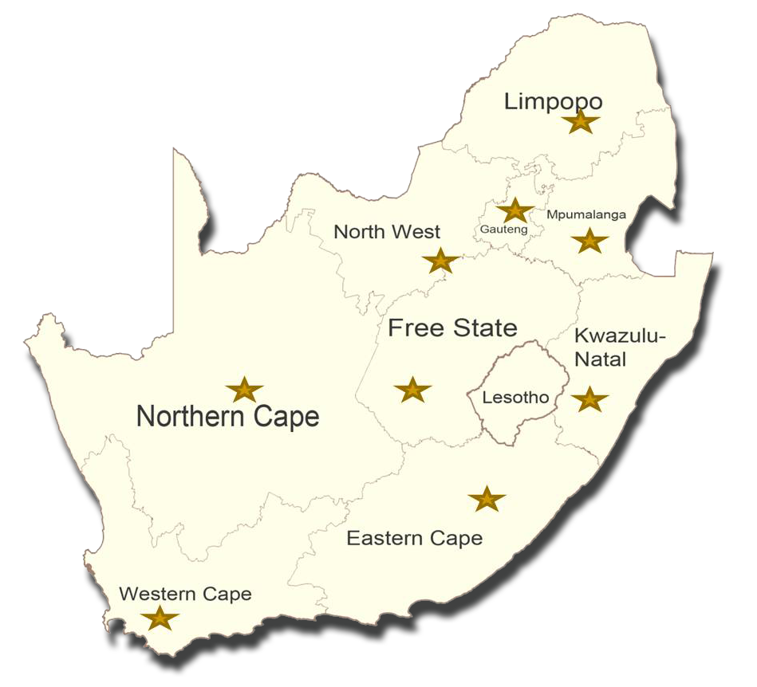

Slide 9
NSDS III 2017/18 Planned Targets

Slide 10
NSDS III 2017/18 Planned Targets

Slide 11
Advanced Manufacturing
Innovation & Growth
Stemming Job Losses
Stabilising current industry
Industry 4.0
- Workers -
- Employers -
- Youth -
- Women -

Slide 12
New Growth Path & the merSETA Response

Slide 13
NGP Priority | merSETA Response | Key Relevant Budget Programme & Objective
Re-industrialisation of the economy and expansion of manufacturing sector Create 5 million jobs Focus on skills development particularly artisanal and engineering skills Develop 50 000 artisans by 2020 | Increased investment in development of artisans & engineering professionals (learnerships, apprenticeships, bursaries, skills programmes) in formal, SME, cooperatives and informal enterprises Research of new occupations & skills for new growth opportunities, to result in reviewed qualification & curricula Reskilling and upskilling of workers Education & skills development of new entrants & unemployed Staff development for TVET Colleges, HEIs & industry based training Modernised career guidance | Programme 2: Skills Planning Increased publication of research products that informs cutting edge solutions in the sector Programme 3: Learning Programmes and Projects Increased contribution to employment & growth opportunities Strengthening partnerships (TVETC, HEI, State, Private Sector) for improved responsiveness to sector needs Improved competency levels of SME, Informal & cooperatives Programme 4: Quality Assurance Increased responsiveness to sector through provision of occupational qualifications Increased throughput of learners in occupation programmes

Slide 14
Industrial Policy Action Plan (incl. Green and Oceans Economy) & merSETA Response

Slide 15
IPAP Priority | merSETA Response | Key Relevant Budget Programme & Objectives
Metal & Steel industry: local procurement, beneficiation and tax incentives for investment Automotive Industry development: investment in local manufacturing OEM and components Boatbuilding Plastics: recycling for local manufacturing Black industrialists Scheme Operation Phakisa (marine economy) Green industries: renewable energy wind and solar Creation of new jobs | Increased investment in development of artisans & engineering professionals (learnerships, apprenticeships, bursaries, skills programmes) in formal, SME, Cooperatives & informal enterprises Research of new occupations & skills for new growth opportunities, to result in reviewed qualification & curricula; Reskilling & upskilling of workers Education & skills development of new entrants & unemployed Staff development for TVET Colleges, HEIs & industry based training HEI support for innovation in industry Modernised career guidance International knowledge/skills exchange network | Programme 2: Skills Planning Increased publication of research products that informs cutting edge solutions in the sector Programme 3: Learning Programmes and Projects Increased contribution to employment & growth opportunities Strengthening partnerships (TVETC, HEI, State, Private Sector) for improved responsiveness to sector needs Improved competency levels of SME, informal & cooperatives Programme 4: Quality Assurance Increased responsiveness to the mer sector through provision of occupational qualifications Increased throughput of learners in occupation programmes

Slide 16
Strategic Integrated Projects (SIPS) & merSETA Response

Slide 17
SIP Priority | merSETA Response | Key Relevant Budget Programme & Objectives
18 catalytic projects at local level to fast track development and growth whilst providing essential infrastructure for service delivery Development of artisans, technologists, engineers, project managers | Participation in and support for development of centres of specialisations for trade qualifications; strengthening TVETC – Industry partnerships for skills development for trade occupations Reskilling & upskilling of workers Skills development for unemployed youth Local government & provincial government partnerships | Programme 3: Learning Programmes and Projects Strengthening partnerships (TVETC, HEI, State, Private Sector) for improved responsiveness to sector needs Programme 4: Quality Assurance Increased responsiveness to the mer sector through provision of occupational qualifications Increased throughput of learners in occupation programmes

Slide 18
Small, Micro, Cooperatives and Informal Enterprise Development & merSETA Response

Slide 19
SBD Priority | merSETA Response | Key Relevant Budget Programme & Objectives
Industrial park revitalisation IDZ and SEZ Community based education and training for cooperatives and informal entrepreneurs | Research into the economies of these enterprises at regional level to identify needs & opportunities for skills development support National, Provincial and Local government partnerships TVET College & HEI capacity building to support these enterprises Skills development for unemployed youth & adults Use of ICT for apprenticeship/artisan training | Programme 2: Skills Planning Increased publication of research products that informs cutting edge solutions in the sector Programme 3: Learning Programmes and Projects Strengthening partnerships (TVETC, HEI, State, Private Sector) for improved responsiveness to sector needs Improved competency levels of SME, informal & cooperatives Programme 4: Quality Assurance Increased responsiveness to the mer sector through provision of occupational qualifications

Slide 20
Comprehensive Rural Development Programme & merSETA Response

Slide 21
CRDP Priority | merSETA Response | Key Relevant Budget Programme & Objective
Rural development Sustainable livelihoods Skills development Economic empowerment of rural communities | Research of rural economy and identification of opportunities for skills development support Funding for learnerships, internships, apprenticeships and bursaries Supporting TVET colleges to provide small business support Support to rural HEIs Establishing training and trade test centres Entrepreneurship, engagement with provincial departments | Programme 2: Skills Planning Increased publication of research products that informs cutting edge solutions in the sector Programme 3: Learning Programmes and Projects Strengthening partnerships (TVETC, HEI, State, Private Sector) for improved responsiveness sector needs Improved competency levels of SME, informal & cooperatives Programme 4: Quality Assurance Increased responsiveness to the mer sector through provision of occupational qualifications

Slide 22
Human Resource Development Strategy; NSDS; WPSET & merSETA Response

Slide 23
Priority | merSETA Response | Key Relevant Budget Programme & Objectives
Foundational Education TVET (midlevel skills development) HEI, Research and Innovation (high level skills development) Skills for the economy (workers’ career advancement, adults, NEET Youth, addressing socially and economically excluded) Developmental State (building capability of state; State as employer to expand workplace skills training opportunities) “Turning every workplace into a training space” | Investment in STEM at technical schools Strengthening quality of TVET Colleges through college – industry partnerships; staff development; TVET research; Bursaries for employed & unemployed; WIL support; TVET graduate placement on learnerships/apprenticeship for trade related occupations; HEI graduate placement internships for professional registration Research future occupations & skills to result in reviewed/new qualifications and curricula Reskilling & upskilling of workers Skills for NEET, unemployed adults Support to SME, Cooperatives, Informal Enterprises Local government & provincial government partnerships Modernised career guidance merSETA staff & governance structures development programmes Industry partnerships | Programme 2: Skills Planning Increased publication of research products that informs cutting edge solutions in the sector Programme 3: Learning Programmes and Projects Increased contribution to employment and growth opportunities Strengthening partnerships (TVETC, HEI, State, Private Sector) for improved responsiveness to sector needs Improved competency levels of SME, informal & cooperatives Programme 4: Quality Assurance Increased responsiveness to the mer sector through provision of occupational qualifications Increased throughput of learners in occupation programmes Programme 1: Administration Increasing public sector capacity for improved service delivery & supporting and building a developmental state.

Slide 24
Advanced Manufacturing, Innovation and Growth & merSETA Response

Slide 25
Priority | merSETA Response | Key Relevant Budget Programme & Objectives
Disruptive technology e.g. robotics, artificial intelligence, Changing manufacturing production processes Flexibility and adaptability of skills Critical thinking skills Unemployment of 11 million by 2020 (ILO) Decline in unskilled and semi skilled , increase of skilled and highly skilled 39% of core skills in RSA completely different by 2020 | Increased investment in development of artisans & engineering professionals in formal, SME, Cooperatives and Informal enterprises Research of new occupations & skills for new growth opportunities, to result in reviewed qualification & curricula; Reskilling & upskilling of workers Education & skills development of new entrants and unemployed Staff development for TVET Colleges, HEIs & industry based training HEI support for innovation in industry Modernised career guidance International knowledge/skills exchange network | Programme 2: Skills Planning Increased publication of research products that informs cutting edge solutions in the sector Programme 3: Learning Programmes and Projects Increased contribution to employment and growth opportunities Strengthening partnerships (TVETC, HEI, State, Private Sector) for improved responsiveness sector needs Improved competency levels of SME, informal & cooperatives Programme 4: Quality Assurance Increased responsiveness to the mer sector through the provision of occupational qualifications Increased throughput of learners in occupation programmes

Slide 26
Stabilising current industry and stemming job losses & merSETA Responses

Slide 27
Priority | merSETA Response | Key Relevant Budget Programme & Objectives
Job shedding – 11 million jobs since Quarter 4 of 2015 Dis-investment Effects of Industry 4.0 Unemployment of 11 million by 2020 (ILO) Decline in unskilled and semi skilled , increase of skilled and highly skilled | Increased investment in development of artisans & engineering professionals in formal, SME, Cooperatives and Informal enterprises Research of new occupations & skills for new growth opportunities, to result in reviewed qualification & curricula; Reskilling & upskilling of workers Training Lay-O ff Scheme & Retrenchment Assistance Programme Education & skills development of new entrants and unemployed Staff development for TVET Colleges, HEIs & industry based training HEI support for innovation in industry Modernised career guidance International knowledge/skills exchange network | Programme 2: Skills Planning Increased publication of research products that informs cutting edge solutions in the sector Programme 3: Learning Programmes and Projects Increased contribution to employment and growth opportunities Strengthening partnerships (TVETC, HEI, State, Private Sector) for improved responsiveness sector needs Improved competency levels of SME, informal & cooperatives Programme 4: Quality Assurance Increased responsiveness to the mer sector through provision of occupational qualifications Increased throughput of learners in occupation programmes

Slide 28
Thank you
Chairperson: Phindile Baleni (Ms)
Chief Executive Officer: Raymond Patel (Dr)
010 219 3338
ceo@merseta.org.za
www.merseta.org.za

