Slide 1





Prof. Mandy Lombard
DST/NRF Chair:
Marine Spatial Planning

Slide 2


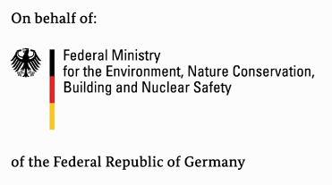
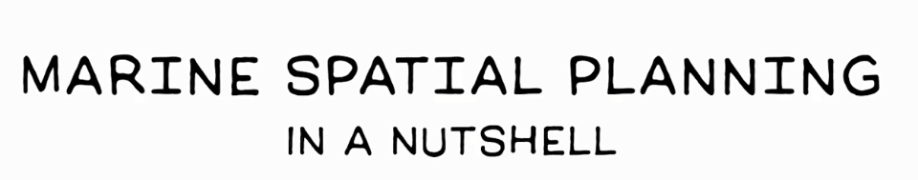
Notes:
https://www.openchannels.org/comment/5302#comment-5302

Slide 3

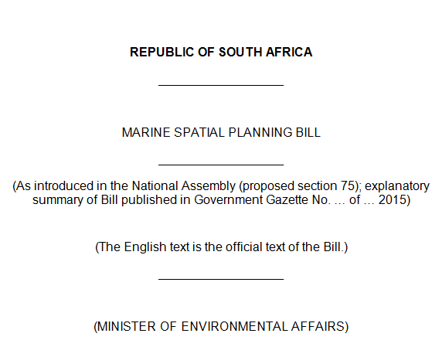



Notes:
A short history of how the recent MSP Bill came about

Slide 4

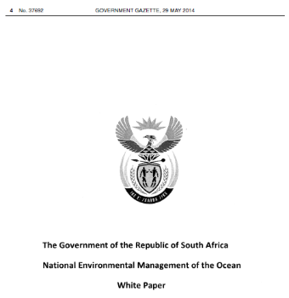


1998
2014
NEMA
NEM: BA
NEM: PA
NEMO
MSP
MPAs
etc.
etc.
OCEANS ACT
Notes:
The National Environmental Management Act^{[1]}(NEMA) provides the underlying framework for environmental law.
In 1996, section 24 of the Constitution enshrined basic environmental rights. A strong theme in the current legal order is that of equitable access to resources.
In 2014, the DEA published the NEMO white paper, which could have evolved onto an over-arching Oceans Act (like a NEAM for the Oceans), and then MSP legislation could have been nested underneath it, following sound ecosystem-based principles. But then Operation Phakisa came along a few months later (also in 2014) and the need for MSP legislation was deemed urgent so cabinet instructed the DEA to prepare an draft MSP Bill (which would not benefit from an over-arching Oceans Act to guide it).

Slide 5

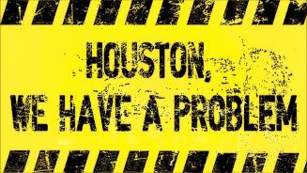
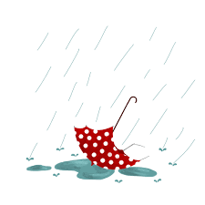


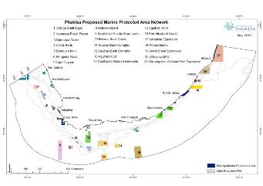
1998
2014
NEMA
NEM: BA
NEM: PA
NEMO
MSP
MPAs
etc.
etc.
MSP
Notes:
At the Phakisa labs, it was also deemed urgent to declare our new marine protected areas (which had been developed by SANBI and other colleagues) but these MPAs have STILL not been declared, whereas the MSP Bill has made it to Parliament.

Slide 6

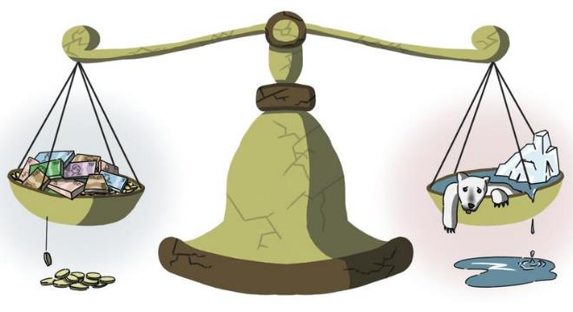
The
“TWO HAT”
problem
DEA
?
Notes:
DEA is mandated to care for the environment, so how will it balance economic objectives with environmental concerns, if the MSP Bill sits within it?

Slide 7
X
The fallacious neoclassical model
Economy
Ecosystem
Waste
Resource
extraction
Today’s global economy
Does not value natural resources
Assumes natural resources are limitless
Waste is only a nuisance
Requires perpetual growth driven by consumption
The real economy
Everything is connected to everything
Everything’s got to go somewhere
There’s no such thing as a free lunch

Slide 8
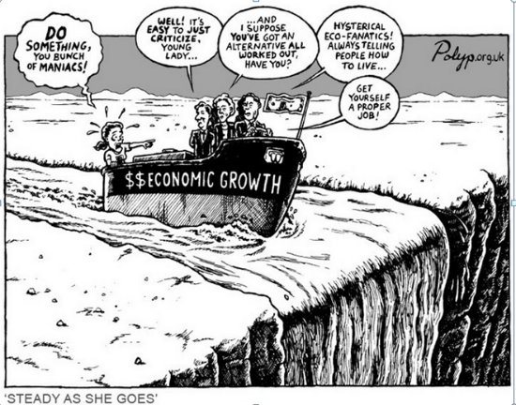
√
Steady state economy
Is an economy of relatively stable size
It features stable population & stable consumption that remain at/below carrying capacity
It has environmental, lifestyle & moral advantages

Slide 9
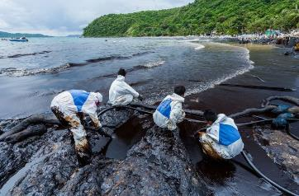
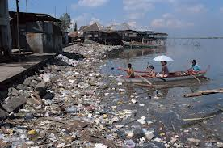
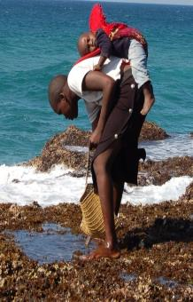
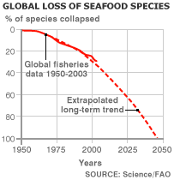
Livelihoods
Food security
Health and water
Notes:
In environmental health collapses, so does everything else

Slide 10
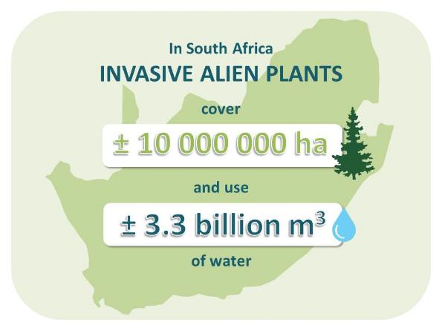
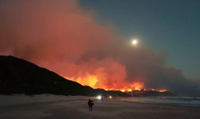
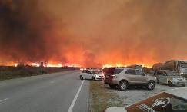
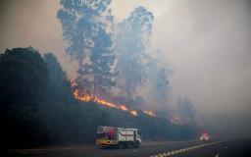
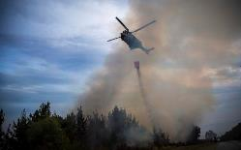
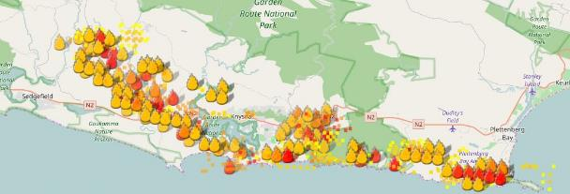
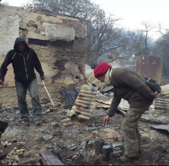
Notes:
For example, the failure to clear alien vegetation has resulted in unmanageable fires in the Garden Route in the last two weeks. The cost of these fires more than likely exceeds the costs of alien clearing (which has other benefits, such as water delivery, jobs, and value added products).

Slide 11
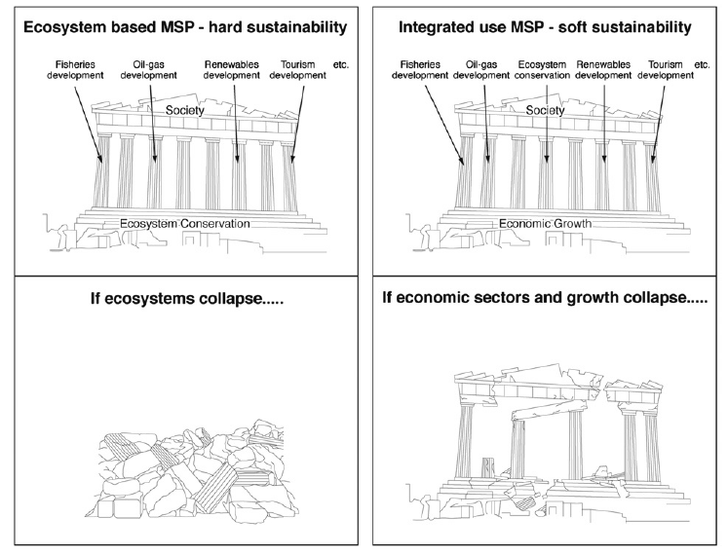
Wanfei Qiu and Peter Jones (2016)
Notes:
Fig. 1. Different views on sustainability in MSP. The two figures on the left describe ecosystem-based MSP, and the anticipated consequences of ecosystem collapse, based on ‘hard sustainability’. This view sees ecosystem conservation as the foundation for MSP, and that irreversible collapses in marine ecosystems would eventually lead to collapses in the economic sectors that depend on such marine ecosystems. The two figures on the right describe integrated-use MSP, based on ‘soft sustainability’, in which economic growth is seen as the foundation of MSP, and the collapse of the ‘environmental pillar’ does not necessarily lead to the collapse of related socio-economic structures.

Slide 12
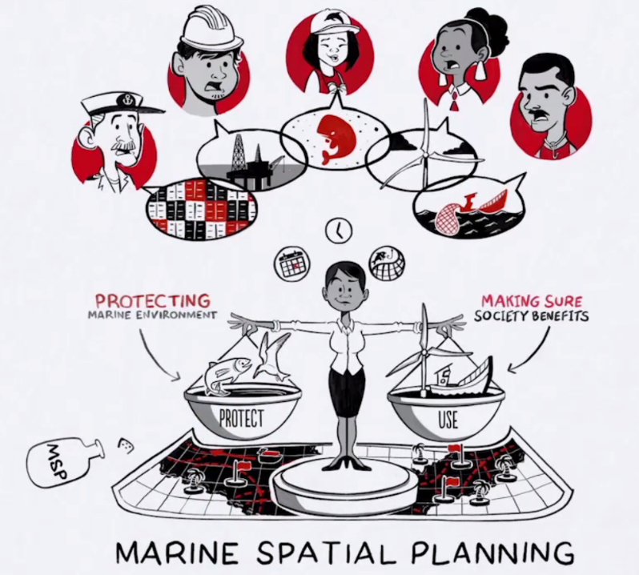
Notes:
Are all stakeholders equal? No, not in real life.

Slide 13
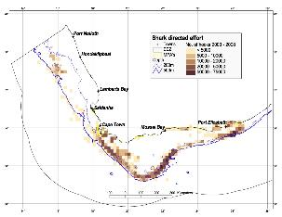
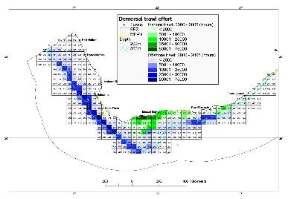
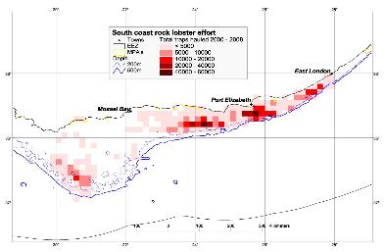
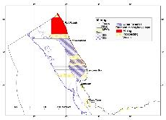
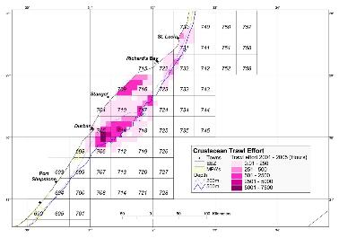
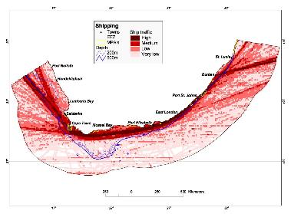
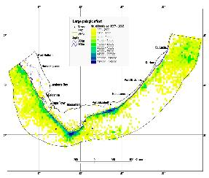
Distribution of ocean uses
Fishing (18 sectors)
Diamond & other mining
Petroleum
Shipping

Slide 14
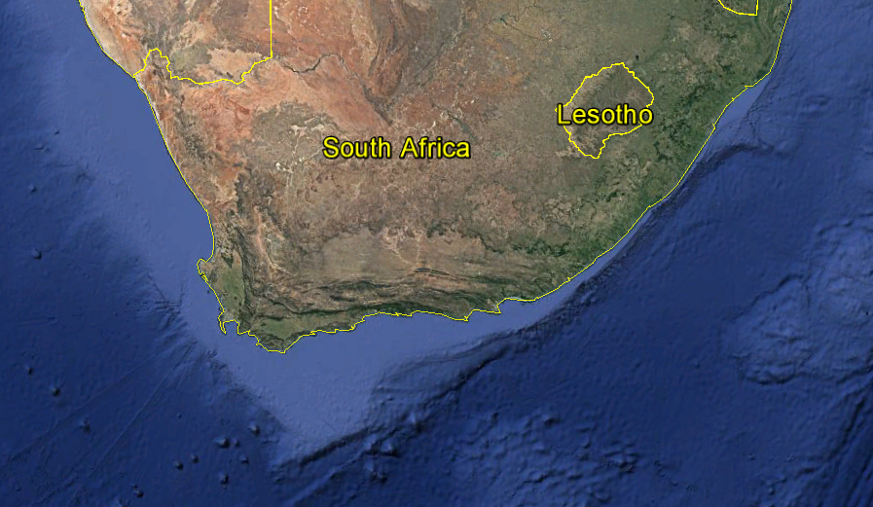
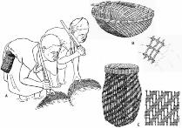

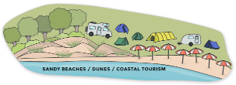
$
$
$
Notes:
Less powerful stakeholders are interested in near-shore activities

Slide 15

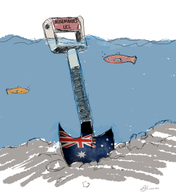
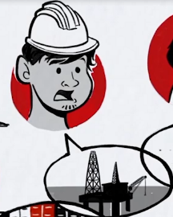
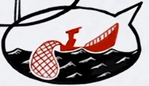
$
$
$
Notes:
More powerful stakeholders are interested in off-shore activities

Slide 16
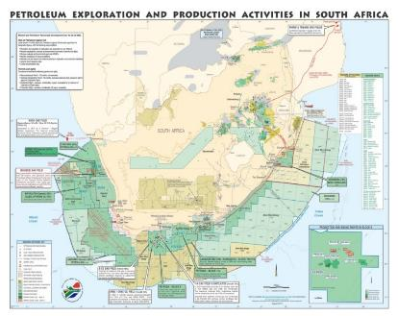

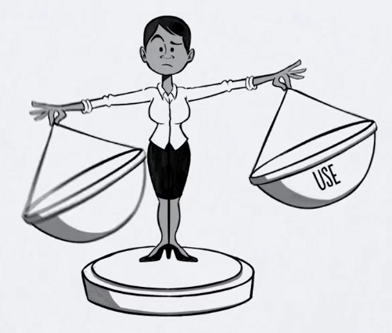




$
$
Notes:
For example, 0.5% of the Exclusive Economic Zone is under protection, whereas about 98% is under petroleum exploration leases.

Slide 17
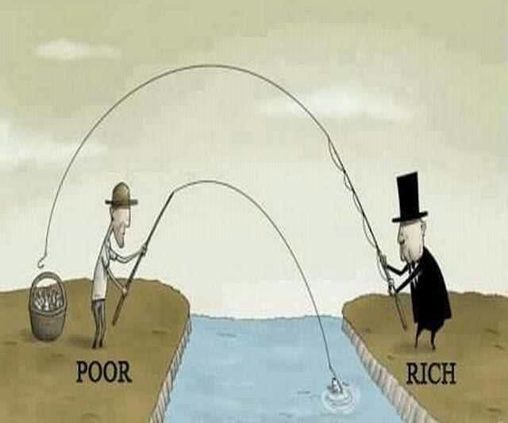

Notes:
With the current executive powers in the MSP Bill, it is likely that the rich will get richer, and the poor will not benefit

Slide 18









Slide 20
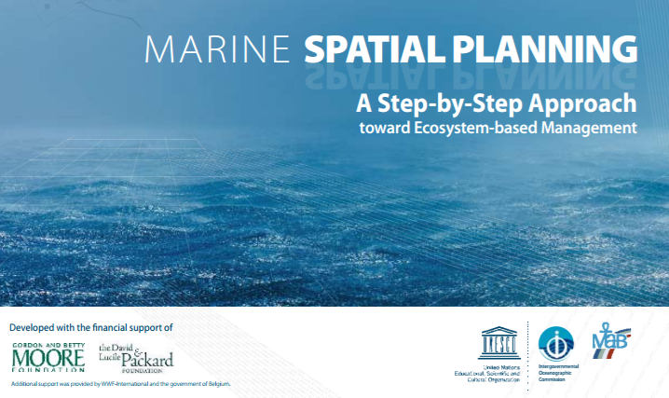
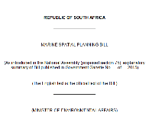

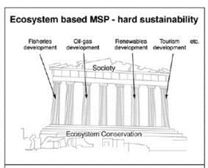
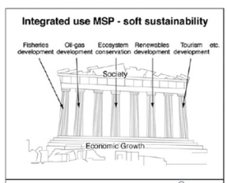


Notes:
We need checkpoints in the Bill – 1 – we need to explicitly adopt ecosystem-based MSP

Slide 21
Notes:
Checkpoint 2 – we need a stronger voice for civil society. Here is a proposed stakeholder forum and its establishment alongside formal MSP institutional structures proposed by the MSP Bill of March 2017.

Slide 22
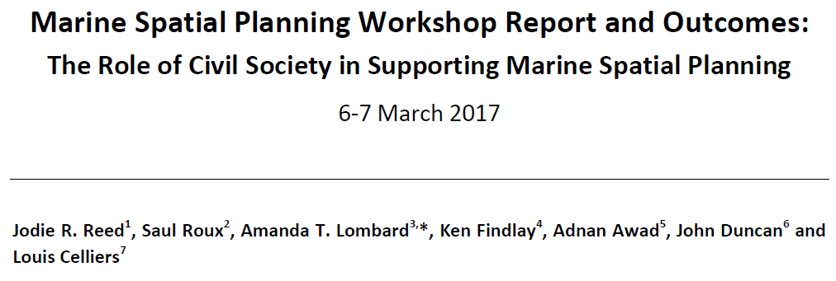

Notes:
The report from our first civil society workshop

Slide 23
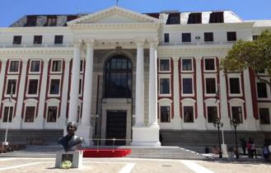
Draft
the plans
Implement the plans
PARLIAMENT
Notes:
Checkpoint 3 – marine area plans should have to go back to parliament for review BEFORE they are implemented, and the public should be given a comment period as per the ICMAct. In addition, if comments from civil society are ignored (as has been the case with previous DEA “stakeholder” processes), there must be the mechanism for an appeal process.

Slide 24
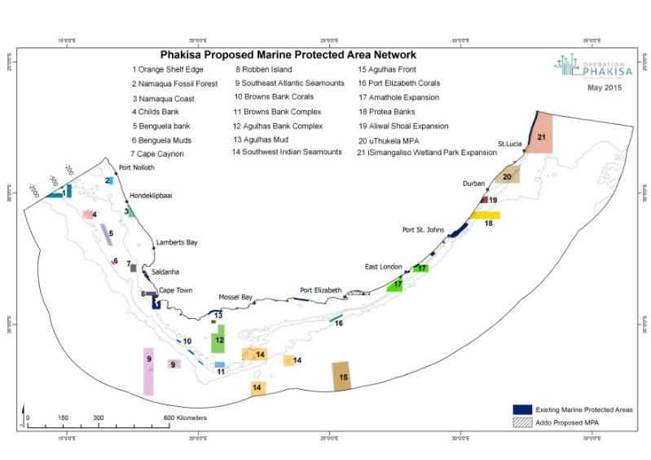
MPAs from 0.5 - 5 %, - 10%
Notes:
Checkpoint 4 - We need to declare our MPAs, which will take our MPA estate from 0.5 to 5%, and then we need to start work on declaring the next 5% to bring the total to 10%. The MPA Expansion strategy actually calls for 20%.

Slide 25
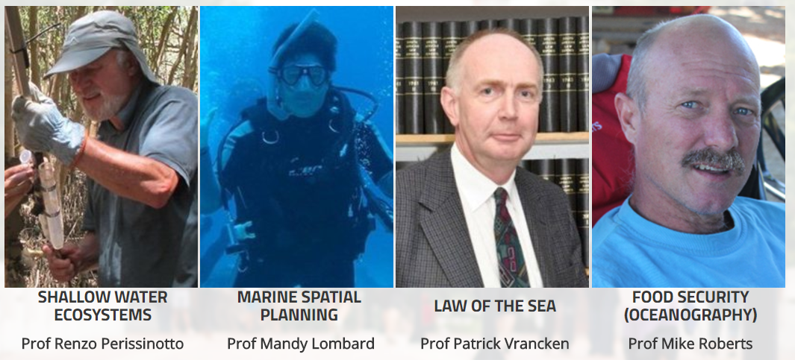
Notes:
We invite DEA to consult with us as South African academics, because we have a lot of experience with MSP. Thus far, consultations have been conducted mainly with international partners, but when we cite international “best-practice” to DEA, we are told that we should not look to northern Hemisphere countries because we have a ”different” situation. This is mixed messaging, and serves to deepen our concerns that civil society is being excluded from the MSP process.

