Slide 1
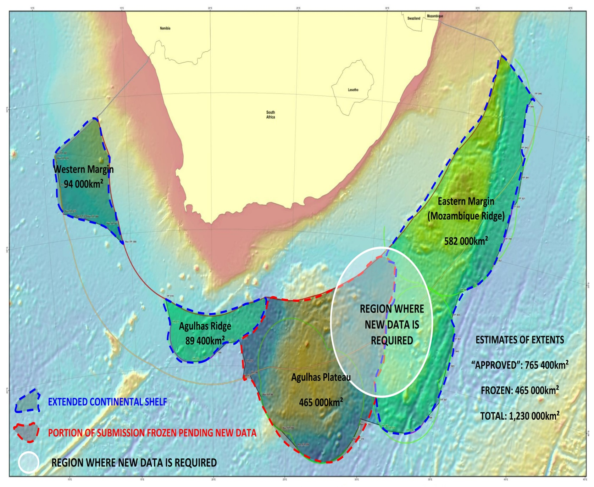
Notes:
These are the areas over which the we had agreement with the sub-commission

Slide 2
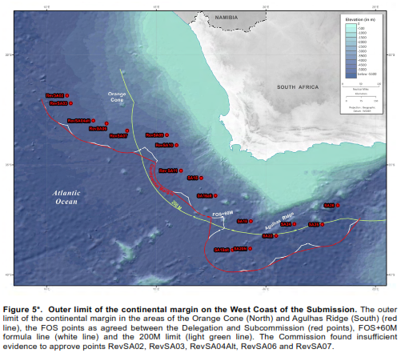
FOS
NOT
APPROVED
FOS APPROVED
Notes:
.
The Commission acknowledges the geological and geophysical data and information provided by South Africa in order to support FOS points on the Orange Cone, the Commission was however, in doubt regarding the validity of the arguments presented to use the full extent of the cone as the continental slope.
Having considered all data and information provided, the Commission reached the consensus view that a clear differentiation between continental slope and continental rise based on morphological, geological and geophysical data and information must be established in order to determine the base of the continental slope in the region of the cone and substantiate the FOS points in that area.
NOTE: All the points that lie outside the 200M have not been approved except for those southern area around the Agulhus Ridge. They say that we should makea differentiation between the slope and rise based on morphology, geological and geophysical data. I believe that is what we have been doing with the sub-commission for at least 4 sessions. This is not a decision the sub-commission took overnight.
The Western Margin

Slide 3
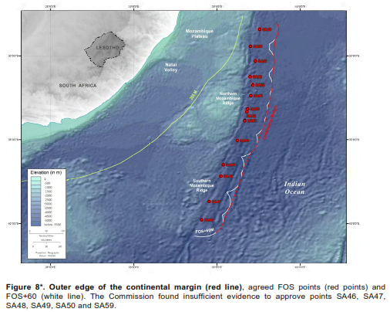
FOS 59
NOT
APPROVED
FOS 51-58
APPROVED
FOS 46-50
NOT
APPROVED
Notes:
Having considered the geological and geophysical data and information provided in the Submission, the Commission decided however accept the locations of FOS points SA58 to SA51.
Some members of the Commission, having considered the scientific data and information available in conjunction with the recent scientific literature (e.g. Fischer et al. 2017), did not agree with the morphological and geological connection between the northern and southern parts of the Mozambique Ridge as submitted by the State and recommended by the Subcommission.
Other members felt that while morphological continuity could be accepted, geological connection between the two parts was insufficiently demonstrated. Consequently, the Commission was unable to recommend the use of FOS points SA50 to SA46 as recommended by the Subcommission, and recommends that more data and information be presented by the State to support its contention of morphological and geological continuity between the northern and southern parts of the Mozambique Ridge.
Mozambique Ridge

Slide 4
What needs to be clear is that during the process of the technical and scientific examination of the submission, where the Delegation was able to influence the Subcommission, we were successful.
From the recommendations issued it is clear that the Commission overturned a whole series of recommendations on the OLCS agreed to and approved by the Subcommission without providing any analysis what so ever.
These recommendations puts the submission back to the most conservative position estimated during the scoping study in preparation of the submission.
The only way to respond to this is by making a re-submission – but this will take time and effort and will be delayed until the needed data around the saddle region and other additional supporting data is acquired.
More importantly, there is no point in preparing a revised submission if the the behaviour of the Commission is to assume the role of “Protector of the Oceans”, a view that is based on ideological views of individuals within the Commission. The problem lies within the Commission and is not one of Coastal States.
Pressure needs to be put on the Commission to carry out their mandate as required by the Convention
States should therefore be ready with strong verbal statements for the meeting at SPLOS in June 2017, where nominated candidates will be elected as members of the new commission – the aim is to put pressure on the Commission and establish why it is not doing its job.
In the immediate term, South Africa should prepare a response from a procedural perspective – this not a technical matter, rather political and should be lead by DIRCO with inputs from the technical team where needed. How South Africa proceeds will need to be discussed by the technical and diplomatic teams.
South Africa should also engage with and initiate interaction with other affected State parties (Norway, Iceland, Cooke Islands, Solomon Islands and others)
We’ve also been advised that whilst the Submission that examined the Bouvet Island of Norway agreed to the establishment of the OLCS in that region, the Commission overturned this and made no recommendations what so ever. This has a significant bearing on how we proceed with the Joint Island partial Submission.

