Slide 1
NDA STRATEGIC PLAN AND ANNUAL PERFORMANCE PLAN PRESENTATION TO THE SELECT COMMITTEE ON SOCIAL SERVICES 20 JUNE 2017
MRS THAMO MZOBE
CHIEF EXECUTIVE OFFICER

Slide 2
Content
Purpose
NDA Mandate
Powers and Duties of the NDA
Vision of the NDA
CSO Development Approach
NDA Programmes and Strategic Objectives
APP Targets
MTEF Budget Allocation
Recommendation

Slide 3
Purpose
To present the NDA Strategic Plan (2017/2022) and the Annual Performance Plan (2017/2018) to the Select Committee on Social Services for consideration.

Slide 4
NDA Mandate
Vision
A society free from poverty
NDA Act
Mission
To contribute to poverty eradication and the elimination of its causes.
Primary Mandate
Values
Integrity with Dignity, Empowerment for Accountability, Responsibility with Transparency, Excellence and Partnering
Carrying out programmes and projects aimed at meeting development needs of the poor
Strengthening the institutional capacity of other civil society organisations involved in direct service provision to the poor communities
To contribute towards the eradication of poverty and its causes by granting funds to civil society organisations for the purpose of:-

Slide 5
NDA Mandate
NDA Act
Secondary Mandate
Debating development policy
Acting as conduit for funding from Government, foreign government and other national and international donors for development work carried-out by CSOs ”
Undertaking research and publication aimed at proving basis for development policy
Promote consultation, dialogue and sharing of development experience between the CSOs and relevance organs of state through

Slide 6
Duties and Powers of the NDA (Section 4 of the NDA Act)
The NDA must:
act as a key conduit for funding from the Government of the Republic, foreign governments and other national and international donors for development work to be carried out by civil society organisations.
develop, conduct and co-ordinate policy relevant to its objects.
contribute towards building the capacity of civil society organisations to enable them to carry out development work effectively.
create and maintain a database on civil society organisations.
The NDA may:
grant money from its funds in accordance with such criteria and procedures as the NDA determines, and with due regard to the NDA’s primary object, to any CSO for any project or programme that organisation intends to undertake or is undertaking.

Slide 7
Vision: A society free from poverty
Empowered society
Engaged communities
Fiscal credibility and sustainability
Sustainable development
High Performing Organisation

Slide 8
CSO Development Model

Slide 9
NDA Programmes
The Strategy NDA has the following 3 Programmes:
Programme 1: Governance and Administration
Programme 2: CSO Development
Sub-programme 2.1: CSO mobilisation and formalisation
Sub-programme 2.2: CSO institutional capacity building
Sub-programme 2.3: CSO resource mobilisation
Sub-programme 2.4: CSO grant funding and sustainability
Programme 3: Research

Slide 10
NDA Programmes & Strategic Objectives
Programmes & Sub-Programmes | Programme Description | Strategic Objective
Programme 1: Governance and Administration | The programme focuses on promoting and maintaining organisational excellence and sustainability through effective and efficient administration that includes performance, employee well-being, cost containment and brand recognition. | To develop and strengthen internal systems, processes and human capability to deliver efficiently and effectively on the NDA mandate.

Slide 11
Programmes & Strategic Objectives
Programmes & Sub-Programmes | Programme Description | Strategic Objective
Programme 2: CSO Development | The programme provides a comprehensive package that aim at developing CSOs to their full potential so as to ensure that CSOs, especially those operating in poor communities, have capabilities to provide quality services to the communities they are serving. This programme has 4 sub-programmes to ensure that the full comprehensive package of services are efficiently delivered and accounted for. | To increase the number of CSOs that have access to development interventions aimed at developing their capabilities to efficiently manage, mobilise resources and sustain themselves for purposes of improving the quality of services provided by the organisations in poor communities.

Slide 12
NDA Programmes & Strategic Objectives
Sub-Programmes | Sub-Programme Description
Sub-Programme 2.1: CSO mobilisation and formalisation | Focuses on civil society organisation engagements, assessments and needs analysis for CSOs, prioritisations of interventions required by CSOs, facilitating registration of CSOs that needs support to register with appropriate registration authorities (NPO and Cooperatives).
Sub-Programme 2.2: CSO’s institutional capacity building | Focus on strengthening institutional capacities of CSOs across all districts and local municipalities in nine provinces. The capacity building interventions will be provided through training, mentoring and incubation to all CSOs assessed and requiring institutional capacity building development.

Slide 13
NDA Programmes & Strategic Objectives
Sub-Programmes | Sub-Programme Description
Sub-Programme 2.3: CSO resource mobilisation | Focuses on all resource (government, foreign governments, international agencies, and private sector) mobilised for purposes of strengthening the CSOs capabilities ,funding levels, increasing CSOs coverage and services.
Sub-Programme 2.4: CSO sustainability | Focuses on ensuring that all CSOs assessed for development needs are linked to appropriate available resources, are supported to establish or strengthen networks that can provide a range of development opportunities and are provided with grants that can ensure their sustainability and growth.

Slide 14
NDA Programmes & Strategic Objectives
Programme | Programme Description | Strategic Objective
Programme 3: Research | The programme focuses on action research and impact evaluative studies that will be used to inform programme planning, implementation and management of NDA CSOs development programmes. In addition, the programme will promote and inform national development policy debates and engagements with the CSOs sector and state organs on issues relating to development and poverty alleviation in general. It will also produce publications and standards for effective best practice in the CSOs sector to promote sharing of lessons and good practice in the social development sector. | To conduct, collate and disseminate research and evaluations that inform the national development agenda.

Slide 15
Programme 1: Governance & Administration Strategic Objectives and annual targets
STRATEGIC STATEMENT: | Implement financial management, information technology, human resource and communications systems and processes to achieve good governance by 2017/22.
Strategic Objective | Audited/Actual Performance |  |  | Estimate performance 2016/17 | Medium-term Targets
 | 2013/14 | 2014/15 | 2015/16 |  | 2017/18 | 2018/19 | 2019/20
To develop and strengthen internal systems, processes and human capability to deliver efficiently and effectively on the NDA mandate | Unqualified Audi Opinion | Unqualified Audi Opinion | Unqualified Audi Opinion | Unqualified Audi Opinion | Unqualified Audi Opinion | Clean Audit | Clean Audit

Slide 16
Programme 1: Governance & Administration Performance indicators and annual targets
Performance indicators |  | Audited/Actual Performance |  |  | Estimate performance 2016/17 | Medium-term Targets
 |  | 2013/14 | 2014/15 | 2015/16 |  | 2017/18 | 2018/19 | 2019/20
1.1 | % of legislative/regulatory compliance including the PFMA, Treasury Regulations and the NDA policies. | New | New | New | New | 100% | 100% | 100%
1.2 | Percentage implementation of marketing and communication activities aimed at improving NDA brand awareness. | New | New | New | New | 100% | 100% | 100%
1.3 | Completed and functional integrated information system per year | New | New | New | Approved ICT Strategy Plan | 60% Implementation | Fully functional and integrated ICT system | 0
1.4 | % implementation of the rollout plan for establishing decentralised program delivery centres at districts | New | New | New | New | 50% | 70% | 100%
1.5 | % of targets achieved in the APP | New | New | 73% | 80% | 90% | 90% | 90%

Slide 17
Governance & Administration Quarterly targets for 2017/2018
Performance Indicator |  | Reporting period | Annual Target | Quarterly Targets
 |  |  |  | 1st | 2nd | 3rd | 4th
1.1 | % of legislative/regulatory compliance including the PFMA, Treasury Regulations and the NDA policies. | Quarterly | 100% | 100% | 100% | 100% | 100%
1.2 | Percentage implementation of marketing and communication activities aimed at improving NDA brand awareness. | Annually | 100% | 0 | 40% | 70% | 100%
1.3 | Completed and functional integrated information system per year | Quarterly | 60% (3 yr Implementation Plan) | 0 | 40% | 60% | 100%
1.4 | % implementation of the rollout plan for establishing decentralised program delivery centres at districts | Quarterly | 50% | 50% | 60% | 80% | 100%
1.5 | % of targets achieved in the APP | Quarterly | 90% | 90% | 90% | 90% | 90%

Slide 18
Programme 2: CSOs Development Strategic Objectives and targets
STRATEGIC STATEMENT 1: Conduct engagements, dialogues, assessments and needs analysis for CSOs to identify the type of development interventions required by CSOs including facilitating formalisation of the organisations to ensure the increased number of CSOs provided with CSO development interventions including registration by 2021/22
Strategic Objectives | Audited/Actual Performance |  |  | Estimate performance 2016/17 | Medium-term Targets
 | 2013/14 | 2014/15 | 2015/16 |  | 2017/18 | 2018/19 | 2019/20
To increase the number of CSOs that have access to development interventions aimed at developing their capabilities to efficiently manage, mobilise resources and sustain themselves for purposes of improving the quality of services provided by the organisations in poor communities. | New | New | New | New | 3050 | 4200 | 4500

Slide 19
Sub Programme 1: CSOs mobilisation and formalisation Performance indicators and annual targets
Performance indicators |  | Audited/Actual Performance |  |  | Estimate performance 2016/17 | Medium-term Targets
 |  | 2013/14 | 2014/15 | 2015/16 |  | 2017/18 | 2018/19 | 2019/20
2.1 | Number of CSOs participated in CSOs mobilisation engagements and consultation processes per year | New | New | New | 2030 | 3050 | 4200 | 4500
2.2 | Number of CSOs assisted to formalise their structures per year | New | New | New | 630 | 720 | 940 | 1000
2.3 | Number of CSOs assessed to identify institutional needs and determine appropriate CSOs development support to be provided per year | New | New | New | 2030 | 3050 | 4200 | 4500
2.4 | Number of CSOs assisted to register with appropriate registration authority per year | New | New | New | 630 | 720 | 940 | 1000
2.5 | Number of CSOs referred to other agencies for technical and/or financial support per year | New | New | New | 406 | 762 | 1260 | 1400

Slide 20
Sub Programme 1: CSOs mobilisation and formalisation Quarterly targets for 2017/2018
Performance Indicator |  | Reporting period | Annual Target 2017/18 | Quarterly Targets
 |  |  |  | 1st | 2nd | 3rd | 4th
2.1.1 | Number of CSOs participated in CSOs mobilisation engagements and consultation processes per year | Quarterly | 3050 | 350 | 1525 | 2440 | 3050
2.1.2 | Number of CSOs assisted to formalise their structures per year | Quarterly | 720 | 72 | 360 | 576 | 720
2.1.3 | Number of CSOs assessed to identify institutional needs and determine appropriate CSOs development support to be provided per year | Quarterly | 3050 | 350 | 1525 | 2440 | 3050
2.1.4 | Number of CSOs assisted to register with appropriate registration authority per year | Quarterly | 720 | 72 | 360 | 576 | 720
2.1.5 | Number of CSOs referred to other agencies for technical and/or financial support per year | Quarterly | 762 | 76 | 305 | 229 | 152

Slide 21
Sub-Programme 2: CSOs Institutional Capacity Building Strategic Objectives & targets
STRATEGIC STATEMENT 2: Implement institutional capacity building interventions for purposes of improving CSOs organisational management, compliance and reporting through training, mentoring, incubation, and continuous support to ensure increased number of CSOs capacitated and developed by 2021/22.
Strategic objective: Increase number of CSOs that have access to development interventions aimed at developing their capabilities to efficiently manage, mobilise resources and sustain themselves for purposes of improving the quality of services provided by the organisations in poor communities. |  | Audited/Actual Performance |  |  | Estimate performance 2016/17 | Medium-term Targets
 |  | 2013/14 | 2014/15 | 2015/16 |  | 2017/18 | 2018/19 | 2019/20
2.2 | To increase accessibility to capacity- strengthening interventions to CSOs with the aim of improving the quality of services. | 2059 | 2531 | 2687 | 4950 | 6250 | 10000 | 14 000

Slide 22
Sub Programme 2: CSOs institutional capacity building Performance indicators and annual targets
Performance indicators |  | Audited/Actual performance |  |  | Estimate performance 2016/17 | Medium-term targets
 |  | 2013/14 | 2014/15 | 2015/16 |  | 2017/18 | 2018/19 | 2019/20
2.2.1 | Number of CSOs assessed to determine institutional capacity with the aim of providing appropriate capacity building support per year | New | New | New | New | 6250 | 10000 | 14 000
2.2.2 | Number of CSOs trained and/or mentored to comply with registration legislations per year | 2 059 | 2 531 | 2687 | 3000 | 3750 | 6000 | 6000
2.2.3 | Number of civil society organisations capacitated in civil society organisational management per year | 2059 | 2531 | 2687 | 2000 | 3000 | 5000 | 5000
2.2.4 | Number of NPOs trained in community development practice per year | New | New | New | 450 | 750 | 900 | 1 500

Slide 23
Sub Programme 2: CSOs institutional capacity building Quarterly Targets for 2017/2018
Performance Indicator |  | Reporting period | Annual Target 2017/18 | Quarterly Targets
 |  |  |  | 1st | 2nd | 3rd | 4th
2.2.1 | Number of CSOs assessed to determine institutional capacity with the aim of providing appropriate capacity building support per year | Quarterly | 6250 | 1 000 | 1 723 | 1 763 | 1 764
2.2.2 | Number of CSOs trained and/or mentored to comply with registration legislations per year | Quarterly | 3750 | 375 | 1875 | 3000 | 3750
2.2.3 | Number of civil society organisations capacitated in civil society organisational management per year | Quarterly | 3000 | 300 | 1500 | 1400 | 3000
2.2.4 | Number of NPOs trained in community development practice per year | Quarterly | 750 | 100 | 250 | 400 | 750

Slide 24
Sub Programme 3: CSOs resource mobilisation (financial & non financial resources) Strategic Objectives & targets
STRATEGIC STATEMENT 3: Conduct resource mobilisation activities aimed at increasing funding streams for CSOs development to ensure increase in the value of funds available for CSOs funding from government, foreign governments and private sector by 2021/22
Strategic objective |  | Audited/Actual Performance |  |  | Estimate performance 2016/17 | Medium-term Targets
 |  | 2013/14 | 2014/15 | 2015/16 |  | 2017/18 | 2018/19 | 2019/20
2.3 | To Increase number of CSOs that have access to development interventions aimed at developing their capabilities to efficiently manage, mobilise resources and sustain themselves for purposes of improving the quality of services provided by the organisations in poor communities. | R98.2m | R104.2m | R67.3m | R80m | R8m | R100m | R120m

Slide 25
Sub Programme 3: CSOs resource mobilisation Performance indicators and annual targets
Performance indicators |  | Audited/Actual performance |  |  | Estimate performance 2016/17 | Medium-term targets
 |  | 2013/14 | 2014/15 | 2015/16 |  | 2017/18 | 2018/19 | 2019/20
2.3.1 | Number of CSOs needs assessment conducted for resource mobilisation per year | New | New | New | New | 2 062 | 3 500 | 4 000
2.3.2 | Rand Value of resources (financial and non financial) raised to fund CSOs per year | R98.2m | R104m | R67.3m | R80m | R80m | R100m | R120m
2.3.3 | Number of civil society organisations grant funded for capacity building per year | New | New | New | New | 900 | 1 200 | 2 000
2.3.4 | Number of individual directly benefiting from programs that have received grants from third parties through NDA per year | New | New | New | New | 2 700 | 3 600 | 6 000
2.3.5 | Number of partnership agreements concluded and signed per year | new | 14 | 19 | 19 | 21 | 25 | 28

Slide 26
Sub Programme 3: CSOs resource mobilisation Quarterly targets for 2017/2018
Performance Indicator |  | Reporting period | Annual Target 2017/18 | Quarterly Targets
 |  |  |  | 1st | 2nd | 3rd | 4th
2.3.1 | Number of CSOs needs assessment conducted for resource mobilisation per year | Quarterly | 2 062 | 287 | 600 | 686 | 489
2.3.2 | Rand Value of resources (financial and non financial) raised to fund CSOs per year | Quarterly | R80m | R10m | R30m | R20m | R20m
2.3.3 | Number of civil society organisations grant funded for capacity building per year | Quarterly | 900 | 150 | 450 | 675 | 900
2.3.4 | Number of individual directly benefiting from programs that have received grants from third parties through NDA per year | Quarterly | 2 700 | 600 | 1500 | 2100 | 2700
2.3.5 | Number of partnership agreements concluded and signed per year | Quarterly | 21 | 3 | 6 | 6 | 6

Slide 27
Sub Programme 4: CSO grant funding & sustainability Strategic Objectives & targets
STRATEGIC STATEMENT 3: Implement interventions that ensure sustainability of CSOs through establishing linkages for access to resources, creating local, provincial and national CSOs networks and increasing the number of CSOs funded through NDA facilitated funding conduits and the NDA by 2021/22
Strategic objective | Audited/Actual Performance |  |  | Estimate performance 2016/17 | Medium-term Targets
 | 2013/14 | 2014/15 | 2015/16 |  | 2017/18 | 2018/19 | 2019/20
To increase the number of CSOs that have access to development interventions aimed at developing their capabilities to efficiently manage, mobilise resources and sustain themselves for purposes of improving the quality of services provided by the organisations in poor communities. | New | New | New | New | 2 062 | 3 500 | 4 000

Slide 28
Sub Programme 4: CSOs grant funding & sustainability Performance indicators and annual targets
Performance indicators |  | Audited/Actual Performance |  |  | Estimate performance 2016/17 | Medium-term Targets
 |  | 2013/14 | 2014/15 | 2015/16 |  | 2017/18 | 2018/19 | 2019/20
2.4.1 | Number of CSOs grant funding and sustainability needs assessed per year | New | New | New | New | 2 062 | 3 500 | 4 000
2.4.2 | Number of CSOs that received grant funding per year | New | New | New | New | 200 | 300 | 400
2.4.3 | Number of CSOs assisted to join CSOs networks per year | New | New | New | New | 400 | 600 | 800
2.4.4 | Number of CSOs linked to sustainable resources per | New | New | New | New | 400 | 600 | 800

Slide 29
Sub Programme 4: CSOs grant funding & sustainability Quarterly targets for 2017/2018
Performance Indicator |  | Reporting period | Annual Target 2017/18 | Quarterly Targets
 |  |  |  | 1st | 2nd | 3rd | 4th
2.4.1 | Number of CSOs grant funding and sustainability needs assessed per year | Quarterly | 2 062 | 415 | 615 | 615 | 417
2.4.2 | Number of CSOs that received grant funding per year | Quarterly | 200 | 30 | 30 | 70 | 70
2.4.3 | Number of CSOs assisted to join CSOs networks per year | Quarterly | 400 | 70 | 130 | 150 | 50
2.4.4 | Number of CSOs linked to sustainable resources per |  | 400 | 70 | 130 | 150 | 50

Slide 30
Programme 3: Research Strategic Objectives & targets
STRATEGIC STATEMENT: |  | Conduct action research and evaluations that inform the formulation of national development policies and Programs focusing on poverty eradication initiatives. Facilitate debates and engagements between the CSO sector and the State on the national development agenda.
Strategic Objectives |  |  | Audited/Actual Performance |  |  | Estimate performance 2016/17 | Medium-term Targets
 |  |  | 2013/14 | 2014/15 | 2015/16 |  | 2017/18 | 2018/19 | 2019/20
3. | To conduct, collate and disseminate research and evaluations that inform the national development agenda. |  | 9 reports produced | 6 reports produced | 14 reports produced | 16 reports produced | 18 reports produced | 20 reports produced | 22 reports produced

Slide 31
Programme 3: Research Performance indicators and annual targets
Performance indicators |  | Audited/Actual Performance |  |  | Estimate performance 2016/17 | Medium-term Targets
 |  | 2013/14 | 2014/15 | 2015/16 |  | 2017/18 | 2018/19 | 2019/20
3.1 | Number of research and policy briefs produced per year | New | 6 reports produced | 14 reports produced | 16 reports produced | 18 reports produced | 20 reports produced | 22 reports produced
3.2 | Number of best practice publications produced per year | 6 | 6 | 7 | 6 publications produced | 9 publications produced | 12 publications produced | 15 publications produced
3.3 | Number of dissemination sessions for research reports, evaluation reports, policy briefs and best practice publication conducted per year | New | New | 3 | 6 | 7 | 7 | 8
3.4 | Number of participants who attended research reports, evaluation reports, policy briefs and best practice dissemination sessions per year | New | New | New | 240 participants | 260 participants | 280 participants | 300 participants
3.5 | Number of evaluation studies on NDA program conducted and results shared out with various stakeholders per year | New | New | New | New | 5 | 5 | 5

Slide 32
Programme 3: Research Quarterly targets for 2017/2018
Performance Indicator |  | Reporting period | Annual Target 2017/18 | Quarterly Targets
 |  |  |  | 1st | 2nd | 3rd | 4th
3.1 | Number of research and policy briefs produced per year | Quarterly | 18 reports produced | 5 | 5 | 4 | 4
3.2 | Number of best practice publications produced per year | Quarterly | 9 publications produced | 2 | 3 | 2 | 2
3.3 | Number of dissemination sessions for research reports, evaluation reports, policy briefs and best practice publication conducted per year | Quarterly | 7 sessions | 2 sessions | 2 sessions | 1 sessions | 2 sessions
3.4 | Number of participants who attended research reports, evaluation reports, policy briefs and best practice dissemination sessions per year | Quarterly | 260 participants | 70 participants | 70 participants | 50 participants | 70 participants
3.5 | Number of evaluation studies on NDA program conducted and results shared out with various stakeholders per year | Quarterly | 5 | 1 | 1 | 1 | 2

Slide 33
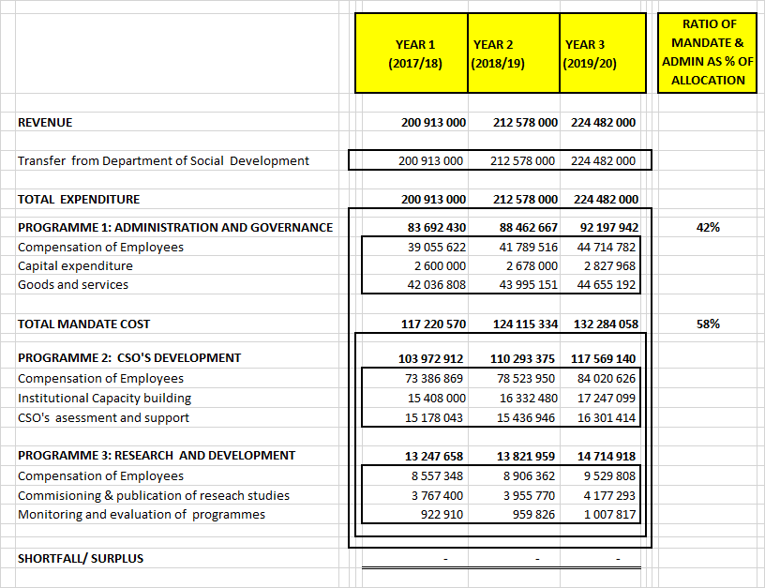
MTEF Budget Allocation

Slide 34
RECOMMENDATION
It is recommended that the Select Committee on Social Services considers both the Strategic Plan (2017/2022) and the Annual Performance Plan (2017/2018) of the NDA.

Slide 35
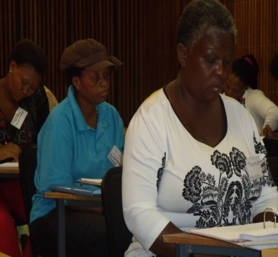
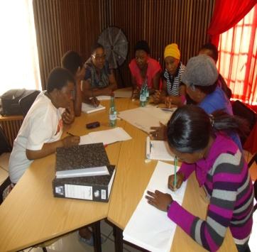
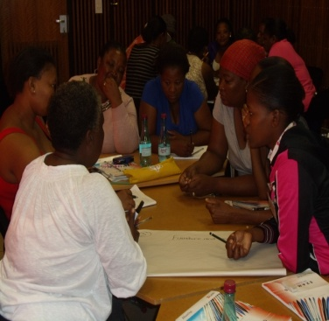
THANK YOU
THANK YOU YOU

