Slide 1
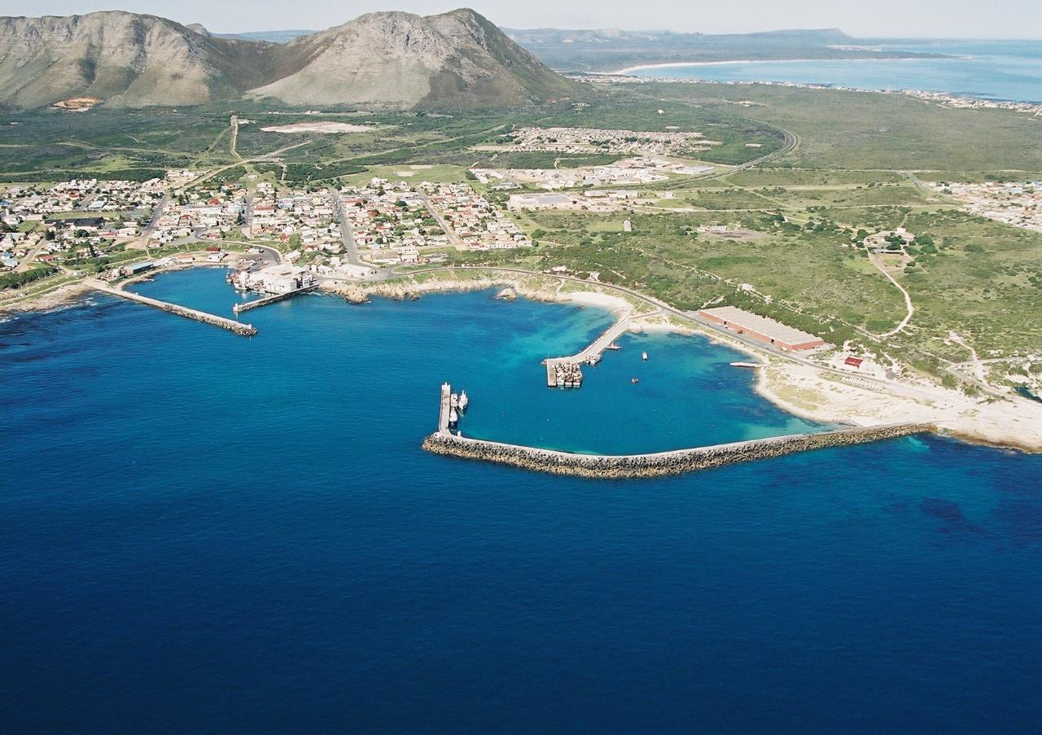
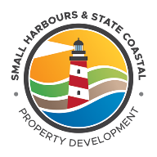
MR. M DLABANTU: DIRECTOR GENERAL DPW
SUPPORTED BY MR M GOVENDER
SMALL HARBOURS AND STATE COASTAL PROPERTY DEVELOPMENT UNIT
PORTFOLIO COMMITTEE
13 JUNE 2017

Slide 2
TOGETHER WE MOVE SOUTH AFRICA
Attracting Investment, in State Coastal Maritime Infrastructure and Properties, to Grow Businesses, Create Jobs, Stimulate Economic Growth and Redistribute Wealth,
The aspiration will be achieved by:
Ensuring territorial integrity through the Management of Small Harbours and Coastal Properties.
Access to State Coastline, Maritime Infrastructure, Small Harbours and Bays
Ensure inclusive Economic Growth and Development through the Empowerment of Local Communities
Empowering Coastal Communities in Skills Development, Education and Enterprise Development
Energise the Growth of Coastal Infrastructure
Unlocking the Economic Potential of South Africa’s Oceans
Delivering on the aspiration of the National Development Plan 2030
Fundamental change in how government accelerates delivery

Slide 3
TABLE OF CONTENTS
Purpose
Problem Statement
Establishment of the Integrated Small Harbour Management Authority (ISHMA)
Organisational Arrangements (SH&SCPDU)
Function: Special Intervention Project: Fixing and Maintenance of 12 Proclaimed fishing harbours
Function: Management and Maintenance of State Coastal Properties
Function: Letting out of State Coastal Properties
Special Function: Convening of Small Harbours and State Coastal Property Development Delivery Laboratory under Oceans Economy of Operation Phakisa
Special Function: National Priority Projects
Contact Details

Slide 4
MAP OF SA COASTLINE, HARBOURS AND PORTS OF ENTRY
3

Slide 5
1. PURPOSE
To Brief Public Works Portfolio Committee on the following:
Current work of the Small Harbours and State Coastal Property Development unit within DPW
Progress made with respect to:
Maintenance programme to the proclaimed fishing harbours
Stimulation of economic development and job creation
Letting out of state coastal properties for revenue

Slide 6
2. PROBLEM STATEMENT
Poor management of the Republic’s Coastal Properties, Slipways and Small Harbours
Lack of development of local skills within the marine infrastructure, marine research and development sector
Lack of management and maintenance programmes in place for harbours from both DAFF and DPW
Lack of management of state coastal properties along the admiralty reserve
The development of fully functional fishing harbours was skewed towards the Western Cape. The NC, EC and KZN provinces have been grossly neglected
A vast majority of our properties are unutilised and a getting vandalised and costing the state money through security and Rates and Taxes
No Over-arching plan to steer immediate and future development and accommodation plans exists for the PFH stifling economic growth
No environmental Management plan (EMP) based upon a strategic environmental assessment (SEA) for each of the PFH exists
Notes:
1.Poor management of the Republic’s Coastal Properties, Slipways and Small Harbours leading to:
- Illegal activities on state owned properties – drugs distribution, prostitution and other criminal activities
- Illegal entry into SA
- Loss of revenue - illegal fishing
- Reduction of the states asset value
- Additional financial stress onto governments fiscus – Costs of rates and taxes, repairs and maintenance, security etc.

Slide 7
2. PROBLEM STATEMENT
Non-existence of land zoning or utilisation system has resulted in haphazard development taking place over the years
No established budget for development purposes
No plan to improve the overall functionality, aesthetics and day to day operations of the harbours exists
Notes:
1.Poor management of the Republic’s Coastal Properties, Slipways and Small Harbours leading to:
- Illegal activities on state owned properties – drugs distribution, prostitution and other criminal activities
- Illegal entry into SA
- Loss of revenue - illegal fishing
- Reduction of the states asset value
- Additional financial stress onto governments fiscus – Costs of rates and taxes, repairs and maintenance, security etc.

Slide 8
3. ESTABLISHMENT OF THE INTEGRATED SMALL HARBOUR MANAGEMENT AUTHORITY (ISHMA)
2005 Cabinet endorsed the creation of an Integrated Small Harbours Management Authority (ISHMA)
Mandate:
Management of all state owned coastal property
2009 A revised proposal was submitted to Cabinet and approved
Mandate:
Manage all state owned coastal property
Develop all state owned coastal property: Aquaculture, academic research, leisure etc
In terms of the 2005 Cabinet decision, the then minister of Public Works issued a letter to the then Minister od DEAT (now DAFF) to confirm that DEAT (now DAFF) would play the lead role in the establishment of the ISHMA

Slide 9
3. ESTABLISHMENT OF THE INTEGRATED SMALL HARBOUR MANAGEMENT AUTHORITY (ISHMA)
It was proposed that the ISHMA be established as an inter-governmental Authority
It was further recommended that the following departments must form part of the Authority:
DAFF and DPW

Slide 10
3. ESTABLISHMENT OF THE INTEGRATED SMALL HARBOUR MANAGEMENT AUTHORITY (ISHMA)
Currently the following departments are involved in the management of Small Harbours:
DAFF: Licencing authority for fishing and aquaculture activity and Harbour management
Marine Living Resources Act number 18 of 1998
DEA/DAFF: Coastal and marine protection
Integrated Coastal Management Act number 36 of 2014
DPW: Custodian of the State’s Immovable Assets including Admiralty reserves and harbours
Government Immovable Asset Management Act number 19 of 2007

Slide 11
3. ESTABLISHMENT OF THE INTEGRATED SMALL HARBOUR MANAGEMENT AUTHORITY (ISHMA)
In August 2016, a task team of DDGs from DPW, DEA, DAFF and NT took a decision to:
Review prior cabinet decisions for the Establishment of the Harbour Management Entity and Provide a final proposal to Cabinet on the management and development of state owned coastal properties including small harbours
On the 19th January 2017, the DG DAFF and DG DPW met to further reaffirm the decision to establish a Management Authority and a task team was established thereof
As a matter of urgency there need to be engagements between DPW and DAFF to agree on and implement security measures at proclaimed fishing harbours

Slide 12
3. ESTABLISHMENT OF THE INTEGRATED SMALL HARBOUR MANAGEMENT AUTHORITY (ISHMA)
INTERIM ARRANGEMENTS
In 2012 a Harbour Steering Committee made up of DPW, DAFF, NT, WCPG and CCTMM was set up as a cooperative joint management structure to manage the Proclaimed Fishing Harbours
DAFF and DPW are co-chairs of HSC
A Harbour Lease (Letting-out) Committee was also established and reported to the HSC

Slide 13
3. ESTABLISHMENT OF THE INTEGRATED SMALL HARBOUR MANAGEMENT AUTHORITY (ISHMA)
Inhibitors:
DAFF currently receives revenue for the use of harbour facilities
DPW does not receive any funds from DAFF, however DPW is responsible for the maintenance of facilities at these harbours with no budget allocation
Proposed Solution:
The combination of the revenue received from DAFF in its Marine Living Resources Fund (MLRF), and
Revenue received from DPWs State Coastal Property Let out, into a separate joint account for the management and development of proclaimed fishing harbours
The establishment of a Management Authority with the required resources to effectively manage all operational requirements and additional projects

Slide 14
4. ORGANISATIONAL ARRANGEMENTS (SH&SCPDU)
Establishment of the Small Harbours and State Coastal property Development Unit within DPW
As part of the Turnaround and the establishment of the PMTE – a specialised unit, the SH&SCPDU, was established within the REMS Division
The functions of managing coastal property in the unit is currently performed by the Real Estate Management Services (REMS) Division at DPWs 5 coastal regional offices
Mandate and Functions of the Small Harbours and State Coastal Property Development Unit within DPW are:
Letting out of state coastal property for economic development
Management of state coastal properties
Maintenance of small harbours and coastal properties
Special intervention programme: repair and maintenance of 12 Proclaimed fishing harbours in the Western Cape

Slide 15
4. ORGANISATIONAL ARRANGEMENTS (SH&SCPDU)
Special functions of the unit:
Convening of the Small Harbours and State Coastal Property Development delivery laboratory under Oceans Economy of Operation Phakisa
National priority project (Phase One) to develop 3 new small harbours in the Northern Cape, Eastern Cape and Kwa – Zulu Natal provinces; Port Nolloth, Port St Johns and Port Edward respectively

Slide 16
5. SPECIAL INTERVENTION PROJECT: MAINTENANCE AND REPAIR OF 12 PROCLAIMED FISHING HARBOURS
In response to long outstanding maintenance and repair requirements at Proclaimed fishing harbours in the Western Cape:
In 2012 ISHMA commissioned the development of Spatial and Economic Development Frameworks (SEDF’s) for 12 Proclaimed Fishing Harbours. Report was finalised in 2014
AIM: directing the development and modernisation of the harbours in order to stimulate the local economies and create much needed work opportunities
The SEDFs identify critical capital and maintenance projects within the 12 Proclaimed Fishing Harbours to the value of R400M (Prior to budget cuts) to initiate the process of the repairing these harbours

Slide 17
5. SPECIAL INTERVENTION PROJECT: MAINTENANCE AND REPAIR OF 12 PROCLAIMED FISHING HARBOURS
Scope of Works identified for the critical capital and maintenance to the Proclaimed Fishing Harbours to the value of R400 Million:
Removal of Sunken Vessels
Dredging
Repairs to Slipways
Repairs to Jetties, Quays and Breakwaters
Shore Crane Maintenance
Infrastructure Maintenance
Security Operations

Slide 18
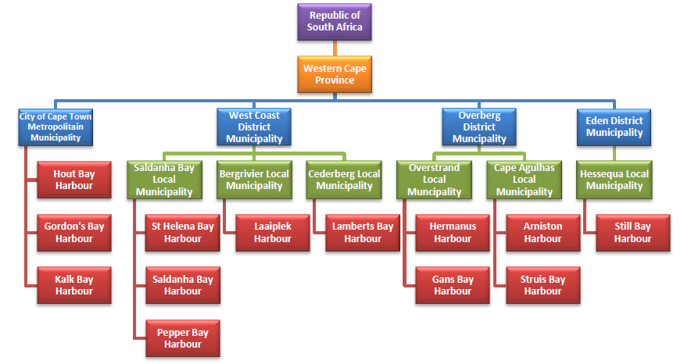
5. SPECIAL INTERVENTION PROJECT: MAINTENANCE AND REPAIR OF 12 PROCLAIMED FISHING HARBOURS
CURRENT INTITIATIVES:
REPAIR AND MAINTENANCE PROGRAMME

Slide 19
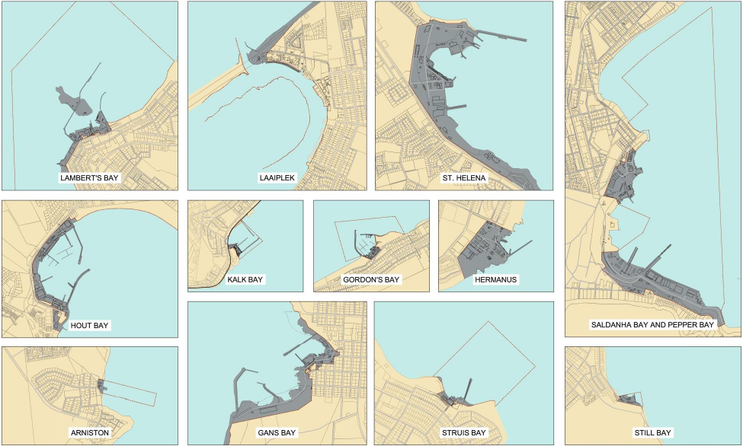

Slide 20
5. SPECIAL INTERVENTION PROJECT: MAINTENANCE AND REPAIR OF 12 PROCLAIMED FISHING HARBOURS
Progress on the Maintenance programme:
High Level Roll-Out Plan
Stage 1: Inception (Sept 2016)
Stage 2: Concept & Viability (Nov 2016)
Stage 3: Design Development (Mar 2017)
Stage 4: Documentation (Apr 2017) & Procurement (May 2017)
Stage 5: Execution / Construction (July 2017)
Stage 6: Close-Out & Handover (March 2019)

Slide 21
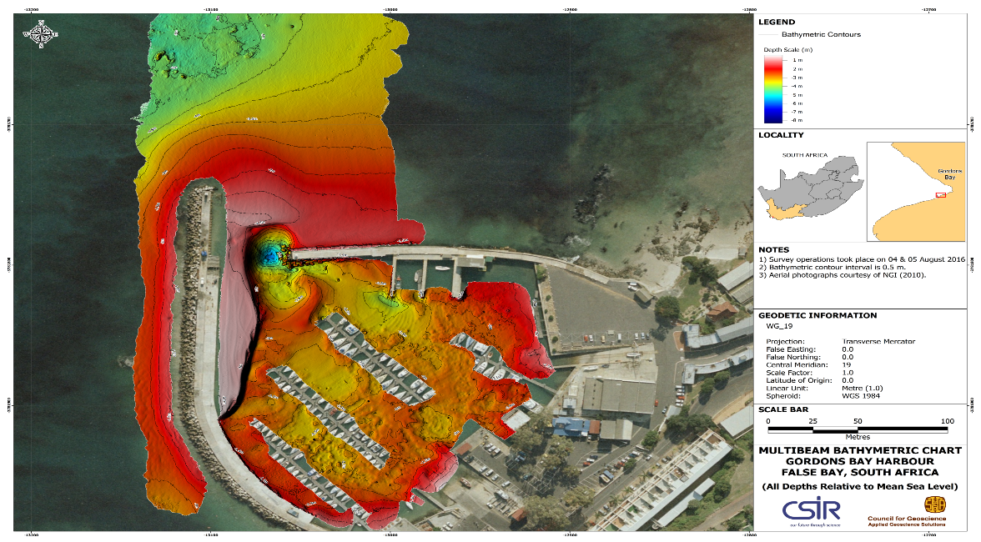
5. SPECIAL INTERVENTION PROJECT: MAINTENANCE AND REPAIR OF 12 PROCLAIMED FISHING HARBOURS
Completion of Bathymetric Surveys at ALL Harbours (EXAMPLE)

Slide 22
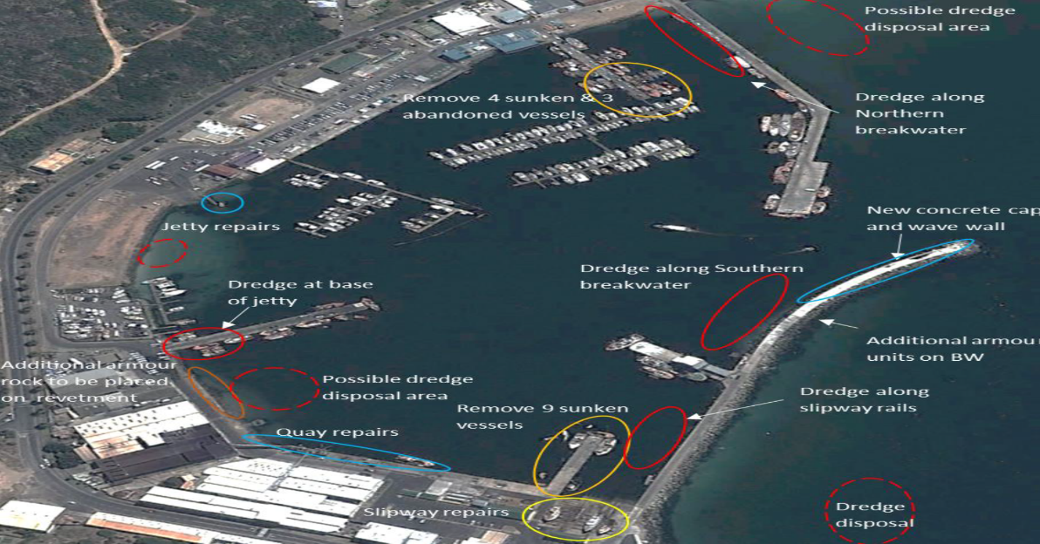
5. SPECIAL INTERVENTION PROJECT: MAINTENANCE AND REPAIR OF 12 PROCLAIMED FISHING HARBOURS
Condition Assessment completed for ALL Harbours (EXAMPLE)

Slide 23
5. SPECIAL INTERVENTION PROJECT: MAINTENANCE AND REPAIR OF 12 PROCLAIMED FISHING HARBOURS
Progress to date:
ALL items under the Scope of Works (SoW) are currently in Stage 3: Design Development
Items 1 and 2 from the SoW i.e. Removal of sunken vessels and Dredging has been prioritised
The actual Removal of the Sunken Vessels to be executed in June/July 2017
Dredging is currently awaiting the approval of the Maintenance Management Plans (MMPs) as part of the final stage of the EIA

Slide 24
5. SPECIAL INTERVENTION PROJECT: MAINTENANCE AND REPAIR OF 12 PROCLAIMED FISHING HARBOURS
Example of the SEDF precinct development and projected job creation
Notes:
Precinct 1: Small Scale Fishing and Tourism Precinct
The development of the northern precinct for mixed use development to support tourism and public amenity.
Precinct 2: Multi-Purpose Precinct
A secondary multi-use area around the ramp for small scale fishing, recreational fishing, recreational boat launching and general landings.
Precinct 3: Commercial Fishing and Processing Precinct
An industrial precinct to contain medium and industrial scale fishing as well as processing facilities and activities.
Precinct 4: Intensive Fish Processing & General Industrial Precinct
A secondary intensive fish processing/general industrial precinct to accommodate processing facilities displaced by the intensive real estate development of Precinct 1.
Precinct 5: Community Interface Precinct
A secondary tourism node located at the southern end of the harbour linking Harbour Road with the foreshore and containing predominantly mixed use to support community enterprises.

Slide 25
5. SPECIAL INTERVENTION PROJECT: MAINTENANCE AND REPAIR OF 12 PROCLAIMED FISHING HARBOURS
Projected Jobs Annually from 2030 with the complete roll out out of the SEDF’s
Between 4,234 – 5,753 Jobs
Projected GGP growth annually from 2030 with the complete roll out of SEDF’s
R1,881,084,000 – R2,078,189,000
Source: WC Proclaimed Fishing Harbours - SEDF, Delta BEC Consultants, April, 2014

Slide 26
5. SPECIAL INTERVENTION PROJECT: MAINTENANCE AND REPAIR OF 12 PROCLAIMED FISHING HARBOURS
Inhibitors:
Proclaimed fishing harbours: DAFF currently receives revenue for the use of harbour facilities however DPW is responsible for the maintenance of facilities at these harbours
The initial budget requested for the complete roll out of the programme was R400 Million and the budget has been cut to R300 Million
A reprioritised Framework is being developed by COEGA to spend within the R300 million excluding the Sea Harvest Pier
Proposed solution:
Allocation of funds as follows:
2016/17 FY: R80 Million
2017/18 FY: R120 Million
2018/19 FY: R200 Million

Slide 27
6. MANAGEMENT AND MAINTENANCE OF STATE COASTAL PROPERTIES
Part of our mandate is to manage and maintain all coastal properties under the custodianship of the Department within the borders of South Africa, including all occupied and vacant:
Admiralty Reserve
Land Parcels
Buildings
Estuaries
Unproclaimed harbours, etc
Inhibitors:
There is currently no maintenance programme or budget for coastal state owned property (vacant and occupied).
Property Management: the REMS regional staff are unable to visit properties with regularity – the properties are extremely far from the location of the regional offices

Slide 28
7. LETTING OUT OF STATE COASTAL PROPERTY
Currently - there are a total of 333 state coastal property Letting Agreements:
Northern Cape – 16
Western Cape – 269
Eastern Cape – 0
Kwa-Zulu Natal – 48
In 2017, there was a total of 86 expired Letting Agreements in 2017:
DPW has extended 68 of these leases
There are 18 leases awaiting the signature of the Lessee to sign

Slide 29
7. LETTING OUT OF STATE COASTAL PROPERTY
Western Cape:
In addition to the list of 269 properties Let – out,
22 properties are also Let - out to Organs of State at nominal rates
City of Cape Town – 11
Cape Agulhas Local Municipality – 1
Cederberg Local Municipality – 1
Overstrand Local Municipality – 2
Saldanha Bay Local Municipality – 3
Swartland Local Municipality – 2
SANPARK/Cape Nature - 2

Slide 30
7. LETTING OUT OF STATE COASTAL PROPERTY
Kwa-Zulu Natal:
In addition to the list of 48 properties Let – out,
There is an estimated number of 40 properties Let - out to the following municipalities at nominal rates
Kwa-Dukuza
eThekwini Metro
Ray Nkonyeni Municipality
uMdoni municipality

Slide 31
7. LETTING OUT OF STATE COASTAL PROPERTY
Key figures emanating from the 333 state coastal property leases nationally:
Annual revenue received: R16,702,251.24
Total number of people currently employed at companies currently occupying DPW property: Approximately 5,594 Jobs (Unaudited and supplied by Lessees)

Slide 32
8. CONVENING OF SMALL HARBOURS AND STATE COASTAL PROPERTY DEVELOPMENT LABORATORY, UNDER OCEANS ECONOMY OF OPERATION PHAKISA
In October 2015 – during the Operation Phakisa : Oceans Economy Laboratory review workshop:
Small Harbours was elevated as a separate focus area arising from a Cabinet Decision in 2015
DPW as the leading department is expected to convene a Small Harbours and State Coastal Property Development Laboratory

Slide 33
8. CONVENING OF SMALL HARBOURS AND STATE COASTAL PROPERTY DEVELOPMENT LABORATORY, UNDER OCEANS ECONOMY OF OPERATION PHAKISA
Progress to date:
Municipal and provincial briefings/ pre –lab engagements have been completed in March 2017.
Public participation sessions have begun
Focused discussions have been held in the following areas:
Education/ Training/ Skills Development and Legal matters
Harbour and Coastline Security and Employment
Economic and Infrastructure Development: and its Alignment of proposed projects with SDFs and IDPs
The Pre-Laboratory consultations with all the coastal municipalities allowed us to obtain a preliminary list of priority projects for each province heading into Investor Conference in August 2017 and the National Laboratory estimated to begin in October 2017
The main purpose of our engagements with coastal municipalities
Is to ensure that proposed projects are endorsed by municipalities and included in municipal Infrastructure Development Plans
To ensure that municipalities commit to expediting the approval of zoning and other municipal approvals in relation to the projects proposed

Slide 34
8. CONVENING OF SMALL HARBOURS AND STATE COASTAL PROPERTY DEVELOPMENT LABORATORY, UNDER OCEANS ECONOMY OF OPERATION PHAKISA
Municipalities Consulted to date:
Northern Cape
Namakwa District Municipality
Richtersveld Municipality
Nama Khoi Municipality
Kamiesberg Municipality

Slide 35
8. CONVENING OF SMALL HARBOURS AND STATE COASTAL PROPERTY DEVELOPMENT LABORATORY, UNDER OCEANS ECONOMY OF OPERATION PHAKISA
Northern Cape

Slide 36
8. CONVENING OF SMALL HARBOURS AND STATE COASTAL PROPERTY DEVELOPMENT LABORATORY, UNDER OCEANS ECONOMY OF OPERATION PHAKISA
Western Cape
West Coast District municipality
Matzikama LM
Cedarberg LM
Bergrivier LM
Saldanha Bay LM
Swartland LM
Overberg District Municipality
Overstrand LM
Cape Agulhas LM
Eden District Municipality
Hessequa LM
Mossel Bay LM
George LM
Knysna LM
Bitou LM
City of Cape Town Metropolitan

Slide 37
8. CONVENING OF SMALL HARBOURS AND STATE COASTAL PROPERTY DEVELOPMENT LABORATORY, UNDER OCEANS ECONOMY OF OPERATION PHAKISA
WESTERN CAPE – PRE-LAB ENGAGEMENT
Provincial planning session was held on 11 January 2017
The Western Cape had three (3) Pre-LAB engagements:
West Coast District: 15-16 February 2017
Eden/Overberg Districts: 20-21 February 2017
City of Cape Town: 23 February 2017
In addition to this a consolidation session was held on the 2 March 2017 to brief the provincial government

Slide 38
8. CONVENING OF SMALL HARBOURS AND STATE COASTAL PROPERTY DEVELOPMENT LABORATORY, UNDER OCEANS ECONOMY OF OPERATION PHAKISA
WESTERN CAPE – PRE-LAB ENGAGEMENT
West Coast District: 15-16 February 2017
ALL municipalities participated in this Pre-LAB engagement
Detailed presentations were done by each respective municipality including the district municipality.
The municipalities had a working session to consolidate a list of coastal priorities along the West Coast
All district projects were rated according to the EzyED project prioritisation tool

Slide 39
8. CONVENING OF SMALL HARBOURS AND STATE COASTAL PROPERTY DEVELOPMENT LABORATORY, UNDER OCEANS ECONOMY OF OPERATION PHAKISA
WESTERN CAPE – PRE-LAB ENGAGEMENT
Overberg and Eden Districts: 20-21 February 2017
The following municipalities were NOT present at the Pre-LAB engagement: Knysna, Overberg and Eden Districts
Detailed presentations were done by each respective municipality
The municipalities had a working session to consolidate a list of coastal priorities within the Overberg and Eden Districts
All projects were rated according to the EzyED project prioritisation tool

Slide 40
8. CONVENING OF SMALL HARBOURS AND STATE COASTAL PROPERTY DEVELOPMENT LABORATORY, UNDER OCEANS ECONOMY OF OPERATION PHAKISA
WESTERN CAPE – PRE-LAB ENGAGEMENT
City of Cape Town: 23 February 2017
DPW conducted a presentation on the Spatial and Economic Development Frameworks for Hout Bay, Kalk Bay and Gordons Bay
A detailed presentation was done by City of Cape Town with their priorities being the Proclaimed Fishing Harbours
During the engagement it emerged that more focus is required on training and skills development as well as empowering small businesses in the metro
During the engagement, the City of Cape Town informed that Department that they will not adopt the proposed SEDF until the disbanding of the Harbour Steering Committee26

Slide 41
8. CONVENING OF SMALL HARBOURS AND STATE COASTAL PROPERTY DEVELOPMENT LABORATORY, UNDER OCEANS ECONOMY OF OPERATION PHAKISA
WESTERN CAPE – PRE-LAB ENGAGEMENT
Consolidation Session: 2 March 2017
DPW conducted a consolidated presentation to the HOD Department of Environmental Affairs and Development Planning and Transport and Public Works
Each district presented their list of priority projects which they intend on tabling at the National Laboratory
The Western Cape Province is highly appreciative of the work of the Small Harbours Unit and fully supports the process

Slide 42
8. CONVENING OF SMALL HARBOURS AND STATE COASTAL PROPERTY DEVELOPMENT LABORATORY, UNDER OCEANS ECONOMY OF OPERATION PHAKISA
Eastern Cape
Alfred Nzo DM
Mbizana Local Municipality
OR Tambo DM
Port St Johns Municipality
Ingquza Hill Local Municipality
Nyandeni Local Municipality
KSD Local Municipality
Amatole DM
Mbhase LM
Mnquma LM
Great Kei Local Municipality
Ngqushwa LM
Sarah Baartman DM
Kou-Kamma LM
Kouga LM
Sundays River Valley LM
Ndlambe LM
Buffalo City Metropolitan
Nelson Mandela Metropolitan

Slide 43
8. CONVENING OF SMALL HARBOURS AND STATE COASTAL PROPERTY DEVELOPMENT LABORATORY, UNDER OCEANS ECONOMY OF OPERATION PHAKISA
Eastern Cape

Slide 44
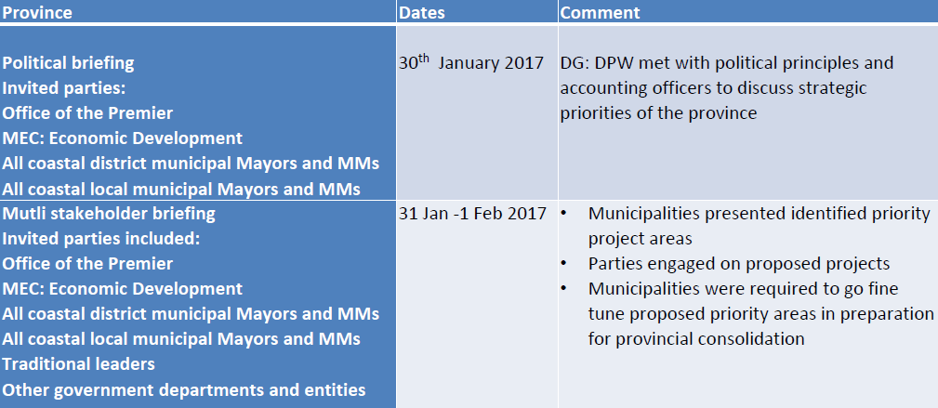
8. CONVENING OF SMALL HARBOURS AND STATE COASTAL PROPERTY DEVELOPMENT LABORATORY, UNDER OCEANS ECONOMY OF OPERATION PHAKISA

Slide 45
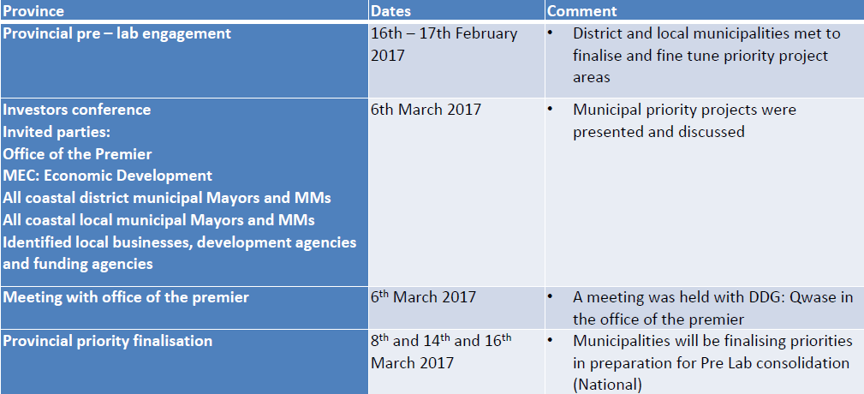
8. CONVENING OF SMALL HARBOURS AND STATE COASTAL PROPERTY DEVELOPMENT LABORATORY, UNDER OCEANS ECONOMY OF OPERATION PHAKISA

Slide 46
8. CONVENING OF SMALL HARBOURS AND STATE COASTAL PROPERTY DEVELOPMENT LABORATORY, UNDER OCEANS ECONOMY OF OPERATION PHAKISA
KwaZulu Natal
uMkhanyakude DM
uMhlabuyalingana LM
The Big Five False Bay LM
Mtubatuba LM
uThungulu DM
Mbonambi LM
uMhlathuze LM
uMlalazi LM
iLembe DM
Mandeni LM
KwaDukuza LM
Ugu DM
Umdoni LM
Ray Nkonyeni LM
eThekwini Metropolitan

Slide 47
8. CONVENING OF SMALL HARBOURS AND STATE COASTAL PROPERTY DEVELOPMENT LABORATORY, UNDER OCEANS ECONOMY OF OPERATION PHAKISA

Slide 48
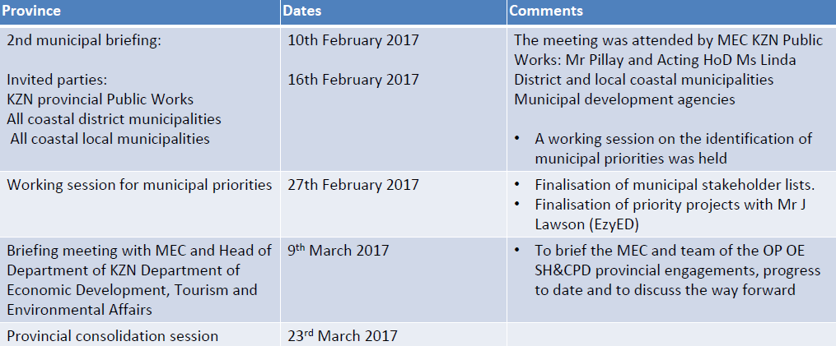
8. CONVENING OF SMALL HARBOURS AND STATE COASTAL PROPERTY DEVELOPMENT LABORATORY, UNDER OCEANS ECONOMY OF OPERATION PHAKISA

Slide 49
8. CONVENING OF SMALL HARBOURS AND STATE COASTAL PROPERTY DEVELOPMENT LABORATORY, UNDER OCEANS ECONOMY OF OPERATION PHAKISA
AREAS IDENTIFIED FOR LOCAL ECONOMIC DEVELOPMENT (INVESTMENT)
Education & Training
Maritime and Aquaculture Training Centres
Renewable Energy
Wind Farm
Solar Farm
Turbine (Sea Water)
Farming
Aquaculture (On Land)
Mari culture (Off Land)
Salt production
Fish Processing and Packaging
Canning
Fish meal

Slide 50
8. CONVENING OF SMALL HARBOURS AND STATE COASTAL PROPERTY DEVELOPMENT LABORATORY, UNDER OCEANS ECONOMY OF OPERATION PHAKISA
AREAS IDENTIFIED FOR LOCAL ECONOMIC DEVELOPMENT (INVESTMENT)
Food and Beverage
Restaurants
Breweries and Distillery;
Government Services
DAFF, DEA, SASSA, SAPS,
Hospitality Industry
Hotels
Holiday Resorts
Caravan Parks
Restaurants
Infrastructure Development
Harbours
Mooring Facilities
Jetties
Slipways

Slide 51
8. CONVENING OF SMALL HARBOURS AND STATE COASTAL PROPERTY DEVELOPMENT LABORATORY, UNDER OCEANS ECONOMY OF OPERATION PHAKISA
AREAS IDENTIFIED FOR LOCAL ECONOMIC DEVELOPMENT (INVESTMENT)
Special Economic Zones
Waterfront
Office Parks, Retail Park and Industrial Park
Logistics
Fuel Storage
Warehousing
Maintenance and Repair (Vessels and Harbour Infrastructure)
Vessel maintenance and repair
Yacht mole facilities
Harbour Infrastructure
Spares and Supplies
Manufacturing and Engineering Services
Small ship/boat building
Mining
Alluvial mining

Slide 52
8. CONVENING OF SMALL HARBOURS AND STATE COASTAL PROPERTY DEVELOPMENT LABORATORY, UNDER OCEANS ECONOMY OF OPERATION PHAKISA
AREAS IDENTIFIED FOR LOCAL ECONOMIC DEVELOPMENT (INVESTMENT)
Pipelines & Pump houses
Pipeline
Pump house
Rescue, Safety and Security
NSRI
Life Saving
Safety & Security
Sport and Recreation
Yacht Club
Fishing Clubs
Water Theme Parks
Speciality Events - Sports, Food, Cultural, etc.
Tourism
Museum
Tourism Office

Slide 53
8. CONVENING OF SMALL HARBOURS AND STATE COASTAL PROPERTY DEVELOPMENT LABORATORY, UNDER OCEANS ECONOMY OF OPERATION PHAKISA
AREAS IDENTIFIED FOR LOCAL ECONOMIC DEVELOPMENT (INVESTMENT)
Transport (Commercial and Leisure)
Water taxis and ferries
Helicopter pads
Water and Waste management
Ice making and supplies
Desalination
Waste management and processing
Other

Slide 54
8. CONVENING OF SMALL HARBOURS AND STATE COASTAL PROPERTY DEVELOPMENT LABORATORY, UNDER OCEANS ECONOMY OF OPERATION PHAKISA
Provincial Priority Project Lists:
The EzyED tool was utilised to asses and prioritise all proposed projects
The tool assists in the assessment of the viability of projects based on various scoring criteria
The software may be used to manage infrastructure projects from conception to final delivery
A total of 70 projects were established nationally with the following split:
Northern Cape: 5
Western Cape: 34
Eastern Cape: 14
kwa-Zulu Natal: 17

Slide 55
8. CONVENING OF SMALL HARBOURS AND STATE COASTAL PROPERTY DEVELOPMENT LABORATORY, UNDER OCEANS ECONOMY OF OPERATION PHAKISA
On the 29th March 2017 – we concluded our municipal and provincial consultations with the National Pre-Laboratory Consolidation Meeting of the Oceans Economy- Small Harbours and State Coastal Properties Development engagements
The programme for the day was as follows:
Exhibitions: Session 1
All Municipalities exhibited proposed investment areas and Projects
Provincial statements: Session 2
Provincial statements were given by the Office of the Premier/ Department of Economic Development for each province
Provincial Development Agencies’ panel discussions: Session 3
All stakeholders: municipal, provincial and national government, private sector, potential investors, environmental protection groups, educational institutes etc. – took part in discussions
Ministerial address: Session 4

Slide 56
8. CONVENING OF SMALL HARBOURS AND STATE COASTAL PROPERTY DEVELOPMENT LABORATORY, UNDER OCEANS ECONOMY OF OPERATION PHAKISA
Highlights of the Keynote address: 29th March 2017
We aim to attract investments of over R12 Billion by the year 2019 and over R20 billion by 2020
It is envisaged that we will facilitate the creation of over 1,000 stable jobs directly linked to our identified projects in the same timeframe and,
As a result of the implementation of our projects, we aim to influence the creation of over 2,000 further work opportunities through secondary activities linked to our identified projects

Slide 57
8. CONVENING OF SMALL HARBOURS AND STATE COASTAL PROPERTY DEVELOPMENT LABORATORY, UNDER OCEANS ECONOMY OF OPERATION PHAKISA
29th March keynote address:
Our commitment to local empowerment and job creation:
All national companies who have submitted business proposals and project proposals must avail up a share ownership to interested local small businesses and co-operatives
With regards to fishing related business investments and projects, pro-rata shares must be given to local fishermen based on the total value of the fishing rights per annum
All approved business proposals must ensure the utilisation of local suppliers and local labour as well as indicate skills development initiatives
In supporting the development of SMMEs partnerships with Provincial, Municipal Economic Development Agencies and the Departments of Small Business Development and the DTI have been established to create viable co-operatives and Micro and Small businesses

Slide 58
8. CONVENING OF SMALL HARBOURS AND STATE COASTAL PROPERTY DEVELOPMENT LABORATORY, UNDER OCEANS ECONOMY OF OPERATION PHAKISA
Way forward
Provincial Investor Conferences: Proposed Dates
DPW will host provincial Investor conferences in each of the four coastal provinces
Desired output: pairing of investment proposals with municipal/ provincial priority projects
Investor Conference are expected to take place in August 2017
National Laboratory:
DPW will host the National Laboratory for one week in each of the four coastal provinces
All projects will be tabled at the Laboratory for final decision making

Slide 59
8. CONVENING OF SMALL HARBOURS AND STATE COASTAL PROPERTY DEVELOPMENT LABORATORY, UNDER OCEANS ECONOMY OF OPERATION PHAKISA
The following provincial development agencies are our key partners: TIKZN, WESGRO, ECDC, NCEDA
Province | Municipal Briefing | Investor Conference | Delivery Laboratory
Kwa-Zulu Natal | 19th June | 1st – 3rd August | Dates to be confirmed upon the finalisation of funding requirements, Presidency availability and other key stakeholders
Eastern Cape | 20th June | 7th – 8th August
Western Cape | 21st June | 15th – 17th August
Northern Cape | 30th June | 22nd – 24th August

Slide 60
8. CONVENING OF SMALL HARBOURS AND STATE COASTAL PROPERTY DEVELOPMENT LABORATORY, UNDER OCEANS ECONOMY OF OPERATION PHAKISA
Inhibitors:
The DPW was supposed to have convened the Small Harbours Laboratory in 2016 however the work was never completed
Since the handover of the Small Harbour Unit to Mr Govender in July 2016, the unit has done extensive work nationally to prepare for this mandatory National Laboratory
Unfortunately funding has not been made available for the execution of the National Laboratory
The outstanding issues of the Baseline Research as well as the Facilitator has since emanated from the lack of funding
Proposed Solution:
The funding for the Delivery Laboratory be approved to the tuned of R45 million

Slide 61
NATIONAL PRIORITY PROJECTS
DPW intends on building three new small harbours in the Northern Cape, Eastern Cape and Kwa-Zulu Natal.
The new harbours to be developed under Phase 1 are as follows:
Port Nolloth of Richtersveld Municipality in NC
Port St Johns of PSJ Municipality in EC
Port Edward of Ray Nkonyeni Municipality in KZN
Phase 2 projects include the development of the following additional areas:
Northern Cape:
Kleinzee
Hondeklip Bay
Eastern Cape
Port Alfred
Gonubie
Kwa-Zulu Natal
Port Shepstone
Hibberdene
Shelley Beach

Slide 62
NATIONAL PRIORITY PROJECTS
Background:
Port Edward – Ray Nkonyeni Local Municipality
In October 2014, the department began engagements with the Ray Nkonyeni Local Municipality, with specific focus on Properties along the Admiralty Reserve within the municipalities’ management boundaries,
During these discussions, the municipality proposed the development of a Small Harbour within its management boundaries,
After various discussions between the department and the municipality, Hibberdene was identified as a priority area to develop a small harbour
The proposed location was later changed and communicated to all parties as Port Ewdard

Slide 63
NATIONAL PRIORITY PROJECTS
Background cont.:
Port St. John’s Local Municipality
In June 2015, the Port St. John’s Municipality invited the Department of Public Works to discuss possible areas of infrastructure development in line with the municipalities Infrastructure Development Plan
As part of the discussions, the municipality proposed the development of a small harbour in Port St. John’s

Slide 64
NATIONAL PRIORITY PROJECTS
Background cont.:
Northern Cape Province
The department held various engagements with the local municipalities and province to identify a possible area for the development of a new small harbour
The initial area proposed for development was Boegoebaai.
Upon interaction with the National Department of Transport and the office of the Premier in the Northern Cape, the proposed area for development was amended to Port Nolloth.
Historically, Port Nolloth was proclaimed as a commercial port management by Transnet, however Transnet has stopped all operations at the Port.
The department is currently in discussion with Transnet to transfer the portion of Port Nolloth under its custodianship back to DPW in order for DPW have sole custodianship of Port Nolloth

Slide 65
NATIONAL PRIORITY PROJECTS
Background cont.:
During a visit to China in October 2016, DPW presented three priority areas for the development of new harbours for the inclusion into the FOCAC agreement between SA and China.
As a result of the above proposal, a delegation of officials and technical staff from the Chinese First Harbour Consulting company visited South Africa to conduct site visits on proposed areas for development
Based on the technical visits to the proposed development areas, a revised list of proposed areas for development was proposed as follows:
Port Edward – Ray Nkonyeni Local Municipality
Port St. Johns – Port St. John’s Local Municipality
Port Nolloth – Richtersveld Local Municipality
The revised list was communicated to the Chinese Ministry of Commerce and First Harbour Consultants through our DIRCO in December 2016.

Slide 66
NATIONAL PRIORITY PROJECTS
Progress to date:
the Department, with the support of DEA and DIRCO began the process of formalising the agreement between DPW and FHC to develop three new harbours in South Africa and to secure Grant funding from the Chinese Ministry of Commerce to the tune of 4 million USD.
The draft MoU between the Accounting Officer of DPW and the CEO of the Chinese First Harbour Consultants has been drafted and received approval from the office of the Chief State Law Advisor
The draft MoU between the Minister of DPW and the Minister of the Chinese Ministry of Commerce to secure the 4 million USD for Phase one of the new harbour development programme needs to be routed through the internal DPW legal processes. Once this process is finalised, the MoU will be routed to DIRCO for final approval.
A draft contract will be discussed by all parties once the MoUs have been singed off.

Slide 67
NATIONAL PRIORITY PROJECTS
Both parties agreed on the phased implementation of the development projects:
Stage 1:
Pre Feasibility study
Feasibility Study
High Level harbour design
Note: Stage 1 will utilise the 4 million USD grant funding which will be secured through the Ministerial MoU between the Minister of DPW and the Minister of the Chinese Ministry of Commerce
Stage 2:
Pen-ultimate design
Model testing
Final design
Building of the harbour (structure)

Slide 68
NATIONAL PRIORITY PROJECTS
Urgent action required:
It is proposed that the Minister, the Director General and the DDG: SH&SCPDU; DPW, travel to China during the last week of July 2017 to finalise the signing of the MoU
Begin discussions with the relevant Chinese authorities to finalise contractual agreements and project plans for the development of the three new small harbours

Slide 69
10. CONTACT DETAILS
For further enquiries regarding the above mentioned information kindly contact:
Mr Dhaya Govender
DDG: Small Harbours and State Coastal Property Development Unit
Tel: (012) 406 2195
Cell: 082 924 4930
E-mail: Dhaya.Govender@dpw.gov.za

Slide 70
END
National Department of Public Works (NDPW)
Head Office: Public Works CGO Building
Cnr Bosman and Madiba Pretoria Central
Private Bag X65
Pretoria
0001
Website: http://www.publicworks.gov.za
THANK YOU
56

