Slide 1


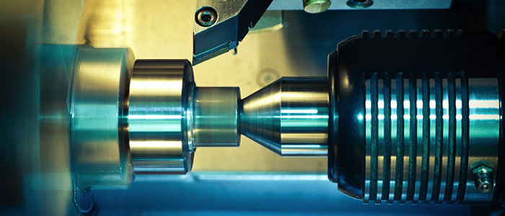

Industrial Policy Action Plan
2017/18 - 2019/20
Economic sectors, infrastructure and employment cluster
Presentation to the Portfolio Committee on
Trade and Industry
13 June 2017

Slide 2
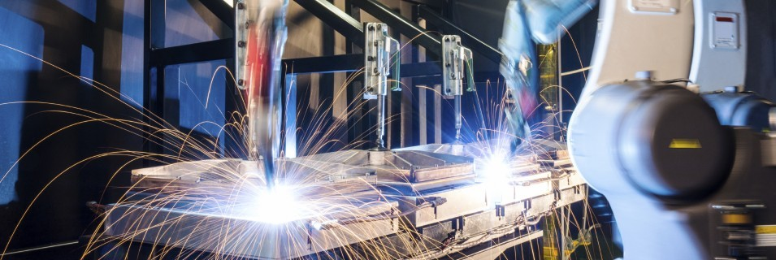
Contents
Policy context
Core objectives
Transversal and sectoral focus areas 2017/18
Selected transversal highlights 2016/17
Selected sectoral highlights 2016/17
Themes for 2017/18
Overcoming challenges
Global context – with supporting data
Domestic context – with supporting data

Slide 3
Policy Context 1:
Situating IPAP
Informed by the vision set out for South Africa’s development provided by the National Development Plan (NDP)
2
A key component of the President’s Nine-Point Plan
  Located within and provides one of the key programmes of the New Growth Path (NGP)
1
3
Aligned to both the Medium Term Expenditure Framework (MTEF) and the Medium Term Strategic Framework (MTSF)
  Special focus on minerals and beneficiation, agriculture and agro-processing, energy, attracting investments and growing the oceans economy
5
4

Slide 4
Policy Context 2:
Embedding IPAP
Economic restructuring
IPAP supports radical economic transformation by an on-going effort to fundamentally change the structure of the economy
Employment & integration
Sustainable job creation is a key priority. Hence:
The focus is on patterns of ownership, management and control, with a central emphasis on the manufacturing sector
an ever-stronger focus on labour-intensity in key sectors of the productive economy and
the integration of primary, manufacturing and service value chains across sectors

Slide 5
Policy Context 2:
The importance of manufacturing
There are very few if any cases, at any time in economic history, where a country has achieved sustained and sustainable economic development, that have not been led by manufacturing
The manufacturing sector has high economic multipliers because of its value-addition, linkages to the upstream production sectors of the economy (mining and agriculture) and the downstream sectors, including services; and because of its all-round contribution to strengthening integrated value chains
The growth of the manufacturing sector has multiple macro-benefits:
Value-added exports break dependency on resource exports
Reduced vulnerability of the current account to commodity cycles
Limits currency volatility
SA has amongst the world’s highest reserves of minerals, which must be used to build competitive capabilities and advantages
Certain manufacturing sectors have high employment multipliers across the value chains
Manufacturing drives technology and innovation through technology absorption and diffusion and research and development
Manufacturing supports and enables the growth of national skills capacity and capabilities and the movement towards a knowledge economy

Slide 6
IPAP core objectives
Diversifying the economy and providing strong support for value-added manufacturing
1
Developmental model focused on radical economic transformation and social inclusion
Building regional investment, trade and industrial development integration
2
3
Emphasis on R&D and movement towards a knowledge economy
4
Working with the private sector to prepare for and adapt to the challenges in digitised production and logistics associated with the “4th Industrial Revolution”
5

Slide 7
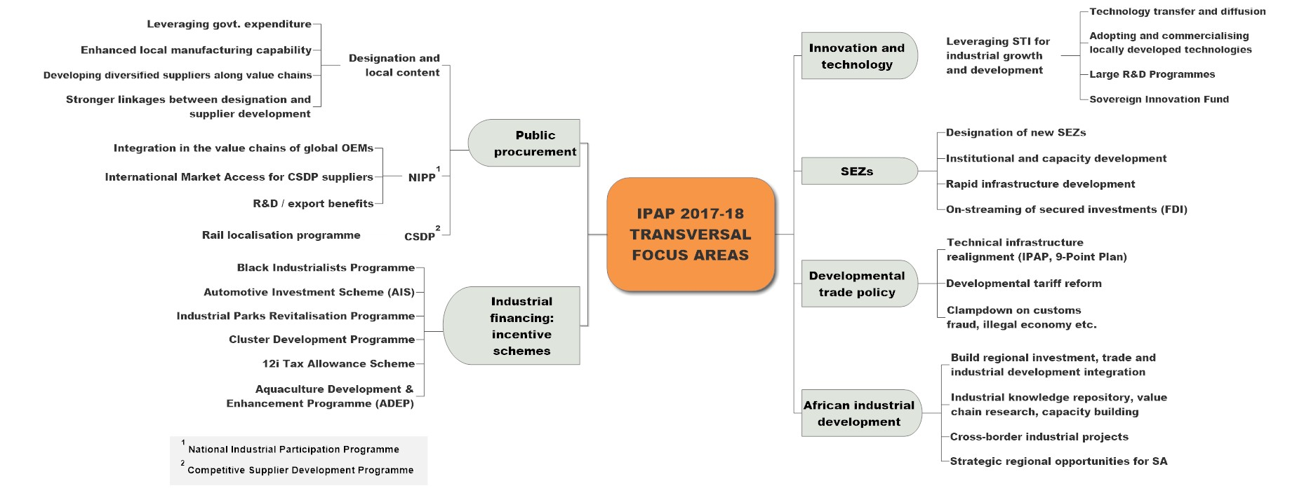
IPAP transversal focus areas 2017

Slide 8
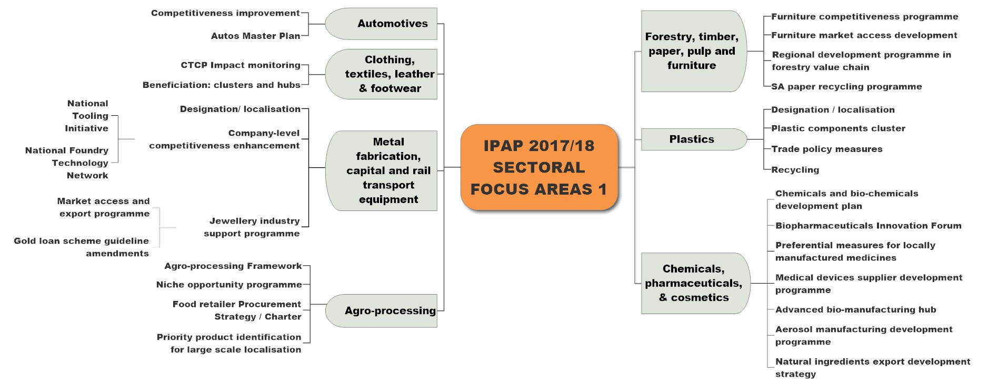
IPAP sectoral focus areas 1

Slide 9
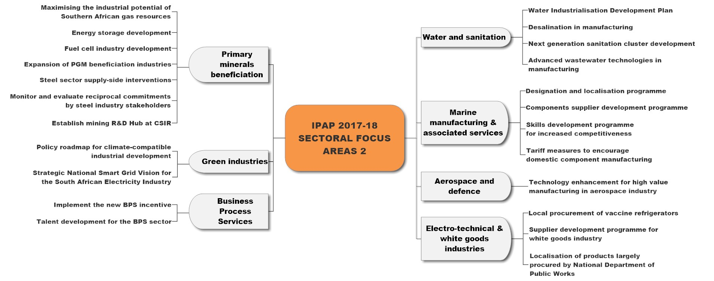
IPAP sectoral focus areas 2

Slide 10
Achievement highlights 2016/17
  Securing SA’s primary steel production capability and supporting the downstream steel sector
  Agreement with the primary steel producer on a set of principles for flat steel pricing in SA that is priced appropriately to ensure competitiveness of steel-dependent industries and sustainability of upstream steel mills
  Tariff increases for a range of steel products to protect industry from ‘dumping’; tariff review on a range of downstream products and the deployment of rebates
  Local procurement by government through the designation of steel and steel products
  Settlement of the Competition Commission issues with AMSA
  Investment support through the dti 12i tax allowance programme for plant, equipment and building upgrades as well as training support
  Establishment of a Steel Development Fund to support key downstream steel sectors/sub sectors

Slide 11
Achievement highlights 2016/17
Industrial Financing & Incentive Support: supporting private sector investment and black economic empowerment in critical industrial sectors
  Automotive Investment Scheme: R8.7bn on investment leveraged through 2 new projects with an estimated investment value of R548.9m, projected to create 1 140 jobs
  Manufacturing Competitiveness Enhancement Programme (MCEP): R1bn loan component reopened; 270 projects supported; R8.24m disbursed, supporting R3.38 bn of investments & 62 2353 jobs
  12i Tax Allowance Incentive Scheme: April 2015 – September 2016, 49 projects approved with an investment value of R25.7bn
  Aquaculture Development and Enhancement Programme (ADEP): R85.6m approved for 17 projects, with a projected investment value of R383.3m; 474 jobs created

Slide 12
Achievement highlights 2016/17
  Black Industrialists Development Programme: 27 approved projects to the value of R577m, with a projected investment of R2.5 bn and a projected 5,235 direct and 1,228 indirect jobs to be created
  R&D tax incentive supported R36.1 bn in R&D expenditure
  Export Marketing and Investment Assistance Scheme (EMIA): support package of R90m and export sales of R4.1 bn
  Industrial Development Corporation (IDC): disbursed R8bn, created and saved 14,636 jobs
  Export Credit Insurance Corporation (ECIC): approved R318.6 m for 3 major export-related projects with a local content value of R3.784 bn achieved

Slide 13
Achievement highlights 2016/17
  Technology and Innovation Agency (TIA): since 2013, disbursed in excess of R1bn; approximately 70 of the technologies funded reached demonstration stage; 23 technologies successfully commercialised
  Industrial Park Revitalisation Programme (IPRP): R180m spent on upgrading 6 industrial parks in 2016 (R216m set aside for 5 additional industrial parks)
  Cluster Development Programme: 6 cluster initiatives totalling R56.6m approved, in the medical device, composites, non automotive, advance manufacturing, pharmaceuticals and creative industries

Slide 14
Achievement highlights 2016/17
  Technology Localisation Programme (TLP)
  DST provided funding of R9m for the Bombardier locomotive building project; total revenue to be generated is R350m, with a full local content value of R350m (100%)
  TLP outputs and impacts 2012-Aug 2016:
No. of companies supported towards the development of new products | 16
Total direct jobs created due to the implementation of FTAPs | 650
No. of companies where export capability was developed | 22
No. of companies supported where import substitution was achieved | 20
No. of companies that have gained work with SOCs | 57
No. of companies supported where SOC/OEM work has been retained | 65
Jobs retained at companies supported | 6,500
Percentage of companies supported that are black women-owned | 40%

Slide 15
Achievement highlights 2016/17
InvestSA: securing foreign direct investment in a difficult economic climate:
  Government has established a national investment One Stop Shop and will open provincial centres in KZN, GP and WC; thus securing a streamlined, inter-departmental ‘clearing house’ system
  InvestSA was awarded the Global Investment Promotion Agency (IPA) Award for excellence
  In 2016, South Africa FDI inflows increased at 38% year-on-year
  Investments by Nestle, Beijing Automotive International Corporation, ACWA Power, Ford, Toyota, Sumitomo Rubber, Cipla, Johnson & Johnson, 3M, amongst others, have reaffirmed South Africa as a regional manufacturing hub
  Public Investment (PI)
  PI increased by R14 bn to R272 bn in 2015; R36 bn in power generation projects and R35 bn in railway equipment

Slide 16
Achievement highlights 2016/17
  Clothing, Textiles, Leather and Footwear (CTLF): supporting and growing a key labour-intensive sector
  dti support amounts to R4.2 billion since inception. 70,000 jobs saved and estimated 9,550 jobs created
  28 new companies established; creation of 2 200 jobs; growth in exports
  Production of footwear grew by over 2 million pairs in 2016
  Agro-processing: securing investment and provision of economic infrastructure in another critical labour-intensive sector:
  Close to R15 billion private sector investment leveraged through projects by Nestle, AB Inbev, GWK Farm Foods and Citrus and Deciduous Fruit industries
  R100 million tomato processing Dursots-All Joy plant launched in Tzaneen, to employ 300 people
  Two Agri-parks are operating while 6 are under construction; Clover, Tiger Brands, McCain and Distell have initiatives to improve market access for small farmers

Slide 17
Achievement highlights 2016/17
Business Process Services: ongoing effort to build this globally competitive and labour-intensive sector
  6 new projects approved, 5-year projected export revenue R4.5 billion. R193.3 million disbursed, 10,466 jobs sustained
  Call Centres - EXL call centre in Cape Town plans to create 6,000 jobs
  SA secured 2 projects to provide tutor services to learners in Asia via online platform, 688 jobs created
  Since inception of the Monyetla Work Readiness Programme, has seen provision of training opportunities to over 16,000 unemployed youth, with the placement rate well over 70%

Slide 18
Achievement highlights 2016/17
  Metal Fabrication, Capital And Rail Transport Equipment: rebuilding and supporting a key industrial sector
  SA’s efforts to up-scale our industrial capacities and capabilities in the manufacture of rail transport and components were boosted by the launch of several new facilities:
  Bombardier Transportation Propulsion and Control facility launched in Elandsfontein with 100 people employed
  AVK Valves, in partnership with Premier Valves, launched a R200m new plant in Benoni
  MTU South Africa unveiled its newly-upgraded workshop facility to assemble the diesel engines for the 232 diesel locomotives for China North Rail
  Rail localisation
  Gibela secured 32 local suppliers for the R51bn Passenger Rail Agency of South Africa (PRASA) contract; 580 trains to be built in SA
  Rail signalling components designated for local procurement

Slide 19
Achievement highlights 2016/17
  Automotives: supporting and strengthening SA’s globally competitive sector
  Through the APDP incentive, R7.8 billion has been disbursed which unlocked R28.5 billion in private investments. For example:
  Beijing Automobile International Corporation (R11 billion)
  Toyota SA (R6.1 billion)
  Ford SA (R11.5 million)
  Volkswagen SA (R120 million)
  Mercedes-Benz and Government (R130 million)
  These investments are expected to create approximately 4,720 direct jobs
  Work is well advanced on an Automotive Masterplan (post-2020) to secure higher economic impacts

Slide 20
Achievement highlights 2016/17
  Green Industries: supporting the development of new industrial capabilities
  Renewable Energy Independent Power Producer Procurement Programme (REIPPPP):
  6 rounds of bids attracted investment of R 194.1 billion, including R 53 billion (27%) from foreign sources. 28,484 job created
  IDC signed agreement with the French Development Agency (Agence Française de Développement - AFD), for a EUR 60-million credit line for a local small-scale green project
  Supply side measures include:
  The National Cleaner Production Centre (NCPC) – working with Unido - assisted 160 companies
  R1.7 billion saved in energy costs, 1,744 jobs created/preserved

Slide 21
Achievement highlights 2016/17
Beneficiation – Fuel Cells: a key platform for technology-intensive investment and for building globally competitive domestic capability
Fuel Cells are a key area for collaboration between the mining industry, manufacturing and government
Key projects:
  CSIR/Busmark (local OEM)/HySA for a bus prototype
  Anglo Platinum collaborating with HySA Infrastructure on developing fuel cell powered mining equipment
  Implats and its partners deployed a fuelling station using the locally developed system - metal hydride compressor
  Impala/Doosan project - Feasibility studies for potential deployment of 85MW Doosan systems under way; to be serviced by proposed SA manufacturing facility
  Isondo Fuel Cell plant launched in Cape Town

Slide 22
Achievement highlights 2016/17
  Beneficiation - Metals and Minerals: building competitive capabilities from SA’s resource endowment:
  The Chamber of Mines Research Organisation (COMRO) has re-opened with funding from the DST to secure upstream mining localisation and downstream beneficiation.
  Tronox opened R3.3bn Fairbreeze mineral sands mine in KZN for titanium dioxide; 250 direct and 1 000 indirect jobs created
  De Beers selected 5 black-owned cutting and polishing companies for entrepreneurship development and beneficiation

Slide 23
Achievement highlights 2016/17
  Domestic Ship/Boatbuilding and Associated Services: rebuilding the Industry
  Armscor announced preferred bidders to supply ships for the Navy’s projects Biro and Hotel: Southern African Shipyards and Damen Shipyards
  A R290 million new Durban floating dock launched on the back of R160 million support through the 12i incentive
  Fabrication of liquefied petroleum gas (LPG) vessels, or ‘bullets’, for an open access LPG terminal being developed at Saldanha Bay completed.
  The pressure vessels were fabricated domestically, and will provide 5,500 t of LPG storage capacity

Slide 24
Achievement highlights 2016/17
Electro-technical and white goods
  Government incentives and tariff reviews contributed to enhancing South Africa’s Value Proposition as an investment destination
  OEM investments by Hisense, Defy and Samsung in the television and White Goods sub-sector
  Zero Medical SURE – a new off-grid vaccine refrigerator technology - launched
  Yangtze Optics Africa Company (YOAC) - R150m Optic fibre plant at Dube Trade Port; 150 jobs to be created
  Purchase orders for set-top boxes placed with the first three companies (Leratadima, CZ Electronics and BUA Africa) out of the 26 identified
  Designation of two-way radio terminals and associated equipment

Slide 25
Achievement highlights 2016/17
  National Industrial Participation (NIP) - a key procurement instrument to support industrialisation:
  Agreement between an obligor and CSIR to provide a full software suite for Product Life Management (PLM). It is estimated that 2,000 companies over a seven year period will be supported
  Agreement Between South African Airways Technical (SAAT) and an obligor to revive the aircraft engine maintenance, repair and overhaul capabilities of SAAT
  Huawei to establish a Joint Innovation Centre in SA for the development of technologies such as 4G/5G and software modules, expected to generate R5 billion in revenues over a seven years

Slide 26
Achievement highlights 2016/17
Special Economic Zones
Securing investment and building industrial and export capabilities
  A total of seven designated zones - Saldanha Bay, Dube Trade Port, Coega, East London, Richards Bay, Maluti a Phofung & Musina
  Investments:
    Dube Trade Port signed a R1, 3 billion agreement with CIPLA to produce biosimilars
    Saldanha Bay IDZ has, to date, a pipeline of 34 investments worth R14 billion (letters of commitment)
    OR Tambo IDZ attracted a total of R260 million new investment covering horticulture and metal refining
    Coega has been allocated 1,000MW under IPP, with an investment value of R25 billion
    RBIDZ awarded 2,000MW under Gas IPP

Slide 27
IPAP key themes for 2017/18
1
Radical Economic Transformation: upscaled efforts to secure shared and inclusive growth: transformation of ownership and management control; empowerment through decent jobs, especially in labour-intensive sectors
Programme alignment: intensified effort to secure a streamlined, inter-departmental ‘clearing house’ to fully align policy and programmes, deal with bottlenecks and ensure that all departments, SOCs and agencies are pulling in the same direction and supporting the industrialisation effort
2
3
Cutting red tape: continuing efforts to achieve a well-regulated, integrated, development-friendly investment framework to raise levels of productive (non-portfolio) capital inflows

Slide 28
IPAP key themes for 2017/18
4
Strengthen efforts to raise aggregate domestic demand – mainly through localisation of public procurement and intensified efforts to persuade the private sector to support localisation and local supplier development
5
Much stronger ongoing focus on labour intensity across the value chains that link the primary and secondary sectors of the economy – CTLF; Agro-processing; component manufacturing and so forth
6
A stepped-up export effort - with a focus on key existing exporters, emerging export-ready firms and strong support for new black-owned industrial export entrants
7
The national Buy Back SA Campaign will be energetically implemented, with the full support of the public sector, led by Proudly SA, the SOCs and the private sector

Slide 29
IPAP key themes for 2017/18
8
Strengthening of ongoing efforts to build a less concentrated, more competitive economic and manufacturing structure in which barriers to entry for new entrants are lowered
9
Building a stronger system of industrial finance and incentives to support and secure higher levels of investment in the productive sectors of the economy
Ensuring that the foreseeable effects of the Fourth Industrial Revolution and emergent disruptive technologies are understood, and adapting SA’s productive and services sectors to meet the challenges, including those relating to employment displacement
10
11
Illegal economy: a concerted national effort to lock out illegal and sub-standard imports - led by the security cluster and involving the NRCS and customs

Slide 30
IPAP key themes for 2017/18
12
Beneficiation: Ongoing effort to secure technology-intensive, value-adding production capabilities to utilise SA’s comparative resource endowment advantage as a global competitive advantage
Technology: a stronger inter-departmental effort is already under way to optimise technology transfer and diffusion (building on the programmes of the CSIR’s Technology Localisation Unit) and to commercialise ‘homegrown’ R&D in key sectors; these efforts will be further broadened and stepped up
13
Gas Industrialisation: First steps are already in place - LPG/LNG; gas to power RFPs and the expansion of the Sasol pipeline. Continuing integrated support for the gas industrialisation effort is critical, given its significant economic and employment multipliers and lower carbon-intensity
14
Greening: Driving energy-efficient production and carbon mitigation efforts and measures which will increasingly have to be phased in to all sectors of the economy in a manner that allows for sustainable adaptation
15

Slide 31
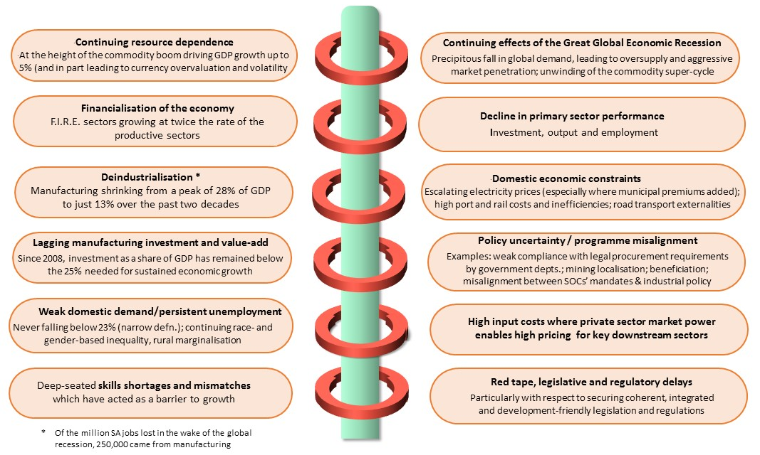
Challenges 2017-2020

Slide 32
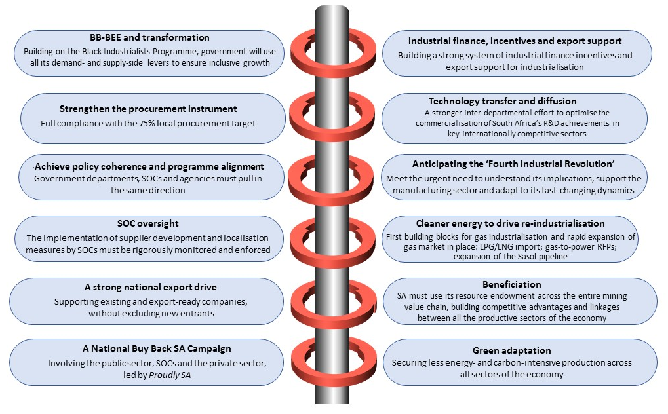
Key action areas 2017-2020

Slide 33
The global context
Ongoing after-shocks of the Great Global Recession. Further deterioration in the already-fragile international economy with steadily declining growth rates; global slowdown affected world trade as imports as a percentage of global GDP declined from 30,2% in 2011 to 28,8% in 2015
Global oversupply and over-capacity in key sectors (China accounting for most of the global growth in steel production in the 21st century and the major contributor to the steel glut)
The ongoing commodity demand/price slump
FDI into middle-income countries declined as outward investment contracted
Increasing use of protectionist measures (‘neo-mercantilism’)
Emergence of right-wing populist backlashes in the US and much of Europe

Slide 34
The global context
KEY STATS

Slide 35
Growth in the world economy
2003-2016
Source: IMF

Slide 36
Growth in global imports and change in imports as a share of world GDP, 2001-2015
Source: World Bank

Slide 37
Index of mining commodities in US dollars, 1990-2012
Source: NBER

Slide 38
Inflows of FDI and net portfolio investment as a share of GDP for middle income countries, 2005-2015
Source: World Bank

Slide 39
Global steel production by country, 1980-2014
Source: WorldSteel

Slide 40
The SA domestic context
Deep-seated structural fault-lines in the economy remain in place and stubbornly difficult to overcome:
Weak growth and domestic demand, reflecting and contributing to persistent unemployment, with unsustainable race- and gender-based inequality and rural marginalisation
Value-add in manufacturing lagged behind the economy as a whole from 2008
Continuing primary resource dependence
Financialisation of the economy - with the financial sector growing at twice the rate of the productive sectors. Private sector investment has been at an average of 13% of GDP since 1994, with especially low levels of investment in the productive sectors
Investment in manufacturing has declined since the global credit crisis, whilst investment in mining has somewhat stabilised
Investment as a share of GDP is also below the 25% level required for sustained economic expansion
South Africa’s trade deficit did, however, narrow from 2012 onwards, assisted by a reduction in the trade deficit for manufacturing

Slide 41
The SA domestic context
KEY STATS

Slide 42
SA GDP Growth 1994-2016
Source: Stats SA
Source: Stats SA

Slide 43
Agriculture: GDP and employment, 1970-2015
Source: Stats SA
Source: Stats SA

Slide 44
Agriculture: investment and exports, 1970-2015
Source: Stats SA
Source: Stats SA

Slide 45
Mining: GDP and employment, 1970-2015
Source: Stats SA
Source: Stats SA

Slide 46
Mining: investment and exports, 1970-2015
Source: Stats SA
Source: Stats SA

Slide 47
Manufacturing: GDP and employment, 1970-2015
Source: Stats SA
Source: Stats SA

Slide 48
Manufacturing: investment and exports, 1970-2015
Source: Stats SA
Source: Stats SA

Slide 49
Value-added in manufacturing and the rest of the economy, 2000-2016
Source: Stats SA
Source: Stats SA

Slide 50
Sales by manufacturing industry sector, 2001-2016
Source: Stats SA
Source: Stats SA

Slide 51
Employment in manufacturing and rest of the economy, 2008-2016
Source: Stats SA
Source: Stats SA

Slide 52
Investment by type of organisation, 2000-2016
Source: Stats SA
Source: SARB

Slide 53
Investment as a percentage of GDP, 2000-2016
Source: SARB
Source: SARB

Slide 54
Public investment as a % of GDP compared to changes in the price of major metals exports, 2001-2015
Source: SARB

Slide 55
Investment in major sectors of the economy, 2000-2016
Source: SARB
Source: SARB

Slide 56
Investment in manufacturing compared to private and public investment, 2000-2016
Source: SARB

Slide 57
SA’s trade balance according to broad sector (R bn) 1992-2016
Source: the dti

Slide 58
SA’s trade balance with the rest of Africa (Rand bn) 2011-2016
Source: the dti

Slide 59
SA’s top export destinations in Africa (R bn) 2011 v. 2016
Source: the dti

Slide 60
Thank you

