Slide 2
PRESENTATION OUTLINE
SECTION | CONTENTS
PART A: | NYDA Vision, Mission and Values NYDA Mandate, Target Group and Overarching Goals NYDA Key Programme Areas
PART B: | PRODUCTS AND SERVICES - Economic Particpation - Education & Skills Development - National Youth Service - Information and Outreach - Research and Policy
PART C: | PRODUCT PERFORMANCE OVER LAST 3 YEARS

Slide 3
PART A
NYDA Vision, Mission and Values
NYDA Mandate, Target Group and Overarching Goals
NYDA Key Programme Areas

Slide 4
VISION
“To be a credible and Capable Youth Development Agency for South Africa’s Youth”
MISSION
To mainstream youth issues into society
To facilitate youth development across all sectors of society
VALUES
Excellence
Respect
Integrity and Honesty
Care
Punctuality and Timeliness
3

Slide 5
MANDATE
Lobby and advocate for integration and mainstreaming of youth development in all spheres of government, private sector and civil society.
Initiate, implement, facilitate and coordinate youth development programmes.
Monitor and evaluate youth development intervention across the board.
Mobilise youth for active participation in civil society engagements
TARGET GROUP
The NYDA is targeted at youth aged between 14 and 35 years;
Emphasis is given to young persons with disabilities;
Bias is towards peri-urban, semi-rural and rural areas; and Community projects are prioritised.

Slide 6
NYDA OVERARCHING GOALS
Improved and sustainable livelihood opportunities for young people in South Africa.
Enhanced enabling environment that promotes youth development in all sectors of South African Society.
Enhanced sustainable social capital for young people between the age of 14 and 35 in South Africa.
Maintaining an accountable, prudent and efficient centre for youth development

Slide 7
KEY PERFORMANCE AREAS: 2017/2018
KEY PERFORMANCE AREA | DEFINITION
ECONOMIC PARTICIPATION | To enhance the participation of young people in the economy through targeted and integrated programmes.
EDUCATION AND SKILLS DEVELOPMENT | To promote, facilitate and provide training and development opportunities to young people to enhance their socio-economic wellbeing
RESEARCH AND POLICY | To Develop a body of knowledge and best practice in the youth development sector to inform and influence policy development, planning and implementation.
4. GOVERNANCE | Ensures that NYDA operations comply with applicable legislation and regulations governing a schedule 3A institution.
5. NATIONAL YOUTH SERVICE | To engage young people in service activities geared towards nationa building, social cohesion and partiotisim

Slide 8
NYDA Programmes and Contribution to Government Programme of Action
STRATEGIC OUTCOME ORIENTED GOAL | GOAL STATEMENT | PROGRAMME | SUB-PROGRAMME | CONTRIBUTION TO GOVERNMENT OUTCOMES
1. Improved and sustainable livelihood opportunities for young people in South Africa | Provide a comprehensive suite of interventions that leads to decent employment, skills development, Education, Entrepreneurship to all young people between ages 14 to 35 | Economic Participation Education and Skills Development | Entrepreneurship development and support, Education and skills Development | Improved Quality of basic Education Long and Healthy life for all SA All People in SA are and feel safe Decent employment through inclusive economic growth A skilled and capable workforce to support and inclusive growth path Vibrant equitable and sustainable rural communities and food security for all Environmental assets and natural resources protected and continuously enhanced Contribute to a better and safer Africa and a better world An efficient, effective and development orientated public service and an empowered and fair inclusive citizenship
2. Enhanced enabling environment that promotes youth development in all sectors of South African Society | Fostering a mainstreamed , evidence based, integrated and result oriented youth development approach ,through relevant research , policy development, capacity building, regulations, monitoring and evaluation , communication and advisory service. | Policy, Research and Development Partnerships and Stakeholder Management Information and Outreach Services | Research Monitoring and Evaluation Knowledge Management Development information and outreach Corporate Communication

Slide 9
CONTI….
STRATEGIC OUTCOME ORIENTED GOAL | GOAL STATEMENT | PROGRAMME | SUB-PROGRAMME
APP and Strategic Plan |  |  | APP
Enhanced sustainable social capital for young people between the age of 14 and 35 in South Africa. | Promote and maximize initiatives for the active participation of young people through Social cohesion, Sports & Recreation, Health and well being, Information provision, Community participation activism for improved social conditions of young people in South Africa (14 – 35) | Social Cohesion Sports Recreation and Arts Health and Well-being National Youth Service | Community participation and activism
Maintaining an accountable, prudent and efficient centre for youth development | Efficient and effective utilization of resources through provision of judicious governance, technology and systems, business operations systems, human capital, financial management systems that adhere to relevant legislative requirements for public funded entities. | Governance and administration National Youth Fund | Policies, Systems and HR Resource Mobilization

Slide 10
PART B
PRODUCTS AND SERVICES

Slide 11
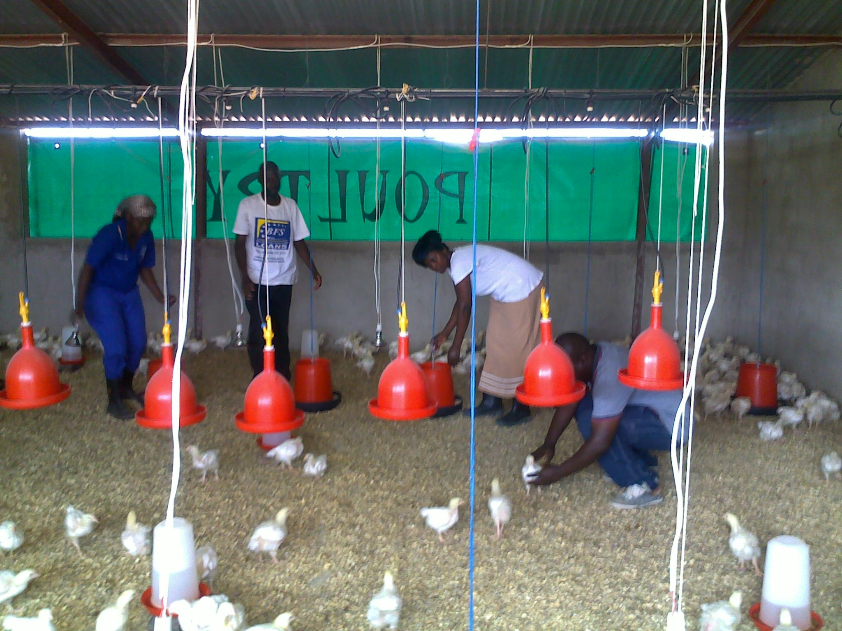
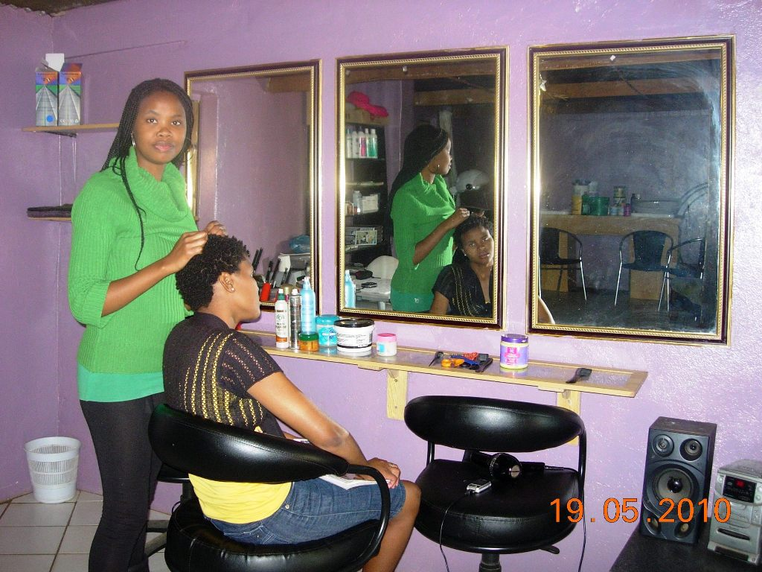
Economic Participation:
Entrepreneurship Awareness Training
Business Management Training
Grant Funding
Mentorship (One on One, Group, Online)
Market Linkages
Economic Development Beneficiaries
Economic Development Beneficiary
Economic Development Beneficiaries
Economic Development Beneficiaries

Slide 12
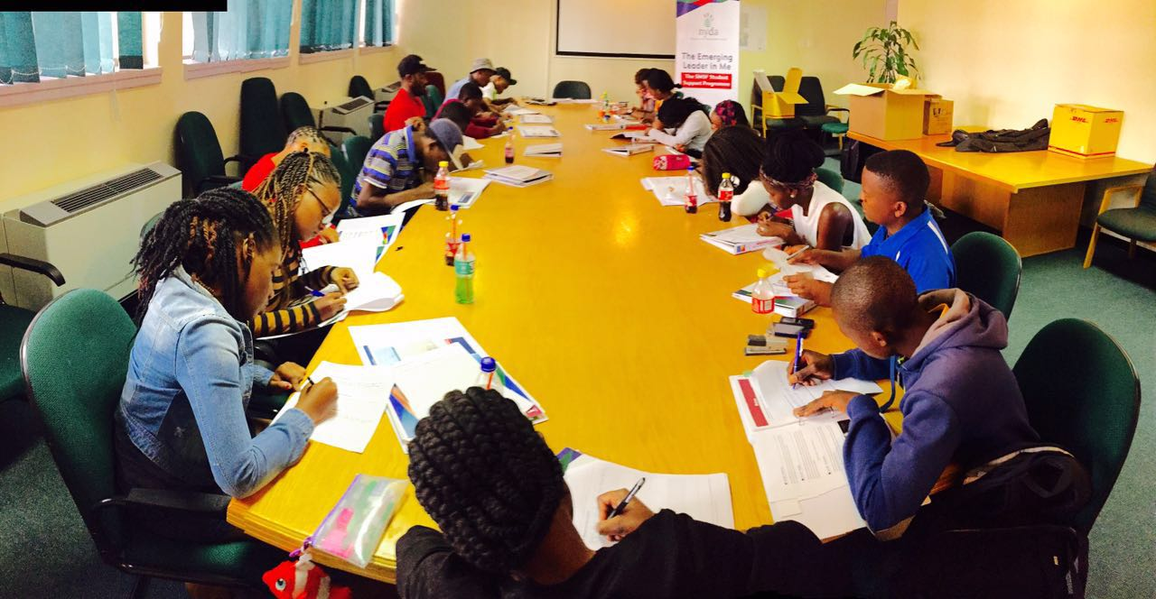
Education and Skills Development
Solomon Mahlangu Scholarship Fund
Jobs Programme
- JOBS Database
- Life skills training
- Job Preparedness training
Technical Skills Programme

Slide 13
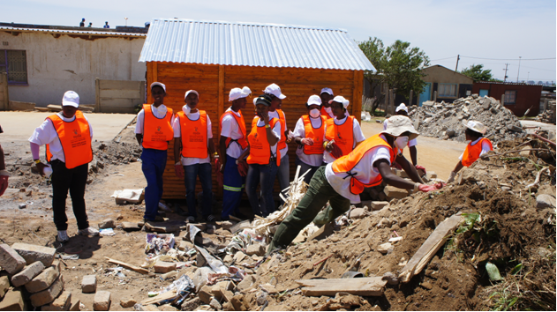
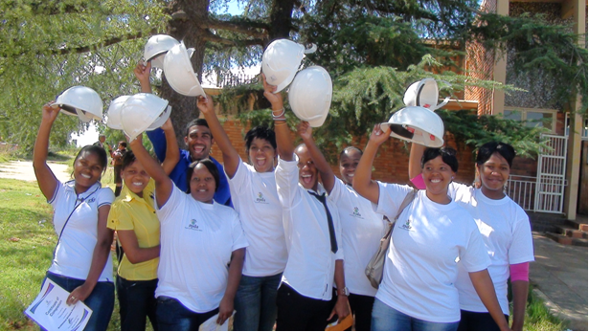
National Youth Service and Social Cohesion Strategic objectives
National Youth Service
Aimed at providing youth with meaningful and accredited skills and activities that benefit their communities through national service and patriotism.
Social cohesion
Defined as “the process through which individuals or groups are included to participate fully in the society in which they live (Government Notice 2008, p. 26). NYDA Social Cohesion programmes are aimed at engaging youth in activities that build their social capital, networks and strengthen the relationships that bind people and communities together. These activities will propel youth to reach their personal goals and develop their full capacity. Furthermore, youth will be aware of themselves and their rights and responsibilities
NYDA National Youth Service Programme recruited volunteers to assist in the
Duduza Recovery Project
NYDA Skills & Development Beneficiaries

Slide 14
3. RESEARCH AND POLICY
Youth Development Institute
Monitoring and Evaluation
Knowledge management

Slide 15
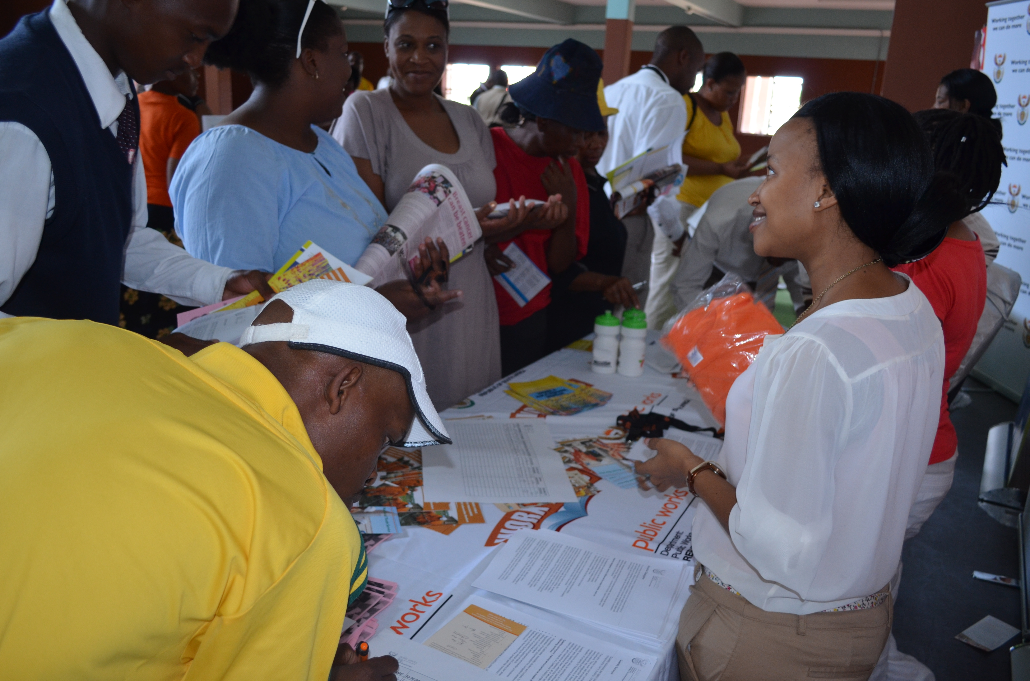
Information Services
To increase access to career guidance information for in-school and out of school youths so as to assist them in making informed career choices
Career Guidance Expo

Slide 16
Partnerships and Stakeholder Management
To lobby key stakeholders and institutions in the public, private and civic society sectors, including international donor agencies to work with, and support the work of Youth Development Initiatives
SETAS - Services, LG,
Private Sector – Lulaway, PrimeStars, Mr Price Foundation, Vodacom, etc.
Universities
Local Youth Offices

Slide 17
PART C: PEFORMANCE ON KEY INDICATORS
PROGRAMME | 2011/12 ACTUAL PERFORMANCE | 2012/13 ACTUAL PERFORMANNCE | 2013/14 ACTUAL PERFORMANCE | 2014/15 ACTUAL PERFORMANCE | 2015/16 ACTUAL PERFORMANCE | 2016/17 ACTUAL PERFORMANCE/ | TOTAL
Career Guidance |  |  | 896,761 | 937,949 | 202,125 | 981,088 | 3,017,923
Young people receiving information youth development through NYDA access points |  |  | 1,060,461 | 1,252,959 | 1,592,203 | 1,444,466 | 5,350,089
Grants (beneficiaries) |  |  | 765 | 1,034 | 622 | 698 | 3,119
Micro loans (beneficiaries) | 56 | 1,833 |  |  |  |  | 1,889
Entrepreneurs supported through (Market linkages, voucher, mentorship, Entreprenneurship Developemnt Programme) | 21,461 | 36,164 | 37,975 | 23,941 | 62,886 | 63,407 | 245,834
Business registrations | 502 | 630 |  |  |  |  | 1,132
Jobs facillitated | 12,579 |  |  |  |  | 5,114 | 12,579
Jobs created |  | 335 | 3,370 | 4,343 | 3,629 | 3,718 | 15,395
Technical skills programme and Youthbuild (NYS) | 647 | 2,124 | 3,788 | 2,342 | 2,136 | 12,191 | 11,037
Matric re-write | 2,641 | 2,950 | 568 | 5,319 | 4,780 | 0 | 16,258

Slide 18
PART C: PEFORMANCE ON KEY INDICATORS
Grants (beneficiaries) |  |  | 765 | 1,034 | 622 | 698 | 3,119
Young people supported through life skills programme, the job preparedness programme and job placement programme | 15,312 | 20,045 | 60,393 | 61,660 | 58,828 | 71,306 | 287,544
Matric re-write | 2,641 | 2,950 | 568 | 5,319 | 4,780 | 0 | 16,258
Solomon Mahlangu Scholarship / bursaries |  | 116 | 263 | 300 | 406 | 444 | 1,529

Slide 19
NYDA PRODUCTS AND SERVICES - GEOGRAPHIC

Slide 20
NYDA PRODUCTS AND SERVICES - GEOGRAPHIC

Slide 21
NYDA PRODUCTS AND SERVICES - GEOGRAPHIC

Slide 22
NYDA PRODUCTS AND SERVICES - GEOGRAPHIC

Slide 23
GENERAL YOUTH POPULATION
The Census 2011 results confirm that South Africa is a youthful country with youth aged 15-34 years constituting about 38% (about 20 Million) of the total population, estimated at 51.8 Million.
When ages 14 and 35 are included in the estimations ( in line with the National Youth Policy), the figure of youths as a proportion of the total population will increase to about 42% (about 21.7 million).
Notes:
The National Youth Policy defines youth category as ages 14-35.

Slide 24
CONTI…
African youth constitute about 82% of the youth population, followed by Coloured youths at about 8%. White youth constitute about 6% of the youth population while Indians constitute about 2%.
Gender distribution of young people is at about 50% for males and females.

Slide 25
YOUTH UNEMPLOYMENT FIGURES
Census 2011 confirmed the high level of unemployment among young people ( See Status of Youth Report). Young people between the 14 and 19 are the most affected with 64.9% being unemployed.
This is followed closely by those aged between 20 and 24 years with an unemployment rate of about 49%.
If an expanded definition of unemployment is used, the unemployment figures increased to 78% for those aged between 15 and 19 and to about 60% for those aged 20 to 24 years. These figures compare unfavourably with the national unemployment figures, which stand at about 30% (narrow definition) and about 40% (expanded).

Slide 26
CONTI..

