Slide 1

Fasset 2017/2018
Strategic Plan & Annual Performance Plan
7 June 2017
Presented to: Portfolio Committee on Higher Education and Training
7 June 2017

Slide 2
Content
  Vision, Mission, Values
  Lasting Legacy Strategy
  Skills Formation Process
  Skills Development Priorities
  SP and APP planning process
  Sector Profile and Entry routes into the Sector
  Top 10 Scarce Skills
  Strategic Goals & Objectives
  Performance Targets 2017/2018 (and baseline)
  Financial Projections: 2015 – 2020
  Budget: 2017/ 2018
  Budget Allocation per Programme
  Implementation, Monitoring & Progress
  SETA Challenges and Successes

Slide 3
  Vision
To facilitate the achievement of world-class finance and accounting skills
  Mission
The Fasset vision and mission are aligned to our organisational strategy and form the foundation upon which we build a pipeline of world-class skills for the broader finance sector whilst driving the transformation agenda.
Increase the flow of new finance and accountancy entrants into employment
Develop and grow the skills required in the sector
Facilitate transformation of the finance and accountancy sector

Slide 4
  Fasset Values
Values | What our values mean to us
Professionalism and accountability | We are a high performance, professional team; we strive for excellence through hard work and by taking responsibility and being accountable within an accepted and agreed code of conduct
Ethics | We work with integrity and honesty and respect internal and external stakeholders at all times
Making a difference | We make a difference to the lives of all our stakeholders by identifying their needs and exceeding expectations
Valuing people | We strive to create a motivating and supportive culture by understanding, respecting, developing and valuing each other
Innovation | We continuously innovate and improve to add value to all our stakeholders

Slide 5
  Lasting Legacy Strategy
#LastingLegacy was conceptualised to address the following:
Aimed to address niche areas which are not adequately funded in the post school system pipeline and achieve greatest impact
Two core areas funded
  1) Facilitating placement of learners
  2) Enhancing employability of learners through funding scarce skills academic and workplace relevant PIVOTAL programmes
Continued focus to address the transformation imperative ito allocating discretionary funding to Black African and disabled people – the population groups currently under-represented in the Fasset sector
A review of the recent sector statistics as well as recent court rulings caused the strategy to shift to include funding Coloured people in the Western and Northern Cape (where their employment is under-represented)

Slide 6
  Education and Skills Formation Pipeline

Slide 7
  Skills Development Priorities
The four most important skills issues that Fasset needs to contend with are:
The need to retain a long-term and holistic view of the skills pipeline and to address the key challenges that occur in the pipeline;
Ensuring that new entrants reach professional status;
Strengthening the capacity of the TVET Colleges and improving the absorption of TVET learners in the labour market and
Supporting the transformation of the sector.

Slide 8
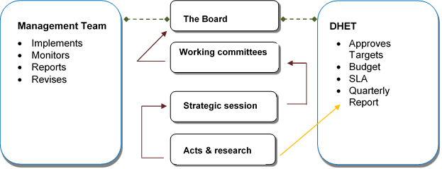
  SP and APP planning process

Slide 9
  Sector Profile
Based on Fasset SSP (Update for 2017/2018) and Sector Survey (2013)
5 529 organisations paid the Skills Development Levy (SDL) to Fasset in 2016
Subsectors
  Investment Entities and Trusts
  Company Secretary Services
  Administration of Financial Markets
  Security Dealing Activities
  Stockbroking
  Asset Portfolio Management
  Development Corporations and Organisations
  Tax Services
  Accounting, Bookkeeping and Auditing
  Activities, Tax Consultancy
  Activities of Accountants and Auditors
  Registered in Terms of the Auditing Profession Act
  Activities of Cost and Management
  Accountants
  Bookkeeping Activities, including Relevant Data Processing and Tabulating Activities
  Activities Auxiliary to Financial Intermediation
  Business and Management Consulting
  Services
  Project Financial Management
  South African Revenue Service (SARS)
  National Treasury
  Provincial Treasuries

Slide 10
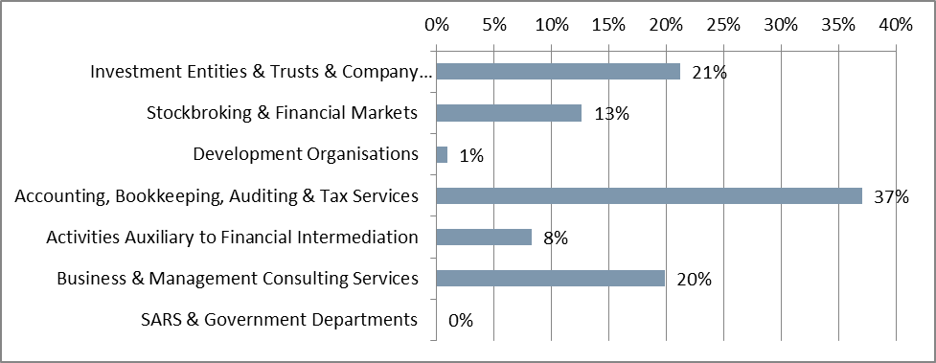
  Subsector Distribution

Slide 11
  Organisation Size

Slide 12
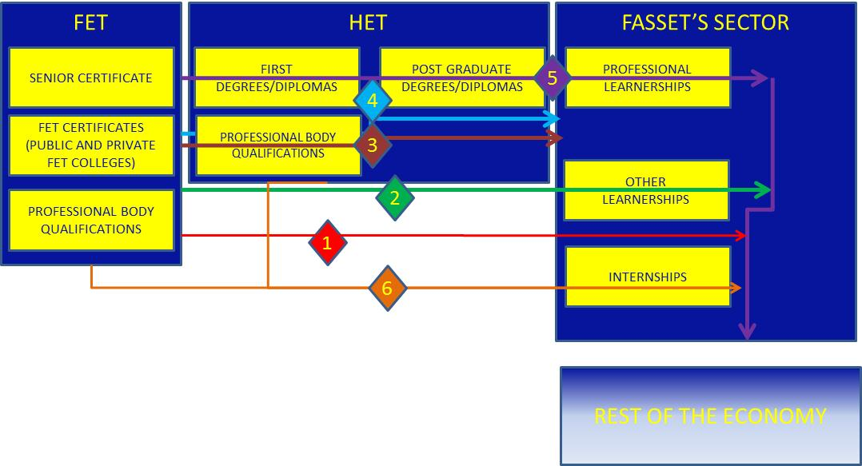
  Entry Routes to the Sector

Slide 13
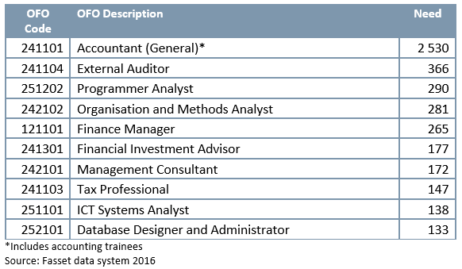
  Top 10 Scarce Skills

Slide 14
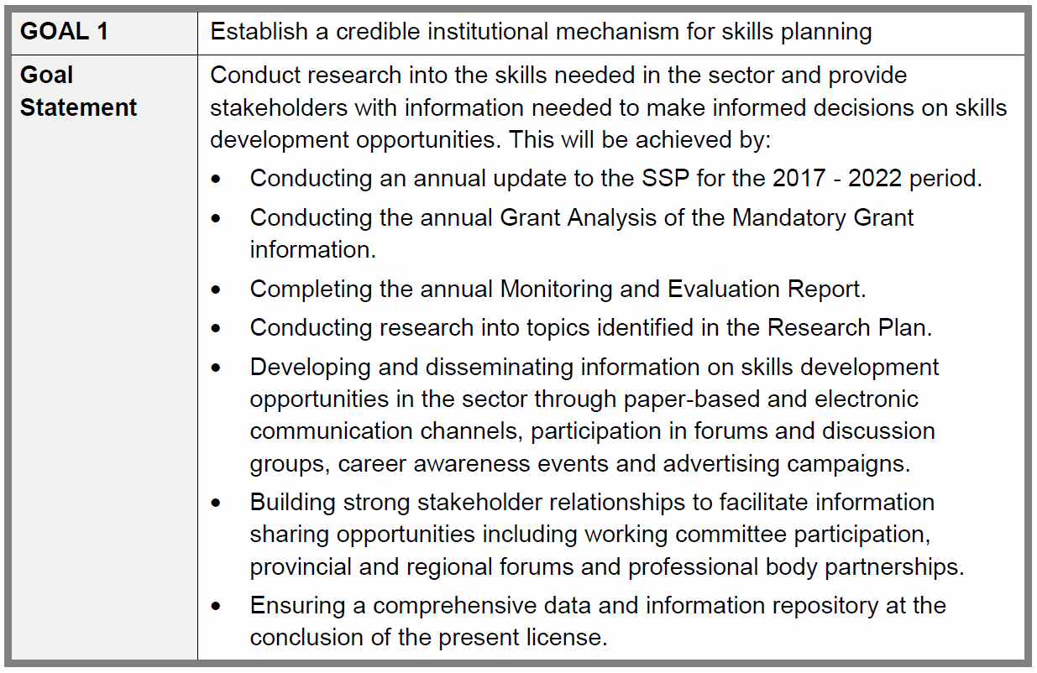
  Strategic Goals & Objectives (1)
Source: SP for 2017/2018 (Page 28)

Slide 15
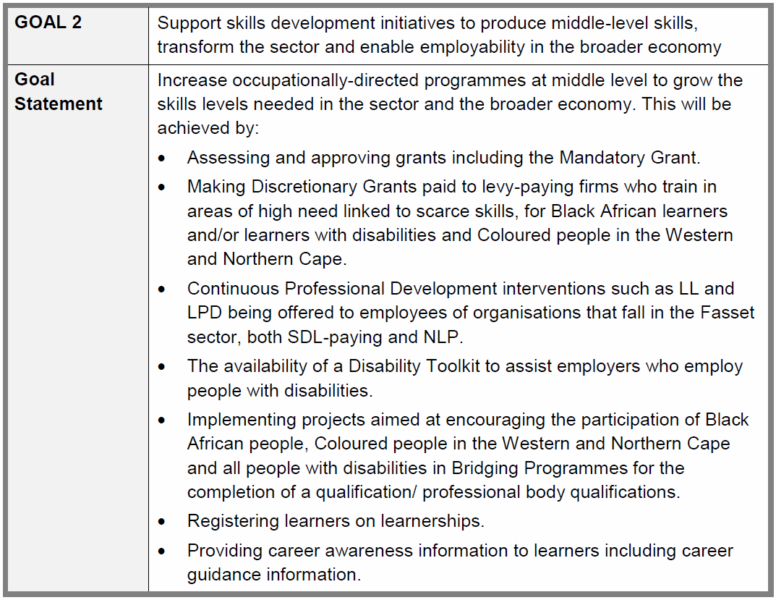
  Strategic Goals & Objectives (2)

Slide 16
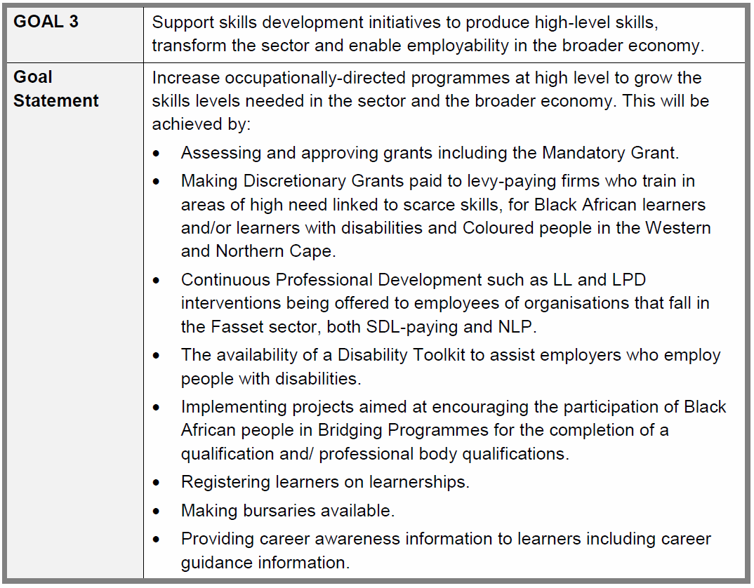
  Strategic Goals & Objectives (3)

Slide 17
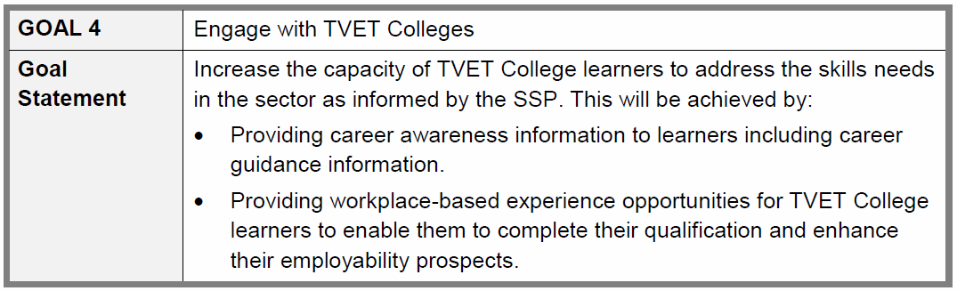
  Strategic Goals & Objectives (4)

Slide 18
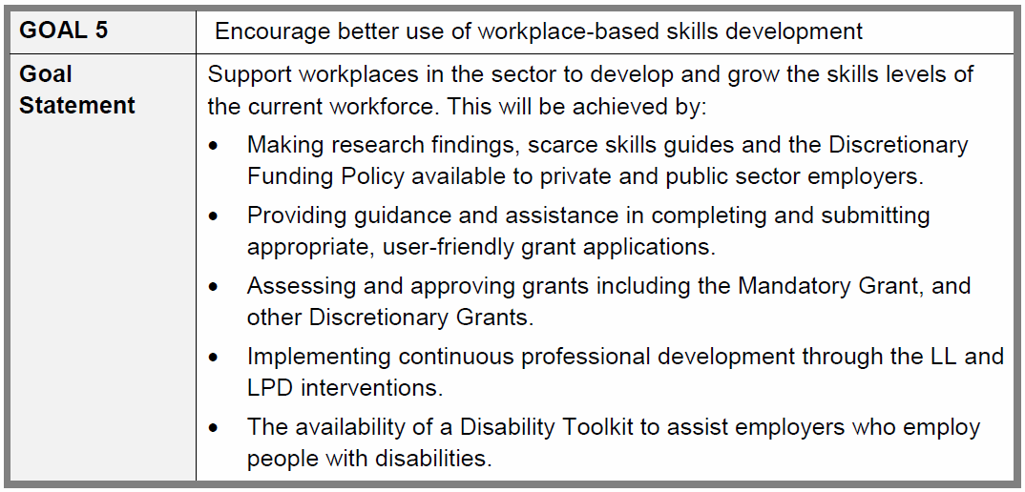
  Strategic Goals & Objectives (5)

Slide 19
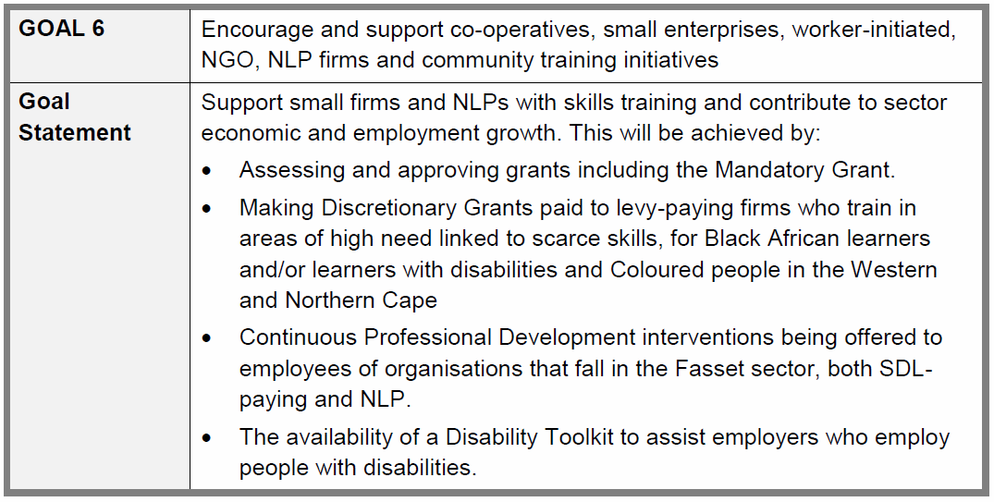
  Strategic Goals & Objectives (6)

Slide 20
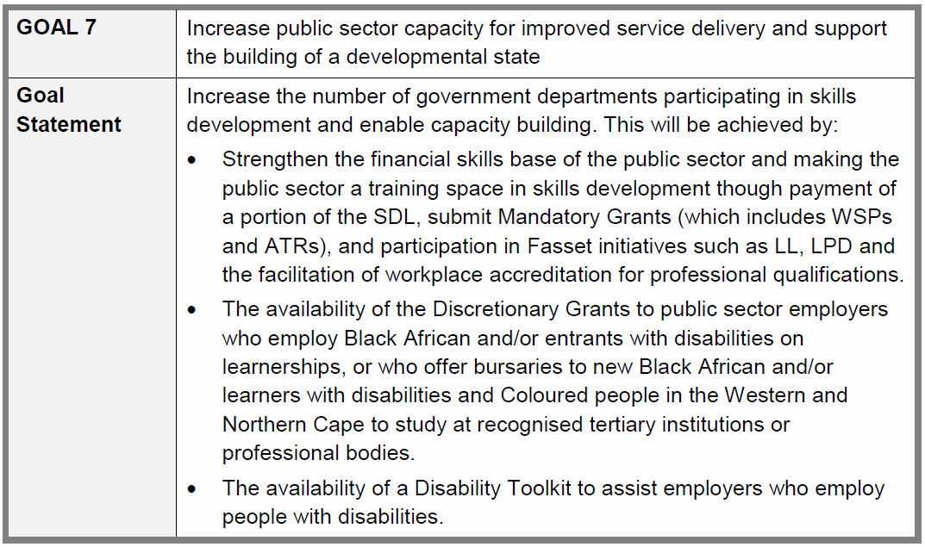
  Strategic Goals & Objectives (7)

Slide 21
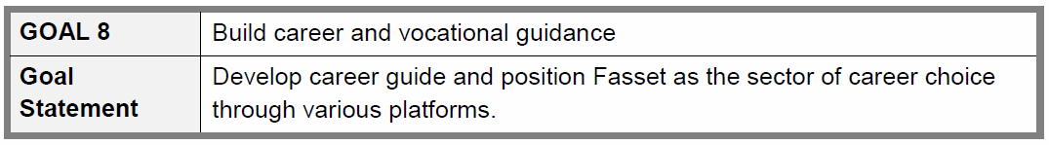
  Strategic Goals & Objectives (8)

Slide 22
  Performance Targets
Current 2017/2018 targets vs previous 2016/2017 targets
# | Target | 2016-2017 | 2017-2018
Prog 1 a) | Research that enables sector skills planning | Commission and conduct 10 research interventions. | Commission and conduct 10 research interventions on topics of relevant to strategic planning, monitoring and evaluation of SETA interventions and SSP development.
b) | Research that enables sector skills planning | Produce annual SSP update for submission to DHET. | Produce annual SSP update for submission to DHET
Prog 2 a) | Number of learners (employed and unemployed) who enter learning programmes (learnerships) | 700 learners (280 employed; 420 unemployed) | 700 learners (280 employed; 420 unemployed)
b) | Number of learners (employed and unemployed) who complete learning programmes (learnerships) | 450 learners (135 employed; 315 unemployed) | 450 learners (135 employed; 315 unemployed)
c) | Number of workers who enter and complete skills programmes – Lifelong Learning | 4000 workers | 4000 workers

Slide 23
  Performance Targets
Current 2017/2018 targets vs previous 2016/2017 targets
# | Target | 2016-2017 | 2017-2018
Prog 3 a) | Number of learners (employed and unemployed) who enter learning programmes (learnerships) | 3 330 learners (360 employed; 2970 unemployed) | 3 330 learners (360 employed; 2970 unemployed)
b) | Number of learners (employed and unemployed) who complete learning programmes (learnerships) | 2 360 learners (95 employed; 2265 unemployed) | 2 360 learners (95 employed; 2265 unemployed
c) | Number of unemployed learners on learnerships funded via Learner Employment Grant | 4000 unemployed learners | 3800 unemployed learners
d) | Number of workers learners who enter and complete skills programme - Learner Professional Development | 3 125 employed | 6000 employed

Slide 24
  Performance Targets
Current 2017/2018 targets vs previous 2016/2017 targets
# | Target | 2016-2017 | 2017-2018
e) | Number of workers who enter and complete skills programmes – Lifelong Learning | 6500 workers | 6500 workers
f) | Number of unemployed learners who enter bridging programme for the completion of a qualification – Universities | 1500 unemployed learners | 1500 unemployed learners
g) | Number of unemployed learners who complete bridging programme for the completion of a qualification - Universities | 1050 unemployed learners | 1050 unemployed learners
h) | Number of unemployed learners who enter bridging programme for the completion of a qualification/designation – Professional Body | 330 unemployed learners | 330 unemployed learners
i) | Number of unemployed learners who complete bridging programme for the completion of a qualification/designation – Professional Body | 231 unemployed learners | 231 unemployed learners
j) | Number of unemployed learners funded on Bursary Grant | 500 unemployed learners | 500 unemployed learners

Slide 25
  Performance Targets
Current 2017/2018 targets vs previous 2016/2017 targets
# | Target | 2016-2017 | 2017-2018
k) | Number of unemployed learners funded on NSFAS Loan Repayment Grant | 150 unemployed learners | 200 unemployed learners
l) | Number of unemployed learners entered and funded on Fasset Bursary Scheme | 330 unemployed learners | 330 unemployed learners
m) | Number of unemployed learners completed and funded on Fasset Bursary Scheme | 0 | 264 unemployed learners
n) | Number of unemployed learners assisted on NSFAS bursary | 300 unemployed learners | 150 unemployed learners
o) | Number of unemployed leaners funded via Non- PIVOTAL Learner Employment Grant | 300 unemployed learners | 300 unemployed learners
p) | Number of unemployed learners who enter bridging programme for the completion of a qualification/designation (Non-PIVOTAL) | 160 unemployed learners | 160 unemployed learners
q) | Number of unemployed learners who complete bridging programmes: Qualification/Professional designations support (Non-PIVOTAL) | N/A | 112 unemployed learners

Slide 26
  Performance Targets
Current 2017/2018 targets vs previous 2016/2017 targets
# | Target | 2016-2017 | 2017-2018
Prog 4 | Number of unemployed TVET graduates placed (in in-service training) | 300 unemployed learners | 480 unemployed learners
b) | Number of unemployed TVET graduates completing in-service training | 100 unemployed learners | 210 unemployed learners
c) | Number of SETA Employer Partnerships established | 10 partnerships established | 15 partnerships established
Prog 5 | Large firms (submission of WSP/ATR) | 60 large firms | 60 large firms
a) | Mediums firms (submission of WSP/ATR) | 80 medium firms | 80 medium firms
b) | Small firms (submission of WSP/ATR) | 600 small firms | 600small firms
c) | Support to non-levy paying firms | 320 firms | 320 firms
d) | Number of government departments supported | 5 departments (submission of WSP/ATR) | 5 departments (submission of WSP/ATR)
e) | Support to small businesses includes attendance at LL. | 400 small firms in sector supported through LL events | 400 small firms in sector supported through LL events

Slide 27
  Performance Targets
Current 2017/2018 targets vs previous 2016/2017 targets
# | Target | 2016-2017 | 2017-2018
Prog 6 | Develop career guide and position Fasset as the sector of career choice through various platforms including stakeholder engagement | The following is planned: 1 Career Guide Updated, 2) 1 national learner print media and online campaign update implemented, 3) 32 learner advertisements placed, 4) 20 career event exhibitions attended, 5) 5 relationships created and/or career guidance/student support offices at HETs/TVETs created, 6) 4 learner e-zine produced and distributed to learners | The following is planned: 1 Career Guide Updated, 2) 1 national learner print media and online campaign update implemented, 3) 32 learner advertisements placed, 4) 20 career event exhibitions attended, 5) 5 relationships created and/or career guidance/student support offices at HETs/TVETs created, 6) 4 learner e-zine produced and distributed to learners

Slide 28
  High Level Financial Projections 2015 - 2020
Annexure 3 SP, Page 78

Slide 29
  Budget
Current 2017/2018 Budget vs Previous 2016/2017 Budget
 | 2016/17 | 2017/18
Income: Total (6.5% increase) | R 460 000 000 | R 490 000 000
Expenditure: Total | R 339 300 000 | R 490 000 000
Expenditure: Admin (9.3% increased to 10.5%) | R 52 000 000 | R 64 000 000
Expenditure: Mandatory Grant (65% pay out rate) | R 73 000 000 | R 79 000 000
Discretionary Funding | R 214 300 000 | R 347 000 000

Slide 30
  Budget Allocation per programme
 | 2016/2017 Budget | Target | 2017/2018 Budget | Target
PIVOTAL Programmes (90%) | R 180 850 000 |  | R 313 500 000
PLACEMENT: | R 27 850 000 |  | R 164 500 000
Learner Employment Grant (R30k p/a and max R90k or 49.5%) | R 120 700 000 | 4 000 | R 114 500 000 | 3 800
Learner Professional Development | R 5 000 000 | 3 000 | R 10 000 000 | 6 000
TVET WBE (R82,5k) | R 22 850 000 | 300 | R 40 000 000 | 480

Slide 31
  Budget Allocation per programme
 | 2016/2017 Budget | Target | 2017/2018 Budget | Target
ACADEMIC SUPPORT: | R 153 000 000 |  | R 149 000 000
Bridging Programme for the completion of academic qualification/ designation: Universities (R60k) | R 60 000 000 | 1 500 | R 60 000 000 | 1 500
Bridging Programme for the completion of academic qualification/ designation: Professional Body (R60k) | R 20 000 000 | 330 | R 20 000 000 | 330
Bursary Grant (R40k) | R 20 000 000 | 500 | R 20 000 000 | 500
Fasset Bursary scheme (R120k) | R 40 000 000 | 330 | R 40 000 000 | 330
NSFAS Loan Repayment Grant (R20k) | R 3 000 000 | 150 | R 4 000 000 | 200
NSFAS Bursaries (flow through) | R 10 000 000 | 300 | R 5 000 000 | 150

Slide 32
  Budget Allocation per programme
 | 2016/2017 Budget | Target | 2017/2018 Budget | Target
Non-PIVOTAL Programmes (10%) : | R 33 450 000 |  | R 33 500 000
Lifelong Learning | R 9 000 000 | 10 500 | R 9 000 000 | 10 500
Strategic communication | R 4 150 000 | - | R 4 000 000 | -
Stakeholder engagement (advocacy programme for non-PIVOTAL interventions) | R 300 000 | - | R 500 000 | -
Non- Pivotal Bridging Programme for the completion of Academic Qualification/ Designation (R60k) | R 10 000 000 | 160 | R 10 000 000 | 160
Non-Pivotal Learner Employment Grant (R30k) | R 10 000 000 | 300 | R 10 000 000 | 300

Slide 33
  Implementation, Monitoring & Progress (1)
Implementation:
  Each area of the SP is allocated to specific management at Fasset who are bound by performance agreements, SLAs and MOUs
Monitoring
  Fasset’s participation in a variety of checks and audits provides opportunities for analysis of the Fasset Seta systems and processes and for feedback that could be used for continuous improvement.
  Internal auditing monitors the optimal functioning of SETA processes
  Interim and final external audits highlights SP implementation
  Regular DHET monitoring and feedback on quarterly SETA performance reports
  To continually improve Fasset processes, a Quality Assurance department identifies areas for improvement
  Regular studies undertaken by Fasset for other purposes will be utilised to monitor impact e.g. Customer Satisfaction Surveys and LEG monitoring visits
  Ad hoc and additional projects to measure impact

Slide 34
  Implementation, Monitoring & Progress (2)
  Research on the achievement of interventions and the impact of interventions highlights shortfalls in SETA implementation, especially the evaluation of impact of Mandatory and Discretionary Grants and funded interventions
Progress
  Fasset’s own system – data is collected as part of the execution of Fasset’s normal functions
  Bi-monthly staff and management meetings where the progress against NSDS targets and any associated risks are assessed and processes amended to address concerns
  Board and working committee oversight to address progress against target achievement

Slide 35
  SETA Challenges
2016/2017 has been a challenging year for the SETA
Mid-year shift in strategy focus
Leadership changes
Investigation into irregular expenditure disclosure
Remaining up-to-date with SCM changes and prescripts
Capacity constraints
Robust monitoring and evaluations system
Changes in license period of SETA impact on long-term nature of strategy to be decided as well as staff continuity

Slide 36
  SETA Successes (1)
Robust review and implementation of internal controls underway
High levels of employer engagement in LL and LPD skills programmes
Extensive career awareness rural reach achieved
Career Portal and Fasset Alumni programme developed
Focus on research via an internal research department to address scarce skills and sector research
Creation of workplace-based opportunities for learners through improved grant scheme
Active involvement of employers in SETA working committees and grant scheme
Introduction of comprehensive Fasset Bursary Scheme to support ‘missing middle’ through tertiary institutions to improve education levels in sector
Partnership agreements created through funding channels to universities and TVET Colleges (where learners are placed in industry)

Slide 37
  SETA Successes (2)
Enthusiastic employer uptake of TVET College learners
Dynamic Professional Body involvement brings high quality and competitive programmes to the sector
Staff morale and stability in the context of leadership changes

Slide 38
Thank You

