Slide 1
DIRCO PRESENTATION
TO THE PORTFOLIO COMMITTEE ON INTERNATIONAL RELATIONS AND COOPERATION
07 JUNE 2017
SOUTH AFRICA- FRANCE RELATIONS IN THE WAKE OF NEW FRENCH PRESIDENCY

Slide 2
OUTLINE OF THE PRESENTATION
Key election drivers
French elections
SA-France relations
Implications of the Macron’s administration

Slide 3
KEY ELECTION DRIVERS
Migration
Rise in Nationalism / right wing tendencies
Terrorism
Socio-economic challenges (unemployment, minimum wages, social grants, education)
Low GDP growth
Brexit
EU integration
Notes:
One of the key election drivers, as has been proven by elections held in Austria, the Netherlands and in France thus far, and as is evident from election campaigns underway in the UK and in Germany, is the issue and challenges linked to irregular migration to Europe. It remains a highly divisive issue between EU members and within the electorate of individual countries. This is also due in part to a lack of a coordinated approach where affected countries find it difficult to agree on or manage (inadequacy of the EU’s Schengen Agreement, strengthening external EU border controls, finance processing centres and better distribute arrivals across the EU). The EU-Turkey deal is unravelling and Italy-Libya MoU legally questioned.
As regards the increasing strains of uncontrolled migration, approximately 590 migrants have drowned on the central Mediterranean route with around 21 900 refugees arriving in Italy during the first three months of 2017. These numbers include refugees from conflicts in Syria, Iraq and Afghanistan and economic migrants from the Balkans, the Middle East and Africa.
Similarly, continuing terror attacks across Europe have fuelled a rise in right wing nationalism tendencies, with racial/religious overtones and xenophobia.
Sluggish economic growth in Europe, including France at 1.2 %, is causing resistance from the voting public against labour and economic reform programmes required to address these challenges.
Brexit is causing uncertainty about the future of the EU which has also been a major factor in recent European elections.
All these factors above including the inadequacy of communication from Brussels threaten the integration of the EU.

Slide 4
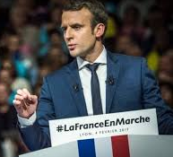
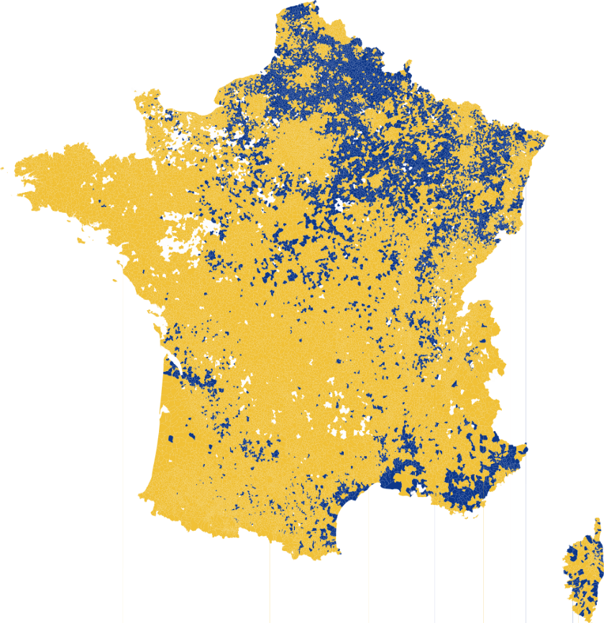
FRENCH ELECTIONS
President Macron inaugurated on 14 May 2017 following his victory of 66.1% of the votes against right wing and anti EU candidate Marine Le Pen in the final round.
His campaign was based on a pro-EU stance and seeking economic revival within EU, a strong anti-terrorism message and a moderate approach on migration.
On his first day of his Presidency, Mr Macron met with German Chancellor Angela Merkel. Within a month he also met with Russian and US President as well as UNSC Antonio Guterres and with President of the EC, Donald Tusk. He also visited French troops in Mali. This demonstrates his main foreign policy priorities.
He announced his cabinet which is a reflection of a mixture of candidates from various parties – a move towards centrist approach.
Outcome of 11 and 18 June 2017 legislative elections - key for the implementation of President Macron’ s agenda and an indication of support of his new Republic En Marche party.
Emmanuel Macron Marine Le Pen
Notes:
The election of a centrist-oriented French President has to a large extent put breaks on fears of a resurgence of right-wing political dominance in France and Europe.
Macron was an advisor to President Hollande - his rise to become a - Minister of Economy in the Hollande government and introduction of economic and labour reforms that saw Hollande become unpopular - his resignation and formation of the En Marche Movement using social media and appealing to youth and young voters - his appeal to both centre left and centre right politicians while rejecting the far right resulting in decimating and disorganising both parties - he remain an investment banker and claim to clean French politics ethically
The reform programme that the new French president wishes to implement might still place the new president in conflict with the interests of labour and socialist oriented organisations and civil society. As Europe’s second largest economy, President Macron’s policy expressions are concentrated around domestic and EU reform. In relation to domestic reforms, he undertakes to significantly cut jobs in the public sector to reduce the budget expenditure and lower the deficit. To achieve this, he seeks to lower unemployment benefits and reform labour, suppress taxes on corporates and modernise agriculture, transport, among others. He also faces the domestic challenges of unemployment (slightly above 10%), security/terrorism, immigration and socio-economic marginalisation of French minorities.
President Macron undertook a visit to Berlin to meet with German Chancellor Angela Merkel. The purpose of the visit was to re-establish a dialogue between Paris and Berlin on Europe and the European Union (EU). The conversation between the two leaders mainly centred on reforming the EU with a view to strengthening integration and addressing common challenges such as migration, unemployment and economic stagnation. Ms Merkel stated that she would not be averse to amending EU treaties to ensure deeper Eurozone reform, signalling that the topic was no longer taboo. On his second day in office, President Macron met with United Nations Secretary General Antonio Guterres to discuss global peace and security issues and reaffirm France's commitment to the U.N. He also met with President of the European Council, Donald Tusk to emphasise the importance of the European Union project to his presidency.
During a meeting with President Putin, Mr Macron warned that France would respond immediately to any use of chemical weapons in Syria, while urging a closer partnership with Russia in fighting Islamic State (Isis) in the country. Whilst during President Macron's meeting with President Trump they discussed issues such as the fight against terrorism, the economy, climate and energy. Given the latter’s withdrawal of US to the Paris Climate Change Agreement.
Fighting terrorism, islamist and militancy are key for Mr Macron’s African agenda as can be seen with his first visit to Africa, in Mali where France deployed 4000 troops in the Sahel region as part of the Barkhane operation.
Therefore, the outcome of legislative elections in June will determine the make-up of and political character of the next French parliament. A parliament not in support of Macron’s policies and reform programme, or one that is a coalition parliament, will make it very difficult for the president to introduce required reforms. President Macron’s appointment of centre-right and Republican Party member, Mr Edouard Phillippe (46), as Prime Minister, is understood to be an attempt to break with traditional political lines – the PM is expected to play a key role in the outcome of the legislative elections.
President Macron’s party could: (a) possibly win an outright majority (as a new party bridging the traditional party lines), (b) be obliged to form a coalition with the conservatives or the socialists, (c) govern without a coalition and reach agreement with political parties on a case-by-case basis, or, (d) an uncomfortable “marriage” between the Presidency and Legislature if the Republicans and/or Conservatives win a majority.
His major challenge will be the need to balance expectation with reality especially if he does not win a majority in parliament.
While the latest polls place President Macron’s new party in front, the narrow margins appear to indicate that a coalition might be in the making.

Slide 5
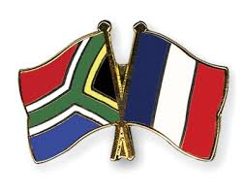
SA-FRANCE RELATIONS
CURRENT
FUTURE
SA-France bilateral relations are currently managed through Forum for Political Dialogue at Director-General level.
France is an important partner particularly as a G7, G20 and P5 member.
SA is important to France as a G20 and BRICS member.
Important source of FDI for SA with estimated investment volume of over R21.9 billion from French companies for the period of 2004-2015.
Total trade 2016: R43.3 billion (29% increase vs. 2015)
Tourist arrivals 2016: 154 220 (20% increase vs. 2015)
France remains a strategic partner for South Africa with the Forum for Political Dialogue and the Defence Strategic Dialogue both elevated to Ministerial level.
It is unlikely that France’s foreign policy toward Africa and South Africa will face a fundamental shift.
Nevertheless, President Macron’s pro-business background and policy might create space for the expansion of trade and investment.
South Africa should continue to reinforce bilateral relations with France through the FDP and JEC, focusing on NDP priorities such as Energy, Agriculture, Science and Technology, Maritime, Education and Arts and Culture.
Likewise, President Macron’s drive to reinvigorate the EU under the leadership of the Franco-German alliance, might also create space for SA-EU relations to expand and strengthen.
Notes:
Although it is too early to determine President Macron's policy towards Africa, particularly South Africa since he did not make much pronouncement during his election campaign, it is not foreseen that there would be a change in South Africa’s position as a strategic partner to France, both bilaterally and in the African Continent where South Africa-France interests dove-tail, as well as internationally.
It is expected that President Macron will continue to address France’s relations with the broader international community and with Africa in terms of its security, economic and global political positioning in order to continue to project influence and be a global player.
South Africa as a large emerging market, with important membership of BRICS and G20 presents a major economic force for France.

Slide 6
SA-France Economic Relations
The South Africa-France Joint Economic Commission (JEC) was resuscitated in 2013 and is a platform to exchange views on trade and investment for both countries. It is important for SA to address the trade imbalance especially by focusing on skills transfer, localisation and opening of market access for SA companies in France.
France remains an important source of FDI for South Africa, there are more than 365 French companies operating in South Africa employing 36 000 South Africans. There are about 17 South African companies that are employing around 10 000 French citizens. (source: Dti).
France is the 4th biggest trading partner in the EU after Germany, UK, and Italy. They are South Africa’s 11th trading partner and the 27th export partner in the world.
Notes:
The outcome of the recent elections in France is likely to enhance the on-going economic diplomacy drive between South Africa and France which is regulated by the SA – France Joint Economic Commission. President Macron, a neo-liberal who believes in business and trade may open Africa to French business. He is also regarded as being pro-European Union which has recently concluded Economic Partnership Agreement (EPA) with Southern African Development Community (SADC).
The economic relationship between SA and France is likely to be boosted by the election of President Macron who carries the hopes of millions of French people and ran a courageous pro-European campaign and stands for openness to the world and is committed decisively to a social market economy. Under his watch, France is unlikely to leave the European Union, with EPA, Southern African countries stand to derive economic benefits and a strong EU is required if these benefits are to be realized.
Total trade between South Africa and France reached R42.1 billion in 2016, increasing by 31.1% from R33.6 billion in 2015. During the same period, South Africa’s exports to France increased by 23% form R9.1 billion in 2015 to R10.2 billion in 2016. This is compared with a 23% increase in imports from R24.4 billion in 2015 to 31.7 billion in 2016. The low base in the volume of exports compared to imports resulted in an expansion in trade deficit, increasing from R15.3 billion in 2015 to R-21 billion in 2016.
South Africa`s export basket into France is dominated by products such as vehicles, machinery, nuclear reactors, boilers, mineral fuels, oils, over the five year period. South Africa’s top 5 imports from France include; aircraft parts, vaccines, human use, turbo jets lubricating oil additives containing pet oils/oils obtained from bitu minerals.
SA-France Joint Economic Committee (JEC) met in April 2015, following a decision to resuscitate the committee during the French State Visit to SA in 2013, and emphasise its important role to expand investment and trade in terms of the priorities of both Governments. France to open its market for South African companies, as well as to work with South Africa to diversify the bilateral trade basket and to address the trade imbalance
Within the bilateral framework a follow-up JEC meeting took place in Paris on 12 and 13 April 2017. During the meeting, it was agreed to convene a bilateral joint economic committee every two years and to hold a follow-up meeting after 6 months between French Treasury and Department of Trade and Industry (DTI).
Other outcomes of the JEC include:-
The JEC to consider additional sectors of cooperation in order to address the burgeoning trade deficit and to change composition of the export basket to France. These include: Engineering services or sub-contracting and component manufacture in sub-sectors such as automotive components, aeronautical components and sub-assemblies, electronics and electrical components, metals components, fabrication and processed foods and beverages;
South Africa is a reliable supplier of a wide range of processed foods and beverages with considerable scope to increase their supply to France under their own brands or through private label manufacture for the leading French and other European retail chains. France is an extremely important market for South Africa’s exports of fresh fruit.
There is a need to emphasise that the large infrastructure and transport contracts acquired by French companies should result into increased manufacturing, localisation, job creation and skills development;
To continue exchanges between the economic department of the French Embassy and the DTI EU Desk on safeguard measures issue since trade relations between South Africa and France are governed by the SADC-EU Economic Partnership Agreement;
To hold follow up discussions in order to identify specific problems faced by French companies in South Africa and to provide a platform of regular dialogue: French companies, the economic department of the Embassy and the DTI;
To monitor the progress of the ongoing institutional cooperation on transport with the Department of Transport;
To organise sectorial workshops with representatives of the South African Departments of Transport and Energy on the margins of the next joint economic committee;
South Africa will send to France a letter expressing its needs in the aquaculture sector in order to initiated on cooperation modalities;
To continue discussions between the two parties on agri-food processing to clarify the issues with the companies concerned;
France will forward to the DTI and the Mandela Bay Composites Cluster a document presented during the session on composite materials in France. The DGE (Directorate General Enterprises) will identify contacts and actors who could draw up a roadmap for cooperation in the field of composite materials and would consider hosting a South-African delegation in France.

Slide 7
IMPLICATIONS UNDER THE NEW FRENCH PRESIDENCY
France’s strong position in favour of EU integration remains intact for the time being
Although nationalists and right wingers now form part of opposition, they have made significant gains – traditional political parties are on the retreat
Migration will continue to put strain on governments and resources – focus will be on curbing migrant numbers – reduction in opportunities for African migrants in EU countries
Terrorism will continue to threaten EU free movement – more restrictive immigration policies and movement control
Strong likelihood that EU members could become more internally focussed especially on intra-EU trade – less ODA to Africa a real possibility
ODA and investment initiatives into Africa appears to be largely driven by European security concerns, rather than support for Agenda 2063 or AU priorities, with a strong focus on North Africa
Notes:
EU integration has been threatened by many factors, including:- Euroscepticism; the dilemma in finding a common European approach to the migration challenges; the continuing poor economic performance in Europe; a growing resistance to the role of Brussels including the inadequacy in communication and its impact on the sovereignty of member states.
Another major concern within the EU is that the UK’s withdrawal could serve as an example to be followed by the Eurosceptic political groupings vying for political power in other Member States.
These multiple challenges (Brexit, stagnant economy, immigration, terrorism, etc.) could have a profound effect on Europe’s future and also expose the EU’s vulnerability to terrorism and growing instability. Hence the growing nationalistic and right-wing tendencies/parties who are increasingly becoming main stream opposition in many EU countries.
The recent election results in France and Netherlands nevertheless appear to have strengthened the pro-EU stance towards closer integration. It could be expected that President Macron’s pro-EU policies would strengthening France’s leadership position within the bloc.
In addition, President Macron has indicated that he will work towards bolstering EU Defence in cooperation with NATO for control over European security.
He has also pledged to issue sanctions against countries that do not respect social and environmental clauses of EU trade agreements – which could impact on relations with the US after President Trump’s decision to withdraw the US from the Paris Climate Change agreement
President Macron indicated that he does not envisage a France that shuts out immigrants and asylum seekers, especially those with special skills required for the French economy true to his dynamic liberal views – however, the effects of this on nationalism sentiments and unemployment at +-10% in France.
The French President has pledged to channel most of France’s foreign aid to Africa which he intends to increase by 0.7 % of French’s GDP. In 2016 - SA Loans : a pipeline of €1 Billion and AFD disbursed €998 Million (which is almost all of the pipeline). Technical Assistance Fund: an envelope of €400 000 and all the fund has been committed.

Slide 8
FRANCE IN THE CONTEXT OF G20
President Emmanuel Macron’s election platform and his strong electoral mandate places him in a position to provide strong leadership in the current context of anti-globalisation and populism debates which have now also surfaced within the G20 in the aftermath of the US elections and the EU Referendum in UK.
With regard to Africa, the French President expressed the desire to transform the relationship with Africa into a genuine partnership and called for a strategic and balanced partnership between the European Union and the African Union. Africa is increasingly occupying an important focus of the G20’s development work.
President Macron highlighted collaboration on security, climate change, education, infrastructure, energy, women’s rights, and access to water as key pillars informing this partnership with Africa.
The above are also areas in which the G20 is playing an increased role and it is therefore reasonable to expect that France could be a positive influence in the context of the development work undertaken by the G20 in support of Africa.
These factors are particularly relevant in view of the fact that France announced the desire to progressively raise development aid to Africa to reach 0.7% of France’s GDP between 2022 and 2030. In the final analysis the policy space of the president will be predicated on the parliamentary elections to be held on 11 and 18 June 2017.
Notes:
South Africa as a large emerging market, with important membership of BRICS and G20 presents a major economic force for France.
The G20 agenda has expanded from its initial focus on the international financial architecture, financial regulatory reform and global economic governance to include topics such as development, trade and investment, energy, counter-terrorism, global health, migration and refugees.
President Macron has vowed to lobby the G20 at its July Summit in Germany to support economic development in African countries. He pledged to defend and respect fundamental democratic principles in Africa working with the African Union and Regional organisations. He is open to a new relationship with Africa depending on African leaders.
Despite all past French Presidents, French Policy on Africa is so much linked to its neo-colonial roots. Mr Macron viewed France’s neo-colonial dominance with some embarrassment but the proof of the pudding is in the eating.
Mr Macron took a bold step during his campaign when he denounced France’s colonial legacy in Algeria. He stated that the “barbarism and cruelty” displayed by France then, would today constitute crimes against humanity. Apart from this statement, it is not immediately apparent whether French foreign policy toward Africa will change.

Slide 9
FRANCE IN THE CONTEXT OF G7
France, it should be expected, would continue to align itself with the objectives and policy programmes of the G7. 27-27 May Summit in Sicily focused on foreign policy, the global economy, reduction of inequalities and migration challenges.
Notes:
G7 outcomes included:-
Foreign policy calls made to end Syria conflict through inclusive Syrian political process supported by the UN;
Called for progress in political dialogue and national reconciliation in Libya;
Condemned North Korea’s missile programme and called for full implementation of the Minsk Agreements on Ukraine;
Global economy support pledged for growth, sustainable development, for improved WTO functioning, levelling of trade playing fields, strengthening the rules based multilateral trading system;
Migration challenges call for increased national and international management coordination; the G7 reconfirmed sovereign rights of states to control their own borders and adopt policies in the national interest and agreed to establish partnerships to assist countries to create conditions within their borders to counter the drivers of irregular migration;
50 000 migrants added up to May 2017 to existing 181 000 in Italy alone;
The G7 Outreach Africa focussed on the need to massively increase investment in Africa in order to assist stemming the flow of migrants across the Mediterranean. Africa Outreach attended (upon invitation) by Tunisia, Niger, Nigeria, Kenya, Ethiopia, Guinea, the UNSC, the OECD, IMF, World Bank, ADB, AU Chair, AU Commission Chair, Britain, France, Canada, Italy, Japan and the EU agreed to find common ground with USA on counter-terrorism and trade, but not on climate change;
Adopted a road map on gender equity and committed to support to innovation, skills and labour; and
Adopted the G7 Taormina Statement against terrorism and violent extremism
South Africa’s unexpected non-invite to the Africa Outreach of this Italian hosted G7 Summit an indication of the above mentioned focus-shift of G7 northern hemisphere geo-strategic concerns linked to migration and Islamic security concerns.

Slide 10
THANK YOU

