Slide 1
Submission to the Standing Committee on Finance and the Portfolio Committee on Health Comments on the Draft Rates and Monetary Amounts and Amendment of Revenue Laws Bill: Proposed Health Levy
PRESENTED BY
VELAPHI RATSHEFOLA – MD
COCA-COLA BEVERAGES SOUTH AFRICA
6 JUNE 2017

Slide 2
Presentation Outline
About Coca-Cola Beverages South Africa (CCBSA)
CCBSA’S Public Interest Commitments
CCCBSA’s response to health concerns
CCBSA’s Proposed Solution and Progress to date
Our Position on the proposed heath levy and Conclusion

Slide 3
Coca-Cola Beverages South Africa – newly merged franchised bottler of TCCC in SA
CCBA Head quartered in SA and Tax resident of SA
CCBA owns 89% CCBSA
67% of our procurement is local, (Sugar is 23% of this)
We have created close to 2000 jobs in the last 4 years mainly in retail
We invest over R40m annually in communities
Notes:
Formed on 4 July 2016, merging 6 separate franchise businesses of Coca-Cola in SA. (CCF, ABI, Shanduka, Appletiser, Valpre, Canners)
89% owned by Coca-Cola Beverages Africa, largest Coke Bottler in Africa (operating in 9 other African Countries)
67% of our procurement is local (85% of sugar bought locally and only about 15% from Swaziland)
Sugar makes up 23% of our local procurement (R3.5b per annum)
Through our value chain we have created close to 2000 jobs in the last 2 years in the retail space through our market development activities and through our recycling efforts
Over R40m is invested in the communities annually
We run the largest schools’ recycling programme in the country (over 800 000 young people participate)
Youth Owned and operated Outlets – Spaza Cafes
Over 5000 Grade 9,10 and 11 supported with Maths, Science and English extra classes.

Slide 4
About Coca-Cola Beverages South Africa
Notes:
Employ about 7500 employees, average service of 15 years (some have been with us for over 30 years).
No retrenchment in the last 5 years (even during the most difficult trading environment). In 2016 Sugar prices increased by 30%, profit declined by double digit, instead of retrenching we choose to not take increases as management but (R60m) saved our employees jobs. We did the same in 2015. PenBev (around for 76 years ,has never retrenched, not even once)

Slide 5
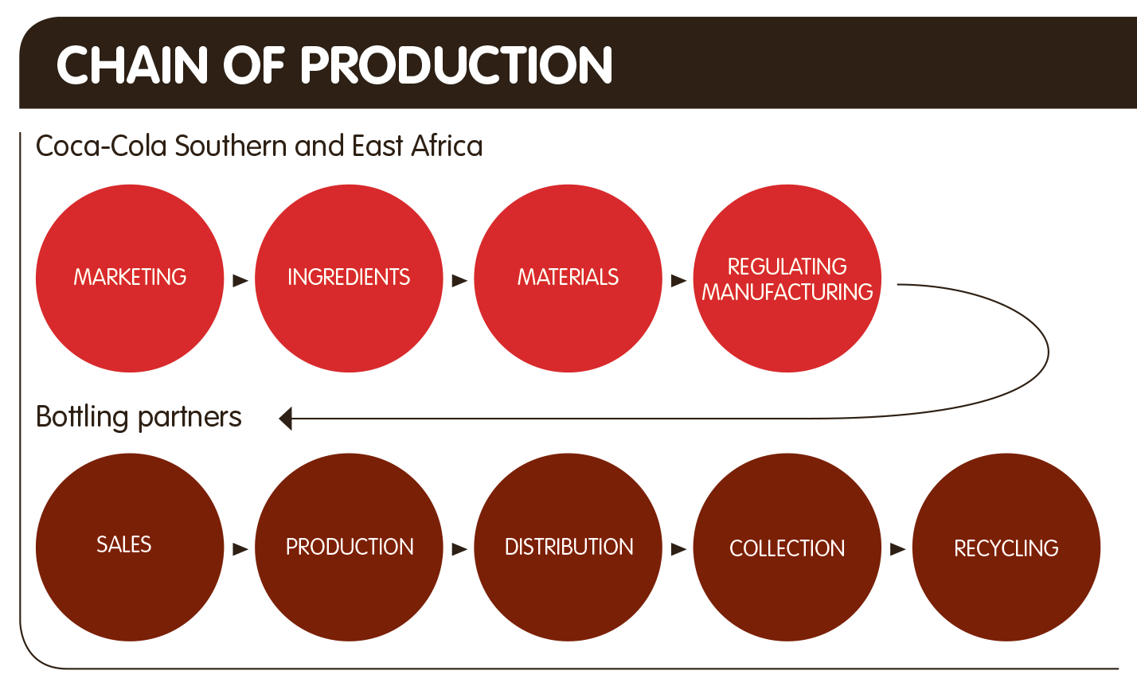
Where does CCBSA fit into the Coca-Cola system?
Coca-Cola Africa (PTY)
THE COCA-COLA COMPANY IS THE FRANCHISE HOLDER
CCBSA IS A SELLING AND DISTRIBUTING FRANCHISEE
Notes:
When it is alleged that ay TCCC globally has announced reduction of 10k jobs, that is the top part of the system
The bottlers make up the bottom part of the system
This is where jobs are created and are at risk (in sales, production and distribution

Slide 6
COCA-COLA BEVERAGES SOUTH AFRICA PUBLIC INTEREST COMMITMENTS

Slide 7
As a result of our recent merger, CCBSA has agreed to the following Public Interest Commitments:
R400 million fund for Supplier Development in the agricultural sector.
R400 million for developing downstream distributors and retailers
25 000 black retailers will receive skills training by 2020
Notes:
We are well on track to deliver these and we are submitting our first annual report by 9 June to the competition tribunal.

Slide 8
As a result of our recent merger, CCBSA has agreed to the following Public Interest Commitments:
20% sale of Appletiser to black investors - at 21.5%)
ensuring cooler space for smaller players
retaining jobs as at prior to the merger – 7489 till 2019
A broader CCBSA empowerment deal is currently in the design stage and will be concluded by 2020

Slide 9
COCA-COLA BEVERAGES SOUTH AFRICA’S Proposed Solution and Progress to date

Slide 10
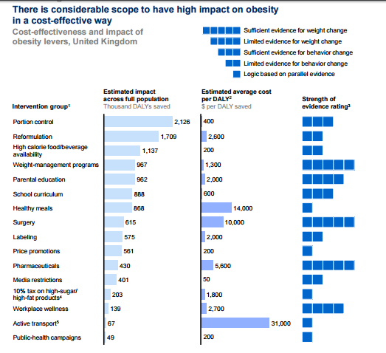
Obesity is a complex health and lifestyle challenge that require a multi-pronged approached. The Mckinsey Global Institute report on obesity (2014) indicates that portion control followed by reformulation are the most effective in reducing obesity. SSB Tax are not as effective.
*
8
*An initial economic analysis: Overcoming obesity: McKinsey Global Institute (GBI) November 2014
Notes:
McKinsey Global reports in addressing obesity states that:
needs to be a portfolio of interventions
Found that portion control is the most effective industry contribution, followed by reformulation of SSBs
Found that SSB taxes rank in the bottom quartile on their effectiveness
Some developed markets which introduced this type of tax are now reversing this, due to it’s failure to effectively address obesity (e.g. Finland and Denmark)

Slide 11
COCA-COLA BEVERAGES SOUTH AFRICA’S PROPOSED SOLUTIONS

Slide 12
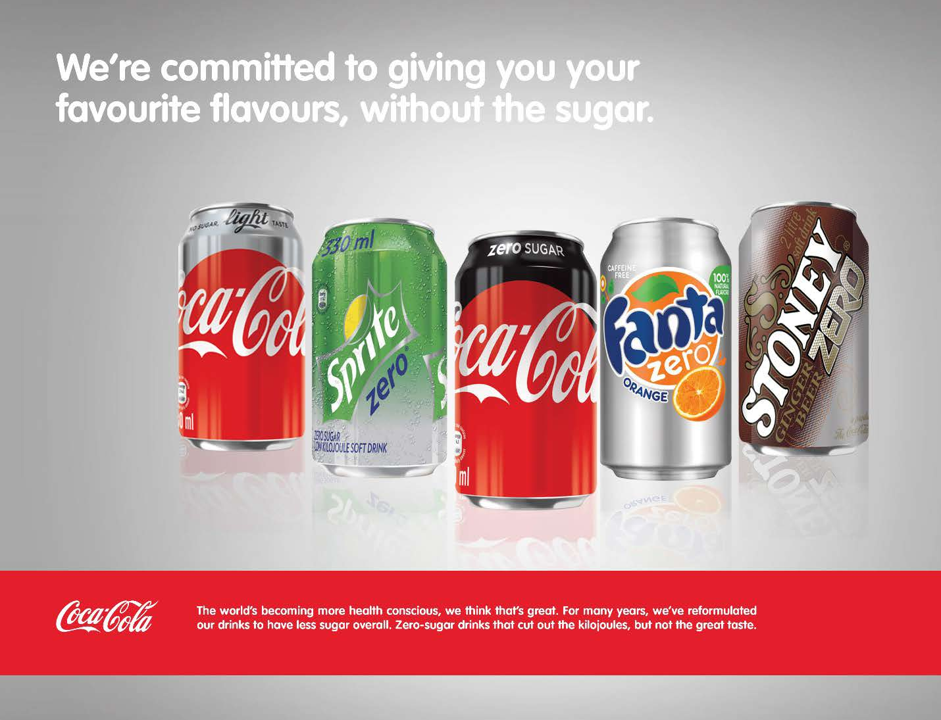
Drive overall change in social behaviour encouraging reduced consumption of sugar by increasing marketing of Diets, Lights and Zeroes
1
Increase zero offering in other various brands
Cheaper pricing for Diets, Lights, and Zeroes
Over indexing on merchanding of Diets, Lights and Zeroes in outlets
Notes:
Focus on the actual drinks we make and how we sweeten them – the things that go inside the bottle
Reformulation progress:
By March 2017 we reduced the sugar content in Fanta Orange and Fanta Grape by 20% and Stoney by 10%.
We will reduce sugar by between 10-70% in Sprite, Fanta Orange, Fanta Grape, Fanta Pineapple, Stoney, Sparletta, Twist, Schweppes Lemonade, Schweppes Dry Lemon, Schweppes Gingerale and Schweppes Tonic. This will be implemented between September and December 2017
Small Pack Conversion:
2.5 litre PET Coke discontinued (completed)
2.25 litre to 2 litre PET Coke and Core Flavours (May 2017)
500ml PET to 440ml PET (Aug 2017)
330ml PET to 300ml PET (Aug 2017)
Expansion of 1.5 litre PET as an alterative to 2L (June 2017)

Slide 13
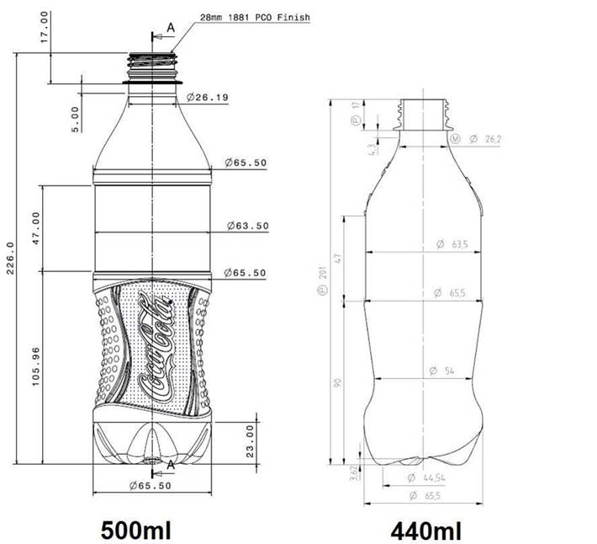
2
Drive overall change in social behaviour encouraging reduced consumption of sugar through promotion of portion control by introducing smaller packs
We continue to introduce numerous smaller pack sizes
2.5 litre PET Coke discontinued - completed
2.25 litre to 2 litre PET Coke and Core Flavours May 2017
500ml PET to 440ml PET - Aug 2017
330ml PET to 300ml PET - Aug 2017
Expansion of 1.5 litre PET

Slide 14
Coca-Cola system efforts will drive down average unit sugar content 22-24% by the end of 2018
3
Drive overall change in social behaviour encouraging reduced consumption of sugar through reformulation of our brands
97
Average added sugar content, g/Litre
94
~7-5
16%-18%
86-87
22%-24%
79-81
74-75
2014 Average
2016 Average
Further reductions due to Reformulation, DLZ* growth, Fruit juice, Water and other
2017 Average
End 2017 run rate
Annualised 2018

Slide 15
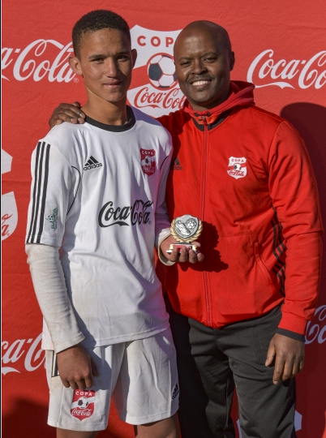
4
Increase percentage of the population engaging in physical activity
The Copa Coca-Cola Cup is over 10 years old
More than 300 000 youths participated in Coca-Cola funded sporting activities
Since 2014, we have been supporting the National Big Walk.
The event attracts over 16 000 participants in Pretoria annually
It’s aimed at promoting walking as a fun physical activity among the youth, women, and fami­lies
Notes:
We have always invested in sports:
Our wellbeing approach is designed to help address the public health challenge of obesity which affects our employees, stakeholders and community in generally.
We help get peo­ple moving by supporting physical activity programmes in every coun­try where we do business. For over 10 years, we have continued to sup­port physical activity programmes, especially those focusing on improv­ing the health of young people and creating awareness of the impor­tance of active healthy living.
More than 300 000 youths have participated in its sporting activities such as the Copa Coca-Cola (where Lucas Radebe began playing), as well as cricket and rugby.
Together with our bottling part­ners, Coca-Cola Beverages South Africa and Coca- Cola Peninsula Beverages, we also sup­port non-mainstream, family-orientated, active, healthy living programmes.
We support the Big Walk, which we host in partnership with the department of sport and recreation. The Big Walk promotes walking as a fun physical activity among the youth, women, and fami­lies. The event attracts over 16 000 participants in Pretoria each year since it was launched in 2015.
This however is not enough, it needs to be a nationally driven initiative with Department of Health and Sports
We are willing to partner nationally through BEVSA with government and health practitioners to increase awareness and education of our consumers

Slide 16
5
Support obesity prevention in early childhood
Primary Schools make up 4.6% of our volume
We have started with education of our Sales force to comply with TCCC Schools’ Beverage Guidelines
From July, we will offer only juice, water and zero products in Primary Schools we sell directly to.
We will start re-branding school boards to remove our products name. This will be concluded by October 2017
No marketing to school children (12 or younger) with replacement of primary school signage (by Oct. 2017)
Notes:
Why so slow:
Challenge is we are managing multiple stakeholders.
This element is linked more with our community development than with selling activities.
The boards are asked for by the schools, so we can’t just remove them. We first have to educate them and then take them out to rebrand and re-install.
We do not service all schools directly. Most schools actually buy from the market (wholesalers and not us) so we have to work with the rest of the trade to educate. This will take time.

Slide 17
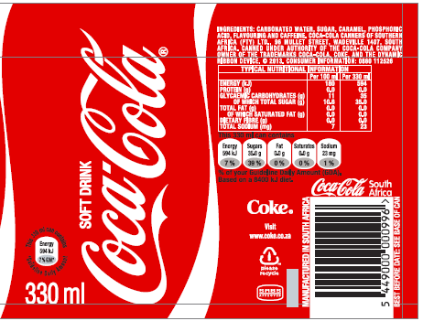
4
Driving education of healthy food choices
We are one of the first companies in SA to voluntarily put nutrition labelling over 8 years ago.
Since 2011, we have included Fact-based Guideline Daily Amount (GDA) Labelling
However, in the absence of a massive nationally led consumer education campaign Informing consumers about their sugar intake, this information is not easily understood.
We call upon the Department of Health to work with us to educate and inform our people

Slide 18
COCA-COLA BEVERAGES SOUTH AFRICA’S Our position on the proposed health levy and conclusion

Slide 19
CCBSA’s position on the proposed health levy
We question the effectiveness of SSB tax, aimed at singling out one food item in addressing this complex and challenging issue, at the risk of other critical socio-economic factors.
There’s a better way - We are asking government for an enabling regulatory framework and not punitive and regressive tax
Regulate amount of sugar in SSB’s per 100mls
Institute external and independent monitoring
Put a timeframe for execution and compliance
Introduce fiscal penalty for failure to comply

Slide 20
CCBSA’s position on the proposed health levy
Benefits of the proposed regulatory framework:
Manage free riders (those players that are not part of the industry body)
Drive collaborative, multi-stakeholder, multi-pronged solution that will bring about effective and sustainable health and economic solution
Will delivery higher impact in addressing drivers of obesity as stipulated by health
Without drastic impact on economic growth of beverage sector while sustaining employment

Slide 21
CONCLUSION
We acknowledge the challenges of obesity and are committed to be part of the solution
We undertake to fully implement our reformulation, portion control and expansion of diets, zeroes and lights.
As a franchised Coca-Cola bottler in SA, we operate locally, we source predominantly locally, we employ locally. We are committed to South Africa
We are confident that our approach will have greater health benefits than the proposed SSB tax, while providing economic opportunity, instead of economic risk

Slide 22
Thank you

