Slide 1
Integrated Financial Management System (IFMS) Programme Presentation to the Portfolio Committee (Public Service) 31 MAY 2017

Slide 2
Table of Contents
IFMS: Rationale
The IFMS vision and value proposition
Fit-for-Purpose: Human Capital Management and Payroll
Implementation Approach and Timeframes
Programme Governance and Recent Headlines

Slide 3
Rationale

Slide 4
What is an Integrated Financial Management System?
Automating resource management (HR, Finance, SCM) with a system that:
tracks events and summarizes information;
supports adequate management reporting, policy decisions, fiduciary responsibilities, and preparation of auditable financial statements; and
should be designed with good relationships between software, hardware, personnel, procedures, controls and data.

Slide 5
The IFMS Value Proposition
Moving towards managing resources for performance
Bringing government to the digital age
Changing antiquated processes
Finding smarter ways to simplify processes and minimise resources to routine processes
Allocating and tracking resource usage towards strategic ends
It is not only about leveraging on available technology – can we really survive without it?

Slide 6
Using Technology for Strategic Ends - What are the Possibilities?
To allow officials to transact remotely – whether applying for leave directly on the system, obtaining reports from mobile devices, etc.
To contribute to more informed decision-making by presenting data from several perspectives. Applying big data techniques in the future could render varying perspectives on a range of issues, when considering financial and non-financial data from various sources.
Render business processes more efficient - for example, validation of information held centrally could be done electronically. Examples range from referencing of tax clearance certificates, confirming identity numbers with Home Affairs and determining the extent to which specific vendors engage with government.
Automation of business processes will increase efficiency, reduce cost and improve data quality.
To allow suppliers to engage directly with government – through self registration on central supplier database and the electronic tendering portal

Slide 7
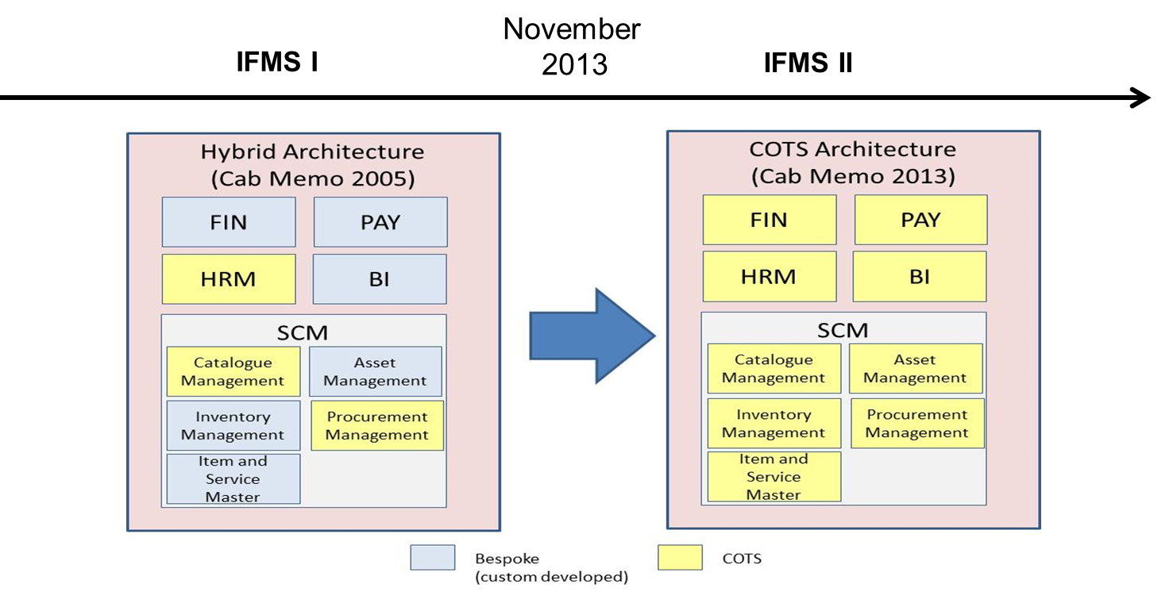
Original vs. Revised Solution Architecture

Slide 8
IFMS 2 A Business-led Modernisation
Identification of affected FM and HR policies and legislative requirements
Mapping of key processes
Comparing the differences, quantifying the change
Consulting and concluding the extent of changes, with training programmes being designed and deployed
Organisational Readiness:
People and Processes
Systems Development and Rollout
Technical Readiness:
Hardware, hosting infrastructure, etc.
Completion of procurement processes, systems configuration and piloting
Concluding sequencing for rollout
Deploying system and scaling up maintenance teams as required
Verification of hardware and hosting infrastructure environment in relation to requirements of a new system
Assisting with specification and timing of procurement and skills acquisition, where necessary
This is a business change, not simply a systems implementation

Slide 9
Fit-for-Purpose:
Human Capital Management and Payroll

Slide 10
Business Applications Fit to Business Process Documents – Level 4 (un-weighted)
Human Capital
Management
Payroll
SCM
Financial
Management

Slide 11
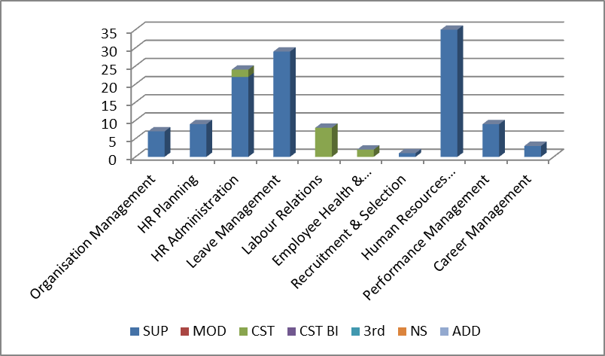
Human Capital Management Fit to Business Process Documents – Level 4 (unweighted)
Top 5 features:
Employees can request leave on mobile devices
Job seeker can apply and submit CV on-line via internet into the system
HR analytics across levels, groups, departments, geographical areas, demographics etc.
Common competence framework
Support on-line learning paths and training
Number of processes
Key:
SUP – Fully supported with no customisation but with some configuration
CST – Requires customisation of ERP’s standard functionality
FUT – Will only be supported in a future software release
NS – Not supported
ADD – Additional modules necessary for enhanced fit

Slide 12
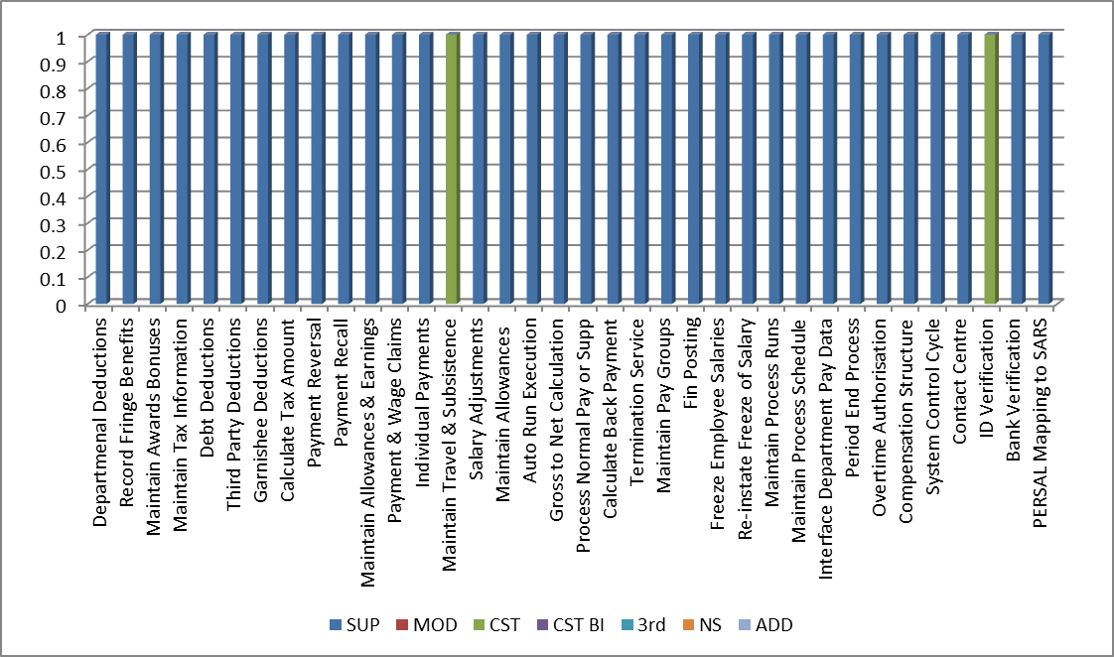
Payroll Fit to Business Process Documents – Level 4 (unweighted)
Top 5 features:
Employees can update their own personal detail
On-line electronic payslips
“What if” modelling to see effect of changes before it is applied
Continuous calculation
Contingency worker/s linked to services supplier in SCM
Number of processes
Key:
SUP – Fully supported with no customisation but with some configuration
CST – Requires customisation of ERP’s standard functionality
FUT – Will only be supported in a future software release
NS – Not supported
ADD – Additional modules necessary for enhanced fit

Slide 13
Implementation Approach
And
Timeframes

Slide 14
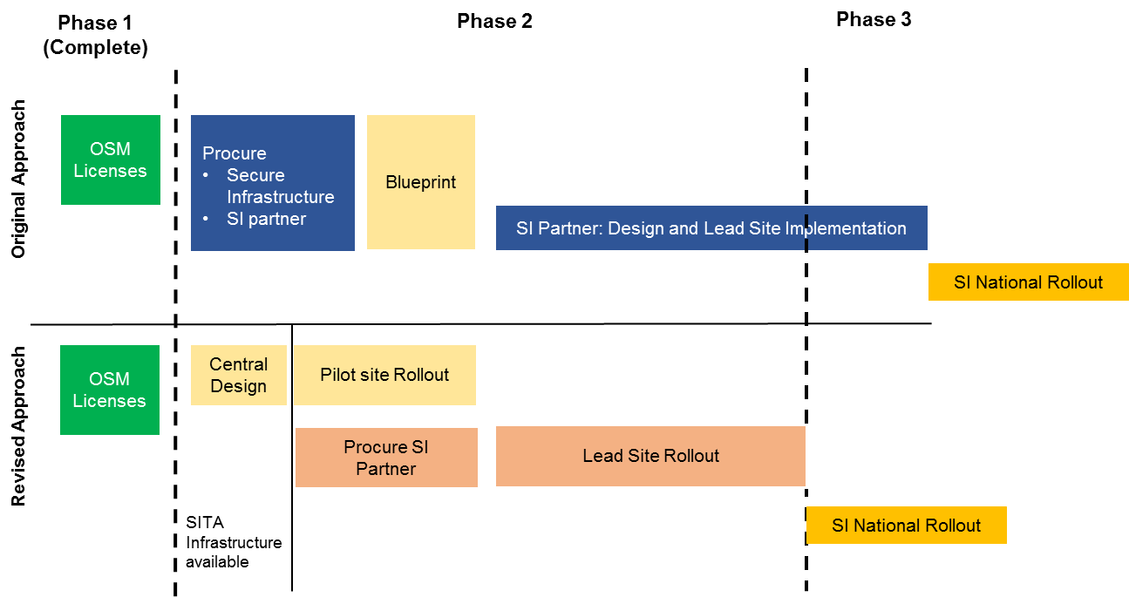
Revised Implementation Approach Central Design

Slide 15
Revised Implementation Approach Pilot Implementations

Slide 16
Approach to the development of the Generic Template
GAP Analysis
TO-BE
Architecture
Generic Template (GT)
Business
Requirements
(FIN, SCM, HR, PAYROLL)
TO-BE BPD
(Level 1-7)
System
Requirements
Oracle and other Leading
Practices
TO-BE System Requirements
Cabinet endorsement to be upheld:
Tier 1, wall-to-wall, vanilla, COTS ERP

Slide 17
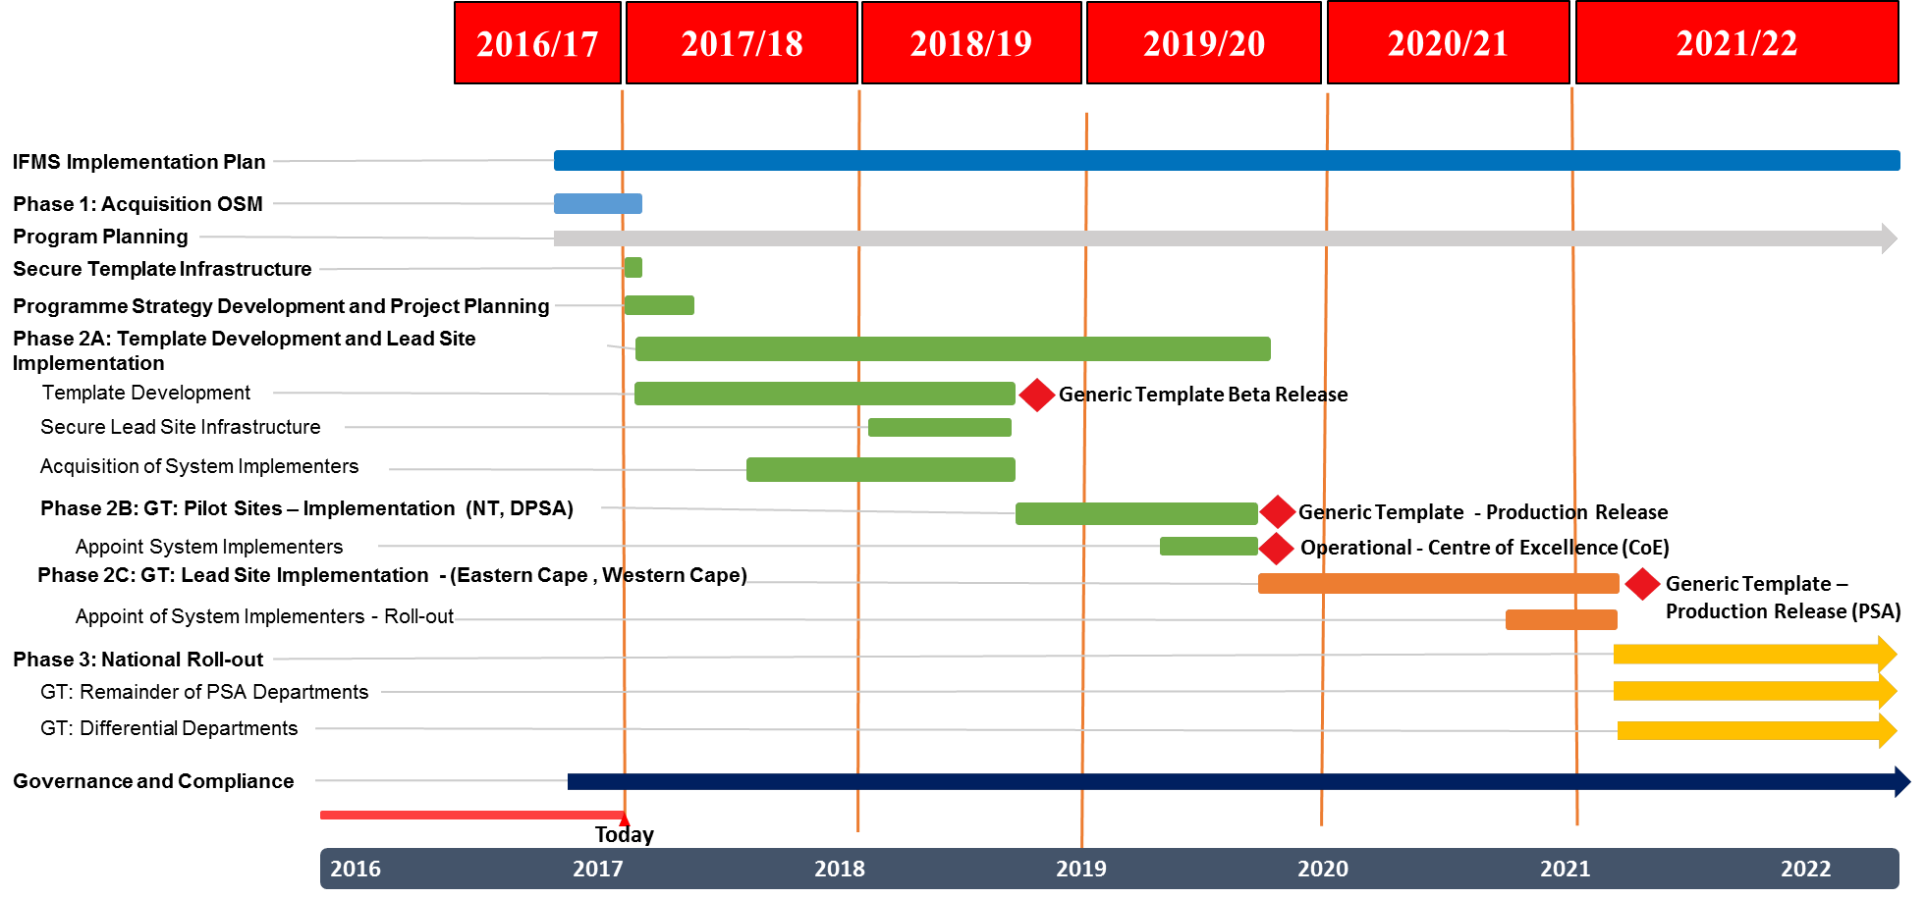
Baseline Plan – IFMS Phase 2
Configuration, piloting and lead site implementation
1451.4 days
94.7 days
89.4 days
18.7 days
816.4 days
239.4 days
129.4 days
278.4 days
119.4 days
229.4 days
119.4 days
587.4 days
539.4 days
539.4 days
1432.4 days
2016

Slide 18
Implementation Approach – Phase 2 For approval by the IFMS Steering Committee
Phase 1 - Completed with contractual agreement with Oracle (software only)
Phase 2 - Focuses on the development of the Generic Template (GT), and its implementation in Pilot and Lead sites:
2A: Design and Template Development → 12 Months, ending May 2018
Planning, scope, objectives and approach;
Securing architecture and design services,
Procurement of implementation services and hosting infrastructure;
Develop Generic Template solution baseline;
Policy owners and assigned business representatives to participate in GT design phases to be as inclusive as possible.
2B: Pilot Site Implementation → 12 Months, ending May 2019
Refine and implement GT at Pilot Sites (DPSA and NT);
Establish the Centre of Excellence (CoE) including capacitation for support, maintenance, training, etc.
2C: Lead Site Implementation → 18 Months, ending December 2020
Further Refinement of GT at Lead Sites (Eastern Cape and Western Cape).

Slide 19
Implementation Approach – Phase 3 For approval by the IFMS Steering Committee
Phase 3 – National Roll-out
Planning for Phase 3 will be done at a later stage - dependent on strategy and resourcing.
Standard departments (Generic Template)
Standardised roll-out of generic template to departments. Additional requirements to be considered through a formal change process.
Differentiated departments (E.g. DOD, SAPS, Education and Health)
The implementation and hosting approach for the differentiated departments to be clarified.
Generic Template will be expanded to accommodate the differentiated departments’ legislative requirements, culminating into a revision of the Generic Template ,
Generic Template will be locked down and formal change management processes will be put in place

Slide 20
Programme Governance
And
Recent Headlines

Slide 21
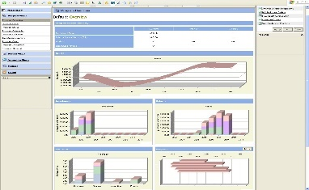
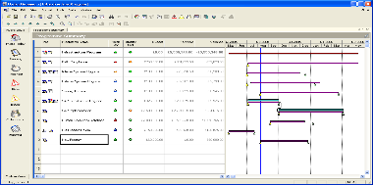
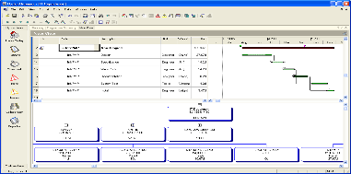
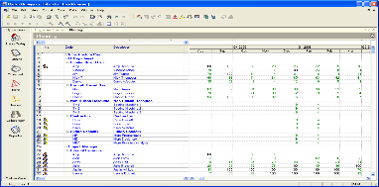
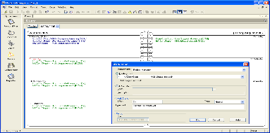
Programme Management Office
Role and broad functions
Knowledge
Management
Portfolio
Management
Management
Information
Program Delivery
& Control
Exception
Management

Slide 22
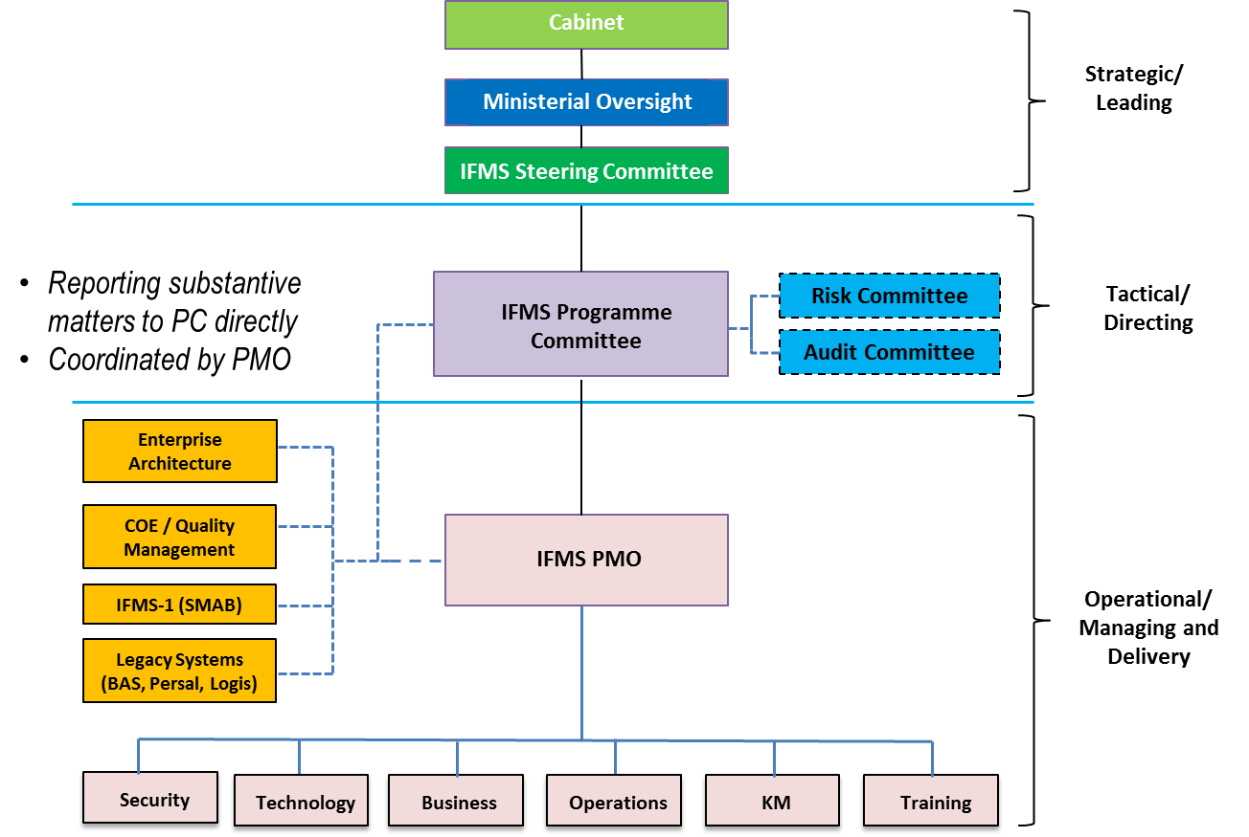
IFMS Governance Structure

Slide 23
IT Governance Maturity Model
Initial
Acquisition of project managers
Stable
Planning
Defined
PM methodology
Managed
Incorporated
Tracking
Schedule management
Progress reporting
Change management
Risk/issue management
Programme process management
Project integration management
CRM
Value management
Business continuity planning
PM Centre of excellence
1
2
3
4
5
2014/2015
2015/2016
2016/2017
Internal review
Recent Headlines (May 2017, Broad Messages):
Lapse in program governance
Questionable procurement practices
No value for money derived from funds spent

Slide 24
Thank You

