Slide 1
PROGRESS IN IMPLEMENTING e-GOVERNANCE
23 May 2017
DPSA

Slide 2
PRESENTATION OUTLINE
INTRODUCTION
GENERAL ICT WEAKNESSES
E-GOVERNANCE WEAKNESSES
E-GOVERNANCE OF ICT
IMPLEMENTATION APPROACH
DPSA E-GOVERNANCE RESPONSIBILITIES
IMPLEMENTATION PROGRESS MPAT
IMPLEMENTATION PROGRESS AGSA
E-GOVERNANCE CHALLENGES

Slide 3
INTRODUCTION
Departments (national and provincial) are heavily reliant on electronic information systems to perform their duties as per their respective mandates and their reporting and administrative functions
These information systems enable the automation of business processes and transaction processing, which contributes significantly to efficient service delivery of the departments
Therefore the information processed and stored on these systems are regarded as a strategic asset crucial to the achievement of service delivery planning, monitoring and reporting
E-Governance is implemented through the Corporate Governance ICT Policy Framework

Slide 4
GENERAL ICT WEAKNESSES
Ineffective information system controls may contribute to:
Financial management weaknesses
Inaccurate financial and performance information
fruitless and wasteful expenditure, fraud
Poor performance of the entity
Non-compliance with applicable laws and regulations

Slide 5
E-GOVERNANCE WEAKNESSES
Weaknesses identified in the e-Governance space were inter alia:
Heads of departments not taking responsibility for ICT
Not clear ownership, roles and responsibilities
Lack of structures, policies and procedures
Not sufficient ICT capacity and competence within departments and a lack of independent measurement and monitoring

Slide 6
E-GOVERNANCE OF ICT
The DPSA, in collaboration with the Government Information Technology Council (GITOC) and the AG, developed the government-wide Corporate Governance of ICT Policy Framework (CGICTPF)
This CGICTPF was adopted by Cabinet on 22 November 2012
Cabinet extended the scope of the CGICTPF to all the Public Administration institutions, as defined in Section 195 of the Constitution namely national, provincial and local government, Organs of State and Public Entities
The MPSA issued the CGICTPF, Implementation Guideline and Assessment Standard per directive on 19 December 2012
The CGICTPF established an accountability framework for the strategic leadership of a department

Slide 7
IMPLEMENTATION APPROACH
The CGICTPF required of departments to follow a three-phased implementation approach:
Phase 1, by March 2014, an enabling environment must be created where departmental CGICTPF should be integrated with overall departmental governance to facilitate alignment of ICT with business activities
During Phase 2, March 2015 business and ICT strategic alignment must be achieved
Phase 3, April 2015 onwards, continuous improvement through an iterative process

Slide 8
DPSA e-GOVERNANCE RESPONSIBILITIES
It is the responsibility of the DPSA to support the more than 500 institutions with the implementation of e-Governance (Corporate Governance of ICT) in their respective environments. It is expected of the DPSA (GCIO) to:
Create multi-layer awareness from executive level up to ICT management level
Maintain prescriptive environment on e-Governance (CGICT)
Development and deployment of guidelines and enabling mechanisms to support policy implementation
Advise and assist the Public Administration institutions with the implementation of e-Governance (CGICT)

Slide 9
DPSA e-GOVERNANCE RESPONSIBILITIES (Cont.)
Provide technical expertise on CGICT, business and ICT alignment, ICT planning in accordance with the Framework and the 2016 Public Service Regulations and other related policy matters.
The DPSA conducted awareness training to more than 2000 persons from:
National departments, provinces, municipalities, public entities and industry, from HoD and audit committee to IT management level.
Other institutions/forums such as Road Accident Fund, Setas/Pseta, SITA, CCMA, National Risk Management Forum, San Parks, the AG, industry, SASSA etc.

Slide 10
IMPLEMENTATION PROGRESS DPME
The implementation of e-Governance (CGICT) is monitored by DPME (MPAT) since 2013
The areas that are assessed are:
The implementation of departmental CGICT policy frameworks, which must be aligned to the government-wide are CGICTPF, explaining the CGICT system, principles and practices of the departmental executives
The CGICT Charter, explaining the accountability structures, roles and responsibilities
ICT planning (ICT Plan, Implementation and operational plan) as per the PSR requirements
Compliance increased from an average maturity level of 1,3 in 2013 to 3 in 2016.
There are still departments and provinces that is performing below the desirable level 3 maturity

Slide 11
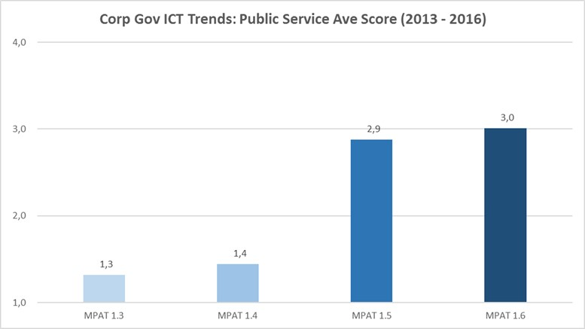
IMPLEMENTATION PROGRESS MPAT (DPME: 2017)

Slide 12
IMPLEMENTATION PROGRESS AGSA
The AG assessed IT controls at 433 national and provincial auditees and found that the number of auditees that were assessed as good increased significantly from 13% in 2013-14 to 29% in 2015-16 and auditees that required intervention declined from 21% to 16%.
However, at 55%, the auditees that are of concern still needs attention. Thus leaving 71% (55% + 16%) of the auditees needing attention.

Slide 13
IMPLEMENTATION PROGRESS AGSA (Cont.)

Slide 14
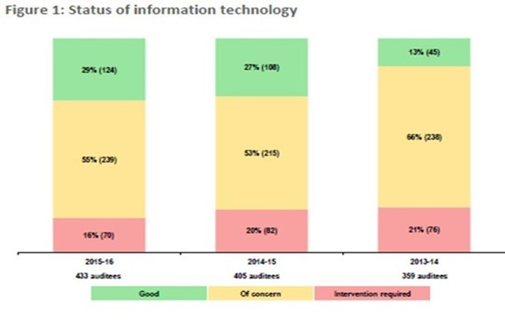
IMPLEMENTATION PROGRESS AGSA (Cont.)

Slide 15
E-GOVERNANCE CHALLENGES
Most departments adopted the framework for corporate governance of ICT developed by the DPSA without customising it for their own departmental environments
The chief information officers, ICT managers and ICT staff did not fulfil their responsibilities by ensuring compliance with the controls established to secure and regulate their departments’ ICT environments, due to a lack of consequence management
The accounting officers and accounting authorities did not prioritise approval of ICT policies and procedures to ensure that proper internal controls exist and can be enforced

