Slide 1
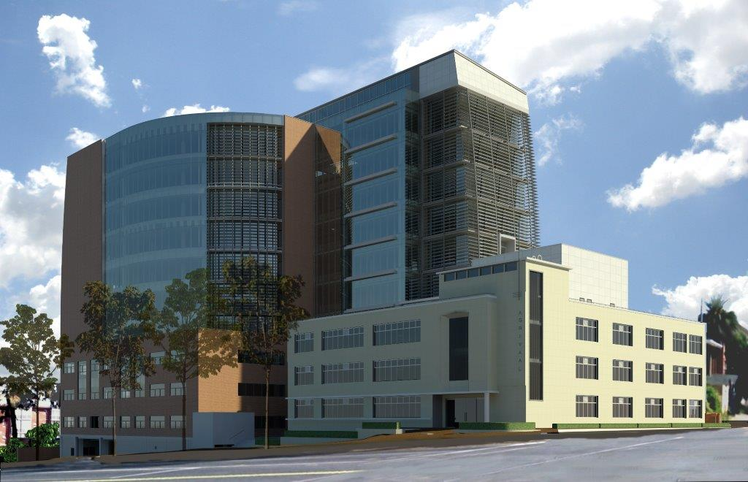


24 MAY 2017
PORTFOLIO COMMITTEE ON PUBLIC SERVICE AND ADMINISTRATION, PERFORMANCE, MONITORING AND EVALUATION
Progress with Research: National Coordination, Institutional and Funding Options
Committee Room 3
Ground Floor,
Plein Street Building
Parliament

Slide 2










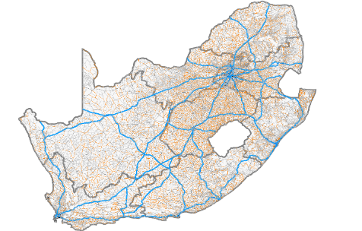
OVERVIEW OF RESEARCH: THUSONG CENTRES
Introduction and Background
Functions of NCC
Introduction
Functions of NCC
PROPOSED SERVICE DELIVERY MODEL
Proposed Service Delivery Model
Institutional Options
Institutional Options
FUNDING MODEL
Funding Model
Recommendations and Way Forward
RECOMMENDATIONS AND WAYFORWARD

Slide 3



PARTICIPANTS
Communications is the current custodians of the national co-ordination functions and business plan
Must provide funding according to affordability
Provided support for funding model
Responsible for Infrastructure Planning of State Buildings

Slide 4
Background
Functional responsibility for national co-ordination function of the Thusong Programme is the Department of Gov Communication and Information Services (GCIS).
Cabinet mandated an Inter-departmental Steering Committee (DPSA, GCIS, NT, CoG, DPW, DPME) with the responsibility of contributing toward the repositioning of the Thusong Service Centre Programme.
Numerous projects completed and critical projects focused on:
  developing a business case containing evidence-based recommendations on most suitable institutional & governance arrangements for oversight & coordination of Thusong programme at national level.
  Funding options including a funding model for the Programme & Centres.
DPSA, together with the GCIS, the NT and CoG partnered with GTAC to analyse current situation & to make recommendations on institutional options including funding options.
Draft reports completed, tabled at Cabinet and will be undergoing consultations at Ministerial level.

Slide 5


2016 PROPOSAL FOR OPTIMUM PROVISIONING OF THUSONGS & CLUSTERS NATIONALLY
Thusong
Service
Clusters/
Grouped Service Points
165
Proposed Locations
67
Thusong
Service
Centres
178
Notes:
Of the existing centres worth noting that
25 centres/clusters serve a population that is far greater than the capacity norms of departments- this includes the centres in the CBD of Johannesburg and Pretoria, Alexandra and Mamelodi. Serve population catchments 500 000 (mostly in metro areas). May have problems in dealing with demand
49 serve a population catchment of less than 20 000 people (sparely rural areas with low population counts). Could consider making it periodic service point
Proposed 67 locations- should be noted that
In only 25 cases are new TSC proposed
In 42 instances a cluster is proposed, where there are already some departments present, but it is not a complete cluster. By adding departments, clusters could be established. Could provide cost saving and greater convenience
11 Local municipalities that did not have a TSC will benefit from a TSC
Remainder will receive services from centres in adjacent municipalities and the deployment of satellite offices and mobiles could address the need

Slide 6





THUSONG SERVICE CENTRE MODEL TYPOLOGY
1
Metro
300 000
People
Large
200 000
People
Small
60 000
People
Thusong Service
Centre
2
3
4
5
Thusong
Service
Cluster
Satellite
Service
Centre
(10 000 to 20 000 People)
Mobile
Service
Centre
(2 000 to 10 000 People)
Outreach Projects
(Less than 2 000 People)
Notes:
Capacity constraints - linked to the size of the centre (population thresholds) for different types and sizes of centres
Capacity constraints informed by access standards of departments and the results of the as-is analysis
What is a Thusong SC- the normal traditional Thusongs service centre- brick and mortar building where a number of department provide service under one roof.
What is a Cluster-these are virtual thusong service centres and consists of a grouping of 3 of the 4 participating departments in vey close proximity to each other. These virtual Thusongs provide the basic backbone to assess the synergy between departments.
The distance standards to determine proximity 1-2 km

Slide 7
Repositioning Strategy
National Co-ordination Function
Setting norms and standards for maximum distance to be travelled by citizens and minimum norms and standards for service delivery.
Coordination, and deployment of mobile units of different departments
Use of Geographic Information Systems (GIS) to develop service delivery spatial maps to be used for aligning services and ensuring that service access points are spatially logical.
Promoting Thusong centres as platforms of direct interactive communication between all three spheres of government and citizens, in the spirit of participatory democracy.
Development of a funding model under the guidance of the National Treasury, DPSA, GCIS.
Continuous monitoring of service delivery by service providers and coordinating departments.
Write up the Maponya Mall experience & capture lessons learnt & develop an establishment and management blueprint.

Slide 8
Repositioning of the Thusong Service Centre Programme: The Road Map
PHASE 1
Feasibility Study: Options
Consultations
Cabinet decision on Location of the National Coordination Function
Funding Model Research conducted
PHASE 2
Cabinet decision & implementation commenced
Institutionalisation of the function (structure, capacity, policy , systems & procedures, legal enabler, Business plan 2030, governance arrangements across three spheres)
PHASE 3
Coordination of the function
Legal framework S18 PAM Act, 2014
Governance & Coordination structures
Business Plan including Funding Model

Slide 9
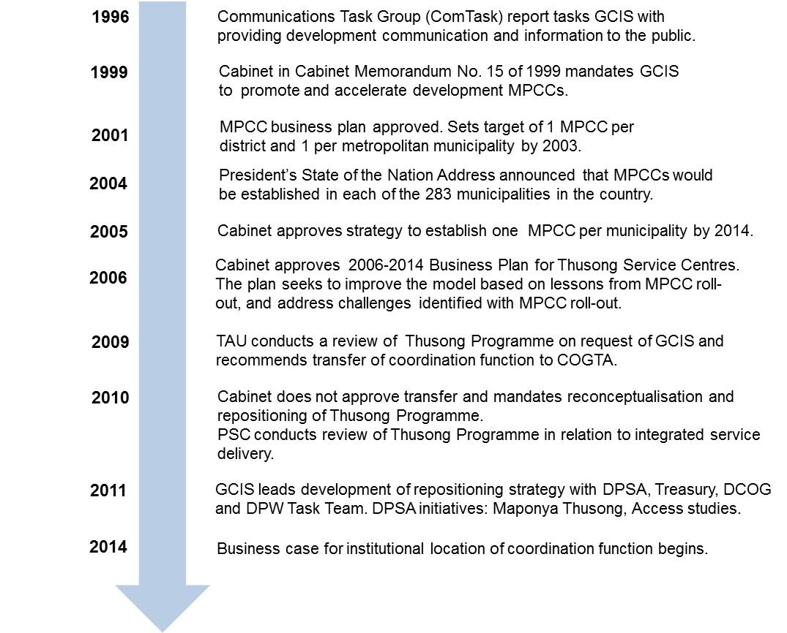
Evolution of Thusong Programme
Current reality of programme needs to be understood against its history:

Slide 10
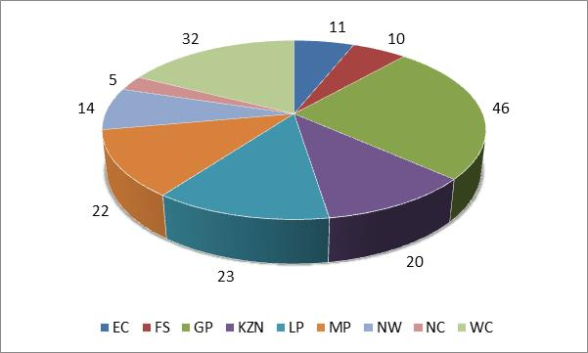
Assessment of State as at 2015/16
As at 2015/16, there were 183 Thusong centres that were established across the
country.
They are at varying levels of maturity.

Slide 11
Gap Assessment
Critical Success Factors for Governance of Thusongs
Regulatory framework | A regulatory framework serves as the foundation for coordination, funding and operations of the programme.
Clear accountability | A single institution must be responsible for the overall coordination of the programme.
Clear mandate | The mandate to carry out the national coordination function must be unambiguous, and must be backed up by the financial and human resources, as well as systems to carry out the coordination function.
Dispute resolution mechanisms | Mechanisms for dispute resolution should be in place at all levels of the programme. The protocols for dispute resolution should be communicated to all partners.
Sound planning for government services | Planning must be done from the perspective of citizens, taking into account national, provincial and local spatial planning framework.
Funding model | The funding model must support the operation of the programme, and must be established upfront.
Infrastructure | Infrastructure that is fit for purpose and reliable ICT are essential enablers for service delivery.
Organisational culture | The organisational culture should be one that supports an intergovernmental programme. This includes cooperative behaviour, flexibility, innovation, a focus on performance and outcomes.
Political support | An intergovernmental programme requires strong support from political principals in all three spheres of government.

Slide 12
Financial Analysis Study
The general objectives of the project:
To determine the past and present revenue and expenditure of a sample of Thusong Service Centres across South Africa’s nine provinces, and based on this, to project the possible future funding shortfall for all 183 Thusong Service Centres.
To obtain an indication of the past and present costs being incurred by a sample of service delivery departments when providing services at Thusong Service Centres and any future funding shortfalls they may experience to this end.
To develop options and make a recommendation on future funding mechanisms for the Thusong Service Centres, taking into account the above financial analysis and projections.

Slide 13
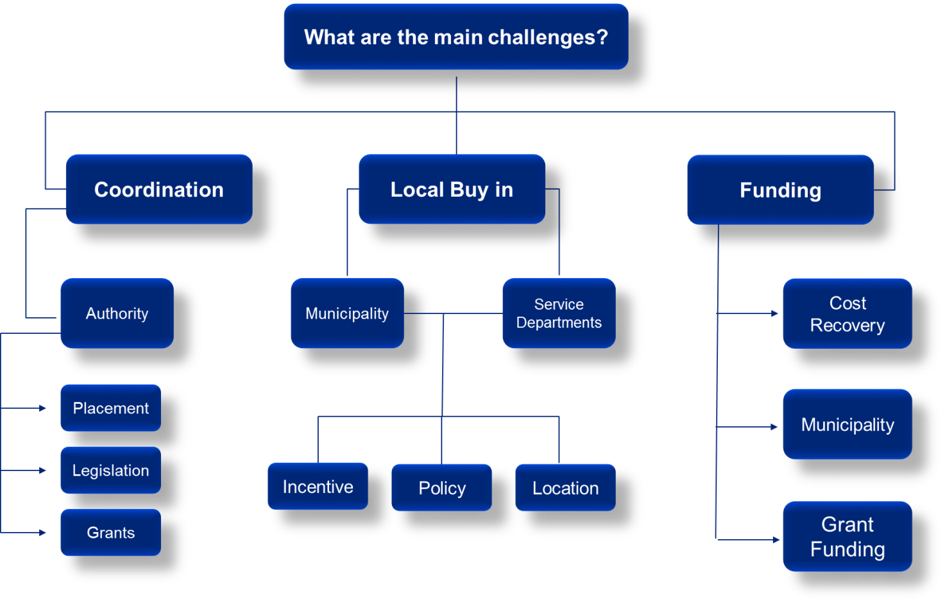
Funding Option Analysis
Three funding options were identified against the background of what we understand to be the main challenges experienced by the Thusong programme at present:

Slide 14
Coordination | Local Buy In | Funding
Co-ordination at provincial level is with OTP (6) or CoG (3). Lack of authority given to coordinating provincial departments. Placement of the coordinating department impacts on the success of the Programme with provincial COGTA experiencing greater success in communicating with municipalities and achieving greater functionality. Coordinating departments that are in a financial position to offer Thusong grants to local municipalities generally have more authority. There is no policy or legislation that exists that defines the role of the coordinating departments except for the 2014 Business Plan. | Lack of buy in from some local municipalities and service delivery departments. Incentivising local municipalities may encourage their active involvement. Grants awarded to local municipalities that adhere to certain criteria set by the coordinating department. There is no legal requirement for local municipalities to allocate funds towards the sustainability of Thusongs. Solution to these challenges would be the integration of applicable basic municipal services with the Thusong Service Centres service offerings. | Lack of adequate funding for the operations. Minimal cost recovery mechanisms. Inability of poorer municipalities to support the Thusongs Minimal grant funding from coordinating departments. Service delivery departments must contribute toward the operational costs. Lease agreements and service level agreements are critical in ensuring all departments contribute. In the absence of cost recoveries, the financial strain of operating these centres are placed on the local municipalities.

Slide 15
Desired Funding State
The sources of expenditure are classified as follows:
  Operational Expenditure derived from financial data received from the Thusong Service Centres and projected forward using the small, medium and large centre classification
  Capital Expenditure was estimated based on the small, medium and large classification for each centre.
The report contains a gap analysis for each province and recommendations for each province to reach the desired state.
The most common themes for all provinces are signed lease agreements and maintenance issues that need to be resolved.
An Income Statement was derived which takes into account the most minimal expenses that each Thusong Service Centre should incur to bring them to a desired state. These figures were then rolled up to all Thusong Service Centres and aggregated to a national level.

Slide 16
National Level – Ideal Total Cost
 | 2015 | 2016 | 2017 | 2018 | 2019 | 2020 | 2021
Operating Expenses | R 412 671 655 | R 441 338 172 | R 472 037 178 | R 504 915 622 | R 540 131 269 | R 577 853 512 | R 618 264 239
Salaries | R 195 310 909 | R 210 935 782 | R 227 810 644 | R 246 035 496 | R 265 718 336 | R 286 975 803 | R 309 933 867
Maintenance | R 13 142 727 | R 13 931 291 | R 14 767 168 | R 15 653 198 | R 16 592 391 | R 17 587 934 | R 18 643 210
Utlilities | R 22 625 455 | R 23 982 982 | R 25 421 961 | R 26 947 278 | R 28 564 116 | R 30 277 962 | R 32 094 639
Consumables | R 6 649 000 | R 7 047 940 | R 7 470 816 | R 7 919 065 | R 8 394 209 | R 8 897 862 | R 9 431 733
Cleaning materials & cleaning services | R 18 771 364 | R 19 897 645 | R 21 091 504 | R 22 356 994 | R 23 698 413 | R 25 120 319 | R 26 627 538
Training | R 2 578 636 | R 2 733 355 | R 2 897 356 | R 3 071 197 | R 3 255 468 | R 3 450 797 | R 3 657 845
Security | R 114 058 909 | R 120 902 444 | R 128 156 590 | R 135 845 986 | R 143 996 745 | R 152 636 550 | R 161 794 743
Communications/ Branding | R 2 812 655 | R 2 981 414 | R 3 160 299 | R 3 349 917 | R 3 550 911 | R 3 763 966 | R 3 989 804
ICT | R 30 677 455 | R 32 518 102 | R 34 469 188 | R 36 537 339 | R 38 729 579 | R 41 053 355 | R 43 516 556
Sundry | R 6 044 545 | R 6 407 218 | R 6 791 651 | R 7 199 150 | R 7 631 100 | R 8 088 966 | R 8 574 303
Service Department Cost | R 978 669 859 | R 1 046 179 042 | R 1 118 441 894 | R 1 195 799 887 | R 1 278 619 478 | R 1 367 293 972 | R 1 462 245 521
Total Cost | R 1 391 341 514 | R 1 487 517 214 | R 1 590 479 072 | R 1 700 715 509 | R 1 818 750 747 | R 1 945 147 484 | R 2 080 509 760
Ideal Capital Expenditure: National
Capital Expenditure |  | R 0 | R 78 111 873 | R 0 | R 0 | R 33 146 456 | R 0 | R 25 299 585
Regular capital funding |  | R 0 | R 27 057 382 | R 0 | R 0 | R 33 146 456 | R 0 | R 25 299 585
Once off capital expenditure |  |  | R 51 054 490.68
Expenditure for the year |  | R 0 | R 78 111 873 | R 0 | R 0 | R 33 146 456 | R 0 | R 25 299 585

Slide 17
Funding Options analysis
Option 1: Cost recovery supplemented by grant funding in perpetuity.
  This option allows for an 80% cost recovery in large and medium centres, and a 60% recovery in small centres.
  The funding shortfall is then supplemented by grant support from a national level on an ongoing basis.
Option 2: Cost recovery supplemented by grant funding for an initial period of 3 years.
  This option assumes cost recovery levels of 70%, 80% and 90% in years 1, 2 and 3 respectively, across all centres.
  The shortfall will be funded in the form of grant support from a national level.
  Following year 3, this funding arrangement will go under review, with the objective of achieving cost recoveries closer to 100%.
Option 3: “Top Slicing”.
  Service departments are levied at national level for their occupancy at Thusong centres across the country.
  The funding derived from the levies is then distributed to local municipalities and earmarked for the Thusong program.

Slide 18
Options: Pros & Cons
NO | ADVANTAGE | DISADVANTAGE
1 | Potential to reach 100% cost recovery in the long term through cost cutting, local economic stimulation or additional support from service departments. Most provinces are looking towards a cost-recovery model (similar to Maponya), and may regard this option as the natural progression towards this. | There is no incentive for centres to move to 100% cost recovery in the long term if grant funding is perpetual. Currently there is approximately 27% cost recovery implemented on a national scale. This needs to triple to reach the 76% required.
2 | Increased incentive for centres to move to 100% cost recovery model in the long term if grant funding is reduced over time. Some proof of concept exists already. The out role of this system is a natural step for most provinces, especially at its inception. As in most provinces strategic emphasis is placed on the collection of rental and the signing of lease agreements and service level agreements. | Currently there is approximately 27% cost recovery implemented on a national scale. To increase this to the eventual 100% required necessitates a quadrupling of the level of the current cost recovery level.
3 | It is easier to administer the program at a centre level. | It is not yet tested within a Thusong context and thus poses additional risk It is complex in terms of determining the correct level of top slicing required on a National Scale as each centre grows at a different rate and many cross subsidies exist. It does not account for the costs incurred by the NGOs operating at the centres.

Slide 19
Provincial level – Situational Analysis
Province | Province Overview | INCOME | CAPEX |  | OPEX
 | Co-coordinating Department | Rental Income | MIG Avail-ability | Infrastructure, ICT and Equipment | Salaries | Water and Electricity | Maintenance | Stationery and Cleaning Materials
Gauteng | OTP | Some | Yes | DPSA, SITA and Municipality | DPSA Municipality | DPSA. Municipality | DPSA. Municipality | DPSA. Municipality
Free State | OTP | None | Yes | Nat. DPW. DPSA, SITA | Office of the Premier | Office of the premier & Municipality | National DPW & Municipality | Office of the Premier
Mpumalanga | COGTA | Some | Yes | Municipality, Private, DPSA and SITA | COGTA & Municipality | Municipality | Municipality | COGTA or Municipality
North West | OTP | None | Yes | Municipality DPSA and SITA | Municipality | Municipality | Municipality | Municipality
Eastern Cape | OTP | Some | Yes | DPW Municipality, DPSA and SITA | Municipality | Municipality | DPW | Rental funds
KwaZulu-Natal | COGTA | Some | Yes | Municipality, COGTA,DPSA and SITA | Municipality COGTA | Municipality and COGTA | Municipality and COGTA | Municipality and COGTA
Limpopo | OTP | Some | Yes | Municipality, OTP, DPSA. SITA and Private | Municipality | Municipality | Municipality | Municipality
Northern Cape | OTP | None | Yes | OTP , DPSA, SITA and municipality | OTP and Municipality | OTP and Municipality | OTP and Municipality | OTP and Municipality
Western Cape | COGTA | Some | Yes | Municipality, DPSA and SITA | Municipality and COGTA | Municipality and COGTA | Municipality and COGTA | Municipality and COGTA

Slide 20
National Co-ordination Institutional Options
Principles | Options | Considerations
Principle 1: National coordinating institution should have mandate & capacity to carry out the range of functions identified. | 1. Retain status quo & strengthen existing unit in GCIS. | GCIS’s mandate is on communication and not service delivery.
Principle 2: National coordinating institution should have the authority & capacity to resolve the challenges identified in the situational analysis. | 2. Relocate function to another dept. | Consideration was given to national departments that form part of the “centre of government” incl DPSA & CoGTA.
Principle 3: National coordinating institution should have a footprint that facilitates its engagement with other spheres of government involved in the Thusong Programme. | 3. Establish function as a govt component. | The current size of the Programme does not warrant the establishment of a separate organisation.
Principle 4: Given the IGR nature of Thusong Programme, the national coordinating institution should have a mandate in the area of IGR. | 4. Establish function as a public entity. | A public entity is a separate juristic person established outside the Public Service.
Principle 5: National coordinating institution should have a provincial counterpart that mirrors it in terms of mandate in the provincial sphere of government. This will facilitate a clear line of sight in planning & budgeting. | 5. Phase out Thusong programme. | Sufficient evidence that Centres provide valuable services to citizens, especially those in rural areas.
Principle 6: National coordinating institution must have an identifiable, dedicated budget to carry out the coordination functions. | 6. Devolve Programme completely to provinces | Will allow for provincial adaptation BUT not in its current state.
 | 7. Devolve completely to municipalities | Many municipalities have serious constraints in terms of financial, human resource and management capacity.

Slide 21
Research Reports Recommendations (1)
COGTA (National)
COGTA as lead department receive a budget from National Treasury.
They allocate a provincial budget for operational costs and capital costs of the Thusong Centres.
COGTA MINMEC (MINISTER & MECs)
The coordinating department (PISSC Chairperson), should be required to communicate with the local municipalities.
Play an active role in the appointment and skills. benchmarking of centre managers, collection of monthly statistics and allocation of Thusong grants.
Coordinating Department (COGTA Provincial)
Regular submission of financial statements and monthly statistics reports of all the Thusong centres.
The role of GCIS at a centre level must be mandated and monitored as part of these statistics in terms of which areas are being serviced and communicated with.
All Thusong Service Centres should be transferred to the municipalities.
Municipalities to cover operational and maintenance costs by lease agreements (cost recovery) supplemented by Thusong grants.
Collection of monthly statistics and applications for Thusong grants.
Municipality
Thusong Centre

Slide 22
Research Report Recommendations – Overall (2)
The lead department at a provincial level be situated in COGTA. This recommendation is based on the experience of better-performing provinces that have COGTA as the lead department. It is also envisaged that greater communication with local municipalities can be established from COGTA.
Cost recovery from service departments should cover all basic operational costs with the shortfall being covered by grant funding which originates from a national level. Furthermore, the grant funding should be available for a minimum of 3 years, at which point it should be reviewed.
In cases where local municipalities are not in a financial position to contribute to the operation of Thusong Service Centres, it is recommended that such cases should be reviewed on a regular basis and costs associated with the involvement of local municipalities within Thusong Service Centres should be covered by the lead department.
Option 2, is the recommended option which allows for grant funding in the initial periods while cost recovery measures are established. Thereafter, it aims to achieve complete cost recovery with minimal national funding, ensuring the sustainability of the Thusong programme.

Slide 23
Way Forward
At the Cabinet Meeting of 31 Aug 2016, the Cabinet noted-
  The progress made with regard to the repositioning of the Thusong Service Centres Programme; and
  That the matter would be resubmitted to the Cabinet Committee on Governance and Administration after the finalisation
  of the relevant consultations
Draft Research Reports sent to affected Ministers
Consultations between affected Ministers to endorse draft recommendations
Final recommendations
G&A Cabinet Committee
Cabinet
Cabinet endorsed decision to be implemented between affected Ministers who will report to Cabinet of decision and progress

