Slide 1
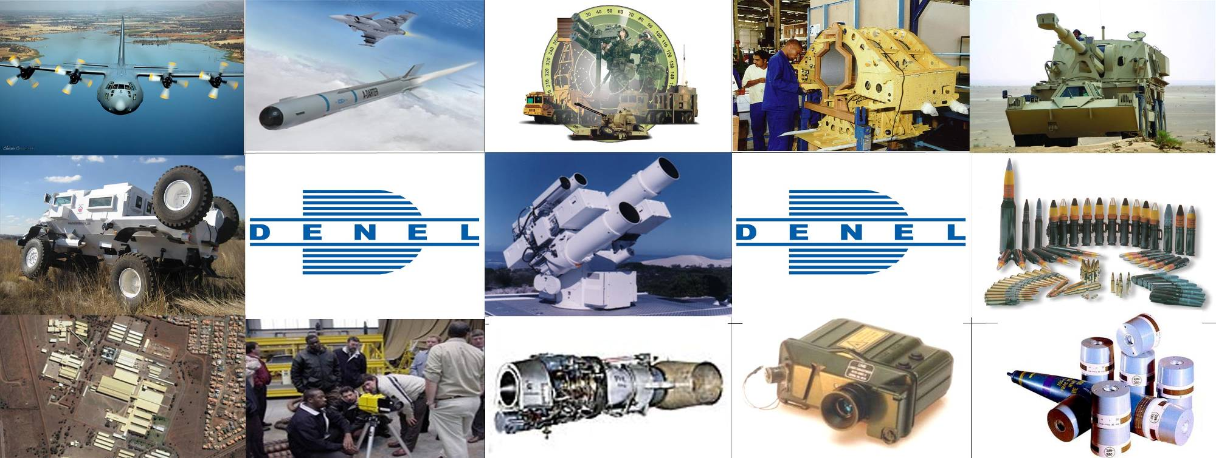
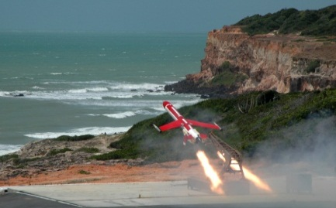
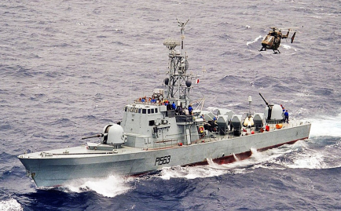
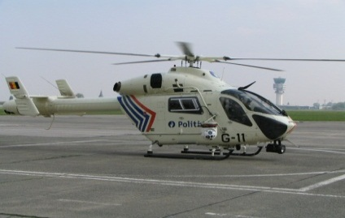
DENEL GROUP
BRIEFING TO THE POTFOLIO COMMITTEE ON PUBLIC ENTERPRISES
24 MAY 2017
Notes:
1

Slide 2
CONTENTS
Update
former Group CEO and Group CFO
Update on Denel Asia
Conclusion

Slide 3
UPDATE
The two topics covered in this update have been a point of discussion with updates evolving as follows:
28 October 2015
Briefing of the Portfolio Committee on Public Enterprises (PCPE) - Annual Report and Financial Statements for 2014/15
UPDATE ON FORMER EXECUTIVES
Matter is still under investigation and caution is to be exercised not to prejudice the parties involved prior to the conclusion of the disciplinary process
The suspensions are for no other reason other than the governance process followed in acquiring LSSA (Pty) Ltd

Slide 4
UPDATE
17 February 2016
Briefing of the Select Committee on Communications & Public Enterprises - Annual Report and Financial Statements for 2014/15
UPDATE ON FORMER EXECUTIVES
Matter is still under investigation and caution is to be exercised not to prejudice the parties involved prior to the conclusion of the disciplinary process
The suspensions are for no other reason other than the governance process followed in acquiring LSSA (Pty) Ltd

Slide 5
UPDATE
11 May 2016
Briefing of the Portfolio Committee on Public Enterprises (PCPE) – Denel Asia and Executives Suspensions
UPDATE ON FORMER EXECUTIVES
Approved funding model for the BAE LSSA transaction was not implemented as per approval
BAE LSSA’s liquidity to service the loans was misrepresented
Decision taken to allow an unfettered investigation into BAE Land Systems South Africa (LSSA) acquisition
Reason for suspension due to facts that transpired after Board and shareholder approval was granted
Preliminary assessment conducted by the Board showed a need for a detailed investigation

Slide 6
UPDATE
UPDATE ON FORMER EXECUTIVES
Board conducted assessment of transactions as part of its oversight and fiduciary duties
The Board is proceeding with disciplinary action
UPDATE ON DENEL ASIA
Strategic business partnerships are preferred as Governments are increasingly looking for ways to create value in their own countries
This includes manufacturing capability, the transfer of skills, as well as the creation of jobs in the client's country
Strategic Partner selection process explained with examples on existing JV arrangements Denel already has.
Rationale for wanting access to the East Asia market and why a company in Hong Kong

Slide 7
UPDATE
UPDATE ON DENEL ASIA
Importance of the Indian Market specifically to Denel as well as Denel’s history and experiences in that market
Denel had gone to Indian Market on its own 15yrs ago and lost almost R500 million.
The need for Denel to have a partner that possesses the following:
Financial muscle to support Business Development activities
Business network to access the market
Defence manufacturing capability
VR Asia agreed to provide R100 million to Denel Asia to support business development activities.
Denel Asia was incorporated in Hong Kong on 29 January 2016 following formal PFMA applications with the DPE and the Department of Finance.
Section 54(2) required the transaction be subject to approval by the executive authority with notification of the National Treasury.

Slide 8
UPDATE
UPDATE ON DENEL ASIA
The Section further stipulates: if no response is received from the executive authority in 30 days, the applicant may deem the application as approved.
No response was received from National Treasury
Section 51 (1)(g) requires the National Treasury be notified of transaction and be granted reasonable time to provide its approval
Denel Executives still engaging with NT through DPE to clarify Denel’s legal compliance in establishing Denel Asia
The capabilities as well as the ownership of both VR Laser South Africa and VR Laser Asia were explicitly articulated.

Slide 9
UPDATE
07 September 2016
Briefing of the Joint NA PC and NCOP SC Meeting with Denel, DPE and National Treasury – Circumstances surrounding the establishment of Denel-Aisa.
National Treasury did not turn up for the meeting.
UPDATE ON FORMER EXECUTIVES
Over and above the same matters discussed in the meeting of 11th May 2016 the following was added:
Following a protracted disciplinary process, which has now lasted for almost a year of incurring legal costs, executive time as well as the Board time, the matter, has now been concluded as follows:
Company Secretary – Mutual separation agreement with a 12 months pay-out effective on the 31 July 2016
Group Chief Financial Director – Mutual separation agreement with a 24 months pay-out effective September 2016

Slide 10
UPDATE
UPDATE ON FORMER EXECUTIVES
The Group CEO’s contract remains not renewed with the remainder of the current contract that runs into January 2017 terminated with payment.
Mutual separation arrangements were arrived at for the following reasons:
Denel’s funders accounting for more than R3.7bn of Denel’s debt were insisting on a stable leadership.
Denel’s Major clients were also making calls for stability
Cost considerations
The business interest and image of Denel
The board is pleased to have concluded these matters to allow that the necessary focus and attention to be placed on taking the Denel business forward.

Slide 11
UPDATE
UPDATE ON FORMER EXECUTIVES
The interim executives just concluded the company’s 2021 strategy aimed at growth of the business further and creating sufficient liquidity to support the envisaged growth, which has been approved by the board. Stability and focus on implementation of this strategy is of utmost importance as we close the suspensions chapter.
These positions are now effectively vacant and the board has commenced with the process of filling them

Slide 12
UPDATE
UPDATE ON DENEL ASIA
Details were provided on why Denel requires strategic partnerships in all its foreign endeavours
Details of markets where Denel already have strategic partnerships and the processes followed at selecting them including their contribution to Denel’s success.
Details of VR laser South Africa ownership as well at their capabilities were spelt out.
Internationally endorsed as a superior quality supplier by the United Nations as well as Patria Land Services Oyj (Defence contractor from Finland whose vehicle platform is used in the Hoefyster Contract)

Slide 13
UPDATE
UPDATE ON DENEL ASIA
“VR Laser Services (Pty) Ltd will be the only and sole Amoured Hull manufacturer and vehicle product assembler for all products on offer as filled in the LTA Agreement…..” (UN OPS letter dated July 2015)
“VR Laser is capable of doing the whole hull from parts to delivery”
“VR Laser references are good”
“……..(competitor) has poor level of welding quality”
“More or less, decision is totally on DLS responsibility…it wouldn’t be beneficial to work load to more than two suppliers . For Hull parts set, there is no hesitation to choose VR-Laser…..” (Patria memo dated March 2014)

Slide 14
UPDATE
UPDATE ON DENEL ASIA
VR has been doing business with Denel for more than 15 years
Fabrication of the hulls for mine protected vehicles (Casspir, RG series, etc.) as well as fabrication of mechanical structures for weapon systems
The first contract awarded to VR Laser on the Badger Vehicle Project was in 2013. This project in totality is for 264 vehicles and VR Laser’s total portion will amount to circa R400 million (not the R10 billion reported).

Slide 15
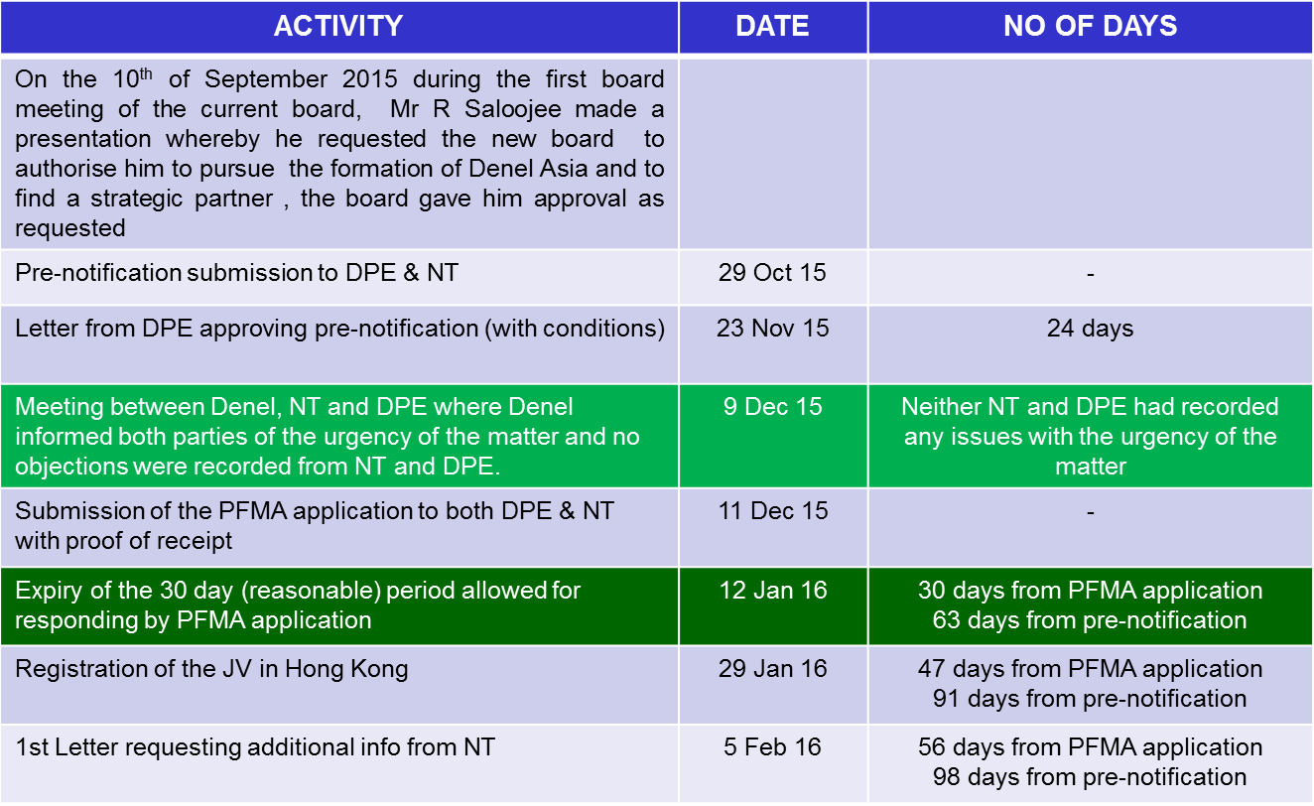
UPDATE
UPDATE ON DENEL ASIA
The following process was also shared

Slide 16
UPDATE
UPDATE ON DENEL ASIA
Two sections of the PFMA governed the approval process of this transaction were considered (Section 54(2)&(3) and Section 51(g).
Section 54(2) required that the transaction be subject to approval by the executive authority with notification in writing to the National Treasury.
Section 54(3) stipulates that if no response is received from the executive authority within 30 days, the applicant may assume that approval has been granted.
Section 51(1)(g) requires the National Treasury be notified of transactions and be granted reasonable time to provide its approval (as defined in Section 54(3)).
Denel Executives are still engaging with NT through DPE to clarify Denel’s legal compliance in establishing Denel Asia

Slide 17
UPDATE
19 October 2016
Briefing of the Joint NA PC and NCOP SC Meeting with Denel, DPE and National Treasury – Circumstances surrounding the establishment of Denel-Aisa
National Treasury again did not turn up for the meeting.
UPDATE ON FORMER EXECUTIVES
Over and above the same matters discussed in the meeting of 11th May 2016 the following was added:
Following a protracted disciplinary process, which has now lasted for almost a year of incurring legal costs, executive time as well as the Board time, the matter, has now been concluded as follows:
Company Secretary – Mutual separation agreement with a 12 months pay-out effective on the 31 July 2016
Group Chief Financial Director – Mutual separation agreement with a 24 pay-out effective in September 2016

Slide 18
CONCLUSION
CONCLUSION ON FORMER EXECUTIVES
The board has concluded the recruitment process for the executive positions currently vacant and has submitted to the executive authority for approval which is expected to be concluded soon.
CONCLUSION ON DENEL ASIA
Denel Asia has never traded, it is dormant company, the shareholder and Denel board took a decision not to trade until the impasse with National Treasury is resolved.
Denel board has also subjected the process of formation of Denel Asia to a judicial review as the court is the final arbiter of disputes and entrusted by the Constitution to interpret the law, this decision was taken after all avenues to engage constructively with National Treasury to resolve the impasse were unsuccessful

Slide 19
CONCLUSION
rebuffed, this signifies a highest adherence to good governance by Denel board, you have also attempted to have the impasse between Denel and National Treasury to be resolved through the Parliamentary process but National Treasury did not heed to your request.
Denel’s executive authority will be engaging with the new Minister of Finance on the way forward.
Denel Board awaits the way forward from the engagement referred to above.

Slide 20
Back up Slides
Parliamentary questions responded to on the same subject

Slide 21
BACK UP SLIDES
QUESTION NO.: 1203 DATE OF PUBLICATION: 22 APRIL 2016 1203. Ms N W A Mazzone (DA) to ask the Minister of Public Enterprises: (1) (a) On what grounds was the contract of employment of a suspended Chief Executive Officer (Mr Riaz Saloojee) terminated on or around 14 April 2016 and (b) what are the further relevant details in this regard; (2) whether any investigation into the specified person’s suspension was conducted; if not, why not; if so, what are the detailed outcomes of the specified investigation? NW1343E
REPLY:
The contract of employment of the Chief Executive Officer was due to terminate by virtue of the effluxion of time on or about 31 January 2017. The board had resolved that it will not put forward a recommendation to the Minister that the contract of the CEO should not be renewed.
An investigation was undertaken. The investigations are still ongoing. Despite these investigations Denel is of the view that it has sufficient basis to institute a disciplinary hearing.

Slide 22
BACK UP SLIDES
2663. Ms N W A Mazzone (DA) to ask the Minister of Public Enterprises: What amount did the former Chief Executive Officer of DENEL, Mr Riaz Salojee receive in payment of a severance package before the specified person’s suspension and subsequent resignation? NW3147E
QUESTION NO.: 2663
DATE OF PUBLICATION: 25 NOVEMBER 2016
REPLY:
Mr. Riaz Saloojee did not receive a severance package and did not resign. He was only paid up to the end of his contract.

Slide 23
BACK UP SLIDES
1204. Ms N W A Mazzone (DA) to ask the Minister of Public Enterprises: (1) What amount is the subcontract for cutting steel for 238 Badger vehicles awarded by Denel to a certain company (VR Lazer) worth; (2) did she approve the subcontract; if not, (a) why not and (b) who approved the subcontract; if so, why was it approved? NW1344E
QUESTION NO.: 1204
DATE OF PUBLICATION: 22 APRIL 2016
REPLY:
The orders placed on VR Laser to date for the Badger systems amount to R236 646 034. It is however estimated that the amount placed on VR Laser through the life of the programme will not exceed R400m.
2. The Minister does not approve sub-contracts as these are business operational matters and get approved within the Denel structures. Approval of sub-contracts are done after following due processes and are approved in accordance to the Denel Delegation of Authority.

Slide 24
BACK UP SLIDES
175. Ms N W A Mazzone (DA) to ask the Minister of Public Enterprises: (a) What are the names of the Board of Directors of Denel Asia and (b) why was it necessary to establish the specified entity, since Denel SOC Ltd already has a large footprint in the Asia-Pacific region? NO1992E
QUESTION NO.: 175
DATE OF PUBLICATION: 30 AUGUST 2016
REPLY:
Board of Directors:
Zwelakhe Nhlanganiso Ntshepe
Abraham Stephanus Burger
Pieter Johannes van der Merwe
Kamal Kant Singhala
It was necessary to establish the entity for the reasons as set out below:
In analysing the Denel business in the Asia Pacific region, the following emerged to Denel management as barriers to entry into this fast growing market:
lack of multilateral defence relationships;
inability to provide funding solutions;
inability to source local production and development partners (particularly in India);
frequent engagement with end user and industry from a distance was not feasible;
company visibility in the market place/region from a distance is not possible;
need for a lawful conduit for developing/aligning with local business networks; and

Slide 25
BACK UP SLIDES
QUESTION NO.: 175
DATE OF PUBLICATION: 30 AUGUST 2016
REPLY:
It was necessary to establish the entity for the reasons as set out below:
active participation in regional initiatives from a distance is not feasible.
With a focus on Asia, Denel's approach was to immediately re-enter the India market through Denel Asia as a way of building a business profile in the Asia Pacific region.
Denel’s history in India has been plagued by allegations that has prohibited Denel from concluding successful contracts in the country. Denel entered the India market during 1994 with a wide range of products. During the period 1998 and 2005, Denel participated in tenders issued by the Indian Ministry of Defence (MOD) and was successfully awarded contracts for various products including ammunition and land systems products. On 17 April 2005, an article appeared in the Cape Argus newspaper alleging that Denel had contravened specific Indian legislation. Notwithstanding the lack of proof thereof and Denel’s denial that it was in breach of the MOD contracts, the MOD issued a notice of termination of the defence programs and instituted legal proceedings against Denel which resulted in, inter alia, protracted arbitrations. Contracts to the value of US$ 77,3 million were adversely affected by these actions. Denel was effectively treated in India as if it were blacklisted notwithstanding no formal blacklisting being in force. In 2007 Denel sought to re-enter the India market as a subcontractor on a tracked gun program where Rheinmetall was the prime contractor. Successful trials for the gun took place during July 2010 and March 2011. However, in 2012, Rheinmetall was recommended for blacklisting which resulted in a termination of the said program. Denel incurred a further loss of R11 million as a result of this termination. This confirmed that Denel competing on its own in India on major programs is very high risk.
Denel was inactive in the India market for a significant length of time until verbal notification was received late in 2014 from the Indian Embassy in South Africa informing Denel that the investigation was completed and that Denel may proceed to conduct business in India.

Slide 26
BACK UP SLIDES
QUESTION NO.: 175
DATE OF PUBLICATION: 30 AUGUST 2016
REPLY:
It was necessary to establish the entity for the reasons as set out below:Since Denel’s absence from the market, the procurement rules in India changed significantly on major programs. In particular, it introduced the requirement for a local Indian Industry partner/s based on the “Buy Make India” procurement program. The India “Buy Make Program” requires that local content should be more than 50% as well as inclusion of technology transfer from the foreign Original Equipment Manufacturer (OEM). This mandatory requirement combined with Denel’s previous unsuccessful attempts to access and remain successful in the Indian market reconfirmed the need for Denel to identify and rather proceed with a local partner in India as opposed to attempting re-entry on its own. The Indian procurement process demands a strenuous and protracted product evaluation process which can become extremely costly (as detailed in paragraph (b) (iii)).
Denel is positioning itself for major programs in India which programs are premised on the ‘Buy Make India’ concept. This means that only Indian Companies that can prove that they have partnered with “foreign technology companies” are allowed to bid as prime contractors. In support of India’s national objective of developing local privately owned defence companies, partnering with (either one or both) Adani and the Reliance Group, both reputable companies having been introduced to Denel via VR Asia, will bring major advantages in terms of Industry knowledge, manufacturing capability, setting up manufacturing partners, business knowledge and investment capital on major programs. Expanding into the Defence business forms part of both companies growth vision and both have a history of success.
The advantages of Denel entering the Asia market with VR Asia via Denel Asia includes:
the provision of design, manufacturing and fabrication skills
a deeper understanding of the local market and industrial landscape
the ability to align with local business networks (Adani and Reliance Group)
the provision of quick access to local potential production and development partners
the ability to increase visibility in the market/region
access to operational funding

Slide 27
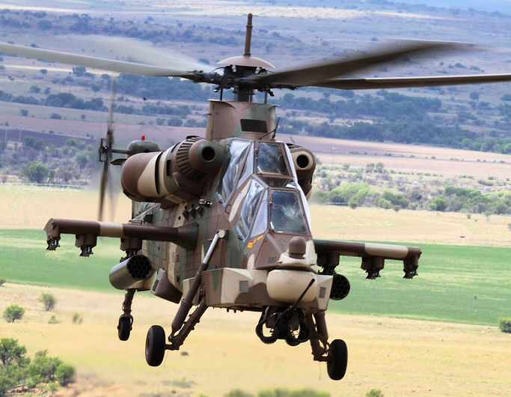
THANK YOU

