Slide 1
SECRETARY TO PARLIAMENT
PRESENTATION OF THE STRATEGIC PLAN OF PARLIAMENT
12 MAY 2017

Slide 2
STRUCTURE OF THE PRESENTATION
Overview
Parliamentary Business: Stakeholder Engagement
Orientation, global, regional and local context
Policy priorities for 5th Parliament
Business and Management process
Main strategies
Strategic objectives applicable to political parties

Slide 3
ALIGNING THE STRATEGY TO THE CONSTITUTION

Slide 4
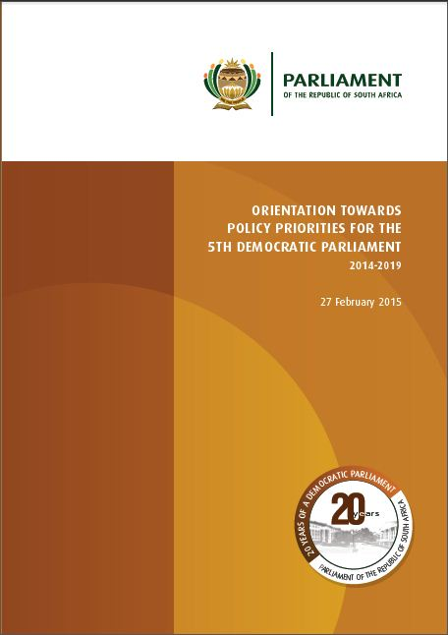
DOCUMENTS: Tabled documents on www.parliament.gov.za Available at Faranani on: Office of the Secretary/Strategic Planning/About US
Orientation:
Policy priorities
Strategy:
Strategic Plan
Implementation:
APP 2015/16

Slide 5
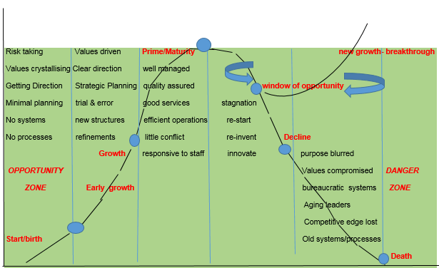
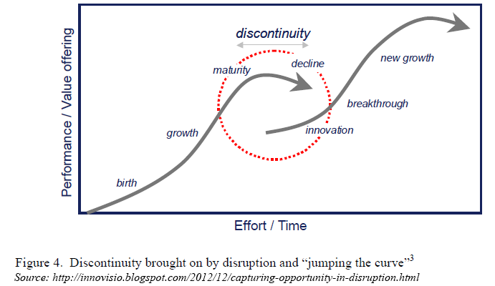
ORGANIZATION’S LIFE CYCLE

Slide 6
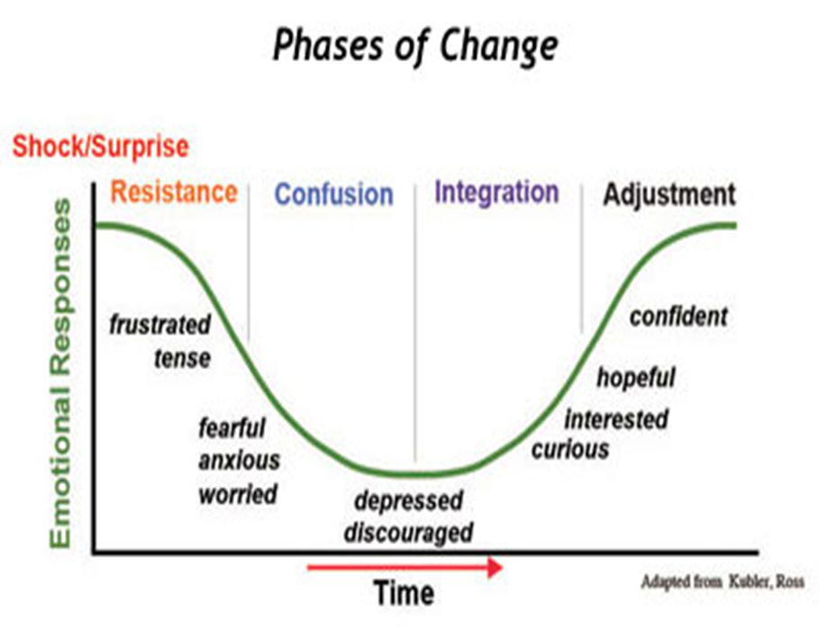
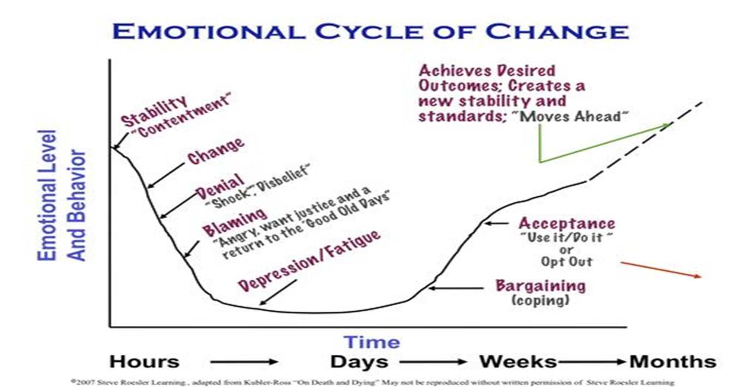
TEAM DYNAMICS

Slide 7
EMPLOYEE ENGAGEMENT

Slide 8
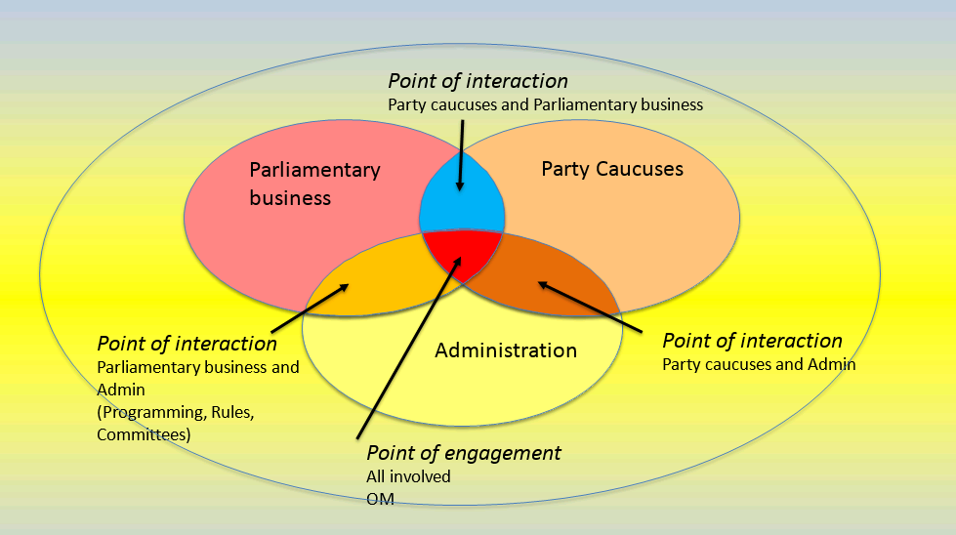
PARLIAMENTARY STAKEHOLDER ENGAGEMENT

Slide 9
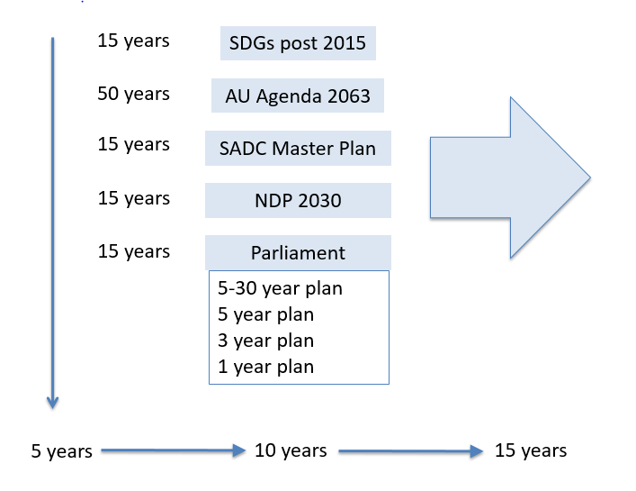
CONTEXT OF PLANNING

Slide 10
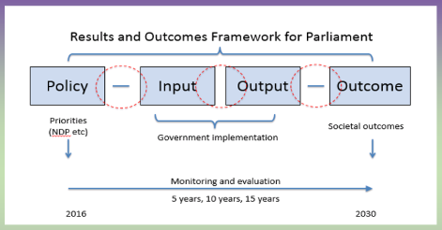
LOCAL CONTEXT

Slide 11
LINKING INSTITUTIONAL OUTCOME TO INDIVIDUAL PERFORMANCE

Slide 12
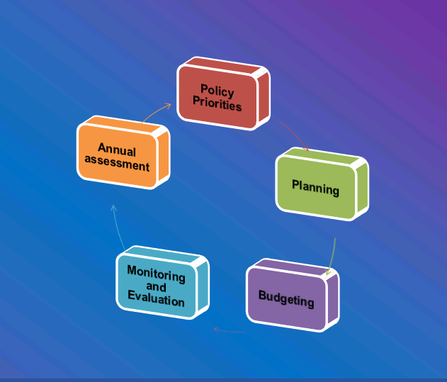
PARLIAMENTARY BUSINESS CYCLE

Slide 13
INSTITUIONAL STRATEGIC REORIENTATION: 2018/19 AND BEYOND
TRANSACTIONAL
Limited to the MTEF
Incremental budgeting
TRANSFORMATIONAL
Zero based planning & budgeting
Service oriented and performance based system
Process oriented
Silo approach
Congestion and mechanisation
Result- based and outcomes oriented
Integrated approach
Focus on transversal developmental issues

Slide 14
OUTCOMES OF PARLIAMENT

Slide 15
5TH PARLIAMENT STRATEGIC PRIORITIES

Slide 16
2018/19 PROGRAMME STRUCTURE
Programme 1: Strategic Leadership and Governance
Political leadership, governance and institutional policy, communication and co-ordination, oversee development and implementation of strategic plan, annual performance plan and budget, Parliamentary Budget Office and Office: ISD.
Programme 2: Administration
Strategic leadership support and management, institutional policy and governance, development programmes for Members, management and administration, internal audit and financial management, and the Registrar of Members’ Interests.
Programme 3: Core Business
Procedural and legal advice, analysis, information and research, language, content and secretarial and legislative drafting services for meetings of the National Assembly, National Council of Provinces and their committees. Provide public education, information and access to support public participation. Provide analysis, advice and content support for parliamentary international engagement.
Programme 4: Support Services
Provide institutional communication services, human resource management, information communication technology, institutional support services and Members’ support services.
Programme 5: Associated Services
Provide travel, communication and other facilities for Members of Parliament to fulfil their duties as elected public representatives. Provide financial support to political parties represented in Parliament, their leaders and constituency offices.

Slide 17
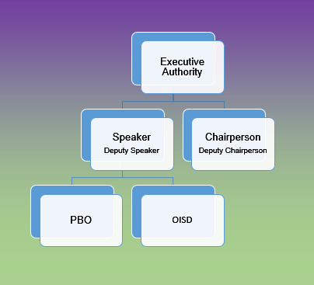
PROGRAMME 1: STRATEGIC LEADERSHIP AND GOVERNANCE
Strategic Objectives:
Improve strategic, advisory, administrative and logistical support to the Executive Authority.
improve overall support to the Executive Authority in regard to the achievement of policy priorities, political and administrative leadership, governance and compliance, co-ordination with external and internal stakeholders, and communication.

Slide 18
ELEMENTS OF THE STRATEGIC OBJECTIVES/KEY RESULTS AREAS
STRATEGIC LEADERSHIP AND GOVERNANCE
Formalisation of the legislative sector
Strengthen Parliament as an independent Arm of the State
Deepen international participation
Inclusion of 4th Parliament legacy issues
ADMINISTRATIVE LEADERSHIP AND GOVERNANCE
Improve governance & administrative leadership mechanisms
Align the strategy, budget & structure to the institutional vision
Infuse efficiency and effectiveness to institutional systems & processes

Slide 19
PROGRAMME 2: ADMINISTRATION
Secretary to Parliament
Strategic Management and Governance
Finance Management Office
Registrar of Members’ Interests
Internal Audit
Legislative Sector Support
Strategic Objectives:
Improve usefulness, relevance and accessibility of development programmes for Members.
Improve co-ordination, cooperation and intergovernmental relations of Parliament with Provincial Legislatures by implementing a revised Sector Strategy.
Strengthening strategic management, governance, internal control, risk management, monitoring and evaluation, and compliance.
Reduce inefficiencies – aim at savings

Slide 20
ELEMENTS OF THE STRATEGIC OBJECTIVES/KEY RESULTS AREAS
CORE BUSINESS
Alignment NDP
Improving on the quality of research, procedural and content advisory services provided
Consolidate the implementation of oversight models

Slide 21
PROGRAMME 3: CORE BUSINESS
Core Business Branch
National Assembly
National Council of Provinces
Core Business Support
International Relations & Protocol
Knowledge and information
Strategic Objectives:
Improve turn-around time and quality of procedural advice, legal advice, content advice, research, minutes and reports.
Refine and implement Oversight and Accountability Model.
Develop and implement a legislative model ensuring enhanced quality of legislation.
Develop and implement a co-operative government oversight mechanism.
Enhance parliamentary international engagement and co-operation.
Increase public access and opportunities to participate in all processes of Parliament.

Slide 22
PROGRAMME 4: SUPPORT SERVICES
Support Services Branch
Parliamentary Communication Services
Human Resources
Information Communication Technology
Institutional Support Services
Member Support Services
Strategic Objectives:
Improve stakeholder management and increase Members’ satisfaction with services.
Improve the communication of the business of Parliament by developing and implementing a comprehensive communications strategy.
Leverage technologies to meet information services needs of Members.
Optimize conducive working environment and facilities.
Increase the availability of strategic competencies, talent and skills.

Slide 23
ELEMENTS OF THE STRATEGIC OBJECTIVES/KEY RESULTS AREAS
SUPPORT SERVICES
Member-centric approach
Seamless and integrated member support
Improve ICT services
Implementation of Members capacity and development programmes

Slide 24
PROGRAMME 5: ASSOCIATED SERVICES
Strategic Objectives
Improve facilities for Members
Review the facility needs of Members, and provide a seamless support service
Reduce average turnaround time for claims payment.
Ensure effective financial management of resources
Party Leadership Support provides financial support to political leadership of parties represented in Parliament.
Political Party Support provides financial support to political parties represented in Parliament.
Constituency Support provides financial support to parties represented in Parliament, for constituency offices.

Slide 25
STRATEGIC AREAS OF FOCUS: 2018/19 AND BEYOND

Slide 26
STRATEGIC AREAS TO BE ADDRESSED: 2018/19 AND BEYOND
Resourcing Parliament adequately
- Ownership and control of the parliamentary space & facilities
Parliamentary identity
- Asserting itself and authority as an independent arm of the state
Capacity Building
- Building depth to deal with issues (building the capacity and quality of the
support provided)
- Capacitating the member as an individual by capacitating the caucus
Appropriate technologies
- give parliament a competitive edge
- position parliament to be on par with institutions it oversees

Slide 27
TRANSFORMATION
(Back to Basics-Efficiency- seamless and integrated services)
SECTOR APPROACH
(Norms and standards)
OVERSIGHT AND ACCOUNTABILITY
2014 2019

Slide 28
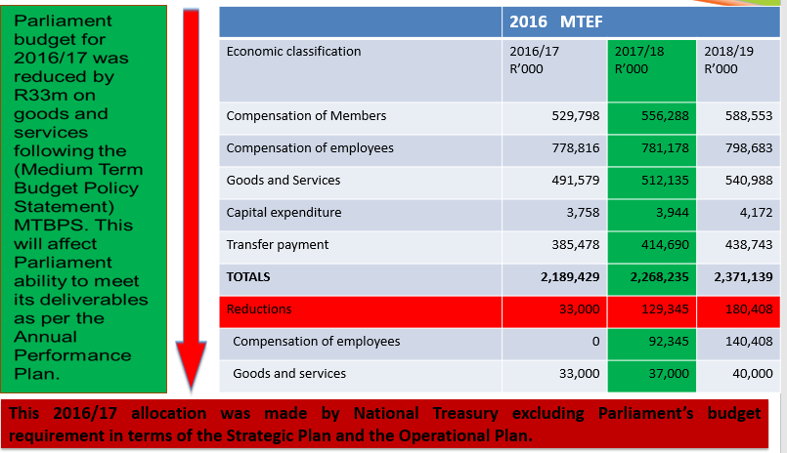
2016/17 ALLOCATIONS AND MTEF

Slide 29
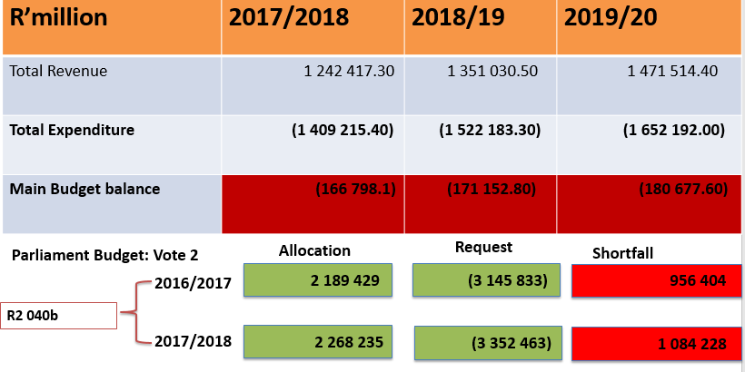
INSTITUTIONAL FINANCES: 2017/18 NATIONAL BUDGET

Slide 30
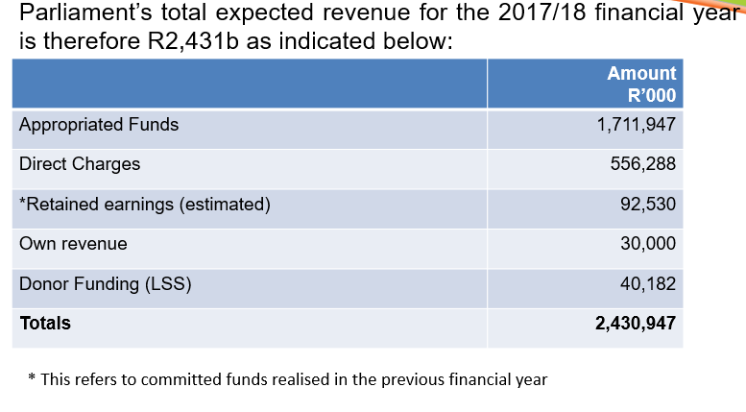
INSTITUTIONAL FINANCES: 2017/18 TOTAL ALLOCATIONS

Slide 31
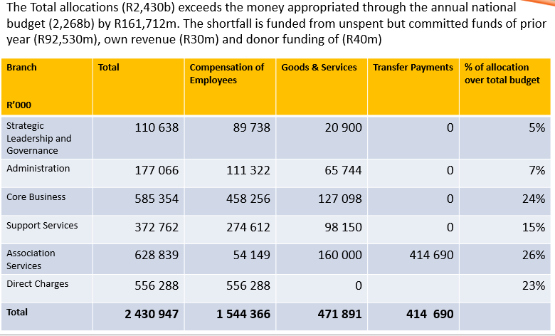
INSTITUTIONAL FINANCES: 2017/18 REVENUE

Slide 32
WAYFORWARD
Alignment of strategy, budget and structure
Institutionalization of the results based approach
Reduce inefficiencies
Improve overall institutional performance
Develop parliamentary value chain
Align reporting with value chain
Focus on monitoring implementation
Move towards Sector Approach

Slide 33
Documents Tabled documents on www.parliament.gov.za Faranani on: Office of the Secretary/Strategic Planning/About US
Orientation:
Policy priorities
Strategy:
Strategic Plan
Implementation:
APP 2015/16

