Slide 1

Presentation to the Select Committee
Trade and International Relations
the dti’s 2017-2020 Annual Performance Plan
Date: 10 May 2017
Director-General
Mr Lionel October

Slide 2
CONTENTS
the dti’s Vision, Mission and Strategic Goals
Economic outlook
Key Interventions for 2017/18
Allocated resources

Slide 3
VISION
“A dynamic industrial, globally competitive South African economy, characterised by inclusive growth and development, decent employment and equity, built on the full potential of all citizens”

Slide 4
STRATEGIC GOALS
Facilitate transformation of the economy to promote industrial development, investment, competitiveness and employment creation.
Build mutually beneficial regional and global relations to advance South Africa’s trade, industrial policy and economic development objectives.
Facilitate broad-based economic participation through targeted interventions to achieve more inclusive growth.
Create a fair regulatory environment that enables investment, trade and enterprise development in an equitable and socially responsible manner.
Promote a professional, ethical, dynamic, competitive and customer-focused working environment that ensures effective and efficient service delivery.

Slide 5
PROGRAMMES OF the department
Programme 1: Administration
Programme 2: International Trade and Economic Development
Programme 3: Special Economic Zones and Economic Transformation
Programme 4: Industrial Development
Programme 5: Consumer and Corporate Regulation
Programme 6: Incentive Development and Administration
Programme 7: Trade Export South Africa
Programme 8: Investment South Africa

Slide 6
Strategic Priorities for 2015 - 2020
the dti’s MTSF Interventions | Linkage to Strategic Goals | Linkages to Government outcomes
Facilitate transformation of the economy to promote industrial development, investment, competitiveness and employment creation | All IPAP interventions implemented Develop MBAP and incorporate into IPAP Increase use of local metals in South African manufacturing Increase localisation target to 75% | Outcome 4: Decent employment through inclusive growth
Build mutually beneficial regional and global relations to advance South Africa’s trade, industrial policy and economic development objectives | FDI investment pipeline R50 billion Economic diplomacy and pavilions Seven investments and five trade promotion projects Tripartite-Free Trade Agreement (T-FTA) South Africa’s position on T-FTA and Continental-FTA | Outcome 11: Create a better South Africa and a better world
The above table contains changes to the Strategic Plan 2015-2020 as per Annexure A of the APP 2017

Slide 7
Economic outlook

Slide 8
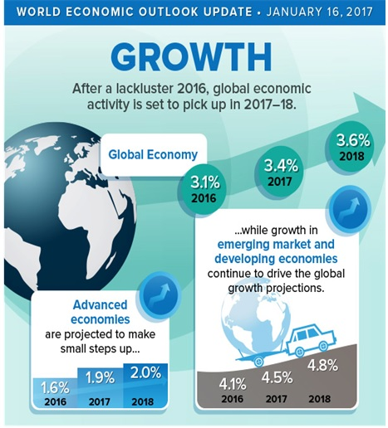
Weak Global economic recovery
International Monetary Fund’s (IMF) World Economic Outlook (WEO) released in January 2017 has global growth forecast for 2017 to 2018 at 3.4% and 3.6%.
 | 2016 | 2017 | 2018
Global GDP | 3.1 | 3.4 | 3.6
US | 1.6 | 2.3 | 2.5
EuroZone | 1.7 | 1.6 | 1.6
China | 6.7 | 6.5 | 6.0
India | 6.6 | 7.2 | 7.7
Brazil | -3.5 | 0.2 | 1.5
South Africa | 0.3 | 0.8 | 1.6
Source: IMF, 2017 World Economic Outlook

Slide 9
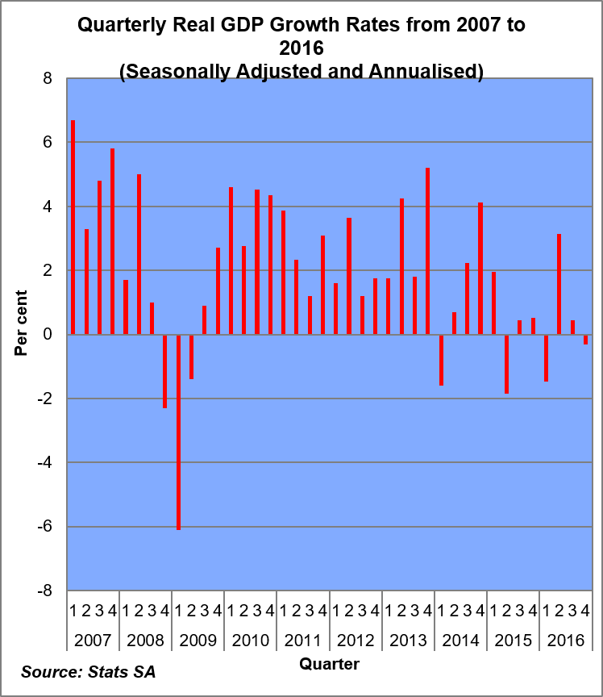
GDP growth in Q4 2016in Q4 2016
Quarter-on-quarter GDP (seasonally adjusted and annualised) contracted by 0.3% after growing by just 0.2% in previous quarter.
Year-on-year GDP (unadjusted) grew by 0.7%.
Q-on-q performance reflected stronger electricity, gas and water; transport, storage and communication; and wholesale and retail trade growth.
Disappointingly, Mining, Manufacturing & Agriculture all contracted in the quarter.
9

Slide 10
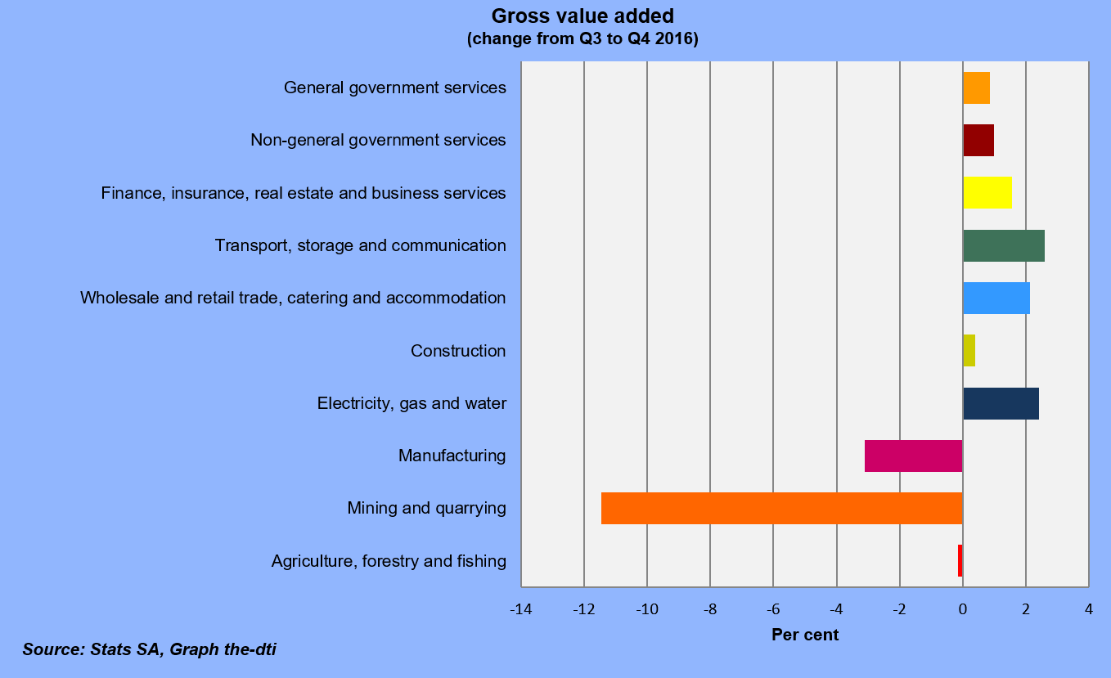
GDP growth Q4 2016 Cont’…

Slide 11
on upward trajectory
Absa Purchasing Managers’ Index (PMI) rose from 50.9 index points in January to 52.5 index points in February 2017 however dropped to 44.7 index points in April 2017.
The following sub-components of PMI dropped sharply in April 2017.
Purchasing Commitments Index
New Sales Orders index
Inventories Index
Business Activity Index
11

Slide 12
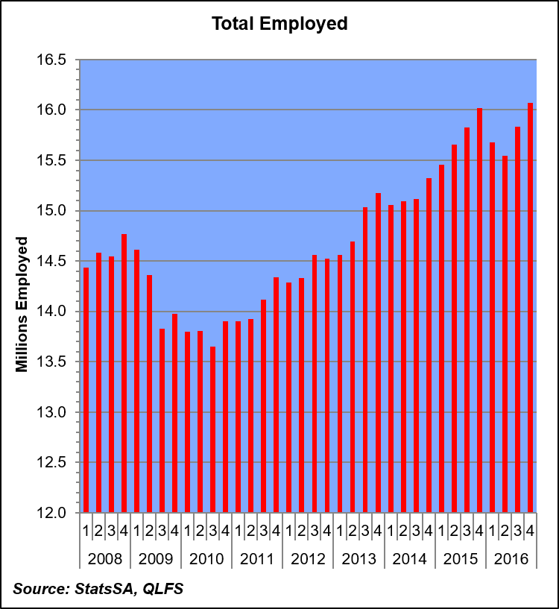
Substantial Jobs created in Q4 2016
Employment increased by 235,000 in the Oct-Dec 2016 quarter. Largest employment increases were recorded in:
    Comm. & Social Services – 73,000
    Transport – 46,000
    Manufacturing – 44,000
    Agriculture – 38,000
    Trade – 24,000.
Employment declined in 2 sectors:
Mining – 17,000
Construction – 9,000

Slide 13
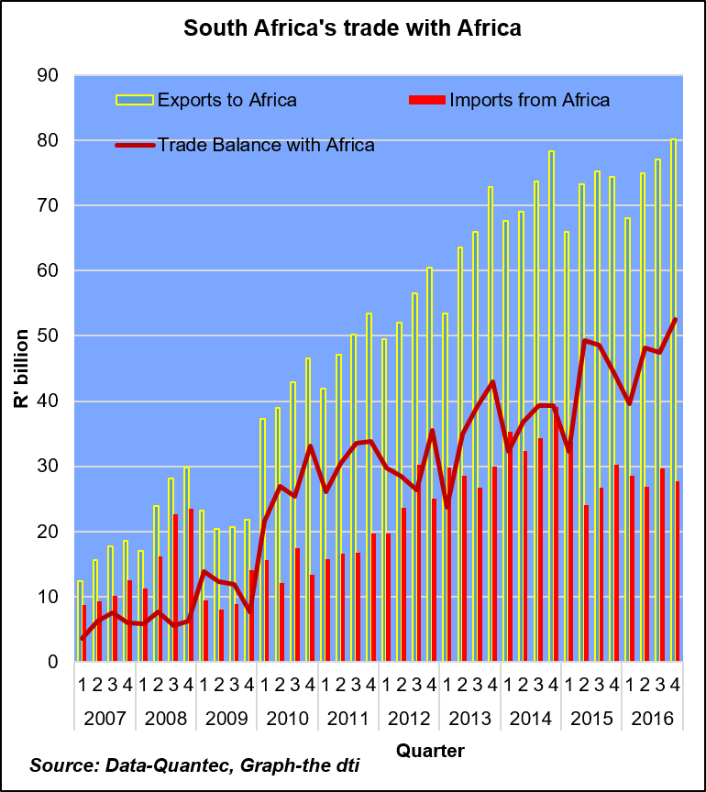
SADC - biggest regional market for SA’s MANUFACTURED GOODS
Exports to Africa increased by 4% to reach R80 bn in Q4 2016, from R77 bn in Q3 2016.
In Q4 2016, about 79% of the total exported goods were manufactured goods, while 13% were mining products.
SADC, remains the biggest market for SA’s manufactured goods in Africa accounting for almost 88% of total manufactured exports to Africa.
SA demand for goods from Africa decreased by 7% in Q4 2016 to mark R28 bn from R30 bn in Q3 2016.
The trade surplus with Africa grew by R 5 bn to reach R53 bn in Q4 2016, from R48 bn in Q3 2016.
Notes:
SAmanufactured goods

Slide 14
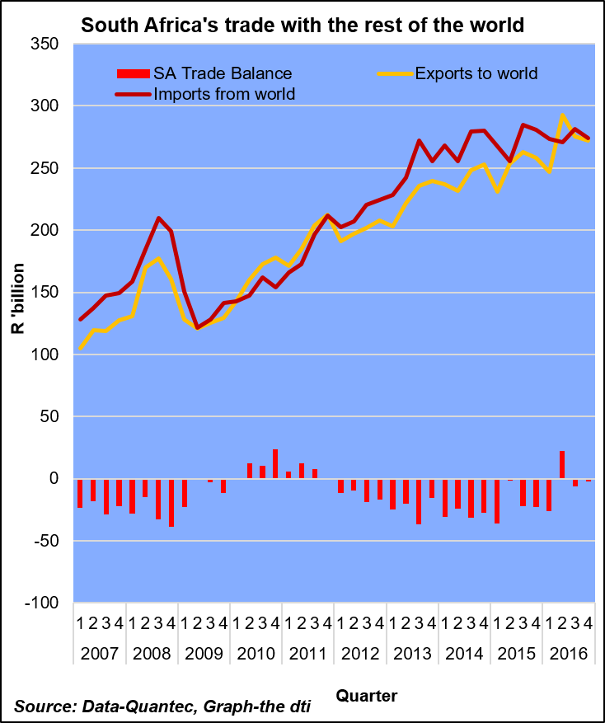
SA trade with the rest of the world
SA exports to the world contracted in Q4 2016
SA exports to the world decreased 1.1% from R275 bn in Q3 2016 to R272 bn in Q4 2016.
About 34% of goods were destined to the following top five export partners: China (R27 bn), US (R18.3 bn), Germany (R18.2 bn), Botswana (R14 bn) and Namibia (R13 bn).
Imports from the world, contracted by 2.5%, reaching R274 bn in Q4 2016 from R281 bn in Q3 2016. This was attributed to a decrease in demand for manufactured goods (-2.6%) and agriculture, forestry and fishing products (-25%).
In the Q4 2016, SA trade deficit with the rest of the world improved to R2 bn from R6 bn in Q3 2016.

Slide 15
KEY PLANNED INTERVENTIONS
FOR 2017/18 FINANCIAL YEAR

Slide 16
KEY INTERVENTIONS – INDUSTRIAL DEVELOPMENT
Upscale industrial policy by submitting for tabling the annual rolling Industrial Policy Action Plan (IPAP) to Cabinet and produce quarterly implementation reports
Value of projected investments across all incentives to be leveraged from projects approved- R15 billion
Projected number of new jobs supported and number of jobs to be retained from enterprises approved 6 000
Number of enterprises/projects approved for financial support across all incentives 800

Slide 17
Programme 4: Industrial Development
Outcome 4: Decent employment through inclusive growth
Strategic objective | 5-year Target | Performance Indicator/ Measure | Actual performance |  |  | Estimated Performance | Medium-Term Targets
 |  |  | 2013/14 | 2014/15 | 2015/16 | 2016/17 | 2017/18 | 2018/19 | 2019/20
Grow the manufacturing sector to promote industrial development, job creation, investment and exports | Annual rolling IPAP, aimed at facilitating a process of structural change involving upgrading and diversification to achieve sustained growth and job creation | 1.8 New iteration of IPAP submitted for tabling in Cabinet annually | IPAP 2013/14-2015/16 was successfully approved by Cabinet in March 2013 and successfully launched on 4 April 2013 | IPAP 2015/16 endorsed by the Economic Cluster and awaiting Cabinet approval | Annual Rolling IPAP 2016/17 finalised and submitted to Minister for approval and tabling in Cabinet. | IPAP tabled in Cabinet in April 2016 and launched on 9 May 2016. | Annual Rolling IPAP 2018/19 submitted to Minister for tabling in Cabinet by March 2018 | Annual Rolling IPAP 2019/20 submitted to Minister for tabling in Cabinet by March 2019 | Annual Rolling IPAP 2020/21 submitted to Minister for tabling in Cabinet by March 2020
 | Instruments rolled out to facilitate strategic use of public procurement to enhance local productive capabilities | 1.9 Number of implementation reports on IPAP tabled at Minister’s Review Meetings per year | 4 implementation reports tabled at IPAP Review Meeting in June 2013, September 2013, November 2013 and February 2014 Additionally, IPAP Annual Report prepared and approved by DG and Minister | 4 implementation reports tabled at IPAP review meetings in July, October and November 2014 and in January 2015 Annual Report for 2013/14 was tabled in Parliament in September 2014 | 3 implementation reports on IPAP tabled at Minister’s Review Meetings on 17 July, 17 September and 1 December 2015. | 1 implementation report on IPAP tabled at Minister’s Review Meetings on 22 August 2017 | 4 Implementation reports on IPAP prepared for the Minister’s Review Meetings per year | 4 Implementation reports on IPAP prepared for the Minister’s Review Meetings per year | 4 Implementation reports on IPAP prepared for the Minister’s Review Meetings per year
Estimated performance is based on verified Quarter Two Report
Cont…

Slide 18
Programme 4: Industrial Development
Outcome 4: Decent employment through inclusive growth
Strategic objective | 5-year Target | Performance Indicator/ Measure | Actual performance |  |  | Estimated Performance | Medium-Term Targets
 |  |  | 2013/14 | 2014/15 | 2015/16 | 2016/17 | 2017/18 | 2018/19 | 2019/20
Grow the manufacturing sector to promote industrial development, job creation, investment and exports | Instruments rolled out to facilitate strategic use of public procurement to enhance local productive capabilities | 1.10 Number of designation requests prepared for Minister per year | 5 designation reports completed and submitted | 1) 6 sector/ product templates were submitted to NT for designation and awaiting publication Transformers, | 2 designation requests submitted to Minister for approval, i.e. solar photovoltaic system components and rail-signalling system and components | 1 designation request prepared for Minister | 2 designation requests prepared for Minister per year | 2 designation requests prepared for Minister per year | 2 designation requests prepared for Minister per year
Estimated performance is based on verified Quarter Two Report
Cont…

Slide 19
Programme 4: Industrial Development
Outcome 4: Decent employment through inclusive growth
Quarterly Milestones for 2017/18
Performance Indicator/ Measure | Reporting Period | Annual Targets 2017/18 | Quarterly Milestones
 |  |  | 1st | 2nd | 3rd | 4th
1.8 New iteration of IPAP submitted to Minister for tabling in Cabinet annually | Annually | Annual Rolling IPAP 2018/19 submitted to Minister for tabling in Cabinet March 2018 | Launch the Annual Rolling IPAP 2017/18 | Nil | Nil | Annual Rolling IPAP 2018/19 submitted to Minister for tabling in Cabinet by March 2018
1.9 Number of implementation reports on IPAP tabled at Minister’s Review Meetings per year | Quarterly | Four | 1 | 1 | 1 | 1
1.10 Number of designation requests prepared for Minister per year | Bi-annual | Two | Nil | 1 | Nil | 1
Reconciling performance targets with the Budget and MTEF
Programme 4 - Industrial Development | 2013/14 | 2014/15 | 2015/16 | 2016/17 | 2017/18 | 2018/19 | 2019/20
Rand thousand | Audited outcome | Audited outcome | Audited outcome | Adjusted appropriation | Medium-term estimates
Economic classification
Current payments | 99,241 | 103,915 | 118,126 | 115,215 | 122,135 | 125,027 | 125,365
Transfers and subsidies | 1,491,531 | 1,670,555 | 1,834,994 | 1,610,428 | 1,696,323 | 1,649,944 | 1,742,947
Payments for capital assets | 410 | 684 | 349 | 1,384 | 819 | 868 | 916
Payments for financial assets | - | - | 147 | - | - | - | -
Total | 1,591,182 | 1,775,154 | 1,953,616 | 1,727,027 | 1,819,277 | 1,775,839 | 1,869,228
…cont

Slide 20
Programme 6: Incentive Development and Administration
Outcome 4: Decent employment through inclusive growth
Strategic objective | 5-year Target | Actual performance |  |  | Estimated Performance | Medium Term Targets
 |  | 2013/14 | 2014/15 | 2015/16 | 2016/17 | 2017/18 | 2018/19 | 2019/20
Grow the manufacturing sector to promote industrial development, job creation, investment and exports | Private Sector Investment leveraged across all incentives | Private Sector Investment leveraged | Private Sector Investment leveraged | Private Sector Investment leveraged | Private Sector Investment leveraged | Private Sector Investment leveraged | Private Sector Investment leveraged | Private Sector Investment leveraged
 | Jobs supported | Jobs supported | Jobs supported | Jobs supported | Jobs supported | Jobs supported | Jobs supported | Jobs supported
Performance Indicator/ Measure | Actual performance |  |  | Estimated Performance | Medium Term Targets
 | 2013/14 | 2014/15 | 2015/16 | 2016/17 | 2017/18 | 2018/19 | 2019/20
1.11 Value (Rand) of projected investments to be leveraged from projects/enterprises approved | - | - | R48.8 bn | R12.5 bn | R15bn | R15bn | R20 bn*
1.12 Projected number of new jobs supported from enterprises approved | - | - | 24 119 | 3300 | 3 000 | *7 500 | *9 500
1.13 Projected number of jobs to be retained from approved enterprises | - | - | 57 901 | *19083 | *3 000 | *16 000 | *22 000*
1.14 Number of enterprises/projects approved for financial support across all incentives | - | - | - | New Indicator | 800 | 1 200 | 1 500
* The 12I programme will be coming to an end in 2017/18. *Potential two new incentives to be launched which are intended to be labour intensive and the ramping up of BI’s.
Estimated performance is based on verified Quarter Two Report
Cont…

Slide 21
Programme 6: Incentive Development and Administration
Outcome 4: Decent employment through inclusive growth
Quarterly Milestones for 2017/18
Performance Indicator/ Measure | Reporting Period | Annual Targets for 2017/18 | Quarterly Milestones
 |  |  | 1st | 2nd | 3rd | 4th
1.11 Value (Rand) of projected investments to be leveraged from projects/enterprises approved | Quarterly | R15bn | R2bn | R4bn | R3bn | R6bn
1.12 Projected number of new jobs supported from enterprises approved | Quarterly | 3 000 | 600 | 1 200 | 1 000 | 200
1.13 Projected number of jobs to be retained from approved enterprises | Quarterly | 3 000 | 600 | 1 200 | 1 000 | 200
1.14 Number of enterprises/projects approved for financial support across all incentives | Quarterly | 800 | 150 | 200 | 200 | 250
Reconciling performance targets with the Budget and MTEF
Programme 6 - Incentive Development and Administration | 2013/14 | 2014/15 | 2015/16 | 2016/17 | 2017/18 | 2018/19 | 2019/20
Rand thousand | Audited outcome | Audited outcome | Audited outcome | Adjusted appropriation | Medium-term estimates
Economic classification
Current payments | 150,833 | 206,875 | 151,232 | 151,569 | 165,411 | 172,338 | 174,689
Transfers and subsidies | 4,943,541 | 4,969,072 | 5,641,276 | 6,732,830 | 5,573,508 | 6,236,358 | 5,159,994
Payments for capital assets | 7,457 | 770 | 3,277 | 7,310 | 7,600 | 7,331 | 14,077
Payments for financial assets | 32 | - | - | - | - | - | -
Total | 5,101,863 | 5,176,717 | 5,795,785 | 6,891,709 | 5,746,519 | 6,416,027 | 5,348,760
…cont

Slide 22
KEY INTERVENTIONS – TRADE, INVESTMENT AND EXPORTS
Facilitate foreign and domestic investment and provide a one-stop shop for investment promotion, investor facilitation, aftercare support for investors
Investment facilitation in targeted sectors - R45 billion

Slide 23
KEY INTERVENTIONS – TRADE, INVESTMENT AND EXPORTS
Trade negotiations concluded: EPA with the EU, SACU India PTA, SADC-EAC-COMESA FTA (T-FTA) - Two status reports produced on progress on the TFTA and CFTA negotiations
Africa regional development programme implemented - Two reports on implementation of the SADC-EU EPA
Bilateral engagements with Rest of the World: Four status reports produced on engagements in Global Fora (BRICS, G20, AGOA, UK Brexit)
Increased manufactured exports by assisting 784 companies in supporting value added exports under EMIA

Slide 24
Programme 2: International Trade and Economic Development
Outcome 11: Create a better South Africa and a better world
Strategic Objective | 5-year target | Performance Indicator/ Measure | Actual performance |  |  | Estimated Performance | Medium Term Targets
 |  |  | 2013/14 | 2014/15 | 2015/16 | 2016/17 | 2017/18 | 2018/19 | 2019/20
Grow the manufacturing sector to promote industrial development, job creation, investment and exports | Trade negotiations concluded: EPA with the EU, SACU India PTA, SADC-EAC-COMESA FTA (T-FTA) | 1.1 Number of status reports on regional economic integration | Status reports produced on progress | Status report prepared outlining areas concluded in the T-FTA negotiations aimed at enhancing preferential market access as well as forming the basis for the decision to launch the T-FTA with a built-in agenda on outstanding issues RSA/SACU Tariff offer for the EAC approved and exchanged | Status reports prepared on progress towards conclusion of trade negotiations | SADC-EU EPA Progress report prepared. Agreement concluded and comes into effect on 10 October 2016 SACU-India PTA Progress report prepared. T-FTA Progress report prepared | 2 status reports produced on progress for T-FTA and CFTA negotiations | 2 status reports produced on progress for T-FTA and CFTA negotiations | 2 status reports produced on progress for T-FTA and CFTA negotiations
 | Africa regional development programme implemented | 1.2 Number of reports on Implementation of SADC-EU Economic Partnership Agreement (EPA) | - | - | - | SACU There was no progress on agreed work programme. SADC FTA Progress report on implementation of the SADC Trade Protocol developed | 2 reports on implementation of SADC- EU EPA | 2 reports on implementation of SADC-EU EPA | 2 reports on implementation of SADC-EU EPA
 | Bilateral engagements with Rest of World | 1.3 Number of status reports on Global fora (e.g. BRICS, G20, AGOA, UK Brexit) | - | - | - | Status report submitted on BRICS and G20 engagements | 4 status reports produced on engagements in Global Fora | 4 status reports produced on engagements in Global Fora | 4 status reports produced on engagements in Global Fora
Estimated performance is based on verified Quarter Two Report
Cont…

Slide 25
Programme 2: International Trade and Economic Development
Outcome 11: Create a better South Africa and a better world
Quarterly Milestones for 2017/18
Performance Indicator/ Measure | Reporting Period | Annual Targets for 2017/18 | Quarterly Milestones
 |  |  | 1st | 2nd | 3rd | 4th
1.1 Number of status reports on regional economic integration | Biannually | 2 status reports produced on progress towards conclusion of T-FTA and CFTA trade negotiations. | Nil | 1 status report produced on progress towards conclusion of trade negotiations (CFTA) | Nil | 1 status report produced on progress towards conclusion of trade negotiations (T-FTA)
1.2 Number of reports on Implementation of SADC-EU Economic Partnership Agreement (EPA) | Biannually | 2 status reports on implementation of the EPA | Nil | Status report on implementation of SADC-EU EPA | Nil | Status report on the implementation of SADC-EU EPA
1.3 Number of status reports on Global fora (e.g. BRICS, G20, AGOA, UK Brexit) | Quarterly | 4 status reports | 1 status report produced on engagements in Global Fora | 1 status report produced on engagements in Global Fora | 1 status report produced on engagements in Global Fora | 1 status report produced on engagements in Global Fora
Reconciling performance targets with the Budget and MTEF
Programme 2 - International Trade and Economic Development | 2013/14 | 2014/15 | 2015/16 | 2016/17 | 2017/18 | 2018/19 | 2019/20
Rand thousand | Audited outcome | Audited outcome | Audited outcome | Adjusted appropriation | Medium-term estimates
Economic classification
Current payments | 88,700 | 81,674 | 86,084 | 93,628 | 93,963 | 99,400 | 102,148
Transfers and subsidies | 31,719 | 41,720 | 26,843 | 24,422 | 25,233 | 26,696 | 28,190
Payments for capital assets | 599 | 714 | 633 | 669 | 622 | 778 | 938
Total | 121,018 | 124,108 | 113,560 | 118,719 | 119,818 | 126,874 | 131,276
…cont

Slide 26
Programme 7: Trade Investment South Africa
Outcome 11: Create a better South Africa and a better world
Strategic objective | 5-year Target | Actual performance |  |  | Estimated Performance | Medium Term Targets
 |  | 2013/14 | 2014/15 | 2015/16 | 2016/17 | 2017/18 | 2018/19 | 2019/20
Grow the manufacturing sector to promote industrial development, job creation, investment and exports | Increased manufactured exports under EMIA | Export sales facilitated | Export sales facilitated | Export sales facilitated | Export sales facilitated | Export sales facilitated | Export sales facilitated | Export sales facilitated
Performance Indicator/ Measure | Actual performance |  |  | Estimated Performance | Medium-Term Targets
 | 2013/14 | 2014/15 | 2015/16 | 2016/17 | 2017/18 | 2018/19 | 2019/20
1.15 Number of companies assisted under EMIA in supporting value added exports | - | - | - | New indicator | 784 | 823 | 864
Estimated performance is based on verified Quarter Two Report
Cont…

Slide 27
Programme 7: Trade Investment South Africa
Outcome 4: Decent employment through inclusive growth
Quarterly Milestones for 2017/18
Performance Indicator/ Measure | Reporting Period | Annual Targets for 2017/18 | Quarterly Milestones
 |  |  | 1st | 2nd | 3rd | 4th
1.15 Number of companies assisted under EMIA in supporting value added exports | Quarterly | 784 | 228 | 197 | 173 | 186
Reconciling performance targets with the Budget and MTEF
Programme 7 - Trade and Investment South Africa | 2013/14 | 2014/15 | 2015/16 | 2016/17 | 2017/18 | 2018/19 | 2019/20
Rand thousand | Audited outcome | Audited outcome | Audited outcome | Adjusted appropriation | Medium-term estimates
Economic classification
Current payments | 221,918 | 216,028 | 260,865 | 237,303 | 205,815 | 192,225 | 253,233
Transfers and subsidies | 83,205 | 110,519 | 200,251 | 171,566 | 180,555 | 191,026 | 201,723
Payments for capital assets | 1,523 | 1,951 | 1,794 | 2,053 | 2,093 | 2,215 | 2,340
Payments for financial assets | 2 | 1,140 | 1 | - | - | - | -
Total | 306,648 | 329,638 | 462,911 | 410,922 | 388,463 | 385,466 | 457,296
…cont

Slide 28
Programme 8: Investment South Africa
Outcome 11: Create a better South Africa and a better world
Strategic objective | 5-year Target | Actual performance |  |  | Estimated Performance | Medium Term Targets
 |  | 2012/13 | 2013/14 | 2014/15 | 2015/16 | 2016/17 | 2017/18 | 2018/19
Grow the manufacturing sector to promote industrial development, job creation, investment and exports | Investment facilitation in targeted sectors | Investment projects facilitated in pipeline | Investment projects facilitated in pipeline | Investment projects facilitated in pipeline | Investment projects facilitated in pipeline | Investment projects facilitated in pipeline | Investment projects facilitated in pipeline | Investment projects facilitated in pipeline
Performance Indicator/ Measure | Actual performance |  |  | Estimated Performance | Medium-Term Targets |  |  | Linkage to Government’s Outcome
 | 2013/14 | 2014/15 | 2015/16 | 2016/17 | 2017/18 | 2018/19 | 2019/20
1.16 Value (Rand) of investment projects facilitated in pipeline | R60.5bn | R2. 779bn | R92. 812bn | R38.6bn | R45bn | R50bn | R50bn | Create a better South Africa and a better world
Estimated performance is based on verified Quarter Two Report
Cont…

Slide 29
Programme 8: Investment South Africa
Outcome 4: Decent employment through inclusive growth
Quarterly Milestones for 2017/18
Performance Indicator/ Measure | Reporting Period | Annual Targets for 2017/18 | Quarterly Milestones
 |  |  | 1st | 2nd | 3rd | 4th
1.16 Value (Rand) of investment projects facilitated in pipeline | Quarterly | R45 bn | R10bn | R11bn | R13bn | R11bn
Reconciling performance targets with the Budget and MTEF
Programme 8 - Investment South Africa | 2013/14 | 2014/15 | 2015/16 | 2016/17 | 2017/18 | 2018/19 | 2019/20
Rand thousand | Audited outcome | Audited outcome | Audited outcome | Adjusted appropriation | Medium-term estimates
Economic classification
Current payments | 32,054 | 37,680 | 38,115 | 47,445 | 50,462 | 51,531 | 53,232
Transfers and subsidies | 20 | 8 | 144 | - | - | - | -
Payments for capital assets | 296 | 271 | 23 | 378 | 397 | 430 | 454
Total | 32,370 | 37,959 | 38,282 | 47,823 | 50,859 | 51,961 | 53,686
…cont

Slide 30
KEY INTERVENTIONS – BROADENING PARTICIPATION
  Enabled increased investment through Special Economic Zones and Industrialised parks
  Two SEZs submitted to Minister for designation
  Two implementation reports on Industrial Parks submitted to Minister
  Implemented B-BBEE Amendment Act and Code of Good Practice for B-BBEE
  Two reports on the implementation of the B-BBEE Amendment Act and Regulations submitted to the Minister
  Black Industrialists (BI) development programmes implemented
  70 new BIs supported in IPAP sectors

Slide 31
Programme 3: Special Economic Zones and Economic Transformation
Outcome 4: Decent employment through inclusive growth
Strategic Objective | 5-year target | Performance Indicator/ Measure | Actual performance |  |  | Estimated Performance | Medium Term Targets
 |  |  | 2013/14 | 2014/15 | 2015/16 | 2016/17 | 2017/18 | 2018/19 | 2019/20
Grow the manufacturing sector to promote industrial development, job creation, investment and exports | Enabled increased investment through Special Economic Zones and Industrial Parks | 1.4 Number of SEZs submitted to Minister for designation | 1 | 1 | 1 | 1 | 2 | 3 | 3
 |  | 1.5 Number of implementation reports on the Industrial Parks submitted to Minister | - | - | 0 | 4 Reports submitted to Minister and to Parliament, i. Report for revitalisation of Seshego industrial park ii. 2 reports were requested by Select Committee and Portfolio Committee iii. Bi-Annual consolidated report on the Revitalisation Programme | 2 | 2 | 2
Estimated performance is based on verified Quarter Two Report
Cont…

Slide 32
Programme 3: Special Economic Zones and Economic Transformation
Outcome 4: Decent employment through inclusive growth
Strategic Objective | 5-year target | Performance Indicator/ Measure | Actual performance |  |  | Estimated Performance | Medium Term Targets |  |  | Linkage to Government’s Outcome
 |  |  | 2013/14 | 2014/15 | 2015/16 | 2016/17 | 2017/18 | 2018/19 | 2019/20
Grow the manufacturing sector to promote industrial development, job creation, investment and exports | Implemented B-BBEE Amendment Act and Code of Good Practice for B-BBEE | 1.6 Number of reports on implementation of the B-BBEE Amendment Act and Regulations submitted to the Minister | Submission of the business case for approval by DPSA and NT and report produced on the phased-in operationalization of the B-BBEE Commission | Draft Business Case developed. Position for the B-BBEE Commissioner advertised. | Reported to Minister on the implementation of B-BBEE Amendment Act Regulations and Trumping Clause with following reports: Briefing Memo on progress on B-BBEE implementation; advocacy and stakeholder report; status report on technical task team on the broad-based ownership schemes; submission on alignment of implementation of sector charters; weekly feedback meetings to BEE Commission and establishment task team | Nil | 2 | 2 | 1 report produced on the Review of B-BBEE Amendment Act and Regulations
 | Black Industrialists (BI) development programmes implemented | 1.7 Number of new BIs supported in key sectors | - | - | New indicator | 6 BIs supported with Access to Markets in Trade Mission to Nigeria | 70 new BIs supported in IPAP sectors | 75 new BIs supported in IPAP sectors | 100 new BIs supported in IPAP sectors
Estimated performance is based on verified Quarter Two Report
Cont…

Slide 33
Programme 3: Special Economic Zones and Economic Transformation
Outcome 4: Decent employment through inclusive growth
Quarterly Milestones for 2017/18
Performance Indicator/ Measure | Reporting Period | Annual Targets for 2017/18 | Quarterly Milestones
 |  |  | 1st | 2nd | 3rd | 4th
1.4 Number of SEZs submitted to Minister for designation | Quarterly | 2 | Nil | Nil | Submission to Minister on 1 SEZ | Submission to Minister on 1 SEZ
1.5 Number of implementation reports on the Industrial Parks submitted to Minister | Bi-Annual | 2 | Nil | 1 | Nil | 1
1.6 Number of reports on implementation of the B-BBEE Amendment Act and Regulations submitted to the Minister | Bi-Annual | 2 | Nil | 1 | Nil | 1
1.7 Number of new BIs supported in key sectors | Quarterly | 70 new BIs supported in IPAP sectors | 20 new BIs supported in IPAP sectors | 20 new BIs supported in IPAP sectors | 15 new BIs supported in IPAP sectors | 15 new BIs supported in IPAP sectors
Reconciling performance targets with the Budget and MTEF
Programme 3 - Special Economic Zones and Economic Transformation | 2013/14 | 2014/15 | 2015/16 | 2016/17 | 2017/18 | 2018/19 | 2019/20
Rand thousand | Audited outcome | Audited outcome | Audited outcome | Adjusted appropriation | Medium-term estimates
Economic classification
Current payments | 54,693 | 51,608 | 65,544 | 106,639 | 86,125 | 86,848 | 88,437
Transfers and subsidies | 176,027 | 183,221 | 11,303 | 11,478 | 32,187 | 32,807 | 33,440
Payments for capital assets | 501 | 291 | 3,740 | 3,775 | 1,098 | 491 | 464
Payments for financial assets | - | - | 11,937 | - | - | - | -
Total | 231,221 | 235,120 | 92,524 | 121,892 | 119,410 | 120,146 | 122,341
…cont

Slide 34
KEY INTERVENTIONS - REGULATION
  Policies and Bills to enforce fair business practices drafted
  Four Socio-Economic Impact Assessment System (SEIAS) reports on Companies, Gambling, Liquor and Credit Amendment Acts developed for Minister’s approval
  Six Bills on Companies, Gambling, Liquor, Credit, Copyright and Performers Protections Amendment Acts developed for Minister’s approval
  Twenty four education and awareness workshops on policies and legislation conducted and report produced for Ministers approval

Slide 35
Programme 5: Consumer and Corporate Regulation
Outcome 4: Decent employment through inclusive growth
Strategic objective | 5-year Target | Performance Indicator/ Measure | Actual performance |  |  | Estimated Performance | Medium Term Targets
 |  |  | 2013/14 | 2014/15 | 2015/16 | 2016/17 | 2017/18 | 2018/19 | 2019/20
Improved conditions for consumers, artists and opening up of markets for new patents players | Policies, Bills and Regulations to enforce fair business practices drafted | 2.1 Number of Socio-Economic Impact Assessment System (SEIAS) reports (previously RIA reports) developed for Minister’s approval | Liquor: RIA was finalised to incorporate the new policy Gambling: A draft RIA report was produced | One RIA report on IP developed for Minister’s approval Two RIA reports on liquor and gambling policies developed for approval | RIA report on Companies Amendment Bill not developed 7 IP Bills (Trade Marks Act, Designs Act, Merchandise Act, Unauthorised Use of Emblems Act, Counterfeit Goods Acts, and Patents Act) not developed. One RIA report (post) on National Credit Act exemptions developed for Minister’s approval | 1st draft SEIAS Report which is preliminary work (research and consultations) on the amendments to the Companies Amendment Act were done while waiting for the Bill to be revised. Copyright/ Performers Protection achieved in the 1st quarter due to the Cabinet programme. | Four SEIAS reports on Companies, Gambling, Liquor and Credit Amendment Acts developed for Minister’s approval | 6 SEIAS reports on Companies, Gambling, Liquor, Credit, Copyright and Performers Protection Regulations developed for Minister’s approval | 1 SEIAS report on education and awareness on policies and legislation developed for Minister’s approval
Estimated performance is based on verified Quarter Two Report
Cont…

Slide 36
Programme 5: Consumer and Corporate Regulation
Outcome 4: Decent employment through inclusive growth
Strategic objective | 5-year Target | Performance Indicator/ Measure | Actual performance |  |  | Estimated Performance | Medium Term Targets
 |  |  | 2013/14 | 2014/15 | 2015/16 | 2016/17 | 2017/18 | 2018/19 | 2019/20
Improved conditions for consumers, artists and opening up of markets for new patents players | Policies, Bills and Regulations to enforce fair business practices drafted | 2.2 Number of Bills developed for Minister's approval | Four Bills developed for approval: NCA Amendment Bill to be assented by President; Lotteries Amendment Bill assented; Licensing of Business Bill done and referred back for consultation and establishment of Task Team by Minister; Liquor Amendment Bill developed, but not yet approved | Four Bills on Licensing of Businesses, Liquor Amendment, Gambling Amendment and Copyright Amendment developed, but not approved by Minister Companies Amendment Bill not developed | Draft Bill on Companies Amendment Act still under development. 7 IP Bills not developed. | Revised the Memorandum on the Objects of the Copyright and Performers Protection Bill Commenced with the drafting of the Companies Amendment Bill | 6 Bills on Companies, Gambling, Liquor, Credit, Copyright and Performers Protections Amendment Acts developed for Minister's approval | 1 Bill on National Consumer Protection Amendment Act (in relation to the effectiveness of the ombudsman and motor schemes) developed for Minister’s approval | 1 Bill on National Lotteries Amendment Act (in relation to the licensing of bookmakers) developed for Minister’s approval
 |  | 2.3 Number of education and awareness workshops on policies and legislation conducted and report produced for Ministers approval | - | - | - | New indicator | 24 education and awareness workshops on policies and legislation conducted and report produced for Ministers approval | 24 education and awareness workshops on policies and legislation conducted and report produced for Ministers approval | 24 education and awareness workshops on policies and legislation conducted and report produced for Ministers approval
Estimated performance is based on verified Quarter Two Report
Cont…

Slide 37
Programme 5: Consumer and Corporate Regulation
Outcome 4: Decent employment through inclusive growth
Quarterly Milestones for 2017/18
Performance Indicator/ Measure | Reporting Period | Annual Targets for 2017/18 | Quarterly Milestones
 |  |  | 1st | 2nd | 3rd | 4th
2.1 Number of Socio-Economic Impact Assessment System (SEIAS) reports (previously RIA reports) developed for Minister’s approval | Quarterly | Four SEIAS reports on Companies, Gambling, Liquor and Credit Amendment Acts developed for Minister’s approval | Nil | 4 (First Draft) SEIAS reports on Companies, Gambling, Liquor and Credit Amendment Acts developed | 4 (Second Draft) SEIAS reports on Companies, Gambling, Liquor and Credit Amendment Acts developed | 4 Final SEIAS reports on Companies, Gambling, Liquor and Credit Amendment Acts developed for Minister’s approval
2.2 Number of Bills developed for Minister's approval | Quarterly | 6 Bills on Companies, Gambling, Liquor, Credit, Copyright and Performers Protections Amendment Acts developed for Minister’s approval | Nil | 6 (First Draft) Bills on Companies, Gambling, Liquor, Credit, Copyright and Performers Protections Amendment Acts developed for approval | 6 (Second Draft) Bills on Companies, Gambling, Liquor, Credit, Copyright and Performers Protections Amendment Acts developed for approval | 6 Final Bills on Companies, Gambling, Liquor, Credit, Copyright and Performers Protections Amendment Acts developed for Minister’s approval
2.3 Number of education and awareness workshops on policies and legislation conducted and report produced for Ministers approval | Quarterly | 24 education and awareness workshops on policies and legislation conducted and report produced for Ministers approval | 6 | 6 | 6 | 6
Reconciling performance targets with the Budget and MTEF
Programme 5 - Consumer and Corporate Regulation | 2013/14 | 2014/15 | 2015/16 | 2016/17 | 2017/18 | 2018/19 | 2019/20
Rand thousand | Audited outcome | Audited outcome | Audited outcome | Adjusted appropriation | Medium-term estimates
Economic classification
Current payments | 68,692 | 70,300 | 68,236 | 71,691 | 71,878 | 80,759 | 75,621
Transfers and subsidies | 186,763 | 210,532 | 219,105 | 222,501 | 226,751 | 240,102 | 253,546
Payments for capital assets | 639 | 290 | 78 | 144 | - | - | -
Payments for financial assets | 604 | - | 1 | - | - | - | -
Total | 256,698 | 281,122 | 287,420 | 294,336 | 298,629 | 320,861 | 329,167
…cont

Slide 38
KEY INTERVENTIONS – ADMINISTRATION
Attract, develop and retain professional and skilled officials
Staff turnover rate 6.8%
Employment of People With Disability to 3.5%
Employment of Women in senior management positions to 50%
Creditors’ Payments made in accordance with legislative requirements
All eligible creditors’ payments to suppliers made within 30 days
Conduct outreach engagements and exhibitions
65 Outreach engagements
49 Exhibitions
Notes:
98 % invoices processed within 14 days.

Slide 39
Programme 1: Administration
Outcome 12: An efficient, effective and development-oriented public service
Strategic objective Strengthened capacity to deliver on the dti mandate | 5-year Target | Actual performance |  |  | Estimated Performance | Medium Term Targets
 |  | 2013/14 | 2014/15 | 2015/16 | 2016/17 | 2017/18 | 2018/19 | 2019/20
Percentage (%) vacancy rate | 5% | 8.2% | 8% | 7% | 4.4% | 5% | 5% | 5%
Performance Indicator/ Measure | Actual performance |  |  | Estimated Performance | Medium Term Targets
 | 2013/14 | 2014/15 | 2015/16 | 2016/17 | 2017/18 | 2018/19 | 2019/20
3.1 Percentage (%) of staff turnover (unexpected) | 6.8% | 5.2% | 7% | 0.7% | 6.8% | 6.8% | 6.8%
3.2. Percentage (%) of people with disability employed | 2.7% | 2.8% | 3% | 3.3% | 3.5% | 3.6% | 3.7%
3.3 Percentage (%) of women employed in senior management positions | 44% | 47% | 49% | 50% | 50% | 50% | 50%
3.4 Eligible creditors’ payments processed within legal timeframes | Payments to all eligible creditors made within 30 days | All eligible creditors payments made within 30 days | All eligible creditors’ payments made within 30 days | All eligible creditors payments made within 30 days (99.1% of 5 460 payments were processed within 15 days and remainder within 30 days.) | All eligible creditors’ payments made within 30 days | All eligible creditors’ payments made within 30 days | All eligible creditors’ payments made within 30 days
3.5 Number of outreach engagements and exhibitions | 76 | 65 outreach engagements | 89 | 10 | 65 outreach engagements | 65 outreach engagements | 65 outreach engagements
 | 77 | 43 exhibitions | 54 | 24 | 49 exhibitions | 49 exhibitions | 49 Exhibitions
Estimated performance is based on verified Quarter Two Report
Cont…

Slide 40
Programme 1: Administration
Outcome 12: An efficient, effective and development-oriented public service
Quarterly Milestones for 2017/18
Performance Indicator/ Measure | Reporting Period | Annual Targets for 2017/18 | Quarterly Milestones
 |  |  | 1st | 2nd | 3rd | 4th
3.1 Percentage (%) of staff turnover (unexpected) | Quarterly | 6.8% | 1.7% | 1.7% (3.4% year to date) | 1.7% (5.1% year to date) | 1.7% (6.8% annualized)
3.2. Percentage (%) of people with disability employed | Quarterly | 3.5% | 3.2% | 3.3% | 3.4% | 3.5%
3.3 Percentage (%) of Women employed in senior management positions | Quarterly | 50% | 48% | 48.5% | 49% | 50%
3.4 Eligible creditors’ payments processed within legal timeframes | Quarterly | All eligible creditors’ payments made within 30 days. | All eligible creditors’ payments made within 30 days | All eligible creditors’ payments made within 30 days | All eligible creditors’ payments made within 30 days | All eligible creditors’ payments made within 30 days
3.5 Number of outreach engagements and exhibitions | Quarterly | 65 outreach engagements | 20 | 20 | 20 | 5
 | Quarterly | 49 exhibitions | 12 | 17 | 14 | 6
Reconciling performance targets with the Budget and MTEF
Programme 1 - Administration | 2013/14 | 2014/15 | 2015/16 | 2016/17 | 2017/18 | 2018/19 | 2019/20
Rand thousand | Audited outcome | Audited outcome | Audited outcome | Adjusted appropriation | Medium-term estimates
Economic classification
Current payments | 676 359 | 674 531 | 697 450 | 758 712 | 715 906 | 752 397 | 787 071
Transfers and subsidies | 3 864 | 6 876 | 2 572 | 787 | 539 | 536 | 575
Payments for capital assets | 6 169 | 14 962 | 27 539 | 17 590 | 15 375 | 15 750 | 16 602
Payments for financial assets | 526 | 3 576 | - | - | - | - | -
Total | 686 918 | 699 945 | 727 561 | 777 089 | 731 820 | 768 683 | 804 248
…cont

Slide 41
ALLOCATED BUDGET

Slide 42
Medium Term Expenditure Framework
 | 2017/18 | 2018/19 | 2019/20
 | Medium-Term Estimates (R ’000)
Programmes | Medium-Term Expenditure Framework (MTEF)
Administration | 731 820 | 768 683 | 804 248
International Trade and Economic Development | 119 818 | 126 874 | 131 276
Special Economic Zones and Economic Transformation | 119 410 | 120 146 | 122 341
Industrial Development | 1 819 277 | 1 775 839 | 1 869 228
Consumer and Corporate Regulation | 298 629 | 320 861 | 329 167
Incentive Development and Administration | 5 746 519 | 6 461 027 | 5 348 760
Trade and Investment South Africa | 388 463 | 385 466 | 457 296
Investment South Africa | 50 859 | 51 961 | 53 686
TOTAL FOR PROGRAMMES | 9 274 795 | 9 965 857 | 9 116 002

Slide 43


Slide 44
SA Unemployment Problem Statement
Unemployment rate is highest amongst youth aged 15–24 years (50,1% in 2015) while their absorption rate was only 13,3% in 2015. (StatsSA, 2016)
The analysis identifies that jobless women, youth and those who have no previous work experience are less likely to transition into employment. (StatsSA, 2016)
The 1 – 3 year work experience requirement by prospective employers.
Regardless of race, unemployment rates are higher amongst black African women. (StatsSA, 2016)

Slide 45
Itukise Phase 1 successes
About the programme:
- 12 month graduate internship at host enterprises across the sectors of the economy
- 18 month in-service training for undergraduates who require practical experience to complete their graduate studies
1455 interns/in-service trainees were placed in 244 enterprises across all the provinces of South Africa.
Achievements:
473 interns were permanently employed at the end Phase 1 (50% were female)
94 in-service trainees successfully completed the programme and
29 were provided support by host companies for an additional 6 months.

Slide 46
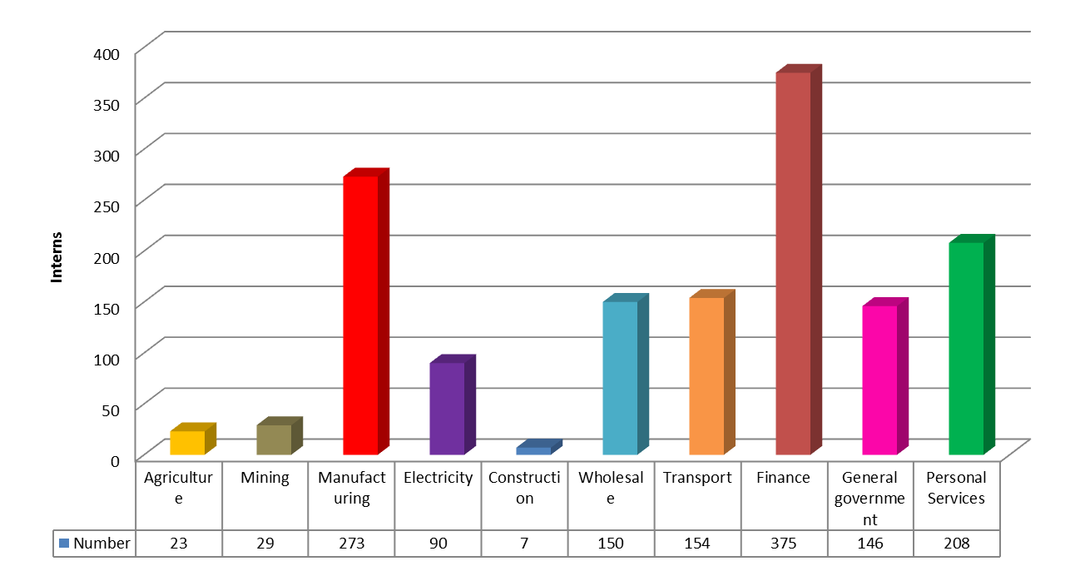
Sectoral Distribution of Placements

Slide 47
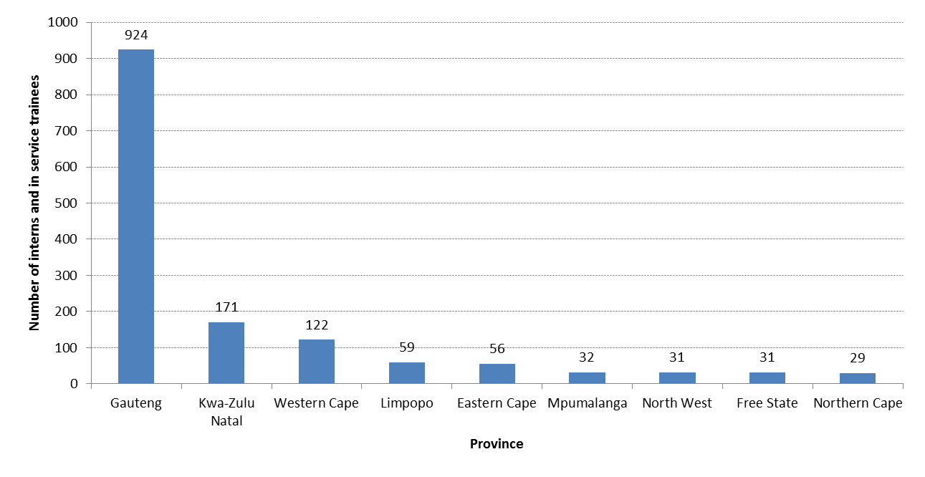
Placements of Interns and In service Trainees by Province

Slide 48
Itukise Phase 1: Assessment Report
(FEM External Evaluation)
75% of graduates found employment 6 months after the close of the programme
72% of respondents found the training helpful and effective
93% felt more employable after the programme
  76.3% of the interns indicated they worked in positions in line with their qualification.
57.4% of Itukise interns employed by host companies after the programme.
90% of the interns indicated they felt ready for employment after the programme.
98.5% of the host companies would like the Itukise programme to continue.

Slide 49


Slide 50
Ke ya leboga
Ke a leboha
Ke a leboga
Ngiyabonga
Ndiyabulela
Ngiyathokoza
Ngiyabonga
Inkomu
Ndi khou livhuha
Dankie
Thank you
50

