Slide 1

9 May 2017
PRESENTATION TO THE PORTFOLIO COMMITTEE OF HOME AFFAIRS
STRATEGIC PLAN 2017 - 2021
ANNUAL PERFORMANCE PLAN 2017/18
1

Slide 2

TABLE OF CONTENTS
ITEM | SLIDE NUMBER
1. STRATEGIC PLAN: 2017 - 2021
About Government Printing Works | 3-5
Contribution to National Government Priorities and Legislative mandate | 6–7
Institutional Transformation Process (2007-2017) | 8
Alignment with Home Affairs mandate and repositioning | 9-10
Progress on implementation of MTEF Strategic Outcome Orientated Goals | 11-25
MTEF Budget (2017 – 2021) | 26-29
2. ANNUAL PERFORMANCE PLAN (APP): 2017-2018
Priorities | 30-31
Branch: Operations and Production | 32-35
Branch: Strategic Management | 36 – 40
Branch: Financial Services | 41-45
Branch: Human Resources | 46 – 48
Conclusion | 49
6

Slide 3
CONTRIBUTION TO GOVERNMENT’S NATIONAL PRIORITIES
The Government Printing Works (GPW) strives to make a significant contribution to:
1
2
3
VISION
To be the State’s mandate security printer
To provide:
cost effective, secure, reliable and timeous printing services to all spheres of government
the public with equitable information; and
dissemination of government information, through technology, innovation and service excellence
MISSION
VALUES
Reliability
Integrity
Accuracy
Stakeholder satisfaction
4

Slide 4
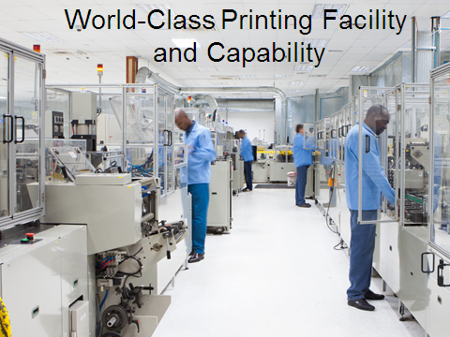
GPW PRODUCTS AND SERVICES
GPW is South Africa’s state security printing specialist with experience spanning more than 125 years
    smart ID cards
    identity documents
    passports
    visas and permits
    birth and education certificates
    examination materials, as well as government stationery and publications (bail receipts, government payment vouchers)
    Stocks items which are critical, highly sensitive and high intrinsic value
    Documents are owned by key departments and disseminated to all relevant departments
Major Customers
DHA
DOT
DOJ&CD
Treasury
Top Documents
DHA Forms
Birth Certificates
License Forms
Court Forms
AARTO Books

Slide 5

GOVERNMENT PRINTING WORKS (GPW)
HR PROFILE
TOTAL FUNDED POSTS 668 (563 filled)
OFFICE OF THE CEO
______
11
(2%)
BRANCH: OPERATIONS AND PRODUCTION
____________
329
(55.4%)
BRANCH:
STRATEGY MANAGEMENT
__________
57
(9.6%)
BRANCH: FINANCIAL SERVICES AND WAREHOUSE MANAGEMENT
______________
143
(24%)
BRANCH: HR
_________
22
(3.7%)
APPRENTISHIPS = 22
INTERNSHIPS = 7
GRADUATES = 23

Slide 6
CONTRIBUTION TO GOVERNMENT’S NATIONAL PRIORITIES
The Government Printing Works (GPW) strives to make a significant contribution to:
NATIONAL GOVERNMENT 14 OUTCOMES (MTEF)
Create a better South Africa and contribute to a better and safer Africa and World
An efficient, effective and development orientated public service and an empowered, fair and inclusive citizenship
A skilled and capable workforce to support an inclusive growth path
GPW
NATIONAL DEVELOPMENT PLAN (NDP)
“BUILDING A CAPABLE STATE”
DEPARTMENT OF HOME AFFAIRS MANDATE
4

Slide 7
LEGISLATIVE MANDATE
The Ministers of Finance, Home Affairs and Public Service and Administration
approved the business case and GPW was established as a Government
Component on 9 October 2009 (Government Gazette 32616); in terms of the
Public Service Act of 1994, as amended in 2007 - from which it derives its
legislative mandate.
A Government Component is defined as “a national or provincial government
component” as set out in section 7(1) and 7(2)(c) [column 1 of Part A of
Schedule 3] of the Public Service Act No 103 of 1994 (as substituted by the
Proclamation 59 Government Gazette 32566, 11 September 2009).
Minister is the Executive Authority for the Company
The Chief Executive Officer is the Company Accounting Officer
EXCO; MANCO; External Risk Committee; External Audit Committee forms part of the Company’s Governance Framework
6

Slide 8
GPW INSTITUTIONAL TRANSFORMATION
INSTITUTIONAL TRANSFORMATION JOURNEY
Road map to becoming a modern “print and media company” and full conversion into a Public Entity in terms of the PFMA
Established as a trading account within the Department of Home Affairs. National Treasury directed that government institutions be obliged to source all of their printing related services only from the GPW.
c
1976
Following various conversations, submission of business case to convert GPW into a government component i.t.o the Public Service Act
Cabinet approves the recommendation that the Department of Home Affairs be authorised to re-organise and rationalise government’s printing functions. The GPW is restructured as a trading entity
1996
2007-2008
2008/9
Continuation of facilitated discussions and pursuit in transforming into a Public Entity - development of new business case
GPW established as a government component i.t.o. Proclamation (Government Gazette 32616, 9 October 2009). Intended as an interim arrangement and linked to the DHA’s turnaround strategy
GPW completed its 3-year transition to becoming a government component
2013
2016
2017
We are here
GPW as a Public Entity which efficiently and effectively delivers on its mandate by providing quality media-, security printing and other general services to all organs of state and the private sector
CONFIDENTIAL

Slide 9
GOVERNMENT PRINTING WORKS (GPW) AS A HOME AFFAIRS ANCHOR AND PARTNER
NATIONAL SECURITY AND PROTECTION
Identity Security
Information Security
Systems security
MANDATORY SERVICES TO CITIZENS
Citizens and Non-Citizen’s mandatory products (ID, Birth, Death, Marriage, Visas and Permits)
ENABLING ECONOMIC GROWTH AND PLANNING
Strategic and Critical Skills
Job creation
Self sustainability
Research and Policy
Protection of State information
Secure Manufacturing equipment
Secure Printing
High Security official documentation to Citizens and
Public Information through Gazettes
Contribute to job creation in the Manufacturing and Printing Sector
Young and skilled Artisans in security printing & digitization
Research & Development in the Security Printing to keep up with technology
GOVERNMENT PRINTING WORKS (GPW)

Slide 10
GPW: ID AND PASSPORT SECURITY VALUE CHAIN
DHA
Front Office
Live Capture
GPW
Passport / ID
Personalisation
Passport / ID Dispatch
Front Office
Collections
CITIZEN
Application
Collection
Delivery
Front Office
SKYNET
GPW has been a critical partner in the DHA’s drive to modernise services

Slide 11
STRATEGIC OUTCOME ORIENTATED GOALS : MTEF
Strategic outcome oriented goal 1 | State-owned Company
Goal statement | To further develop the Government Component to become a State-owned Company
Strategic outcome oriented goal 2 | Optimise processes and facilities
Goal statement | To optimise processes and facilities to increase operational effectiveness and improve customer service
Strategic outcome oriented goal 3 | Developed workforce
Goal statement | To have an efficient, effective, well-trained and developed workforce; and a special remuneration dispensation for the Government Component.
13

Slide 12
GOAL 1 – STATE-OWNED COMPANY
13

Slide 13
STRATEGIC OUTCOME ORIENTED GOAL 1: State-owned Company
GPW is currently a self-funded National Government component established as such in 2009 in accordance with section 7(5)(c) of the Public Service Act, 1994 (Proclamation No. 103 of 3 June 1994) (“Public Service Act”) and listed in Part A of Schedule 3 to that Act.
The Bill is aimed at facilitating the conversion of GPW from a National Government Component into a State-Owned company, to enable GPW, once converted into a company, to operate as a business concern and outside the public service. The Company will be governed through provisions of the PFMA and the Company’s Act.
The service delivery and operating model will be reviewed in line with GPW’s policy direction
11

Slide 14
CONT…… PROGRESS ON CONVERSION PROCESS
Business Case approved by Executive Authority in 2016
GPW SOC Draft Bill approved by Executive Authority in January 2017
Socio-Economic Impact Assessment approved by DPME in January 2017
Presentation to JCPS Development Committee (February/ March / April 2017)
Presentation to JCPS Cabinet Cluster
18 May 2017
Presentation to JCPS DG’s Cluster on
2 May 2017
Presentation to NICOC on 31 March 2017
Preliminary final legal opinion from State Law Advisers
Tabling to Cabinet on 24 May 2017
Gazetting for Public Comment
Public Comments
(June / July 2017)
Re-tabling to Cabinet end July 2017
with final legal opinion from State Law Advisers
Tabling to Parliament end August 2017
10

Slide 15
Financial Year | Audit Opinion
2013/14 | Unqualified
2014/15 | Clean audit
2015/16 | Unqualified
2016/17 | In progress
13

Slide 16

 | 2016 | 2015 | 2014 | 2013 | 2012 | 2011 | 2010 | 2009
Revenue | 1 138 249 | 1 013 017 | 780 659 | 928 792 | 692 919 | 753 443 | 639 035 | 487 074
Cost of sales | (632 460) | (602 212) | (500 146) | (726 521) | (455 548) | (473 799) | (497 025) | (403 771)
Gross Profit | 505 789 | 410 805 | 280 513 | 202 271 | 237 371 | 279 644 | 142 010 | 83 303
Other income | 71 446 | 52 134 | 66 014 | 69 613 | 68 769 | 63 427 | 60 248 | 28 341
Operating expenses | (195 464) | (158 123) | (196 840) | (161 932) | (114 358) | (128 257) | (109 278) | (100 668)
Operating profit | 381 771 | 304 816 | 149 687 | 109 952 | 191 782 | 214 814 | 92 980 | 10 976
Interest received | 1 363 |  |  | 2 |  |  |  | 4 260
Profit for the year | 383 134 | 304 816 | 149 687 | 109 954 | 191 782 | 214 814 | 92 980 | 15 236
13

Slide 17
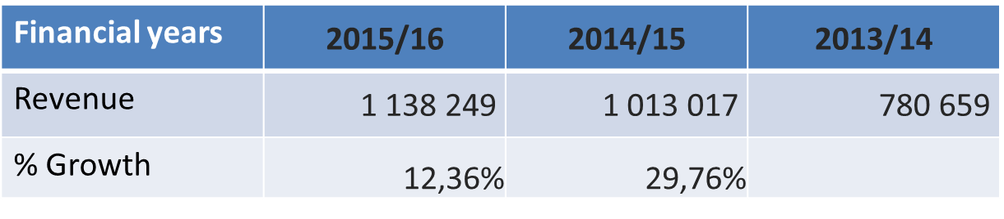
GPW FINANCIAL PERFORMANCE
The Revenue generation of the GPW has grown over the years as detailed below:
Consistent revenue growth is predicted
13

Slide 18
GOAL 2 – OPTIMISE PROCESSES AND FACILITIES
13

Slide 19
STRATEGIC OBJECTIVE 2 : OPTIMISE PROCESSES AND FACILITIES
Completion of Pavilion 3 construction project (Scheduled completion – end 2017 at a cost of R257 million)
The new building will accommodate a state-of-the art digital printing room with capacity to produce examination papers in a highly secure environment.
Document sortation system - large volumes of printed documents such as passports and ID-cards are sorted manually for distribution. The new production line will mechanise the sortation and packaging process. This will mean no human intervention in the production of smart ID cards from the time of live capture of the citizens details to the point of handover to the courier in the Dispatch Centre
2. Renovation of GPW Head Office (ABSA Building)
Renovate into a modern building at the corner of Visagie and Sophie de Bryn
Pedestrian bridge connecting Visagie factory precinct and Administration Building across the street. All Administration personnel to be house in the building
Overall cost estimated at R49 million
Completion planned for December 2017 / January 2018
13

Slide 20
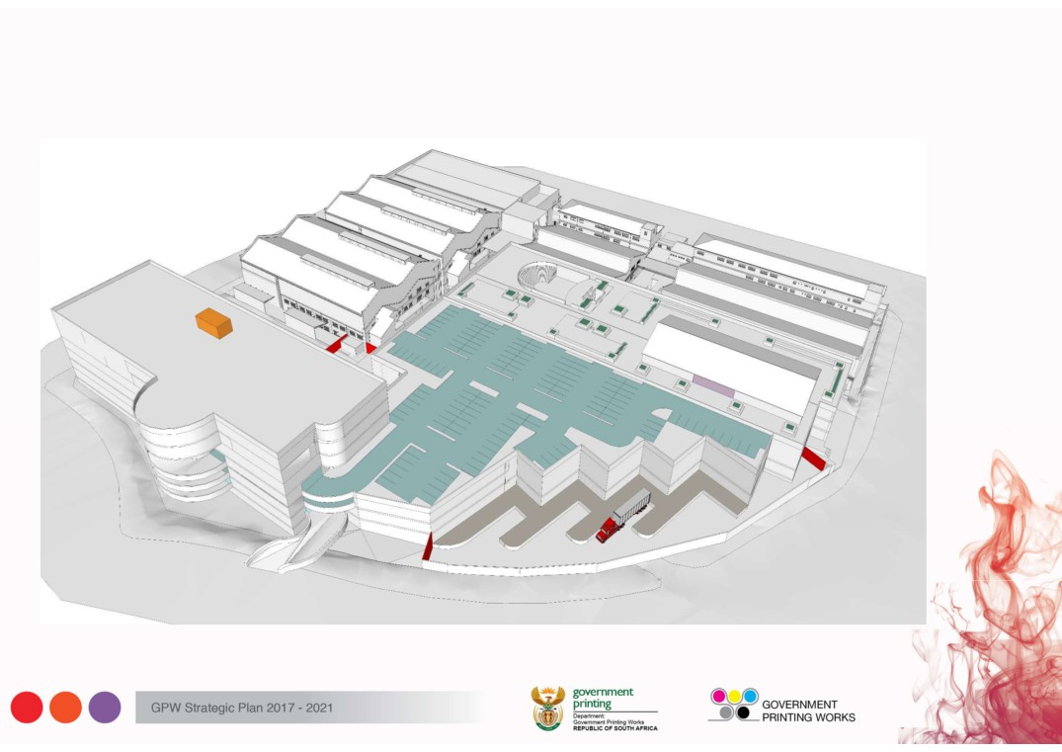
GPW MASTER PLAN – SCHEDULED COMPLETION: 2020
14

Slide 21
STRATEGIC OBJECTIVE 2 : OPTIMISE PROCESSES AND FACILITIES
3. Acquisition and commissioning of the printing equipment:
A multi-unit web fed printing press - At present GPW has a single web-fed printing press with capacity to produce printed matter with high value security features such as rainbow images, micro-text. The press is utilised for production of security documents such as residency permits, visas, birth certificates and others. GPW’s will acquire an additional press with similar capacity to provide for redundancy in support of its present limited capacity.
4. E-gazette System
Launched in 2012. Customers apply for publication of gazettes electronically using PDF files. Tones of papers saved every year. E-quotation model enforced from February 2017 with customer call centre to handle queries
5. Enterprise Resource Planning (ERP) System
Launched in 2012. ICT driven system. Working efficiently and constantly improved to ensure integration of manufacturing and financial systems.
13

Slide 22
GOAL 3 – DEVELOPED WORKFORCE
13

Slide 23
MTEF BUDGET: COMPENSATION OF EMPLOYEES
205 posts were filled in the 2016/17 financial year (6 SMS)
105 priority posts will be filled in the 2017/18 (7 SMS)
47

Slide 24
STAFF TRAINING AND DEVELOPMENT PROGRAMMES
Leadership Development Programme for middle and senior management
Performance Enhance training – linked to performance agreement and personal development plans
Internship = 7
Graduate Development Programme = 23
Apprenticeship Programme
      2014-2016 programme: 22
      2017-2019 programme in partnership with P&FM Seta and Printing Federation of SA (Printing SA): 18
26

Slide 25
EMPLOYEE RELATIONS – ORGANISED LABOUR
PUBLIC SERVICE ASSOCIATION (PSA) = 81,87% MEMBERSHIP
NEHAWU = 18.13% MEMBERSHIP
DISCUSSION MATTERS AT DIVISIONAL BARGAINING COUNCIL (DBC)
State Owned Company conversion
Salary discrepancies (Public Services vs Printing Industry)
Implementation of resolutions (recognition of improved qualifications)
Job Evaluation
26

Slide 26
MEDIUM TERM EXPENDITURE FRAMEWORK (MTEF)
2017/18 to 2019/20
47

Slide 27
MTEF BUDGET: REVENUE
The GPW does not get any funding from the fiscus. It generates revenue in order to cover its operations, it is thus self funded.
The Department of Home Affairs (DHA) is the GPW’s biggest customer and the revenue targets is linked to the targets the DHA has included in its APP.
The below projections is taking the above into account:
47

Slide 28
MTEF BUDGET: PER COST CENTRE
47

Slide 29
MTEF BUDGET: PER COST CENTRE
GPW has 5 Cost Centers for budget purposes.
Productions and Operations is the core of the GPW. The machinery currently employed by the GPW is custom built and requires replacement in regular intervals to ensure that the GPW continues delivering the high quality of goods. The construction of the Visage Street factory is budgeted under this cost centre. The increase year on year is to fund the renovations to the factory.
Financial Services include facilities management. The GPW is in the process of appointing a service provider to conduct the renovations of the building purchased in the 2015/16 financial year. The increase in the budget under financial services is to cater for these renovations. It is estimated that the renovations will be completed by the end of the 2018/19 financial year.
Strategic Management includes Legal Services and Marketing. The increase over the MTEF period is to capacitate the cost centre. Although the cost centre existed on the GPW organizational structure, it was not operationalized and funded adequately.
Human Resources received a minimal growth over the MTEF period.
Office of the CEO includes Internal Audit and Information Communication and Technology (ICT). The annual increase in the budget of the Office of the CEO is due to the replacement of computer equipment and software that ICT is implementing. Security printing is the heart of the GPW and in order to the GPW to continue offering this printing service, the technology should be secure and advance to maximize quality and efficiency.
47

Slide 30
2017/18
ANNUAL PERFORMANCE PLAN (APP)
24

Slide 31
2017-2018 PRIORITIES
GPW will:
Manage the State Owned Entity conversion process until final approval by Cabinet and Parliament.
Continue to implement the MTEF Strategic Plan and APP commitments
Implement the Asset recapitalisation and optimization of facilities programme (including updated and secure technology)
Ensure return on investment and ensure sound financial management and sustainability
Long term vision – State security printer of choice (Vision 2030) that will allow us to pursue SADC and African Union member states to utilize GPW as a service provider for State and non-state printing.
Capacitate and train the workforce to meet market and client demands
47

Slide 32
BRANCH: OPERATIONS AND PRODUCTION
26

Slide 33
GPW’S TARGETS PER BRANCH: 2017/18
Strategic Outcome 2: Optimize processes and facilities
Strategic Objective | Indicator | Medium term targets
 |  | 2017/18 | 2018/19 | 2019/20
Acquire modern production equipment to satisfy all State security printing requirements | Number of equipment items procured and commissioned | Recapitalisation plan rescheduled for 2019/20 | Recapitalisation plan rescheduled for 2019/20 | 3 new equipment items procured according to the Recapitalisation Plan
Produce security printed materials according to customer requirements and local/ international standards | Identity Cards distributed according to client’s specifications | 100% of Identity Documents/ Cards distributed must conform to the client’s specifications | 100% of Identity Documents/ Cards distributed must conform to the client’s specifications | 100% of Identity Documents/ Cards distributed must conform to the client’s specifications
Produce security printed materials according to customer requirements and local/ international standards | Travel Documents delivered according to client’s specifications | 100% of Travel Documents delivered must conform to the client’s specifications | 100% of Travel Documents delivered must conform to the client’s specifications | 100% of Travel Documents delivered must conform to the client’s specifications
Produce security printed materials according to customer requirements and local/ international standards | Examinations Scripts delivered according to Quality specifications | 100% of examination papers delivered must conform to the client’s specifications | 100% of examination papers delivered must conform to the client’s specifications | 100% of examination papers delivered must conform to the client’s specifications.
26

Slide 34
GPW’S TARGETS PER BRANCH: 2017/18
Strategic Outcome 2: Optimize processes and facilities
Strategic Objective | Indicator | Medium term targets
 |  | 2017/18 | 2018/19 | 2019/20
Produce security printed materials according to customer requirements and local/ international standards | Government Gazette published according to Quality specifications | 100% of Government Gazettes published to conform to quality and timeline specifications | 100% of Government Gazettes published to conform to quality and timeline specifications | 100% of Government Gazettes published to conform to quality and timeline specifications
Construction of pavilion 3 completed New Head office building completed Construction of Remaining GPW Visagie Street Site 10% complete | Progress of Construction of Secure Facilities | Construction of pavilion 3 completed New Head office building completed. Construction of Remaining GPW Visagie Street Site 10% complete. | Construction of Remaining GPW Visagie Street Site 40% complete | Construction of Remaining GPW Visagie Street Site 80% complete
26

Slide 35
GPW’S TARGETS PER BRANCH: 2017/18
Branch Performance Indicator | Reporting period | Annual target | Quarterly targets
 |  |  | 1st | 2nd | 3rd | 4th
Number of equipment items procured | Annually | Recapitalisation plan rescheduled for 2019/20 |  |  |  | Recapitalisation plan rescheduled for 2019/20
Identity Cards distributed according to clients specifications | Quarterly | 100% of Identity Documents/ Cards distributed must conform to the client’s specifications | 100% of Identity Documents/ Cards distributed must conform to the client’s specifications | 100% of Identity Documents/ Cards distributed must conform to the client’s specifications | 100% of Identity Documents/ Cards distributed must conform to the client’s specifications | 100% of Identity Documents/ Cards distributed must conform to the client’s specifications
Travel Documents delivered according to client’s specifications | Quarterly | 100% of Travel Documents delivered must conform to the client’s specifications | 100% of Travel Documents delivered must conform to the client’s specifications | 100% of Travel Documents delivered must conform to the client’s specifications | 100% of Travel Documents delivered must conform to the client’s specifications | 100% of Travel Documents delivered must conform to the client’s specifications
Examinations Scripts delivered according to Quality specifications | Quarterly | 100% of examination papers delivered must conform to the client’s specifications | 100% of examination papers delivered must conform to the client’s specifications | 100% of examination papers delivered must conform to the client’s specifications | 100% of examination papers delivered must conform to the client’s specifications | 100% of examination papers delivered must conform to the client’s specifications
26

Slide 36
BRANCH: STRATEGIC MANAGEMENT
AND
OFFICE OF THE CEO
26

Slide 37
GPW’S TARGETS : BRANCH STRATEGIC MANAGEMENT AND OFFICE OF CEO
Strategic Outcome 1: State Owned Company
Strategic Objective | Indicator | Medium term targets
 |  | 2017/18 | 2018/19 | 2019/20
Secure and protect ICT assets | Percentage of security vulnerabilities (detected by security assessments) mitigated | >99% security vulnerabilities mitigated | >99% security vulnerabilities mitigated | >99% security vulnerabilities mitigated
Availability of ICT services | Availability of ICT systems | >99% system availability | >99% system availability | >99% system availability
Introduce new and or re-design ICT service offerings | Percentage (number) of ICT services offerings identified implemented | >80% ICT services offerings identified implemented | >80% ICT services offerings identified implemented | >80% ICT services offerings identified implemented
Diversification of product mix within security printing | Number of new security products developed for customers | 3 new security products developed | 3 new security products developed | 3 new security products developed
Conversion of the Government Component to a State Owned Company | Completed design and implemented procedures identified in the business case to support the establishment of a State Owned Company | Publication of Bill and finalization of Memorandum of Incorporation and Shareholder Compact | State Owned Company Bill approved | Implement the establishment of the State Owned Company
26

Slide 38
GPW’S TARGETS : BRANCH STRATEGIC MANAGEMENT AND OFFICE OF CEO
Strategic Outcome 1: State Owned Company
Strategic Objective | Indicator | Medium term targets
 |  | 2017/18 | 2018/19 | 2019/20
To protect and secure the assets, people and information of GPW | Developed and implemented security risk management plan | Implement 100% security risk management programs in accordance with approved plan. | Review and Implement 100% security risk management plan in line with SOC requirements | Implement 100% security risk management plan in line with SOC requirements
To assist management to improve organizational operations by providing assurance and consulting services on the adequacy and effectiveness of internal controls, governance and risk management processes | Percentage of annual internal audit plan implemented. | 90% of annual internal audit plan implemented | 90% of annual internal audit plan implemented | 90% of annual internal audit plan implemented
Implement controlled risk management environment | Percentage of annual risk & compliance plan implemented | 100 % of annual risk & compliance plan as approved by the Risk Committee, implemented | 100 % of annual risk & compliance plan as approved by the Risk Committee, implemented | 100 % of annual risk & compliance plan as approved by the Risk Committee, implemented
26

Slide 39
GPW’S TARGETS : BRANCH STRATEGIC MANAGEMENT AND OFFICE OF CEO
Branch Performance Indicator | Reporting period | Annual target | Quarterly targets
 |  |  | 1st | 2nd | 3rd | 4th
Percentage of security vulnerabilities (detected by security assessments) mitigated | Annually | >99% security vulnerabilities mitigated |  |  |  | >99% security vulnerabilities mitigated
Availability of ICT | Quarterly | >99% system availability | >99% system availability | >99% system availability | >99% system availability | >99% system availability
Percentage (number) of ICT services offerings identified implemented | Annually | >80% ICT services offerings identified implemented |  |  |  | >80% ICT services offerings identified implemented
Number of new security products developed for customers | Annually | 3 new security products developed |  |  | 1 new security product developed | 2 new security products developed
Establishment of State Owned Company | Annually | Submit all required and identified documentation for the establishment of a State Owned Company to Parliament for approval |  |  |  | Submit all required and identified documentation for the establishment of a State Owned Company to Parliament for approval
26

Slide 40
GPW’S TARGETS : BRANCH STRATEGIC MANAGEMENT AND OFFICE OF CEO
Branch Performance Indicator | Reporting period | Annual target | Quarterly targets
 |  |  | 1st | 2nd | 3rd | 4th
To protect and secure the assets, people and information of GPW | Annually | Implement 100% security risk management programs in accordance with the approved plan | Implement security risk management programs in accordance with the approved plan | Implement 40% security risk management programs | Implement 40% security risk management programs | Implement 20% security risk management programs in accordance with the approved plan
Percentage of annual internal audit plan implemented | Annually | 90% of annual internal audit plan implemented |  |  |  | 90% of annual internal audit plan implemented
Percentage of annual risk & compliance plan implemented | Annually | 100 % of annual risk & compliance plan as approved by the Risk Committee, implemented |  |  |  | 100 % of annual risk & compliance plan as approved by the Risk Committee, implemented
26

Slide 41
BRANCH: FINANCIAL SERVICES
26

Slide 42
GPW’S TARGETS PER BRANCH: 2017/18 – FINANCIAL SERVICES
Further develop the government component (SOC)
Strategic Objective | Indicator | Medium term targets
 |  | 2017/18 | 2018/19 | 2019/20
Provide quality financial and supply chain management services in compliance with legislation and stakeholders needs to contribute towards financial sustainability | Clean audit report | Maintain unqualified audit opinion for 2016/17 | Maintain unqualified audit opinion for 2017/18 | Maintain unqualified audit opinion for 2018/19
Provide quality financial and supply chain management services in compliance with legislation and stakeholders needs to contribute towards financial sustainability | Operating cost as percentage of revenue | 18% Operating cost as percentage of revenue | 17.6% Operating cost as percentage of revenue | 18% Operating cost as percentage of revenue
Provide quality financial and supply chain management services in compliance with legislation and stakeholders needs to contribute towards financial sustainability | Gross profit margin | 28% gross profit margin | 25.5% gross profit margin | 27.3% gross profit margin
Provide quality financial and supply chain management services in compliance with legislation and stakeholders needs to contribute towards financial sustainability | Debtor collection period | 80 days debtor collection period | 80 days debtor collection period | 80 days debtor collection period
Provide quality financial and supply chain management services in compliance with legislation and stakeholders needs to contribute towards financial sustainability | Maintain a positive working capital ratio | 5 Positive working capital ratio | 5 Positive working capital ratio | 5 Positive working capital ratio
26

Slide 43
GPW’S TARGETS PER BRANCH: 2017/18 – FINANCIAL SERVICES
Further develop the government component (SOC)
Strategic Objective | Indicator | Medium term targets
 |  | 2017/18 | 2018/19 | 2019/20
Provide quality financial and supply chain management services in compliance with legislation and stakeholders needs to contribute towards financial sustainability | Inventory turnover ratio | 3 Inventory turnover ratio | 3 Inventory turnover ratio | 3 Inventory turnover ratio
Provide quality financial and supply chain management services in compliance with legislation and stakeholders needs to contribute towards financial sustainability | Number of SLA’s concluded with external customers and suppliers | Conclude SLA’s with 10 external customers 10 suppliers | Conclude SLA’s with 10 external customers 10 suppliers | Conclude SLA’s with 10 external customers 10 suppliers
Provide quality financial and supply chain management services in compliance with legislation and stakeholders needs to contribute towards financial sustainability | Return on capital investment | 19% return on capital investment | 16% return on capital investment | 17% return on capital investment
26

Slide 44
GPW’S TARGETS PER BRANCH: 2017/18 – FINANCIAL SERVICES
Branch Performance Indicator | Reporting period | Annual target | Quarterly targets
 |  |  | 1st | 2nd | 3rd | 4th
Clean audit report | Annually | Maintain unqualified audit opinion for 2016/17 |  | Maintain unqualified audit opinion for 2016/17
Operating cost as percentage of revenue | Quarterly | 18% Operating cost as percentage of revenue | 15.9% Operating cost as percentage of revenue | 18.4% Operating cost as percentage of revenue | 18.5% Operating cost as percentage of revenue | 19.1% Operating cost as percentage of revenue
Gross profit margin | Quarterly | 28% gross profit margin | 48.6% gross profit margin | 21.4% gross profit margin | 21.2% gross profit margin | 20.7% gross profit margin
Debtor collection period | Quarterly | 80 days Debtor collection period | 80 days Debtor collection period | 80 days Debtor collection period | 80 days Debtor collection period | 80 days Debtor collection period
Maintain a positive working capital ratio | Quarterly | 5 Positive working capital ratio maintained | 5 Positive working capital ratio maintained | 5 Positive working capital ratio maintained | 5 Positive working capital ratio maintained | 5 Positive working capital ratio maintained
26

Slide 45
GPW’S TARGETS PER BRANCH: 2017/18 – FINANCIAL SERVICES
Branch Performance Indicator | Reporting period | Annual target | Quarterly targets
 |  |  | 1st | 2nd | 3rd | 4th
Inventory turnover ratio | Quarterly | 3 Inventory turnover ratio | 3 Inventory turnover ratio | 3 Inventory turnover ratio | 3 Inventory turnover ratio | 3 Inventory turnover ratio
SLA’s concluded | Annually | Conclude SLA’s with 10 external customers 10 suppliers |  |  |  | Conclude SLA’s with 10 external customers 10 suppliers
Return on capital investment | Annually | 19% return on capital investment |  |  |  | 19% return on capital investment
Percentage completed construction of secured facilities | Annually | Construction of pavilion 3 completed Master plan for remainder of facilities complete |  |  |  | Construction of pavilion 3 completed Master plan for remainder of facilities complete
Completed design and implemented procedures identified in the business case to support the establishment of a State Owned Company | Annually | Publication of Bill and finalization of Memorandum of Incorporation and Shareholder Compact |  |  |  | Publication of Bill and finalization of Memorandum of Incorporation and Shareholder Compact
26

Slide 46
BRANCH: HUMAN RESOURCES
26

Slide 47
GPW’S TARGETS PER BRANCH: 2017/18 – HUMAN RESOURCES
Strategic Outcome 3: Developed workforce
Strategic Objective | Indicator | Medium term targets
 |  | 2017/18 | 2018/19 | 2019/20
Human Resource Staffing Plan | Revised and implemented Human Resource staffing plan | Implement 100% revised Human Resource staffing plan | Revise Human Resource staffing plan 100% completed in line with conversion to State Owned Company | Implement 100% Human Resource staffing plan in line with conversion to State Owned Company
Human Resource Staffing Plan | Fill positions in accordance with identified needs | Fill 85% of positions identified in accordance with HR staffing plan | Fill 85% of positions identified in accordance with HR staffing plan | Fill 85% of positions identified in accordance with HR staffing plan
Learning and Development Plan | Develop GPW Training and Development Programmes | Develop 3 GPW training and development programmes | Implement 3 GPW training and development programmes | Evaluating the effectiveness of the 3 implemented training and development programmes
Learning and Development Plan | Provide training and development | 2 average training interventions based on organizational / employee developmental needs | 3 average training interventions based on GPW developmental needs | 3 average training interventions based on GPW developmental needs
26

Slide 48
GPW’S TARGETS PER BRANCH: 2017/18 – HUMAN RESOURCES
Branch Performance Indicator | Reporting period | Annual target | Quarterly targets
 |  |  | 1st | 2nd | 3rd | 4th
Revised and implemented Human Resource staffing plan | Quarterly | Implement revised Human Resource staffing plan | Implement 25% of revised Human Resource staffing plan | Implement 50% of revised Human Resource staffing plan | Implement 75% of revised Human Resource staffing plan | Implement 100% revised Human Resource staffing plan
Fill positions in accordance with identified needs | Quarterly | Filled 85% of posts identified for filling in accordance with HR staffing plan | 20% of identified posts filled | 50% of identified posts filled | 70% of identified posts filled | Filled 85% of posts identified for filling in accordance with HR staffing plan
Develop internal GPW Training and Development Programmes | Bi - annually | Develop 3 GPW training and development programmes |  | 1 training and development programme developed | 1 training and development programme developed | 3 training and development programmes developed
Provide training and development | Quarterly | 2 average training interventions per person | 25% of identified target completed | 50% of identified target completed | 75% of identified target completed | 2 average training interventions
26

Slide 49
CONCLUSION
GPW continues to provide services to government and its agencies as per the mandate and key priorities;
Revenue generated will be invested into the professionalisation of the Company;
The approval of the GPW SOC Bill and conversion into an SOC remains central to the achievement of the vision;
Security of documentation and facilities is a priority; and
Management will continue to prioritise capacitation and skilling of personnel
46

Slide 50
THANK YOU
46

