Slide 1
Presentation to the Portfolio Committee on Mineral Resources
Annual Performance Plan 2017/2018

Slide 2
Strategic Overview

Slide 3
Presentation outline
Strategic overview
Financial overview
Annual Performance plan per programme
Concluding Remarks

Slide 4
Strategic overview
Mandate
Legislative Mandate
The Department’s mandate is derived from section 24 of the Constitution of South Africa (Act No. 108 of 1996).
The Mineral and Petroleum Resources Development Act (Act No. 28 of 2002) as amended, Mine Health and Safety Act (Act No. 29 of 1996) as amended provide the regulatory framework for the promotion and regulation of the industry, as well as the equitable access to and the sustainable development of the nation’s mineral resources and related matters.

Slide 5
Strategic overview
Vision 2020
Vision 2030
Mission
A globally competitive, sustainable and meaningfully transformed mining and minerals sector.
Promote and regulate the minerals and mining sector for transformation, growth and development, and ensure that all South Africans derive sustainable benefit from the country’s mineral wealth.
A leader in the transformation of South Africa through economic growth and sustainable development by 2030.

Slide 6
Strategic overview
Values
Batho Pele (people first)
Ethics
Honesty
Integrity
Accountability
Professionalism
Ubuntu

Slide 7
Strategic overview
Integrated Plan outlining priority areas of the Department
Transformation and Inclusion through decisive interventions to ensure increased black ownership and participation in the sector.
Stakeholder engagements towards growing the sector sustainably
State ownership in the mining sector
Upstream Petroleum Investment including the hiving off of PASA
Attracting Investment and Growing the sector, through mineral investment promotion:
Focus will be on black ownership and participation; Community benefit from mining activities; Monitoring and enforcement of compliance and finalising the MPRDA and Mining Charter.

Slide 8
Strategic overview
Integrated Plan outlining priority areas of the Department
Transformation and Inclusion through decisive interventions to ensure increased black ownership and participation in the sector.
Attracting Investment and Growing the sector, through mineral investment promotion.
Focus will be on black ownership and participation; Community benefit from mining activities; Monitoring and enforcement of compliance and finalising the MPRDA and Mining Charter
Stakeholder engagements towards growing the sector sustainable
State ownership in the mining sector
Upstream Petroleum Investment including the hiving off of PASA

Slide 9
Strategic overview
Integrated Plan outlining priority areas of the Department
Mineral Beneficiation
Beneficiation strategy developed with implementation plan, and Identification of 3 practical projects for support as well as work of Mintek and State Diamond Trader.
Skills Development
Improved coordination of skills development initiatives

Slide 10
Strategic overview
Integrated Plan outlining priority areas of the Department
Enablers for the plan to be implemented
Internal Efficiencies are improved, through:
Integrated information and systems including development of information sharing, management and efficient use of systems
Review and execution of a DMR Brand & Communication strategy
Review the Department Service Delivery Model

Slide 11
Strategic overview
Integrated Plan outlining priority areas of the Department
Enablers for the plan to be implemented
Improving coordination and streamlining of efforts of SOEs especially in skills, beneficiation, small scale mining, investment promotion and international relations
Entity Oversight, through ensuring alignment of resources and collaboration across other Department and entities by:
Review of the Governance Framework for SOEs to include regular engagements with entities at a senior level.

Slide 12
Strategic overview
Outcome oriented goals
Equitable and sustainable benefit from mineral resources
Efficient, effective and development-oriented department
Outcome 4:
Transformed minerals sector
Increased investment in the minerals, mining and petroleum sectors
Outcome 4:
Decent employment through inclusive economic growth
Outcome 6:
An efficient, competitive and responsive economic infrastructure network
Outcome 4:
Outcome 6
Outcome 10:
Environmental assets and natural resources that are well protected and continually
enhanced
Outcome12:
An efficient, effective and development- oriented public service and an empowered fair and inclusive citizenship

Slide 13
Strategic overview
Office of the Director General
Strategy Risk and entity oversight including internal audit
Branch Financial Administration
Branch: Corporate Services
Branch: Mine Health and Safety
Branch: Mineral Regulations
PASA
Diamond and Precious Metal Regulator
Mine Health and Safety Council
Branch: Mineral Policy and Promotion
Council for Geoscience
Mintek
State Diamond Trader
Ministry
Programme structure

Slide 14
Financial Overview

Slide 15
Financial overview over the MTEF
Description | 2017/18 | 2018/19 | 2019/20
 | R ‘000 | R ‘000 | R ‘000
MTEF Allocation | 1 779 449 | 1 906 669 | 1 850 012
The increase over the medium term is due to additional funding allocated for digital
information system, building, equipment and facilities in Counsel for Geoscience(CGS) equipment and facilities, Research and Development and efficiency projects in Mintek; expanded public works programme for derelict and ownerless mines and Petroleum Agency of South Africa (PASA) first baseline allocation.
The increase over the medium term is due to additional funding
allocated for digital information system, building, equipment and facilities in CGS;
equipment and facilities, Research and Development and efficiency projects in Mintek;
expanded public works programme for derelict and ownerless mines and Petroleum Agency of South Africa first baseline allocation.

Slide 16
Financial overview over the MTEF
Description |  | 2017/18 | 2018/19 | 2019/20
 |  | R ‘000 | R ‘000 | R ‘000
Revised Baseline | 1 779 449 | 1 906 669 | 1 850 012 | 5 536 130
Reprioritised Indicative Baseline | 1 847 244 | 1 824 594 | 1 938 867 | 5 610 705
Change to baseline | (67 795) | 82 075 | (88 855) | (74 575)
The increase over the medium term is due to additional funding
allocated for digital information system, building, equipment and facilities in CGS;
equipment and facilities, Research and Development and efficiency projects in Mintek;
expanded public works programme for derelict and ownerless mines and Petroleum Agency of South Africa first baseline allocation.
The budget allocation for the MTEF period amounts to R5.5 billion which represents 3.5% nominal growth , in real terms the MTEF budget growth is -2.2%.
The net change to 2016/17 baseline relates to a reduction of R74.575 million over the MTEF, of which R20.300 million was effected on compensation of employees, and R7,074 million on goods and services

Slide 17
Financial overview over the MTEF

Slide 18
Financial overview over the MTEF

Slide 19
Financial overview over the MTEF
DESCRIPTION | 2017 MTEF
 | 2017/18 | 2018/19 | 2019/20
 | R ‘000 | R ‘000 | R ‘000
Compensation of employees (COE) | 572 760 | 598 008 | 643 596
The original 2017/18 allocation for compensation of employees was R579, 130 million and during Estimate of National Expenditure an amount of R6, 370 million was cut by National Treasury to R572, 760 million which represent 31.1% of the total departmental budget. The CoE baseline allocation is now capped at R572.7 million in 2017/18; R598.0 million in 2017/18 and R643.6 million in 2018/19.

Slide 20
Financial overview over the MTEF
DESCRIPTION | 2017 MTEF
 | 2017/18 | 2018/19 | 2019/20
 | R ‘000 | R ‘000 | R ‘000
Goods and Services | 273 901 | 288 489 | 304 175
Goods and services budget represents only 15.39% (R273.901 million) of the 2017/2018 total budget of R1.779 billion and 15.65% (R886.565 million) of the R5.536 billion over the MTEF. The budget was reduced by R7.074 over the MTEF period to cater for compulsory efficiency savings.

Slide 21
Financial overview over the MTEF

Slide 22
Financial overview over the MTEF
Transfers and Subsidies
 |  | R’000 | R’000 | R’000
Departmental agencies and accounts |  | 430 855 | 461 506 | 392 310
South African Diamond and Precious Metals Regulator | 55 865 | 59 105 | 62 415 | 177 385
Mine Health and Safety Council | 6 162 | 6 519 | 6 884 | 19 565
Council for Geoscience | 366 988 | 393 909 | 320 928 | 1 081 825
Mining Qualification Authority | 1 840 | 1 973 | 2 083 | 5 896
Public corporations and private enterprises | 483 199 | 538 833 | 489 008 | 1 511 040
Mintek | 367 256 | 420 368 | 369 989 | 1 157 613
Industrial Development Corporation of South Africa | 28 805 | 30 476 | 32 183 | 91 464
Petroleum Agency of South Africa | 87 138 | 87 989 | 86 836 | 261 963
Total | 914 054 | 1 000 339 | 881 318 | 2 795 711

Slide 23
Financial overview over the MTEF

Slide 24
Financial overview over the MTEF
Allocation per programme in R’

Slide 25
Financial overview over the MTEF

Slide 26
Financial overview over the MTEF
The targets set by programmes are based on the funds available, more needs to be done to transform the industry.
The Department has seen an improved performance on the audit outcome of 2015/16 financial year – the Department however remain inadequately funded, these include funding for integrated systems which could make access to information easier and improve operational excellence.
The funding of strategic priorities are sourced from the baseline allocation, with continuous trade-offs that the department must apply.
This process is not sustainable , at some point permanent funding will have to be allocated to the baseline in order to improve efficiency and service delivery to the people of South Africa.

Slide 27
Programme 1: Administration
Purpose
To provide strategic support and management services to Ministry and the Department of Mineral resources.

Slide 28
Programme 1: Administration Financial Administration
Strategic objectives
Provide efficient services to internal and external customers (Customer perspective) .
Implement processes and systems( Processes).
Manage financial resources(Financial).
Promote corporate governance(Financial). services to internal and external customers

Slide 29
Programme 1: Administration_ Financial Administration
Provide efficient services to internal and external customers
95% achievement of Service Level Agreement
Level 3 Customer satisfaction index(1–5)
100% of financial reports delivered on schedule
100% of suppliers paid within 30 days

Slide 30
Programme 1: Administration_ Financial Administration
Implement Processes and systems
100% implementation of the Master Systems Plan

Slide 31
Programme 1: Administration_ Financial Administration
Manage Financial Resources
≤2% variance on allocated budget
No incidents of irregular expenditure
100% implementation of asset management plan

Slide 32
Programme 1: Administration_ Financial Administration
Promote corporate governance
100% implementation of management action plan (Internal Audit)
100% implementation of management action plan (External Audit)
100% adherence to compliance framework
100% implementation of risk management plans
100% Implementation of ICT Governance Initiatives % achievement of Service Level Agreement

Slide 33
Programme 1:
Corporate Services

Slide 34
Programme 1: Administration _ Corporate Services
Strategic objectives
Contribute to skills development
Contribute to skills development
Sustainably develop vulnerable groups
Communicate DMR programmes with internal and external stakeholders
Provide adequate facilities for effective service delivery

Slide 35
Programme 1: Administration_ Corporate Services
Contribute to skills development
Mining Career Awareness Initiatives
Bursaries on Mining related qualifications

Slide 36
Programme 1: Administration_ Corporate Services
Sustainably develop vulnerable groups
Facilitation of projects for women, people with disability and youth

Slide 37
Programme 1: Administration_ Corporate Services
Communicate DMR programmes with internal and external stakeholders
Branding or re-branding of DMR offices – national and regional
Media and Stakeholder engagements held
Public Participation initiatives implemented to raise awareness on DMR programmes and policies
Published/Broadcast items from DMR initiated activities
Manage DMR Online platforms – Website, intranet and Social Media
Revamp of the DMR website
Internal Communication initiatives to raise awareness of DMR policies and programmes

Slide 38
Programme 1: Administration_ Corporate Services
Provide adequate facilities for effective service delivery
Facilities aligned with business needs
Development of the facility management strategy

Slide 39
Programme 1: Administration_ Corporate Services
Improve internal processes/guidelines/procedures
-Policies and guidelines(10)
- Processes improved(15)
-Operating procedures(10)

Slide 40
Programme 1: Administration_ Corporate Services
Legal support and advisory
- Timeous response to opinion, appeals , inquiries, agreement and litigations(80%)
Incident enquiries

Slide 41
Programme 1: Administration_ Corporate Services
Improved Turnaround times
adherence to defined turnaround times (100%)

Slide 42
Programme 1: Administration_ Corporate Services
Implementation of National Strategies
Vetting
Pre-employment screening
Screening of contractors
Gender Equality strategic plans
Health and safety and wellness programmes

Slide 43
Programme 1: Administration_ Corporate Services
Compliance with HR legislation
Human resource development initiatives aligned to the National skills development strategy
Maintain vacancy to an acceptable level
Affirmative action measures implemented

Slide 44
Programme 2:
Mine Health and Safety

Slide 45
Programme 2: Mine Health and Safety
Purpose
To execute the Department’s mandate to safeguard the health and safety of the mine workers and people affected by mining activities

Slide 46
Programme 2: Mine Health and Safety
Strategic objectives
Promote Health and Safety.
Contribute to skills development.
Implement Service Level Agreements.
Develop and review internal processes.
Improve turnaround times.

Slide 47
Programme 2: Mine Health and Safety
Promote Health and Safety.
Percentage reduction in occupational fatalities and injuries.
20% improvement per annum.
Percentage reduction in occupational diseases (including TB). - 10% improvement per annum.
Percentage Investigations and Inquiries completed.
- 80% per annum.

Slide 48
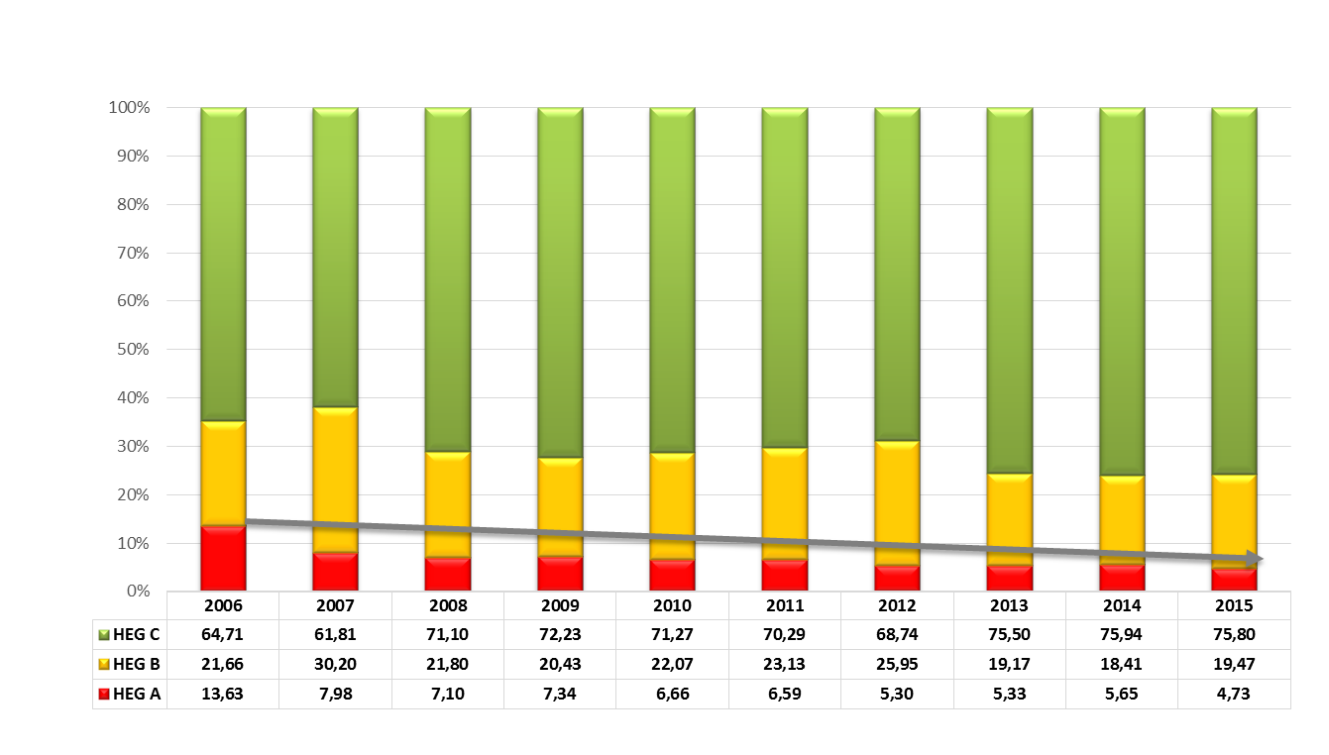
Programme 2: Mine Health and Safety
% Exposures to Employees Noise – 10 years trend

Slide 49
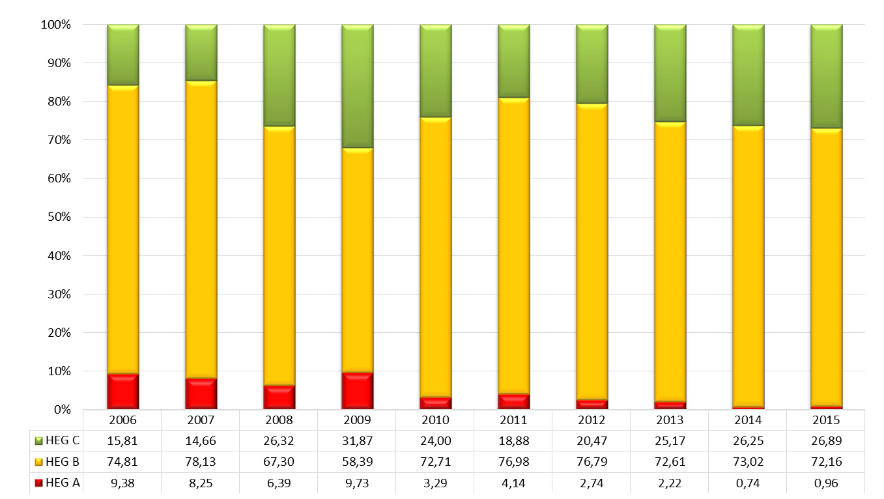
Programme 2: Mine Health and Safety
% Exposures to Employees Noise – 10 years trend

Slide 50
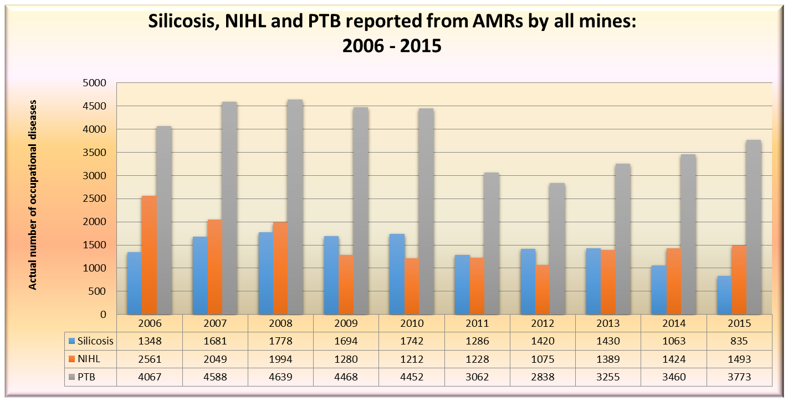
Programme 2: Mine Health and Safety

Slide 51
Programme 2: Mine Health and Safety

Slide 52
Programme 2: Mine Health and Safety
Data elements | 2013 Labour force 432 032 | 2014 Labour force 465 923 | 2015 Labour force 476 625
Counselled for HIV | 229 151 (54.2%) | 259 297 (55.7%) | 299 566 (62.9%)
Tested for HIV | 192 557 (84%) | 183 202 (70.7%) | 191 333 (64.1%)
HIV positive | 17 384 | 19 084 | 21 913
Co-infected | 2905 (80.8%) | 2820 (63.2%) | 3063 (72.7%)
Living with HIV and on ART | 28 887 | 24 740 | 27 272

Slide 53
Programme 2: Mine Health and Safety
Data elements | 2013 Labour force 432 032 | 2014 Labour force 465 923 | 2015 Labour force 476 625
Screened for TB | 308 403 (72.9%) | 376 718 (80.8%) | 422 670 (88.7%)
Diagnosed with TB | 3593 (1.2%) | 4461 (1.2%) | 4211 (1.0%)
On TB treatment | 3483 | 3999 | 4367
Diagnosed with MDR-TB and on Treatment | 149 (4.1%) 172 | 190 (4.3%) 197 | 112 (2.7%) 131
Diagnosed XDR-TB and treatment | 11(0.3%) 11 | 18 (0.4%) 18 | 14 (0.3%) 14

Slide 54
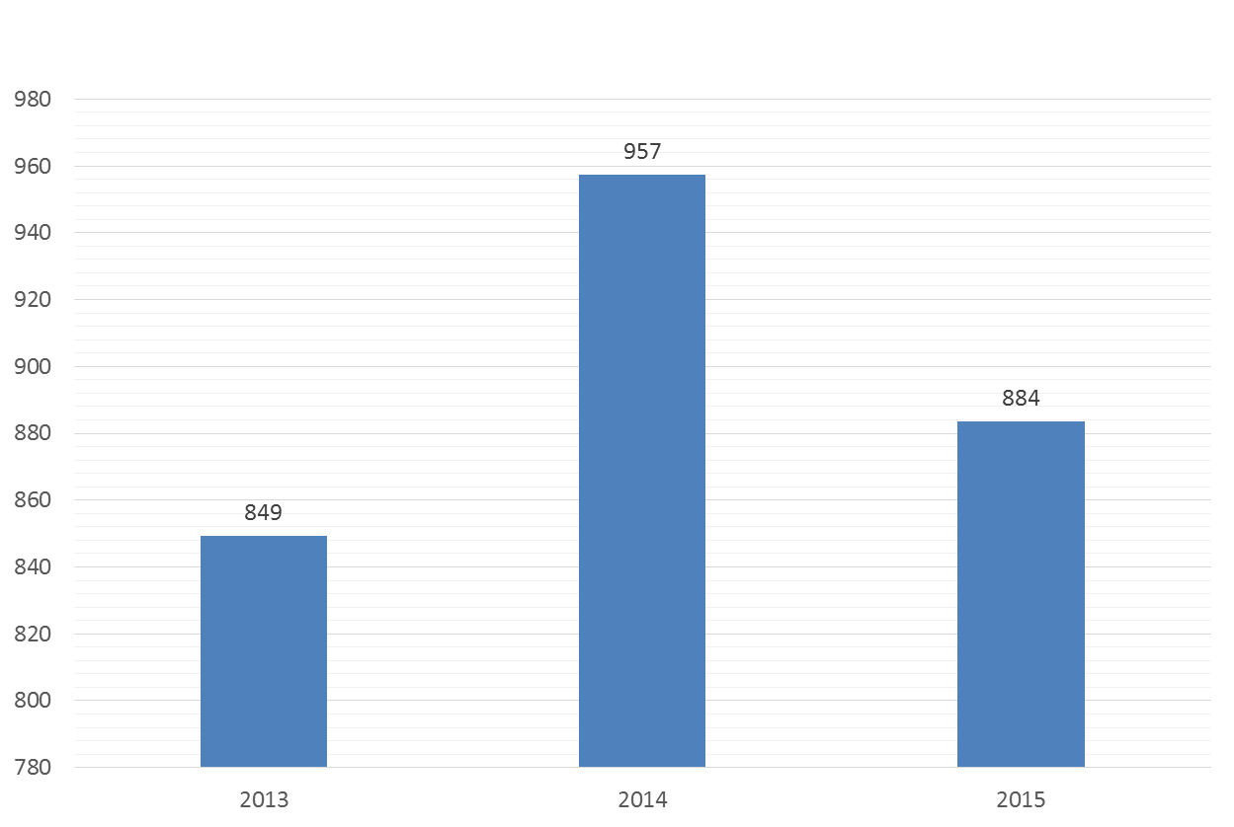
Programme 2: Mine Health and Safety
TB Incidence in SAMI

Slide 55
Programme 2: Mine Health and Safety
Promote Health and Safety.
Number of Tripartite workshops conducted (40).
Mine Health and Safety Annual Report.
Number of Audits conducted (396).
Number of Inspections conducted (8000).

Slide 56
Programme 2: Mine Health and Safety
Contribute to skills development
Implement certificates of competency model to improve pass rate.
Collaborate with DHET and other stakeholders through Mining Qualifications Authority (MQA) to ensure implementation of skills development programmes.

Slide 57
Programme 2: Mine Health and Safety
Implement Service Level Agreements.
Percentage adherence to SLAs (100%).

Slide 58
Programme 2: Mine Health and Safety
Develop and review internal processes.
Percentage of identified internal processes developed, implemented and reviewed (100%).

Slide 59
Programme 2: Mine Health and Safety
Improve turnaround times.
Percentage adherence to prescribed timeframes for medical appeals (80%).
Percentage adherence to prescribed timeframes for Chief Inspector of Mines appeals (100%).

Slide 60
Programme 3: Mineral Regulations

Slide 61
Programme 3: Mineral Regulations
Purpose
To regulate the minerals and mining sectors to ensure economic development, employment and ensure transformation and environmental compliance.

Slide 62
Programme 3: Mineral Regulations
Strategic objectives
Promote Job Creation
Promote Sustainable Resource Use and Management
Reduce State environmental liability and financial risk
Implement transformation policies / legislation
Monitor and enforce compliance
Improve turn around times

Slide 63
Programme 3: Mineral Regulations
Promote Job Creation
Number of jobs created –
Issuing mining rights and implementation of Social and Labour Plans
Compliance inspections
Number of SLP development projects
Implementation of Social and Labour Plans
Compliance inspections

Slide 64
Programme 3: Mineral Regulations
Promote Sustainable Resource Use and Management
Percentage of approved work programmes relative to Rights issued considering the elements of sustainable development
100% - Adjudicate work programmes
Percentage of approved Social and Labour Plans relative to Rights issued considering the elements of sustainable development
100% - Adjudicate Social and Labour Plan
Percentage of approved Environmental Authorisations (EAs) relative to rights issued considering the elements of sustainable development
100% - Adjudicate Environmental Management Programme/ Environmental Authorisations

Slide 65
Programme 3: Mineral Regulations
Reduce State environmental liability and financial risk
Percentage orders issued to remedy inadequate financial provision - (100%)
Through:
review of environmental management programmes in respect of financial provision and performance assessment reports
Issue statutory notices in cases of non-compliance
Percentage closure certificates issued in line with regulatory framework -(100%)
assessment of closure applications in line with section 43 of the MPRDA

Slide 66
Programme 3: Mineral Regulations
Implement transformation policies / legislation
Number of rights and permits issued to HDSA controlled entities
150 per annum
Number of consultations/engagements and conflict management with communities and the mining industry
150 per annum
Number of industry workshops
(9) (1 per province)

Slide 67
Programme 3: Mineral Regulations
Monitor and enforce compliance
A total of 2062 inspections would be conducted to monitor and enforce compliance (100%)

Slide 68
Programme 3: Mineral Regulations
Improve turn around times
Adjudicate prospecting and mining rights applications in line with granting or refusal timeframes

Slide 69
Programme 3: Mineral Regulations
The Framework Agreement for Sustainable Mining
The Framework Agreement for Sustainable Mining was signed by stakeholders in July 2013.
Ensuring rule of law, peace and stability
Strengthening Labour Relations
Implementation of human settlement interventions and improving workplace relations
Short to medium term measures to support growth and stability
Long term measure to support growth and stability
The Framework had the following key commitments:

Slide 70
Programme 4: Mineral Policy and Promotion
Purpose
To develop mining, minerals and upstream petroleum industries' policies and promote investment and development of these industries.

Slide 71
Programme 4: Mineral Policy and Promotion
Strategic objectives
Promote investment in the mining, minerals and upstream petroleum sectors
Facilitate transformation in the mining and minerals sector
Develop and review internal processes
Improve turnaround times
Manage and implement mineral resource diplomacy
Promote sustainable resource use and management
Integrated and aligned environmental efforts

Slide 72
Programme 4: Mineral Policy and Promotion
Stakeholder perspective
Implementation of Ocean Economy Operation Phakisa
(100%)
Support for SMME’s in mining
(80)
Social dialogue with social partners
(4)
Implementation of Shale Gas Action Plan
(100%)
Minerals and Petroleum Investment Promotion Strategy
(1)
Report on Critical Minerals for NDP
(1)
Technical and promotional publications
(12)
Promote investment in the mining, minerals and upstream petroleum sectors
Investment Promotional Events
(55)
Report on mineral input quantities for beneficiation value chains (1)

Slide 73
Programme 4: Mineral Policy and Promotion
Stakeholder perspective
Manage and Implement Mineral Resource Diplomacy
Technical and Strategic Partnerships with other Countries
(3)

Slide 74
Programme 4: Mineral Policy and Promotion
Stakeholder perspective
Promote sustainable resource use and management
Technical partnerships implemented with SOE’s and governmental organisations
(5)
A reviewed EMP Document
(1)
Rehabilitation of derelict and ownerless mines
(45)
Mine Environmental Tools Developed
(3)
Reports on Mine Closure & Derelict and Ownerless Mines
(4)

Slide 75
Programme 4: Mineral Policy and Promotion
Stakeholder perspective
Engagements with Relevant Departments
(4)
Integrated and Aligned Environmental Efforts

Slide 76
Programme 4: Mineral Policy and Promotion
Stakeholder perspective
Facilitate transformation in the mining and minerals sector
Legislative Instruments developed and reviewed
(5)
Ensure MPRDA, MinCoSA and MHSA Bills are processed and finalised
Finalise Mining Charter
Develop Mining company of South Africa( MinCoSA) and amend MPRDA, & Mine Health and Safety Act (MHSA) Regulations

Slide 77
Programme 4: Mineral Policy and Promotion
Business Processes
Develop and review internal processes
Develop and review internal processes
(1)
- Review of internal business processes to improve efficiency
Improve turnaround times
(95%)
- Adherence to prescribed time frames

Slide 78
Programme 4: Mineral Policy and Promotion
Progress in the Mineral Beneficiation strategy
Amending of Mining Charter to strengthen the Procurement element.
Collaboration with DTI on capital goods programme (to leverage off the amended Mining Charter).
Working with IDC on their strategic high impact projects with focus on manufacturing fuel cells in the country.

Slide 79
Programme 4: Mineral Policy and Promotion
Progress on exploration of Shale Gas
Hydraulic Fracturing Monitoring Committee (HFMC) has been constituted and is comprised of the Department of Science and Technology (DST), the Department of Energy (DoE), the Department of Environmental Affairs (DEA), the Department of Water and Sanitation (DWS) and the SOEs, namely Petroleum Agency South Africa (PASA) and the Council for Geoscience (CGS).
The Regulations for Petroleum Exploration and Production have been finalised and were gazetted in June 2015. The Regulations have included provisions for the protection and coexistence of the SKA and shale gas development.
The Department is engaged in public awareness session in line with the shale gas communication strategy.

Slide 80
Programme 4: Mineral Policy and Promotion
Implementation of Budget Review Recommendations
State Liability for environmental legacy of mining
The national strategy for management and rehabilitation of D & O is in place.
Costing of asbestos (provision) is approx. R2 billion.
Road map for the Parliamentary processes for legislation
The MinCoSA Bill – currently being processed through the government Cluster system.
Compliance with Mining Charter
DMR has reviewed the Mining Charter with a view to strengthen elements on mine communities and labour sending areas to benefit from mining, to be gazetted soon.
Procurement in Mining Charter
The reviewed Mining Charter is being strengthened with focus on local content.

Slide 81
Concluding Remarks
Transforming the mining sector meaningfully and sustainably continues to be our focus area, we are confident that the plan has responded adequately to the National Development Plan, the recommendations from Budget Review Processes , Nine Point Plan , State of the Nation address and other plans of government.
The Department has put in processes in place to ensure that annual performance plan is implemented effectively.

Slide 82
Thank you
Thank You

