Slide 1
Seda Annual Performance Plan 2017/18 – 2019/20
Presentation to the Portfolio Committee on Small Business Development
Ms Mandisa Tshikwantamba, CEO
3 May 2017

Slide 2
Presentation Outline
Key Insights on the SMME sector
Major considerations during the 2016/17 strategic planning cycle.
Alignment with the DSBD through the Portfolio Strategy Framework
Seda’s Strategy Architecture
Seda’s Balanced Scorecard
Seda’s Budget
Seda’s Vote 31 – ENE Allocations

Slide 3
Key Insights on the SMME sector (Source: SMME Quarterly Update, 3rd Quarter 2016/17; BER).

Slide 4
Challenges faced by SMMEs and Cooperatives .
Access to finance and credit
Start-up SMMEs and Cooperatives not financed easily.
Obstacles to credit access
Poor infrastructure
Low levels of research and development
Onerous labour laws
Labour laws discourage SMMEs to employ
An inadequately educated workforce
Skills shortage a constraint
Inefficient government bureaucracy
Permit delays are an obstacle
Lack of coordination in government
High levels of crime
Security spending pushes up costs
Lack of access to markets
More rural areas lack market access
BER, Stellenbosch University, 2016

Slide 5
SMME ownership by race: 2015/16Q3 vs 2016/17Q3
BER, Stellenbosch University, 2017

Slide 6
SMMEs by province: 2015/16Q3 vs 2016/17Q3
BER, Stellenbosch University, 2017

Slide 7
SMMEs by industry: 2015/16Q3 vs 2016/17Q3
BER, Stellenbosch University, 2017

Slide 8
Major considerations during the 2016/17 strategic planning cycle.

Slide 9
Major considerations
Board resolution to implement a Balanced Scorecard planning and performance management system.
Department of Small Business Development’s (DSBD) planning cycle and areas of focus.
The Development of the Portfolio Strategy Framework to align the plans of the DSBD, Sefa and Seda.
The possible implications of local government elections on programmes done in partnership with local government
Sector trends based on research done with Bureau of Economic Research.
Engagements with the Portfolio Committee, e.g. on areas such as assisting township and rural enterprises and cooperatives, etc.

Slide 10
Alignment with the DSBD through the Portfolio Strategy Framework

Slide 11
Portfolio Strategic Framework 2015/16 – 2019/20
Portfolio Strategic Framework 2015/16 – 2019/20 seeks to align the plans of the DSBD, Sefa and Seda and will feed into a larger Sectoral Strategy Framework that will be used to coordinate the entire SMME sector.
The Framework has five Strategic Outcome Oriented Goals which are linked to the National Development Plan and the MTSF 2014-2019 Sub-Outcomes, which are:
Policy and planning coherence in the sector, that promotes an enabling ecosystem for SMMEs and co-operatives.
Equitable access to responsive and targeted products and services that enables the growth and development of SMMEs and co-operatives.
An enhanced contribution to socio-economic development outcomes by the sector.
Sound governance and the optimal utilisation of available resources.
A professional and capacitated Small Business Development Sector.

Slide 12
Portfolio Strategic Framework 2015/16 – 2019/20
Over an above ensuring alignment of the Seda APP 2017/18 – 2019/20 to the Portfolio Strategic Framework 2015/16 – 2019/20 , Seda will also contribute to the five Strategic Outcome Oriented Goals by prioritising the flowing:
Strategic Outcome Oriented Goals | Seda Contribution and Role
Policy and planning coherence in the sector, that promotes an enabling ecosystem for SMMEs and co-operatives. | Seda will in future establish incubators, branches and colocation points in underserviced areas.
Equitable access to responsive and targeted products and services that enables the growth and development of SMMEs and co-operatives. | Seda has harmonised its demographic indicators and targets with those of the Portfolio Strategy Framework

Slide 13
Portfolio Strategic Framework 2015/16 – 2019/20
Strategic Outcome Oriented Goals | Seda Contribution and Role
An enhanced contribution to socio-economic development outcomes by the sector. | Seda has done research and is currently working on a service delivery model for township based small enterprises
Sound governance and the optimal utilisation of available resources. | Seda has implemented the balanced scorecard system to ensure sound management and optimal resource allocation
A professional and capacitated Small Business Development Sector. | Seda will work with partner institutions towards the development and professionalization of the small business development sector.

Slide 14
Seda Strategy Architecture

Slide 15
Seda’s Strategic Pillars
Vision – To be the centre of excellence for small enterprise development in South Africa.
Mission – To promote entrepreneurship and develop small enterprises by providing customised non-financial business support services that results in business growth and sustainability in collaboration with other role players
Values – Customer centricity, Nurturing, Innovation and Responsible conduct
Goal – Ensure that the small enterprise sector grows and increases its contribution to sustainable and equitable social and economic development, employment and wealth creation.

Slide 16
Seda’s Service Offerings
For survivalist and micro enterprises
Entrepreneurship awareness | Franchise awareness
Business start-up training | Business planning
Business registrations | Business start-up advice
For small and medium enterprises
Access to local markets | Access to export opportunities
Incubation | Access to technology
Quality and standards testing, advice and implementation | Hotline to assist with late payment of SMMEs
Business mentoring | Facilitation of access to finance
For collectively owned enterprises
Social facilitation and mobilisation | Cooperatives development and registration
Access to local markets | All other relevant products and services still apply
For people with disabilities
Programmes with DeafSA and SANCB | All other relevant products and services still apply

Slide 17
Seda’s Delivery Network

Slide 18
Outcome-oriented goals and strategic themes of Seda.
Government Outcome 4: Decent employment through economic growth Government outcome 7: Vibrant, equitable, sustainable rural communities contributing towards food security for all
Ultimate Outcome (Impact) | Increased contribution of small enterprises and cooperatives to the SA economy, and promotion of economic growth, job creation and equity.
Intermediate Outcomes | Increase in turnover of assisted small enterprises and cooperatives Increased number of people employed in assisted small enterprises and cooperatives Reduced mortality rate of assisted small enterprises and cooperatives
Seda’s Strategic Themes | Increased service delivery | Improved operational excellence | Increased stakeholder partnering

Slide 19
Seda’s Balanced Scorecard

Slide 20
Seda’s Tier 1 Balanced Scorecard

Slide 21
Planned Programme Performance

Slide 22
Seda’s Budget
The total Revenue budget for Seda for the 2017/18 financial year amounts to R796,19 million and the total Expenditure budget amounts to R796,19 million.
The Vote 31 contribution to the Seda budget is R575,766 million to Seda and R159,935 million to the Seda Technology Programme.
Budget 2017/18
Direct Service Delivery
77.11%
Support Functions
22.89%

Slide 23
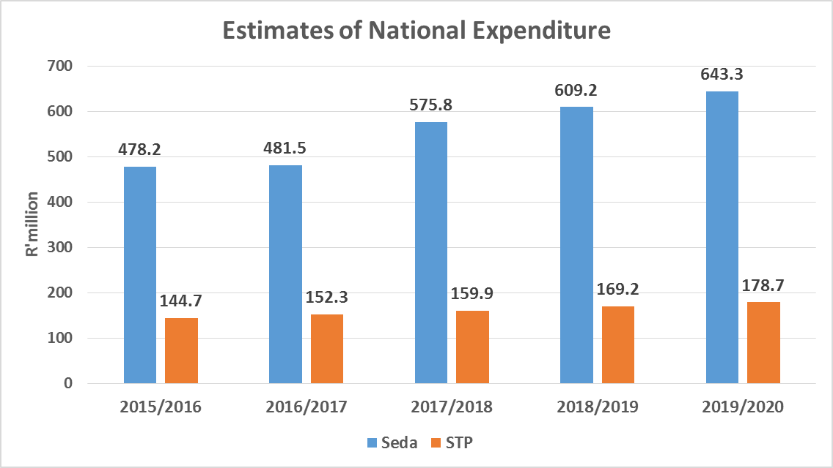
Seda’s Vote 31 – ENE Allocations

