Slide 1
DRDLR 2017/18
ANNUAL PERFORMANCE PLAN
PRESENTATION TO PORTFOLIO COMMITTEE ON RURAL DEVELOPMENT AND LAND REFORM
3 MAY 2017

Slide 2
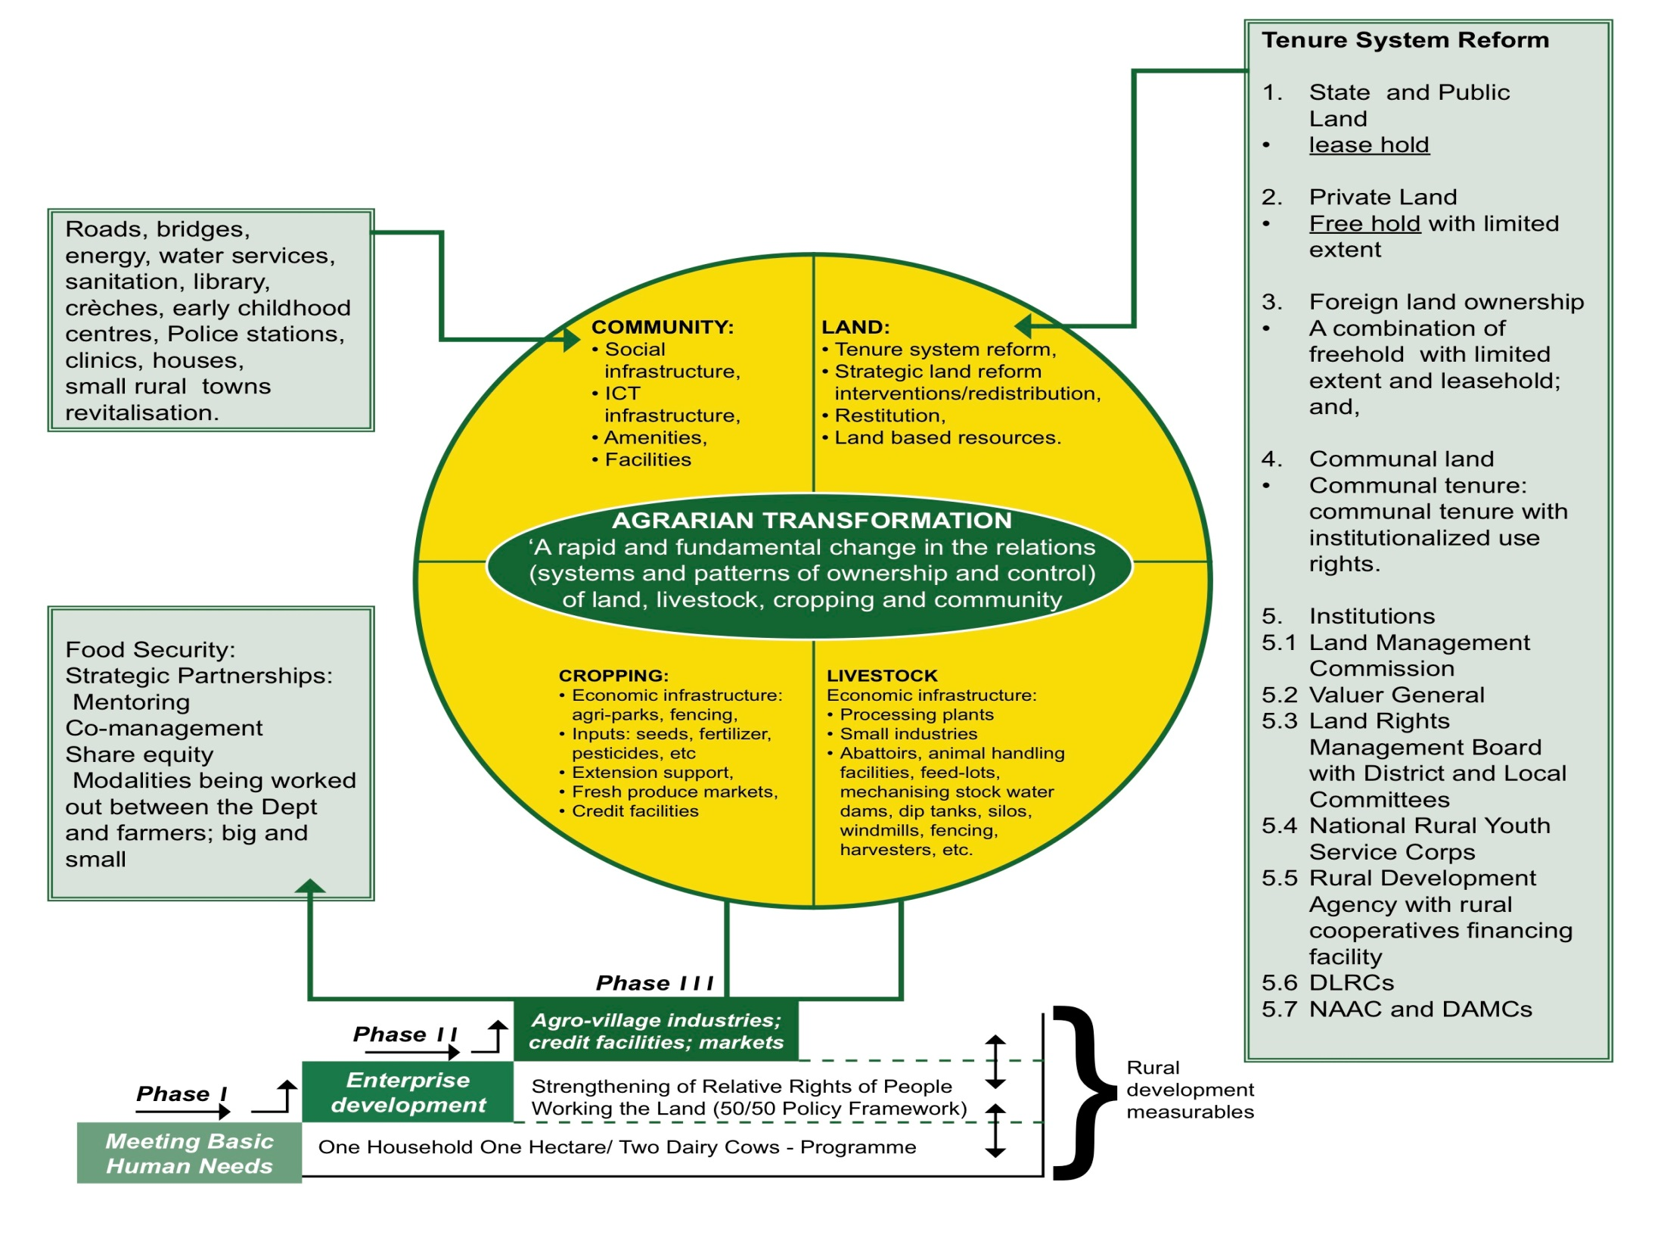
RURAL ECONOMY TRANSFORMATION:
AGRARIAN TRANSFORMATION SYSTEM

Slide 3
Programme 1: Administration

Slide 4
STRATEGIC OBJECTIVE INDICATOR
Strategic Objective Indicator |  | Strategic Plan Target | Estimated Performance | Medium-Term Targets
 |  |  | 2016/17 | 2017/18 | 2018/19 | 2019/20
1.1 | % compliance with all public sector legal prescripts by 2020 | 100% | 70% | 80% | 90% | 100%

Slide 5
PERFOMANCE INDICATORS AND ANNUAL TARGETS
Strategic Objective Statement |  | Performance Indicator | Annual Target | Medium-Term Targets
 |  |  | 2017/18 | 2018/19 | 2019/20
1.1 | Ensure 100% compliance with government regulation and legal prescripts by 2020 | % of valid invoices paid within 30 days upon receipt by supply chain management | 100% | 100% | 100%
1.2 | Obtain an unqualified regularity audit opinion on financial and non-financial performance by 2020 | Unqualified audit opinion | Unqualified audit opinion | Unqualified audit opinion | Unqualified audit opinion with no material findings on performance and compliance

Slide 6
PERFOMANCE INDICATORS AND QUARTELY TARGETS
Performance Indicator |  | Reporting Period | Annual Target | Quarterly Targets
 |  |  | 2017/18 | 1st | 2nd | 3rd | 4th
1.1.1 | % of valid invoices paid within 30 days upon receipt by supply chain management | Quarterly | 100% | 100% | 100% | 100% | 100%
1.2.1 | Unqualified audit opinion | Quarterly | Unqualified audit opinion | - | Unqualified audit opinion | - | -

Slide 7
Programme 2: Geospatial and Cadastral Services

Slide 8
STRATEGIC OBJECTIVE INDICATOR
Strategic Objective Indicator |  | Strategic Plan Target | Estimated Performance | Medium-Term Targets
 |  |  | 2016/17 | 2017/18 | 2018/19 | 2019/20
2. | Number of deeds and documents registered | 4 912 294 | 929 241 | 996 975 | 1 011 928 | 1 027 108

Slide 9
PERFOMANCE INDICATORS AND ANNUAL TARGETS
Strategic Objective Indicator |  | Performance Indicator | Estimated Performance | Medium-Term Targets
 |  |  | 2016/17 | 2017/18 | 2018/19 | 2019/20
2.1 | Ensure integrated and comprehensive land administration system | Number of District Rural Development Plans facilitated for implementation | 15 | 35 District Rural Development Plans (DRDPs) implementation plan | 44 District Rural Development Plans implementation plan | Monitoring and evaluation of 44 District Rural Development Plans (DRDPs)
 |  | % of Deeds made available within 7 days from lodgement for execution | 95% | 95% | 95% | 95%

Slide 10
PERFOMANCE INDICATORS AND ANNUAL TARGETS
Strategic Objective Indicator |  | Performance Indicator | Estimated Performance | Medium-Term Targets
 |  |  | 2016/17 | 2017/18 | 2018/19 | 2019/20
2.1 | Ensure integrated and comprehensive land administration system | Number of maps of the national map series produced | 199 | 204 | 209 | 219
 |  | Average number of working days taken to process registerable diagrams, sectional plans and general plans | 14 | 14 | 14 | 14

Slide 11
PERFOMANCE INDICATORS AND QUARTERLY TARGETS
Performance Indicator |  | Reporting Period | Annual Target | Quarterly Targets
 |  |  | 2017/18 | 1st | 2nd | 3rd | 4th
2.1.1 | Number of district RDPs facilitated for implementation | Quarterly | 35 DRDPs implementation plans | 35 DRDPs facilitated for approval by municipal councils | Monitoring report on the implementation of DRDPs (35) | Monitoring report on the implementation of DRDPs (35) | 35 DRDPs implementation report
2.1.2 | % of Deeds made available within 7 days from lodgement for execution | Quarterly | 95% | 95% | 95% | 95% | 95%

Slide 12
PERFORMANCE INDICATORS AND QUARTELY TARGETS CONT….
Performance Indicator |  | Reporting Period | Annual Target | Quarterly Targets
 |  |  | 2017/18 | 1st | 2nd | 3rd | 4th
2.1.3 | Number of maps of the national map series produced | Quarterly | 204 | 50 | 54 | 48 | 52
2.1.4 | Average number of working days taken to process registerable diagrams, sectional plans and general plans | Quarterly | 14 | 14 | 14 | 14 | 14

Slide 13
Programme 3: Rural Development

Slide 14
STRATEGIC OBJECTIVE INDICATORS
Strategic Objective Indicator |  | Strategic Plan Target | Estimated Performance | Medium-Term Targets
 |  |  | 2016/17 | 2017/18 | 2018/19 | 2019/20
3.1 | % support provided towards rural economic transformation | 100% | New indicator | 70% | 80% | 100%
3.2 | Number of opportunities provided for successful implementation of the CRDP. | 62620 | 15000 | 18720 | 14200 | 14700

Slide 15
PERFORMANCE INDICATORS AND ANNUAL TARGETS
Strategic Objective Statement |  | Performance Indicator | Annual Target | Medium-Term Targets
 |  |  | 2017/18 | 2018/19 | 2019/20
3.1 | Facilitation of infrastructure development to support rural economic transformation by 2020 | Number of infrastructure projects facilitated to support production | 120 | 130 | 130
 |  | Number of Agri-parks infrastructure projects facilitated | 53 | 53 | 53
 |  | Number of socio –economic projects facilitated in support of the Revitalisation of Rural Towns and villages | 30 | 10 | 10
3.2 | Facilitate the development of rural enterprises and industries in areas with economic development potential and opportunities by 2020 | Number of new Agricultural enterprises supported in the 44 districts aligned to Agri-parks | 141 | 150 | 159
 |  | Number of new non-agricultural enterprises supported in the 44 districts | 55 | 60 | 66

Slide 16
PERFORMANCE INDICATORS AND ANNUAL TARGETS
Strategic Objective Statement |  | Performance Indicator | Annual Target | Medium-Term Targets
 |  |  | 2017/18 | 2018/19 | 2019/20
3.3 | Increase job opportunities and ensure skills development through CRDP and land reform initiatives by 2020 | Number of skills development opportunities provided in rural development initiatives. | 6 612 REID: 3000 RID: 3612 | 5 200 REID:3200 RID: 2000 | 5400 REID: 3400 RID: 2000
 |  | Number of job opportunities created in rural development initiatives | 5448 REID: 2918 RID: 2530 | 6 700 REID: 3200 RID: 3500 | 6 700 REID: 3200 RID: 3500

Slide 17
PERFORMANCE INDICATORS AND QUARTERLY TARGETS
Performance Indicator |  | Reporting Period | Annual Target | Quarterly Targets
 |  |  | 2017/18 | 1st | 2nd | 3rd | 4th
3.1.1 | Number of infrastructure projects facilitated to support production | Quarterly | 120 | 24 | 27 | 29 | 40
3.1.2 | Number of Agri-parks infrastructure projects facilitated | Quarterly | 53 | 1 | 6 | 20 | 26
3.1.3 | Number of socio-economic facilitated in support of the Revitalization of Rural Towns and villages | Quarterly | 30 | 2 | 9 | 7 | 12
3.2.1 | Number of new Agricultural enterprises supported in the 44 districts aligned to Agri-parks | Quarterly | 141 | 11 | 46 | 58 | 26
3.2.2 | Number of new non-agricultural enterprises supported in the 44 districts | Quarterly | 55 | 5 | 20 | 22 | 8

Slide 18
PERFORMANCE INDICATORS AND QUARTERLY TARGETS
Performance Indicator |  | Reporting Period | Annual Target | Quarterly Targets
 |  |  | 2017/18 | 1st | 2nd | 3rd | 4th
3.3.1 | Number of skills development opportunities provided in rural development initiatives. | Quarterly | 6612 RID 3612 (RDMS: 1480 NARYSEC: 2132) REID: 3000 | 1135 RID: 639 (RDMS:150 NARYSEC: 489) REID: 496 | 1 768 RID: 943 (RDMS: 380 NARYSEC:563) REID: 825 | 1 968 RID: 943 (RDMS:530 NARYSEC: 413) REID: 1025 | 1 741 RID: 1087 (RDMS: 420 NARYSEC: 667) REID: 654
3.3.2 | Number of job opportunities created in rural development initiatives | Quarterly | 5448 RID: 2530 REID: 2918 | 1017 RID: 450 REID: 567 | 1448 RID: 600 REID: 848 | 1641 RID: 750 REID: 891 | 1342 RID: 730 REID: 612

Slide 19
Programme 4: Restitution

Slide 20
STRATEGIC OBJECTIVE INDICATOR
Strategic Objective Indicator |  | Strategic Plan Target | Estimated Performance | Medium-Term Targets
 |  |  | 2016/17 | 2017/18 | 2018/19 | 2019/20
4.1 | Number of land claims finalised | 2047 | 454 | 724 | 832 | 865

Slide 21
PERFOMANCE INDICATORS AND ANNUAL TARGETS
Strategic Objective Statement |  | Performance Indicator | Annual Target | Medium-Term Targets
 |  |  | 2017/18 | 2018/19 | 2019/20
4.1 | Facilitate the restoration of land rights or alternative forms of equitable redress by 2020 | Number of land claims settled | 1001 | 1151 | 1179
 |  | Number of phased projects approved | 105 | 112 | 118
 |  | Number of claims lodged by 1998 to be researched | 916 | - | -

Slide 22
PERFORMANCE INDICATORS AND QUARTELY TARGETS
Performance Indicator |  | Reporting Period | Annual Target | Quarterly Targets
 |  |  | 2017/18 | 1st | 2nd | 3rd | 4th
4.1.1 | Number of land claims settled | Quarterly | 1001 | 200 | 290 | 280 | 231
4.1.2 | Number of phased projects approved | Quarterly | 105 | 18 | 29 | 31 | 27
4.1.3 | Number of claims lodged by 1998 to be researched | Quarterly | 916 | 916 | - | - | -

Slide 23
Programme 5: Land Reform

Slide 24
STRATEGIC OBJECTIVE INDICATORS
Strategic Objective Indicator |  | Strategic Plan Target | Estimated Performance | Medium-Term Targets
 |  |  | 2016/17 | 2017/18 | 2018/19 | 2019/20
5.1 | % of acquired land allocated to smallholder farmers | 50% | 50% | 50% | 50% | 50%
5.2 | % of hectares of land allocated under land reform to people living and/or working on farms | 10% | 10% | 10% | 10% | 10%
5.3 | % of functional land tenure institutions | 100% | 100% | 100% | 100% | 100%

Slide 25
PERFORMANCE INDICATORS AND ANNUAL TARGETS
Strategic objective statement |  | Performance Indicator | Medium-Term Targets
 |  |  | 2017/18 | 2018/19 | 2019/20
5.1 | Promote equitable land redistribution and agricultural development by acquiring strategically located land by 2020 | Number of hectares acquired Agricultural Land Holding Account (b) Household Grants | 96 165 | 90 000 | 95 000
 |  |  | 85 568 | 81 000 | 85 500
 |  |  | 10 597 | 9 000 | 9 500
 |  | Number of hectares allocated to Smallholder Farmers | 48 000 | 45 000 | 47 500
 |  | Number of hectares allocated to Farm Dwellers and/or Labour Tenants | 9 600 | 9 000 | 9 500
 |  | Number of farms on Strengthening Relative Rights Policy acquired | 18 | 18 | 18

Slide 26
PERFORMANCE INDICATORS AND ANNUAL TARGETS CONT….
Strategic objective statement |  | Performance Indicator | Medium-Term Targets
 |  |  | 2017/18 | 2018/19 | 2019/20
5.2 | Provide comprehensive farm development support to smallholder farmers and land reform beneficiaries for agrarian transformation | Number of Households supported under the One Household One Hectare programme | 5 000 | 5 775 | 6 064
 |  | Number of Households supported under the One Household Two Dairy Cows | 384 | 403 | 423
 |  | Number of jobs created in the Land Reform programme | 5 500 | 5 775 | 6 064

Slide 27
PERFORMANCE INDICATORS AND ANNUAL TARGETS CONT….
Strategic objective statement |  | Performance Indicator | Medium-Term Targets
 |  |  | 2017/18 | 2018/19 | 2019/20
5.3 | Functional systems and institutional arrangements for tenure and land administration to enable agrarian reform in all provinces by 2020 | Number of Communal Property Associations supported to be compliant with legislation | 256 | 500 | 620
 |  | Number of labour tenants’ applications settled | 1 434 | 2 000 | 3 000
 |  | Number of State Land Parcels confirmed as vested | 686 | 561 | 450

Slide 28
PERFORMANCE INDICATORS AND QUARTELY TARGETS
Performance Indicators |  | Reporting Period | Annual Target | Quarterly Targets
 |  |  | 2017/18 | 1st | 2nd | 3rd | 4th
5.1.1 | Number of hectares acquired Agricultural Land Holding Account (b) Household Grants | Quarterly | 96 165 | 28 581 | 40 746 | 26 313 | 525
 |  |  | 85 568 | 26 350 | 35 937 | 22 816 | 465
 |  |  | 10 597 | 2 231 | 4 809 | 3 497 | 60
5.1.2 | Number of hectares allocated to Smallholder Farmers | Quarterly | 48 000 | 14 290 | 20 373 | 13 157 | 180
5.1.3 | Number of hectares allocated to Farm Dwellers and/or Labour Tenants | Quarterly | 9 600 | 2 858 | 4 075 | 2 630 | 37
5.1.4 | Number of farms on Strengthening Relative Rights Policy acquired | Quarterly | 18 | 0 | 0 | 9 | 9

Slide 29
PERFORMANCE INDICATORS AND QUARTELY TARGETS CONT….
Performance Indicator |  | Reporting Period | Annual Target | Quarterly Targets
 |  |  | 2017/18 | 1st | 2nd | 3rd | 4th
5.2.1 | Number of Households supported through the One Household One Hectare programme | Quarterly | 5 000 | 0 | 1 375 | 2 250 | 1 375
5.2.1 | Number of Households supported through the One Household Two Dairy Cows programme | Quarterly | 384 | 0 | 0 | 11 | 373
5.2.3 | Number of jobs created in the Land Reform programme | Quarterly | 5 500 | 0 | 1 375 | 2 750 | 1 375

Slide 30
PERFORMANCE INDICATORS AND QUARTELY TARGETS CONT….
Performance Indicator |  | Reporting Period | Annual Target | Quarterly Targets
 |  |  | 2017/18 | 1st | 2nd | 3rd | 4th
5.3.1 | Number of Communal Property Associations supported to be compliant with legislation | Annually | 256 | - | - | - | 256
5.3.2 | Number of labour tenants applications settled | Quarterly | 1 434 | 200 | 401 | 414 | 419
5.3.3 | Number of State Land Parcels confirmed as vested | Quarterly | 686 | 80 | 207 | 200 | 199

Slide 31
THANK YOU

