Slide 1
CORPORATE PLAN 2017-2020
Presentation to the Portfolio Committee on Telecommunications and Postal Services

Slide 2
Presentation outline
ORGANISATIONAL IDENTITY
BUSINESS STRATEGY
STRATEGIC PRIORITIES
KEY PERFORMANCE AREAS
FINANCIAL PLAN
CONCLUSION

Slide 3
Organisational Identity
Vision | A global enabler of broadcasting and digital content delivery
Mission | To enable our customers to reach their audiences anywhere through innovation
Values | Integrity Quality Customer Service Innovation Accountability Social Responsibility

Slide 4
Corporate plan
ORGANISATIONAL IDENTITY, MANDATE AND STRUCTURE
BUSINESS STRATEGY
STRATEGIC PRIORITIES
KEY PERFORMANCE AREAS
FINANCIAL PLAN
CONCLUSION

Slide 5
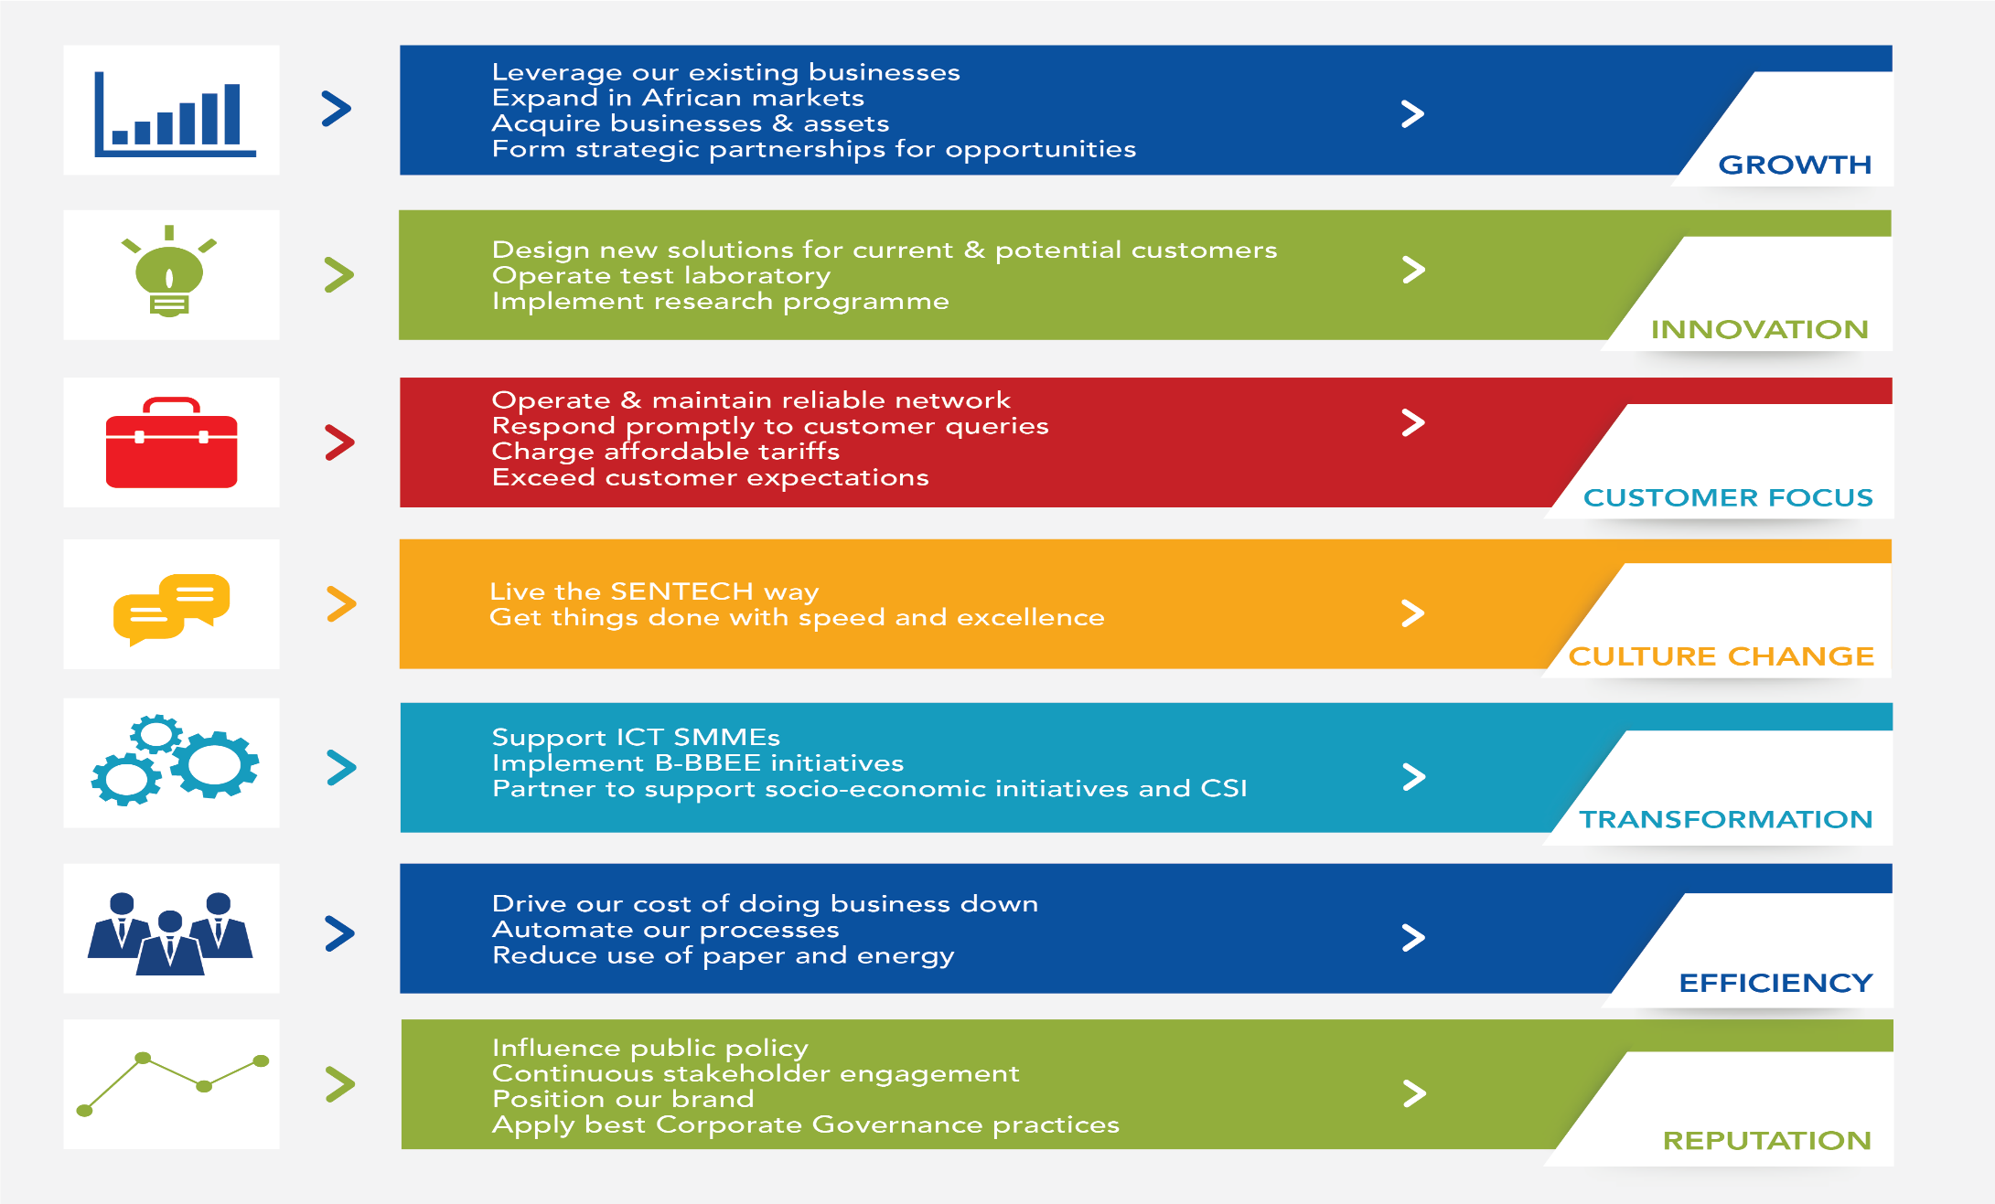
Organisational Strategy-7 strategic pillars
The strategy considers the need for revenue growth in the context of technology disruptions, the future of broadcasting, changing consumer behaviour and socio-economic transformation imperatives.
It is centred on the Seven Strategic Pillars, namely, growth, innovation, customer focus, culture change, efficiency, transformation and reputation.

Slide 6
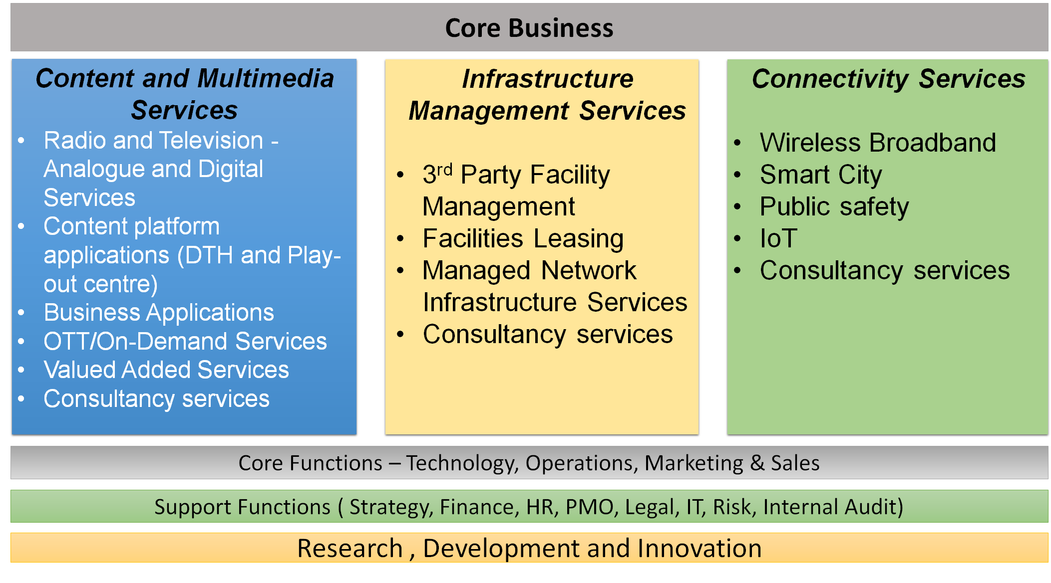
Business Model
The Business Model is to ensure that the Company is prepared for the converged digital communications ecosystem.
It puts more emphasis on across-the-board research, development and innovation, has products and services focused on Content and Multimedia Services, Infrastructure Management Services and Connectivity Services
The business model focuses on innovative areas for revenue diversification

Slide 7
Corporate plan
ORGANISATIONAL IDENTITY, MANDATE AND STRUCTURE
BUSINESS STRATEGY
STRATEGIC PRIORITIES
KEY PERFORMANCE AREAS
FINANCIAL PLAN
CONCLUSION

Slide 8
STRATEGIC PRIORITIES:
Sustainability
Business sustainability is generally understood to mean managing economic, environmental and social demands and concerns, the aim being to ensure responsible, ethical and ongoing success.
In relation to SENTECH, sustainability refers to the ability of the business to continue providing services to its customers for the long term, whilst contributing to a healthy environment and being socially responsible.
SENTECH will continue with the implementation of the ‘Six Capitals’ as defined in the Company’s Sustainability Plan. These Six Capitals are financial, manufactured, natural, human, social and relationship, and intellectual capitals.
Emphasis will be placed on business expansion and new product innovation to ensure financial sustainability. Transformation, as a social capital, will also receive greater attention to advance social and economic transformation of society.

Slide 9
STRATEGIC PRIORITIES:
Human Capital
The primary focus of the strategy is to position SENTECH as an employer of choice by creating a healthy organisational climate that allows for the attraction and retention of employees who have the required capabilities and competencies to support a high-performance organisation.
The following strategic deliverables are aligned with SENTECH’s strategic objectives and key challenges:
Transformation practices;
Strategic workforce planning;
Organisational culture and change management;
Leadership excellence;
Talent management;
Performance management;
Skills development;
Employee value proposition;
Stakeholder engagement and improvement;
Employee health, wellbeing and safety;
Human resources service delivery model;
People analytics and management information system.

Slide 10
STRATEGIC PRIORITIES:
South African-Based Pan-African Satellite
SENTECH will play a leading role in the development of the South African-based Pan-African satellite. The satellite is expected to cover the Southern African Development Community (SADC) and support broadcast requirements, and broadband initiatives and targets, as well as other initiatives such as e-education, e-health, and e-government in respect of SADC countries.
The project will also stimulate economic growth, skills development, job creation and citizen development in the region.
With the support of government through the DTPS, in the first year of the MTEF, SENTECH is planning to develop a Business Plan, Project Plan and Funding Proposal for sanction by government so that implementation of the project can proceed.
The Project Plan will determine time allowed for design, construction and launch of the satellite once the project is sanctioned.

Slide 11
STRATEGIC PRIORITIES:
DTT Commercialisation
SENTECH has been stabilising the network for DTT commercialisation. In the first year of the MTEF SENTECH will focus on supporting DTT uptake and creating value-added applications for DTT.
National consumer-viewing households will provide user feedback on the DTT network quality.
The reliability of the DTT network will further be enhanced by densification, using low power transmitters for gap filling.
In line with the policy framework and international trends, SENTECH will be implementing digital-to-digital migration for DTT, to enable additional beneficiation for other countries from spectrum due to DTT migration.
SENTECH will be extending its Research and Development Laboratory to include a receiver conformance testing regime to support DTT migration in South Africa and across Africa.

Slide 12
Corporate plan
ORGANISATIONAL IDENTITY, MANDATE AND STRUCTURE
BUSINESS STRATEGY
STRATEGIC PRIORITIES
KEY PERFORMANCE AREAS
FINANCIAL PLAN
CONCLUSION

Slide 13
KEY PERFORMANCE AREAS:
Alignment with Shareholder Priorities
The Board has adopted a set of strategic objectives for the 2017–2020 MTEF planning period that will ensure that the Company achieves its public service mandate objectives, which are aligned with Shareholder priorities, and will ensure financial sustainability.
SENTECH has ensured alignment of its business operations with the Shareholder Strategic Goals and Objectives for 2017–2020 planning period.
We will put efforts on assisting the Shareholder in delivering on SA Connect national project.

Slide 14
KEY PERFORMANCE AREAS:
Alignment with Shareholder Priorities
Shareholder Strategic Goals | Shareholder Strategic Objectives | SENTECH Strategic Plan Alignment
SG 1: Broadband connectivity that provides secure and affordable access for all citizens to education, health and other government services and stimulates socio-economic development | SO 1.1 Co-ordinate Broadband connectivity to achieve 100% population reach. | SENTECH to play a leading role in the development of the South African-based Pan-African satellite, supporting Broadband initiatives.

Slide 15
KEY PERFORMANCE AREAS:
Alignment with Shareholder Priorities
Shareholder Strategic Goals | Shareholder Strategic Objectives | SENTECH Strategic Plan Alignment
SG 2: South Africa has a modern, sustainable and competitive postal and telecommunications sector | SO 2.1: Develop and Implement ICT policy and legislation aimed at improving access to and affordability of ICTs. SO 2.2: Advance South Africa’s National ICT interests in regional and international forums towards attaining partnerships for economic growth and development. | SENTECH will ensure assess and affordable services of its products and services. SENTECH strategy, amongst others, is to forge strategic partnerships and pursue international expansion especially in the Pan-African region. SENTECH is developing a Pan-African Strategy and will collaborate with the DTPS’ International branch.

Slide 16
KEY PERFORMANCE AREAS:
Alignment with Shareholder Priorities
Shareholder Strategic Goals | Shareholder Strategic Objectives | SENTECH Strategic Plan Alignment
SG 3: An inclusive Information Society and Knowledge Economy driven through a comprehensive e-Strategy and access to government services | SO 3.1: Develop a national e-Strategy that will give priority to e-Government Services. | SENTECH will actively engage and participate with the DTPS in the development and implementation of the strategy. SENTECH will use its infrastructure to support its obligations in relation to the National e-Strategy.

Slide 17
KEY PERFORMANCE AREAS:
Alignment with Shareholder Priorities
Shareholder Strategic Goals | Shareholder Strategic Objectives | SENTECH Strategic Plan Alignment
SG 4: Optimally functional Department and SOCs that effectively deliver on their respective mandates | SO 4.1: Improve performance of SOCs through proactive and stringent oversight. SO 4.2: Create a high performing organisation to enable achievement of the Department’s mandate. | Ensure that SENTECH has the appropriate corporate governance structures and policies to enable effective shareholder oversight.

Slide 18
Key Performance Indicators
Strategic Goals | Strategic Objectives | KPI | Performance Targets
 |  |  | FY17/18 | FY18/19 | FY19/20
SG 1: Sustainable Business Growth | Increase sales revenue | Revenue growth by 8–10% annually | R1 275 826 | R1 352 376 | R1 433 518
 | Increase Earnings Before Tax and Interest (EBIT) | Earnings before interest and tax (EBIT) | R138 082 | R146 366 | R155 148
 | Contribute to socio-economic transformation | Actual spend of NPAT on Supplier Development (2%), Enterprise Supplier Development (ESD) [3%] and Socio-Economic Development (SED) [1.5%] | Actual 6.5% spend achieved on ESD and SED | Actual 6.5% spend achieved on ESD and SED | Actual 6.5% spend achieved on ESD and SED
 | Ensure reliable commercial DTT network | 550 DTT national viewer sites installed and field trial experience tested | 550 DTT national field trial sites installed | Viewer experience test results showing 95% availability | Viewer experience test results showing 98% availability
 | Achieve clean audit | Clean audit achieved | Clean Audit achieved | Clean audit achieved | Clean audit achieved
SG 2: Achieve high levels of customer satisfaction | Ensure network availability meets SLA requirements across all platforms | Weighted average availability based on product revenues | Weighted average availability based on product revenues of 99.80% | Weighted average availability based on product revenues of 99.80% | Weighted average availability based on product revenues of 99.80%
 | Enhanced customer orientation | Customer satisfaction level of 80% | Achieve 80% customer satisfaction level | Maintain 80% customer satisfaction level | Maintain 80% customer satisfaction level

Slide 19
Key Performance Indicators
Strategic Goals | Strategic Objectives | KPI | Performance Targets
 |  |  | FY17/18 | FY18/19 | FY19/20
SG 3: Build a high-performance culture | Achieve a high-performance culture | Average employee performance ratings of 3.6 achieved | Average employee performance score of 3.6 | Average employee performance score of 3.7 | Average employee performance score of 3.8
 | Ensure employee development | 85% of Training plan implemented | 85% of Training plan implemented | 90% of Training plan implemented | 95% of Training plan implemented
SG 4: Lead the preparation of the launch of the South African-based Satellite | Develop a South African-based Satellite business plan and funding proposal | South African-based Satellite business plan and funding proposal submitted to Shareholder subject to feasibility study results | South African-based Satellite business plan and funding proposal submitted to Shareholder subject to feasibility study results | Support implementation of the South African-based Satellite project plan as directed by the Shareholder | Support the launch of a South African-based Satellite subject to completion of all projects and funding

Slide 20
Annual Performance plan
Strategic Goals | Strategic Objectives | KPIs | Annual Target | Performance Targets
 |  |  |  | Quarter Q 1 April 2017 to June 2017 | Quarter 2 July 2017 to September 2017 | Quarter 3 October 2017 to December 2017 | Quarter 4 January 2018 to March 2018
SG 1: Sustainable business growth | Increase revenue | 1. Revenue growth by 8–10% annually | R1 275.8 million | R312 million | R627 million | R942 million | R1 275.8 million
 | Increase Earnings Before Tax and Interest (EBIT) | 2. Earnings before Interest and Tax | R138 million | R13 million | R27 million | R65 million | R138 million
 | Contribution to socio-economic transformation | 3. Actual spend of NPAT on Supplier Development (2%), Enterprise Development (3%) and SED (1.5%) | 6.5% of Actual NPAT for the 2017/18 Financial Year | Achieve 20% of budgeted Enterprise and Supplier Development Spend | Achieve 50% of budgeted Enterprise and Supplier Development Spend | Achieve 70% of budgeted Enterprise and Supplier Development Spend | Actual spend of NPAT on Supplier Development (2%), Enterprise Development (3%) and SED (1.5%)
 | Ensure reliable commercial DTT network | 4. 550 DTT national viewer sites installed and viewer experience measured | 550 DTT national viewer sites installed and field trial experience tested | 550 DTT national field trial sites installed | Achieve viewer experience test results of 95% availability | Achieve viewer experience test results of 98% availability | 550 DTT national viewer sites installed and field trial experience tested
 | Achieve clean audit | 5. Clean audit achieved | Clean audit achieved | No performance required | No performance required | No performance required | Complete and issue Interim Financial Statements for the period ended 31 December 2017

Slide 21
Annual Performance PLAN
Strategic Goals | Strategic Objectives | KPIs | Annual Target | Performance Targets
 |  |  |  | Quarter Q 1 April 2017 to June 2017 | Quarter 2 July 2017 to September 2017 | Quarter 3 October 2017 to December 2017 | Quarter 4 January 2018 to March 2018
SG 2: Achieve high levels of customer satisfaction | Ensure network availability meets SLA requirements across all platforms | 6. Weighted average availability based on product revenues | Weighted average availability based on product revenues of 99.80% | Weighted average availability based on product revenues of 99.80% | Weighted average availability based on product revenues of 99.80% | Weighted average availability based on product revenues of 99.80% | Weighted average availability based on product revenues of 99.80%
 | Enhanced customer orientation | 7. Customer satisfaction level of 80% | Customer satisfaction level of 80% achieved | Monitoring Tool for Customer Survey recommendations completed and implementation started | 4 Customer Engagement Workshops for the 4 customer segments | Introduce 2 innovative products | Achieve customer satisfaction levels of 80% based on the survey completed
SG 3: Build a high-performance culture | Achieve high performance culture | 8. Average employee performance ratings of 3.6 achieved (85% Organisational Objectives achieved) | Performance rating of 3.6 for the 2017/18 Financial Year | 25% of Organisational objectives achieved | 50% of Organisational objectives achieved | 75% of Organisational objectives achieved | 85% and more of Organisational objectives achieved
 | Ensure employee development | 9. 85% Training Plan implemented | 85% of the 2017/18 Approved Training Plan interventions implemented | 20% of training interventions completed | 45% of training interventions completed | 63% of training interventions completed | 85% of training interventions completed

Slide 22
Annual Performance PLAN
Strategic Goals | Strategic Objectives | KPIs | Annual Target | Performance Targets
 |  |  |  | Quarter Q 1 April 2017 to June 2017 | Quarter 2 July 2017 to September 2017 | Quarter 3 October 2017 to December 2017 | Quarter 4 January 2018 to March 2018
SG 4: Lead preparation for the launch of the South African-based Satellite Project | Develop a South African-based Satellite business plan and funding proposal | 10. South African-based Satellite business plan and funding proposal submitted to Shareholder subject to feasibility study results | South African-based Satellite business plan and funding proposal submitted to Shareholder subject to feasibility study results | Submit project proposal to DTPS for approval | Establish the Project Office and develop concept document | Develop a business plan and funding model for submission to the Board | Approval of business plan and funding model received from Board and submitted to the DTPS

Slide 23
Corporate plan
ORGANISATIONAL IDENTITY, MANDATE AND STRUCTURE
PERFORMANCE REVIEW
STRATEGIC PRIORITIES
KEY PERFORMANCE AREAS
FINANCIAL PLAN
CONCLUSION

Slide 24
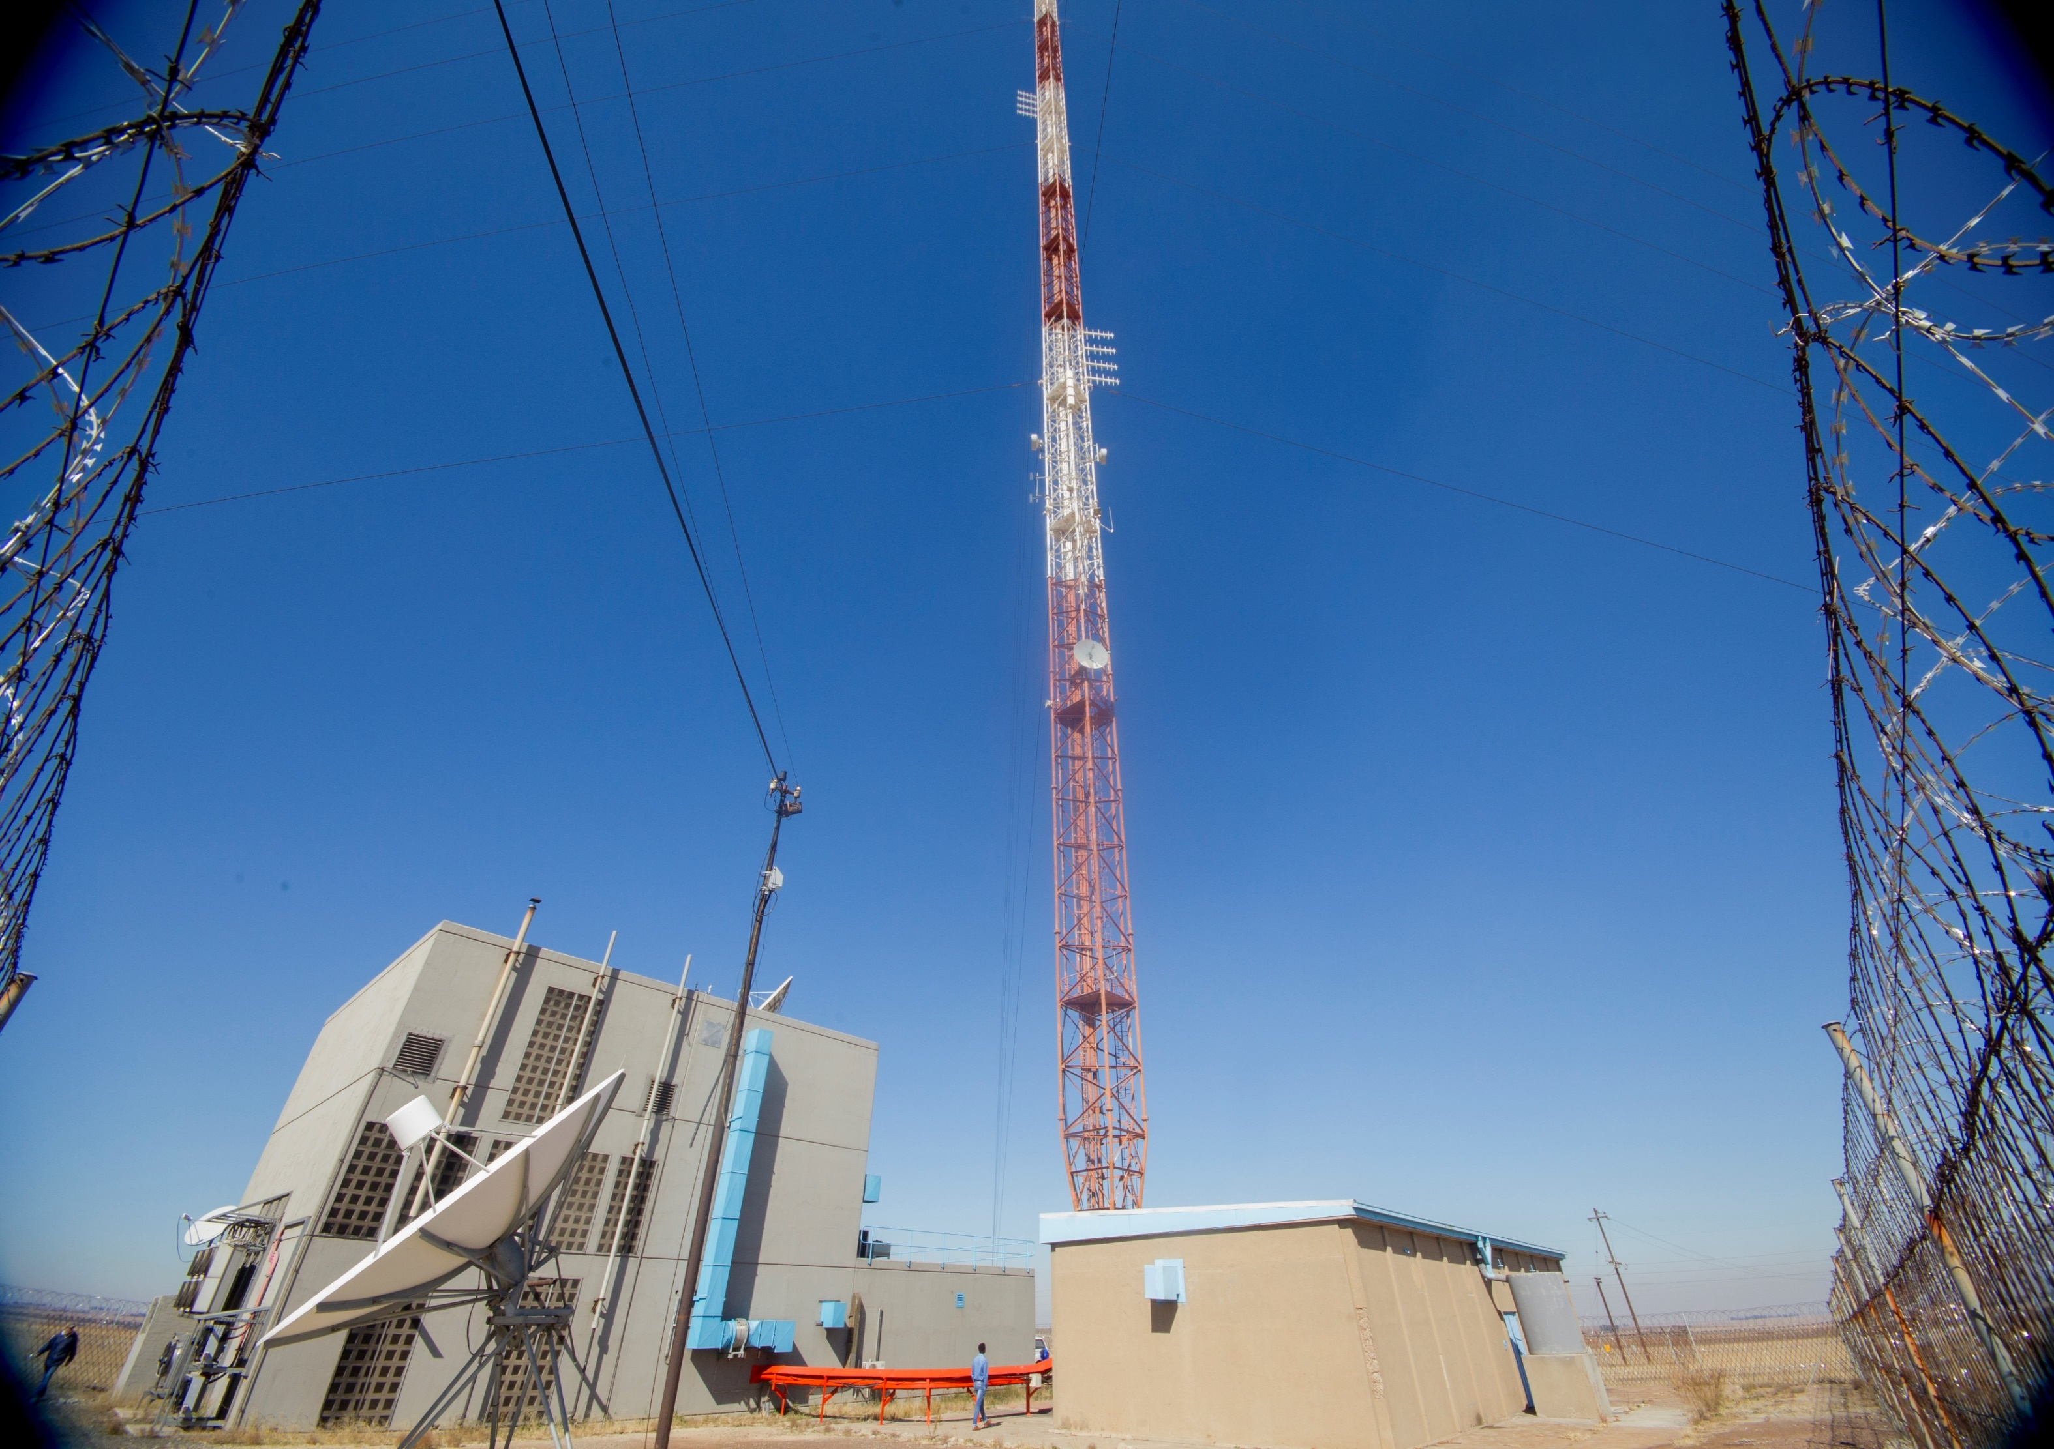
contents
Key Financial Performance Metrics/ Financial Assumptions
Financial performance 2018-2020
Financial Position
Cash Flows analysis
Capital Spending
Financial summary
Conclusion

Slide 25
Key financial performance metrics
Performance Indicator/ Key Budget Assumption | 2018 | 2019 | 2020
EBIT Margin % (From continuing business) | 11% | 11% | 11%
Normalised RONA (Return on Net Assets) % | 7% | 7% | 8%
Net Profit Margin % | 10% | (0%) | (1%)
CPI /Inflation | 6,4% | 6% | 6%
ZAR/US$ exchange rate | 16.00 | 17.10 | 17.95
Building reserves to fund replacement needs | R100 196 | R170 334 | R289 568
This financial plan provides insight onto the investment and financing decisions made in building a financially sustainable company, and streamlining of business processes and implement initiatives that positively drive shareholder’s value.
The company projects continued stable growth in revenues from continuing operations over the MTEF period resulting in forecasted operating profit from continuing business.
SENTECH is pursuing a strategy that incorporates both acquisitive and organic growth.
Dual Illumination is projected to continue during the MTEF period, thus, SENTECH will be running the DTT and analogue networks simultaneously.
The Funding of Dual illumination continue to pose a risk to SENTECH Business.

Slide 26
FINANCIAL SUMMARY
DETAILS | 2016 R’000 | 2017 R’000 | 2018 R’000 | 2019 R’000 | 2020 R’000
Revenue | 1 078 317 | 1 150 160 | 1 275 826 | 1 352 376 | 1 433 518
Cost of Sales | (867 087) | (957 736) | (1 103 502) | (1 169 712) | (1 239 895)
Gross Profit | 211 230 | 192 424 | 172 324 | 182 664 | 193 623
Operating Expenses (total) | (115 814) | (167 282) | (194 274) | (205 930) | (218 286)
Adjustment for dual illumination | 125 849 | 135 415 | 160 031 | 169 633 | 179 811
EBIT (Continuing Operations) | 221 265 | 160 557 | 138 081 | 146 367 | 155 148
Dual illumination shortfall | (25 121) | (47 696) | - | (160 367) | (179 960)
EBIT (including dual illumination) | 196 144 | 112 853 | 138 082 | (14 000) | (24 663)
Cash generated from operations | 161 540 | 89 216 | 36 816 | 73 892 | 83 476
Cash balances | 957 242 | 883 169 | 812 283 | 766 175 | 669 651
Capital expenditure | 380 822 | 502 016 | 330 000 | 180 000 | 240 000

Slide 27
FINANCIAL ANALYSIS - REVENUE
Forecasted revenue for 2018 – 2020 is based on the actual CPI of October 2016 i.e. 6,4% and the projected CPI for the other 2 years.
Revenue growth is expected in both radio and television. The key driver on the radio growth network enhancements for broadcasters and expansion programs on MW and FM.
Television growth is driven by the DTT and DTH businesses with new customers coming on board and some of the DTT sites being switched on.
Infrastructure Management services will grow by 18% to R72 million in 2018, this is due the CPI adjustments and new customers.

Slide 28
FINANCIAL ANALYSIS - PROFITABILITY
It is clear that the business is profitable from the “continuing” operations, however, the effects of the unfunded dual illumination caused losses in the last 2 years of the MTEF.
Management and the Board will put significant effort in the next financial year to secure funding for dual illumination.
Cost of sales and other operating costs have been increased in line with inflation. Additional costs have been added and these relate to maintenance, filling of critical positions, additional satellite rental , people development and expenditure required to support growth .
All expenditure required to execute the Corporate Plan has been adequately budgeted for!

Slide 29
FINANCIAL ANALYSIS - FINANCIAL POSITION
The company will remain in a stable financial position throughout the MTEF period.
Capital expenditure will increase the value of the assets and the NAV of the company. This investment will also position the company for future growth.
There are no borrowings planned for the period and the liabilities will be reduced.
This financial position will enable the company to explore opportunities whilst in a stronger position. Acquisitions and partnerships will be more feasible.

Slide 30
FINANCIAL ANALYSIS – CASH FLOWS
Cash preservation was the key focus in putting together this budget. Cash generation from operations will remain under pressure throughout the MTEF period. Cash balances will decrease due to the R750 million capital expenditure, however, this should position SENTECH for growth in the future years.

Slide 31
FINANCIAL ANALYSIS – CASH FLOW
Cash Inflows (R’000) | Opening Cash | Cash generated by operations | Total Cash available
 | 883 169 | 703 660 | 1 586 829
Cash Outflows (R’000) | Capital expenditure (Internal funds) | Unfunded Dual illumination costs | Total outflows
 | (577 000) | (340 178) | (917 178)
Net cash balance – end of the MTEF (R’000) |  |  | 699 651
Net cash balance – end of the MTEF (R’000) – with full funding of dual illumination |  |  | 1 009 829

Slide 32
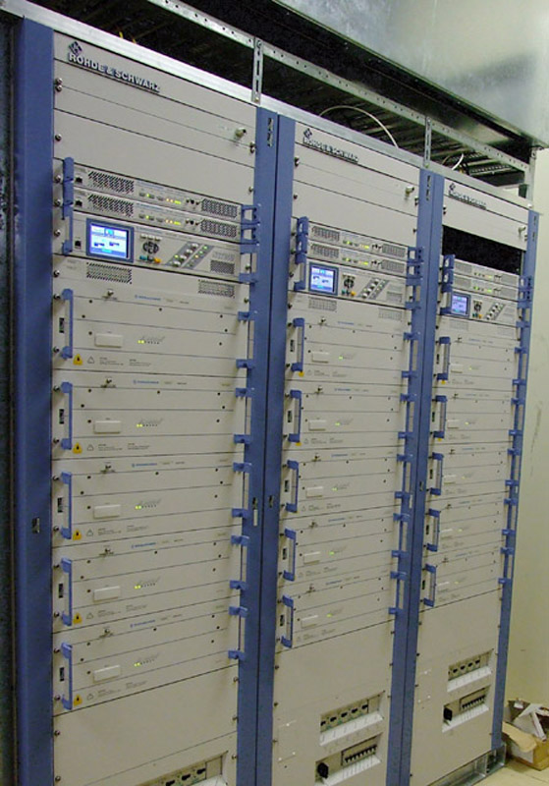
Financial Plan: Capital Expenditure
Source of funding | 2017 R’000 | 2018 R’000 | 2019 R’000 | 2020 R’000
Internal funds | R 502,016 | R 277,000 | R 120,000 | R 180,000
External funds | - | R 53,000 | R 60,000 | R 60,000
Total | R 502,016 | R 330,000 | R 180,000 | R 240,000
SENTECH is mandated to ensure that its BSD and related ICT infrastructure is accessible, robust, reliable, affordable and secure to meet the needs of the country and its people.
SENTECH has budgeted a total of R750m for capital expenditure in the MTEF period from internal & external sources.
A strategic sourcing plan has been developed to get maximum value out of the capital expenditure program and operating expenditure
The expenditure plan is within the affordability limits of the company.
Borrowing opportunities will be considered pursuant to viable growth opportunities over the MTEF years.

Slide 33
Conclusion
The company will also focus on the following initiatives to improve the financial performance and ensure financial stability during the MTEF period:
Pursue opportunities to diversify revenue streams both locally and on the African continent,
Identify possible acquisition targets which will assist with growing the business and diversification;
Develop a funding plan (including borrowings) for the acquisitions and consider options around funding of capital expenditure;
Disciplined execution of the capital expenditure programme; and
Focus on innovative ways of delivering new products and services to the market.
Digital migration remains the main strategic project
Funding of DTT will remain a key financial focus area
Annexures attached reflect the details on Governance Structure, Risk Management Plan, Fraud Prevention Plan and Materiality and Significance Framework.

Slide 34
annexures
Governance Structure
Risk Management Plan
Fraud Prevention Plan
Materiality and Significance Framework

Slide 35
Thank you
SENTECH SOC LIMITED
Octave Street, Radiokop, Ext 3, Honeydew, 2040
www.sentech.co.za

Slide 36
QUESTIONS AND DISCUSSION…

