Slide 1
Portfolio and Select Committees
2017/18 Annual Performance Plan
March 2017

Slide 2
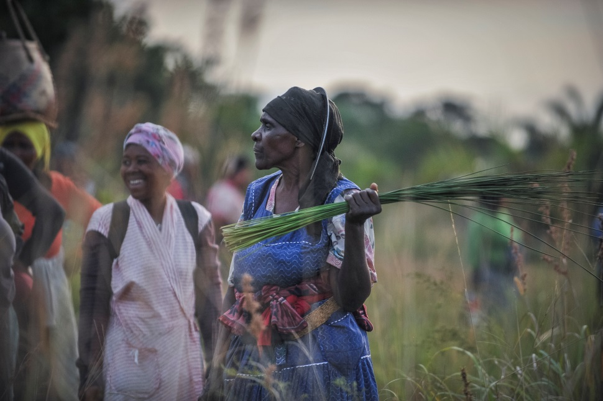
Presentation Outline
Background
Mandate
Vision
Mission
High level structure
NDP Contribution
Alignment with DEA Plans
Strategic plan
Programme structure
Budget Estimates

Slide 3
Background to iSimangaliso
South Africa became a signatory to the World Heritage Convention in 1997
iSimangaliso was the first South African site to be listed; it was listed in December 1999
It was listed for 3 World Heritage Values:

Slide 4
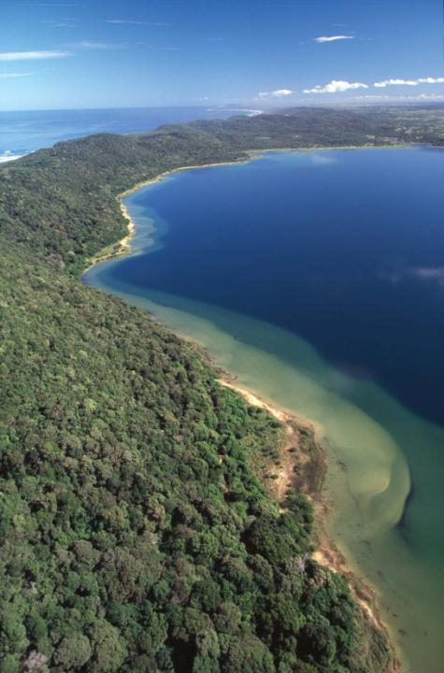
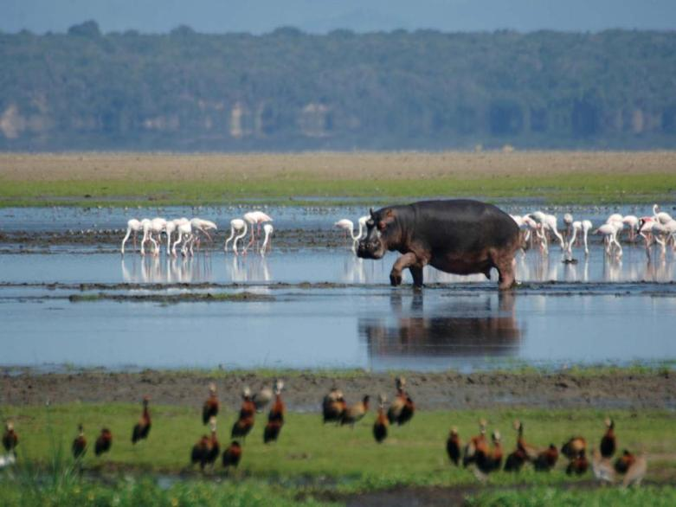
Superlative natural phenomena (sense of place)
Unique ecological and biological processes
Biological diversity

Slide 5
iSimangaliso’s Legislative Framework
The World Heritage Convention was brought into South African law in 2000 when the World Heritage Convention Act was promulgated
The iSimangaliso Wetland Park was established under the World Heritage Convention Act regulations consolidating 16 different parcels of land under one proclamation in November 2000
The iSimangaliso Wetland Park Authority was established to manage the Park under the World Heritage Convention Regulations in November 2000

Slide 6
iSimangaliso’s Establishment
iSimangaliso’s was established in April 2002
It has a board with a max of 9 members & includes representation from traditional communities and land claimants
Its mandate as set out in the act is to:
Protect, conserve and present the Park, especially World Heritage Values;
Empower historically disadvantaged adjacent communities; and
Promote and facilitate optimal tourism and related development in Park.
Its MTEF allocation for its first year of operations was R3.96m; its total revenue for that year was R16.82m and it had a staff complement of 14 people. March 2016 the MTEF allocation was R26.1 and total revenue R160.8m; staff complement 41)

Slide 7
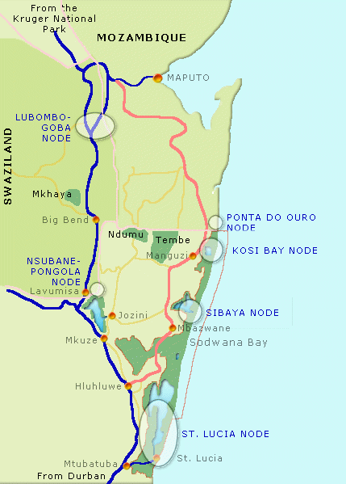
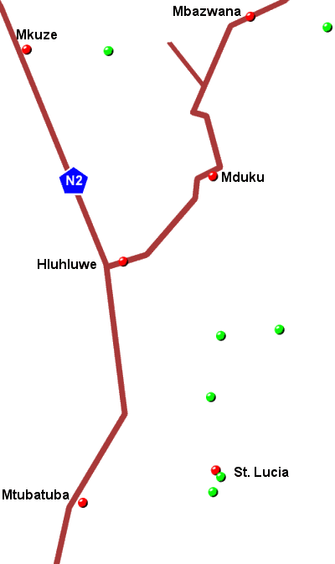
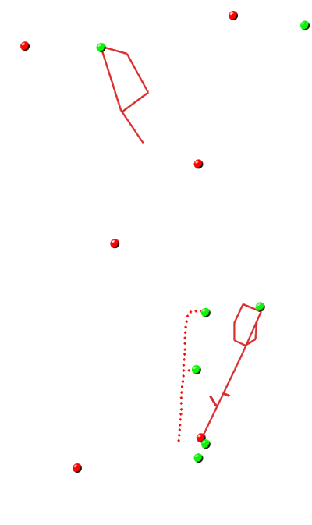
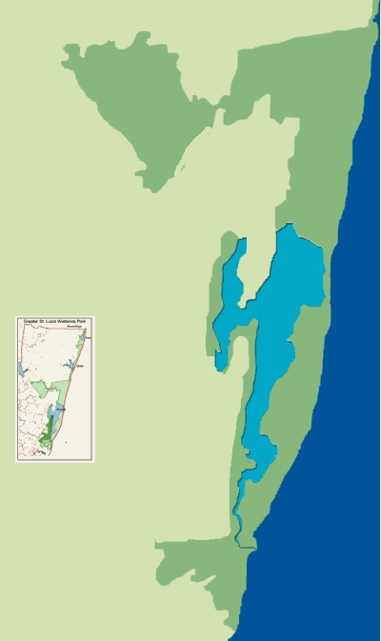
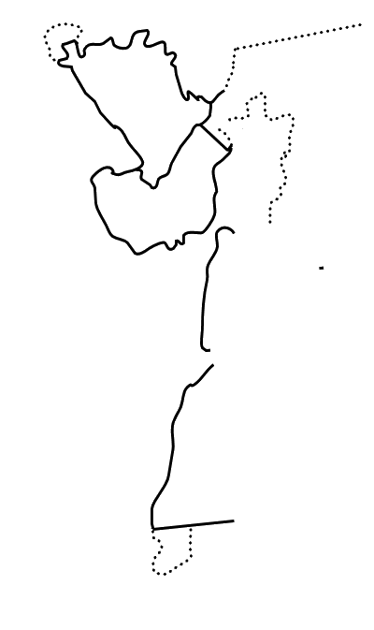
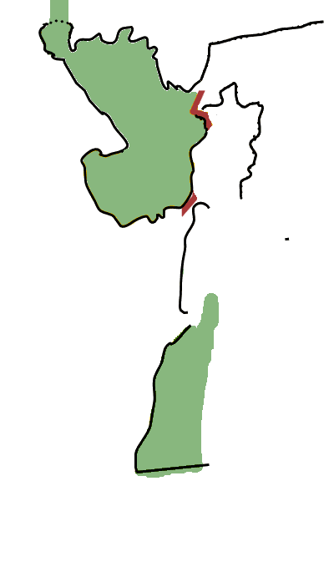
iSIMANGALISO Progress
Major tourism routes | N2 and R22
Community feeder roads | Sibaya & uMkhuze
Internal park roads | Eastern & Western Shores & uMkhuze
Land consolidation and rehabilitation Land consolidation commercial forestry areas Alien clearing | 16 parcels of land Eastern & Western Shores 15000ha
Fencing of entire park | Almost the distance from Durban to Jhb Wilderness fenced for first time
Infrastructure upgrades

Slide 8
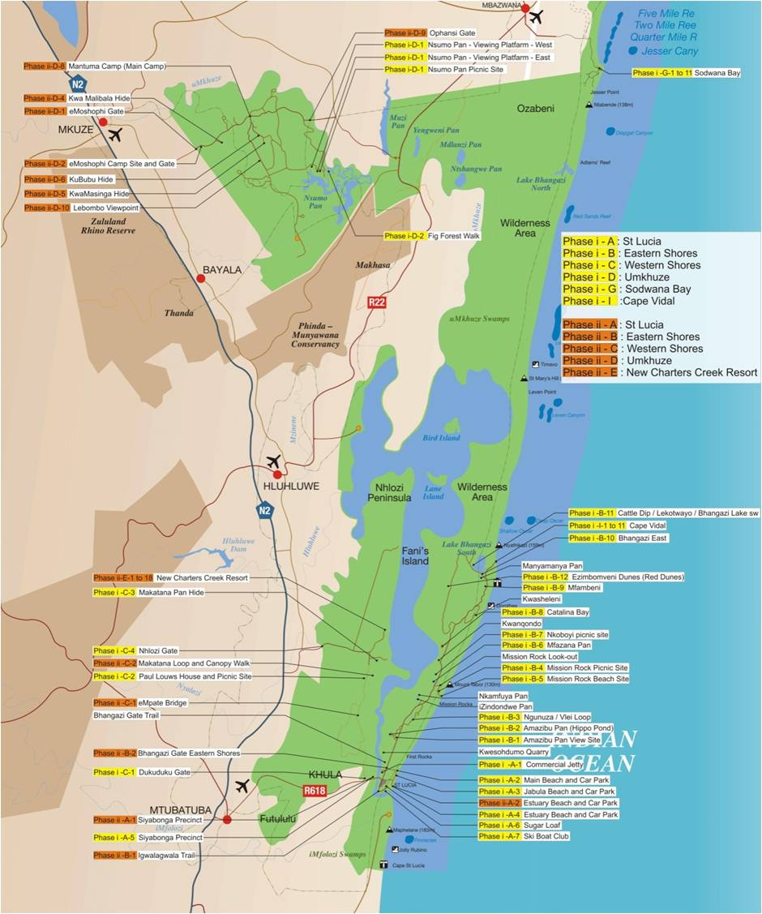

Slide 9
iSimangaliso’s Progress
Game introductions | All species that existed reintroduced except Eland
Small business support | 215 small businesses supported through enterprise programme
Bursary programme | 77 bursaries to youth from the areas adjacent to the Park
Intern programme | 14 interns now all permanently employed (8 absorbed into iSimangaliso)
Job creation | 2016 figures – 55547 temporary jobs since inception
Training programmes | Arts, craft, tourism, hospitality, construction, agriculture (artists sold commissions for R100k a piece and exhibited inter alia at JAG and Moses Mabhida)
Revenue share | 8% of commercial revenue paid to claimants annually (approx R1.3m FY2016; 116% increase in 6 year)

Slide 10
iSimangaliso’s Progress
Tourism growth | 84% increase in tourism supply around the Park from 2000 to 2011; Park contributes approx 0.06% of SA’s tourism GDP & 6.8% of KZN tourism GDP; 8000 direct jobs; tourism expenditure in area estimated at R1219m per annum; 5 wholly community-owned tourism licences – fishing charter, estuary cruises, turtle tours; 4 community-owned lodges (3 operating; 1 in process) equity from 20-100%

Slide 11
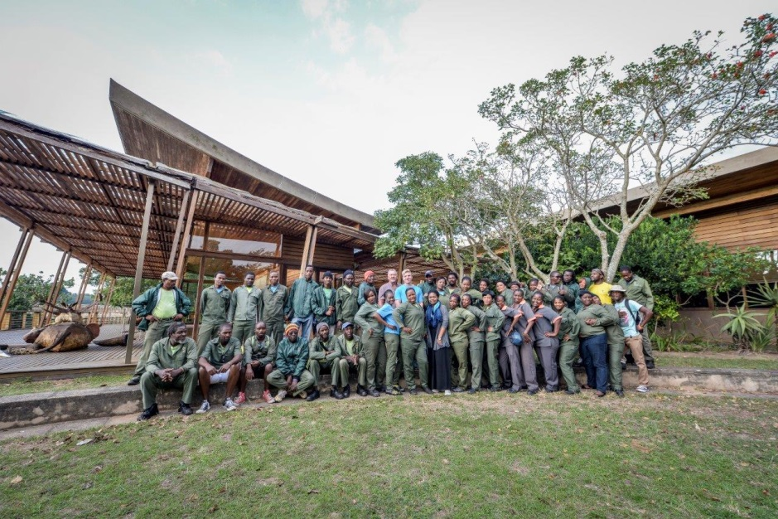

Slide 12
Mandate: (The World Heritage Convention Act and Regulations)
to protect, conserve and present the Park;
to empower historically disadvantaged adjacent communities;
to promote and facilitate optimal tourism and related development in Park.

Slide 13
Vision: to create Africa’s greatest conservation-based tourism destination driven by community empowerment
Mission:
To protect, conserve and present the Wetland Park and its World Heritage Values for current and future generations in line with the standards laid down by UNESCO and the World Heritage Act, and to deliver benefits to communities living in and adjacent to the Park by facilitating optimal tourism and related development

Slide 14
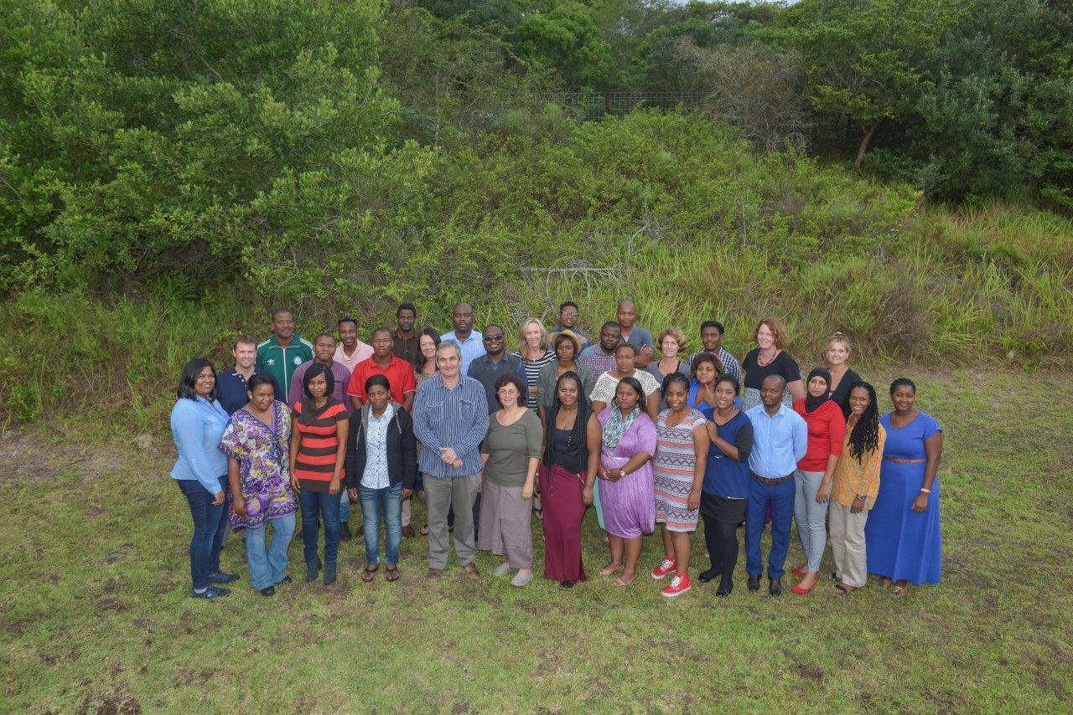

Slide 15
High-Level Structure
Minister
Board
Chief Executive Officer
Park Operations
Director
Business
Director
Research, Policy & Planning
Senior Manager
CFO

Slide 16
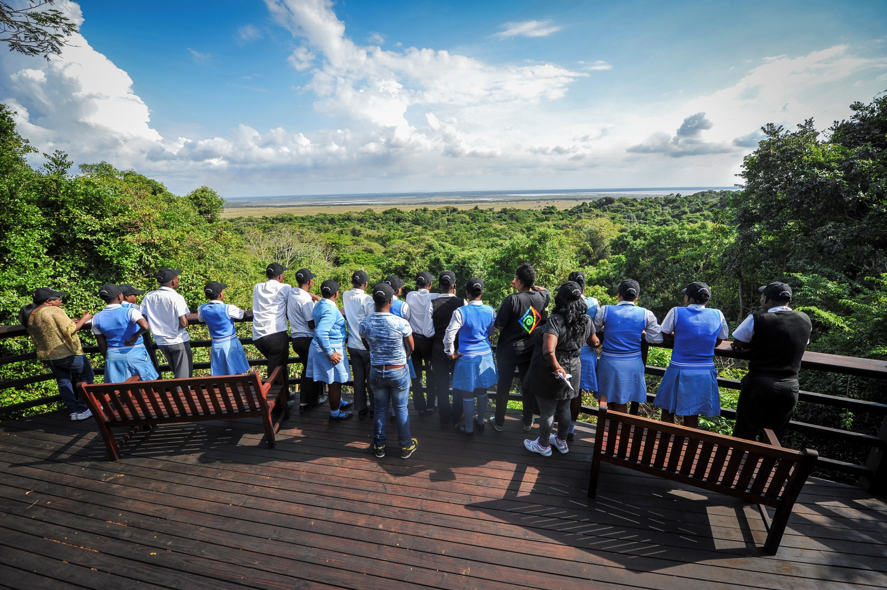

Slide 17
NDP Contribution
NDP OBJECTIVE: | NDP CONTRIBUTION:
Environmental Sustainability and Resilience | Land and oceans under protection Energy-efficiency Zero emission building standards Climate change Investment in rural livelihoods Regulatory framework for land to ensure conservation and restoration of protected areas
South Africa in the Region and in the World | Regional integration strategy identifying and promoting practical opportunities for cooperation based on complementary and national endowments
Economy and Employment | Reduce unemployment Young labour market entrants Increased GDP Broaden ownership of assets
Social Protection | Provide income support through labour market initiatives such as public works programmes, training and skills development
Inclusive Rural Economy | Tourism investments

Slide 18
NDP Contribution cont.
NDP OBJECTIVE: | NDP CONTRIBUTION:
Improving Education, Training and Innovation | Provide learning opportunities Increase enrolments at universities
Health care | Prevent and reduce disease burdens through deterring and treating HIV/AIDS, new epidemics and alcohol abuse
Building a capable and developmental state | Public service immersed in the development agenda Experienced, competent staff Relations between national, provincial and local government
Fighting corruption

Slide 19
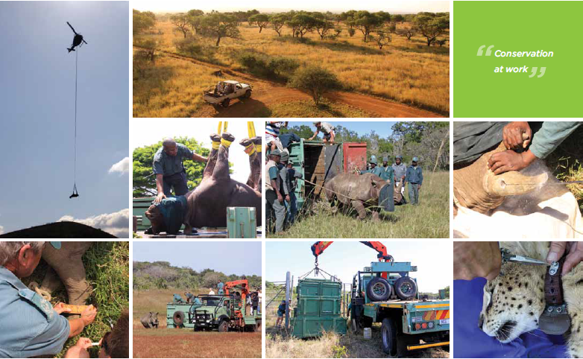

Slide 20
Alignment with DEA Plan
DEA OBJECTIVE: | DEA CONTRIBUTION:
Biodiversity and conservation | Ecosystems conserved, managed, and sustainably used Strengthened knowledge, science and policy interface Improved socio-economic benefits
Climate change and air quality | Threats to environmental quality and integrity managed
Environmental programmes | Improved socio-economic benefits Ecosystems conserved, managed, and sustainably used
Administration | Equitable and sound corporate governance Adequately appropriately skilled diverse workforce Efficient and effective information technology service Strengthened knowledge and science for policy interface Enhanced international cooperation of SA environmental/sustainabile sustainable plans

Slide 21
Alignment with DEA Plan cont.
DEA OBJECTIVE: | NDP CONTRIBUTION:
Legal authorisations compliance and enforcement | Improved compliance with environmental legislation by effective compliance and enforcement
Oceans and coasts | Threats to environmental quality and integrity managed Strengthened knowledge, science, and policy interface Ecosystems conserved, managed, and sustainably used

Slide 22
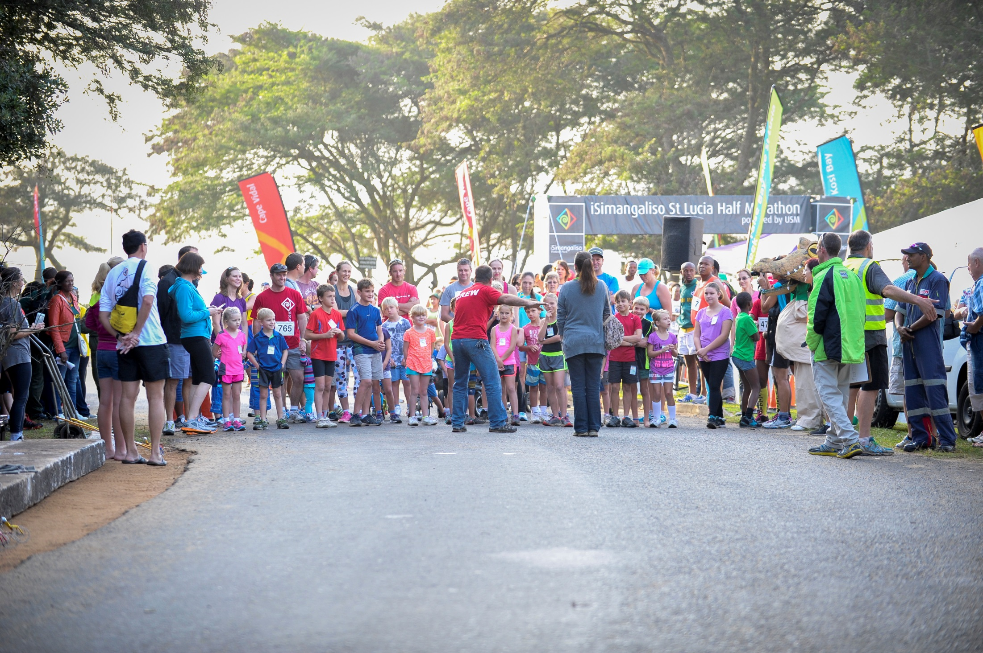

Slide 23
Programme Structure
Park Operations: To ensure the regulation and management of the World Heritage Values in a manner that facilitates sustainable economic growth and development
Transformation (Social and Economic Development) : To improve access to job and income generation opportunities for previously disadvantaged individuals and communities
Commercialisation: To position the Park as a premiere tourism destination
Governance and Administration: To improve the framework for policy making in iSimangaliso, promote innovative research that supports management objectives, and develop, implement, and maintain cost-efficient and effective systems that support the execution of business processes

Slide 24
Programme 1: Park Operations
STRATEGIC OBJECTIVE: | PERFORMANCE INDICATOR: | BASELINE: | TARGET:
Ensure the regulation and management of the World Heritage values in a manner that facilitates sustainable economic growth and development | Number of park management meetings attended with day-to-day conservation manager | 6 | 6
 | Number of new environmental audits completed | 6 | 6
 | Number of follow-up environmental audits completed | 5 | 5
 | Number of environmental monitors deployed in iSimangaliso | 30 | 30
 | Number of hectares of invasive alien plants treated | 15500 | 25000
 | Number of kilometres of accessible coastline cleaned | 320 | 320

Slide 25
Programme 1: Park Operations
STRATEGIC OBJECTIVE: | PERFORMANCE INDICATOR: | BASELINE: | TARGET:
 | Percentage completion of annual controlled burning programme | 100 | 100
 | Percentage applications processed in respect of developments in the buffer zone | 80 | 80
 | Percentage of identified unauthorised developments/activities actioned legally | 100 | 100
 | Percentage completion of annual infrastructure maintenance programme | 100 | 100

Slide 26
Programme 2: Transformation
STRATEGIC OBJECTIVE: | PERFORMANCE INDICATOR: | BASELINE: | TARGET:
To optimise empowerment in all Park activities in order to support the transformation of tourism, conservation and research sectors through ownership, education, training, and job creation | Number of temporary jobs created | 1400 | 1221
 | Number of training days | 1550 | 4800
 | Number of SMMES participating in and skills development programmes | 142 | 50
 | Number of bursaries awarded | 20 | 31
 | Percentage procurement from black-owned suppliers | 76 | 76

Slide 27
Programme 3: Commercialisation
STRATEGIC OBJECTIVE: | PERFORMANCE INDICATOR: | BASELINE: | TARGET:
To optimise the Park’s revenue generation in an environmentally- and commercially sustainable manner that fosters job creation and empowerment of historically-disadvantaged communities | Revenue to the Park from commercial sources (rand million) | 15.9 | 18.4
 | Visitor entries | 506860 | 520000
 | Percentage lapsed licenses/concessions retendered | 80 | 80
 | Percentage implementation of plan in respect of new tourism developments | 60 | 60

Slide 28
Programme 3: Commercialisation
STRATEGIC OBJECTIVE: | PERFORMANCE INDICATOR: | BASELINE: | TARGET:
To promote and market the Park and establish it as a prominent tourism destination | Number of annual events implemented | 3 | 3
 | Implementation of annual marketing and PR programme (%completion) | 100 | 100
To develop environmentally appropriate tourism infrastructure that supports the development of the tourism market for the Park as well as conservation management | Implementation of annual infrastructure programme (%completion) | 100 | 100

Slide 29
Programme 4: Finance and Administration
STRATEGIC OBJECTIVE: | PERFORMANCE INDICATOR: | BASELINE: | TARGET:
To promote research that is innovative and relevant to the knowledge requirements and management objectives of the iSimangaliso Wetland Park | Percentage of new approved proposals that relate to management | 50 | 50
 | Implementation of effective monitoring programme for the Park | Monitoring of impacts of implementation on the ecological health of Lake St Lucia Monitoring of impacts of implementation on the ecological health of Lake St Lucia | Monitoring of impacts of implementation on the ecological health of Lake St Lucia
 | Number of visitor market surveys | 2 | 2
To present the World Heritage values | Percentage completion of the environmental education plan for the year | 100 | 100

Slide 30
Programme 4: Finance and Administration
STRATEGIC OBJECTIVE: | PERFORMANCE INDICATOR: | BASELINE: | TARGET:
To develop plans, policies and strategies for | Percentage implementation of plans to mitigate impact of identified threats to rare and endangered species and ecosystems | Initiation of implementation | 100
 | Percentage completion of plans requested/required within the financial year | 80 | 80
To maintain good governance and a sound control environment | Unqualified external audit opinion | Unqualified opinion | Unqualified opinion
To staff the organisation with appropriately skilled people in order to deliver against it mandate and business plan | Percentage retention of skills | 80 | 90

Slide 31
Programme 4: Finance and Administration
STRATEGIC OBJECTIVE: | PERFORMANCE INDICATOR: | BASELINE: | TARGET:
To provide effective information technology and other systems that support business processes | Assessment of and percentage implementation of business improvements | Complete strategy | Complete assessment for business systems improvements and technical requirements

Slide 32
Strategic risks
RISK: | RISK DISCRIPTION: | RISK IMPACT: | MITIGATION PLANS
Compliance burden of rapidly changing legal environment | Managing the impacts of a rapidly changing and increasing legal environment on service delivery and benefit creation | Development project delivery slowed down impacting negatively on job creation and tourism potential | Actively participate in development of new legislation and streamline processes internally to meet requirements of multiple acts and avoid duplication of effort
Incompatible land uses outside the Park | Incompatible land uses outside the Park may impact negatively on the world heritage values for example catchment degradation | Ecology and habitats inside the Park become degraded negatively impacting world heritage values, livelihoods and tourism | Engagement with agencies responsible for areas outside the park Use of legal avenues available
Shortages of funding for programmes | Insufficient funding secured for benefit creation programmes | Reduced jobs and benefits created | Improve own revenue generation potential Develop donor funding strategy

Slide 33
Strategic risks cont.
RISK: | RISK DISCRIPTION: | RISK IMPACT: | MITIGATION PLANS
High dependence on key skills | Limited skills available in the area | If key skills leave the organisation institutional memory and delivery and negatively impacted | Human resource development strategy Intern programme Bursary programme Capacity building programmes Retention strategies

Slide 34
Budget Estimates
 | Medium-term expenditure estimate
R thousand | 2017/18
Park Operations | 108,768
Transformation | 7,573
Commercial | 3,857
Governance and administration
Policy, Planning and Research | 14,389
Finance & administration | 52,927
Total expenses | 187,514

Slide 35
Budget Estimates cont.
 | Medium-term expenditure estimate
Of which: | R thousand | %
Salaries | 23,327 | 12.4
Repairs & Maintenance | 11,489 | 6.1
Training & skills development (communities) | 6,183 | 3.3
Infrastructure | 68,780 | 36.7
Land rehabilitation | 30,255 | 16.1
Other operations | 47,480 | 25.3
Total expenses | 187,514

Slide 36
Employment Equity
 | African |  | Indian |  | Coloured |  | White |  | Disabled |  | Female
 | # | % | # | % | # | % | # | % | # | % | # | %
PQ/Mid-management | 6 | 21.4 | 1 | 33.3 | 0 | 0.0 | 4 | 50.0 | 0 | 0.0 | 5 | 23.8
Semi-skilled | 2 | 7.1 | 0 | 0.0 | 0 | 0.0 | 0 | 0.0 | 0 | 0.0 | 2 | 9.5
Senior Management | 0 | 0.0 | 0 | 0.0 | 0 | 0.0 | 1 | 12.5 | 0 | 0.0 | 1 | 4.8
Skilled tech | 19 | 67.9 | 1 | 33.3 | 0 | 0.0 | 1 | 12.5 | 0 | 0.0 | 11 | 52.4
Top Management | 1 | 3.6 | 1 | 33.3 | 0 | 0.0 | 2 | 25.0 | 1 | 100.0 | 2 | 9.5
Total | 28 | 72 | 3 | 8 | 0 | 0 | 8 | 21 | 1 | 3 | 21 | 54
Total staff complement | 39 | 100.0 |  |  |  |  |  |  |  |  | 21 | 53.8
of which: snr and top management | 5 | 12.8 |  |  |  |  |  |  |  |  | 3 | 60.0
National demographic |  | 77.4 |  | 2.7 |  | 10.0 |  | 9.9 |  |  |  | 45.2
KZN demographic |  | 86.4 |  | 8.4 |  | 0.9 |  | 4.3 |  | 0.8 |  | 46.5
Average |  | 81.9 |  | 5.6 |  | 5.5 |  | 7.1 |  |  |  | 45.9
 |  | 1 job | = | 2.6%

Slide 37
SIYABONGA – THANK YOU from Africa’s greatest conservation-based tourism destination driven by community empowerment

