Slide 1
Briefing to the Portfolio Committee on Arts and Culture
Review of the 2017-18 APP
02 May 2017

Slide 2
Reputation promise/mission
The Auditor-General of South Africa has a constitutional mandate and,
as the Supreme Audit Institution (SAI) of South Africa, it exists to strengthen our
country’s democracy by enabling oversight, accountability and governance in the
public sector through auditing, thereby building public confidence.
2

Slide 3
Purpose of the briefing and Index
To provide the Portfolio Committee (PC) with audit insights on the interim review of the departments’ draft annual performance plan (APP) in order to add value to oversight.
Index
Overview of the performance reporting process
Audit outcomes of the portfolio
Performance Plans (APPs) 2017/18 review of the portfolio
Overview of key findings of the 2017/18 APP review of DAC
DAC Budget analysis
Key matters for noting
Progress on Matters discussed on the 14th of February 201
AGSA improved audit methodology
Key recommendations for improvements
3

Slide 4
Overview of the performance reporting process
1

Slide 5
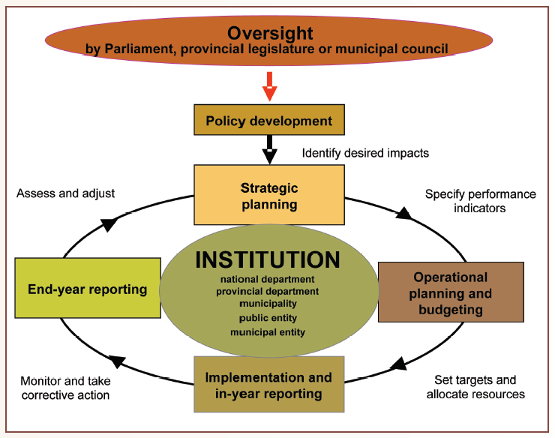
1. Overview of the performance reporting process
5

Slide 6
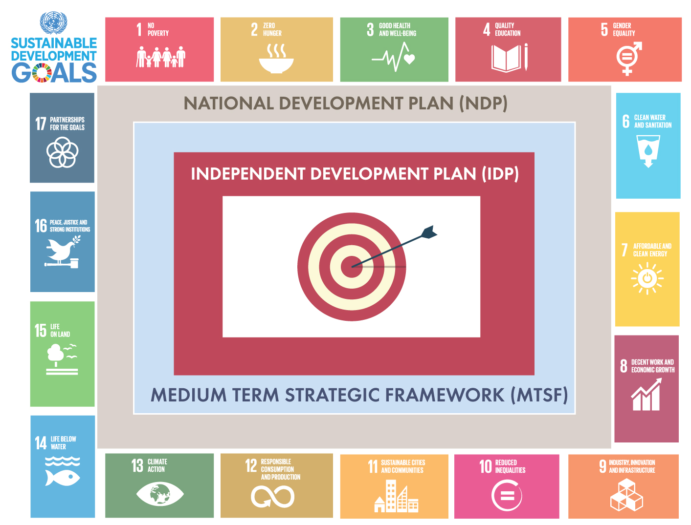
1. Overview of the performance reporting process (cont.)
ANNUAL PERFORMANCE PLAN (APP)
6

Slide 7










1. Overview of the performance reporting process (cont.)
National Development Plan:
The point of departure in planning.
Provide a fuller picture by implementing the value chain approach in planning and auditing.
Too few people work
Quality of school education for black people is poor
Spatial divides hobble inclusive development
Infrastructure is poorly located, inadequate and under-maintained
The economy is unsustainably resource intensive
The public health system cannot meet demand or sustain quality
Public services are uneven and often of poor quality
Corruption levels are high
South Africa remains a divided society.
1
2
3
4
5
6
7
8
9
7

Slide 8
2
Audit outcomes of the portfolio
8

Slide 9
2. Audit outcomes of the portfolio
Financial audit outcomes over 3 years
Unqualified with
no findings
Unqualified with findings
Qualified with findings
Adverse with findings
Disclaimed with findings
4%(1)
4%(1)
27 auditees
27 auditees
27 auditees
9

Slide 10
2. Audit outcomes of the portfolio (cont.)
Financial audit outcomes over 2 years
Entity | Audit outcome 2015-16 | Audit outcome 2014-15
Department of Arts and Culture | Unqualified with Matters | Unqualified with Matters
Artscape | Unqualified | Unqualified
Die Afrikaanse Taalmuseum | Unqualified with Matters | Unqualified
Ditsong Museums of South Africa | Adverse | Qualified
Freedom Park | Unqualified | Unqualified
Iziko Museums of South Africa | Qualified | Qualified
KwaZulu-Natal Museum | Qualified | Qualified
Luthuli Museum | Unqualified | Unqualified with Matters
Market Theatre Foundation | Unqualified with Matters | Unqualified with Matters
Msunduzi/Voortrekker Museum
National Arts Council of South Africa | Unqualified | Unqualified
National Film and Video Foundation of South Africa | Unqualified | Unqualified
National Heritage Council of South Africa | Unqualified with Matters | Unqualified with Matters
National Library of South Africa | Qualified | Qualified
National Museum | Qualified | Unqualified
4%(1)
4%(1)
10

Slide 11
2. Audit outcomes of the portfolio (cont.)
Financial audit outcomes over 2 years
Entity | Audit outcome 2015-16 | Audit outcome 2014-15
Nelson Mandela National Museum (Mthatha) | Qualified | Qualified
Pan South African Language Board | Qualified | Disclaimer
Robben Island Museum | Unqualified | Unqualified
South African Library for the Blind | Unqualified with Matters | Unqualified with Matters
South African Heritage Resources Agency | Unqualified with Matters | Unqualified with Matters
The South African State Theatre | Disclaimer | Qualified
National English Literary Museum (Grahamstown) | Qualified | Qualified
The Playhouse Company | Unqualified | Unqualified
War Museum of the Boer Republics | Qualified | Unqualified
William Humphreys Art Gallery | Qualified | Qualified
Windybrow Theatre | Unqualified with Matters | Qualified
11

Slide 12
2. Audit outcomes of the portfolio
Quality of performance information over 2 years
Usefulness of annual
performance information
Reliability of
performance information
With no
material findings
With material
findings
-----------------------------------------------------------------------
-----------------------------------------------------------------------
Usefulness
The most common findings on the usefulness of information were the following:
Indicators/measures not well defined
Performance targets not measurable
Reasons for variance not supported
Reliability
The most common findings on reliability of
information were the following:
Reported information not complete
Reported information not valid
Reported information not accurate
12

Slide 13
Annual Performance Plans (APPs) 2017/18 review of the portfolio
3
13

Slide 14
3. APPs 2017/18 review of the portfolio (cont.)
Scope of the 2017/18 APP review
The interim review provides an early warning where concerns with regards to the measurability and relevance of the indicators and targets have been identified
The interim review does not entail the performance of detail procedures where underlying systems and supporting documentation are inspected to give assurance on the verifiability of indicators and targets
The interim review is only performed on a selection of significant programmes
14

Slide 15
3. APPs 2017/18 review of the portfolio (cont.)
Scope of the 2017/18 APP review
Review process
Assessed the process followed by departments to prepare and submit strategic plans and APPs.
Reporting
Findings from the review are communicated in the 2016-17 interim management report to enable changes to be made.
Findings relevant to the interim review do not have an impact on the audit conclusion on usefulness or reliability of the selected programmes for the PFMA 2016-17 year end audit.
Assessed the measurability and relevance of the final draft indicators and targets planned for selected programmes
15

Slide 16
3. APPs 2017/18 review of the portfolio (cont.)
Key considerations when reviewing the APP
Does the APP align with MTSF?
Are adequate resources (human and financial) available to achieve APPs?
How can the APP be achieved e.g. Performance contracts/ monitoring
Review annual achievement against APP targets
Are indicators relevant and complete?
Is there a logical link between objectives, indicators and targets?
Are the targets realistic i.e. SMART?
Review quarterly progress against APP targets
Review and track changes to strategic plans and annual performance reports.
16

Slide 17
3. APPs 2017/18 review of the portfolio (cont.)
Criteria used to assess the draft APP
Measurability of indicators and targets
Indicators are well-defined
Indicators are verifiable
Relevance of indicators and targets
Indicators and targets are relevant to the mandate and realisation of strategic goals and objectives
Targets are specific, measurable and time-bound.
  Well-defined = clear, unambiguous definition so that data will be collected consistently and will be easy to understand and use.
  Verifiable = it must be possible to validate the processes and systems.
  Specific = the nature and the required level of performance can be clearly identified
  Measurable = the required performance can be measured
  Time bound = the time period or deadline for delivery is specified
The performance measure/ indicator and target relates logically and directly to an aspect of the entity’s mandate and the realisation of its strategic goals and objectives.
17

Slide 18
3. APPs 2017/18 review of the portfolio (cont.)
Strategic alignment of portfolio – DAC (APP 2017-18)
National Development Plan (Chapter 15)
Social cohesion and Nation building.
MTSF: (Outcome 14)
FUNCTIONS
DAC
CORE
Fostering constitutional values
Equal opportunities, inclusion and redress
Promoting social cohesion across society through increased interaction across race and class
Active citizenery and leadership
Fostering a Social Compact
Programme 4
Programme 3 and 4
Programme 4
Not linked to a programme
Programme 2
18

Slide 19
3. APPs 2017/18 review of the portfolio (cont.)
Key objectives per ENE vs Targets – DAC (APP 2017-18)
Programme 3 : Arts and Culture development and promotion
Key Objective per ENE | Target included in APP 2017-18 | Included in the APP
Develop, protect and promote the cultural and creative sector through interventions and initiatives that stimulate local content creation and attract large audiences | Number of flagship events supported financially | Included in the APP for 2017/18
 | Number of public art projects supported financially | Included in the APP 2017/18
Lead, coordinate and implement social cohesion programmes aimed at creating an integrated and inclusive society that contributes to economic growth | Number of community arts centres (CACs) Refurbishment projects supported financially | Included in the APP 2017/18
 | Number of artists placed in schools
 | Number of community arts projects supported financially
 | Number of community arts centres (CACs) refurbishment projects supported financially
Build human resource capacity and promote excellence in the sector | Number of bursaries awarded towards development of qualified language practitioners Number of incubator projects financially supported | Included in the APP 2017/18
19

Slide 20
3. APPs 2017/18 review of the portfolio (cont.)
Key objectives per ENE vs Targets – DAC (APP 2017-18)
Programme 3: Arts and Culture development and promotion
Key Objective per ENE | Target included in APP 2017-18 | Comment/Observation
Build relationships and partnerships locally and internationally to develop, preserve and promote arts and culture | Number of market access platforms supported Financially | Included in the APP 2017/18
 | Number of Touring Venture projects supported financially
Promote South African languages through the provision of access to information by translating and/or editing 100 per cent of documents, such as letters, pamphlets and posters received and accepted per year. | % of documents received and accepted translated and/or edited | Included in the APP 2017/18
20

Slide 21
3. APPs 2017/18 review of the portfolio (cont.)
Key objectives per ENE vs Targets – DAC (APP 2017-18)
Programme 4:
Key Objective per ENE | Target included in APP 2017-18 | Comment/Observation
Develop, preserve, protect and promote heritage through the construction and management of heritage infrastructure : -supporting four heritage infrastructure projects annually - undertaking a feasibility study on the Liberation Movement Museum by 2017/18. | No. of reports generated on the heritage infrastructure projects being implemented | Target included in the 2017/18
 | Not included | The indicator or target has not been included in the departments APP. Chapter 14 of the MTSF has a target of 8 project to be completed by 2018/19, and nothing has commenced on the projects.
Lead, coordinate and implement social cohesion programmes to unite people through the creation of visual, verbal or iconic representations of national values and goals : -providing 6 430 national symbol toolkits to schools by March 2018 - distributing 500 South African flags by March 2018. | No. of flags installed in schools | Target included in the 2017/18
 | No. of national symbols toolkits distributed to districts offices of the department of education. | Target included in the 2017/18 APP, however DAC will be delivering the toolkits to the district office of Department of Education and not directly to the schools as described in the ENE.
Build human resources capacity and promote excellence in the sector to promote indigenous heritage and languages by providing 65 heritage bursaries annually. | No. of heritage bursaries awarded | Target included in the 2017/18 APP
21

Slide 22
3. APPs 2017/18 review of the portfolio (cont.)
Key objectives per ENE vs Targets – DAC (APP 2017-18)
Programme 4:
Key Objective per ENE | Target included in APP 2017-18 | Comment/Observation
Provide access to information and promote a culture of reading and writing across society by: distributing 420 000 items of library material in 2017/18 providing 26 new and/or modular community libraries by March 2018 - maintaining and upgrading 40 existing community libraries by March 2018. | No. of newly built and or modular libraries financially supported | Target included in the APP
 | Target not included in the 2017/18 APP (Number of library materials Provided.) | Target not included in the 2017/18 APP
 | No. of library maintenance and or upgrading projects financially supported | Target included in the APP
22

Slide 23
3. APPs 2017/18 review of the portfolio (cont.)
Strategic alignment of portfolio – Entities: PANSALB (APP 2017-18)
KEY SUBPROGRAMME AS PER THE ENE
FUNCTIONS
PanSALB
CORE
Creates an environment that is conducive to developing, using and promoting all official languages Khoi, Nama and San languages and South African sign language.
Programme 2
23

Slide 24
3. APPs 2017/18 review of the portfolio (cont.)
Key objectives per ENE vs Targets – PANSALB (APP 2017-18)
Programme
Key Subprogrammes per ENE | Target included in APP 2017-18 | Comment/ Observation
Pan South African Language Board transfers funds to the Pan South African Language Board, which creates an environment that is conducive to developing, using and promoting all official languages, as well as the Khoi, Nama and San languages and South African sign language | Number of institutions and entities engaged with the use of indigenous and previously marginalised languages Number of language policy compliance reviews conducted for departments and institutions Number of language promotion awareness campaigns Number of communication charters compiled for Sign Language Percentage of terminology and lexicography lists verified and authenticated once received Percentage of linguistic human rights complaints received and attended to Percentage of Language in Education complaints received and attended to Percentage of complaints responded to during the year and concluded within three months of being received Percentage of complaints finalised during the year through court procedures, within six months of being received Number of draft revised spelling and orthography rules for the previously marginalised official languages compiled including the Khoi, Nama and San languages) Number of communication charters compiled for Sign Language | Target included in the 2017-18 APP
24

Slide 25
3. APPs 2017/18 review of the portfolio (cont.)
Strategic alignment of portfolio – NLSA (APP 2017-18)
KEY SUB PROGRAMME AS PER THE ENE
.
FUNCTIONS
NLSA
CORE
Provide access to information and promote a culture of reading and writing across society
Programme 3 : Community engagement
25

Slide 26
3. APPs review of the portfolio (cont.)
Key objectives per ENE vs Targets NLSA (APP 2017-18)
Programme 3: Community Engagement
Key Objective per ENE | Target in included APP 2017-18 | Comment/Observation
Provide access to information and promote a culture of reading and writing across society | Number of monographs publications purchased Number of reading promotional events organised nationally Number of books donated to the public Number of reading promotion posters printed and distributed nationally Number of book clubs established nationally Number of users accessing library and information service on site Number of users accessing internet facilities on site Number of writer’s grants allocated to support budding writers | Target included in the 2017-18 APP
26

Slide 27
3. APPs 2017/18 review of the portfolio (cont.)
Strategic alignment of portfolio – NHC (APP 2017-18)
KEY SUBPROGRAMME AS PER THE ENE
FUNCTIONS
NHC
CORE
National Heritage Council transfers funds to the National Heritage Council, whose mandate involves enhancing knowledge production on heritage and ensuring the promotion and awareness of heritage
Programme 2: Heritage Promotion
27

Slide 28
3. APPs 2017/18 review of the portfolio (cont.)
Key objectives per ENE vs Targets – NHC (APP 2017-18)
Programme 2 : Heritage Promotion
Key Subprogrammes per ENE | Target included in APP 2017-18 | Comment/Observation
National Heritage Council transfers funds to the National Heritage Council, whose mandate involves enhancing knowledge production on heritage and ensuring the promotion and awareness of heritage | Number of exchange programmes participated in per annum Number of international multilateral engagements per Annum Number of community based cultural expressions implemented or supported. Number of nation building initiatives implemented and funded. Number of knowledge production partnerships implemented per annum Number of research products produced per annum Number of policy position papers produced per year Number of heritage journal articles contributed per annum | Included in the 2017/18 APP
28

Slide 29
3. APPs 2017/18 review of the portfolio (cont.)
Strategic alignment of portfolio – SAHRA (APP 2017-18)
KEY SUBPROGRAMME AS PER THE ENE
FUNCTIONS
SAHRA
CORE
South African Heritage Resources Agency transfers funds to the South African Heritage Resources Agency, whose key strategic objectives are to develop and implement norms and standards for managing heritage resources.
Programme 2: Business Development
29

Slide 30
3. APPs 2017/18 review of the portfolio (cont.)
Key objectives per ENE vs Targets – SAHRC (APP 2017-18)
Programme 2: Business Development
Key Subprogrammes per ENE | Strategic Objective in included APP 2017-18 | Comment/Observation
South African Heritage Resources Agency transfers funds to the South African Heritage Resources Agency, whose key strategic objectives are to develop and implement norms and standards for managing heritage resources. | Number of heritage resources inspected Percentage of compliant Section 38 applications processed within 60 days Percentage of compliant permit applications processed within 60 days Number of nominated heritage resources Graded Number of heritage resources declared Number of monuments and memorial sites rehabilitated and erected Publication of a report on the current content of the inventory of the national estate. Number of Heritage collections in state, custody inventorised The number of SAHRA owned properties repurposed for income generation. | Included in the 2017/18 APP
30

Slide 31
3. APPs 2017/18 review of the portfolio (cont.)
Strategic alignment of portfolio – SAST (APP 2017-18)
KEY SUBPROGRAMME AS PER THE ENE
FUNCTIONS
SAST
CORE
Provides a platform for the artistic and cultural expression of artists and those interested in performing arts.
Programme 2 :Business Development
Programme 3 : Public engagements
31

Slide 32
3. APPs 2017/18 review of the portfolio (cont.)
Key objectives per ENE vs Targets – SAST (APP 2017-18)
Programme 2: Business Development Programme 3: Public Engagements
Key Subprogrammes per ENE | Target included in APP 2017-18 | Comment/Observation
Provides a platform for the artistic and cultural expression of artists and those interested in performing arts | Number of stage In-house artistic productions which includes (In-house produced Festivals and productions and Indie-Spotlight Productions staged. Increase audience attendance. Number of School set-works staged. Number of interns Number of Directors provided with dramaturgy. | Targets included in the 2017/18 APP
32

Slide 33
3. APPs 2017/18 review of the portfolio (cont.)
Strategic alignment of portfolio – IZIKO Museum (APP 2017/18)
KEY SUBPROGRAMME AS PER THE ENE
FUNCTIONS
Iziko
CORE
To preserve, research, protect, and promote South African heritage.
Programme 2 :Business Development
Programme 3 : Public engagements
33

Slide 34
3. APPs 2017/18 review of the portfolio (cont.)
Key objectives per ENE vs Targets – SAST (APP 2017-18)
Programme 2: Business Development Programme 3: Public Engagements
Key Subprogrammes per ENE | Target included in APP 2017-18 | Comment/Observation
To preserve, research, protect, and promote South African heritage. | Number of other research publications, including guides. Number of peer-reviewed research publications. Number of new exhibitions. Number of museum education programmes conducted. Number of public programmes presented. Number of outreach programmes implemented. | Target included in the APP for 2017/18.
34

Slide 35
Overview of key findings on the review of the DAC 2017/18 APP
4
35

Slide 36

4. Overview of Key findings on the review of the 2017-18 APP
Key findings on the review of the 2017-18 (DAC APP)
Note: Review was done on the 2th draft APP – 17 Jan 2017 final version
of the APP which was submitted on 13 March 2017
Indicators not well defined and targets not specific and measurable
Indicators not verifiable when inspecting the Technical Indicator Description (TID)
Discrepancies between the annual, quarterly targets and listings provided by management
Technical indicator description blank or incomplete
Indicator and target in the MTSF (Medium Term Strategic Framework) which is the responsibility of the Minister of Arts and Culture not included in the Strategic plan and Annual Performance Plan of the department
TIDS = provide further information eg. the short definition, calculation type, source, purpose/ importance , indicator responsibility ,data limitations ,desired performance ect.
Note:
We only conducted the review of the measurability criteria on the National Department and as such the remaining entities’ APP will be assessed as part of the 2017-18 audit processes.
Notes:
Use slide if interim review was performed and findings were raised.
Challenges experienced during the 2016-17 APP Review process

Slide 37
4. Overview of Key findings on the review of the 2017-18 APP
Review performed for DAC – Indicators and targets
Programme | No of total indicators in the APP | No of indicators not well defined and targets not specific | No of indicators corrected as per Final APP 2017/18 | No of indicators not corrected as per Final APP 2017/18
Programme 3 | 18 | 11 | 7 | 4 (22 %)
Programme 4 | 17 | 10 | 10 | 0 (0%)
(*) Findings reported were corrected by management by end of Feb 2017.
37

Slide 38
4. Overview of Key findings on the review of the 2017-18 APP
Review performed for DAC – Targets
Programme | No of total indicators in the APP | No of targets not measurable | No of targets corrected as per the Final APP 2017/18 | No of targets not corrected as per Final APP 2017/18
Programme 3 | 18 | 8 | 4 | 4 (22 %)
Programme 4 | 17 | 3 | 3 | 0 (0%)
(*) Findings reported were corrected by management by end of Feb 2017.
38
Notes:
Use slide if interim review was performed and findings were raised.

Slide 39
4. Overview of Key findings on the review of the 2017-18 APP
Review performed for DAC – Alignment (Annual vs Quarterly)
Programme | No of total indicators in the APP | Discrepancies between the annual ,quarterly targets and listings provided by management | No of discrepancies corrected as per the Final APP 2017/18 | No of discrepancies not corrected as per Final APP 2017/18
Programme 3 | 18 | 4 | 4 | 0 (0%)
Programme 4 | 17 | 2 | 2 | 0 (0%)

Slide 40
4. Overview of Key findings on the review of the 2017-18 APP
Indicator and target in the MTSF not included in the Strategic plan and Annual performance plan.
Sub-outcome 2: Equal opportunities, inclusion and redress
Action | Indicators | Target
Promote heritage and culture | Number of movies produced on African civilizations | 2 movies produced on African civilizations such as Mapungubwe by 2018/19

Slide 41
4. Overview of Key findings on the review of the 2017-18 APP
Key changes in the planning process for 2017-18 (DAC)
1. New indicators
Programme 4 : Heritage Promotion and Preservation (New indicators)
Targets for programme performance indicators | New indicator : One consolidated report on heritage infrastructure project being implemented
 | Objective :To monitor new infrastructure as part of the transformation of the heritage landscape.
 | New Indicator : Legislative framework (South African Public Library and Information Services Bill) developed
 | Objective :To facilitate transformation and redress in the heritage sector to ensure the promotion and preservation of South Africa’s heritage
41

Slide 42
4. Overview of Key findings on the review of the 2017-18 APP
Key changes in the planning process for 2017-18 (DAC)
2. Revision of the strategic objective, e.g:
Strategic goal | Revised strategic objective | Old strategic objective
Goal 1: A transformed and productive ACH | To develop, protect and promote the cultural and creative sector To develop, preserve, protect and promote heritage To develop and promote official languages To build relationships and partnerships locally and internationally To provide access to information | To drive integrated and joint outcomes-based planning, monitoring and evaluation across the Sector To facilitate an enabling, responsive, and coherent policy, legislative and regulatory environment for the ACH Sector locally and internationally To document South Africa’s oral traditions, promote respect for oral knowledge and histories, and promote a culture of reading and writing across society Opening market access and maintaining a positive image and good relations for ACH and language locally, continentally, regionally and internationally To develop, promote and maintain multilingual infrastructure and technology that promote access to and increase participation in ACH at local, continental, regional and international level To promote the use of official languages, a culture of reading and writing across society, and respect for oral knowledge and histories To ensure development and maintenance of ACH infrastructure that can support local, regional, national and international ACH offerings as well as increase participation in, and access to ACH
42

Slide 43
5
DAC Budget analysis
43

Slide 44
5. DAC Budget analysis
Comparison between current year and prior year budget
% Budget increase | % Budget decrease
44
Notes:
Note: The information contained in this slide must be populated with the programme and budget information relevant to specific auditees.
This include an analysis of the budget, how much will be spent on various programmes, the purpose is to determine the extent to which the allocated resources are geared towards service delivery

Slide 45
Budget analysis – Per Economic classification 2017-18
5. DAC Budget analysis
Department of Arts and Culture - R’000
Remaining Budget – R’000
45
Notes:
Note: Please populate graph with information relevant to specific auditees

Slide 46
5. DAC Budget analysis
DAC budget – Transfers and subsidies for 2017-18 (R’000)
46
Notes:
Note: Please populate graph with information relevant to specific auditees.

Slide 47
5. DAC Budget analysis
DAC budget – Transfers and subsidies to entities for 2017-18
47
Notes:
Note: Please populate graph with information relevant to specific auditees.

Slide 48
6
Key matters for noting
48

Slide 49



6. Key matters for noting – Portfolio leadership instability and accounting issues
Entity | Executive Vacant Positions
DAC | Director General (DG) since September 2014
Nelson Mandela Museum | CEO
Performing Arts of Free State | CEO
Msunduzi/ Voortrekker Museum | CFO and Manager : Income
Ditsong Museum of SA | CFO and the HR manager
We note with concern the current vacancies/suspensions in the leadership positions in the portfolio as these could have a negative impact in future audit outcomes due to leadership instability, which may pose challenges for accountability!
49

Slide 50
6. Key matters for noting – Portfolio leadership instability and accounting issues
The following recommendations were discussed with the committee on 14 February 2017 :
National Treasury, AGSA, ASB, DAC and all the entities impacted by the standard need to work together and communicate to find a solution to the problem
Progress to date since the meeting
On the 1st of April 2017, the budget was made available to the impacted entities to perform an assessment on their Heritage assets
National Treasury has formed a steering committee of the entities impacted by GRAP103 and officials from Treasury
DAC has formed a CFO forum where key matters like GRAP 103 are matters which are discussed
An assessment done by AGSA and based on the limited information available to date, majority of the entities may not be able to resolve the GRAP 103 matters and therefore could possible be qualified in the current year
50

Slide 51
AGSA Improved audit methodology
7
51

Slide 52
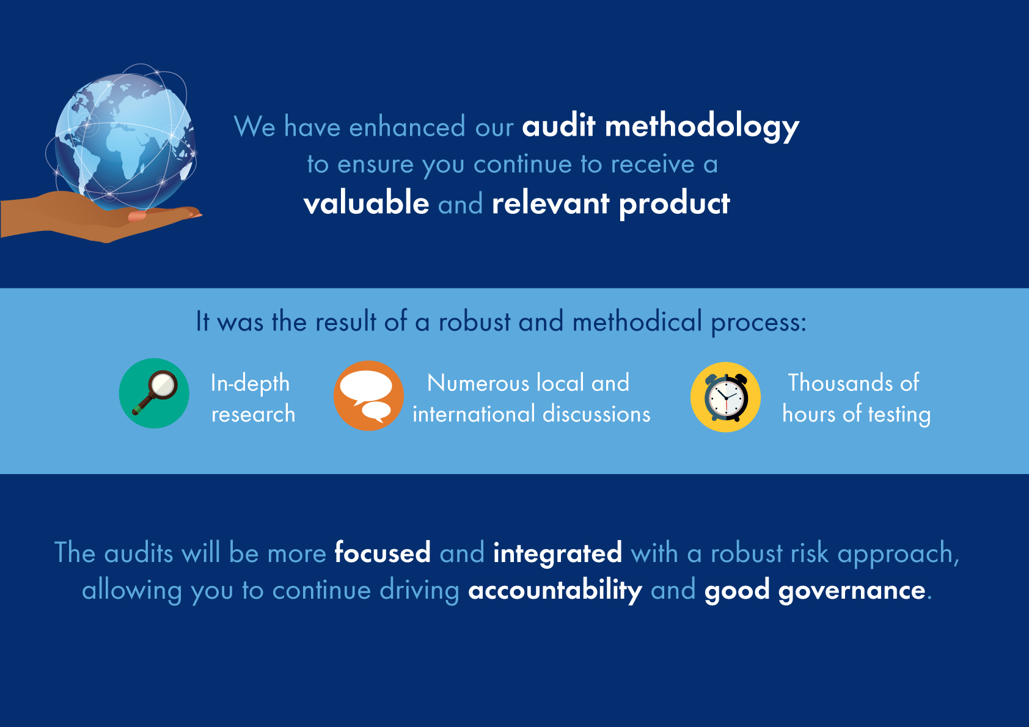
7. AGSA improved audit methodology
1. Risk-based audit approach (minimising audit areas where auditees are now mature or are changing socio-politically, and addressing auditee-specific risk).
2. Allows for an approach that supports full integration between:
(a)financial reporting, performance reporting and reporting on compliance, and
(b) regularity audit and the work of specialists (users of reports should not perceive these as separate, unrelated products).
3. Formal approach for repeat disclaimers.
52

Slide 53
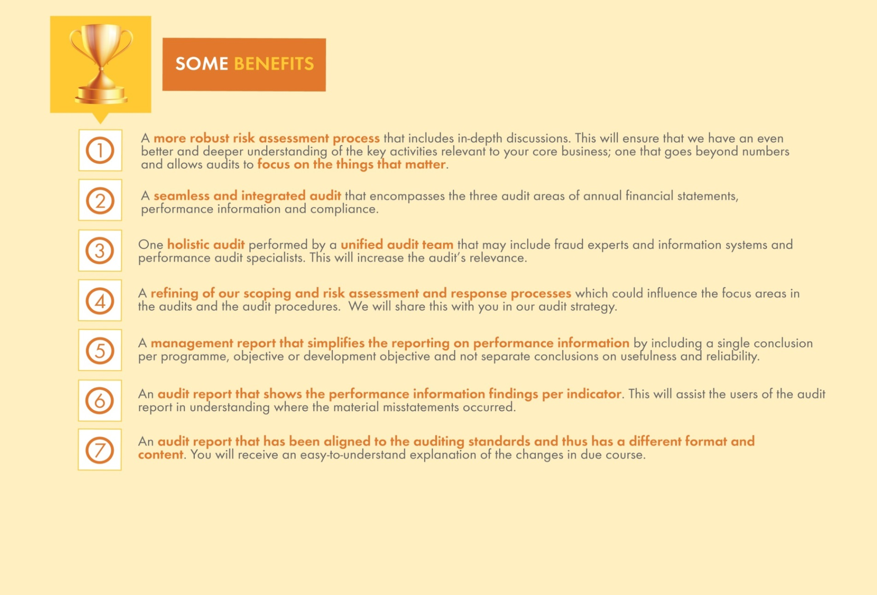
7. AGSA improved audit methodology
We have improved our audit methodology and audit report
  Delivering a valuable and relevant product focusing on the things that matter
53
Auditing to build public confidence

Slide 54
Key recommendations for improvements
8
54

Slide 55



8. Key recommendations for improvements in the portfolio
Ongoing monitoring of entities and how they implement GRAP 103 and ensure that funds made available by Treasury have been used for the intended purpose.
Performance management system to ensure reliable reporting on performance information.
Filling of key vacancies with competent personnel.
55

Slide 56

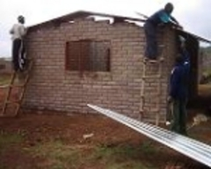



How to get in touch with the AGSA
56

Slide 57

QUESTIONS
57

