Slide 1

Briefing on the Annual Performance Plan for the 2017/18 Financial Year
Portfolio Committee on Home Affairs
2 May 2017

Slide 2

Vision and Mission
Vision
To be a pre-eminent leader in electoral democracy.
Mission
The Electoral Commission is an independent constitutional body which manages free and fair elections of legislative bodies and institutions through the participation of citizens, political parties and civil society in deepening electoral democracy.

Slide 3
Values
To enable the Electoral Commission to serve the needs of stakeholders, including the electorate, political parties, the media and permanent and temporary staff, the organisation subscribes to the following organisational values:
Impartiality
Integrity
Accountability
Transparency
Participation
Responsiveness
Respect

Slide 4
Legislative and Other Mandates
The Electoral Commission is a constitutional institution that falls under Schedule 1 of the Public Finance Management Act (Act 1 of 1999)
Constitutional mandate
In terms of Section 190(1) of the Constitution of the Republic of South Africa (Act 108 of 1996), the Electoral Commission must ­
manage elections of national, provincial and municipal legislative bodies in accordance with national legislation;
ensure that those elections are free and fair; and
declare the results of those elections within a period that must be prescribed by national legislation and that is as short as reasonably possible.

Slide 5
Legislative and Other Mandates (continued)
Electoral Commission Act, 51 of 1996
The duties and functions of the Electoral Commission are defined in section 5 of the Electoral Commission Act, 1996. These include to –
manage any election;
ensure that any election is free and fair;
promote conditions conducive to free and fair elections;
promote knowledge of sound and democratic electoral processes;
compile and maintain a voters' roll by means of a system of registering eligible voters by utilising data available from government sources and information furnished by voters;
compile and maintain a register of parties;
establish and maintain liaison and co-operation with parties;
undertake and promote research into electoral matters;

Slide 6
Legislative and Other Mandates (continued)
develop and promote the development of electoral expertise and technology in all spheres of government;
continuously review electoral legislation and proposed electoral legislation, and to make recommendations in connection therewith;
promote voter education;
promote co-operation with and between persons, institutions, governments and administrations for the achievement of its objects;
declare the results of elections for national, provincial and municipal legislative bodies within seven days after such elections;
adjudicate disputes which may arise from the organisation, administration or conducting of elections and which are of an administrative nature; and
appoint appropriate public administrations in any sphere of government to conduct elections when necessary.

Slide 7
Legislative and Other Mandates (continued)
Electoral Act, 73 of 1998
The duties and functions of the Electoral Commission in respect of elections are also defined in the Electoral Act.
This Act includes among other things the requirements for registration as a voter and the sealing of ballot boxes. It provides for the administration of elections, election timetables, procedures for voting, counting and determining results, the accreditation of observers, and voter education.
Regulations have been published in terms of the Electoral Act.

Slide 8
Legislative and Other Mandates (continued)
Municipal Electoral Act, 24 of 2000
In addition to the provisions in the Electoral Act; the Municipal Electoral Act deals with the specific nature of municipal elections. It provides for the administration of parties and candidates and all other related voting and counting issues.
As in the case of the Electoral Act, appropriate regulations have been published in support of the provisions of this Act. The most notable amendment of the Act has been the recent addition of special votes for persons who require home visits owing to infirmity or disability or who are not able to visit their voting stations on Election Day.
The Municipal Structures Act, 117 of 1998
The Municipal Structures Act deals with the establishment, management and functions of the various municipalities for a municipal election, as well as seat calculation formulas (i.e. the conversion of votes into seats).
This legislation is required to conclude the results process.

Slide 9
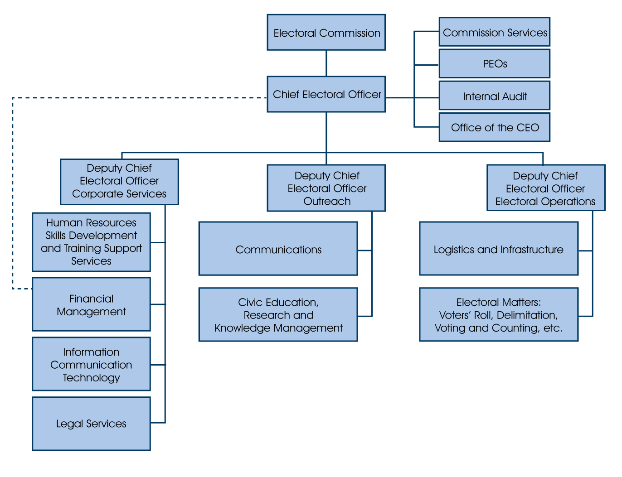
Organisation Structure

Slide 10
Strategic Outcome-oriented Goals
The strategic outcome-oriented goals of the Electoral Commission are to do the following:
Strengthening governance, institutional excellence, professionalism and enabling business processes at all levels of the organisation
Achieving pre-eminence in the area of managing elections and referenda, including strengthening of a cooperative relationship with political parties
Strengthening electoral democracy

Slide 11
Summary Indicators in Respect of Performance Information
A total of 23 targets for performance indicators were set for 2017/18
Programme | Strategic Outcome-oriented Goal | # of targets
Programme 1: Administration | Goal 1: Strengthening governance, institutional excellence, professionalism and enabling business processes at all levels of the organisation | 11
Programme 2: Electoral Operations | Goal 2: Achieving pre-eminence in the area of managing elections and referenda, including the strengthening of a co-operative relationship with political parties. | 7
Programme 3: Outreach | Goal 3: Strengthening electoral democracy | 5
Total |  | 23

Slide 12
Programme 1: Administration

Slide 13
Programme 1: Administration

Slide 14
Programme 1: Administration

Slide 15
Programme 1: Administration

Slide 16
Programme 1: Administration

Slide 17
Programme 2: Electoral Operations

Slide 18
Programme 2: Electoral Operations
* On the National common voters’ roll as at 31 March 2016 there were 16,458,351 voters for whom the Electoral Commission did not have addresses or sufficient particularities. This indicator measures the reduction, through address harvesting and capturing campaigns in this number.

Slide 19
Programme 2: Electoral Operations

Slide 20
Programme 2: Electoral Operations

Slide 21
Programme 2: Electoral Operations

Slide 22
Programme 3: Outreach

Slide 23
Programme 3: Outreach

Slide 24
Programme 3: Outreach

Slide 25
Budget 2017/18
 | Sub-programmes (R'000) | Audited Outcome |  |  | Unaudited | 2017 MTEF
 |  | 2013/14 | 2014/15 | 2015/16 | 2016/17 | 2017/18 | 2018/19 | 2019/20
 | Management | 16,330 | 17,171 | 17,053 | 25,399 | 19,838 | 22,146 | 27,921
 | Corporate Services Management | 2,276 | 2,406 | 2,697 | 2,959 | 3,187 | 3,290 | 3,525
 | Financial Management | 53,962 | 57,317 | 65,651 | 65,278 | 69,176 | 76,752 | 80,710
 | Human Resources Management | 42,437 | 52,024 | 54,324 | 55,771 | 57,482 | 63,873 | 61,474
 | Legal Services | 13,356 | 15,582 | 13,220 | 20,360 | 11,558 | 18,027 | 20,355
 | Internal Audit | 12,096 | 13,774 | 7,500 | 13,008 | 14,010 | 14,831 | 15,572
 | ICT | 192,215 | 229,318 | 203,169 | 256,819 | 217,385 | 240,164 | 263,782
 | Facilities Management | 31,922 | 47,455 | 36,096 | 52,673 | 43,951 | 44,165 | 49,929
 | Risk Management | 1,779 | 1,648 | 1,903 | 1,989 | 2,336 | 2,543 | 2,414
 | Accommodation | 80,039 | 85,593 | 94,444 | 103,564 | 116,090 | 137,525 | 140,071
 | TOTAL FOR SUB-PROGRAMME: ADMINISTRATION | 446,412 | 522,288 | 496,057 | 597,820 | 555,013 | 623,316 | 665,753
 | Electoral Operations Management | 2,129 | 2,118 | 3,058 | 4,577 | 2,842 | 5,050 | 6,171
 | Electoral Matters | 36,789 | 97,703 | 40,275 | 99,569 | 42,520 | 73,259 | 80,968
 | Logistics and Infrastructure | 136,226 | 181,406 | 107,255 | 261,552 | 47,430 | 146,841 | 200,954
 | Political Parties | 1,752 | 4,538 | 2,807 | 4,675 | 2,746 | 2,803 | 4,740
 | Provincial and local offices | 304,402 | 320,448 | 358,467 | 385,340 | 401,100 | 433,911 | 458,397
 | Electoral capacity building | 199,696 | 320,331 | 152,326 | 449,395 | 4,664 | 250,658 | 396,550
 | TOTAL FOR SUB-PROGRAMME: ELECTORAL OPERATIONS | 680,994 | 926,544 | 664,188 | 1,205,108 | 501,302 | 912,522 | 1,147,780
 | Outreach Management | 2,300 | 2,332 | 2,677 | 2,990 | 3,115 | 3,313 | 3,540
 | Civic and Democracy Education and Research | 118,584 | 95,356 | 121,583 | 137,635 | 90,882 | 150,929 | 127,754
 | Communications | 157,293 | 63,851 | 127,140 | 72,708 | 18,114 | 150,091 | 75,115
 | International Liaison | 3,875 | 5,509 | 3,629 | 1,598 | 4,387 | 4,870 | 3,730
 | TOTAL FOR SUB-PROGRAMME: OUTREACH | 282,052 | 167,048 | 255,029 | 214,931 | 116,498 | 309,203 | 210,141
 | TOTAL | 1,409,458 | 1,615,880 | 1,415,274 | 2,017,859 | 1,172,813 | 1,845,041 | 2,023,674

Slide 26
Budget 2017/18 – unfunded projects
ICT Platform upgrade
2017/18 - R61 million
2018/19 - R89 million
Total - R150 million
Address harvesting
2016/17 - R180 million
2017/18 - R119 million
Total - R299 million

