Slide 1
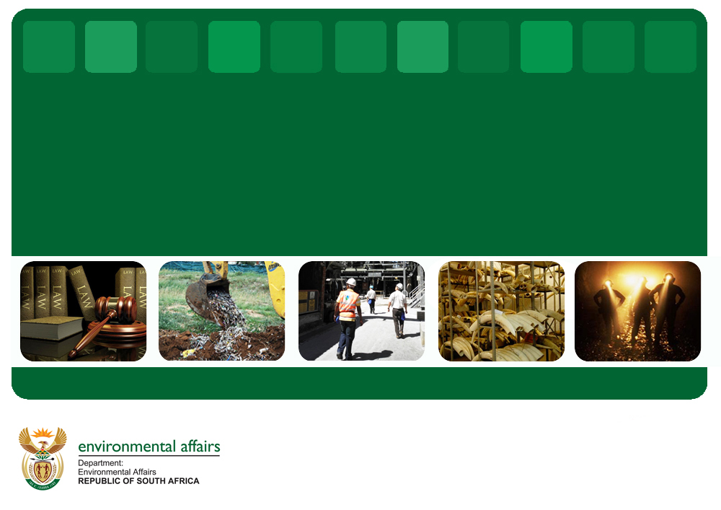
Department of Environmental Affairs
2017/18 Annual Performance Plan
Overview by the Director-General
Presentation to the Portfolio Committee – 02 May 2017
PRIVATE AND CONFIDENTIAL

Slide 2
Delivering on the NDP Policy Framework
NDP desired 2030 outcome
Transition to a society and economy which is
  internationally competitive,
  equitable, job creating &
  sustainable (resilient, green and low carbon)
Priorities: Ecosystems are sustained and natural resource are used efficiently; An effective climate change mitigation and adaptation response; An environmentally sustainable, low-carbon economy resulting from a well-managed just transition ;Enhanced governance systems and capacity; and Sustainable human communities
Requires
A coherent & conducive policy, fiscal and regulatory system to facilitate innovation & incentives for;
  Investment in development of new green sectors/industries
  Growth of existing green sectors/industries
  Investment in the green transition of existing sectors/industries
  Consumer and societal behavior change.
Economy-wide implementation at scale (leverage both public & private sector investment in the transition)
PRIVATE AND CONFIDENTIAL

Slide 3
DEA’s Mandate, Vision and Mission
DEA’s Mandate
The Department of Environmental Affairs is mandated to ensure the protection of the environment and conservation of natural resources, balanced with sustainable development and the equitable distribution of the benefits derived from natural resources for current and future generations. This is to be achieved while giving effect to the right of the Nation to an environment that is not harmful to their health and wellbeing.
DEA’s Vision
A prosperous and equitable society living in harmony with our natural resources.
DEA’s Mission
Providing leadership in environmental management, conservation and protection towards sustainability for the benefit of South Africans and the global community.
PRIVATE AND CONFIDENTIAL

Slide 4
DEA Strategy Map
Transition to society and economy which is internationally competitive, sustainable and equitable
Vision
A prosperous and equitable society living in harmony with our natural resources
ENVIRONMENTAL ECONOMIC CONTRIBUTION OPTIMISED
ECOLOGICAL/ENVIRONMENTAL INTEGRITY
SAFEGUARDED AND ENHANCED
SOCIALLY TRANSFORMED & TRANSITIONED COMMUNITIES
Improved access, fair and equitable sharing of benefits
Growth in industries that depend on environmental services
Ecosystems conserved managed and sustainably used
Key DEA outcomes
F7
Negative impacts on health & wellbeing minimized
Threats to environmental quality & integrity managed
Improved socio-economic benefits
GLOBAL AGENDA INFLUENCED & GLOBAL/LOCAL OBLIGATIONS MET
Enhanced international cooperation supportive of SA environmental /SD priorities
Develop and set the environmental agenda
Build a culture of sustainability
Coordinate and monitor implementation
Economy wide implementation
Effective partnerships,cooperative governance and local government support
Strengthened knowledge, science and policy interface
Improved profile , support and capacity building for Environment sector
Internal Strategic Objectives
Coherent and aligned multi-sector regulatory system & decision support across government
Effective knowledge and information management for the sector
Improved compliance with environmental legislation
Enhanced sector monitoring and evaluation
Value focused funding and resourcing (leveraged public & private sector investments)
Achieve synergies, efficiencies and effectiveness
Adequate, approppriately skilled, transformed and diverse workforce
People & Infrastructure Capability
Secure harmonious and conducive working environment
Equitable and sound corporate governance
Efficient and effective information technology systems

Slide 5
DEA PROGRAMME STRUCTURE
Administration: Provide leadership, strategic centralised administration and executive support, corporate services and facilitate effective cooperative governance, and environmental education and awareness
Legal, Authorisations, Compliance and Enforcement: Promote the development of an enabling legal regime, licensing/authorisation system that will promote enforcement and compliance.
Oceans and Coasts: Promote, manage and provide strategic leadership on oceans and coastal conservation
Climate Change and Air Quality: Improve air and atmospheric quality, lead and support, inform, monitor and report efficient and effective international, national and significant provincial and local responses to climate change (South African Weather Service)
Biodiversity and Conservation: Ensure the regulation and management of all biodiversity, heritage and conservation matters in a manner that facilitates sustainable economic growth and development.(South African National Parks, South African National Biodiversity Institute, Isimangaliso Wetland Authority Park)
Environmental Programmes: Implementation of expanded public works and green economy projects in the environmental sector.
Chemicals and Waste Management : Manage and ensure that chemicals and waste management policies and legislation are implemented and enforced in compliance with chemicals and waste management authorisations, directives and agreements.

Slide 6
DEA ORGANISATIONAL STRUCTURE
TOTAL POSTS: 1833
MINISTER OF ENVIRONMENTAL AFFAIRS
OFFICE OF THE MINISTER
DEPUTY MINISTER OF ENVIRONMENTAL AFFAIRS
OFFICE OF DEPUTY MINISTER
DIRECTOR-GENERAL
INTERNAL AUDIT
UNIT
FINANCIAL MANAGEMENT SERVICES
UNIT ENVIRONMENTAL ADVISORY SERVICES
OFFICE OF THE CHIEF OPERATING OFFICER
LEGAL, AUTHORISATIONS COMPLIANCE AND ENFORCEMENT
OCEANS AND COASTS
CLIMATE CHANGE AND AIR QUALITY
BIODIVERSITY AND CONSERVATION
ENVIRONMENTAL PROGRAMMES
CHEMICALS & WASTE MANAGEMENT

Slide 7
Environmental Scan
Problem Statements & DEA Strategic Responses

Slide 8
Problem Statements & DEA Response
Problem Statement | Critical DEA Outputs
SA is committed to a transition towards a low carbon and climate resilient society. The adoption of the National climate change policy in 2011, as well as the recent ratification of the Paris agreement are critical steps towards improving the country’s raking among the world’s biggest greenhouse gas Emitters | Reduction of emissions of CO2: Reduce CO2 emissions by 34% by 2020 and 42% by 2025 from the Business As Usual trajectory Renewable Energy deployment: Increasing the percentage of power generation from renewable sources Adapting to climate change impacts: Develop and implement key Sectors Adaptation Plans
Most parts of SA enjoy a relatively good quality of air. There are however priority areas where air pollution continues to be a problem, and the levels of SO2, PM, and O3, are a cause for concern. Exposure to air pollution leads to respiratory health problems in people | Declaration of hotspots as priority areas; Development of Air Quality Management plans Regulation of industrial emissions Establishment of the draft strategy to address air pollution in dense low-income settlements
DEA implements the National Waste Management Strategy to minimize waste generated ; waste going to landfill sites and to unlock economic opportunities. Access to waste management services remains a challenge . Correcting status of unlicensed landfill sites and enforce compliance with conditions of existing waste licences | Less and better managed waste: solid waste management and minimisation through improved collection and disposal and recycling All unlicensed waste landfill sites will be issued with waste management licenses by 2019. Policy and legislative mechanisms has been put in place; and implementation to be

Slide 9
Problem Statements & DEA Response
Problem Statement | Critical DEA Outputs
In the context of a developmental state it is critical to manage the impacts of development activities on ecological integrity. While the department has made strides in this area, the impact of mining activities on the environment and natural resources still remain a challenge | Sector Focus: Ensure rehabilitation and closure of abandoned, derelict and ownerless mines
DEA and other key sector partners have over the years implemented a successful programmes for the restoration and rehabilitation of degraded ecosystems. However Land degradation and soil erosion still required attention | Sustainable Land use management: Ensure alignment of sustainability criteria in all levels of integrated and spatial planning as well as in project formulation Restore & rehabilitate degraded ecosystems
The protected area network has been increased over the years to 12% (implementing the Protected Areas Expansion Strategy. The network is however inadequate for sustaining biodiversity and ecological processes with only 22 per cent of terrestrial ecosystem types well protected and 35 percent completely unprotected. | Expansion of the conservation estate: Land protection and rehabilitation by increasing the percentage of land mass under conservation from 12% to 13.2% by 2018 Biodiversity Economy: Increase contribution of biodiversity sector to economic growth/dev
SA coastline and ocean presents economic opportunities which are currently being explored through the Ocean Phakisa programme, there are however a number of concerns which require intervention. These include: Sand-mining along SA’s coastline, Activities undertaken illegally, Over- exploitation of natural resources from the ocean and the coastal Zone; Unplanned and uncontrolled coastal developments | Expansion of the conservation estate: percentage of coastline with partial protection to increase from 12% to 14.5% by 2018 and % of coastline with full protection to increase from 9% to 11.5% by 2018

Slide 10

Progress Report on Operationalisation of the Waste Bureau
PCEA, 09 May 2017

Slide 11
Amendments to the Waste Act
The following amendments have been approved by Cabinet and tabled to parliament for strengthening governance and establishment of the board
Clause 54: The clause seeks to provide clarity that the Waste Management Bureau is established as a juristic person with a Board, and that in absence of a functional board, the powers and duties of the Board revert to the Minister;
Clause 55: The clause sets out the Minister’s supervisory powers over the Waste Management Bureau;
Clause 56: The clause sets out the general powers of the Bureau, governing Board of the Bureau, composition and membership, qualifications for members of the governing Board, appointment procedure for members of the governing Board, term of office of members of the Board and conditions of appointment of members of the governing Board;
Clause 57: This clause sets out the governance matters of the Board; Conduct, Procedures, appointment and termination processes etc

Slide 12
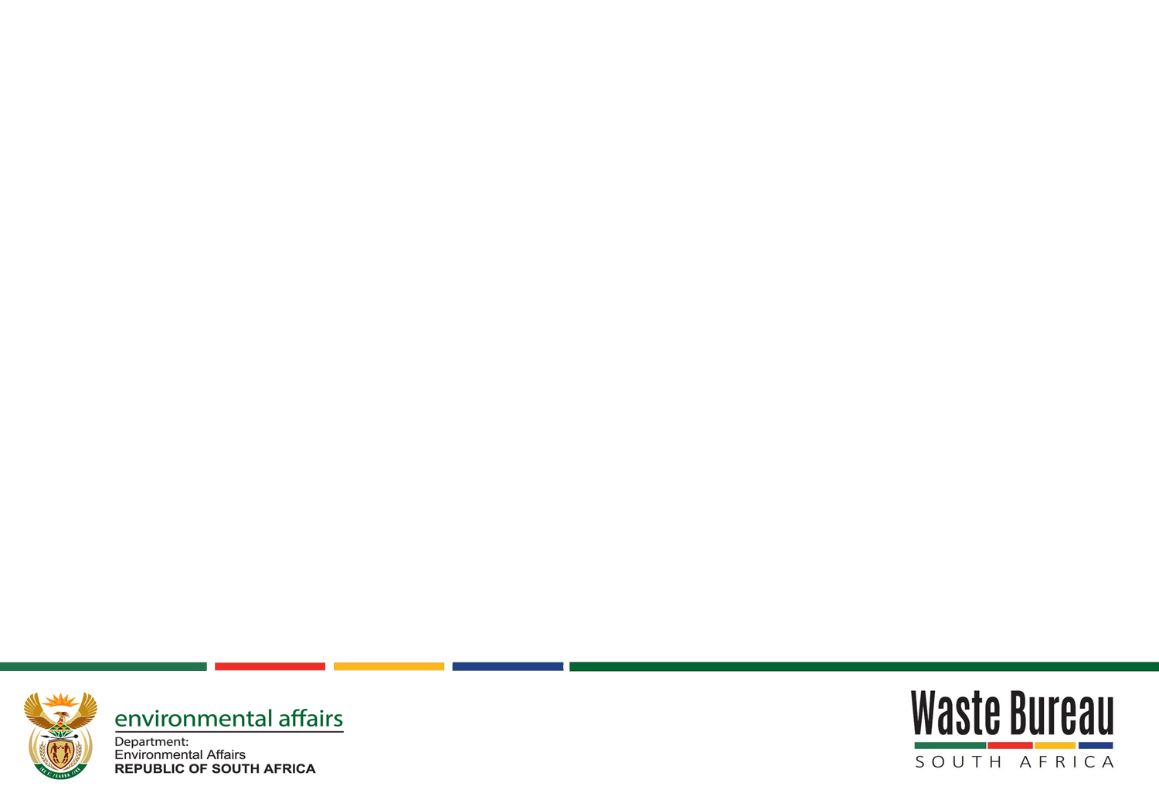
Objects of the Waste Bureau
Objects of the Bureau (S34D)
a) Function as a specialist implementing agent | b) Promote and facilitate minimisation, re-use, recycling and recovery of waste
c) Manage the disbursement of incentives and funds | d) Monitor implementation of industry waste management plans
e) Progressively build capacity to provide specialist support for the development and implementation of municipal waste management plans and capacity building programmes | f) Support and advise on the development of waste management plans, tools, instruments, processes, systems, norms, standards and municipal waste management plans and capacity building programmes

Slide 13
Waste Bureau Macro Structure
Chief Executive Officer
Risk Management
Executive Manager
Extended Producer Responsibility
Executive Manager
Operations and Innovation
HEAD: RESEARCH & DEVELOPMENT
HEAD: CORPORATE SERVICES
HEAD: EXTENDED PRODUCER RESPONSIBILITY FOR GENERAL WASTE
HEAD: EXTENDED PRODUCER RESPONSIBILITY FOR HAZARDOUS WASTE
Research and Incentives Specialist
Research and Incentives
Financial Management & Supply Chain Management
Senior Specialist Project Manager
tyres and other Gen waste streams
SENIOR SPECIALIST PROJECT MANAGER
Lighting and other Haz. waste streams
Specialist Project Manager
Specialist Project Manager
Innovation Specialist
Innovation, skills development
Legal & Contract Management
Information & Knowledge Management
Board of Directors
Governance and Compliance
Senior Specialist Project manager
Paper & Packaging (Paper, Plastics, glass, metal etc)
Specialist Project Manager
SENIOR SPECIALIST PROJECT MANAGER
Waste Electric & Electronic Equipment
Specialist Project Manager

Slide 14
Current Arrangements
Bureau housed at Environment House, Pretoria
The Bureau appears under the Chemicals and Waste Branch: Programme 7 of DEA
Currently five personnel working in the Bureau

Slide 15


