Slide 1
Presentation to the Parliamentary Portfolio Committee on Public Works STRATEGIC & ANNUAL PERFORMANCE PLAN

Slide 2
Vision - Reviewed
A transformed construction industry that is inclusive, ethical and contributes to a prosperous South Africa and the World

Slide 3
Mission reviewed
We exist in order to regulate and develop the construction industry through strategic interventions and partnerships

Slide 4
Values - reviewed
Responsive
Effective
Innovative
Ethical
Accessible
Agility

Slide 5
Strategic Pillars
Transformation
Development
Regulation
Partnership
High Performing Organisation

Slide 6
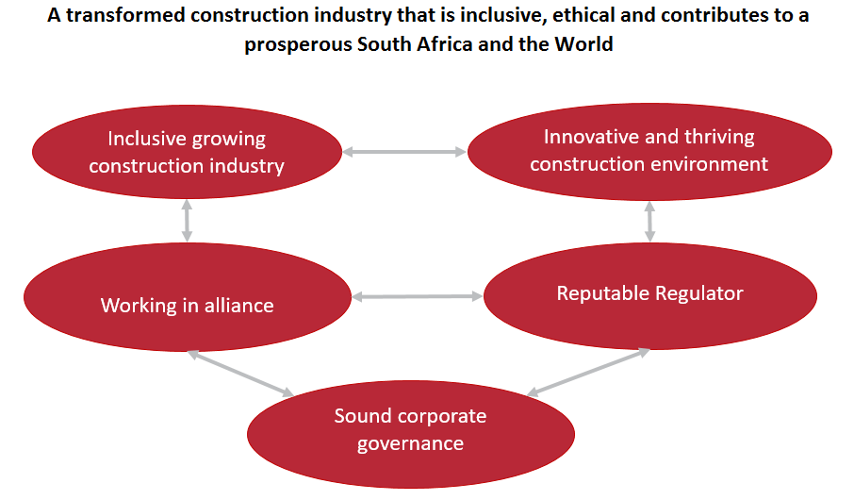
Strategic Outcome Orientated Goals

Slide 7
Strategic Goal 1 | Inclusive growing construction industry
Goal Statement | To transform the construction industry by increasing infrastructure spend to support and reflect the demographics of South Africa
Goal Indicator | % construction Gross Fixed Capital Formation of GDP % public Sector Contract Awards Index 5-Year Independent Review and Impact Assessment
Strategic Goal 2 | Innovative and thriving construction environment
Goal Statement | Provide mechanisms and support to enterprises to be competitive and sustainable and to deliver value for money within the construction industry
Goal Indicator | % contractor and PSP satisfaction with clients’ index % client satisfaction with contractors and PSPs index % artisan development index

Slide 8
Strategic Goal 3 | Reputable regulator
Goal Statement | To regulate the construction industry in the public interest to ensure a fair, inclusive, ethical, transformed, enabling and reputable construction environment
Goal Indicator | % Code of Conduct Investigations Finalised within 6 Months % sanctions per 1 000 Contractors (Grades 2 to 9) % Register of Contractors (ROC) effective index % Register of Project Compliance index % Provincial Performance Index

Slide 9
Strategic Goal 4 | Working in alliance
Goal Statement | Pursuing progressive partnerships and alliances with industry stakeholders to achieve cidb's strategic intent
Goal Indicator | % cidb Perception and Acceptance index
Strategic Goal 5 | Sound corporate governance
Goal Statement | An effective, efficient adequately structured well-governed and sustainable institution
Goal Indicator | Clean Audit

Slide 10
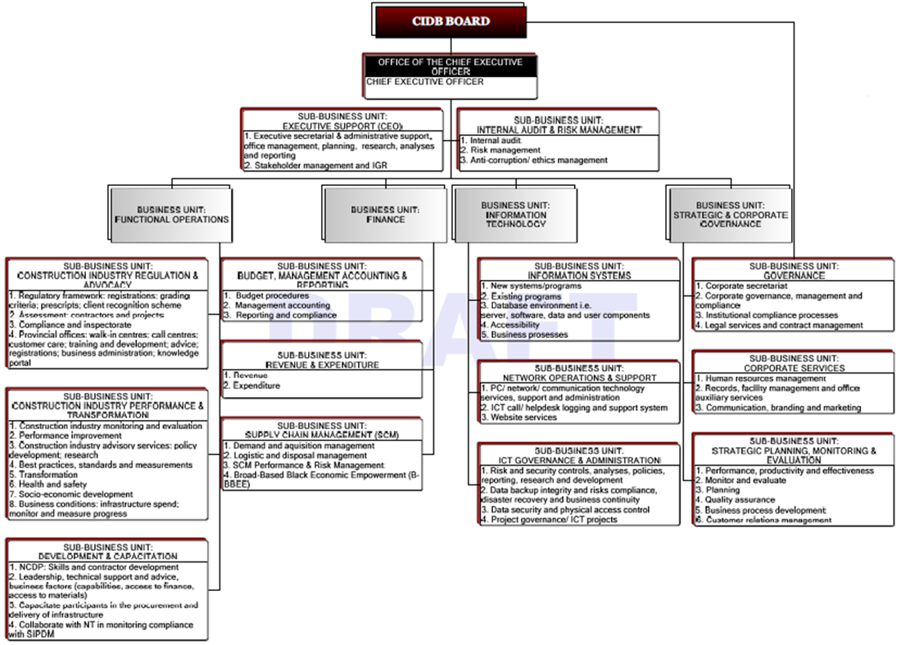
Approved Macro structure – Programme alignment

Slide 11
Finalised Programmes
Programme 1 – Administration
Financial Management
Information and Communications Technology (ICT)
Strategic and Corporate Governance
Office of the CEO
Programme 2 – Regulation and Advocacy
Regulatory Framework Compliance
Registrations
Provincial Offices

Slide 12
Finalised Programmes
Programme 3 – Development and Capacitation
Contractor and PSP Recognition
Developmental Opportunities and Support
Construction Skills Development
Programme 4 – Industry Performance and Transformation
Construction Industry Monitoring and Evaluation
Business and Policy Advisory Services
Partnerships and Collaboration

Slide 13
CIDB: Roadmap for 2017/2022
Contributor Institute for Performance Management
PROGRAMME 1 – ADMINISTRATION
Strategic Goal 5 – Sound corporate governance
Goal Statement - An effective, efficient adequately structured well-governed and sustainable institution
Strategic Goal 4 – Working in alliance
Goal Statement – Pursuing progressive partnerships and alliances with industry stakeholders to achieve cidb's strategic intent
Impact / End Result
Service Excellence
Goal Indicator
Clean Audit
Impact / End Result
Progressive construction industry that works in synergy
Goal Indicator
% cidb perception and acceptance index
Sub Programme
Financial Management
Information and Communications Technology (ICT)
Strategic and Corporate Governance
Office of the CEO
Strategic Objective 1.4 – To ensure that the cidb is complying to all legislative requirements (Strategic and Corporate Governance)
Strategic Objective 4.3- To grow and develop contractors through establishment of partnerships and other collaborative initiatives
Strategic Objective 1.1 - To increase alternate revenue streams to more than 75% of total budget by 2020 (Financial Management)
Objective statement | To manage and improve on the mechanisms within the cidb to comply to all legislative requirements
% legislative compliance index
Objective statement | To network and foster relationships with relevant education, training and industry institutions to develop relevant qualifications and improve delivery mechanisms. To facilitate accessibility to credit for contractors. To interact and engage with construction industry related training institutions and influence relevance and development of training and skills development curriculum
Objective statement | To source alternative revenue to achieve cidb objectives
SP Indicator
% of total revenue received through other revenue streams
APP Indicator
% of fraud cases reported investigated within specified timeframes
% of service provider paid within 30 days
% of budget spent on contracts
APP Indicator
% actual expenditure on budget
Current ratio
% Irregular expenditure / budget
SCM Turnaround index
% contractors grown through strategic partnerships
Strategic Objective 1.2 – To achieve a 4th level of maturity of ICT governance framework by 2020 (Information and Communications Technology)
Strategic Objective 1.5 - To grow talented human capital by achieving a human capital value add rating of 9% by 2020 (Strategic and Corporate Governance)
APP Indicator
% index rating inadequate access to credit as a constraint
% contractors grown through strategic partnerships
% index of quality and relevance of current construction industry training programme
R-value Credit Available to Construction Enterprises by DFI's
Objective statement | To increase accessibility of ICT services to improve on the service delivery turnaround times that risks can be minimised
Objective statement | To provide all inclusive timeous human resource value chain and services for optimal human resource allocation, utilisation and efficiency within a trusting relational environment
Level of maturity regarding implementation of ICT governance strategy
% Human Capital Value Add (ROI)
APP Indicator
% Down time of multiple systems
% Incidence / reports attended to within a specific time
APP Indicator
% Competency assessment index
% Employee satisfaction rating
% Average employee performance assessment rating
Strategic Objective 1.7 – To become a reputable organisation through sound stakeholder relations and improved customer satisfaction levels by 2020 (Office of the CEO)
Strategic Objective 1.3 – To become a high performing organisation that will achieve all objectives and set targets (Strategic and Corporate Governance)
Strategic Objective 1.6 – To ensure that sound governance practices are implemented through effective implementation of all Board decisions and resolutions (Office of the CEO)
Objective statement | To improve the internal and external brand awareness, customer understanding of the mandate and responsiveness of the cidb services as well as the reputation and credibility of the cidb through effective liaison, communication and stakeholder relations management.
Objective statement | To ensure that all systems, processes and procedures are effective in order for the organisation to achieve all targets
Objective statement | To ensure that the board can fulfil fiduciary duties and mandate through decisions and resolutions that are effectively implemented within the organisation
SP Indicator
% of targets achieved in scorecard
% Customer satisfaction rating
APP Indicator
% of items approved in line with the 5-year strategy
% Board resolutions and decisions implemented within specified timeframes
APP Indicator
% Stakeholder perception index
% IGR resolutions implemented
APP Indicator
Internal audit risk rating on final report
% of recurring audit findings resolved
% of completed Internal Audits

Slide 14
CIDB: Roadmap for 2017/2022
Contributor Institute for Performance Management
PROGRAMME 2 – REGULATION AND ADVOCACY
PROGRAMME 3 – DEVELOPMENT AND CAPACITATION
Strategic Goal 3 – Reputable Regulator
Goal Statement - To regulate the construction industry in the public interest to ensure a fair, inclusive, ethical, transformed, enabling and reputable construction environment
Strategic Goal 2 – Innovative and thriving construction environment
Goal Statement - Provide mechanisms and support to enterprises to be competitive and sustainable and to deliver value for money within the construction industry
Impact / End Result
Cohesive governance
Goal Indicator
% Code of Conduct investigations finalised within 6 months
% Sanctions per 1000 Contractors (Grades 2 to 9)
% Registrations effective index (Contractors and PSPs)
% Register of Project Compliance index
% Provincial Performance Index
Impact / End Result
Competitive Sustainable Construction Industry
Goal Indicator
% contractor and PSP satisfaction with clients Index
% client satisfaction with contractors and PSPs index
% Artisan development index
Sub Programme
Regulatory Framework Compliance
Registrations
Provincial Offices
Sub Programme
Contractor and PSP recognition
Development Opportunities and Support
Construction Skills Development
Strategic Objective 2.1 – To increase compliance with the regulatory framework by ensuring projects and client developmental procurement practices achieves high levels of compliance (Regulatory Framework Compliance)
Strategic Objective 3.1 – To support risk management within the industry to ensure that by 2020 at least 85% of projects comply to contractor and client performance ratings (Contractor and PSP recognition)
Objective statement | To ensure compliance with cidb prescripts for registrations, invitation and awards, best practice and standards, Code of Conduct, reform and improvement of the construction sector.
Objective statement | To ensure delivery capability through setting of standards and recognition of contractors and PSPs by implementation of recognition schemes
% developmental procurement index (for contractors and PSP's)
% projects with client performance ratings by contractors and PSPs
% public sector project compliance index
% private sector project compliance index
% Construction works contracts with dispute resolution index
% contractor and PSP recognition index
% projects with contractor and PSP performance ratings by clients
% projects specifying CPOG’s for targeted enterprises
Strategic Objective 2.2 – To achieve a 98% correlation of contracts awarded to correct level of contractor or PSP by 2020 (Registrations)
Strategic Objective 3.2 – To improve availability of developmental support to at least 0.05% of the total construction Gross Fixed Capital Formation by 2020 (Development Opportunities)
Objective statement | To establish, manage and enhance registers of contractors, PSPs and projects that support risk management in procurement and facilitates development of enterprises and promotes performance improvement and transformation within the industry
Objective statement | To have contractors, clients and PSP's deliver value for money and socio-economic objectives by ensuring that more resources are spend on development, training and capacity development within the industry that will enhance socio-economic development
% of projects awarded on correct grade level of contractor/PSP
% developmental support of construction GFCF
% Register of Project Information Verified and Corrected within Eight Weeks Index
% of contractor and PSP’s registered within 21 working days
% of contractors and PSP’s correctly graded through validation sampling
% Contractor and PSP’s satisfied/very satisfied with registration services
% of contractors graduating from CDP’s
% project assessment scheme compliance index
% accelerated contractor growth index
% contractors with more than 30 H&S demerit points on public and private sector contracts
Strategic Objective 2.3 – To enhance provincial footprint in support of cidb strategic objectives (Provincial Offices)
Strategic Objective 3.3 – To improve the skills development pipeline by providing 4 000 learners with access to workplace learning opportunities by 2020 (Construction Skills Development)
Objective statement | To have well-run, efficient, effective offices supporting the strategic intent of the cidb
Objective statement | To increase the number of learners receiving artisan qualification and built environment graduates achieving professional registration
% Provincial Performance Index
% Customer registration satisfaction rating
# of learners receiving workplace opportunities
Grade 1 Turnaround time
% of Contractors Graduating from CDP's Provincial Index
% Contractor and PSP Recognition Provincial Index
% Provincial Performance Index per Province
% Provincial Business Advisory Services to Contractors at Grades 2 to 6 Index
% Project Assessment Scheme Compliance Provincial Index
% Projects Compliance Provincial Index
# of TVET Colleges participating in WorldSkills SA construction trade competitions
Rand value of Skills Development support provided

Slide 15
CIDB: Roadmap for 2017/2022
Contributor Institute for Performance Management
PROGRAMME 4 – INDUSTRY PERFORMANCE AND TRANSFORMATION
Strategic Goal 1 – Inclusive growing construction industry
Goal Statement – Transform the construction industry by increasing infrastructure spend to support and reflect the demographics of South Africa
Impact / End Result
Sector growth and equitable market share
Goal Indicator
% Construction Gross Fixed Capital Formation of GDP
% Public Sector Contract Awards Index
5-Year Independent Review and Impact Assessment
Sub Programme
Construction Industry Monitoring and Evaluation
Business and Policy Advisory services
Partnerships and Collaboration
Strategic Objective 4.1 – To monitor the growth and transformation of the construction industry to achieve transformational targets by 2020 (Construction Industry Monitoring and Evaluation)
Objective statement | To monitor business conditions, infrastructure spend, contractor development and PSP development to inform transformation of the industry through different indexes and data
% User profile index
% Industry Transformative index
% public sector SME contracts awards index
% of contractor payment within 30 days index
Strategic Objective 4.2 – To improve the capacity and competitiveness of the construction industry by 2020 (Business and Policy Advisory Services)
Objective statement | To provide business and policy advisory services to the construction industry to ensure SME contracts are awarded according to procurement and other regulatory guidelines
% public sector SME contracts awards index
% advisory services provided to contractors at level 2 - 6 rated as good
# of export advisory services provided to contractors at grades 5 to 9
Strategic Objective 4.3 – To grow and develop contractors through establishment of partnerships and other collaborative initiatives (Partnerships and Collaboration)
Objective statement | To network and foster relationships with relevant education, training and industry institutions to develop relevant qualifications and improve delivery mechanisms To facilitate accessibility to credit for contractors To interact and engage with construction industry related training institutions and influence relevance and development of training and skills development curriculum
% contractors grown through strategic partnerships
% index rating inadequate access to credit as a constraint
% contractors grown through strategic partnerships
% index of quality and relevance of current construction industry training programme
R-value Credit Available to Construction Enterprises by DFI's

Slide 16
Budget (Rk)
 | 2017/18 | 2018/19 | 2019/20
Administration | 75 967 | 77 693 | 82 044
Regulation and Advocacy | 64 710 | 67 628 | 71 415
Development and Capacitation | 13 303 | 13 914 | 14 693
Industry Performance and Transformation | 14 497 | 15 188 | 16 039
Total | 168 477 | 174 423 | 184 191

Slide 17
ANNUAL PERFORMANCE PLAN

Slide 18
Programme 1 - Administration
Sub-Programme – Financial Management
Strategic Objective 1.1 | To increase alternate revenue streams to 75% by 2020
Objective Statement: | To source alternative revenue to achieve cidb objectives.
Sub-Programme – Information Communications and Technology
Strategic Objective 1.2 | To achieve a 4th level of maturity of ICT governance framework by 2020
Objective Statement: | To increase accessibility of ICT services to improve on the service delivery turnaround times that risks can be minimised.

Slide 19
Programme 1 - Administration
Sub-Programme – Strategic and Corporate Governance
Strategic Objective 1.3 | To become a high performing organisation that will achieve all objectives and set targets
Objective Statement: | To ensure that all systems, processes and procedures are effective for the organisation to achieve all targets.
Strategic Objective 1.4 | To ensure that the cidb is complying to all legislative requirements
Objective Statement | To manage and improve on the mechanisms within the cidb to comply to all legislative requirements.
Strategic Objective 1.5 | To grow talented human capital by achieving a human capital value add rating of 9% by 2020
Objective Statement | To provide all-inclusive timeous human resource value chain and services for optimal human resource allocation, utilisation and efficiency within a trusting relational environment.

Slide 20
Programme 1 - Administration
Sub-Programme – Strategic and Corporate Governance
Strategic Objective 1.6 | To ensure that sound governance practices are implemented through effective implementation of all Board decisions and resolutions
Objective Statement: | To ensure that the Board can fulfil fiduciary duties and mandate through decisions and resolutions that are effectively implemented within the organisation.
Strategic Objective 1.7 | To become a reputable organisation through sound stakeholder relations and improved customer satisfaction levels by 2020
Objective Statement | To improve the internal and external brand awareness, customer understanding of the mandate and responsiveness of the cidb services as well as the reputation and credibility of the cidb through effective liaison, communication and stakeholder relations management.

Slide 21
Programme 2 – Regulation and Advocacy
Sub-Programme – Regulatory Framework Compliance
Strategic Objective 2.1 | To increase compliance with the regulatory framework by ensuring projects and client developmental procurement practices achieves high levels of compliance
Objective Statement: | To ensure compliance with cidb prescripts for registrations, invitation and awards, best practice and standards, Code of Conduct to stimulate sustainable growth, reform and improvement of the construction sector.
Sub-Programme – Registrations
Strategic Objective 2.2 | To achieve a 98% correlation of contracts awarded to correct level of contractor or PSP by 2020
Objective Statement: | To establish, manage and enhance registers of contractors, PSPs and projects that support risk management in procurement and facilitates development of enterprises and promotes performance improvement and transformation within the industry.

Slide 22
Programme 2 – Regulation and Advocacy
Sub-Programme – Provincial Offices
Strategic Objective 2.3 | To enhance provincial footprint in support of cidb strategic objectives
Objective Statement: | To have a well-run, efficient, effective offices supporting the strategic intent of the cidb.

Slide 23
Programme 3 – Development and Capacitation
Sub-Programme – Contractor and PSP Recognition
Strategic Objective 3.1 | To support risk management within the industry to ensure that by 2020 at least 85% of projects comply to contractor and client performance ratings
Objective Statement: | To ensure delivery capability through setting of standards and recognition of contractors and PSPs by implementation of recognition schemes.
Sub-Programme – Development Opportunities and Support
Strategic Objective 3.2 | To improve availability of developmental support to at least 0.05% of the total construction Gross Fixed Capital Formation by 2020
Objective Statement: | To have contractors, clients and PSP's deliver value for money and socio-economic objectives by ensuring that more resources are spend on development, training and capacity development within the industry that will enhance socio-economic development

Slide 24
Programme 3 – Development and Capacitation
Sub-Programme Construction Skills Development
Strategic Objective 3.3 | To improve the skills development pipeline by providing 4 000 learners with access to workplace learning opportunities by 2020
Objective Statement: | To increase the number of learners receiving artisan qualification and built environment graduates achieving professional registration.

Slide 25
Programme 4 – Industry Performance and Transformation
Sub-Programme – Construction Industry Monitoring and Evaluation
Strategic Objective 4.1 | To monitor the growth and transformation of the construction industry to achieve transformational targets by 2020
Objective Statement: | To monitor business conditions, infrastructure spend, contractor development and PSP development to inform transformation of the industry through different indexes and data
Sub-Programme – Business and Policy Advisory Services
Strategic Objective 4.2 | To improve the capacity and competitiveness of the construction industry by 2020
Objective Statement: | To provide business and policy advisory services to the construction industry to ensure SME contracts are awarded according to procurement and other regulatory guidelines

Slide 26
Programme 4 – Industry Performance and Transformation
Sub-Programme – Partnerships and Collaboration
Strategic Objective 4.3 | To grow and develop contractors through establishment of partnerships and other collaborative initiatives
Objective Statement: | To network and foster relationships with relevant education, training and industry institutions to develop relevant qualifications and improve delivery mechanisms. To facilitate accessibility to credit for contractors. To interact and engage with construction industry related training institutions and influence relevance and development of training and skills development curriculum

Slide 27
Thank You

