Slide 1
2015-16
Health Sector Report
Presentation to the Standing Committee on Appropriations
22 March 2017
PFMA

Slide 2
Reputation promise
The Auditor-General of South Africa (AGSA) has a constitutional mandate and, as the Supreme Audit Institution (SAI) of South Africa, it exists to strengthen our country’s democracy by enabling oversight, accountability and governance in the public sector through auditing, thereby building public confidence.
2015-16
PFMA

Slide 4
2015-16
PFMA
Health sector service delivery and audit outcomes

Slide 5
2015-16
Use and maintenance of medical equipment
1
1

Slide 6
Medical equipment - Planning for the procurement and
maintenance of equipment
2015-16
6

Slide 7
Medical equipment - Use of medical equipment
2015-16
PFMA
2015-16
7

Slide 8
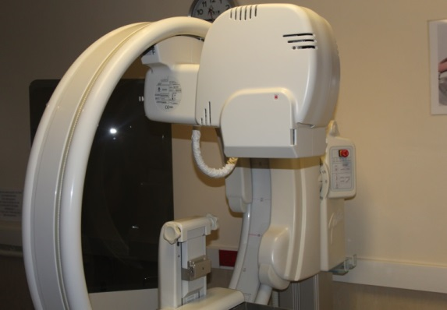
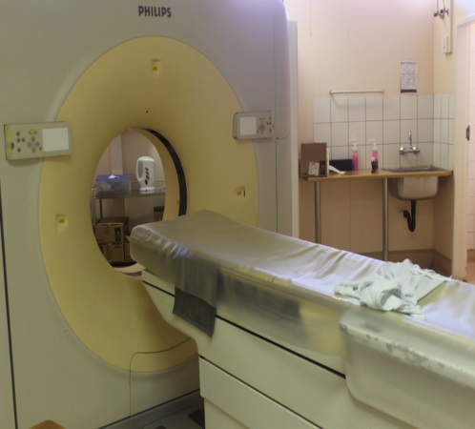
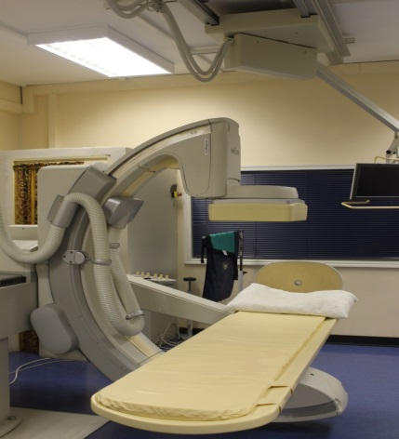
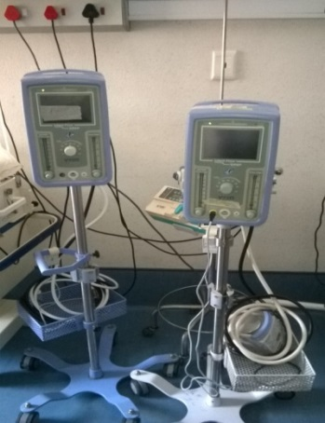
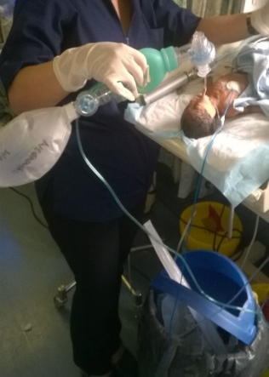
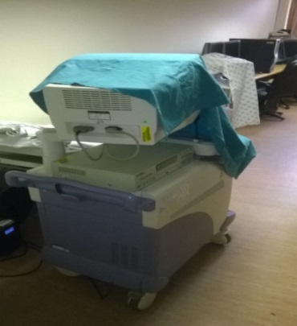
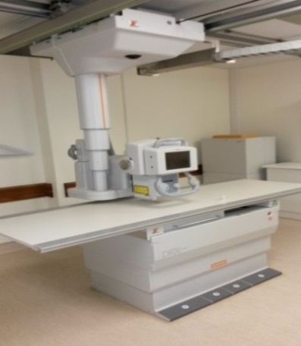
Medical equipment - Use of medical equipment
2015-16
PFMA
2015-16
Frere Hospital - mammography machine
Pietersburg Hospital - CT scanner
Kimberley Hospital - fluoroscopy machine
Rob Ferreira Hospital - SiPAP systems, resuscitator, ultrasound machine
King Dinuzulu Hospital - X-ray machine
8

Slide 9
Medical equipment - Maintenance and repairs of medical equipment
2015-16
PFMA
2015-16
9

Slide 10
2015-16
Infrastructure planning and maintenance
2
2

Slide 11
Findings on planning of health infrastructure projects
2015-16

Slide 12
Findings on the maintenance of health infrastructure
2015-16

Slide 13
Most prevalent root causes
2015-16
Low adherence to technical specifications.
Poor project planning, supervision, monitoring and coordination by implementing agents.
Insufficient guidance by the Planning division (DoH) on needs determination.
Use of an accepted methodology (IDMS) to program work.
Monitoring the submission of procurement plans to Treasury.
The management of documents and records is deficient in departments.
The U-AMPS of departments don’t contain the required content.
Use of latest conditional assessments to update U-AMPS.
Vacant posts in infrastructure units at provincial level.

Slide 14
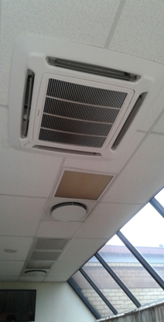
Pictures
2015-16
JST Hospital, North West
MDR TB Ward No mechanical ventilation system as stipulated in the norms of standards for hospitals

Slide 15
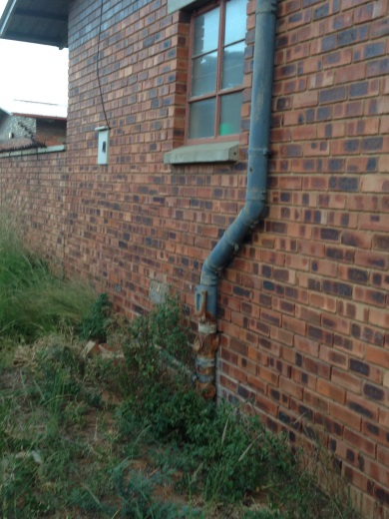
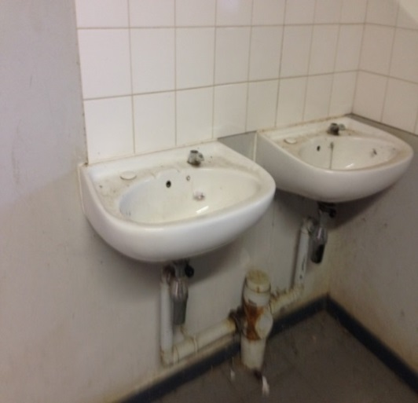
Pictures
2015-16
Mmabatho College of Nursing
Figure 1 and 2 :Poor maintenance of gutters
Figure 3: Deteriorating infrastructure due to neglect

Slide 16
Pictures
2015-16
Midoroni and Vaal Bank clinics
Figure 1: Ponding at surface bed due to poor sloping of surface at Vaal Bank Clinic (EC)
Figure 2: Honeycombing of concrete surface due to inferior concrete mix, at Midoroni Clinic (LP)

Slide 17
2015-16
3
Information Technology
3

Slide 18
Information Technology- Overall Status of E-Health Strategy Implementation at provincial level
2015-16
PFMA
2015-16
PFMA
Development and alignment of provincial strategies to the E-Health Strategy
Prioritisation and progress of E-Health initiatives
Support Structures and Committees established
Monitoring and reporting of E-Health strategy initiatives
Good | Concerning | Intervention required
18

Slide 19
Information Technology - Network infrastructure and connectivity
2015-16
PFMA
No findings | New finding | Repeat finding

Slide 20
Information Technology- Billing and revenue systems
2015-16
PFMA
No findings | New finding | Repeat finding

Slide 21
Information Technology- Pharmaceutical systems
2015-16
PFMA
No findings | New finding | Repeat finding

Slide 22
2015-16
4
Management of healthcare waste
4

Slide 23
Management of healthcare waste - Internal control weaknesses
2015-16
PFMA
No findings | New finding | Finding in the current year not a focus in the prior year | Repeat finding | Action plan not prepared | Policies not in place

Slide 24
Management of healthcare waste – Procurement and Contract management
2015-16
PFMA
No findings | New finding | Finding in the current year not a focus in the prior year | Repeat finding

Slide 25
Management of healthcare waste - Compliance with NEMA and NEMWA
2015-16
PFMA
No findings | New finding | Finding in the current year not a focus in the prior year | Repeat finding

Slide 26
2015-16
PFMA
5
5
Health Sector audit outcomes

Slide 27
Overall audit outcomes for health sector
2015-16
PFMA
Unqualified with no findings
Unqualified with findings
Qualified with findings
Adverse with findings
Disclaimed with findings
Audits outstanding
10 Auditees
10 Auditees
10 Auditees
10 Auditees
10 Auditees

Slide 28
Movement in audit outcomes
Movement
2015-16
PFMA
2
6
2
0
 | Improved | Unchanged | Regressed | Outstanding audits
Unqualified with no findings = 0
Unqualified with findings = 4 | Eastern Cape, Gauteng | National Department of Health, Western Cape
Qualified with findings = 6 |  | Free State, Kwa-Zulu Natal, Mpumalanga, Northern Cape | Limpopo, North West
Adverse with findings = 0
Disclaimed with findings = 0
Audit outcome
Unqualified with no findings
Unqualified with findings
Qualified with findings
Adverse with findings
Disclaimed with findings
Audits outstanding
Colour of the provinces indicates audit opinion from which department has moved

Slide 29
Overall audit outcomes per audit criteria
2015-16
PFMA
Financial statements (F)
Compliance with legislation (C)
Key compliance areas
Unauthorised,
irregular and /or fruitless
and wasteful expenditure
expenditure (8)
Material corrections
to AFS (8)
Control of expenditure
and/or payments within
30 days (8)
Billing and revenue
management (6)
Unqualified with no findings
Unqualified with findings
Qualified with findings
Adverse with findings
Disclaimed with findings
Audits outstanding
Top 4 qualification areas
Irregular expenditure (4)
Property, Plant, and Equipment (4)
Expenditure (4)
Other disclosure items (4)
Performance reports (P)

Slide 30
Three-year trend in irregular expenditure
R7,718 million
(10 auditees [100%])
2015-16
PFMA
Identified by auditees
Identified during audit

Slide 31
Three-year trend in unauthorised expenditure
2015-16
PFMA
Identified by auditees
Identified during audit
R272 million
(3 auditees [ 30%])

Slide 32
2015-16
PFMA
Root causes and recommendations
6
6

Slide 33
Root causes should be addressed (top three)
Root causes | Recommendation
Slow response by political leadership and senior management in addressing the root causes of poor audit outcomes (10) | Leadership and senior management must take ownership of service delivery weaknesses and poor audit outcomes. Management at facility level should be improved in order to implement the recommendations and these need to be regularly monitored by the leadership in each province. Senior management should ensure that they address the weaknesses in key controls reported by the AGSA and internal auditors. Leadership should implement a culture of accountability.
2015-16
PFMA

Slide 34
Root causes should be addressed (top three)
2015-16
PFMA
Root causes | Recommendation
Lack of consequences for poor performance and transgressions (8) | Accounting officers should ensure that compliance findings are investigated to determine whether there are indicators of financial misconduct or misconduct in the SCM processes, followed by disciplinary hearings where misconduct has been confirmed. All unauthorised and irregular expenditure should be investigated promptly, as required by the PFMA, to determine whether such expenditure should be recovered from the responsible official(s). Leadership should set the tone by implementing sound performance management processes, evaluating and monitoring officials’ performance and consistently demonstrating that poor performance has consequences. All service delivery failures should be followed up and corrective action implemented at all health facilities.
Instabilities and key positions vacant (3) | Key positions should be filled as soon as possible with officials who have the appropriate competencies to improve service delivery and financial outcomes.

Slide 35
Commitments
2015-16
PFMA
The national department has committed to greater involvement in key infrastructure projects
The national health council will approve a national health infrastructure maintenance strategy
The national department will strengthen monitoring and evaluation structures over the implementation of the e-health strategy
Healthcare waste regulations will be gazetted for implementation across all provinces
The national department will continue to engage CFO’s at the CFO forum
The national health council will track progress against sector audit and service delivery outcomes at national health council meetings.

Slide 36
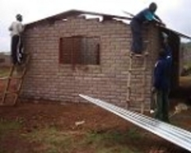
How to get in touch with the AGSA

