Slide 1
Co-operatives Role in LED…
Parliament’s Standing Committee on Finance
22 March 2017
Public Hearing on Transformation of Financial Services Sector
‘Towards reducing vulnerabilities and building resilient self-help and self-reliant financial & economically inclusive communities’
Presented by:
Ms. Ann Ngutshane
NACSA President
0721237784

Slide 2
Need for a Inclusive New Growth Path…
Background
National Apex Co-operative of South Africa
Founded on 25 June 2016,
Currently has 25 tertiary co-op members
1 secondary operating nationally
Board is made up of 8 Executive and 9 provincial coordinators
Key Objectives
Advances, promote and defend interests of co-operatives in all sectors
Lobby and provides support and promotes access to affordable finance, markets and technology for co-operatives and SMEs who are co-operatives
Establish a shared services model and national co-operative bank to improve economies of scale and equitable opportunities
Promote culture of self-reliance, self-responsibility through financial and economic inclusion for social cohesion and equality
Vision
NACSA, the voice of South African co-operatives, united in building a vibrant and inclusive co-operative economy.
Mission
NACSA unites, represents and capacitates cooperatives by harnessing knowledge and technology for radical socio-economic transformation and sustainable development.

Slide 3
Exclusions
Discrimination
Exploitation
RSA Context…
APARTHEID LEGACY
Inequalities
Economy
Opportunities
Education
Privileged
(White)
Impoverished
(Black)
Middle Class
Poor Class
Most affected
Rich
Class
Co-opted
Black
Elite
Vulnerable Groups
Blacks & Rural
Youth
Women
People with Disabilities
Debt Trapped
Poverty Trapped

Slide 4
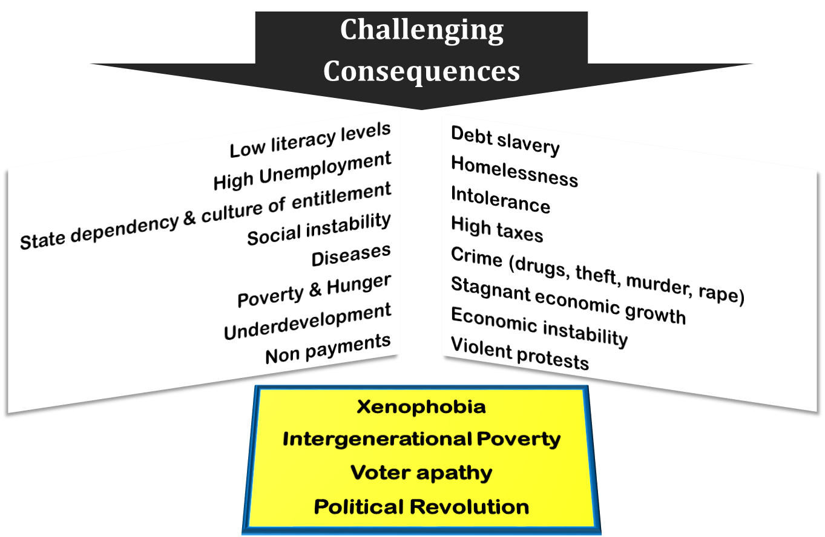
Ticking time bomb…

Slide 5
Solution! Inclusive Co-operatives Ecosystem
reduce vulnerabilities and building resilient self-help and self-reliant financial & economically inclusive communities…
‘The creation of jobs and economic growth requires a combination of initiatives that require direct state involvement, private sector partnerships, as well as the mobilization of civil society to take a pro-active interest in addressing the problems presented by unemployment and economic exclusion’. NDP
National Development Plan…‘by 2030 South Africans can proudly say we have created a home where everybody feels free yet bounded to others; where everybody embraces their full potential. We are proud to be a community that cares’

Slide 6
Co-operatives Quick Facts
Operating environment
Co-op Act 2005 as amended by 2013
Primary co-operatives
Secondary co-operatives
Tertiary co-operatives
APEX co-operative (NACSA)
Co-op Banks Act 40, 2007
Principles
1. Voluntary and open membership
2. Democratic member control
3. Members’ economic participation
4. Autonomy and independence
5. Education, information and training
6. Co-operation between co-operatives
7. Concern for community
Co-operative Sectors:
Financial Co-operatives (Co-op Banks)
Agricultural Co-operatives
Consumer Co-operatives
Housing Co-operatives
Services Co-operatives (Transport etc.)
Arts & Crafts Co-operatives
Marketing Co-operatives

Slide 7
Sustainable co-operative ecosystem…
Success Key Indicators
Self-help and self-reliance philosophy among members
Skills and education (professionalism)
Inclusive Economy (financial, opportunities & fair market access)
Self administration & determination (independent from state)
State support (friendly legislation, opportunities & capacity)
Strong federation or APEX body with integrity and competence

Slide 8
Sustainable Inclusive Co-operative Ecosystem…
Sustainability Pillars
1. Culture of self-help & self-reliance
2. education, skills, support, mentoring & coaching
5 Pillars
5. access to affordable financial services
3. national saving
culture
4. ownership
transformation of industries & banks

Slide 9
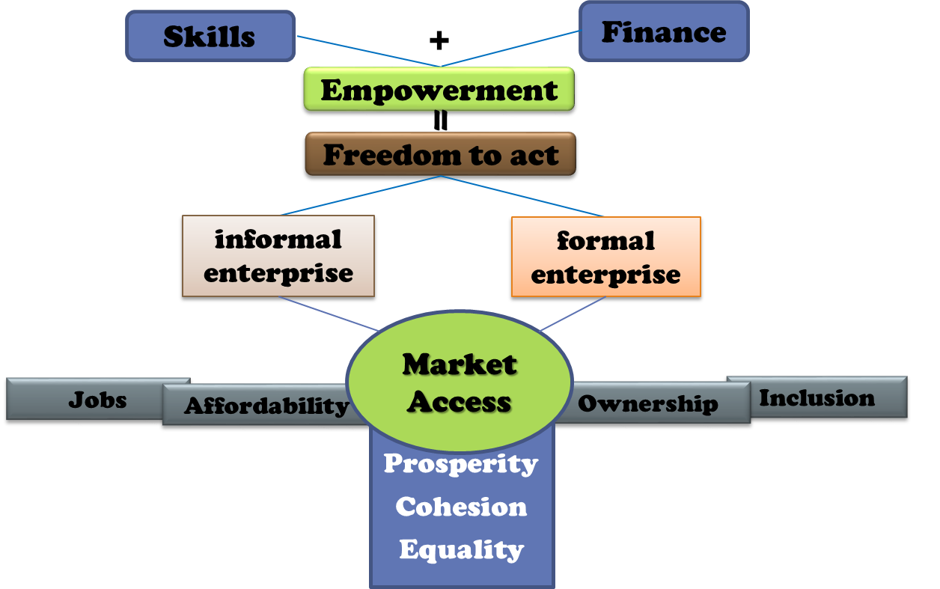
Skills_Finance_Market Loop

Slide 10
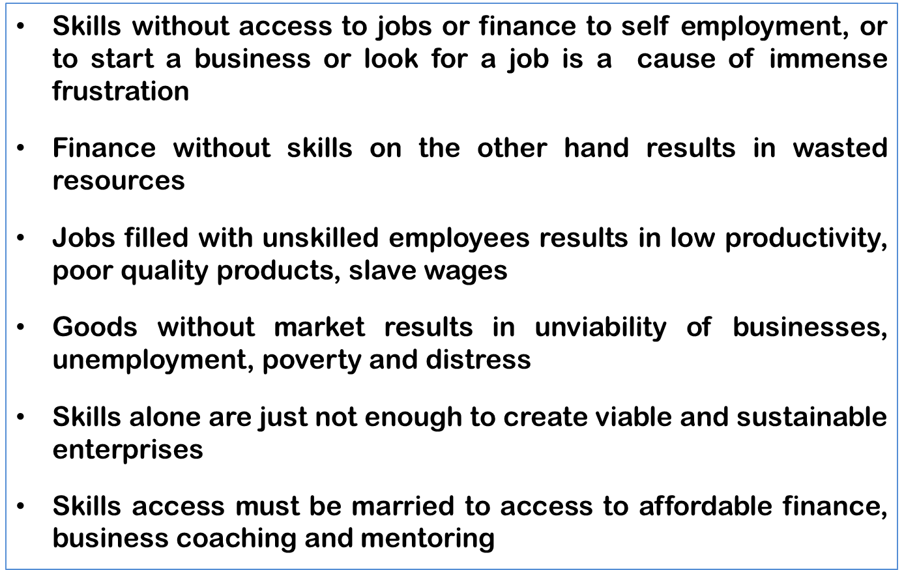
Skills_Finance_Market Loop

Slide 11
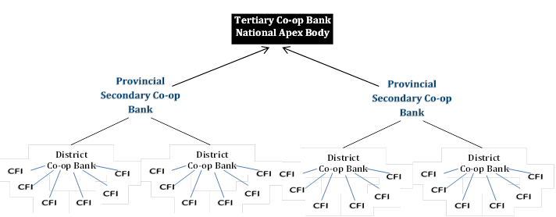
The Inclusive Co-operative Ecosystem…
National Co-operative Bank
Provincial Consumer Co-ops
Consumer Co-ops
Consumer Co-ops
Consumer Co-ops
Consumer Co-ops

Slide 12
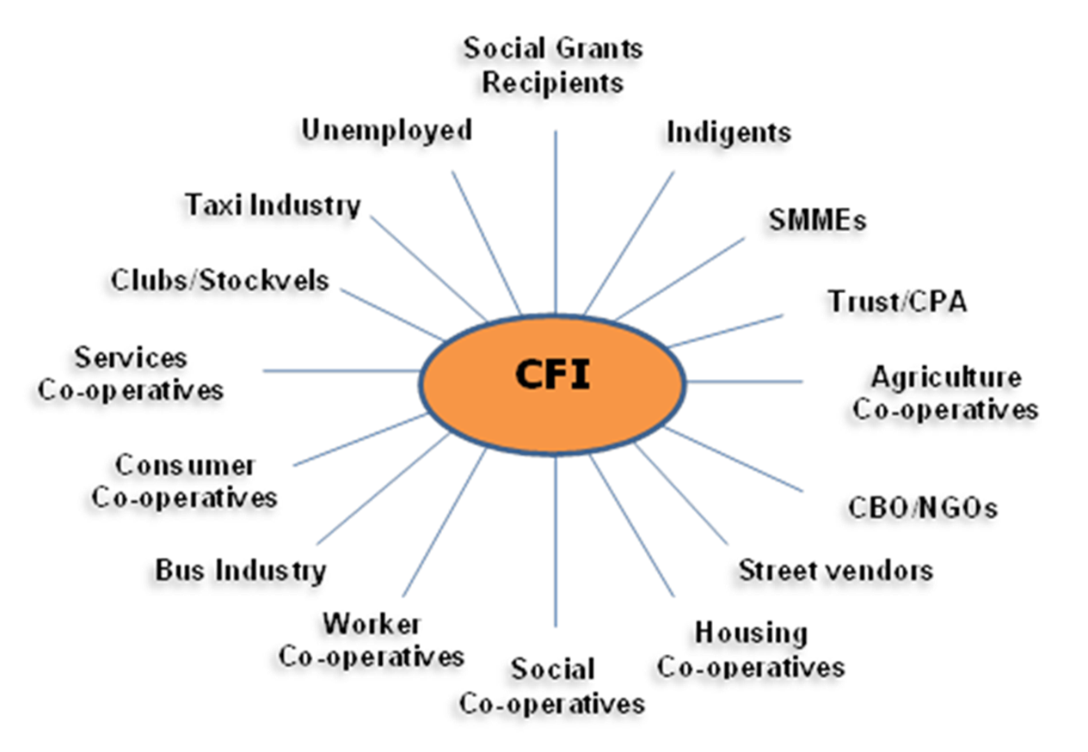
The Inclusive Co-operative Ecosystem…
Participants
National Co-op Bank

Slide 13
National Co-operatives Bank Functions…
Will serve as reserve bank of Co-operatives in South Africa:
Wholesale productive loans
Large investment loans
Development funding loans
Assets acquisition finance
Co-operative business restructuring finance
Bailout and mergers finance
Co-operatives and SMEs bridging finance
Credit and deposit insurance
Insurance (including health) and assurance products
Mobile payments and ecommerce administration
The establishment of a Deposit Guarantee Fund
The establishment of a Solidarity Fund
The establishment of an Audit Fund

Slide 14
NACSA desirable partnerships…
SEFA
SEDA
NEF
IDC
NYDA
DTI
DBSA
PIC
DSBD
Co-operatives Development Agency
Land Bank
DSD
Private FSI’s
Jobs Fund
NACSA
DHS
Post Bank
DBE
SALGA
DHET
SABC
SOE’s
DARD
COGTA
RHLF
DoL
DoT
Relevant Regulators

Slide 15
Partnership Scenario
National Imperatives
NDP
NSDS III
Post School Education
Work Integrated Learning
Co-ops Co-ordination
Learner Mobilization
Demand Management
Learning Institutions
Curriculum
- Recognition
- Infrastructure
- Academic staff
Government
NACSA/NACFISA
Co-operatives
-Non Financial
-Financial
MUNICIPALITIES
Funding
Support to Co-ops
Set Asides
Market access
Regulating
Support
Incubation
Mentoring
Mon. & Evaluation
DGRV, BANKS
CORPORATES, NGO’s etc.

Slide 16
Recommendations…
Review of legislation an regulations to:
Give APEX recognition as supporting and representative organization of all co-operatives
Give APEX mandate to be a co-operatives’ verifying authority of all compliance and viability related matters before registration or de-registration by CIPC and other regulators
Give APEX mandate to be an auditing authority and supervisor of all co-operatives whilst the state keeps regulatory responsibility
Give APEX mandate to manage, co-ordinate, plan, and implement all cooperatives development initiatives
Give APEX mandate for administration, disbursement and collection of funds meant for co-operatives support – including stabilisation fund, deposits guarantee fund etc.
Give APEX mandate to oversee disputes, supervise mergers and winding down of cooperatives
Give APEX mandate to collect statistics, information and compiling of sector performance report

Slide 17
Need for a Inclusive New Growth Path…
Conclusion
Co-operatives are the game changers in every successful economy – more powerful if they control their financial destiny…
‘The creation of jobs and economic growth requires a combination of initiatives that require direct state involvement, private sector partnerships, as well as the mobilization of civil society to take a pro-active interest in addressing the problems presented by unemployment and economic exclusion’.
National Development Plan
Thank you for your attention…
Contact:
Ms. Ann Ngutshane
NACSA President
0721237784

