Slide 1

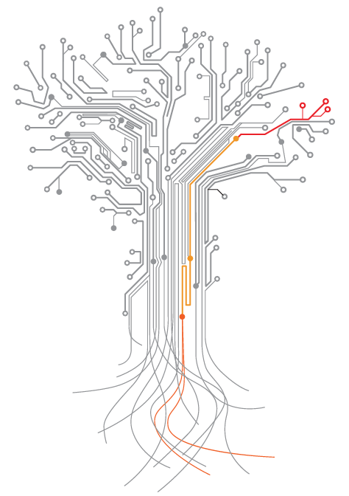

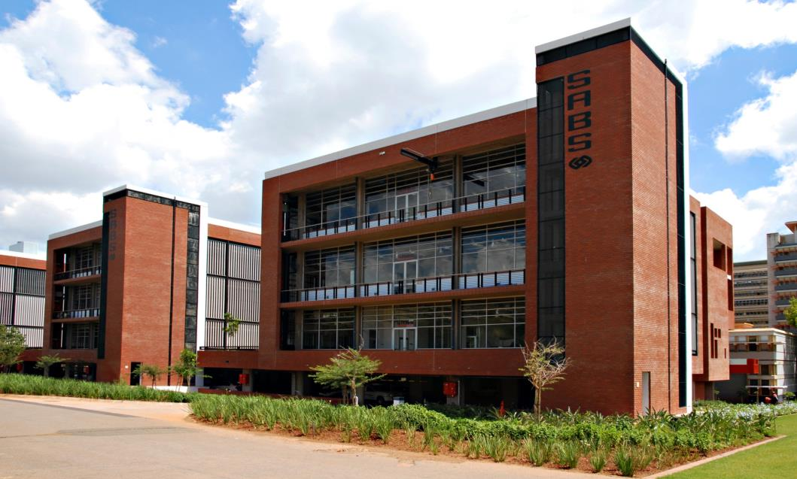

SELECT COMMITTEE ON TRADE & INTERNATIONAL RELATIONS
BRIEFING ON THE 2015/16 SABS ANNUAL REPORT
15 MARCH 2016
Notes:
QUESTION:

Slide 2

RENEWAL AFTER 62 YEARS OF REGULATORY
The SABS was established in terms of the Standards Act, 1945 (Act No. 24 of 1945)
A key focus for the SABS is to ensure the integrity of full conformity assessments to eliminate the exposure of consumers to non-compliant products by conforming to the Consumer Protection Act (CPA) Act No.68 of 2008 which stipulates that the South African consumer has the right to receive goods that comply with applicable standards set under the Standards Act or any other public regulation.
4
Notes:
Intertek pioneered the development of the product conformity assessment programmes, which is now being applied in many parts of the world to prevent dangerous and unsafe products entering into the market.

Slide 3







SABS VALUE CHAIN OF SERVICES
Testing
Stakeholder
Management
Standards
Development
Standards Sales
Certification
Design
Institute
International Standards Engagement
Training
23%
Government Grant
77% Services
& Other
Income
5
Notes:
Intertek pioneered the development of the product conformity assessment programmes, which is now being applied in many parts of the world to prevent dangerous and unsafe products entering into the market.

Slide 4
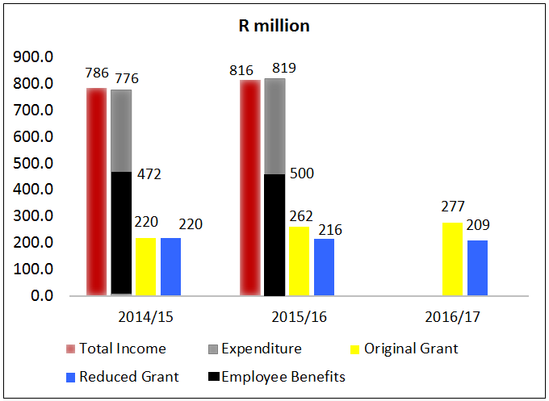
FINANCIAL SUMMARY
HIGH LIGHTS
Total Revenue:
R815.8, 3.8% growth year-on-year
Revenue from services (excl. rental):
R544.7m, -2.3% growth year-on-year
Total Expenses:
R819m, 5.6% growth year-on-year
Employee benefits:
R500.4m, 6.1% growth year-on-year
Net profit:
R22.4m, 31.6% lower than prior year
LOW LIGHTS
R45m reduction in the government grant
Slower uptake of Local Content Verification
High staff costs due to the introduction of additional benefits in 2014/15 & 2015/16
9
Notes:
Intertek pioneered the development of the product conformity assessment programmes, which is now being applied in many parts of the world to prevent dangerous and unsafe products entering into the market.

Slide 5



GROWTH
INDICATOR | TREND | 2015/16
 |  | Target | Actual | Comment on variance
Revenue generated from sales (R million) |  | R622.6m | R554.7m | Target not met. Focus was on reviewing Certification and Testing processes to improve governance; Low demand in the organisation’s services
Operating profit % |  | 0.00% | 2.28% | Target exceeded
Implementation of the standardisation road map |  | 25% | 26% | Target exceeded
Number of new certificates issued against a new scheme |  | 3 | 3 | Target exceeded
5

Slide 6
CUSTOMER CENTRICITY
INDICATOR | TREND | 2015/16
 |  | Target | Actual | Comment on variance
Retention of customers in Certification |  | 95% | 97% | Target exceeded
Number of SMEs and new and existing entrepreneurs for which design, innovation and standardisation interventions are implemented |  | 50 | 120 | Target exceeded
6

Slide 7
PRODUCTIVITY
INDICATOR | TREND | 2015/16
 |  | Target | Actual | Comment on variance
% of accreditation retained in Certification |  | 100% | 100% | Target met
% implementation of a technology solution in Certification |  | 20% | 30% | Target exceeded
7

Slide 8
COMPETENT & EMPOWERED EMPLOYEES
INDICATOR | TREND | 2015/16
 |  | Target | Actual | Comment on variance
% implementation of the Knowledge Hub programme |  | 25% | 30% | Target exceeded
% implementation of the Academic Engagement Plan (AEP) |  | 40% | 46% | Target exceeded
Progress against the implementation of culture programme for customer centricity |  | 100% | 0% | Target not met The organisation underwent substantial changes in terms of culture, however, activities were not integrated and collectively managed as was planned.
8

Slide 9
2016/17: Digitisation is enabling our Quantum Leap
STANDARDS
Develop Standards
Attract Customer
Sell Standards Online
Sell Standards Over Counter
Enable Customer Services
TESTING
Attract Customers
Onboard Customers
Manage Samples
Manage Test & Reports
TRAINING
Attract Customer
Onboard Customers
Develop Course
Conduct Training
CERTIFICATION
Attract Customer
Onboard Customers
Conduct Audit
Review AB Pack
The SABS Business Transformational journey is empowered by technology.
Customer Centricity is no longer just a SABS value and strategic objective, it is rapidly becoming part of our SABS DNA and an integral part of who we are, what we do and is our north star for every initiative we implement.
Market Certification
Sell Certification Services
Conduct Audit
Make Decision
Provide Customer Services
Perform Customer and Market Analytics
Manage Sales Leads and Opportunities
Plan Audit
Make Certification Decision
Develop Customer Services Strategy
Evaluate and Prioritize Market Opportunity
Manage Customer and Accounts
Initiate Certification Audit
Maintain Certification
Manage Customer Problems, Request, and Enquiries
Develop Marketing Strategy
Manage Sales Proposal and Quotations
Conduct Audit
Manage Appeals
Manage Customer Complaints
Develop and Manage Marketing Plan
Manage Sales Order
Manage Client Records
Evaluate Customer Satisfaction
Develop Sales Strategy
Manage Sales Partners and Alliance
9
The SABS Customer Portal went live in 2016 and enables our customers to engage with the SABS for products and services via a self-service online channel.

Slide 10

CoC Enquiries
CoC
Query Type
CoC Product Selection
Client
Information
Submit Details of
Query

Slide 11
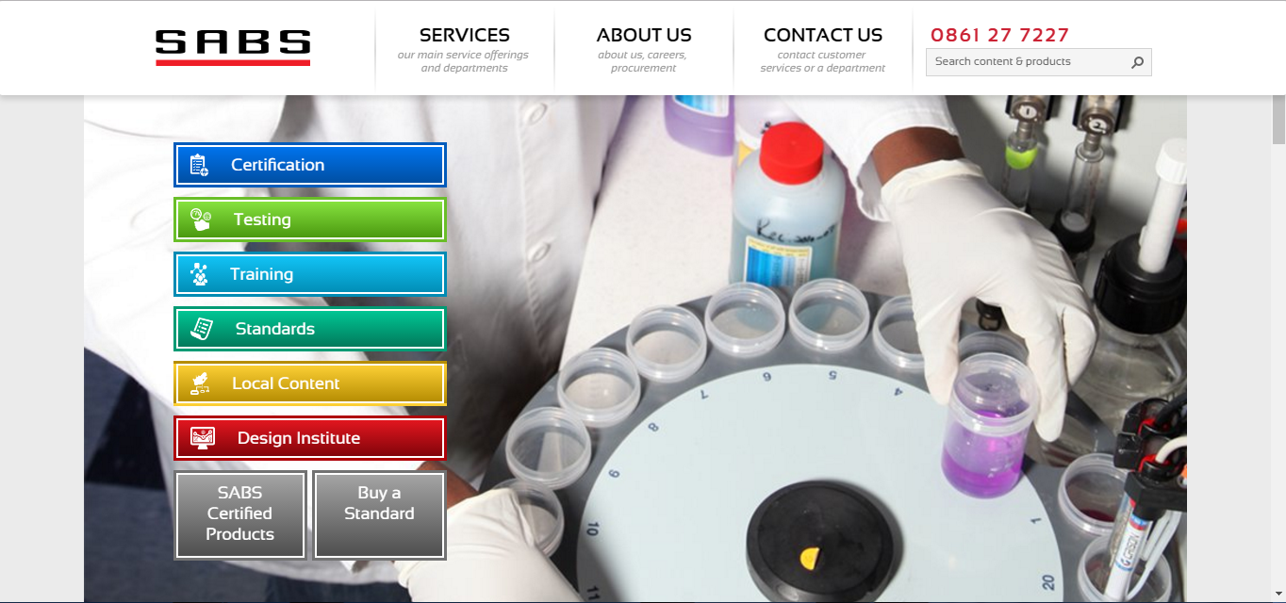
The New SABS Website
11
http://sabs.westeurope.cloudapp.azure.com/
THANK YOU

