Slide 1
National Core Standards Inspectorate Annual Report 2015/16
15 March 2017

Slide 2
Outline
 | Slide #
Vision, Mission of the new Office | 3
Organisational Structure and service model | 4
Evolution of process of policy reform | 5
Legislation | 7 - 9
Detail on Domains | 11
Problems | 12 - 15
Findings | 14

Slide 3
Vision, Mission of the new Office
Our vision:
Safe and Quality Healthcare for all South Africans
Our Mission:
We act independently, impartially, fairly and fearlessly in guiding, monitoring and enforcing health care safety and quality standards in health establishments to serve the people of South Africa

Slide 4
National Core Standards
7 Domains = areas of risk
Standards (ca. 100) with explanatory criteria specify performance required / expected to reduce risk
Evidence required to show that standards are met specified in measures, for different areas of a health establishment
Captured on-site into database for immediate reporting

Slide 5
Certified HE or listed HE on register
Monitoring unit
Monitoring system:
facility profile submission, self assessments, EWS
Low risk
Medium risk
High or extreme risk
Schedule inspection before 4 years
Schedule inspection as soon as possible
Annual Self reporting & renewal within 4 years
Scheduling/
planning
Inspectorate
unit
Conduct inspection
Review OR 1st re-inspection
Compliance notice
Verify, comments etc.
Yes
Is HE compliant?
Compliance notice
No
Process for certification / renewal
2nd re-inspection
Certification and enforcement unit
Enforcement
Notes:
I will work over the weekend on combining this and next slide

Slide 6
INSPECTORATE APP

Slide 7
Actual Coverage for 2015/2016 Financial Year

Slide 8
Health Establishments inspected in each province per facility type

Slide 9
Figure Percentage outcome per province

Slide 10
Central Hospitals
There are 10(ten) central hospitals in South Africa which provides varying specialized services as will be defined in their individual profiles. For 2015/2016 financial year 4 Central Hospitals were inspected based on Compliance Inspections Operational plan:
Dr. George Mukhari Central Hospital- Gauteng Province
King Edward VIII Central Hospital- KwaZulu-Natal Province
Charlotte Maxeke Central Hospital- Gauteng Province
Nelson Mandela Central Hospital- Eastern Cape Province

Slide 11
Central Hospitals Overall/Combined Scores

Slide 12
Central Hospitals Performance Scores by Domains

Slide 13
Central Hospitals Performance Scores in respect of the Six Priority Areas

Slide 14
CENTRAL HOSPITALS( OVER THE YEARS)

Slide 15
Dr. George Mukhari Academic Hospital

Slide 16
Dr. George Mukhari Academic Hospital

Slide 17
King Edward VIII Central Hospital

Slide 18
King Edward VIII Central Hospital

Slide 19
Charlotte Maxeke Academic Hospital

Slide 20
Charlotte Maxeke Academic Hospital

Slide 21
Nelson Mandela Academic Hospital

Slide 22
Nelson Mandela Academic Hospital

Slide 23
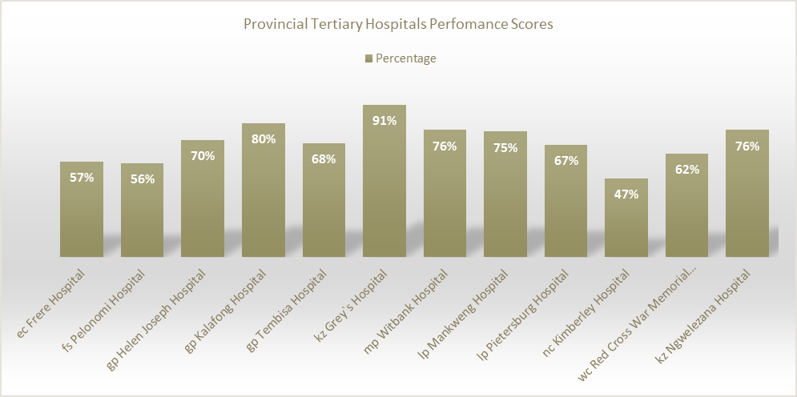
Overall Tertiary Hospitals Scores

Slide 24
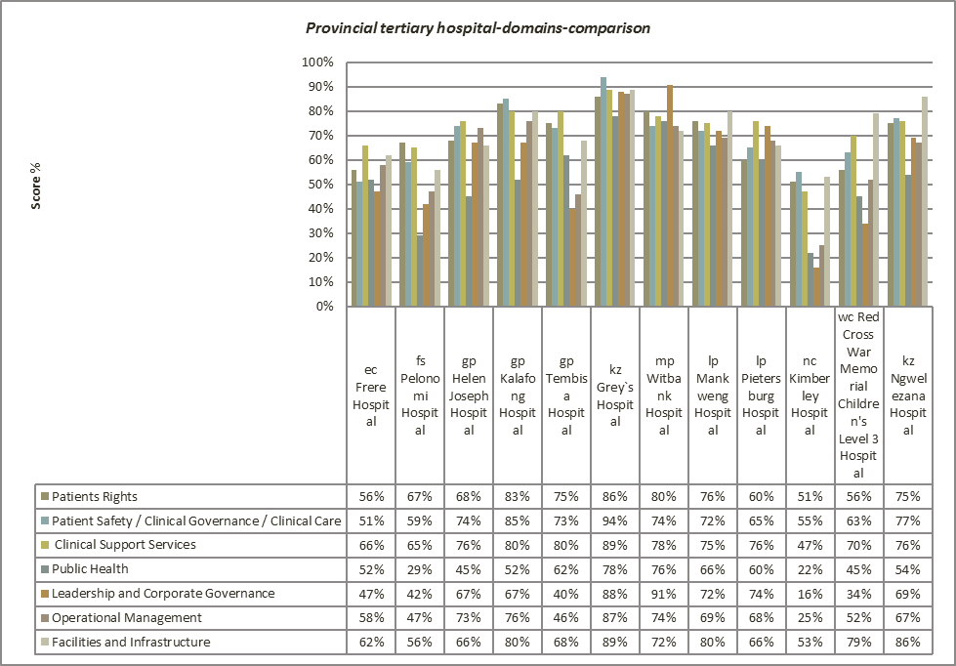
Provincial tertiary hospital-domains-comparison

Slide 25
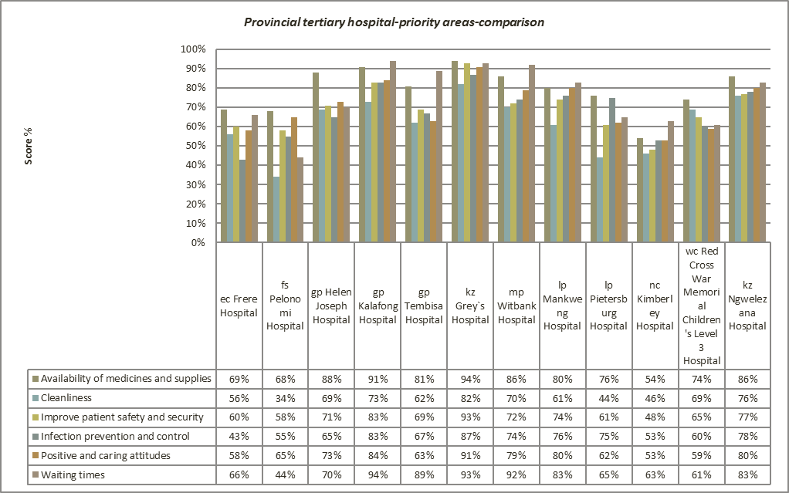
Provincial tertiary hospital-priority areas-comparison

Slide 26
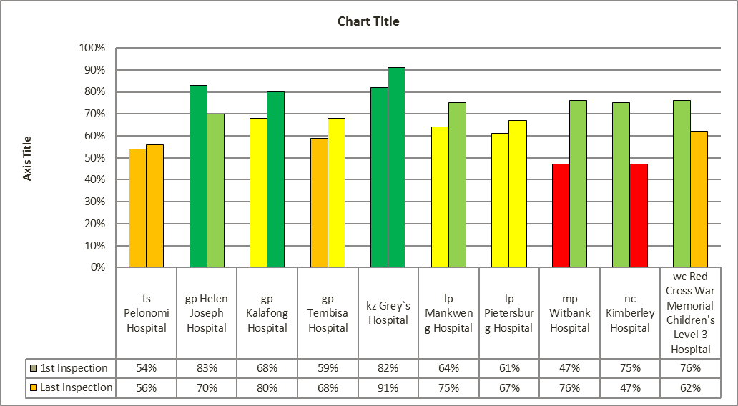
Re-inspections of Provincial Tertiary Hospitals

Slide 27
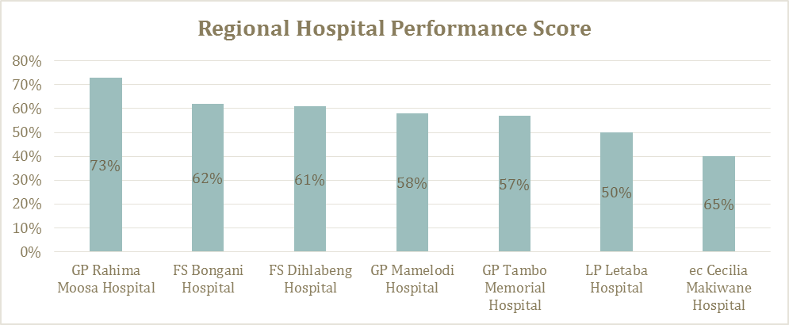
Regional Hospitals Performance Scores

Slide 28
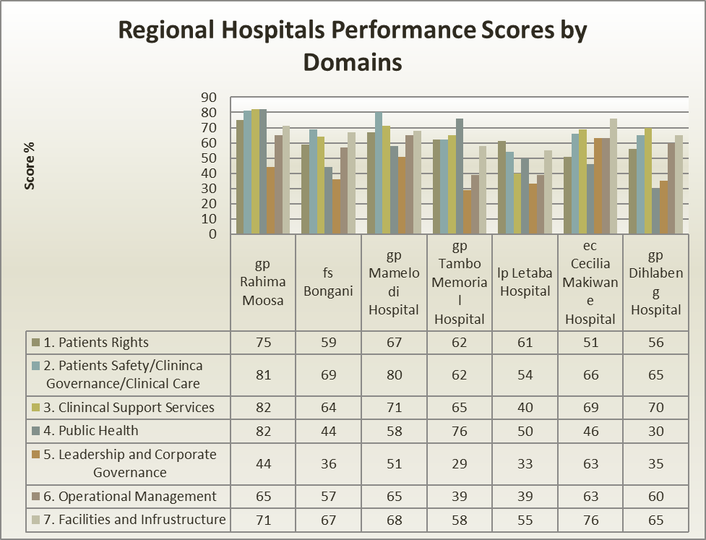
Overall Performance of Regional Hospitals Inspected (2015/16) by Domain

Slide 29
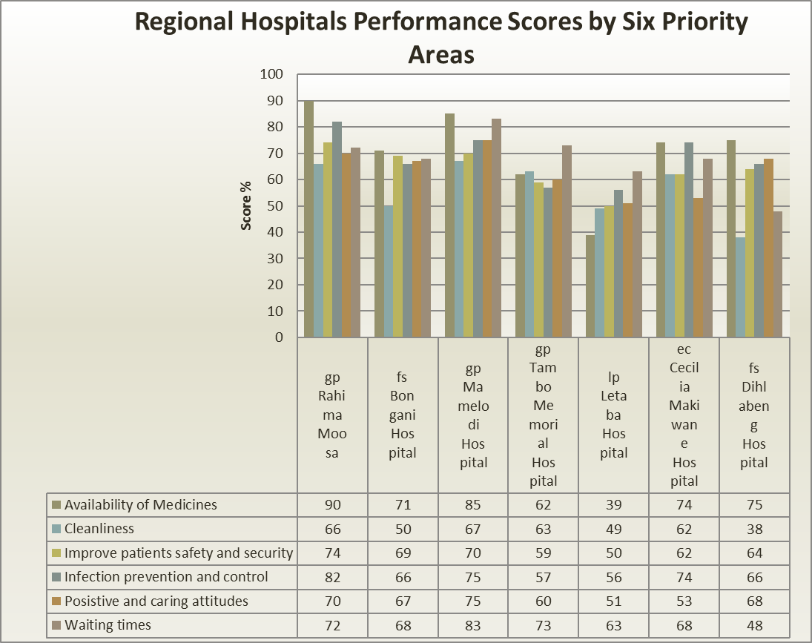
Regional Hospitals Performance Scores by Six Priority Areas

Slide 30
District Hospitals Performance Scores

Slide 31
Overall Performance of District Hospitals Inspected (2015/16) by Domain

Slide 32
Overall Performance of District Hospitals Inspected (2015/16) by Priority Areas

Slide 33
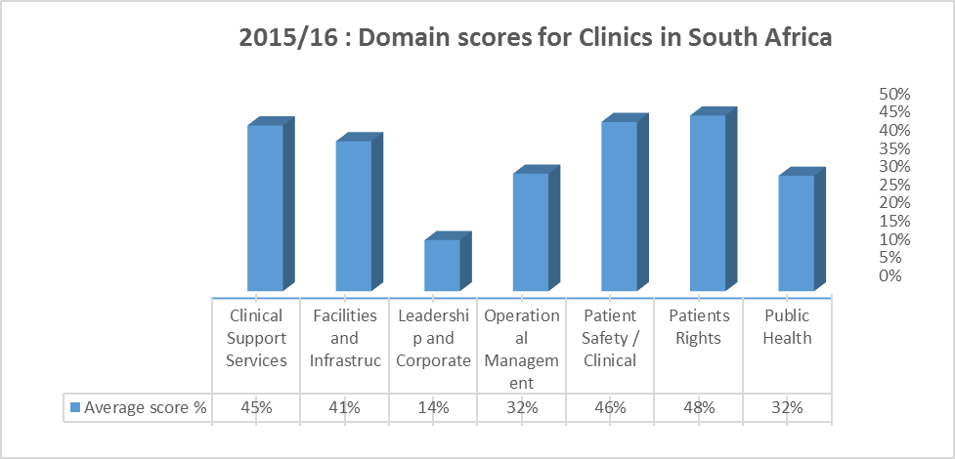
Overall Performance of Clinics Inspected 2015/16 by Domain Outcome

Slide 34
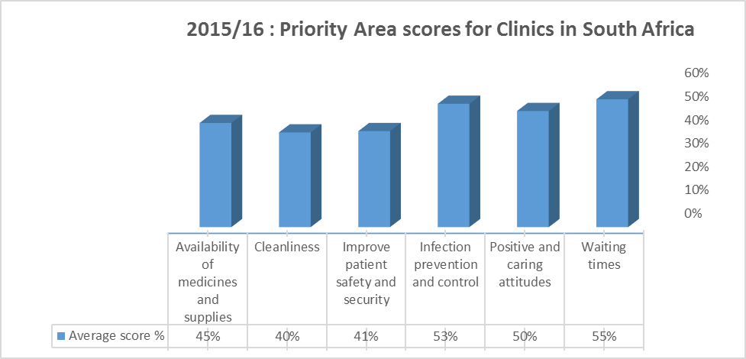
Overall Performance of Clinics Inspected 2015/16 by Priority Areas Outcome

Slide 35
Community Health Care Centres inspections for 2015 – 2016

Slide 36
CHC- Domains-Comparison

Slide 37
CHC’s-priority areas-comparison

Slide 38
Overall PHC comparison per Domains per province

Slide 39
Inspection findings to date – what do they tell us?
Large variations and deficits in the quality of health services:
Between health establishments and types of HE (particular problem with clinics – cornerstone for NHI)
Between provinces (persistent inequities)
In the functionality of SCM and oversight at all levels
In the degree of personal responsibility and accountability (managerial, clinical) for delivering basic quality care
In the level of accountability (Clinical Policies development and implementation)
Poor Contract and equipment management

