Slide 1
Submission On The Division Of Revenue Bill 2017/18 SELECT COMMITTEE AND STANDING COMMITTEE ON APPROPRIATIONS 10 MARCH 2017

Slide 2
Outline
Background
The 2016/17 Division of Revenue Bill
Comments on FFC Recommendations
Comments on the 2016/17 DoRB
Conclusion

Slide 3
Background
The local government elections held on 03 August 2016 ushered the fourth dispensation of our democratic local government system
All parties presented manifestos which acknowledged the enormity of the work yet to be done in transforming the sector and in bringing qualitative and quantitative changes in the lives of the people
Key in these endeavours is the coordination of efforts between the three spheres, better planning, resource allocation and management within the sector
Equally important was the acknowledgement by all that the macro-economic realities of the country characterised by slow economic growth, increasing state debt, high unemployment levels, large numbers of indigent households, etc. have a stark bearing and expression at local government level

Slide 4
Background
It is against these realities that SALGA together with the FFC, CoGTA and NT engaged on various allocation scenarios at the Budget Forum in September 2016
It is also these dynamics that delegates at the Salga National Elective Conference held late November 2016 discussed and made recommendations and resolutions.
Particularly the conference acknowledged that:
Positive strides were made during the previous term and that a clear positive trajectory is beginning to emerge
This trajectory is evidenced by the fact that the non-financial census conducted by StatsSA points a positive trend of service delivery improvement across the board
The NT section 71 reports painted a picture of increasing capacity, accountability and compliance
The AG reports showed an incremental trend of clean and unqualified audits, with these two categories accounting for 80% of municipal spend in 2014/15 FY
The sector also experienced increasing accountability and in over 50% of municipalities there were clear consequence management systems to deal especially with the UIF

Slide 5
Background
It is against this background that the Salga Conference among others resolved upon
Finding alternative revenue instruments to enhance the financial viability and health of municipalities
Find measures to deal with the increasing debt currently standing at R117 billion
Build municipal capacity to manage both debtors and creditors
Find sustainable measures to resolve Eskom issues
Work with NT and SARS in better profiling municipal clients and better manage their payment records
Lobby for increased allocations to the sector in line with the Cost of Basic Services Study recommendations
Provide differentiated support to small struggling municipalities and districts

Slide 6
The 2016/17 Division of Revenue Bill
Salga acknowledges the good work done by the Treasury team in putting together the budget in a very trying environment
As participants in the budget crafting process, we support the theme of “transformation for inclusive growth” which was articulated by the Minister of Finance to include:
Transformation that opens a path to inclusive economic growth and development.
An observation that growth without transformation would only reinforce the inequitable patterns of wealth inherited from the past. Transformation without economic growth would be narrow and unsustainable.
That broad-based transformation should promote growth, mobilise investment, create jobs and empower citizens. It must create new resources to support social change, including assets and livelihoods for the majority, and strengthen South Africa’s constitutional foundations.
That the budget plays a central role in transformation by promoting redistribution and directing scarce resources towards catalytic investments in human and physical capital.
These statements resonate with some of our analysis and resolutions taken at our conference

Slide 7
The 2016/17 Division of Revenue Bill
Response to FFC Recommendations
SALGA supports the following recommendations as made by the commission;
Chapter 8: Financing rural local municipalities for rural development
Chapter 9: Effectiveness of transfers to local and district municipalities for rural development
Chapter 10: Farm evictions and increasing rural local municipalities’ responsibilities
Government dose not deem evictions as falling under the definition of ‘disaster’ and therefore eligible for the municipal disaster grant. The services municipalities are expected to provide after these evictions however come from unplanned sources and places municipal budgets under great pressure.

Slide 8
The 2016/17 Division of Revenue Bill
Summary of budget proposals:
Expenditure revised down by R10 billion in 2017/18 and an additional R28 billion will be raised in taxes.
The need to grow local economy, especially in our urban centres poses a particular challenge in municipalities given the high-levels of inward migration, impact on old infrastructure, demand for services and increased indigence (and inability to pay for services)
The budget deficit for 2017/18 will be 3.1 per cent of GDP, in line with government’s commitments.
This implies limited resources to be distributed across the board and has seen local government still stuck on the 9.1% of the previous MTEF
Government net debt will stabilise at about 50 per cent of GDP over the next three years.
The high debt level requires better management of limited resources, reduction in under expenditure, and the need to improve the quality of spending across the board

Slide 9
The 2016/17 Division of Revenue Bill
Summary of budget proposals:
4. Redistribution in support of education, health services and municipal functions in rural areas remains the central thrust of our spending programmes.
Salga acknowledges that some of our municipalities are financially unviable and need more allocations from through the Equitable Share. We are therefore pleased that the budget is taking this stance of supporting poor rural municipalities
5. Government’s wage bill has stabilised. Procurement reforms continue to improve the effectiveness of public spending and opening opportunities for small business participation.
Procurement reforms in local government are underway. We have been working with NT in ensuring that municipal service providers are registered on the Central Database System. More initiatives that will ensure value for money and economies of scale are being discussed and will be gradually introduced
6. Our state-owned companies and finance institutions play a substantial role in infrastructure investment and financing development. Restructuring of governance and improved financial performance is necessary to ensure they can deliver on their developmental mandates.
Of equal importance for us in the attention that we will be giving to our various delivery models, especially through SOEs in our Metros and the Economic Development Agencies in other municipalities.

Slide 10
The 2016/17 Division of Revenue Bill
The budget redistributes resources to the rural poor:
The division of revenue redistributes substantial resources from the urban economy to fund services in rural areas.
It also subsidises services to millions of poor households in towns and cities through considerable allocations to rural municipalities
Metropolitan municipalities account for 70 per cent of personal income tax revenue, but receive only 31 per cent of local government transfers.
The 61 mostly rural local municipalities also receive 31 per cent of transfers to local government, but account for only 5 per cent of personal income tax revenues.

Slide 11
The 2016/17 Division of Revenue Bill
Per household allocations to municipalities

Slide 12
The 2016/17 Division of Revenue Bill
Transfers to provinces and local government grow faster than national allocations over the MTEF
National Departments - 6.9%
Provinces – 7.5%
Local Government – 8.6%
We also note that:
LG grants have been reduced by R2,5 billion
The Equitable Share has been increased by R5.1 billion in line with the 3.3% HH growth projections
We note that this fast growth in LG transfers is against a background of a lower base!

Slide 13
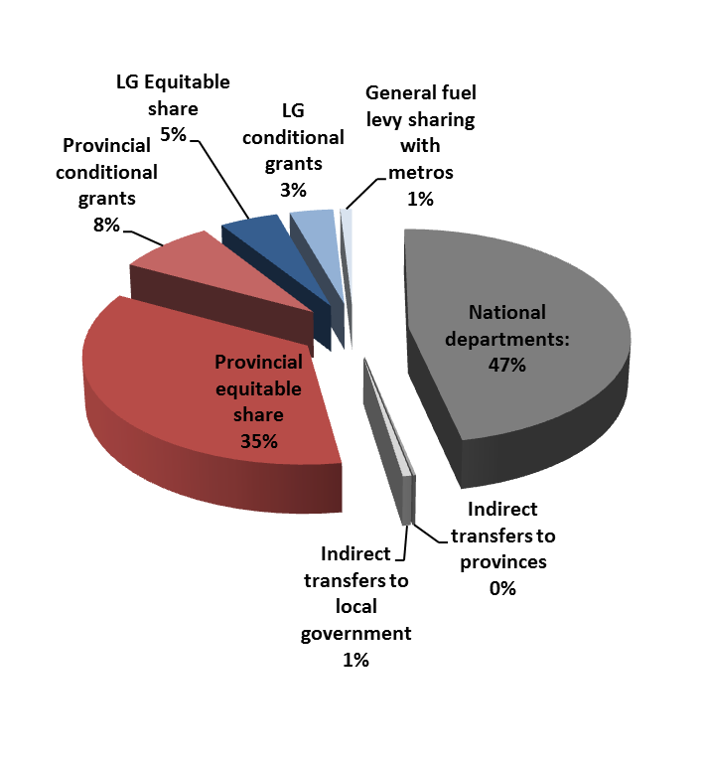
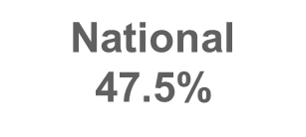
The 2016/17 Division of Revenue Bill

Slide 14
The 2016/17 Division of Revenue Bill
The division of revenue achieves a substantial redistribution of revenues raised through taxes in relatively wealthy (mainly urban) areas to areas where demand for subsidized public services is highest
As a result, most rural municipalities receive twice the allocation per household that is transferred to metros (although 70% of tax revenue is raised in metros)
Efforts to improve municipal financial management will focus on the following four “game changers”:
The new Municipal Standard Chart of Accounts, which will be implemented from 1 July 2017
(SALGA proposes more focus on S.154 of the Constitution)
Improved supply chain management
Improved revenue management (municipalities need to set and collect cost-reflective tariffs)
Improved asset management (e.g. municipalities must spend at least 8 per cent of the value of their assets on maintenance)

Slide 15
General Comments on the 2016/17 DoRB
Though we appreciate the general thrust of the budget, Salga would continue engaging on the following:
The consideration by NT of the recommendations of the study conducted by Salga and the FFC on the Cost of Basic Services so that the ES review process factors some of the recommendations made
It continues to be of concern to us that LG only gets 9.1% from the budget (5% ES, 3% Grants and 1% indirect transfers and 1% fuel levy)
A need for a continuous review of the allocation method to address the fact that a number of municipalities are economically and financially unviable. The challenges faced by these areas cannot be addressed through the demarcation instrument
We will engage with NT on the cost of traded services and the tariff increases granted by NERSA
Unless a holistic and sustainable solution is found, the increasing debt to municipalities has to be resolved as a matter of urgency otherwise it undermines the financial stability of local government

Slide 16
Conclusion
The financial context of our country requires that we collectively find measures to do more with limited resources
We will continue lobbying for increased allocations to the sector while at the same time continuing to provide support to municipalities so that they improve their financial management capacity, audit accountability, reduce UIF and enhance the quality of spending
In partnership with the FFC we will undertake research on various fiscal policy issues including on items such as the operating revenue models where both municipalities and Eskom are reticulating electricity
We have a plan currently under execution to build the financial skills and oversight capacity of councillors so that they exercise maximum vigilance and monitoring of budget management in their councils
SALGA will be conducting thorough costing exercise on the recent demarcations and present findings at the 2017 Budget forum. We urge the Committees to conduct hearings in these areas!
We shall continue with our endeavours to engage both NT and CoGTA for a belter financial dispensation for local government.

Slide 17
THANK YOU!

