Slide 1


Presentation to the Select Committee on Communications and Public Enterprises
8 March 2017

Slide 2


Slide 3

Mandate of the HSRC
(cf. Section 3, Act 17 of 2008)
Initiate, undertake and foster strategic basic and applied research in human sciences;
Address developmental challenges by means of projects linked to public sector-oriented collaborative programmes;
Inform the effective formulation and monitoring of policy, as well as to evaluate the implementation thereof;
Stimulate public debate through the effective dissemination of fact-based research results;
Help build research capacity and infrastructure for the human sciences;
Foster research collaboration, networks and institutional linkages;
Respond to the needs of vulnerable and marginalised groups in society;
Develop and make available data sets underpinning research, policy development and public discussion of developmental issues, and to
Develop new and improved methodologies for use in the development of such data sets

Slide 4

MANDATE OF THE HSRC
(cf. Section 3, Act 17 of 2008)
The HSRC in the National System of Innovation
“…to promote research of the highest quality, aimed at improving understanding of social conditions and the processes of social change, and to engage with research counterparts through research on pressing social issues relevant to human welfare and prosperity.”
(Preamble of the HSRC Act, Act 17 of 2008)

Slide 5
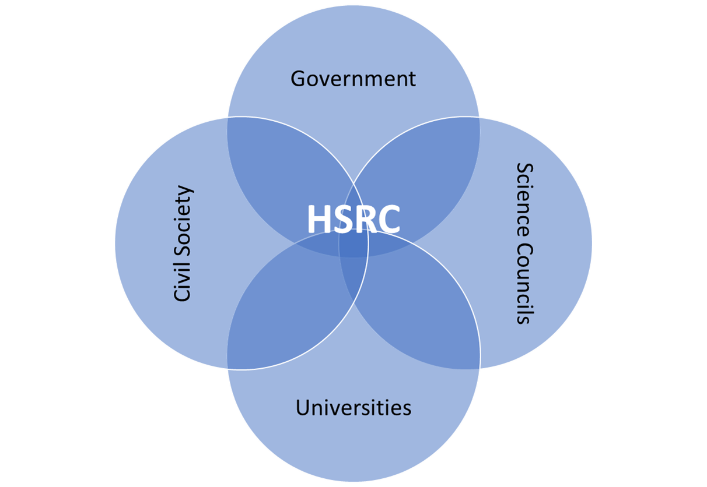
The HSRC in the National System of Innovation
Notes:
The South African National System of Innovation consists of numerous role players, operating in an enabling policy framework. Institutions with important roles and responsibilities in the NSI may be categorised as follows
The Government Sector (e.g. the Department of Science and Technology, Presidency, national Treasury, Department of Health)
The Business Sector (e.g. Sasol, the commercial banking sector, SMMEs involved in R&D, private research service providers)
The Higher Education Sector (i.e. the 26 publicly-funded universities as well as private universities)
The Not-for Profit Sector (e.g. research NGOs such as IDASA, ISS)
The Science Council Sector (the nine statutory science councils, as well as national facilities)
Academies and Advisory Bodies (e.g. NACI, ASSAf, CHE)
Very few, if any of the individual institutions mentioned above have a totally unique and exclusive role to perform in the NSI. In fact, the work of the HSRC shows overlap with at least three of the above-mentioned categories, namely the Higher Education Sector, the Science Council Sector and the Academies and Advisory Bodies. It collaborates with these bodies on a regular basis.
However, as a national public entity dedicated to research in the social sciences and humanities, the HSRC is uniquely placed in the NSI. It is located at the interface between government, other science councils, the university sector and civil society.

Slide 6
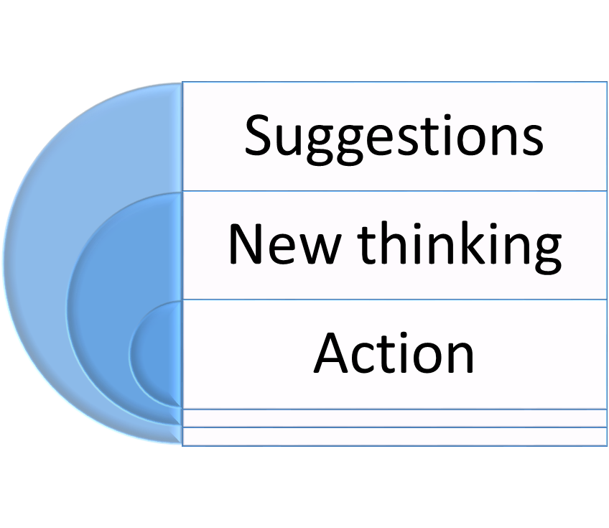
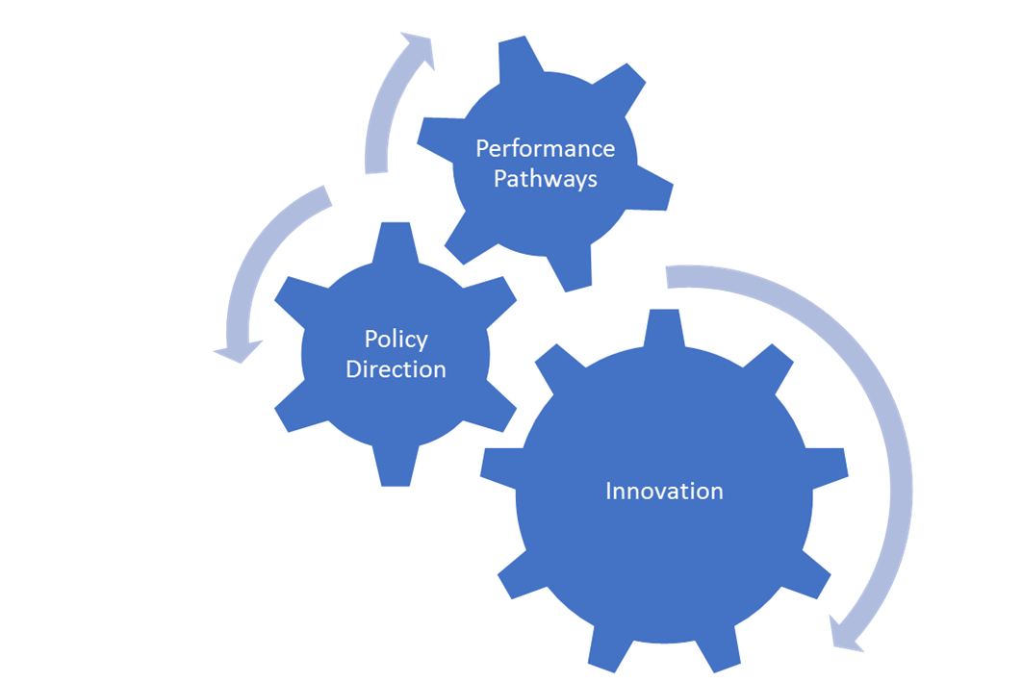
The HSRC in the National System of Innovation
Problem-oriented and applied research
Areas of national importance
Across the spectrum of disciplines and methodological approaches
Notes:
Its work is typically problem-oriented and applied in nature, and provides unique opportunities to harness research projects and programmes of work around areas of national importance. It creates and acquires new knowledge through a range of projects across the spectrum of disciplines and methodological approaches, and benefits from the inputs of research peers both as collaborators and critical reviewers of its work. In fact, the majority of its research projects is based on teamwork. It engages with role players such as policy makers, civil society activists, academics, educators, research funders, the media and public at large through its research projects but also through the various ways in which it makes its research outputs and data available. The purpose of these engagements is often to help build bridges between research and public understanding, policy development and improved practice in a responsible, accountable and transparent manner. The HSRC’s focus on innovation will include looking at performance pathways, and to provide policy direction on how successful or desirable interventions can be scaled up. It wishes to go beyond describing, to making suggestions and to help build new thinking and action aimed at addressing and turning around pressing issues such as poverty and inequality.

Slide 7
OUR ROLE AND CONTRIBUTION
Poverty and Inequality: Diagnosis, Prognosis, Responses
Enhance the analysis of current forms, patterns and trajectories of poverty and inequality
Improve understanding of the drivers, dynamics and structural constraints underlying the contemporary situation; and
Explore the opportunities, triggers and tools for transforming current pathways and processes through action by government and other social institutions.
Notes:
The guiding theme behind the HSRC’s Strategic Plan for the next five years is therefore ‘poverty and inequality: diagnosis, prognosis, responses’. This recognises the far-reaching consequences of poverty and inequality for the well-being and life chances of South African citizens and for the stability and cohesion of society. These issues are also hugely and increasingly significant for the rest of Africa and the wider world. In particular, the HSRC’s research strategy will continue to seek to:
•Enhance the analysis of current forms, patterns and trajectories of poverty and inequality;
•Improve understanding of the drivers, dynamics and structural constraints underlying the contemporary situation; and
•Explore the opportunities, triggers and tools for transforming current pathways and processes through action by government and other social institutions.
The research agenda will be influenced and inspired by a positive vision of inclusive development and an awareness of the factors in the social, political and economic environment which impede progress towards the attainment of development. Inclusive development is both a process and an outcome. As a concept, inclusive development encompasses the following principles (i) the social ideal that the entire population shares equitably in the benefits of economic progress, (ii) the social value of direct and indirect participation of the people of the country in the development process, (iii) the building and nurturing of social trust, (iv) the consequent development of legitimacy of public structures and institutions. As a process it requires wide and inclusive participation both in decision-making and in the practical activities of the social, political and economic domains of everyday life.
Starting with what it has already done, the HSRC will be more deliberate in its attempts to produce and present research-based evidence that can be used to better understand, analyse and address aspects of poverty and inequality in the diverse communities of the country, country, the continent and, through comparative exercises.

Slide 8
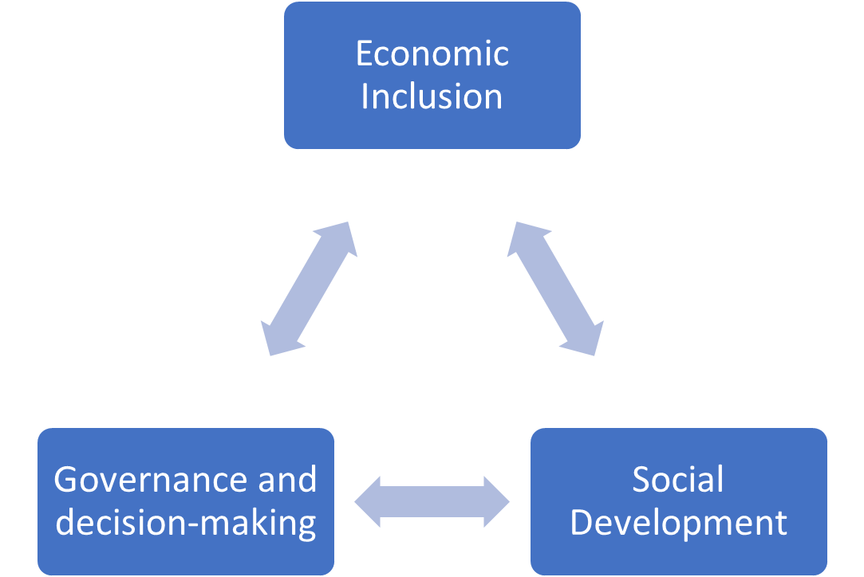
OUR ROLE AND CONTRIBUTION
Poverty and Inequality: Diagnosis, Prognosis, Responses
Notes:
The research programme of the HSRC over the next five years will be structured around three broad dimensions of poverty, inequality and inclusive development:
•economic inclusion - including growth, competitiveness, regional integration, infrastructure, technological innovation, ICT, resources (natural, human, land), labour markets and spatial dynamics (urbanisation, agglomeration, density);
•social development - including well-being (quality of life, security, social and spatial mobility, migration), human capabilities (education, skills, health etc.), social relationships (race, class, gender, identity etc.), social institutions and cohesion (family, community etc.);
•governance and decision-making - including political participation, democracy, trust-building, nurturing legitimacy in public structures, capacity-building in the state, enhancing leadership, distributing power, accountability, responsiveness, social movements, multi-level government and coordinated decision-making.

Slide 9
REPEAT SURVEYS
BIG DATA
TIMSS
SASAS
SABSSM
R&D SURVEY
Notes:
SASAS is a large, nationally representative, survey on public perceptions, run annually since 2003. The 10th round was conducted towards the end of 2012. Data from this survey are available in the public domain for further analysis and re-use. Apart from serving as resource for the ten-, fifteen- and forthcoming twenty-year review of government, the survey also contributed to evidence-based policies in areas such as energy, and financial literacy.
TIMSS monitors trends in Mathematics and Science performance. It was introduced in the 1990s when system-wide assessment in the area of education was not common. Findings were initially not popular amongst decision makers, but the HSRC continued to provide evidence-based findings that could feed into planning and monitoring systems. Today, the National Development Plan contains a specific national target in terms of improved levels of performance in the TIMSS survey
The first of an on-going series of repeat cross-sectional, population-based surveys was conducted in 2003, with repeats in 2005, 2008 and 2012. Survey findings contribute to better understanding of prevalence levels across the South African population, and to guide future strategies and programmes. The results of the first survey were greatly influential in changing perceptions on HIV/AIDS prevalence in the country.

Slide 10
TIMSS

Slide 11
South African TIMSS Grade 9 achievement from 2003 to 2015
Mathematics | Ave scale score (SE)
TIMSS 2015 | 372 (4.5)
TIMSS 2011 | 352 (2.5)
TIMSS 2003 | 285 (4.2)
20
67
Science | Ave scale score (SE)
TIMSS 2015 | 358 (5.6)
TIMSS 2011 | 332 (3.7)
TIMSS 2003 | 268 (5.5)
26
64

Slide 12
Change in TIMSS achievement between 2003 and 2015
SA has shown the largest improvement-
87 points in math
90 points in science

Slide 13
SABSSM
The South African National HIV Behavioural and Health Survey
Significance of SABSSM
The 4 surveys have provided an important gauge of the health status of South Africa, including HIV and AIDS.
The results are used as a foundation to inform important health programmes such as the national HIV/AIDS and STI Strategic Plan (NSP).
The results are key to international reporting such as Sustainable Development Goals (SGDs) and UN General Assembly Special Session (UNGASS)
South Africa will be the only country that will have conducted such a study five times by the end of Sept 2017.

Slide 14
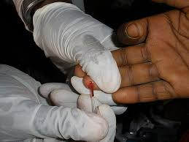
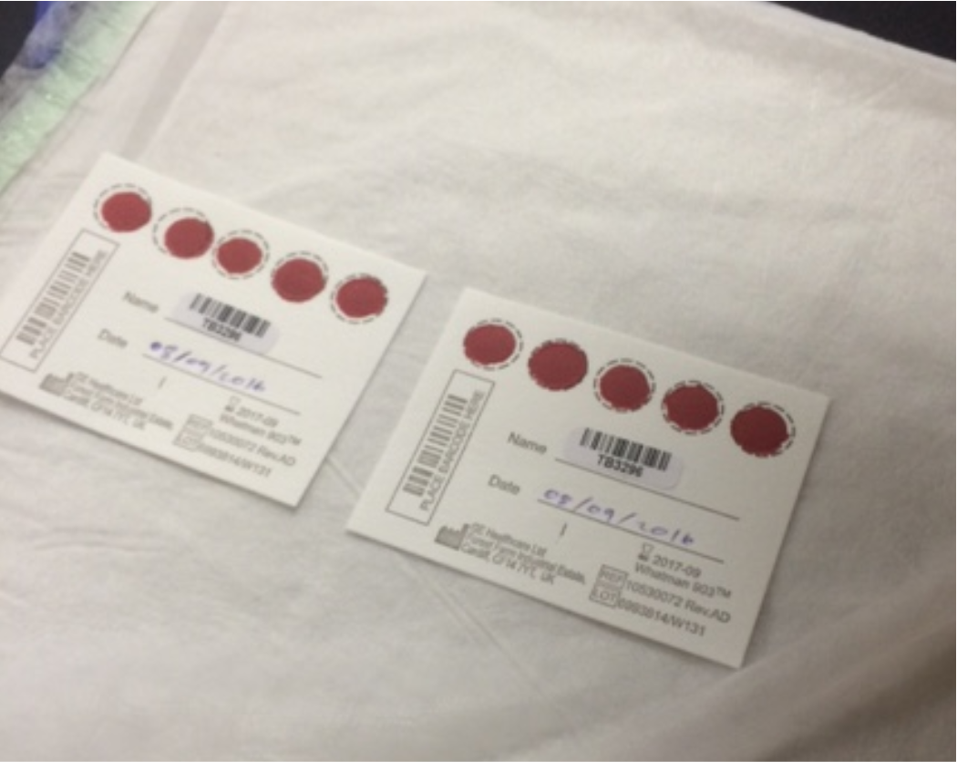
SABSSM V: Objectives
Determine the prevalence and incidence of HIV infection;
Track current social and behavioral determinants;
Describe trends in HIV prevalence, HIV incidence, and risk behaviour in South Africa over the period 2002 to 2017
Track the current level of HIV knowledge
Determine the proportion of HIV infected individuals on Anti-Retroviral Therapy in South Africa;
Assess HIV Resistance;
To determine the Viral Load

Slide 15
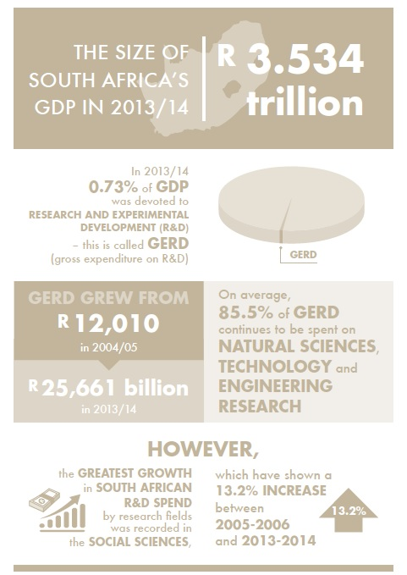

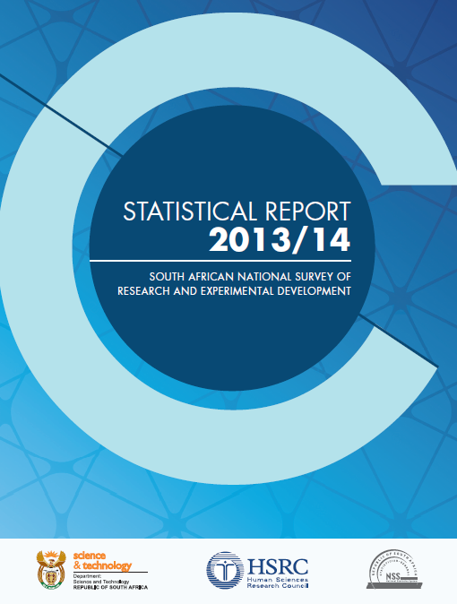
R&D Survey
Research and Development
COMING SOON
2014/5 R&D Report
*To download all R&D Survey reports:
http://www.hsrc.ac.za/en/departments/cestii
Notes:
The Centre for Science, Technology and Innovation Indicators (CeSTII) is responsible for the production of science, technology and innovation (STI) indicators in South Africa as well as conducting research in the same and related fields.

Slide 16
IMPACT PROJECTS
Rural Innovation Assessment Tool
Self-discovery diagnostic tool for actors in the local innovation space
Notes:
The Department of Science and Technology (DST) contracted the Human Sciences Research Council (HSRC) to develop and pilot the Rural Innovation Assessment Toolbox (RIAT) in four rural district municipalities. The RIAT aims to enhance the contribution of science and technology interventions to rural development, deepen understanding of the social and institutional dynamics of rural innovations and inform the work of the multi-stakeholder Rural Innovation Partnership. Based on the outcomes of this project, the team must also explore ways to institutionalise RIAT as a self-discovery diagnostic tool for actors in the local innovation space

Slide 17
RIAT
Rural Innovation Assessment Toolbox
A DST-funded initiative (2012-2018) aimed at fostering a “science, technology and innovation mind-set” in local municipalities - strong COGTA and DRDLR support
Finding innovative solutions to pressing societal problems in remote rural localities
Sets of tools developed for resource-poor local municipalities to measure and promote innovation
Networking with universities to strengthen capacity of Local Economic Development (LED) offices in resource poor municipalities
Pilot phase in 16 local municipalities spread across 8 district municipalities shows strong local municipality uptake

Slide 18
IMPACT PROJECTS
Labour Market Intelligence Partnership
State wide institutional mechanism for skills planning
Notes:
Multi-partner HSRC led consortium, funded by DHET, undertaking research to support building a state wide institutional mechanism for skills planning

Slide 20
LMIP: Universities and TVET colleges: skills for the economy
Notes:
Degree & Diplomas from University: 185 400
TVET NATED 6 completers: 24 400
TVET NCV 4 completers : 4043

Slide 21
LMIP: Education-Job Match: Industrial Sectors
Industry sector | 1.2 million degrees | 1.8 million Post-grade 12 cert & diploma
Community, social services | 50 | 43
Financial | 25 | 18
Manufacturing | 8 | 10
Wholesale and Retail | 6 | 13
Transport | 4 | 6
Construction | 3 | 5
Mining and quarrying | 2 | 3
Agriculture, forestry and fishing | 1 | 1
Electricity, gas and water supply | 1 | 2

Slide 22
IMPACT PROJECTS
Maternal and Infant Morbidity and Mortality Surveillance
Strengthened maternal
and child morbidity and mortality surveillance system
Notes:
Accurate measurement of maternal and child morbidity and mortality requires comprehensive registration of births and deaths, including information on cause of death. While South Africa has a well-established Civil Registration and Vital Statistics system (CRVS), not all deaths are registered and the quality of the cause of death information is often inadequate. This project aims to strengthen the maternal and child morbidity and mortality surveillance system in South Africa employing both qualitative and quantitative methodology approaches. The system was analysed to identify gaps that result in inaccurate data, making it difficult to introduce evidenced-based approaches

Slide 23
IMPACT PROJECTS
iKhaya Lami
Understanding homelessness in Durban
Notes:
Homelessness is a multi-dimensional concept that manifests itself in different ways in different regions of the world. While substantial work has been conducted on better understanding homelessness in more developed contexts, little has been written on homelessness in developing country context. From what we know, homelessness and the associated challenges in the developed world are different from those observed in less developed countries. Obtaining a contextual understanding of homelessness is essential to developing relevant programmes and interventions that will bring about change. Following the eThekwini Municipality’s dispersal strategy of the homeless community that congregated in Albert Park, there was an increase for the Municipality to respond to the growing problem of homelessness and the problems of the homeless. The HSRC identified the need to grow the evidence base within the Durban context and after a series of consultations with the municipality, a mixed methods, multiphase study emerged.
The study was designed in three phases with each phase building on the work of the preceding phases. Phase 1 of the study comprised of establishing relationships, gaining entry and qualitative data collection. Phase 2 comprised of a point in time census and survey and a final component, phase 3, comprised of feedback sessions and policy discussions.
This study was designed as a community based research study that worked closely with various parties including academia, governmental representatives and community based organisations (both non-governmental and faith-based) with the aim of building on existing relationships that such organisations have with a hard-to-reach population, building and supporting relationships within the various actors and foster joint-project ownership.
This study is the largest study on homelessness conducted in Durban and the first study to combine qualitative methodologies with a census and survey in South Africa. The qualitative components of the study provided a deep understanding of the pathways into homelessness, the challenges associated with homelessness and the envisioned pathways out of homelessness. The census and survey of close to 4,000 people provided the breath to the qualitative narratives allowing for a deeper understanding of homelessness in the Durban context. The final phase of the study comprised of feedback sessions to all stakeholders involved as part of the methodology adopted. Representatives from each stakeholder group were invited to a policy discussion meeting – the first of its kind held in Durban. Stakeholder representatives included municipal government, provincial government, national government, community based organisations, academia and business.
Through the community-based research methodology adopted the study was able to achieve a number of outcomes:
• Provides a formal documentation of the state of homelessness in Durban allowing for evidence-based decision making
• Brought together community based organisations, many of which had never met; who have subsequently started a forum aimed at co-coordinating their organisations efforts
• First meeting of actors from all levels to discuss homelessness in Durban.
• Provided the first step in the discussion around policy implications and recommendations

Slide 24
iKhaya Lami: Study overview
A Multi Phase Mixed Methods Study aimed at providing a comprehensive description of the nature and scale of homelessness in the central region of Durban.
Funded by the Safer Cities unit of the eThekwini Municipality
Designed in collaboration with various community based organisations, academics, business and municipal department representatives
Phase 1: Formative phase
Phase 2: Homelessness census
Phase 3: Feedback workshops/ roundtable policy discussions
Developing research and community networks,
Establishing Steering Committee
Establishing Advisory committee
Qualitative data collection
A census of all persons sleeping on the streets/in shelters within a demarcated study site.
Feedback results to stakeholders
Foster project ownership
Stakeholder representatives invited to policy discussion meetings
Collectively develop policy recommendations
Fostering joint project ownership

Slide 25
iKhaya Lami Highlights
Street-Living
Shelter-living
Count
1959
1974
Gender
88% Male
80% Male
Race
87% Black
62% Black
Region of origin
Primary
reason for homelessness

Slide 26
iKhaya Lami intimidation/violence
Street-living
Primary perpetrators of violence: type of violence experienced:
Other street people
Physical abuse (60%)
Verbal abuse (36%)
Property seized (24%)
Police
Physical abuse (61%)
Verbal abuse (35%)
Property seized (54%)
Shelter- Living
Of those people that said they experienced violence
Most (69%) said they did not report it to the police as they did not think it would help.
12% reported the violence, but nothing was done about it.

Slide 27
iKhaya Lami Next steps in policy development
Round-table policy discussions were held with representatives from a national and provincial governments, the municipality, academic institutions, community groups and the private sector
Six themes emerged, requiring further investigation
Public Awareness
Job Creation
Shelters
Text Here
Referral & advice centres
Law enforcement
Targeted services

Slide 28
IMPACT PROJECTS
City Support Programme
Upgrading of informal settlements
Treasury’s City Budget Forum to discuss reforms to:
Water Use License Act
Environmental Impact Assessments
Land-use zoning and planning procedures
MFMA Procurement ceiling
Notes:
The Economic Performance and Development Unit is undertaking a study for the National Treasury (City Support Programme) on how national policy frameworks and regulations affect municipal decisions in relation to accommodating poor communities within SA cities. Practitioners complain that different forms of ‘red tape’ get in the way of constitutional obligations in relation to the socio-economic rights of low income groups. The study is particularly concerned with excessive regulatory burdens and inflexible procedures that inhibit the upgrading of informal settlements and the provision of land for low cost housing. The focus is on Cape Town and eThekwini.

Slide 29
CENTRE FOR SCIENCE, TECHNOLOGY AND INNOVATION INDICATORS - CeSTII
Undertake statistical surveys that support measurement and analysis of STI indicators.
Analysis of STI indicators to enhance the understanding of the STI environment and inform policy development.
Knowledge sharing and exchange with the national, regional and global community of practice in STI measurement and policy.
Notes:
The Centre for Science, Technology and Innovation Indicators (CeSTII) is responsible for the production of science, technology and innovation (STI) indicators in South Africa as well as conducting research in the same and related fields.

Slide 30
CHALLENGES
Dependence on external research income to deliver on mandated objectives
Attraction of critical skills (impacting on deliverables, performance targets)
PFMA Scheduling – Schedule 3A National Public Entity

