Slide 1
Frontline Service Delivery Monitoring and Citizen-Based Monitoring
Presentation to Portfolio Committee on Public Administration as well as Monitoring & Evaluation
08/03/2017

Slide 2
Purpose
To present the Implementation Report for the Frontline Service Delivery and Citizen-Based Monitoring programmes

Slide 3
Introduction
How does FSDM fit into the DPME monitoring systems:
FSDM supports and augments other monitoring systems through the following actions:
It verifies how citizens experience frontline services on the ground
It also verifies elements of the Outcomes reported
It provide further areas for assessment through Management Assessment Performance Tool
It assess infrastructure and processes that supports quality service delivery

Slide 4
FSDM Information Sources:
Frontline Monitoring System
CBM Monitoring using civil society and citizen feedback
Frontline Service Delivery Monitoring
Izimbizo /
Siyahlola
Presidential Hotline

Slide 5
Categorisation of Identified challenges
Challenges identified have been categorised as follows:
Accommodation of government services
Staffing at frontline facilities
Poor coordination between state entities
Procurement and equipment

Slide 6
Accommodation of government services
Challenges identified related to physical infrastructure found in the majority of facilities monitored were as follows:- inadequate sizing, design, construction and compounded by poor maintenance, cleaning and furnishing.
Overcrowding at government facilities as reoccurring feature in historically disadvantaged areas, with citizens having to wait in makeshift waiting areas, often without access to functional toilets.

Slide 7
Accommodation continued.
Dilapidated buildings.
Inadequate and badly maintained toilets were a defining feature at schools.
A lack of responsiveness and clear roles and responsibilities between the Department of Public Works and sector departments for maintenance of buildings and management of lease contracts is frequently raised by facility managers.

Slide 8
Findings relating to staffing
Understaffing at frontline facilities is a problem at many facilities. Primary cause is unfilled vacancies.
Managers complained of the long time taken to appoint staff, because recruitment was handled from the head office in the provincial capital.
Staff shortages were also found to be caused by poor scheduling of lunch hours, training, leave and meetings.

Slide 9
Findings related to poor coordination
Problems at the frontline are often the result of poor coordination between and within departments.
For example administrative bottlenecks between Department of Social Development and SASSA are hampering access to foster care grants. This was detected in North West, Mpumalanga and Kwa-Zulu Natal.
End-to-end planning and monitoring of service delivery processes must be put in place, especially where the service involves multiple role-players.
Notes:
MTSF ACTION # 12.6.2. Improved feedback opportunities for citizens and other service users

Slide 10
Findings related to procurement and equipment
At Driver Licence and Testing Centres (DLTCs), Home Affairs and SASSA offices long waiting times were often the result of computer system problems.
Services that rely on IT systems need highly responsive support in place, esp. in rural areas.
Non-functional equipment such as eye testing machines (DLTCs), blood pressure and blood sugar meters (health facilities) contribute to citizens either waiting for long or being turned away without service.

Slide 11
Procurement and equipment cont.
Police stations across the country continue to report frustration at the long turnaround time for the maintenance and repair of vehicles.
Facility managers reported not having sufficient information and authority to hold service providers to account.
Greater inclusion of facility managers and sub-district managers in decision-making and oversight is required, as is capacity building, oversight and professionalization of supply chain management.

Slide 12
FSDM Annual Report (15/16) – Summary results
Sector | Location and access | Visibility & signage | Queue Management & waiting times | Dignified treatment | Cleanliness & comfort | Safety | Opening and closing times | Complaints systems
DLTC | 2,49 | 2,06 | 2,39 | 3,03 | 2,63 | 2,40 | 2,64 | 1,60
Education | 2,60 | 1,95 | 2,31 | 3,07 | 2,41 | 2,37 | 2,94 | 1,56
Health | 2,76 | 2,53 | 2,58 | 3,07 | 2,65 | 2,59 | 2,82 | 2,30
Home Affairs | 2,35 | 2,13 | 2,79 | 3,08 | 2,62 | 2,33 | 2,94 | 2,00
Justice | 2,82 | 2,74 | 2,83 | 3,21 | 2,70 | 2,95 | 2,91 | 2,10
MCCC | 2,71 | 1,71 | 2,17 | 3,14 | 2,47 | 2,24 | 2,57 | 1,65
SAPS | 2,69 | 2,33 | 2,46 | 3,02 | 2,53 | 2,46 | 2,88 | 2,02
SASSA | 2,43 | 2,10 | 2,69 | 3,14 | 2,86 | 2,69 | 2,96 | 1,79
Grand Total | 2,62 | 2,23 | 2,52 | 3,09 | 2,60 | 2,51 | 2,85 | 1,91
Green(3,50-4)=Very Good/Beyond Compliance Orange (1,50 – 2,49) = Fair
Yellow (2,50 – 3,49)= Good/Compliance Red (1,00 – 1,49) = Poor
Refer to Annexure 1

Slide 13
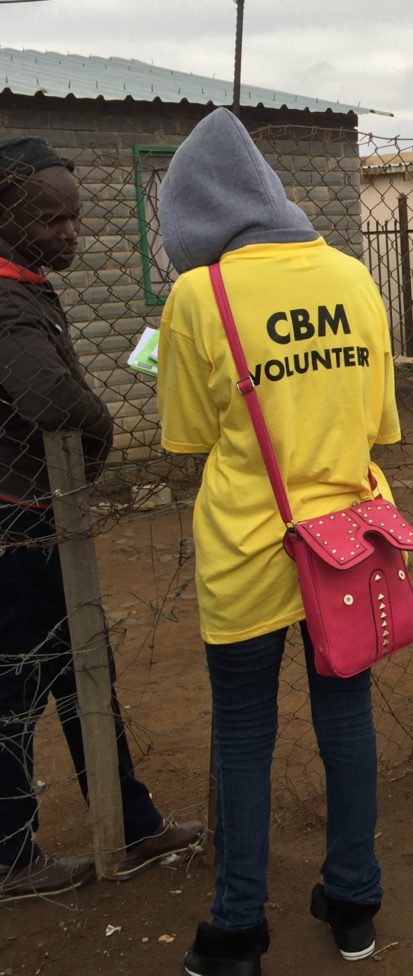
Community Based Monitoring (CBM) Implementation Report
Focus for 16/17 has been on:
Supporting SAPS to implement CBM
Special project interventions: e.g. Kabokweni Ideal Clinics Project
Using IDP consultation to lay foundations for citizen-based monitoring of service delivery (Umsobomvu LM, Northern Cape)
Open Government Partnership
(Refer to annexure 2)

Slide 14
Where to with Frontline Service Delivery Monitoring and Support (FSDMS)?
Increase coverage and impact.
FSDMS to cover sectors including the Mining Sector and Development Finance Institutions as well
Strengthen monitoring of responsiveness of government on commitments made during Izimbizo
Institutionalise FSDMS at a provincial and municipal level.
Identify and unblock systemic challenges to service delivery across government departments at a strategic level.
Work more closely with StatsSA to identify break points/hotspots in customer satisfaction, timeously.

Slide 15
Recommendations
That Portfolio Committee:
Takes note of the Implementation Report;
Invite the Department of Public Works to present to the portfolio committee on actions to address challenges relating to accommodation of frontline government services including:
(i) state and maintenance of buildings
(ii) poor lease management

Slide 16
Recommendations cont.
Invite DPSA to present on plans to address challenges related to delegations for frontline managers
Invite National Treasury to provide the status of its efforts in building capacity and professionalising supply chain management
Supply chain management at frontline level must respond to equipment and resourcing challenges faced by frontline facilities.

Slide 17
THANK YOU

