Slide 1
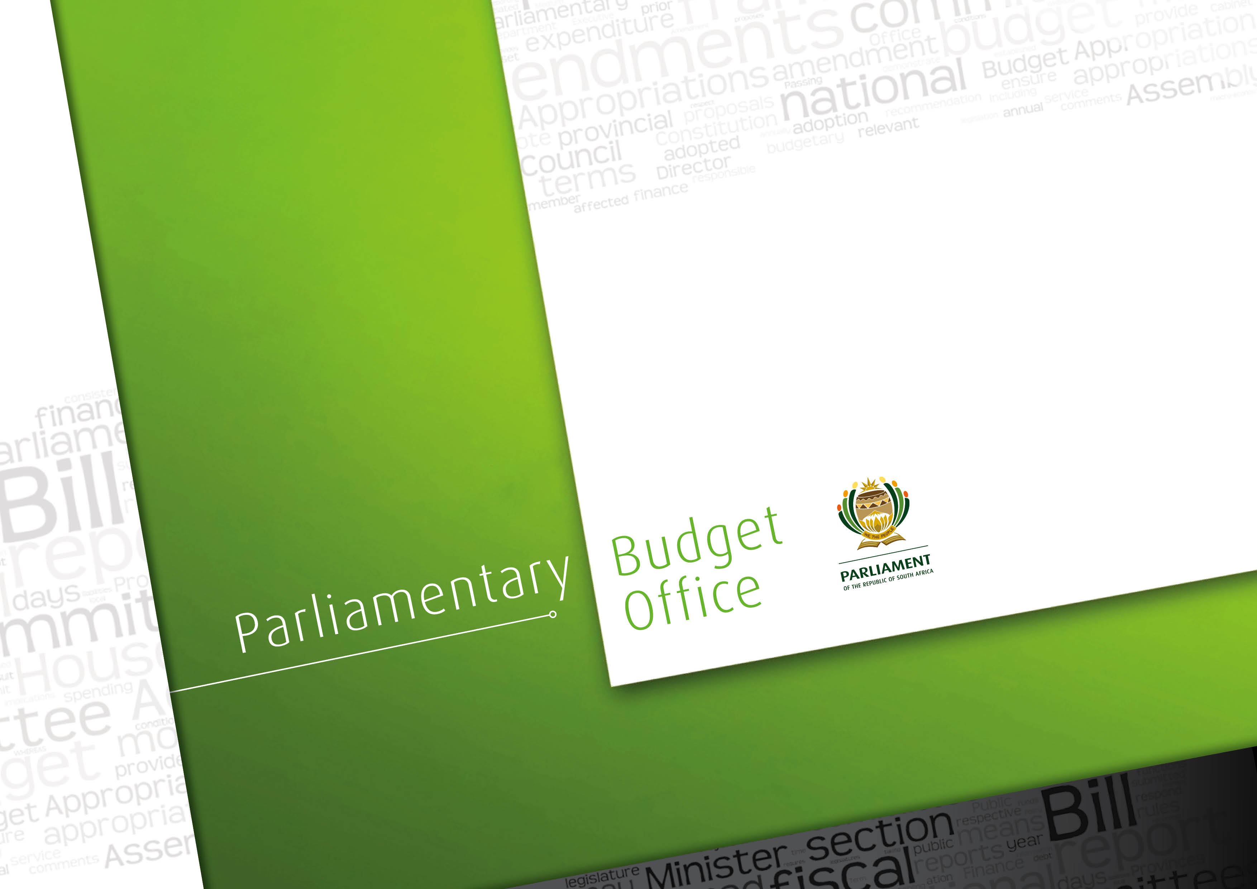
Analysis of Eskom’s finances

Slide 2
Outline
Purpose
Background
Revenues
Expenditure
Balance sheet and liabilities
Changes in the electricity supply industry
Conclusions

Slide 3
Purpose
The Money Bills Amendment Procedure and Related Matters Act enables Parliamentary Committees to amend Money Bills
This report has been compiled in response to a request from the Chairperson of the Standing Committee on Appropriations in Parliament. The Committee asked the PBO to investigate the financial position of Eskom.

Slide 4
Background
Eskom is a state owned enterprise (SOE) whose importance to South African society and the economy is unquestionable.
There is no doubt that the financial challenges faced by Eskom require ongoing close oversight.
These challenges are complex and there are no easy fixes.
The financial challenges stem from the condition and operation of the physical plant, transmission and distribution systems as well as conditions that affect the cost structure and revenue collection of the utility, including regulatory issues.
We also explore some of the broader political economy issues affecting outcomes for Eskom.
Overall, Eskom has had to make substantial new investments while facing large increases in primary energy and other costs
There are risks and uncertainties in the global economy and in South Africa that could negatively affect Eskom
There are large changes in the global power sector that may affect the future structure of power utilities and decision to be made about Eskom’s future
Notes:
The 2017 Budget Review explains :
“The budget plays a central role in transformation by promoting distribution and directing scarce resources toward catalytic investments in human and physical capital. But the budget depends on the economy to generate the resources to finance these investments, and South Africa has had several years of very low growth (p.1.)”
Overall, there is recognition in the 2017 Budget Review that this is a moment for transformation but this possibility is constrained by several years of low growth. Therefore, as with the past few budgets, the 2017 Budget Review calls for fiscal consolidation.

Slide 5
Revenues
The next section discusses Eskom’s revenues

Slide 6
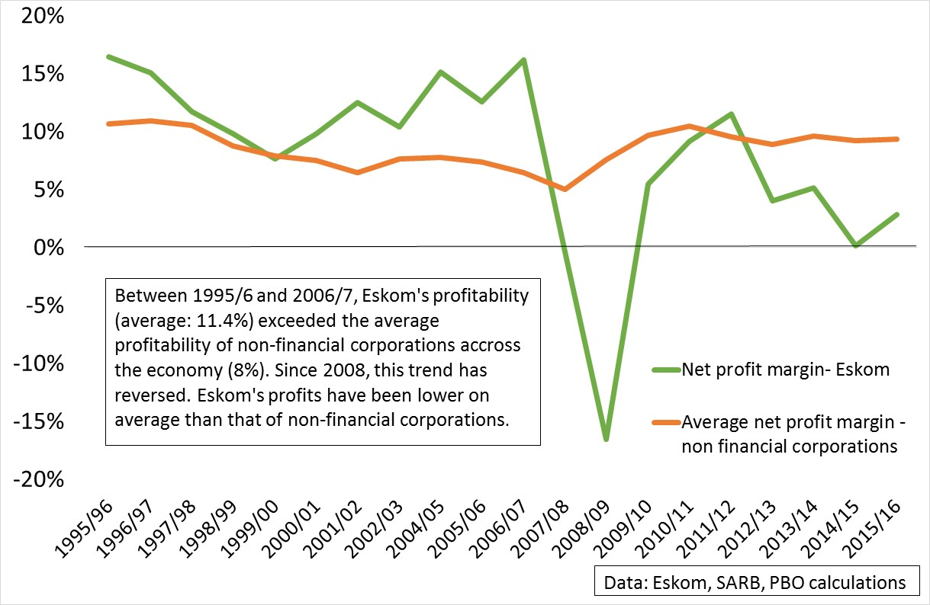
Declining profitability since 2008

Slide 7
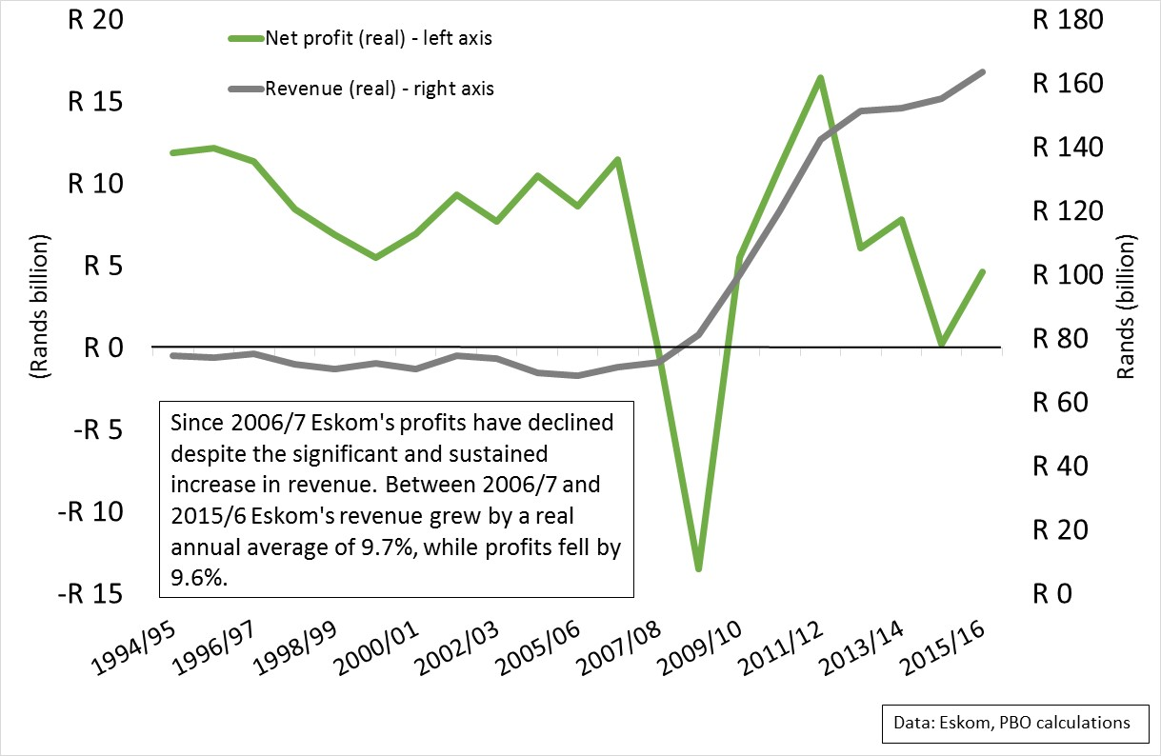
Higher revenue but lower profit margins

Slide 8
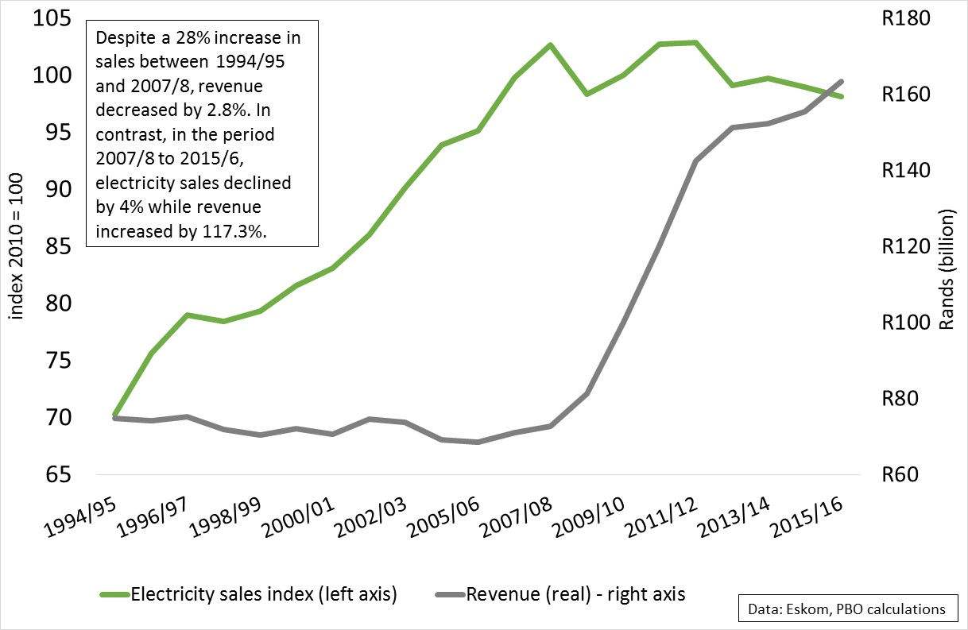
Revenue increases as sales decline

Slide 9
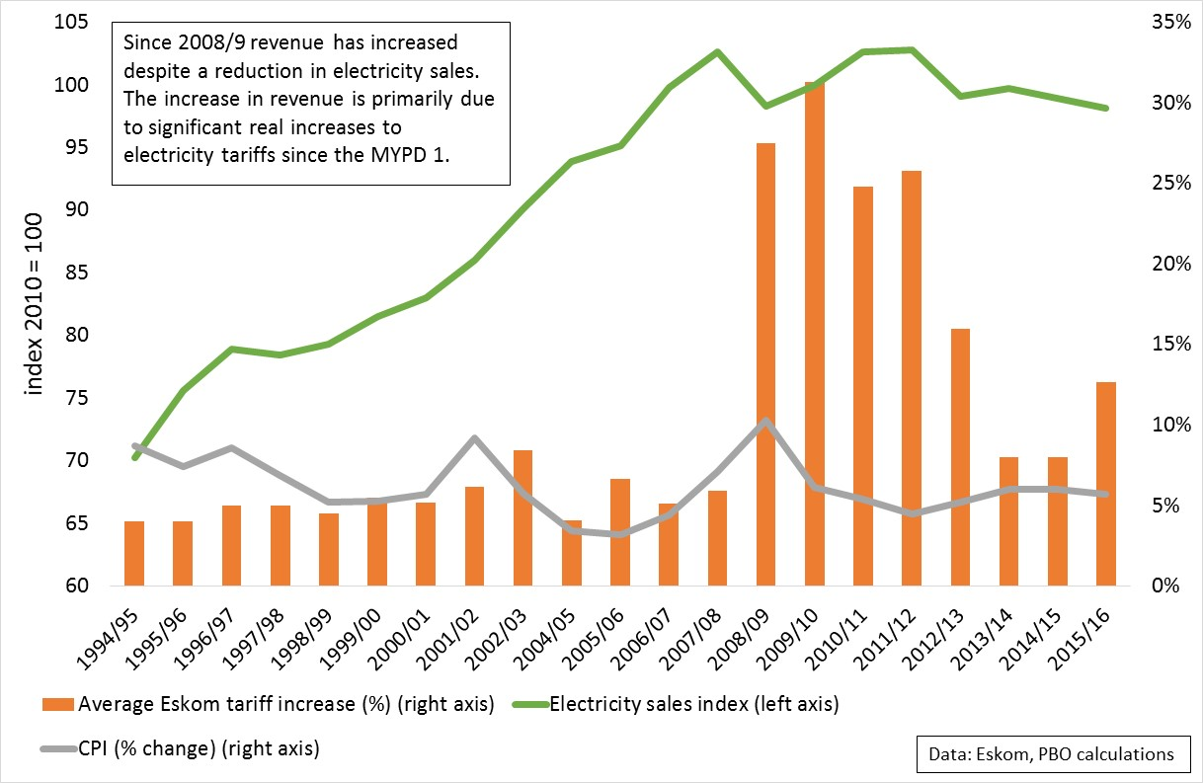
Higher revenue due to large tariff increases

Slide 10
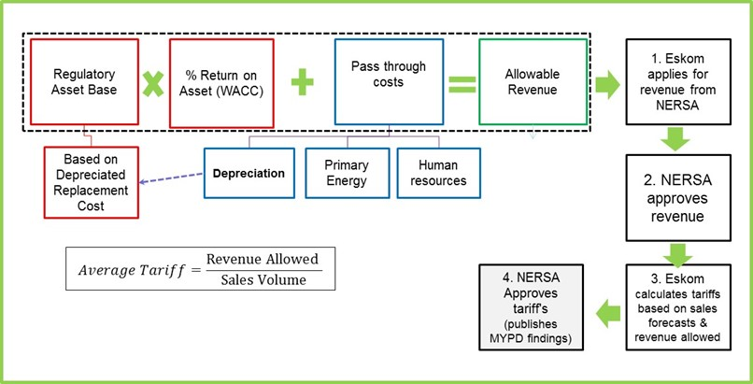
Several elements determine tariff level

Slide 11
Regulatory asset base is a key determinant
Revaluation of asset base was necessary to allow Eskom to finance future expansion
Asset base value increased drastically
Eskom is entitled to return on this asset base
Eskom has never been afforded a full return on its asset base – tariffs are not cost-reflective
A cost reflective tariff would require higher tariffs and revenue for Eskom

Slide 12
Expenditure
This section considers certain drivers of Eskom’s primary energy cost
  Coal: The SA electricity supply industry is predominantly powered by coal
  Diesel and open cycle gas turbines (OCGTs)
  Renewable independent power producers
it provides background to the challenges faced by Eskom
And, considers the impact of these rising costs at a time when large investments were made by Eskom

Slide 14
Background to the development of the electricity and coal sectors
The development of electricity and the coal industry from the 1970s occurred rapidly
The washing of coal that separeated grades from run of the mine coal created opportunities for Eskom and the coal mines
The high quality coal could be exported and the lower grade coal could be used by Eskom
Eskom secured supply and supported the coal mining companies by entering into long-term cost plus contracts
Eskom provided capital for development of the mines and took risks based on the geology of the mines
The mining companies developed new rail infrastructure and port facilities to export coal

Slide 15
Background to the development of the electricity and coal sectors 2
The term minerals and energy complex (MEC) does not only describe the dominant sectors of the economy
MEC also describes a system of accumulation – the relationships between the state, state owned enterprises and private sector corporations that shape economic outcomes
The evolution of the MEC required close coordination between these actors
The investments in Eskom, the increase exports of coal, the development of the state coal railway line and the privately owned coal terminal supported the benefits gained from washing coal
Eskom saw itself as integrally linked to the mining industry and to ensure adequate electricity supply to mining and minerals processing

Slide 16
Eskom’s rapid growth from the 1970s
Eskom was confronted with increasing demand
There response was to build enough capacity to meet this demand
The result was a rapid upscaling of generation capacity
This build put pressure on Eskom’s resources and skills
This build put pressure on Eskom’s finance
  The was a large increase in debt
  The long lead time of building power plants meant capital was tied into plant under construction and not supporting current revenue growth
  Eskom increased borrowing but also increased tariffs
Eskom’s management was more concerned with financial management that ensuring the efficiency of the system
  There was an overcapacity which led to mothballing
  Tariffs were not cost-reflective and steered economic development towards energy intensive intensity

Slide 17
Eskom through the 2000s
Because of the overcapacity and the rapid tariff increases during the 1980s Eskom was able to pay down debt and keep prices low
Eskom also played an important role in electrification
From 2000s there was increased demand for electricity in response to rapid global and domestic economic growth and electrification
The age of the mines and the electricity generation capacity reduced quality of coal and efficiency of electricity production
Eskom’s costs increased
  Labour, water and other costs rose
  Spending on maintenance, property, plant and equipment rose
  Primary energy costs, particularly of coal, but also other inputs rose significantly
  From 2011/12 The diesel costs rose significantly because OCGTs were used to ensure peak demand was supplied

Slide 21
OCGT electicity production and diesel usage (R millions
 | 2015/16 | 2014/5 | 2013/14
OCGT production, GWh | 3 936 | 3 709 | 3 621
OCGT diesel usage, R million | 8 690 | 9 546 | 10 561
Source: Eskom annual report 2016

Slide 26
Liabilities
Total liabilities steadily increasing over the past ten years, R77 000 million (2006) compared to R480 000 million (2016)
Increased reliance on government financial backing, 2016 –
  Equity injection of R23 billion
  Shareholder loan converted to equity amounting to R60 billion
  R350 billion contingent liabilities available R168 billion used

Slide 27
Cost of debt
Over 50% of profit generated by Eskom goes towards debt financing
Significant increase in finance costs from R5 billion in 2016 to R9.3 billion for the six months ended September 2016 (2017 financial year interim report)

Slide 28
Interest cover ratio
The lower the interest cover ratio, the greater the burden of the debt expense on the entity
When an entity’s interest coverage ratio is 1.5 or lower, its ability to meet interest expenses may be questionable.

Slide 29
Changes to the Electricity supply industry: risks and opportunities
There is a possibility that South Africa may face serious coal shortages in the future
A process described as disruption for power utilities has started globally

Slide 30
Coal security of supply and energy security
The South Africa Coal Roadmap report estimates a shortage of coal of 60MT per annum in the near future
Eskom estimates shortages for generation of 40 MT per annum
Possibility of large new coal production in the Waterberg but there will be an increase in coal prices due to transport
The IRP 2016 update assumes a price of R450 per ton compared to the 2013 update price of R350 per ton
Source: Eskom presentation to Portfolio Committee on Public Enterprises (2013)
~2 100 Mt
UNCONTRACTED
~1 970 Mt CONTRACTED
2012
2018
2025
2033
2049
2051

Slide 31
Disruption in the power sector
The current utility model of large scale thermal power generation is over a century old and was seen as having matured 50 years ago.
The term disruption is being used more often to describe changes in the power sector globally
Rapid decreases in prices and increases in installed capacity of renewable energy in developed and developing countries
  During 2015 & 2016 more new capacity was from renewables
  The increases in renewables associated with large increases in employment (e.g., USA employs more people in renewables than in all fossil fuels combined)
There is rapid progress in large-scale storage
The application of big data in demand management
Integrated systems management to develop digitalised grids and a ‘self-healing grid’
The future of grid systems seems to be decentralised, digitalised and dynamic.

Slide 32
Global financial woes in power sector
The financial problems of Eskom are not unique.
  World Bank Independent Evaluation Group (2016) says of a sample of 40 leading power utilities across developing countries only 10 were profitable.
  Eurelectric a sector association of electricity utilities in Europe report in 2013 found that operating margins have been declining.
  China announced in January 2017 that it would cancel the building of 103 coal fired power stations across 13 provinces and by 2020 it would be spend $360 bn on renewable energy power sources
  After massive investments in coal Indian power supplier have huge losses because of inadequate coal supplies and non-cost reflective tariffs
Overall, the problems in electricity utilities seem systemic and may indicate that the old utility model that dominated over the past 100 years may be in trouble.

Slide 33
How should South Africa respond to disruption
How should South Africa manage a large utility whose value to the country is unquestionable when that utility may continue to have poor financial performance?
The adoption of the changes that could be disruptive to the electricity supply industry in South Africa could be negatively affected by policies and regulations.
In the short-run some of these decisions may seem to benefit Eskom’s viability and South African energy security.
However, a short-term perspective could tie South Africa into a road of path dependence based on an outdated electricity utility model that could be a burden on the economy and future generations.

Slide 34
Conclusions
In the short-term Eskom seems able to manage their finance adequately
There are many uncertainties, such as the possibility of further delays for the new build and shortages in supply of coal that increases risk in the medium term
There are also large-risks in the global economy that could affect South Africa and Eskom
These risks reduce the narrow space that Eskom has for managing its finances
Eskom may need further large increases in tariffs to manage if any of these risks negatively affect their revenues and costs.
The state may have to provide further equity injections or guarantees

Slide 35
Conclusions
The current situation is one where Eskom because of its importance to the South African economy seems almost “too big to fail”
This status means that as in the past their could be a moral hazard problem where Eskom’s management could incur large costs and risks that lead to an oversupply but they do not bear the full costs of taking on those risks
There could also be a risk that Eskom as in the past focuses on managing their finances but because of overcapacity do not manage the efficiency of there plant adequately.
In the longer-term there are big questions about the future of utilities and whether and how they adapt to possibly disruptive changes.

Slide 36
Conclusions
Policymakers will have to seriously discuss their future vision of the South African electricity supply industry.
South Africa has large sunk capital in Eskom and needs it for energy security
At the same time, choices with regard to Eskom today can constrain the country’s options in the future given the massive changes in the global electricity sector
The MEC grew because there was cooperation between the government, SOEs and the private sector
The lesson from that phase of Eskom’s growth was that it was costly and inefficient and led to an overcapacity
Today the MEC is different and the strategic role of Eskom in real restructuring the economy must be discussed not just increasing capacity

Slide 37
Thank you

