Slide 1
Department of Higher Education and Training
National Skills Development Plan (NSDP) and the Sector Education and Training Authority (SETA) Landscape
Presentation to the Portfolio Committee on Higher Education and Training
8 March 2017

Slide 2
Presentation Outline
Consultation and Inputs on the National Skills Development Strategy and Sector Education ad Training Authorities Landscape (NSLP 2015)
Updated and revised Proposal: National Skills Development Plan (NSDP)
Road ahead

Slide 3
Background
NSDS III and SETA Landscape – 31 March 2016;
White Paper for Post-school Education and Training was issued in January 2012;
Ministerial Task Team Report on SETA Performance;
Human Resource Development Council - Skills System Review;
Post consultation a gazette calling for public comments issued 10 November 2015 - “Proposal for the New National Skills Development Strategy (NSDS) and Sector Education and Training Authorities (SETAs) Landscape within the Context of an Integrated and Differentiated Post-School Education and Training System (NSLP 2015)”;

Slide 4
Background
Minister of Higher Education and Training issued a government gazette extending the period for public comments to be submitted – as per numerous requests;
SETAs and NSDS III – Respectively re-established/established and extended until 31 March 2018 to provide sufficient time for consultation

Slide 5
Comments and Inputs
Inputs received from and through all relevant structures including on both NSLP 2015 and commenced with NSDP:
White Paper Task Team,
National Skills Authority (NSA),
National Economic Development and Labour Council (NEDLAC),
SETAs,
Quality Councils,
Public comments,
Government engagements and workshops (National Treasury, and all other government departments)

Slide 6
Public Comments Analysis: NSLP 2015
The total number of comments received from the public as at 18 March 2016 is 121.
The analysis included all late submissions received until 18 March 2016.

Slide 7
Approach to analysis
All public comments received have been analysed in line with the following indicators:
Classification of Respondent
Sector
Classification of respondents comments:
Supported proposal
Supported Change with recommendations
Did not support with recommendations
Did not support
Classification of key themes based on comments received:
Additional recommendations
Matter for clarification

Slide 8
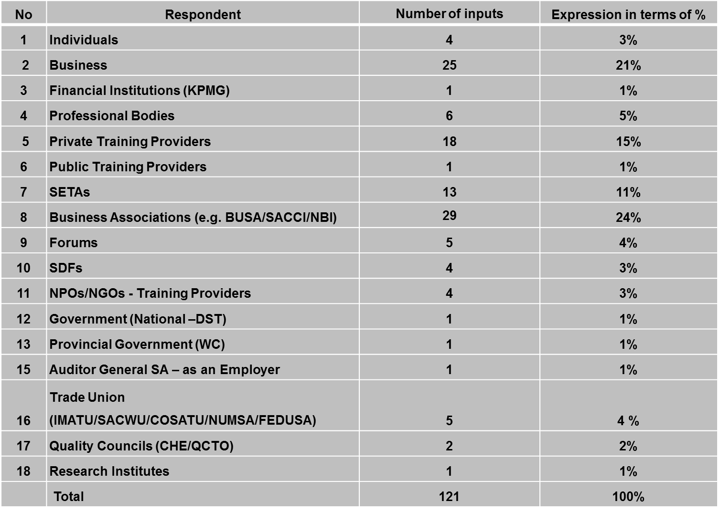
Type of Respondents

Slide 9
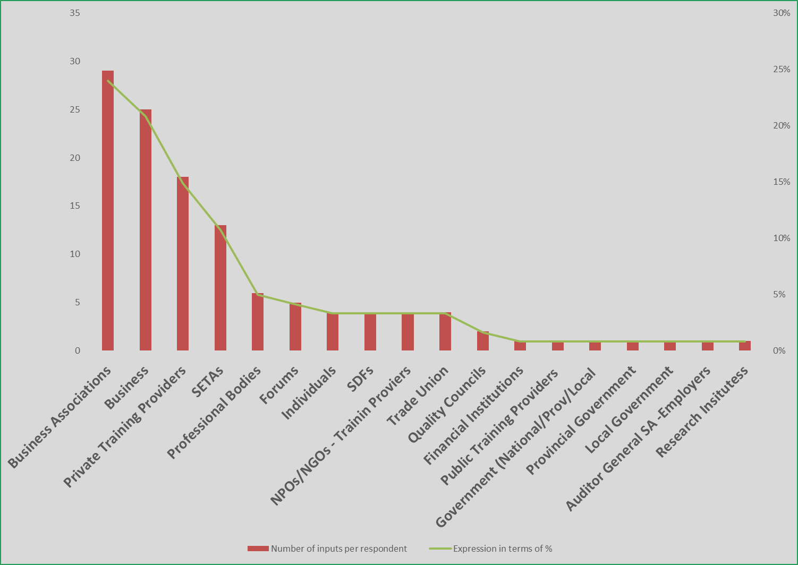
Type of Respondents

Slide 10
Sector
1. Stakeholder comments predominately (linked to SETA Consultation):
Agricultural
Financial
2. Public comments were received from SETAs:
AGRISETA CHIETA
ETDPSETA HWSETA
MERSETA FASSET
FOODBEV LGSETA
INSETA FPMSETA
EWSETA WRSETA
TETA

Slide 11
Classification of Respondent’s comments

Slide 12
Thematic Area
SETAs Permanency
Shared Services
Centralisation of Discretionary Grant
National Skills Fund Managing Discretionary Grant
Change of SETA Boards to Advisory Boards
Keep status quo of SETAs
Improve Monitoring and Evaluation for better performance
Quality Assurance and Accreditation
Support some form of change in the SETA system

Slide 13
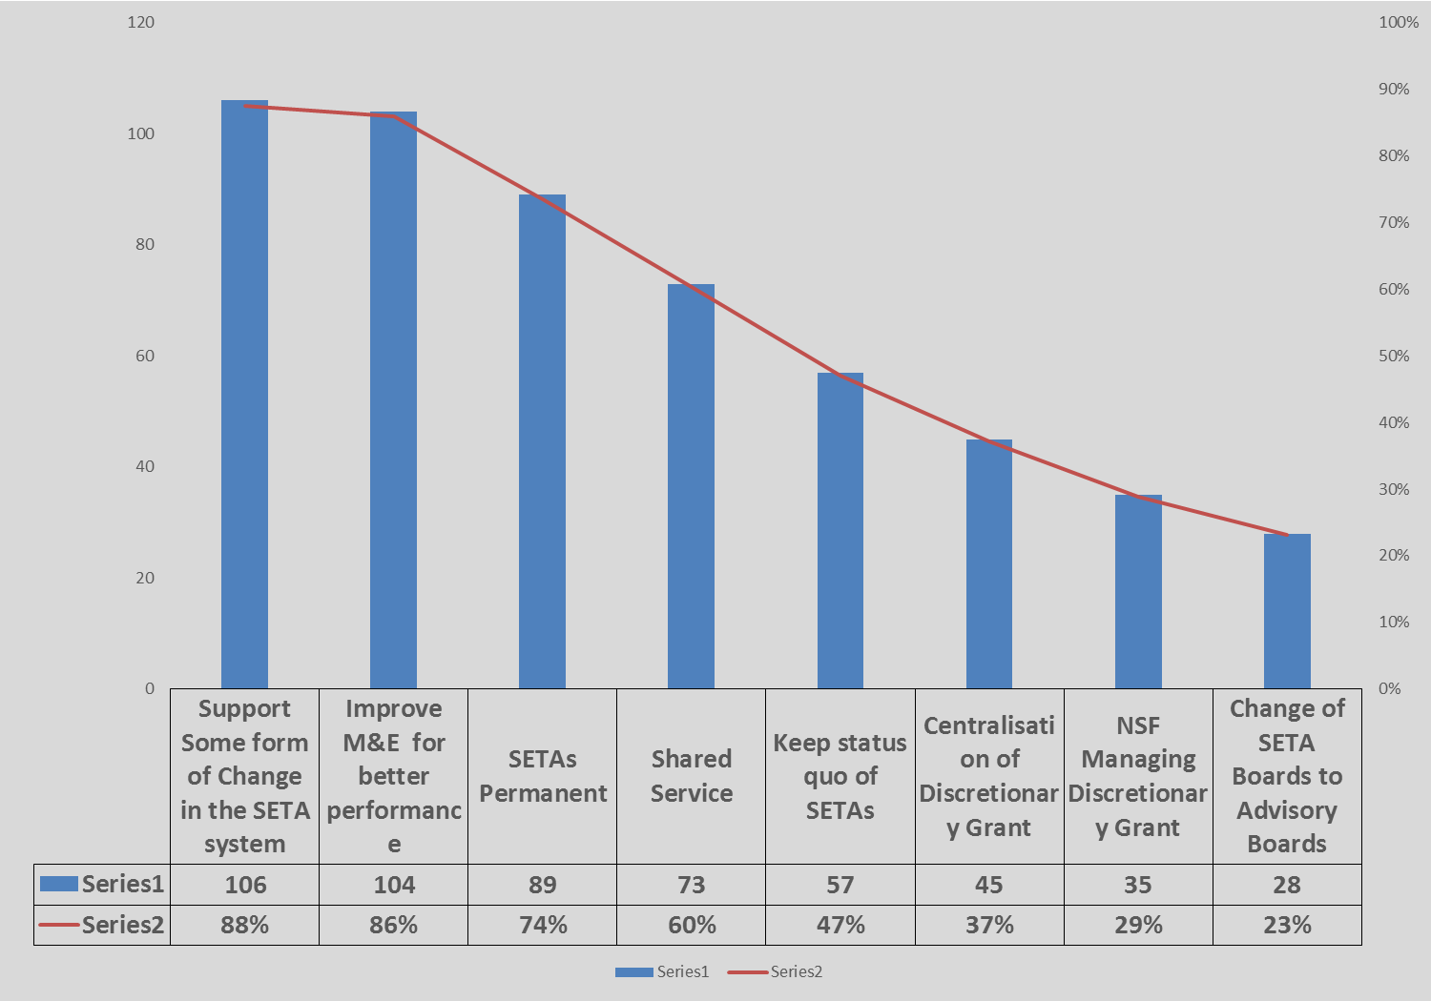
Common Themes

Slide 14
Supported
Permanency of SETAs;
Leave SETAs and change a few things to make them effective;
Shared Service & Discretionary Grants but not to the NSF;
Something must change as the SETAs are inefficient;
Support the strengthening of monitoring and evaluation;
Occupations as “lingua Franca”, however build capacity;
Central skills planning

Slide 15
Considerations
Build Monitoring and Evaluation capacity of the system;
Clarification regarding shared services and centralisation;
NSF and/or “Independent Agency”;
Role Clarification/Constituency participations;
Not in support of the strong role of government (Veto power);
SETABs should not be in DHET (too much power);
Make explicit - Governance and accountability;
Inputs to the strategy;

Slide 16
Considerations
Funding model;
Employment for WIL/graduates and unemployed;
Business/Labour must play a strong role;
Must have a balance between sector and national priorities;
QCTO roles versus the occupational teams;
Quality Assurance – this matter arose in most submissions;
QCTO requires additional funding through levy;
Role of private providers;
Transitional arrangements;
Strengthen/support education process for occupation

Slide 17
Summary of Consultation
There is synergy between the public comments received by DHET; and the discussion and report from the Provincial and Roundtable consultations.
The NSLP 2015 not supported. Comments signalled that the proposal be revised to focus on:
Improving effectiveness and efficiency of the system by:
Make SETAs permanent structures;
SETA Accounting Authorities remain and streamlined;
Improving and strengthening monitoring and evaluation across the system;
Establishment of shared services and streamlining of processes; and the
Quality Assurance arrangement to be made explicit and streamlined.

Slide 18
Summary of Consultation
Not Supported:
Centralisation of Funds;
Advisory role proposed;
Changes to the funding allocations proposed for centralisation of funds;

Slide 19
Next Steps
Led to the review of the proposals for the Skills development System;
Updated proposal developed: National Skills Development Plan (NSDP) in 2016. The updated proposal included the consideration of an extension of NSDS III and reestablishment of SETAs until 31 March 2020 while providing that additional objectives could be included to the NSDS III. The main principle proposed relates to the phase-in and implementation of transitional and legislative amendments from 1 April 2018

Slide 20
Next Steps
3. Consultation and engagement on the NSDP proposals have commenced
4. Minister of Higher Education and Training issued government gazette to extend NSDS III and re-establish SETAs until 31 March 2020 – 15 December 2016.

Slide 21
Purpose of next steps
To address the challenges that undermine the efficacy of the post-school system.
Share the revised proposal that the Department of Higher Education and Training (DHET) has developed for the National Skills Development Plan (NSDP).
This proposal outlines the institutional mechanisms and implementation plans to address priorities.
This proposal is made recognising the importance of a phased approach such that there is no negative disruption of the system. Changes can only be introduced when there is capacity to support these changes in place.
Takes into account input and advice received.

Slide 22
Part 1: National Skills Development Plan

Slide 23
Content
Implementation Against Priorities
Overarching Principles
Purpose of the Plan
Overview of the National Skills Development Plan

Slide 24
Implementation against Priorities
The DHET is shifting from developing National Skills Development Strategies to a Longer-Term Plan.
This recognises the White Paper for Post-School Education and Training which provides the overarching Strategy for Skills Development.
What is now required is a clear outline of the activities that will be undertaken in support of the achievement of the vision and objectives as laid out in the White Paper.
That is, how the levy-grant institutions will support and steer the system to support the Post-School Education and Training system and address occupations in demand to enable economic growth, employment creation and social development.

Slide 25
Overarching Principle 1
Towards an integrated post-school system:
Focus on greater levels of integration and coordination of the planning, funding, monitoring and evaluation of the system.
This in intended to encourage stakeholders to actively participate and articulate their concerns and objectives as DHET will take responsibility for driving this system by working closely with key social partners.
These changes are intended to improve the quality, quantity and relevance of post-school education and training in South Africa.

Slide 26
Overarching Principle 2
Locating the post-schooling system within a wider context:
The White Paper sets out a vision of a transformed post-school education and training system, which is expanded, equitable, diverse and integral to government’s policies and contribute to the development of the economic, social and cultural life of our country.
This speaks directly to the Vision 2030 and the youth focus of the National Development Plan.

Slide 27
Purpose of the Plan (revised NSDP)
1. The White Paper highlights the need to build on the important policy shifts that were introduced in NSDS III, these include:
“providing greater levels of access to education and training in rural areas; increasing collaboration between the skills system, government and industry; driving skills development primarily through the public education system, and in particular through universities and TVET colleges; and focusing less on numerical targets and more on outcomes and impact”.

Slide 28
Purpose of the Plan (revised NSDP)
2. This plan focuses on how the levy-paying institutions will:
contribute to the vision of the White Paper and in so doing supports the work of the DHET with funds from the treasury;
indicate the roles played by DHET and the key institutions implementing the NSDP;
guide the disbursement of the levy grant money; and
indicate how the DHET will work with social partners to realize the intentions of the plan.

Slide 29
Understanding demand
DHET is creating the capacity for the analysis of development plans and labour market information to determine occupational demand (occupational priorities).
DHET will continue to work in partnership with the Higher Education and Research Institutions – this will support:
An analysis of the data that SETAs gather from the workplace to understand the demand for occupational qualifications
A review of the skills priorities emanating from government departments’ development plans.
DHET will support and guide SETAs to use the analysis to encourage an employer and labour voice.

Slide 30
Steering Supply: Qualifications and Provision
DHET will engage with the Quality Councils to ensure that qualifications and related curricula are in place to meet the occupations in high demand.
DHET (through relevant institutions) will retain the responsibility for detailed learning programmes and materials.
The DHET will communicate the demand analysis to the CET, TVET and HE sectors and engage on how this informs the enrolment planning process within institutions. This will be coupled with resources to support the improvement of the throughput and quality of these programmes.

Slide 31
Steering Supply: Qualifications and Provision
This could include incentives for materials, lecturer development, and incentives for students (across the system – public and private).
SETAs will participate in such discussions so as to encourage partnerships between institutions and workplaces and where relevant across public and private providers.

Slide 32
Steering Supply: Funding
DHET will create a framework for collaboration between the Skills Planning and the Community Education and Training (CET), Technical and Vocational Education and Training (TVET) and Higher Education to consider how best the SETAs can:
Fund institutions to increase enrolment and throughput in occupations;
Support workplaces and institutions partnerships for integrated programmes; and
Design and implement Workplace-Based Learning Incentives.
Ensure an alignment of funding sources to support occupational priorities and will allow for medium to long-term planning.

Slide 33
Growing Supply
The DHET will be responsible for provision, and the SETAs will coordinate efforts to meet supply needs. Funding will come from the fiscus and be complimented by funding to institutions in support of occupational priorities.
This additional funding will be aligned to the 5-year planning cycle (MTSF) and the 3-year funding cycle (MTEF) – focus on ensuring there is capacity to deliver occupational programmes/offer bursaries in these occupations in high demand.
DHET will also take responsibility for ensuring that the materials that are required to deliver learning programmes against the Occupational Qualifications are in place.

Slide 34
Funding
There are two dimensions to this funding process:
Support the funding of Occupations in High Demand for economic growth, employment creation, and social development (49.5%);
Support national imperatives that focus on the needs of the poor (20%).

Slide 35
SETA Funding Process
Funding will be approved for 3 years within a 5-year programme planning cycle, to ensure the stability of the system and to allow planning and effective and efficient distribution of funds to workplaces.
Funding applications will utilise a standard template and will focus on programmes for existing employees, unemployed, and pre-employed (students) to access occupations in high demand.
These include occupational qualifications and workplace-based learning experience. The applications will indicate:
The number of individuals that will access these different programmes and the workplaces where the learning will take place;
Funding to support these programmes; and,
Funding to develop the capacity of these Institutions to deliver these programmes.

Slide 36
National Imperatives
The National Skills Fund, utilising the 20%, will continue to operate as a ‘catalytic’ fund and will support both unsolicited (proactive and reactive) and solicited proposals.
This will enable the state to drive key skills strategies as well as to meet the training needs of the unemployed, non levy-paying cooperatives, worker education, NGOs and community structures and vulnerable groups.
It will promote strategic partnerships and innovation in project delivery and contribute significantly to raising the low base of education and training in South Africa, guided by government policies aimed at promoting equity and social justice.

Slide 37
Monitoring and Evaluation
DHET will improve Reporting, Monitoring and Evaluation.
The Department will develop a Monitoring and Evaluation framework for the NSDP. This will outline the outcomes and indicators and intended impact of the system.
Monitoring the SETAs' APPs will focus on outcomes achieved and the extent to which this appears to be contributing towards the intended impact within each sector and of the system.
At the three-year point, the NSA will commission evaluative work to determine the extent to which the SETA work is contributing to the objectives of the NSDP. This will include making recommendations about areas that need to be adapted to strengthen this contribution.

Slide 38
Capacity Development within DHET
This plan requires considerable capacity to be developed within DHET. This includes the ability to develop milestones, templates and standardized processes.
Further, the DHET will require the capacity to plan within the context of the overarching PSET Plan.
In addition, DHET will put in place the capacity to review the Annual Performance Plans of the SETAs. This will include monitoring capacity as well as budget analysis capacity.

Slide 39
Role of Social Partners
Recognises the commitment that social partners have made in a range of forums (including the Accords and more recent pledges made).
The NSDP recognises the important role that other Government Departments should play both with respect to supporting training of their own employees and in supporting the development of individuals in Occupations in High Demand.
Further, it recognises that Government Departments play a key role in these processes to work actively with social partners to achieve these commitments.

Slide 40
Part 2: Implementing the National Skills Development Plan (Landscape)

Slide 41
Content
A summary of the Institutional skills landscape
Phase-in: SETA Establishment and NSDS III Extension.

Slide 42
Institutional Landscape
Current 21 SETA status;
Accounting Authorities;
Current scope - mandate and functions;
Levy funds management; and
SETAs and DHET reporting arrangements.
It also outlines the role that the NSA will play in support of these objectives.

Slide 43
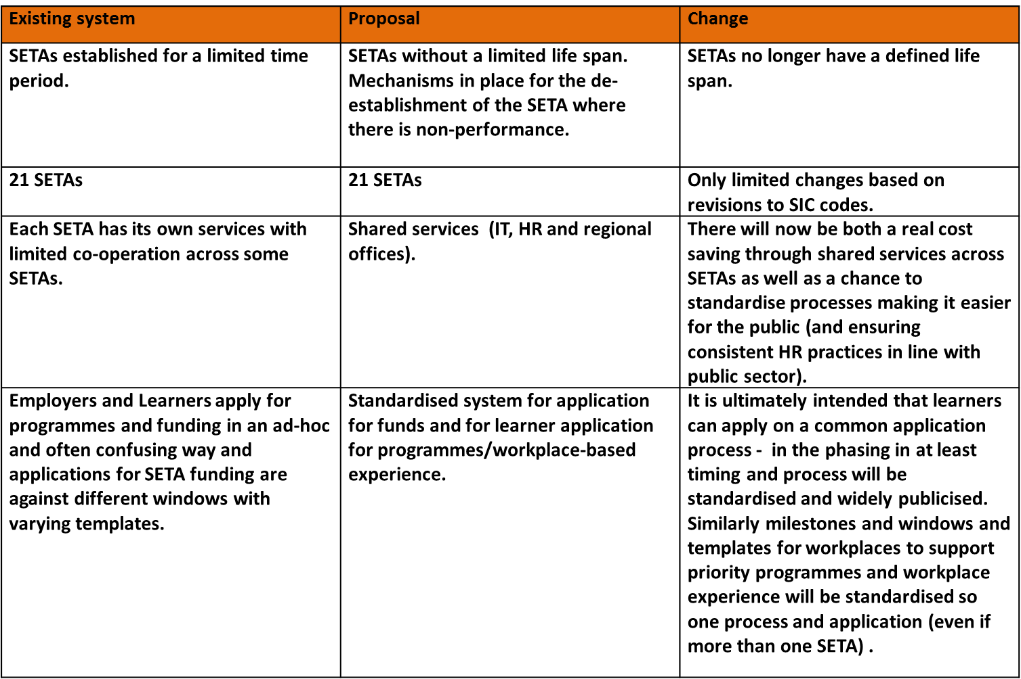
Establishment of SETAs

Slide 44
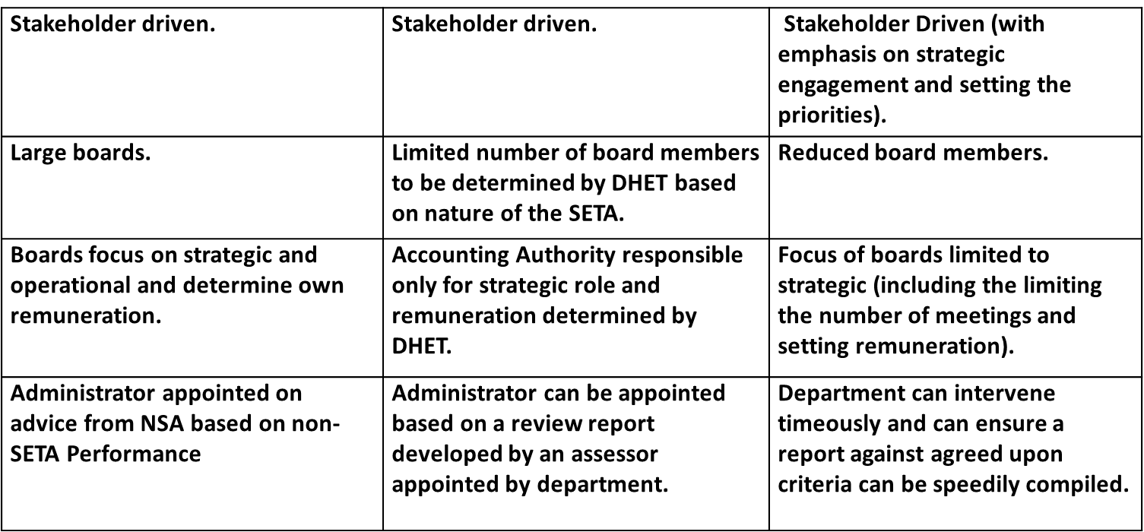
Accounting Authorities
Existing system | Proposal | Change

Slide 45
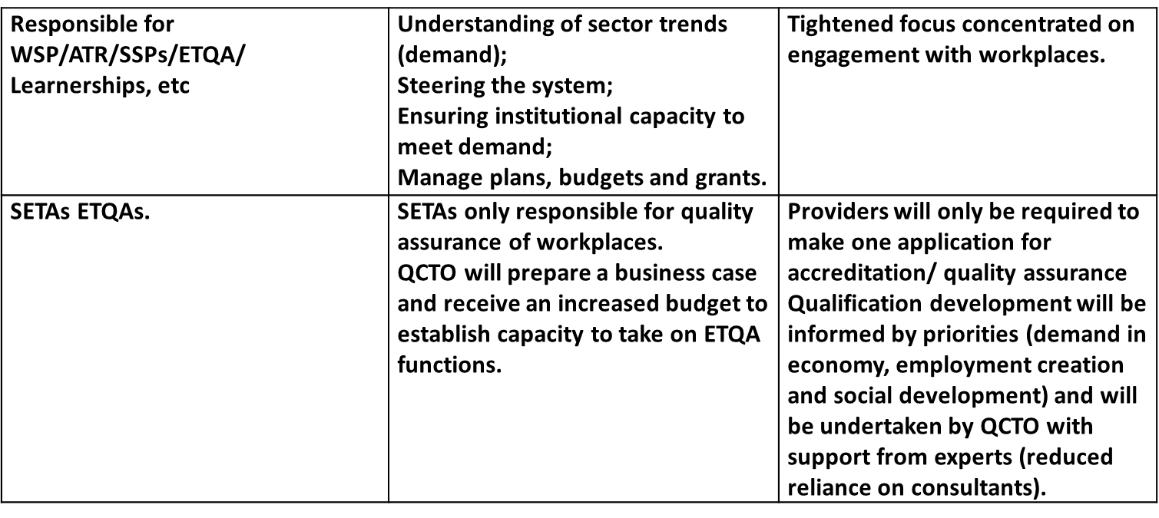
Scope of SETAs
Existing system | Proposal | Change

Slide 46
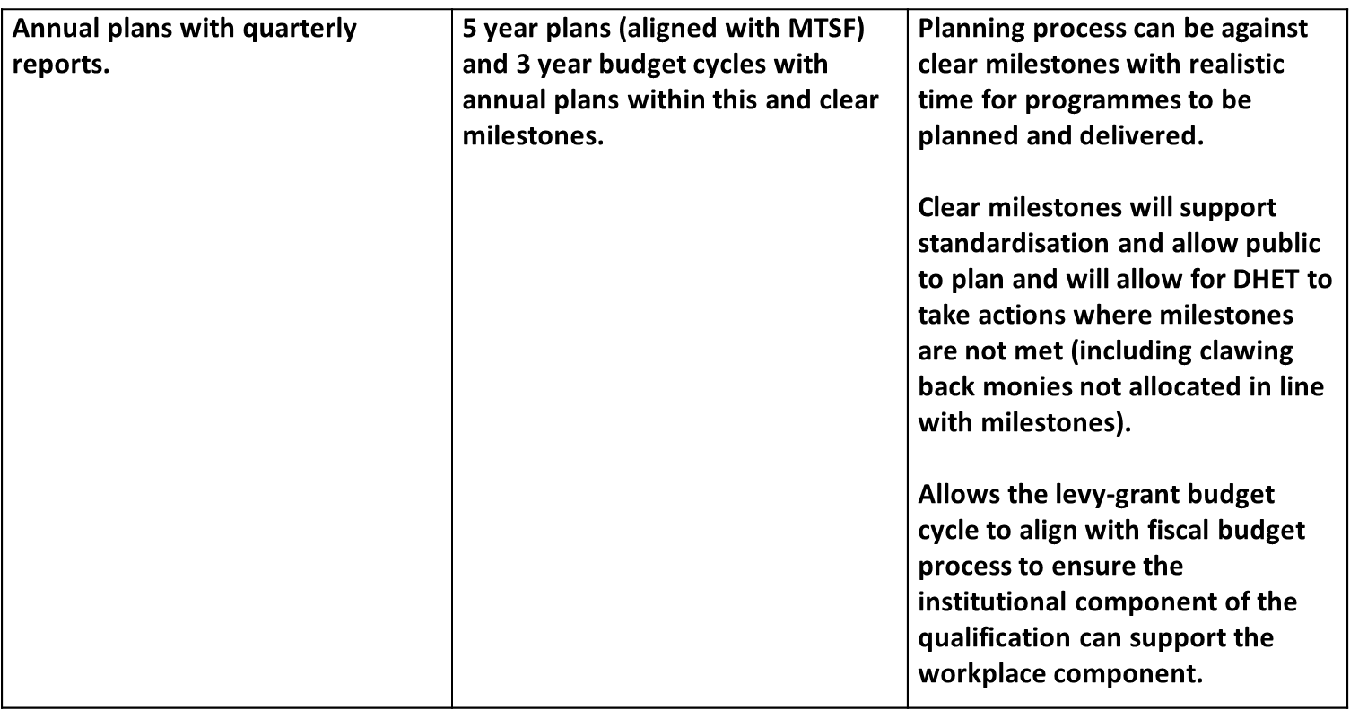
Planning, reporting and accountability
Existing system | Proposal | Change

Slide 47
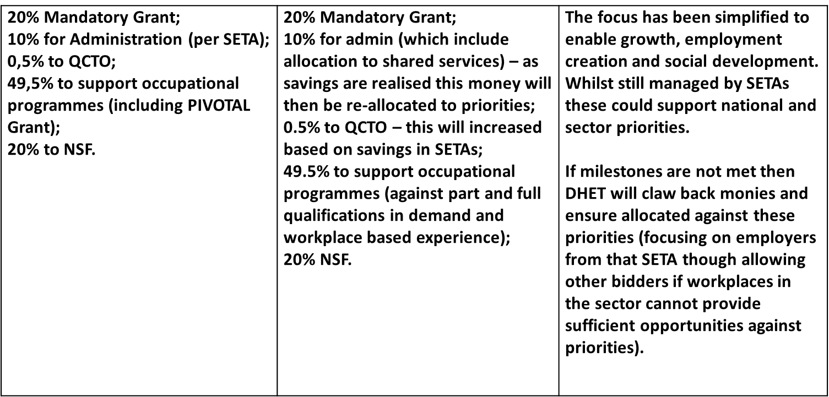
Funding
Existing system | Proposal | Change

Slide 48
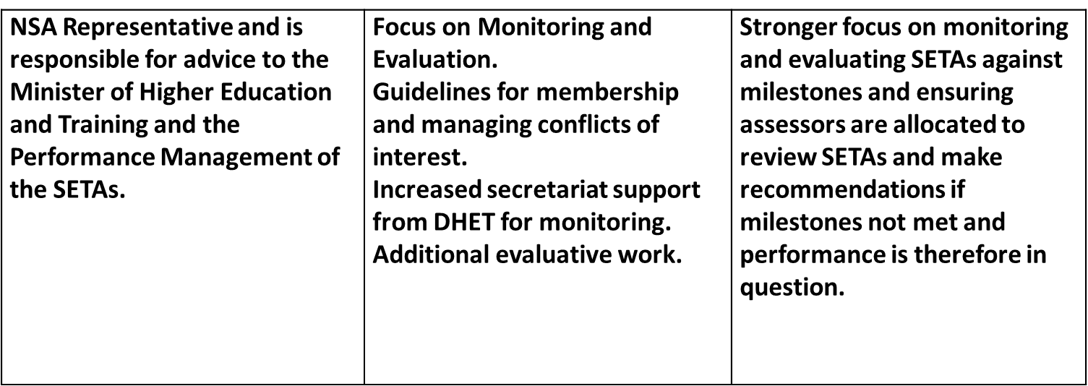
National Skills Authority
Existing system | Proposal | Change

Slide 49
Thank You

