Slide 1
Significance of SONA for dti Mandate
by Rob Davies
Minister of Trade and Industry

Slide 2
Key Themes of SONA
Radical Economic Transformation
“..fundamental change in the structure, systems, institutions and patterns of ownership, management and control of in favour of all South Africans, especially the poor, the majority of whom are African and female…”
Continued improved implementation of 9 Point Plan:
3 elements specifically relevant to dti work:
(1) higher impact IPAP
(2) mineral beneficiation
(3) promoting investment.
Significant focus on trade issues in light of changing global context

Slide 3
Higher Impact IPAP
Industrialisation vital “to fundamental change in structure…of economy…”.
Essential to move away from dependence on production and export of primary commodities.
Also need to see more visible and deep seated “ fundamental change in ..patterns of ownership, management and control” in sector.
Two interrelated, and need to be simultaneously pursued.
      Performance of sector to date erratic.
      Employment has grown much less than output.

Slide 4
Value-added in manufacturing and the rest of the economy
Source: Stats SA

Slide 5
Employment in manufacturing and rest of the economy
Source: Stats SA

Slide 6
Investment in manufacturing compared to private and public investment
Source: SARB

Slide 7
Higher Impact IPAP cont’
Performance of sector partly influenced by global factors (e.g. glut of steel, weaker demand in key African export markets). And by domestic challenges:
Weak growth in domestic demand;
High levels of concentration in key sub-sectors (sub-optimal competition and higher barriers to entry);
High administered prices
Inconsistent application of key programmes, (e.g. localisation)
But our programmes have had a positive impact; with respect to tax incentives alone, World Bank concluded that investment tax incentives:
“have…contained job destruction in industrial sectors…”
“have encouraged additional investment in agriculture, construction, manufacturing, trade, and other services.”
“the additional investment generated by tax incentives exceeds the government’s foregone revenue from distributing the tax incentives.”

Slide 8
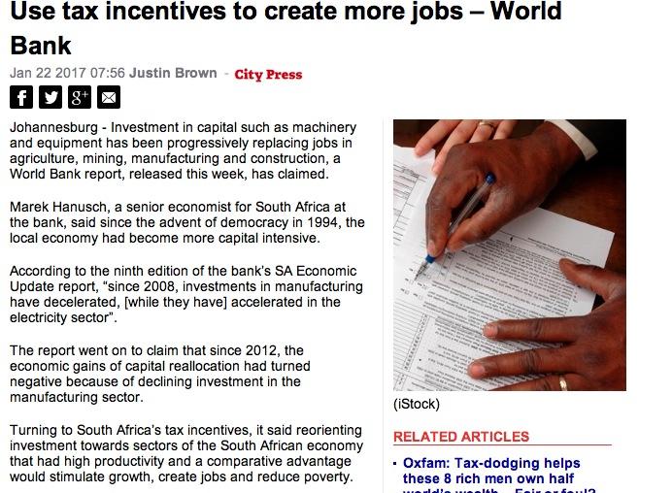
Higher Impact IPAP cont’
Is justified by “the existence of large employment multipliers (which) brings the fiscal cost of job creation to a fraction of total labor costs, especially in the manufacturing sector.”
And “Moving forward, reorientating incentives…towards industrial sectors would create additional jobs at no additional fiscal cost, the more so as industrial sectors would benefit in the medium term from the depreciation of the rand, declining commodity prices, and the coming online of additional power generation.”
World Bank, 2017, Private Investment for Jobs; South African Economic Update.

Slide 9
Higher Impact IPAP cont’
Notable successes in :
Automotives
(Capital investment R6,6 bn, 2015 (2012: R4,7bn)
Export units 333,000: 2015 (2012: 278,00)
CTFL
(Output R41bn: 2015 (2012: R28bn)
Employment 144,000: 2015 (2014: 138,000)
BPS
Investments R34 bn supporting 30,000 jobs 2016
Ship/boat building
Exports R2,39bn: 2015 (2014: R1,49bn)

Slide 10
Higher Impact IPAP cont’
Progress also in:
Film, Railway equipment, Aerospace, pharmecuticals, Agroprocessing , renewable industries, among others
Moving forward we need to address, inter alia, the following:
(1) Identifying and prioritising the most job rich, and job enabling, parts of manufacturing including agro-processing, clothing and textile, component manufacturing.

Slide 11
Higher Impact IPAP cont’
(2) Working towards greater coherence in deployment of policy levers e.g. localisation.
(3) Getting greater value (in terms of jobs, capacity and empowerment) from deployment of incentives in a context where resources scarce.

Slide 12
Higher Impact IPAP cont’
Greater Inclusivity within Manufacturing and through impact of manufacturing on economy
A socio-political, but also economic imperative;
Strengthen ongoing efforts to build a less concentrated, more competitive economic and manufacturing structure in which barriers to entry for new entrants are lowered across key sectors of the economy.
2013 B-BBEE Act requires all organs of state to implement B-BBEE; dti will now require level of compliance as condition for support (level 4).
Sub-minima for skills, supplier development.
Focused Black Industrialist’s programme.

Slide 13

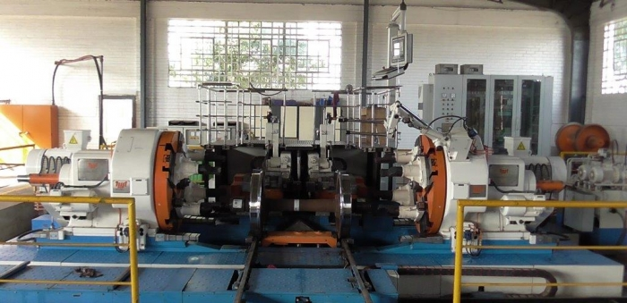
Black Industrialists
27 Black Industrialists supported to the value of R577m, resulting in R2,5bn private-sector investment and projected 5,235 direct and 1,228 indirect Jobs.
Additionally IDC programme, approved approximately R5,205bn to support black industrialists, thereby creating about 6,209 jobs.
Programmes targeted at significant real operators in the industry who are taking risk, personally involved in operation of enterprise.

Slide 14

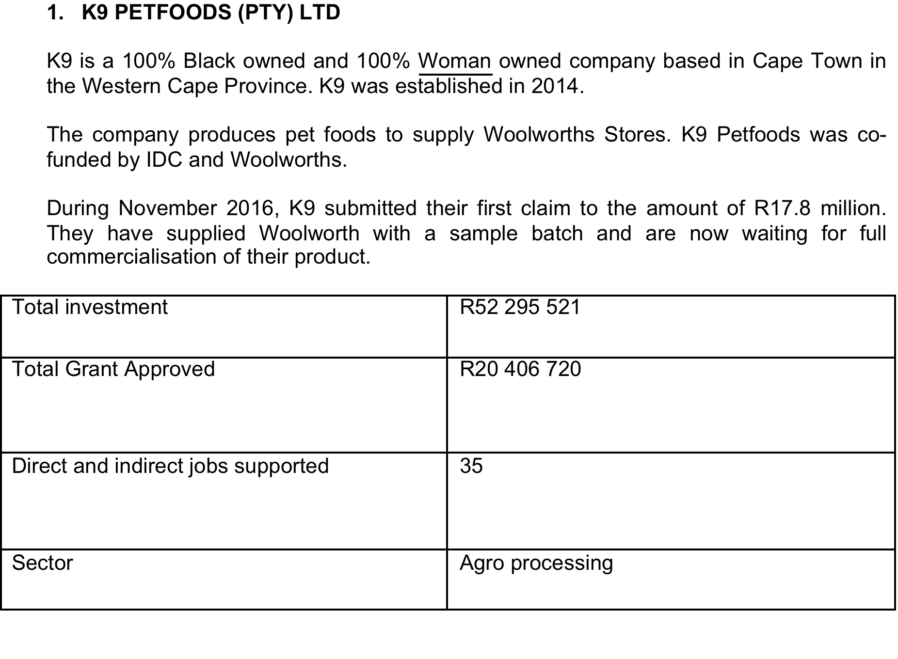
Black Industrialists cont’

Slide 15

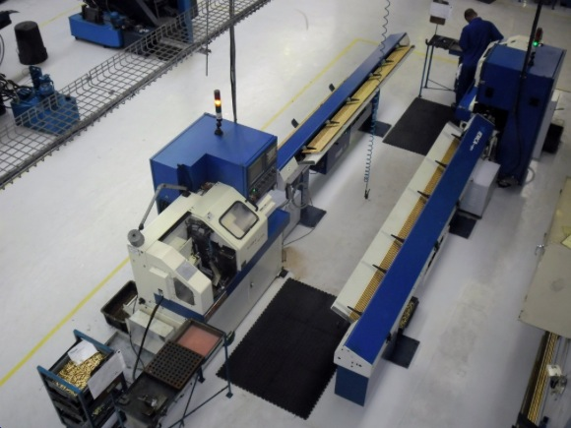
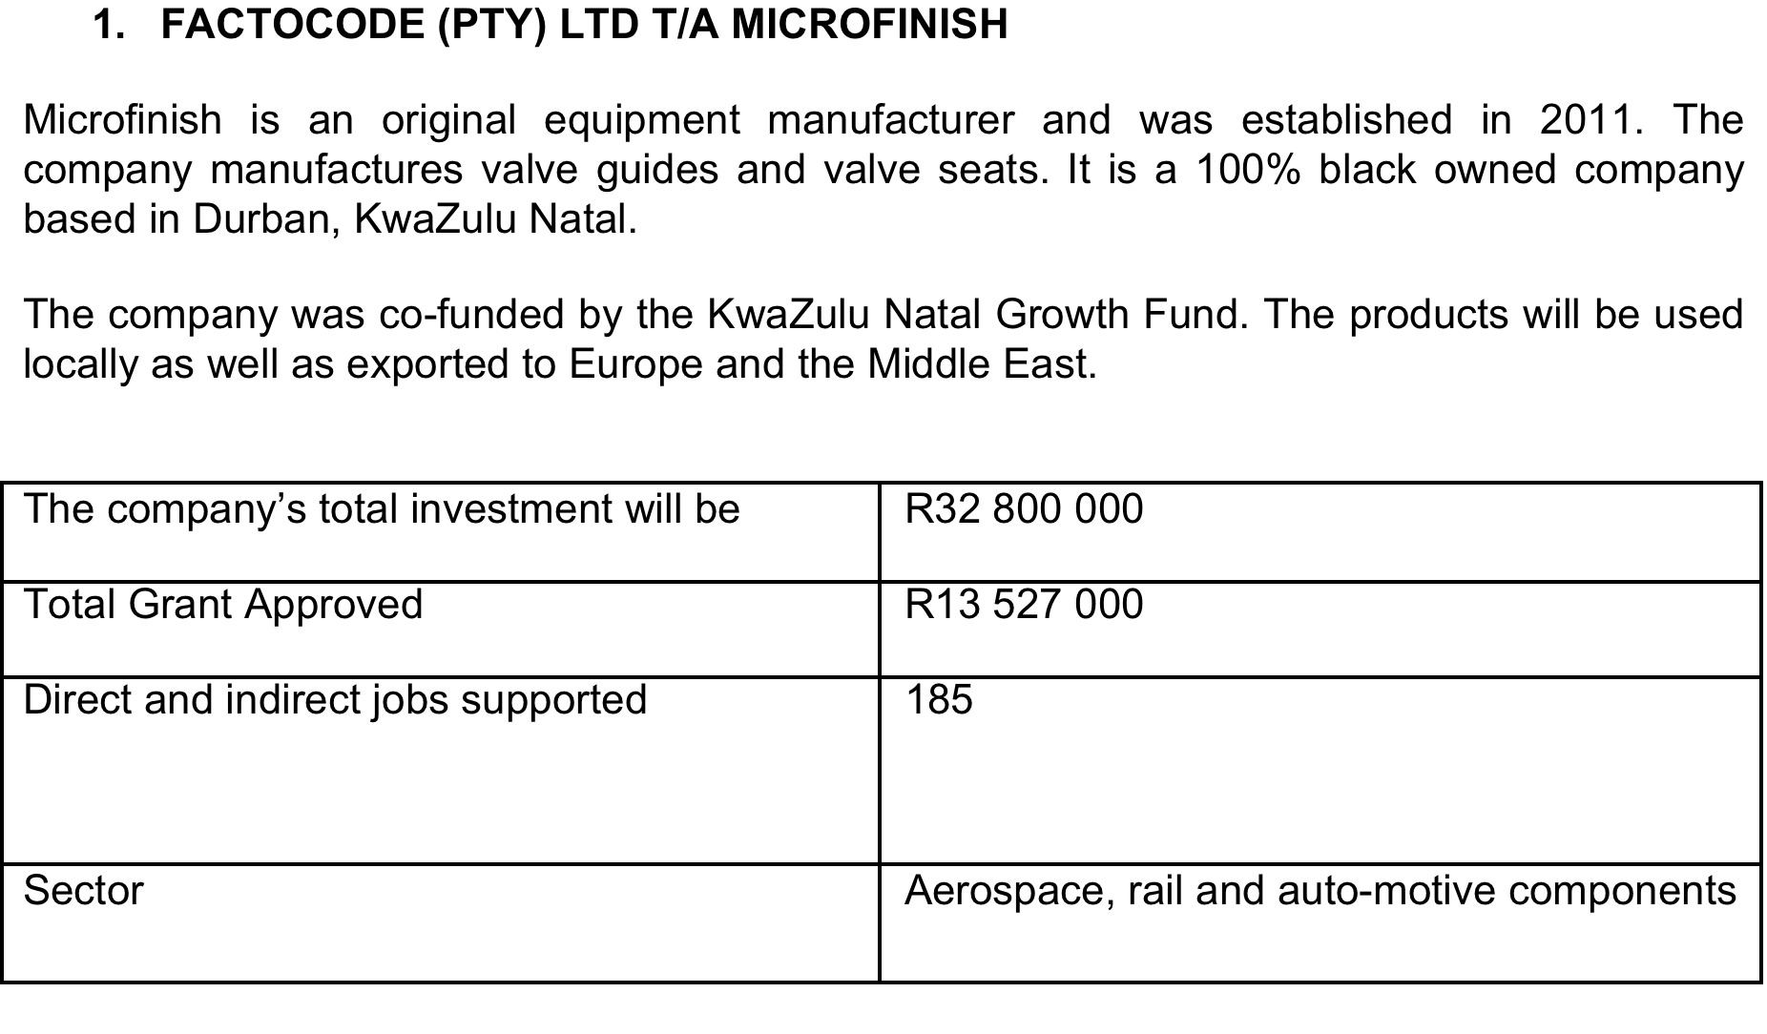
Black Industrialists cont’

Slide 16
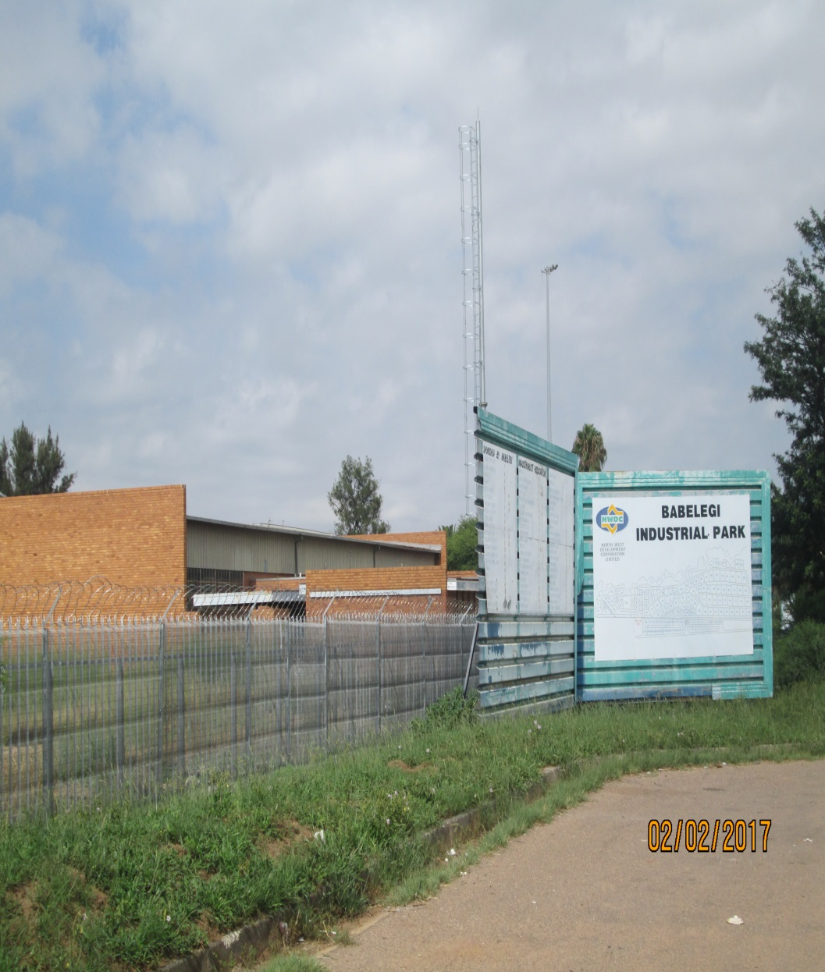
SEZ’S and Industrial Parks
Programmes support both industrial decentralization and greater inclusion of smaller players with significant job creation potential.
First phase of rehabilitation of four industrial parks completed and launched.
348 jobs by 37 SMMEs created in the revitalisation project; R166 million spent by government.
But crucially, many thousands more people work in the Industrial Park or are indirectly dependent on the Industrial Park for their livelihoods.
Small infrastructure upgrades that can significantly improve attractiveness of parks.

Slide 17
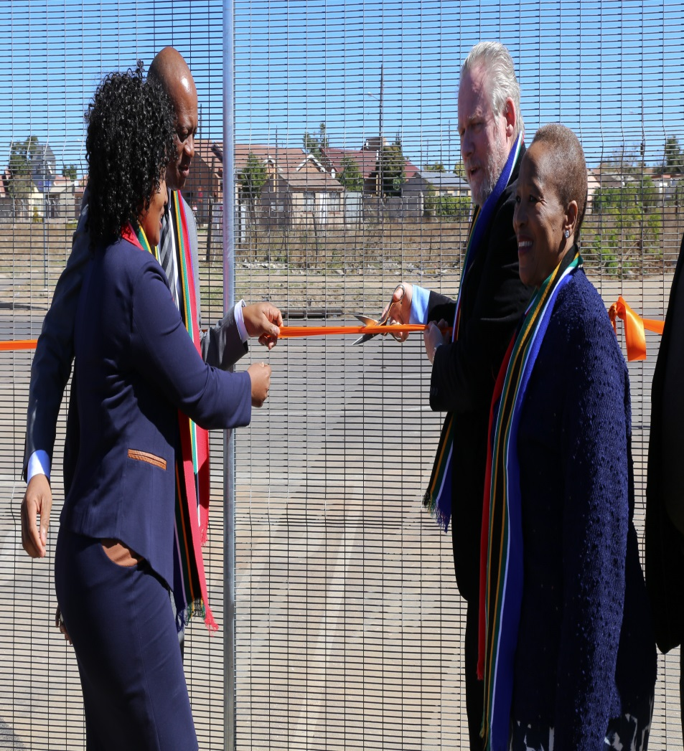
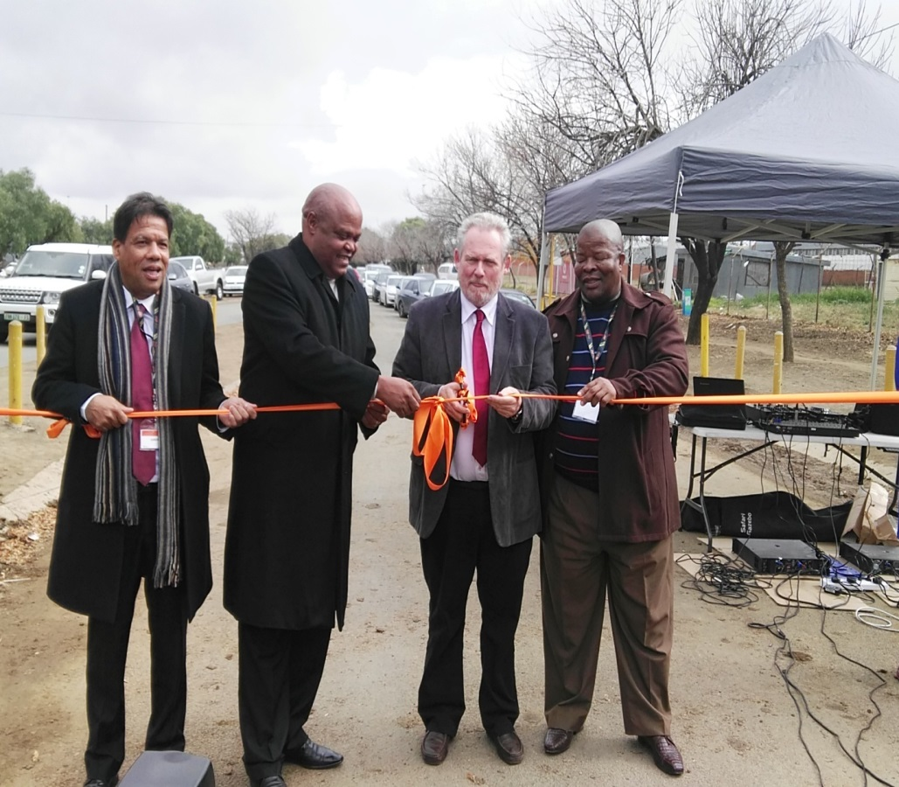
SEZ’S and Industrial Parks
Launch of Botshabelo and Seshego Industrial Parks

Slide 18
SEZ’S and Industrial Parks
Three SEZs were designated - Maluti-a-Phofung in September 2015, Dube Trade Port in October 2014 and Musina-Makhado SEZ received a Cabinet approval for designation in July 2016.
The collective investments secured for these new zones amount to at least R70 billion and projected to create 23 000 jobs.
To date 73,000 jobs have been created in the IDZs, of which 6,896 (9.6%) were direct and 65,637 (90.4%) indirect.
Future operational investments are projected to result in the creation of over 2,194 direct jobs in the zones.

Slide 19
The looming Challenge of the 4th Industrial Revolution
New digitised technologies predicted to bring about “disruptive change” in production and service sectors in near future-robotics, Internet of Things, 3 D printing, Artificial Intelligence.
Will also have profound social impact;
    Most jobs existing now won’t exist in next decade or so, and new jobs will require higher and new skills ;
    Could be “reshoring to developed world”
    Could be overall reduction of demand for labour (with possibly 7 million job losses worldwide).
Notes:
ti

Slide 20
The looming Challenge of the 4th Industrial Revolution
Some of this existing reality of manufacturing and service sectors in SA. Young people in SA can operate, run and manage digitised production processes but they all have post-secondary education.
Technological innovation taking place in context of “winner takes all markets” …populist backlash.
Notes:
ti

Slide 21
Beneficiation
Moved from calling for beneficiation to actual implementation.
The Chamber of Mines Research Organisation (COMRO) has re-opened with funding from the DST to secure upstream mining localisation and downstream beneficiation.
Tronox opened R3.3bn Fairbreeze mineral sands mine in KZN for titanium dioxide; 250 direct and 1 000 indirect jobs created
De Beers selected 5 black-owned cutting and polishing companies for entrepreneurship development and beneficiation
Notes:
)

Slide 22
Beneficiation
PGM Frontier industry, Fuel cells,
Fuel Cells are a key area for collaboration between the mining industry, manufacturing and government and the Key projects include:
CSIR/Busmark (local OEM)/HySA for a bus prototype
Anglo Platinum collaborating with HySA Infrastructure on developing fuel cell powered mining equipment
Implats and its partners deployed a fuelling station using the locally developed system - metal hydride compressor
Impala/Doosan project - Feasibility studies for potential deployment of 85MW Doosan systems under way; to be serviced by proposed SA manufacturing facility
Notes:
)

Slide 23
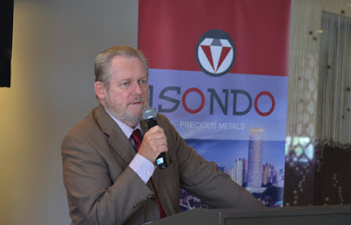
Beneficiation
Isondo Fuel Cell plant launched in Cape Town
MEC for Transport in Gauteng has reached an agreement with Gautrain to run a fuel cell powered Gautrain bus to highlight efficiencies.
The Gauteng Industrial Development Zone (IDZ) is currently conducting a feasibility study to assess the viability of establishing a fuel cells industrial park in Springs in partnership with Impala Platinum.
Notes:
)

Slide 24
Promoting Investment
Invest SA will be formally launched on 17 March 2017.
Will be involved in active promotion and improved facilitation of investments.
Cabinet identified pipeline of approximately 40 projects that are capable of being brought to fruition before the end of this term of government.

Slide 25
Trade issues - SADC
  SA’s objectives is to promote investment-led growth and pursue the development integration model that combines market integration, industrial and infrastructure development.
  The aim of this is to promote more intra African trade, support industrialization through creation of large regional markets that support the development of regional value chains.
  Extra-ordinary Summit on 18 March 2017 to consider Action Plan on Industrial development.
  Recognises that Government action through appropriate policy instruments and interventions remains a legitimate instrument for development to support dynamic manufacturing growth.

Slide 26
Trade issues - SADC Cont’
Aims to create an integrated regional economy with a diversified, innovative and globally competitive industrial base, which contributes to sustainable growth and employment creation.
Key priorities:
    Agriculture-led growth including agricultural value chains;
    Natural resource-led growth including minerals beneficiation
    Pharmaceuticals- Increase regional manufacturing of pharmaceuticals
    Enhanced participation in domestic, regional and global value chains.

Slide 27
TFTA negotiations
TFTA offers regional market of 26 countries with a population of 625m and a combined GDP of US$1.6 trillion.
  The African market is very important for SA, particularly for value added products. 29% of SA’s merchandise exports in 2015 were sold in other African countries.
  SA is involved in the Continent as an investor and provider of services.
Progress:
  Framework agreement negotiated and finalised, including all the Annexes and will be presented to Parliament in the second half of 2017.
  Tariff negotiations with the EAC and Egypt advanced with the plan to conclude well before the end of 2017.

Slide 28
TFTA negotiations Cont’
The TFTA is a building block for the Continental FTA, it is envisaged that the key deliverable of the CFTA this year will be the legal framework.
KENSA – strategic alliance established to promote practical implementation of the development integration agenda and to coordinate positions to advance the TFTA and CFTA

Slide 29
South Africa’s trade with the United Kingdom (UK)
United Kingdom (UK) was 8th largest trading partner of SA in 2015. South Africa’s export of goods to the UK was R42.8 billion and imports were R29.6 billion in January-November 2016.
South Africa’s top exports to the UK are platinum products that accounts for about 40% of our exports, motor vehicles (12%), machinery (4%), grapes (4%), wine (4%), citrus (4%), apples (3%), apricots (1,2%) and flat rolled steel products (1,2%).

Slide 30
South Africa’s trade with the United Kingdom (UK) Cont’
South Africa’s top imports from the UK are motor vehicles (15%), petroleum (11%), spirits (7%), original equipment components (4,5%), medicaments (4%); books (2%) and bulldozers (1,7%)
UK Government aims to give notification as is required by Article 50 of the Lisbon Treaty by March 2017. This notification will start negotiations for the UK exit from the EU.
The UK has two years from the date of the Article 50 notification to finalise the negotiations for their exit from the EU but this period can be extended if all the other EU member states agree.

Slide 31
Effect of BREXIT on EPA
SA’s trade relations with the European Union (EU) have been governed by the trade chapter of the Trade, Development and Cooperation Agreement (TDCA) since 1 January 2000.
The EPA provisionally entered into force on 10 October 2016 and replaced the trade chapter in the TDCA.
SA’s objectives is to ensure that there will not be an interruption in the trade between SA and the UK once the UK exits the EU.
BREXIT presents an opportunity for SA to increase market access into the UK, especially agricultural products.
SA’s objective is to ensure a smooth transition and no interruption in the trade between the UK and SA based on the EPA.

Slide 32
Effect of BREXIT on EPA cont’
There are a number of Tariff Rate Quotas (TRQs) in the EPA and SA will have to negotiate the volume of the TRQs with the UK.
Since the TRQs in place with the EU were never increased as more countries became part of the EU, like Croatia in 2014, it is SA’s position that TRQs in the EPA should not be reduced.

Slide 33
World Trade Organisation
The 11th Ministerial Conference (MC11) to be held in December 2017 in Argentina.
Period of considerable uncertainty in trade policy, including a widening backlash against trade agreements and globalization.
Divergences on the mandate of the development agenda in the DDA.
Strong push for “cherry-picking” - e-commerce.
SA Position:
      Preserve the multilateral trading system
      Continue to advocate for progress on the outstanding Doha issues.

Slide 34
World Trade Organisation
  Any package agreed must have clear developmental character and content and should ensure trade supports inclusive growth.
  we will need to calibrate expectations realistically - possibility may be that the best outcome for MC11, in the current context, is simply to preserve the status quo in the WTO.

Slide 35
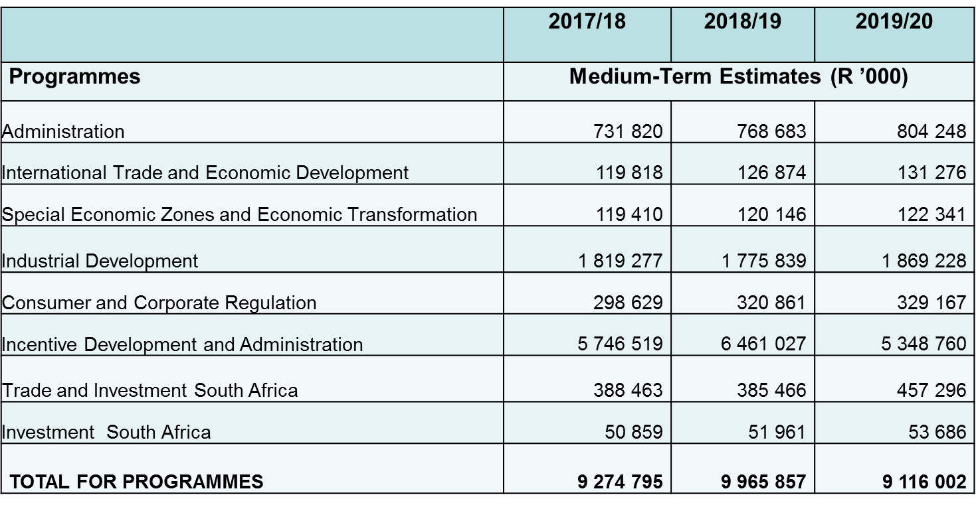
BUDGET ALLOCATED – 2017-18 TO 2019/20

Slide 36
BUDGET ALLOCATED TOWARDS Industrial INFRASTRUCTURE
Spending on incentives over the medium term is estimated at R16.9 billion, funded through the Incentive Development and Administration programme.
Description | Y1- 2017/18 | Y2- 2018/19 | Y3- 2019/20 | TOTAL
 | R’000 | R’000 | R’000 | R’000
Special economic zones | 605 421 | 1 300 000 | 1 457 280 | 3 362 701
Critical infrastructure programme | 209 500 | 211 071 | 222 891 | 643 462
Manufacturing development incentives | 3 564 850 | 3 617 002 | 2 462 594 | 9 644 446
Services sector development incentives | 692 500 | 732 069 | 704 425 | 2 128 994
Export market and investment assistance | 212 500 | 227 725 | 240 478 | 680 703
Support programme for industrial innovation | 63 937 | 67 645 | 71 433 | 203 015
Industrial development zones: other | 140 000 | 80 000 | - | 220 000
TOTAL | 5 488 708 | 6 235 512 | 5 159 101 | 16 883 321

Slide 37
THANK YOU!

