Slide 1

SABC
ANNUAL REPORT
2015/16

Slide 2


Slide 3

TABLE OF CONTENTS
SABC AT A GLANCE
FY2015/16 PERFORMANCE
ANNUAL FINANCIAL PERFORMANCE
ACHIEVEMENTS AND AWARDS
TRANSFORMATION, INDUSTRY DEVELOPMENT, SOCIAL RESPONSIBILITY

Slide 4


Slide 5
SABC AT A GLANCE
The ability to provide content in all official languages and multiple genres ranging from children’s and educational programmes to drama, documentaries, news and current affairs and top revenue-grossing soap operas, positions the SABC as the most influential broadcaster in South Africa. The SABC is the only broadcaster serving the information, educational and entertainment needs of millions of citizens who rely on its radio, television and digital services for access to reliable content in the language of their choice.
Public Broadcasting Service Mandate
The mandate of the SABC, as a Public Broadcaster, is embedded in the following legislation, regulations, policies, codes of conduct and license conditions, among others:
• The Constitution of the Republic of South Africa, Act No. 108 of 1996, as amended;
• The Broadcasting Act No. 4 of 1999, as amended;
• The Independent Communications Authority of South Africa Act No. 13 of 2000, as amended; and
• The Electronic Communications Act No. 36 of 2005, as amended.

Slide 6
SABC AT A GLANCE
The obligations arising from the Broadcasting Act are encapsulated in the Independent Communications Authority of South Africa (ICASA) Regulations, which determine the license conditions for the SABC’s five television channels and 18 radio stations. The Act also provides the Legislative Charter which charges the SABC with meeting the broadcasting needs of all South Africans. The SABC is therefore enjoined to do the following:
• Ensure access of its services to all citizens throughout the country;
• Inform, educate and entertain;
• Make services available in all official languages;
• Reflect both the unity and diverse cultural and multilingual nature of South Africa and all its cultures and regions to audiences;
• Provide programming for children, women, youth and people with disabilities;
• Broadcast national, developmental and minority sports;
• Develop talent and showcase South African content; and
• Provide independent news of a high quality.

Slide 7























SABC AT A GLANCE
Broadcasting daily on 18 Radio Stations and 5 Television Channels in all official 11 languages
AUDIENCES PER WEEK
SABC Radio – 28,8m
SABC 1 – 28,8 m
SABC 2 – 26,9 m
SABC 3 – 21 m
SABC News – 1,1m
SABC Encore – 1,5m

Slide 8

SABC AT A GLANCE – Public Service Mandate
Average of 65% Local Music played on Radio against 40% ICASA target
9 of the SABC’s Radio Stations are in the Top 10 favourite stations to listen to
Average of 68% Local Content on Television full day, 80% during Prime Time = Total of 17 342 hours or 1 040 580 minutes of local content
17 of the nation’s 20 most watched television shows are carried on SABC – the top 15 on the list belongs to the SABC
SABC News available in 52 African countries. Per week, 52 TV news bulletins, 9 current affairs programmes – over 16 000 minutes of news and 9 000 minutes of current affairs
Sporting events covered – 58% Sports of National Interest, 38% Developmental and Minority Sports, 4% other Sports of interest

Slide 9
SABC AT A GLANCE – Public Service Mandate
Concerted effort, negotiations and strategic decisions by the executive management of the SABC during 2015/16 culminated in the increase of local content on television and radio, to close to 90% levels during the current year.
This ground-breaking strategic decision received overwhelming support from South Africans.

Slide 10


Slide 11
FY2015/16 PERFORMANCE
FINANCIAL HEALTH
To be discussed under Annual Financial Performance

Slide 12
FY2015/16 PERFORMANCE
AUDIENCES
Radio
70%
PBS 59%
PCS 11%
TV
49%
Primetime 55%
The SABC remained the dominant TV network in the country with primetime audience share above 55%. Audience share during the performance period was slightly lower than expected, however, it remains stable year-on-year.
SABC Radio maintained an excellent average audience share of 70% throughout the year. To many who have limited access to broadcasting services, radio remains a critical source of information, current affairs and entertainment. The SABC’s PBS radio stations continue to be a key channel for delivering its public service mandate.

Slide 13

FY2015/16 PERFORMANCE
CONTENT AND PLATFORMS
The SABC gave special attention to delivering more programmes in sign language, procuring productions from companies owned by people with disabilities as well as procuring provincial productions in different official languages.
The SABC showed healthy growth in the performance of its digital media platforms. The Corporation’s TV, News and Radio platforms actively populated content on their respective digital and social media platforms and audience uptake reflected listeners’ and viewers’ desire to engage with the SABC and its content on these alternative platforms.
Broadcasting plans for the 2016 Elections progressed well and towards the end of the financial year a number of pre-election programmes were already broadcast.
The SABC was able to roll out all of the 31 licensed transmitters in the year under review, thereby extending language reach across various provinces. This is considered to be a major achievement for the Corporation.

Slide 14
FY2015/16 PERFORMANCE
TECHNOLOGY AND INFRASTRUCTURE
During the year, the SABC continued with various technology projects to upgrade internal and external broadcasting and production facilities in order to take advantage of the opportunities presented by the launch of DTT, the rapid rollout of broadband Internet connectivity and the rise of alternative mobile entertainment options.
These upgrades are imperative for the SABC to create a sustainable platform for broadcasting and content distribution in the digital age.

Slide 15
FY2015/16 PERFORMANCE
HUMAN RESOURCES
Talent Attraction and Retention | Progress was made in the development of the SABC’s Employee Value Proposition (EVP) Model. The critical workforce segments were identified according to business area and the EVP Implementation Plan will ensure the attraction of new critical and scarce talent for the core business while also retaining existing talent vital for organisational success.
Performance Management | The SABC developed a new Performance Management Policy and system for the organisation. In preparation for the rollout of performance management in the new financial year, all staff received training and the necessary information. The system is further linked to the Pay-for-Performance Incentive Programme that will ensure improved morale and motivation among SABC staff.
Skills Training | The 2015/16 WSP continued to focus on addressing the skills gaps that were identified in the Skills Audit as well as the challenges posed by the migration to digital broadcasting. The SABC achieved 82% of its WSP objectives against a target of 70% which is a significant accomplishment for the organisation.

Slide 16
FY2015/16 PERFORMANCE
GOVERNANCE
The SABC embedded a risk management culture into the day-to-day business operations. Annual Risk Assessments were conducted against the Corporate Plan as well as divisional and provincial strategies to determine strategic and operational risks the SABC was exposed to.
The SABC’s Fraud and Corruption Prevention Strategy seeks to support the SABC’s business and operational strategies and was developed to clearly indicate the SABC’s stance on fraud and corruption, theft and maladministration.
The SABC also embarked on and invested in the Internal Control transformation process to ensure that the control environment is sound and effective for protecting the assets of the organisation as well as ensuring quality public service delivery.

Slide 17


Slide 18
ANNUAL FINANCIAL PERFORMANCE
Net Asset position = R2.7 billion Cash balance = R881m
Current Ratio = 1.7:1
Net loss = R411m
Expenditure incurred on unforeseen events of national interest
Growth in post-retirement service costs
Investment in mandated sports and other events yielding negative return
R411m
Loss for the year
Impact of tax adjustments arising from correction of prior years’ financials
Less than 3% funding from Government
Revenue impacted by global economic slowdown, increased competition in the broadcasting industry, television and radio advertising budget cuts, particularly by multinationals, and decreasing public funding.

Slide 19
ANNUAL FINANCIAL PERFORMANCE
Investment in capital expenses funded out of reserves
CASH FLOW
Taxation – Net income tax payment position. Assessed losses diminished (Sec 24F)
Cost of Employment
R1, 017 b (2015)
R881m (2016)
Events of national interest (e.g. Sports, Elections):
Exorbitant cost of Sports Rights;
Revenue: Negative return on investment
Forex (Sports Rights, CAPEX)
Revenue impacted by global economic slowdown, increased competition in the broadcasting industry, television and radio advertising budget cuts, particularly by multinationals, and decreasing public funding.

Slide 20
ANNUAL FINANCIAL PERFORMANCE
PUBLIC MANDATE PROFITABILITY ANALYSIS
COST OF NEWS
R876m
SPORTS RIGHTS
R573m
PRODUCTION COSTS
R187m
As per ICASA Regulations, TV News bulletins may not be sponsored.
Costs are prohibitive and SABC is a price taker. Costs outweighs revenue.

Slide 21
ANNUAL FINANCIAL PERFORMANCE
STATEMENT OF CASH FLOW
 | GROUP
 | 2016 R’ 000 | 2015 R’000
Cash utilised by operations | (42 695) | (285 070)
Net cash inflows (outflows) from operating activities | 21 753 | (313 020)
Net cash outflows from investing activities | (323 876) | (194 803)
Net cash inflows from financing activities | 166 265 | 99 945
Net decrease in cash and cash equivalents | (135 858) | (407 878)
Cash and cash equivalents at the beginning of the year | 1 016 965 | 1 424 843
Cash and cash equivalents at 31 March 2016 | 881 107 | 1 016 965

Slide 22
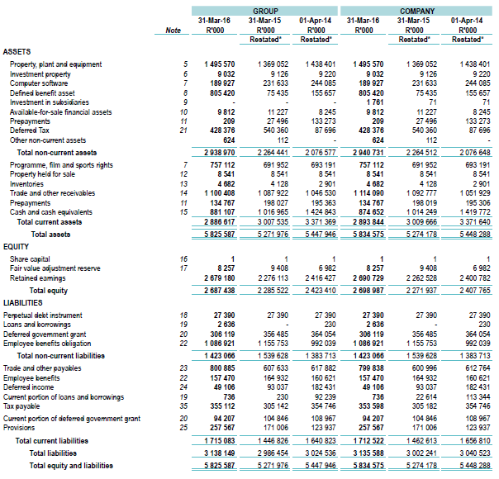
STATEMENT OF FINANCIAL POSITION 31 MARCH 2016

Slide 23
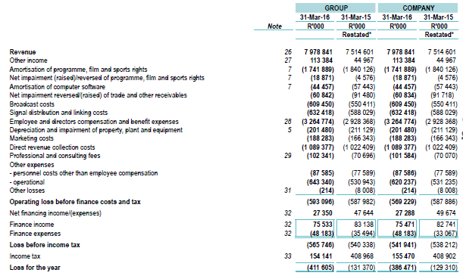
STATEMENT OF FINANCIAL PERFORMANCE 31 MARCH 2016

Slide 24
AUDITOR GENERAL REPORT
The audit opinion for the past three years moved from a disclaimer in 2013 to a qualified audit over the past three years. The SABC made remarkable progress this year in clearing three qualification issues from the prior year. It is currently remaining with a qualification on Irregular Fruitless and Wasteful Expenditure.
The SABC remains committed to resolving the remaining qualification paragraph in the next financial year by building on the work performed in the 2015/16 financial year, to effectively managing its expenditure as well as improving the revenue collection model across all revenue streams.

Slide 25
ANALYSIS OF SABC AUDIT OPINIONS
 | 2011 | 2012 | 2013 | 2014 | 2015 | 2016
Audit Opinion | Qualified | Qualified | Disclaimer | Qualified | Qualified | Qualified
Movement
Number of paragraphs | 1 | 1 | 9 | 8 | 3 | 1
Status | Regression | Constant | Regression | Improved | Improved | Improved
IMPROVED FINANCIAL MANAGEMENT

Slide 26
2016 AUDIT OPINION
AREA QUALIFIED | 2015 | 2016
Licence fees and receivables | ✓ | ✓
Deferred tax, tax payable and income tax | ✓ | ✓
Irregular, fruitless & wasteful expenditure | ✓ | ✓
Symbol | Explanation to symbols
✓ | Previous year’s qualification in process of being cleared
✓ | Previous year’s qualification successfully resolved

Slide 27
AWARDS AND ACHIEVEMENTS

Slide 28
ACHIEVEMENTS AND AWARDS
During the year under review, the public broadcaster won many of the most prestigious awards and received numerous accolades , thereby confirming its status as South Africa's top broadcaster.
RADIO
35
TELEVISION
42
NEWS
4
SPORT
7
Details of Achievements and Awards on pages 64 & 65.

Slide 29

TRANSFORMATION
ENTERPRISES DEVELOPMENT
SOCIAL RESPONSIBILITY

Slide 30
TRANSFORMATION
The SABC’s strategic approach and improved reporting has resulted in the organisation maintaining its Level 2 BBBEE compliance. This is attributed to the number of black participants at Board level as well as at the senior and middle management levels. The organisation views transformation as a strategic initiative which is depicted in the corporate plan.
INDICATOR | Compliance Target | Achievement
All Suppliers
BBBEE Procurement Spend from all suppliers based on the BBBEE Procurement Recognition Levels as a % of Total Measured Procurement Spend. | 50% | 100%
Qualifying Small Enterprise/ Exempt Micro Enterprise (QSE/EME)
BBBEE Procurement Spend from QSEs or EMEs based on the applicable BBBEE Procurement Recognition Levels as a % of Total Measured Procurement Spend | 12% | 40%
50% Black-Owned Suppliers
BBBEE Procurement Spend with suppliers that are 50% black owned as a % of Total Measured Procurement Spend | 9% | 39%
30% Black Women-Owned Suppliers
BBBEE Procurement Spend with suppliers that are 30% black women-owned as a % of Total Measured Procurement Spend | 6% | 19%

Slide 31
ENTERPRISE DEVELOPMENT INITIATIVES
SABC BEAUTY SALON
Atlegang CC is a small company owned by Ms Lebo Mboni operating within the SABC and providing all beauty-related services. The business has been gradually growing and her clientele now includes both SABC personnel and contracted production companies. This service was identified as an expedient means to develop upcoming black enterprises and has created employment opportunities for the unemployed youth.
FRESHLY WATER
Sikho Mobiles CC is a holding company of the Freshy Water brand which is a 100% black-owned company operating under the approved trademark of Freshy Water. Their mission is to provide premium-quality drinking water. In 2015, this entity was identified as the enterprise development beneficiary to supply drinking water to the SABC.
VICHIL CAR WASH SERVICE
In 2009, the BEE and Equity Development (ED) Unit assisted two previously disadvantaged individuals who were running the car wash company in the absence of the owner. These individuals were guided and assisted to register their own company, namely, VICHIL Car Wash Service. It is thus a 100% black-owned and 50% black woman-owned company fully capable of executing its services.
During the year under review, the SABC actively supported the development of the following enterprises through various enterprise development initiatives:

Slide 32
SOCIAL RESPONSIBILITY
During the period under review, SABC platforms and Divisions carried out their corporate social responsibility, socio-economic programmes and campaigns in partnership with the SABC Foundation.
SOCIO-ECONOMIC DEVELOPMENT
Support for education programmes, resources and materials at primary, secondary and tertiary education levels, as well as bursaries and scholarships
Community training, skills development for unemployed people and adult basic education and training
Development programmes for women, youth, people with disabilities and people living in rural areas;
Support of healthcare and HIV/AIDS programmes

Slide 33
SOCIAL RESPONSIBILITY
The SABC Radio Stations implemented individual socio-economic programmes in conjunction with the SABC Foundation. Examples of these programmes implemented during the year under review are detailed on pages 72 – 78 in the Annual Report.
Education
Disability
Nelson Mandela Day
Healthcare & HIV AIDS
Development
Women’s Month: Strong Girl Campaign
Public Service Announcements
Child-headed Households
Supporting the Elderly

Slide 34
PERFORMANCE AGAINST PREDETERMINED OBJECTIVES

Slide 35
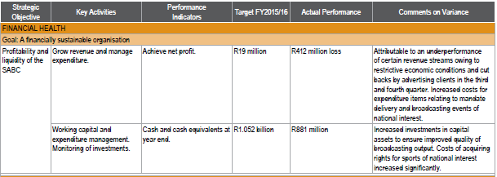
PERFORMANCE AGAINST PREDETERMINED OBJECTIVES

Slide 36
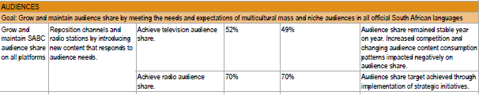
PERFORMANCE AGAINST PREDETERMINED OBJECTIVES

Slide 37
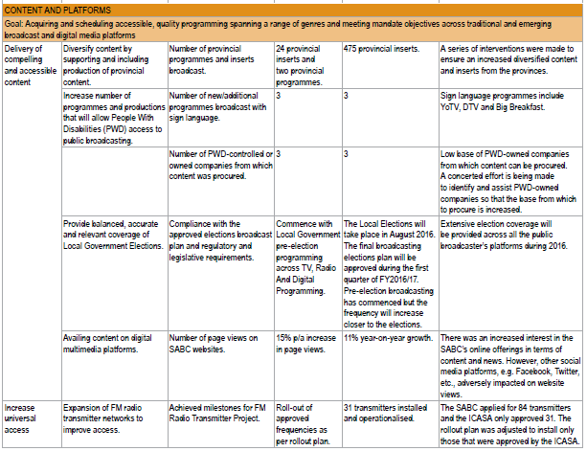
PERFORMANCE AGAINST PREDETERMINED OBJECTIVES

Slide 38
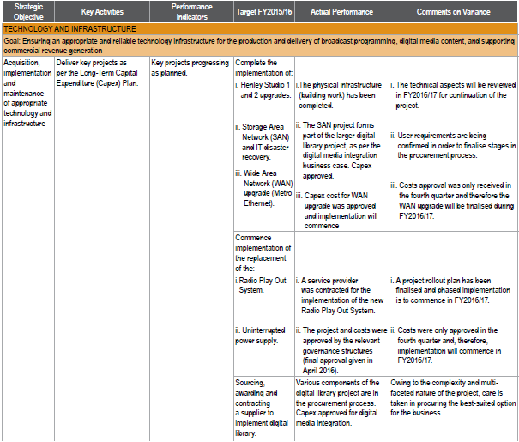
PERFORMANCE AGAINST PREDETERMINED OBJECTIVES

Slide 39
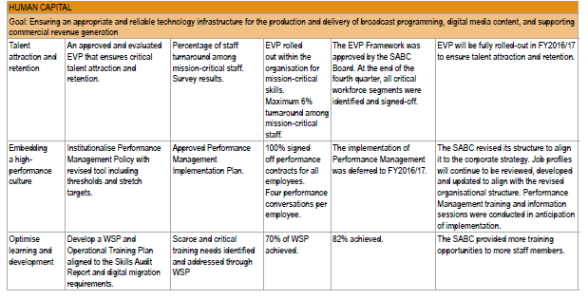
PERFORMANCE AGAINST PREDETERMINED OBJECTIVES

Slide 40
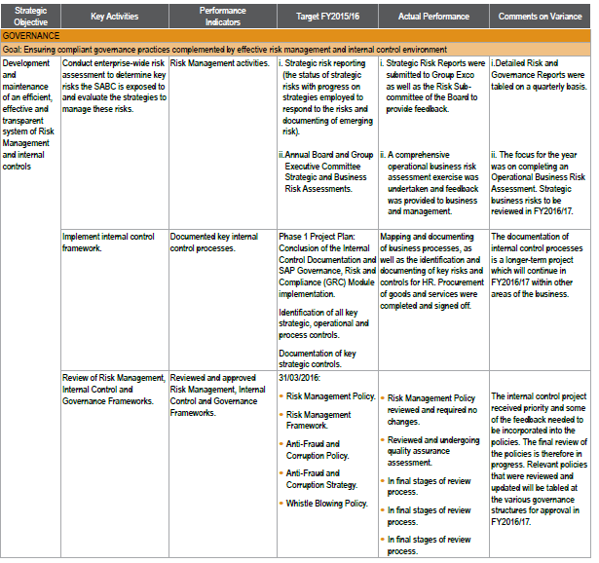
PERFORMANCE AGAINST PREDETERMINED OBJECTIVES

Slide 41
THANK YOU

