Slide 1
PORTFOLIO COMMITTEE MEETING PROGRESS ON THE IMPLEMENTATION OF THE CURRICULUM AND ASSESSMENT POLICY STATEMENT (CAPS) Dr MJ Maboya Deputy Director-General: Curriculum Branch 28 FEBRUARY 2017

Slide 2
PRESENTATION OUTLINE
1.1. Purpose
1.2. Background and Context
1.3. Progress
1.4. Successes
1.5. The New Emerging Challenges in CAPS
Implementation
1.6. Plans to deal with Curriculum and Assessment
Overload 1.7. Recommendations

Slide 3
1.1 PURPOSE
To present to the Portfolio Committee a progress report on the implementation of CAPS.

Slide 4
1.2. BACKGROUND AND CONTEXT

Slide 5
1.2.1. THE RATIONALE FOR CAPS
Challenges on the implementation of the National Curriculum Statement including:
Overload and administrative burden;
Unclear on what and how to teach & to assess
Learner underperformance in international and local assessments; etc.
Minister appointed a Task Team to review the implementation of the NCS (July 2009).

Slide 6
1.2.3 THE MINISTERIAL TASK TEAM (MTT)
Terms of Reference of the Task Team
Key areas investigated
Identify challenges and pressure points in the implementation of the NCS Grades R-12;
Investigate how challenges could be addressed; and
Develop a set of practical interventions to respond to the noted challenges.
Curriculum policy and guideline documents;
Transition between grades and phases;
Assessment, particularly SBA;
LTSMs, particularly textbooks; and
Teacher support and training (for curriculum implementation).

Slide 7
1.2.3 KEY FINDINGS AND RECOMMENDATIONS
FINDINGS | RECOMMENDATIONS
A plethora of policies, guidelines and interpretations of policies and guidelines – often with discrepancies and repetitions. | Develop one Curriculum and Assessment Policy Statement (CAPS) for every subject (by phase). i.e. Streamline and clarify policies.
Complicated planning requirements and administrative burdens of teachers make little contribution to improving learner attainment. | Reduce teachers’ workload particularly with regard to administrative requirements and planning. i.e. Allow more time for teaching. CAPS to indicate sequencing, pacing, hence make planning easier.

Slide 8
KEY FINDINGS AND RECOMMENDATION
FINDINGS | RECOMMENDATIONS
Current teacher development policies to support the curriculum are often too generic and superficial and do not provide the needed support to teachers – a ‘one size fits all approach’; and many newly trained teachers are not competent to teach the curriculum. | The training of teachers to support curriculum implementation should be subject specific and targeted only where needed. AND All support staff, including school management, subject advisors and district officers, should also undergo training on the CAPS.

Slide 9
KEY FINDINGS AND RECOMMENDATIONS
FINDINGS | RECOMMENDATIONS
Especially in the GET, a new assessment policy was never developed to support the NCS. As a result, teachers and parents are confused about several aspects of assessment. | Simplify and streamline assessment requirements and improve the quality and status of assessment by: making the GET and FET phases consistent; conducting regular national systemic assessment at Grades 3 and 6; and replacing the CTAs with ANAs for all Grade 9 learners in Mathematics, Home Language and English.

Slide 10
KEY FINDINGS AND RECOMMENDATIONS
FINDINGS | RECOMMENDATIONS
Subject Advisors act as intermediaries between curriculum policy and implementation and yet their roles differ from province to province. AND They are too few nationwide to do justice to thorough and qualitative in-class support to teachers. | Clarify Subject Advisor roles nationally. i.e. Specify the exact nature of in-classroom and school support they should provide to teachers.

Slide 11
KEY FINDINGS AND RECOMMENDATIONS
FINDINGS | RECOMMENDATIONS
Teachers expected to develop learning materials (eroding their time for teaching), undermining the textbook as the most effective tool to ensure consistency, coverage, and better quality. | Centralise (National) the quality assurance and catalogue development for textbooks and other LTSM; and each learner from Grade 4 to Grade 12 should have a textbook for each subject.

Slide 12
KEY FINDINGS AND RECOMMENDATIONS
FINDINGS | RECOMMENDATIONS
There are too many subjects in the I/Phase, where learners shift from 3 LAs in Grade 3 to 9 in Grade 4. | Reduce the number of LAs in the I/Phase to 6 subjects, including 2 languages.
Most provinces only introduce English as a subject in Grade 3 and not in Grade 1 as suggested in the NCS | Introduce English FAL in Grade 1.

Slide 13
1.2.4 CAPS IMPLEMENTATION PLAN
2011 Prepare the system for introduction of the CAPS
2012 Grades R – 3 and Grade 10
2013 Grades 4 – 9 and Grades 11
2014 Grade 12

Slide 14
CAPS IMPLEMENTATION… cont.
One Curriculum and Assessment Policy Statement (CAPS) for every subject developed (Grade R – 12);
CAPS indicate sequencing, pacing, content and assessment per subject;
Subject specific training of teachers offered to support curriculum implementation (40 hours per year of implementation).

Slide 15
CAPS IMPLEMENTATION… cont.
Assessment requirements simplified and streamlined;
Quality and status of assessment improved by making the GET and FET phases consistent;
National catalogue developed of approved CAPS aligned LTSM per subject per grade (Grade R – 12).
Exemplar question papers developed and distributed to support implementation.
Progression regulated in grades 10 – 12.

Slide 16
1.3. PROGRESS

Slide 17
PROGRESS
Continuous Teacher development: New topics; challenging content and School Based Assessment;
LTSM: National catalogue and Sector plan developed and implemented;
Introduction of English FAL in Grade 1.
Strengthening Languages and Mathematics: DBE workbooks developed and distributed annually (Grade R – 9);
Reconfiguration of the Maths, Science and Technology (MST) Grant to support all MST subjects;
Item bank development to support teachers with assessment tasks

Slide 18
PROGRESS…continued
Promoting Access and Inclusivity:
Screening Identification, Assessment and Support Policy;
Sign Language Implementation;
Technical Vocational curriculum;
Technical Occupational curriculum;
Curriculum for Profoundly Intellectually Disabled;
Development of State Owned Textbooks: Grades 10 and 11 Mathematics and Physical Sciences Siyavula Textbooks.

Slide 19
1.4. SUCCESSES

Slide 20
SOUTHERN AND EASTERN AFRICA CONSORTIUM FOR MONITORING EDUCATIONAL QUALITY (SACMEQ)
20

Slide 21
WHAT WAS THE SITUATION AND HAVE WE MOVED SINCE 2007? Significant
 | Reading score |  | Mathematics
 | 2000 | 2007 | 2000 | 2007
1. Mauritius | 536 | 574 | 585 | 623
2. Kenya | 547 | 543 | 563 | 557
3. Tanzania | 546 | 578 | 522 | 553
4. Seychelles | 582 | 575 | 554 | 551
5. Swaziland | 529 | 549 | 517 | 541
6. Botswana | 521 | 535 | 513 | 521
7. Zimbabwe | 504 | 508 | ** | 520
8. South Africa | 492 | 495 | 486 | 495
9. Zanzibar | 478 | 534 | 478 | 486
10. Mozambique | 516 | 476 | 530 | 484
11. Uganda | 482 | 479 | 506 | 482
12. Lesotho | 451 | 468 | 447 | 477
13. Namibia | 449 | 497 | 431 | 471
14. Malawi | 429 | 434 | 433 | 447
15. Zambia | 440 | 434 | 435 | 435

Slide 22
TRENDS IN INTERNATIONAL MATHEMATICS AND SCIENCE STUDY (TIMMS)
22

Slide 23
Change in achievement between 2003 and 2015
SA has shown the largest improvement-
87 points in math
90 points in science

Slide 24
NATIONAL SENIOR CERTIFICATE (NSC)
24

Slide 25
NSC PERFORMANCE: 2010 TO 2016
17
Notes:
Drop 2015 number of factors
2016 first year of upper trajectory
We are a system on the rise

Slide 26
1.5. THE NEW EMERGING CHALLENGES IN CAPS IMPLEMENTATION

Slide 27
THE NEW EMERGING CHALLENGES IN CAPS IMPLEMENTATION
Despite interventions some challenges remain persistent, including:
content overload and curriculum coverage;
quality of formal assessment tasks;
Understanding of the use of cognitive levels;
forms of assessment;
weighting of assessment with regards to time and marks.
Accommodation and concessions as a principle in the CAPS
Teaching for assessment not mastery;
Reading levels of learners;
Development of 21st century skills.

Slide 28
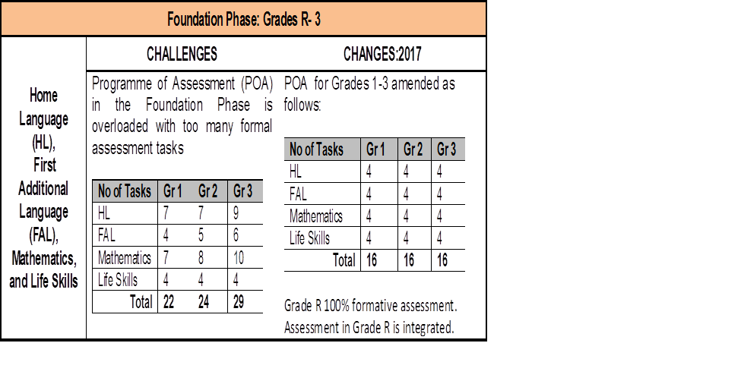
EXAMPLE- OVERLOAD OF ASSESSMENT TASKS

Slide 29
1.6. PLANS TO DEAL WITH CURRICULUM AND ASSESSMENT OVERLOAD

Slide 30
FUTURE PLANS: SHORT TERM (2017)
Assessment tasks per subject: number, weighting in terms of time and mark allocation;
Specification of Forms / Type of assessment tasks;
Cognitive levels and difficulty levels within the cognitive levels;
Editorial corrections;
Examination guidelines; and
Accommodation and concessions as a principle in the CAPS

Slide 31
FUTURE PLANS : MEDIUM TERM(2018-2020): FOCUS AREAS
Mathematics in the Foundation Phase (Language vs Mathematical Concepts)
Strengthening content in Life Orientation and re-packing of FET Curriculum
Inclusion of the skills curriculum (Three Steam Model)
Include accommodation and concessions as a principle in the CAPS
The depth and breadth of content in the CAPS (Repackaging)
EMS: Accounting weighting from 40% to 50%
Scaffolding: Smooth transition from one phase to another iro content, aims, & skills in the CAPS: Section 2, 3 and 4
ICT/CAT: New and emerging trends and technologies
Pass requirements in the Senior Phase (SP)
NCS Examinations: Two papers –Business Studies, Accounting.
The National Integrated Assessment Framework

Slide 32
FUTURE PLANS :LONG TERM (2020 – 2030)
Compulsory offering of History
Transition to Grade 4 : Subject specialisation in Grade 3
CAPS: Two subjects – Chemistry and Physics
Decolonisation of the CAPS – KiSwahili, Indigenous Knowledge systems and practices etc.
Teaching and Learning in Mother tongue from Intermediate Phase
Research on curriculum design and development
Multi-grade core curriculum
Review of School Calendar days and compulsory teaching time.

Slide 33
FUTURE PLANS …continued
Strengthen feedback on tracking learner performance in Grade 3, 6, 9 and FET on SASAMS to generate the required data
Orientate provincial and district advisors on the use of SASAMS
NSLA reporting tool revised to include actual data on learner attainment in Grade 3, 6 and 9
Strengthening CAPS 2018 to 2020: Implementation and mediation of medium and long-term implications
Strengthen monitoring, evaluation and verification processes in 2017.

Slide 34
1.7. RECOMMENDATION
It is recommended that the Portfolio Committee discusses the progress report and provide inputs to strengthen implementation.

