Slide 1
Department of Higher Education and Training
Resulting and Certification
Presentation to the Portfolio Committee on Higher Education and Training
22 February 2017

Slide 2
Introduction
The Department may only process raw subject marks and release subject results where-
the capture rate meets the required 95% nationally
overall capture rate of raw marks in a subject meets the required 80% for an examination centre
For smaller cohorts of students (i.e. 1-14) the capture rate meets the required 100%
The Department relies on examination centres to submit all raw marks for-
Integrated Summative Assessment Task (ISAT – applicable to NC (V) only)
Internal Continuous Assessment (ICASS) – applicable to NC (V) and NATED
External Examination where marking takes place internally, i.e. NC (V) Levels 2 and 3 and Report 190/1 Engineering Studies N1.

Slide 3
Introduction
The Department relies on national and provincial marking centres which are under the supervision of CDNEA to submit all raw marks for External Examination where marking takes place externally, i.e. NC (V) (i.e. Level 4) and Report 190/1 (i.e. N2-N6)
It is also expected of all centres (examination and marking) to capture and submit the raw marks they generate in the assessment / marking process in an electronic format to CDNEA

Slide 4
Resulting Process
Examination centres submit raw marks in TXT file format generated on their own individual IT systems which are required to generate data in a format prescribed by CDNEA and marking centres via a customised capturing tool provided by CDNEA
CDNEA officials upload the data received from examination and marking centres directly onto the national examinations IT system
The raw data as submitted by centres is not manipulated in any way by CDNEA officials in the uploading process so the electronic raw mark TXT data files are therefore deemed an accurate record of the actual raw marks submitted per component by each centre.
Separate TXT data file is submitted per component (ICASS/ISAT/EXAM) by examination centres

Slide 5
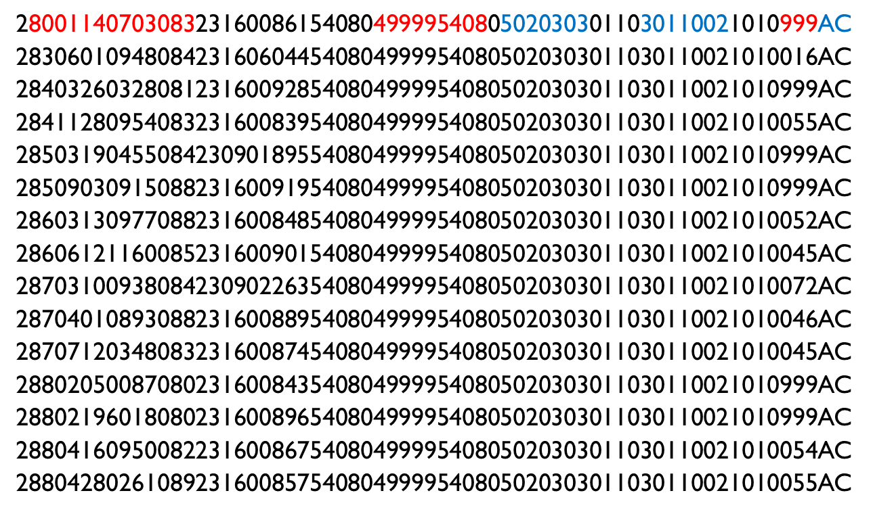
Extract from Txt Data File Submitted by Exam Centre for Exam Marks for 201611

Slide 6
Resulting Process
Standardisation process applied as per directives of quality council to combine raw marks to generate a subject result
Resulting data verified and approved for release by quality council
Consolidated Schedule of Results released to examination centres via email
Individual Statement of Results dispatched to examination centres
Certificates processed and issued 3 months post the publication of results

Slide 7
Resulting process
NOTE:
All examinations data (registration and raw marks) is captured / uploaded onto national examinations IT system
SITA is responsible for the programming, maintenance and enhancement of IT system which involves processing of raw marks to arrive at subject results as well as consolidation to arrive at certificates
CDNEA officials apply and use functionality on the IT system
All data is verified and approved for release by the quality council

Slide 8
Reasons for Non-release
The Department may not release results for the following reasons:
irregularity reported during conduct of examinations impacts on the overall integrity of subject, e.g. suspected leakage. In this instance, the results for affected subjects are released as soon as investigations there into have been concluded.
candidate has been alleged to have engaged in an act of honesty during examination, e.g. copying, ghost writing, and crib notes. In accordance with national policy 21 days is allowed for candidate to be informed of alleged irregularity post resulting and a final decision on the candidate’s status (guilty / not guilty) is made by the National Examinations Irregularities Committee on basis of reports and evidence submitted and investigations where required. In such instances, results for affected candidates are only released where a candidate has been found not guilty.

Slide 9
Reasons for Non-release
Candidates who wrote November 2016 examinations without complying with the minimum examination admission requirements as indicated in Memorandum 46 of 2015 – 80% attendance and ICASS sub-minimum. These candidates are reflected as MQ in the Schedule of Results released to centres and will therefore not receive a subject result for the affected subject(s) at all as resulting is deemed complete in such instances.
Colleges allowed candidates to write national examinations and need to explain to candidates why they will not get resulted. Some colleges have admitted to allowing candidates to write to avert rioting and disruption of examinations at their campuses. Several colleges requested a concession to ignore the examination admission requirements but no concessions were granted in this respect.

Slide 10
Reasons for Non-release
Despite the instruction in Memorandum 46 of 2015, a significant number of candidates who did not meet the requirements were allowed to write the November 2016 examinations, which shows that colleges failed to properly manage the implementation of the minimum examination entry requirements.
The raw examination marks presented to the quality council for standardisation subsequently excluded all of these candidates and displayed an upward trend in performance in many subjects on the levels on which the requirements were implemented across the TVET qualifications for the November 2016 examinations.

Slide 11
Reasons for Non-release
Where the examination centre has not submitted all the raw marks for all of the components of a subject. The collective capture rate for the ISAT (only applicable to NC (V)), ICASS and exam components is below 80% for a subject at an examination centre (i.e. marks outstanding – 777s) which means that the raw marks may not be processed to generate subject results. In instances where a centre submits an outstanding mark (777) the accompanying evidence (scripts, portfolios of evidence) must be verified by both the Department and the quality council before the raw marks can be captured and the results for the affected subjects / candidates be released.

Slide 12
Reasons for Non-release
Where an examination centre submitted incorrect raw marks and requests the amendment of a mark (i.e. 999s to a mark or change from the original mark submitted to another mark). In such instances the accompanying evidence (scripts, portfolios of evidence) must be verified by both the Department and the quality council before the raw marks can be amended and the results for the affected candidates be released.

Slide 13
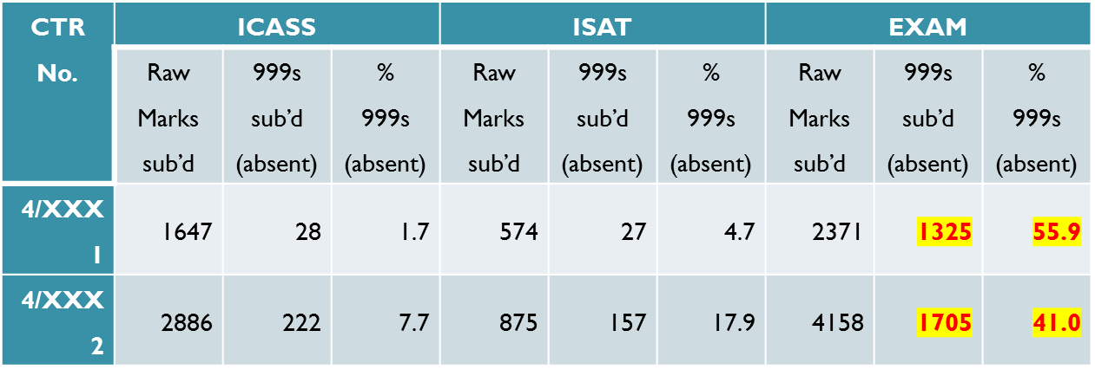
Incorrect Raw Marks
An extraordinarily high number of raw marks were incorrectly captured and submitted as 999s (absent) by the majority of the public TVET Colleges for the November 2016 examinations – this has been a trend across the past 3 cycles dating back to the November 2015 cycle.
Examples of 2 centres from 201611
Direct impact on the CERTIFICATION process, esp. 201511 & 201611

Slide 14
Incorrect raw marks
Process for resolving 777s (outstanding) and incorrectly captured marks (999s and other)-
Colleges where incorrect raw marks have been submitted are required to present said evidence to the Department for verification so that the Department can effect the correction of marks on the examinations IT system.
The quality council also has to participate in the verification of said evidence as it has to approve the amendment of raw marks post resulting before the Department may release amended results
This is a due process applied to protect the integrity of subject results and the qualification by ensuring that marks have not been fabricated / inflated
14

Slide 15
Incorrect raw marks
NOTE-
In several instances for the 201611 cycle several colleges adamant that the correct raw marks had been submitted, yet when the electronic TXT data files submitted by their examination centres were presented to said colleges it was clear that the error had originated at the examination centre during the capturing process and/or the processing of separate tasks into one consolidated ICASS mark and/or error on the part of the lecturer when transcribing a mark onto an official mark sheet.
From the reports received from colleges during the verification of evidence most colleges admit that the inaccuracies in the submission of raw marks is in general caused by a lack of or an ineffective data verification process at institutional level.
15

Slide 16
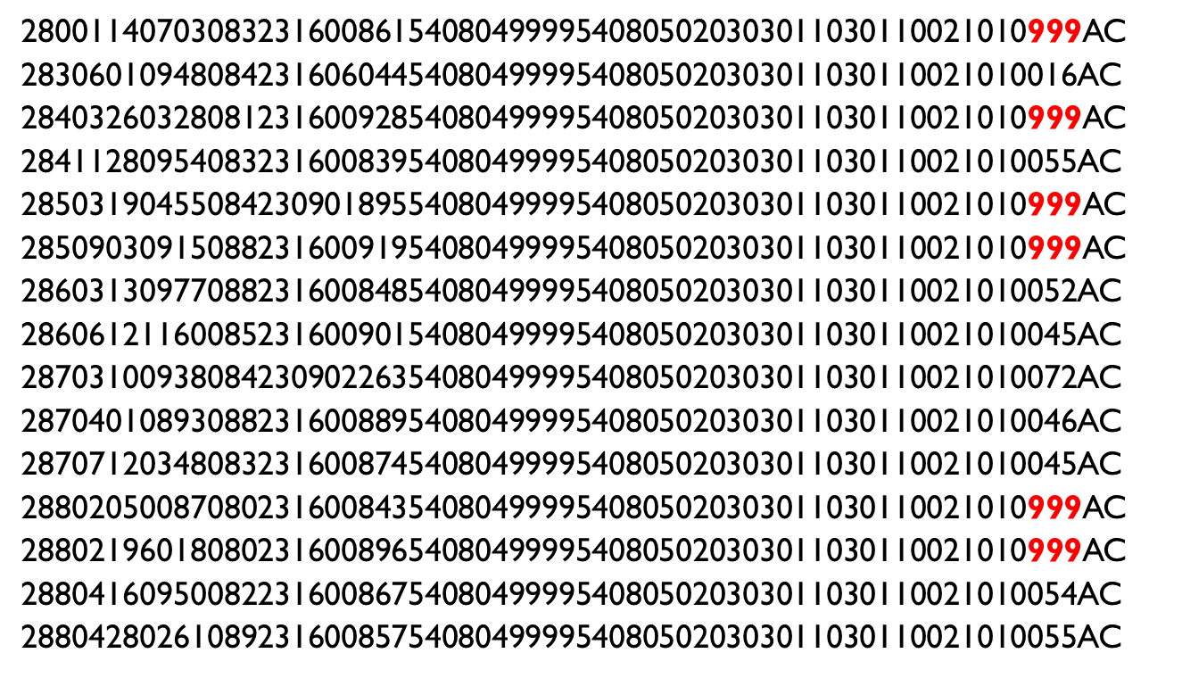
Example of Txt Data File Submitted by Exam Centre for Exam Marks for 201611
16

Slide 17
Gaps in 201611 Results
Outstanding ISAT/practical and ICASS/term marks (777s)
ISAT / ICASS / TERM marks submitted as 999s / 0
Incomplete mark sheets / Open spaces on mark sheets
Unmarked scripts
Repeat candidates not completing ICASS (NCV)
Unregistered students allowed to write without approval as late entries
Will not be resulted
Data processing errors leading to the generation of 999 / 777 as the final subject result
NOTE-
TWO underlying causes in 201611
Quality of raw data submitted by centres (incomplete and incorrect) = majority
Data processing errors on the examinations IT system = minority
17

Slide 18
Status of 201611 Results
Subsequent to the publication of results on 31 December 2016, further resulting runs have taken place for all TVET qualifications to fill gaps in results, the last being on 11 February 2017.
All amended results verified by 03 February 2017 and subsequently captured by 08 February 2017 were released to examination centres on 11 February 2017. The time lapse between the two processes (capturing and release) is due to the fact that the Department has to standardise and process the final subject results where raw marks were amended and then the quality council has to test the amended resulting data before the Department may draw the resulting data from the system and release the amended results to centres.
18

Slide 19
Status of 201611 Results
Where evidence was presented after 03 February 2017 the capturing of amended marks is scheduled to conclude on 16 February 2017 (extended period required due to volume of marks presented for amendment by centres after 03 February 2017) and a final resulting run will take place for the November 2016 examinations on or before 22 February 2017.
19

Slide 20
Way Forward
No results in future to be released unless there is 100% compliance by Colleges.
Analyses being undertaken in regards to the quality of data by Colleges and consequence management to be instituted.
Principal as the accounting officer to be appointed as Chief Examinations Officer for the college-
Oversight of all assessment practices and services across all exam centres belonging to the college
Maintenance of a fully functional IT system and verification of all raw data prior to submission to CDNEA
Establish and maintain an institutional assessment committee
20

Slide 21
Way Forward
Policy guidelines for Principals on management of the whole examination process.
Institutional Assessment Committee = accountability mechanism
Implementation of new examinations IT system.
Reconciliation of November 2016 results – see separate attachment
21

Slide 22
Thank You

