Slide 1

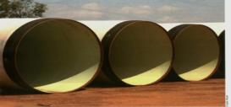
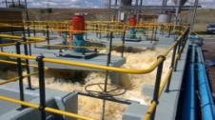
Rand Water
Integrated Results
For The Year Ended 30th June 2016

Slide 2
Rand Water Strategy
Rand Water Key Strategic Themes
Rand Water’s Vision
Key Strategic Themes
High Performance Culture Pillars
To be a provider of sustainable, universally competitive water and sanitation solution to Africa
Achieve growth
Organisation Culture and Values
Rand Water’s Mission
Achieve operational integrity and use best fit technology
Organisational Performance
The Mission of Rand Water is to deliver and supply world-class affordable, reliable, and good quality water and related services to all stakeholders through:
Safe, efficient, transparent, sustainable and innovative business practices;
Empowered employee;
Mutually beneficial strategic relationships;
Legislative compliance and best practice
Achieve a high performance culture
Capacity Building
Positively engage with stakeholder base
Maintain financial health and sustainability
ROI
And it can only be achieved through effective management of organisational performance
2

Slide 3
Added Value
RELIABILITY OF SUPPLY
Met peak daily demands and abided to Bulk Water Supply Contracts
OCCUPATIONAL, SAFETY, HEALTH & ENVIRONMENT
Embedded in our project management processes
BLUE DROP CERTIFICATION
Increased awards during the year & special recognition for helping Municipalities
achieve their Blue Drop Status
QUALITY MANAGEMENT SYSTEMS
MAINTAINED CERTIFICATION
Corporate ISO 9001:2000 - OHSAS 18001:2007 - Laboratories ISO 17025 - Corporate ISO 14001:2004
PRODUCT QUALITY
Product Quality - Consistently maintained the national drinking water standard and
delivery to customers on the SANS 241 Class 1 and 2 specification.
IMPROVEMENT IN DIFR FROM 0.28 to 0.24
3

Slide 4
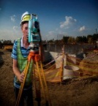
Regulatory Framework
Added Value
UNQUALIFIED AUDIT OPINION
CUSTOMER CENTRIC APPROACH SATISFACTION RATE OF 83.2%
ACHIEVED 87.5 % OF PERFORMANCE TARGETS AS SET
OUT IN THE SHAREHOLDERS COMPACT
ATTAINED BBBEE of 93.3% AGAINST TARGET OF 85%
JOB CREATION
312 permanent & contract & 5 858 direct/Indirect temporary jobs created
FINANCIAL CAPITAL
Strong improvement in operating margins and returns in
excess of the weighted cost of capital
EMPLOYEE ENGAGEMENT
Improvement in employee engagement from 66% to 71%
Rand Water Foundation – Internal funding (R62.6 million) and External funding (R10.9 million)
4

Slide 5
Performance Snapshot
Skilled and capable workforce: Rand Water Academy, Capacity building and Job creation
Environmental: Blue & Green drop standards achieved, Environmental conservation programs; Water Catchments, Wetland rehabilitation
Economic: YOY increases; Revenue 12%, Gross income 25%, Net income 51%, Cash from operations 47% and Capital expenditure 16% growth
Efficient local government system: Rand Water Mpumalanga
A long and healthy life for all South Africans - Uninterrupted supply of quality water for over 24 hours. System stabilised and energy management initiatives enhanced after the interruptions experienced in September 2014.
Enhanced quality and quantity of water resources; Water demand management and Acid mine drainage
R3.3 bn spent on ensuring the maintenance and supply availability of our bulk water infrastructure
Implemented projects amounting to R1.4 bn on behalf of National Departments & Local Authorities
Social: Continuous Water supply, Sanitation solutions, RWA, RWF & CSR initiatives as well as job creation and capacity building.
Implementing Agent on behalf of Municipalities or Government Departments
Institutional Realignment
Triple Bottom line
Presidential Outcomes
Shareholder Compact
5

Slide 6
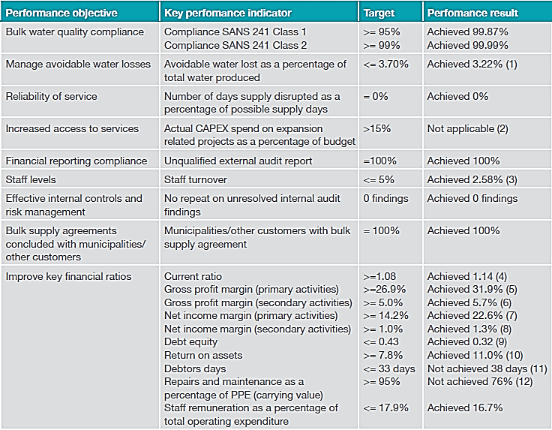
Key Performance Indicators
6

Slide 7
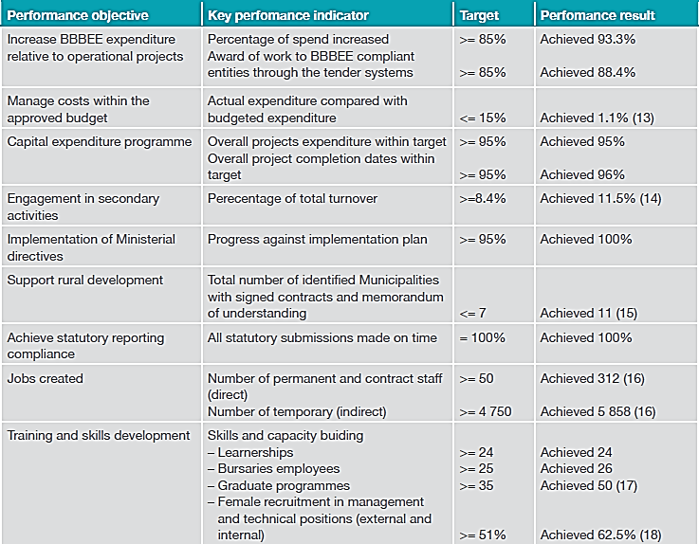
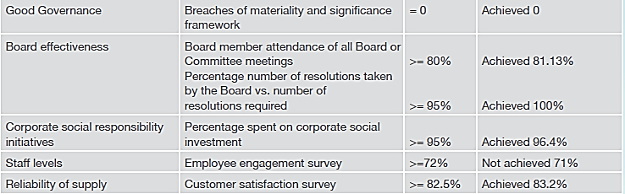
Key Performance Indicators
7

Slide 8
IRREGULAR, FRUITLESS AND WASTEFUL EXPENDITURE AND CRIMINAL CONDUCT
For the year under review the Group recorded R6.066 million worth of expenditure incurred as a result of irregular expenditure and R15 thousand worth of fruitless and wasteful expenditure. No material cases of criminal conduct has been recorded for the year. Approximately R14.7 million worth or irregular expenditure incurred in prior years has been condoned in the current financial year. The Group is in the process of obtaining approvals for the condonation of the remaining balance of R8.2 million for irregular expenditure incurred in prior years.
Irregular expenditure : R6.066 million
Details of the current financial year movement is as follows:
Work awarded to supplier in contravention of CIDB regulations R2.5 million:
During the year, work to the value of R10.5 million was awarded to a supplier who was two levels beneath the CIDB limit for award. The expenditure incurred for the year in respect to the contract is R2.5 million.
Status: The irregular expenditure is in the process of being condoned. Disciplinary action has been taken and the SCM structure has been strengthen as per Board approval. The organisation has further planned continuous training by National Treasury.
Travel reimbursements claimed by employees in contravention of Income Tax Act R146 thousand
During the financial year six employees claimed travel from home to work in contravention of the organisation’s policies and the Income Tax Act.
Status: The organisation has initiated its disciplinary and recovery process accordingly. The organisation will thereafter request the necessary condonation.
Supply Chain related non-compliance R3.4 million
During the financial year the organisation identified certain supply chain non-compliances related to invalid tax clearance certificates, BBBEE certificates and the process adopted for obtaining quotations.
Status: The organisation is in the process of investigating the matter. Disciplinary action has been taken and the SCM structure has been strengthen as per Board approval. The organisation has further planned continuous training by National Treasury.
Rand Water is guided by the Updated Guidelines on Irregular Expenditure issued by National Treasury in April 2015 and the internal Fruitless, Wasteful and Irregular Expenditure Management Framework. In line with those documents Rand Water undertakes a comprehensive investigation on all Irregular Expenditures. The report on the investigation will determine the corrective action required which may entail disciplinary action, recovery of the amount, criminal action or any other. As part of the internal process, the Irregular Expenditure report is then submitted to Executives, Audit Committee and Board. In line with legislation Rand Water has to submit all irregular expenditures for condonation to the National Treasury. The current irregular expenditures have been investigated internally and the organisation is implementing the action as per the investigation reports. The irregular expenditure will thereafter be submitted to National Treasury for condonation.
8

Slide 9
IRREGULAR, FRUITLESS AND WASTEFUL EXPENDITURE AND CRIMINAL CONDUCT
NATIONAL TREASURY AND PFMA COMPLIANCE REQUIREMENT - THEFT AND LOSS REGISTER
Since the 2015/2016 Financial year, National Treasury regulations dictate that the Organization must maintain a Theft and Loss Register that have be reported on quarterly to the PIC, Board Risk and Audit Committees.
The Register has been developed and the Group Governance Portfolio compile, maintain and report on it as directed.
For the year under review the organization opened 5 criminal cases after internal investigations were initiated into allegations received or control measures detected transgressions.
Total losses R2 953 748
Recoveries to date R1 453 798
Losses recovered through civil litigation or direct recoveries.
None of the criminal offences registered resulted in material losses that breached the organization’s materiality and significance framework
PROCUREMENT AND CONTRACT MANAGEMENT
Contracts were awarded where, in certain instances the following were not complied with :
  The supply chain management policies and processes
  PFMA and CIDB Regulations
9

Slide 10

Contribution to Government & Minister’s Performance Agreement
Outcome 5: SKILLS - A skilled and capable workforce to support an inclusive growth path
Rand Water Academy
15000 UNEMPLOYED YOUTH (ARTISANS & PLUMBERS)
2015
Training starts
2015 – 2020
Training / Placements – Water Agents
Training
2015 – 2020 Training / Placements – Artisans / Plumbers
Sustainability
Phase 1 : September 2015; 3000 students
Phase 2 : August 2016 ; 7000 students
Phase 3 : April 2017 ; 5000 students
  National Training Rollout
  Artisans / Plumbers to attend national curriculums at TVETS
  Water Agents attend unit standards based class room training
  Training Venues in all 9 provinces
RW Academy
    Continuation of the National treasury Graduate internship programme, and the Rural 40 project.
    Implementation of the National War on Leaks project
    Graduate intern programme for Ditsobotla & Western area
10

Slide 11
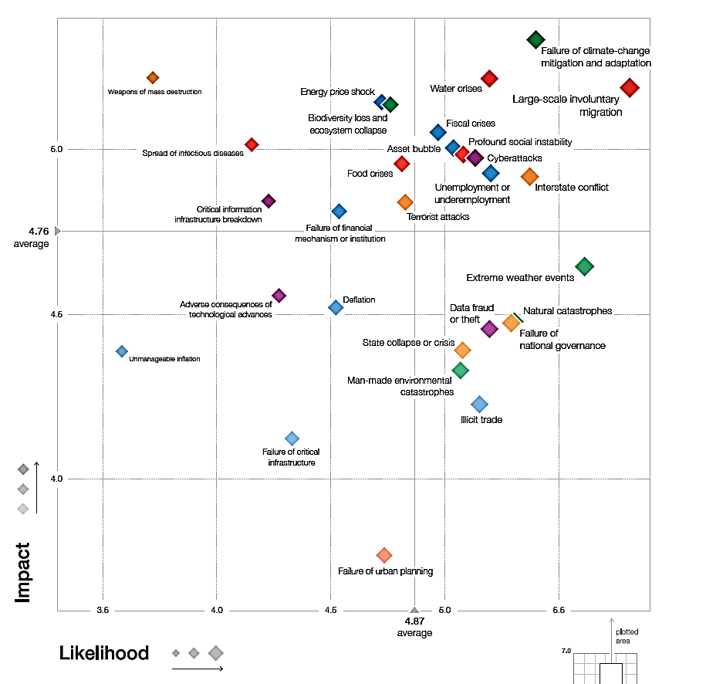
Rand Water And The Drought Situation
World Economic Forum Global Risk Analysis Report sheds light on global risks and developments
  It creates a shared understanding of the most pressing issues confronting the world
  Converts these global risks into country, government, entity and community risks
  Combines and aggregates from – the - bottom shared solutions
The impact of the 2015-16 ENSO – El Nino Southern Oscillation is one of the strongest on record resulting in the highest temperatures & lowest rainfall experienced.
The following are some of the actions taken to assist in addressing the challenges the drought is imposing:
15% cut in water supply
Water Restrictions
Penalties
Communication/Media
Educating the public on the current challenges and its implications
Water crises rank among the highest risks
Given the uncertainties Rand Water has reviewed its operational & Capex plan for the 15% reduction in water supply
CAPEX, operational and funding budgets have been revised
The revised budget and plan is based on the assumption that the 15% reduction in volumes is the new sustained volume base, growing on average at 1.75% per annum over the 5 year period
11

Slide 14
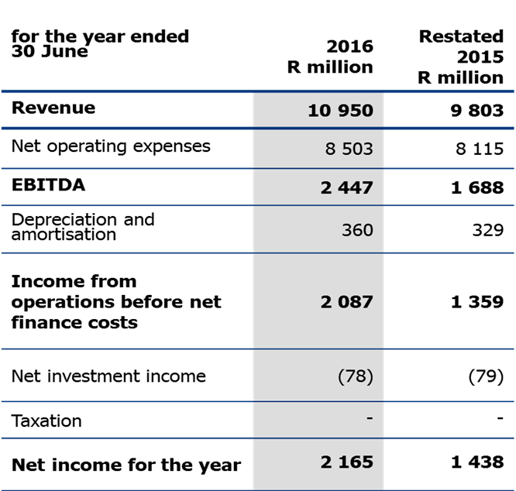
Consolidated Income Statement
2016
41%
21%
14

Slide 15
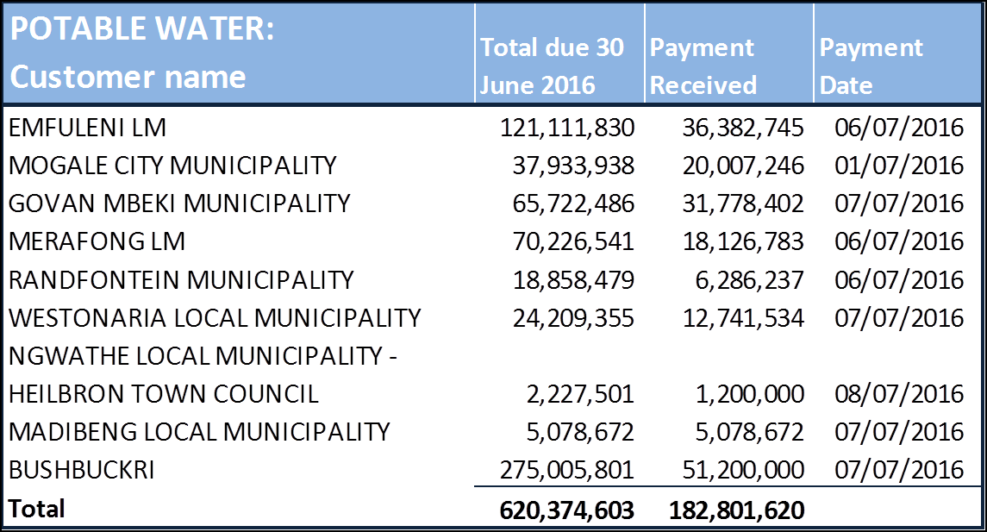
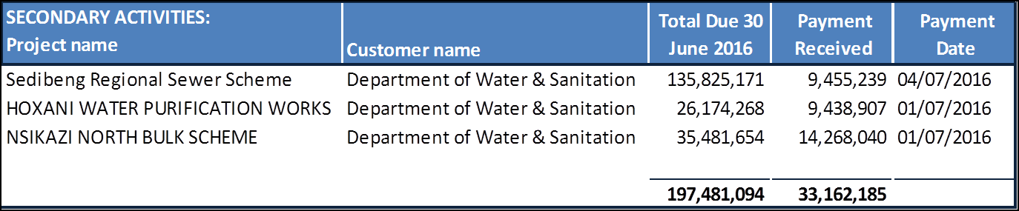
Default Debtors as at 30 June 2016
15

Slide 16
Default Debtors to date
16

Slide 17
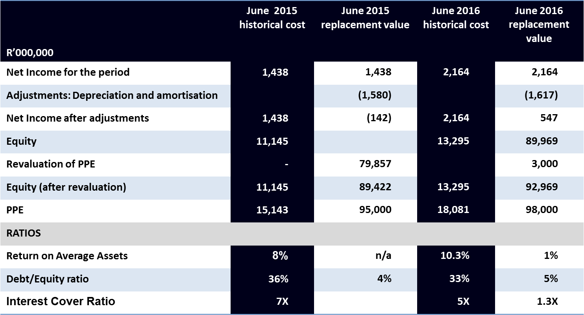
Analysis of Capital Expenditure
Asset Base Analysis And Cost Breakdown
Capital expenditure 2015/16
R2.7 billion
*Excluding borrowing costs
5-year Capital expenditure 2017 to 2021
R 16.8 billion
The application of the replacement value method has a direct impact on tariffs.
The replacement value used is an estimate.
17

Slide 24
Rand Water – Value Optimisation
Innovation & Piloting
New Business Development
Augmentation, Rehabilitation Projects
Co-generation
Sanitation
Operating Model Review
Advisory and O&M Support
Institutional Alignment
Business is gearing up for growth
Optimising & capacitating internal business processes
Optimising business infrastructure
Ensuring that human resources are ready
Playing a strong role in influencing key decision makers
Policy Influence
Governance & Procedures Review
Engagement with Sectors on climate change effects
Impact of climate change on infrastructure investment requirements – to mitigate evaporation, etc
Funding solutions:
Structured Finance
Project Finance
Debt Capital Markets
Bilateral Agreements
Optimisation of shared services
Cost Savings and Efficiency projects
Strategic Balance Sheet Mgmt
Leadership Modelling
Integrated Training
Performance Management
Strategy Alignment
Integrated Stakeholder Engagement
RW / Subsidiaries working relationship
Org Design & Development
Knowledge Management
Transformation & Change Mgmt
Talent Modelling & Retention
Enablement Technology & Systems
Capacity & Capability Assessment
24

Slide 25
Themes for the coming year
Water restrictions
Auditor General Processes and Presence
Emerging risks
Alignment to National Government Objectives and Annual Performance Plan of DWS
Knowledge Management
Rand Water – Value Optimisation
~~~~~~End of Presentation ~~~~~~~
~~~~~~ Thank You ~~~~~~~
25

