Slide 1
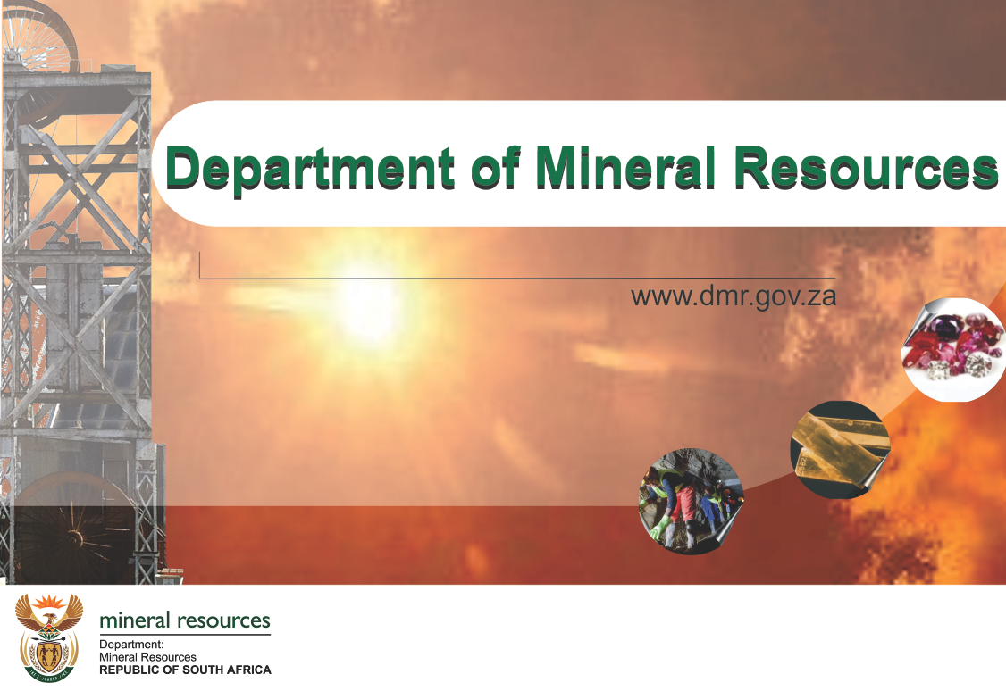
PRESENTATION TO THE PORTFOLIO
COMMITTEE OF MINERAL RESOURCES
22 FEBRUARY 2017

Slide 2
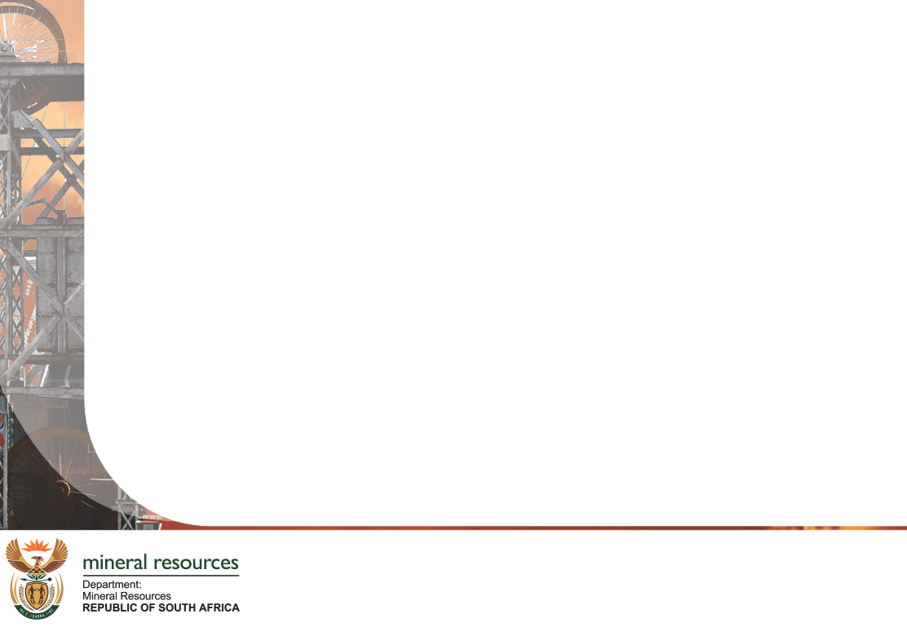
PRESENTATION OUTLINE
Introduction
Objectives
Derelict and Ownerless (D&O) Mine Sites
  Distribution of the D&O Mine Sites
  Financial Support
  Asbestos Mines Rehabilitation Progress
  Sealing of Dangerous Holings
Government consolidated efforts in dealing with Acid Mine Drainage (AMD)
  Ingress Control
  Pumping and treating of AMD
Conclusion

Slide 3
INTRODUCTION
Derelict and ownerless mines refer to mines whose owners or mining rights or lease holders have abandoned, and are not operating nor maintaining to mitigate and manage their associated health and environmental impacts as well as those mines whose owners or operators can no longer be traced.
These would comprise of mines sites that were operational during the period when environmental management at the mining was not well regulated.

Slide 4
OBJECTIVES
The objectives for the management of the D & O mine sites are to address the following:
Public Health and Safety impacts. The risks include:
    Cavities and subsidence features;
    Human and animals falling into shafts; and
    Illegal mining.
Environmental Impacts on both surface and ground water.
Air quality impacts.

Slide 5
DERELICT AND OWNERLESS MINE SITES
Distribution
PROVINCE | TOTAL NUMBER OF D&O’s
EASTERN CAPE | 326
FREE STATE | 229
GAUTENG | 360
KwaZULU NATAL | 410
LIMPOPO | 886
MPUMALANGA | 794
NORTH WEST | 1040
NORTHERN CAPE | 1065
WESTERN CAPE | 866
TOTAL | 5976

Slide 6
DERELICT AND OWNERLESS MINE SITES
Database Verification And Management

Slide 7
DERELICT AND OWNERLESS MINE SITES
Database Verification And Management

Slide 8
DERELICT AND OWNERLESS MINE SITES
Valuation of the Liability
Asbestos mines are estimated to be 245 of the total estimated figure of 5976.
The fair value of the liability in relation to rehabilitation of former Asbestos mining sites is estimated at R2 billion as at 31 March 2016. R199.6 million of this liability is disclosed as a provision and the balance of R 1.8 billion is disclosed as a contingent liability.
The best estimate present value of the closure cost of other derelict and abandoned mines is estimated at R45.9 billion as at 31 March 2015, consisting of R44.7 billion for Class A mines and R1.2 billion for Class B & C mines.

Slide 9
  DERELICT AND OWNERLESS MINE SITES
  Financial Support
 | 2010/11 | 2011/12 | 2012/13 | 2013/14 | 2014/15 | 2015/16 | Total
 | R'000 | R'000 | R'000 | R'000 | R'000 | R'000 | R'000
Department | 22,063 | 26,095 | 10,390 | 23,000 | 37,000 | 41,740 | 160,288
Mintek | 30,000 | 30,000 | 30,000 | 50,000 | 55,000 | 60,000 | 255,000
Council for Geoscience | - | - | 20,000 | 20,000 | 20,000 | 20,921 | 80,921
Total | 52,063 | 56,095 | 60,390 | 93,000 | 112,000 | 122,661 | 496,209

Slide 10
  DERELICT AND OWNERLESS MINE SITES
  Asbestos Mines Rehabilitation Progress
PROVINCE | MINE NAME | DESCRIPTION
Northern Cape | Buisvlei North Asbestos Mine | Mine Dumps
 | Masaneng Asbestos Mine | Shafts/Adits
 | Buisvlei South Asbestos Mine | Mine Dumps
 | Strelley | Mine Dumps
 | Langley Mine | Mine Dumps
 | Prieska Old Hospital | Shafts/Adits
 | Heuningvlei | Mine Dumps
 | Vergenoegd | Mine Dumps
 | Ga-lotolo | Mine Dumps
 | Prieska Parkland Creation | Mine Dumps
 | Buisvlei North Asbestos Mine | Mine Dumps
 | Buisvlei South Asbestos Mine | Mine Dumps And Shafts
 | Masaneng Asbestos Mine | Mine Dumps And Shafts

Slide 11
  DERELICT AND OWNERLESS MINE SITES
  Asbestos Mines Rehabilitation Progress
PROVINCE | MINE NAME | DESCRIPTION
Limpopo | Motsane Asbestos mine | Mine dumps and shafts
 | Mafefe Penge | Mine dumps and shafts
 | Ditabogong | Mine dumps and shafts
 | Mahlatjane | Mine dumps and shafts
 | Ga-madiba | Mine dumps and shafts
 | Betle | Mine dumps and shafts
 | Mang le mang | Mine dumps and shafts
KwaZulu Natal | Klip river | Mine dumps and shafts
 | Sithilo | Mine dumps and shafts

Slide 12
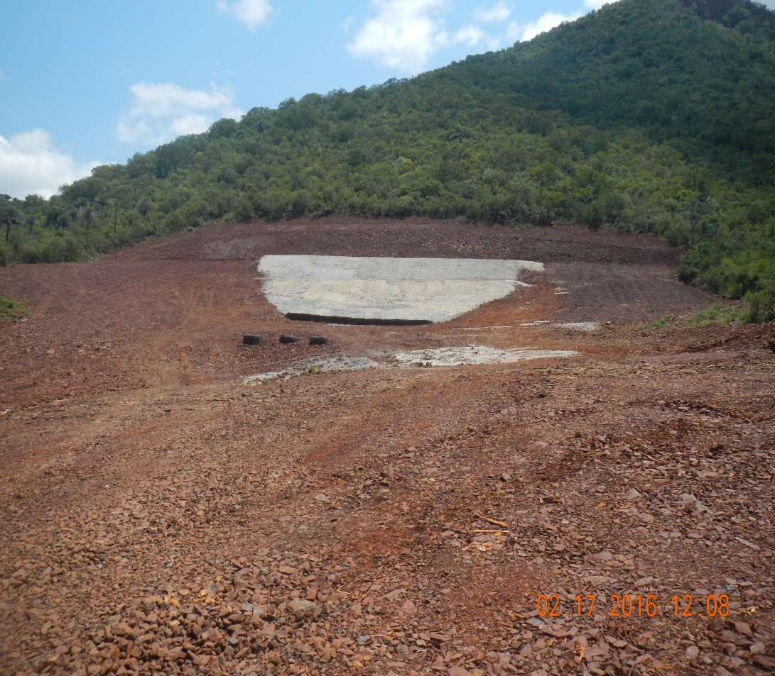
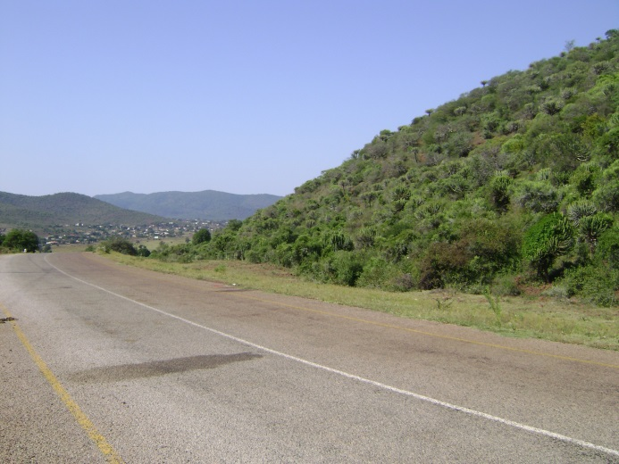
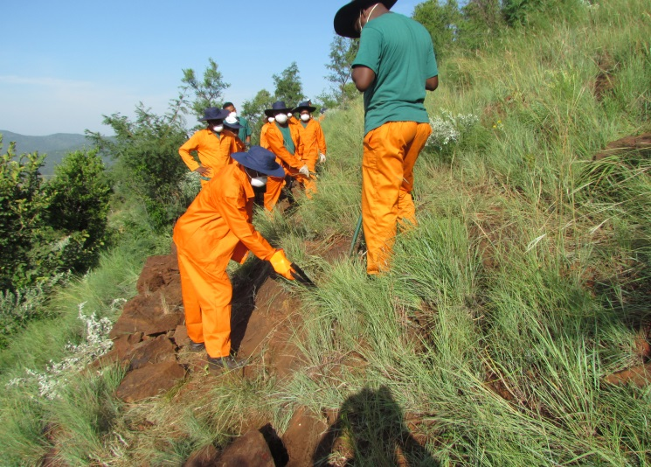
  DERELICT AND OWNERLESS MINE SITES
  Asbestos Mines Rehabilitation Progress
Village
Before
Ga-Madiba (Limpopo) – After
During Construction

Slide 13
  DERELICT AND OWNERLESS MINE SITES
  Sealing Of Dangerous Holings Progress
PROVINCE | NUMBER OF SEALED HOLINGS
Limpopo | 47
Gauteng | 178
Mpumalanga | 42

Slide 14
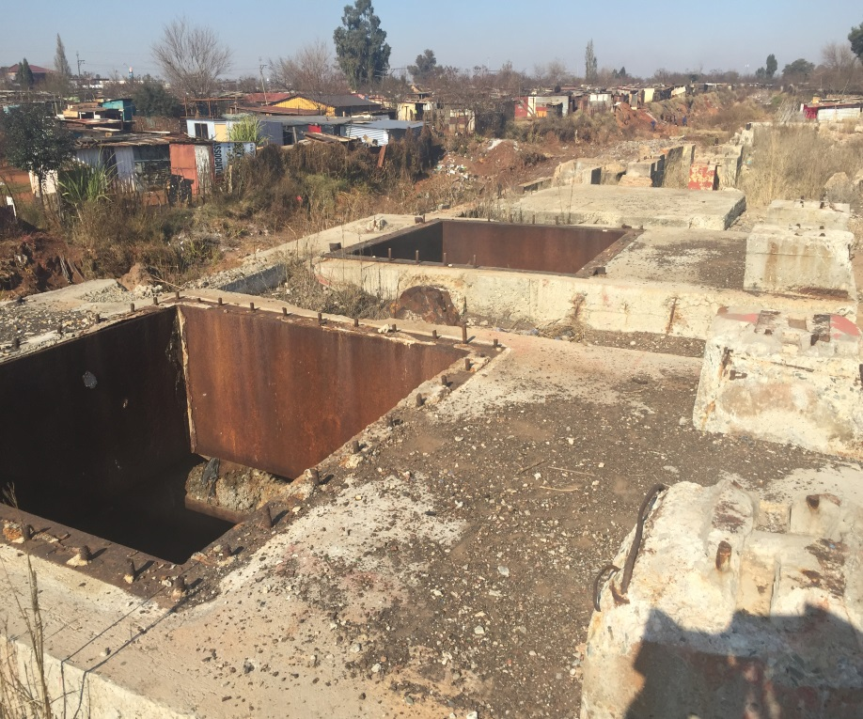
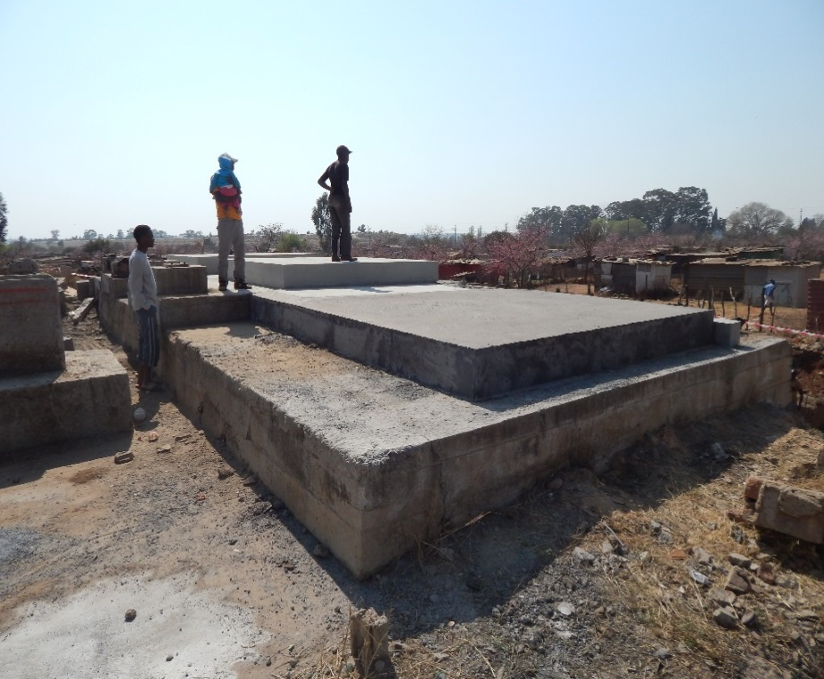
  DERELICT AND OWNERLESS MINE SITES
  Progress on Sealing of Dangerous Holings
Grootvlei Ventilation Shaft (Before)
Grootvlei Ventilation Shaft (After)

Slide 15
EMPLOYMENT AND JOB OPPORTUNITIES
FROM D&O PROJECTS (2016/17)
Project Name | Budget | Total Number of Work Opportunities | Number of adult male Employed | Number of adult women Employed | Number of Youth Employed
Kwa-Mhlanga Shafts | R 1,700,000 | 10 |  | 5 | 5
Greylingstad | R 2,000,000 | 14 | 7 | 3 | 4
Motsana | R 3,500,000 | 21 | 6 | 5 | 10
Giyani Shafts Closure | R 3,000,000 | 40 | 14 | 11 | 15
Masaneng | R 2,000,000 | 10 | 4 | 1 | 5
Buisvlie North | R 1,700,000 | 10 | 3 | 2 | 5
Buisvlie South | R 4,000,000 | 20 | 6 | 4 | 10
Heinningsvlie | R 7,000,000 | 55 | 14 | 7 | 34
Closure of seven abandoned mines | R 2,653,469 | 9 | 5 | 1 | 3
Totals | R 27,553,469 | 189 | 59 | 39 | 91
 |  |  |  |  | Mpumalanga
 |  |  |  |  | Limpopo
 |  |  |  |  | Northern Cape
 |  |  |  |  | Gauteng

Slide 16
GOVERNMENT CONSOLIDATED EFFORTS IN DEALING WITH AMD
In the year 2010 a Team of Experts was instructed by government, chaired by the Directors-General of Mineral Resources and Water and Sanitation to advise the Inter Ministerial Committee (IMC) on dealing with AMD, comprising the Ministers of Mineral Resources, Water and Sanitations and Science, and Technology and the Minister in the Presidency: National Planning Commission.
The IMC produced a report which intent to guide the management of AMD in the Witwatersrand Basin.

Slide 17
GOVERNMENT CONSOLIDATED EFFORTS IN DEALING WITH AMD (CONT…)
The Report recommended that:
  Steps be implemented to reduce and stop the ingress of water into the underground workings as far as is possible. This will reduce the volumes of water which need to be pumped and treated to more acceptable levels and consequently reduce the operational costs of AMD management.
  The acid mine water be pumped and treated to reduce the mine water contribution to the salinity of major river systems (e.g. Vaal River System).

Slide 18
GOVERNMENT CONSOLIDATED EFFORTS IN DEALING WITH AMD
Central Rand Ingress Volumes And Costs
Gold Field | Project | Costs (ZAR) | Volume (ML per Day)
Central Rand | Amalgam Canal | R8 016 367 | 2ml/d
Central Rand | DRD Canal | R98 774 635 | 5.62
Central Rand | Boksburg Canal | R33 043 865 | 11.23
Central Rand | City Deep Mine Canal | R61 775 404 | 6.92

Slide 19
GOVERNMENT CONSOLIDATED EFFORTS IN DEALING WITH AMD
East Rand Ingress Volumes And Costs
Gold Field | Project | Costs (ZAR) | Volume (ML per Day)
East Rand | South Blesbokspruit | R457 187 | 5.7
East Rand | Central Blesbokspruit | R7 759 199 | 3.9
East Rand | North Blesbokspruit | R8 016 367 | 2.1
East Rand | Cowles Dam Ingress ERB | R36 511 198 | 5.6
East Rand | Van Rhyn ponding- Repair canal | R45 492 970 | 1.4

Slide 20
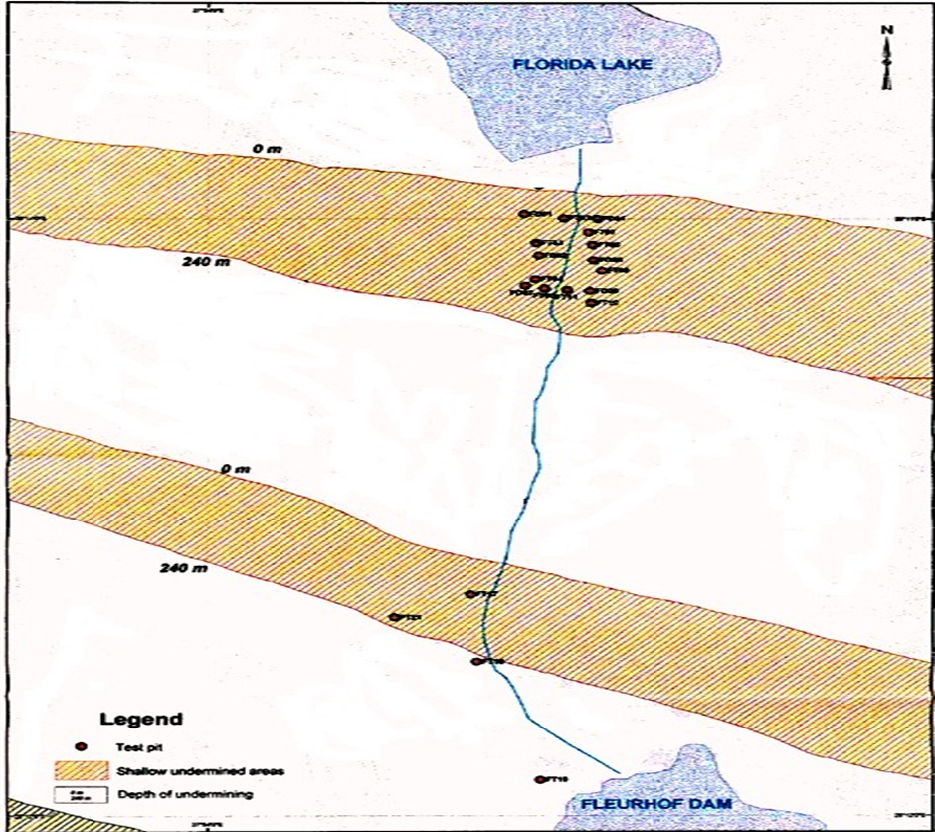
GOVERNMENT CONSOLIDATED EFFORTS IN DEALING WITH AMD
Florida Lake Canal (Ingress Control)

Slide 21
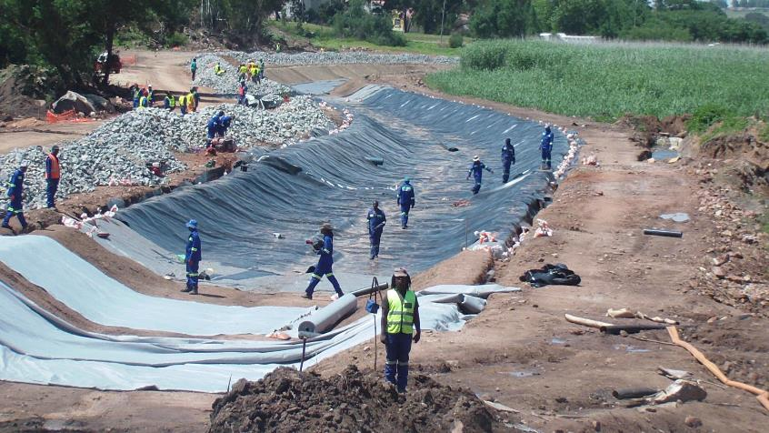
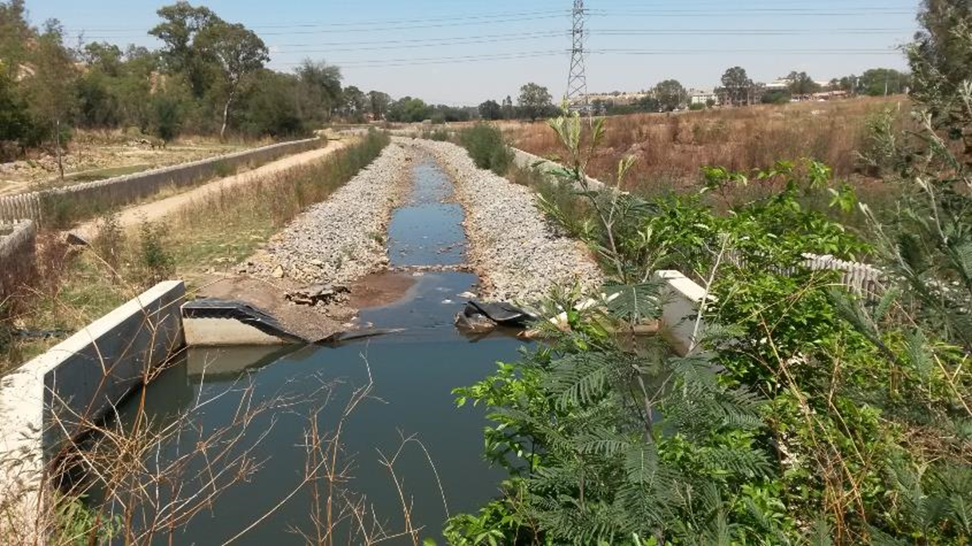
GOVERNMENT CONSOLIDATED EFFORTS IN DEALING WITH AMD
Florida Lake Canal (Ingress Control)
Construction
Completed

Slide 22
GOVERNMENT CONSOLIDATED EFFORTS IN DEALING WITH AMD
Pumping And Treating
Short term solution: Wits Basins
Western Basin
  Old Rand Uranium AMD treatment plant upgraded to 36ML per day.
  Project has mostly eradicated surface decant with the exception of sporadic decants during high rainfall.
  Neutralised AMD released to Tweelopiespruit.
  Project further augmented by new clarifiers and new pump station.
Central Basin
  Constructed a new AMD treatment plant in January 2013 next to South West Vertical Shaft (capacity 84 ML/day).
  Operational since May 2014.
  72 ML AMD daily in the long term.
  Treated water released into Elsburgspruit.

Slide 23
GOVERNMENT CONSOLIDATED EFFORTS IN DEALING WITH AMD
Pumping And Treating
Eastern Basin
New HDS plant next to Grootvlei No 3 shaft - 110ml/d.
  Operational since Aug 2016.
Treated water released into Blesbokspruit.
Total cost for all three Basins is R2,8 billion.

Slide 24
CONCLUSION
The Department will continue with the rehabilitation of derelict and ownerless mines to enhance on public health and safety and the environment.
The Department is:
  finalising the verification process of D&O mine sites.
  Updating the State Contingent Liability to reflect current developments.
  Engaging both National Treasury and the Department of Water and Sanitation with a view to the implementation of ingress control initiatives.
The implementation of ingress control initiatives will reduce the amount of pumping and treating AMD.

Slide 25
Thank You.

