Slide 1

State of Municipalities Finances
Eskom arrears affected municipalities
.
x
| Intergovernmental Relations | 21 February 2017

Slide 2
Contents
National Transfers
  LGES and Conditional Grants
Performance of affected municipalities
  Audit outcomes
  State of LG finances
  S71 2nd Quarter performance
  Conclusion

Slide 3
  Local Government Equitable Share (LGES) is designed to fund poor households

Slide 4
The structure of the local government equitable share formula
The basic services component of the LG equitable share formula funds the cost of free basic services for 59% of South African households (those earning less than 2 old age grants)
The equitable share formula also funds community services and institutional costs, but these funds are only allocated to poorer municipalities
  Redistribution in the formula is driven by the allocations for the community services and institutional components to poor municipalities
  Annual updates to the data used:
    Cost data to account for price increases
    Household numbers

Slide 5



The local government fiscal framework (LGFF) includes transfers and own revenues
The
LGFF
National Transfers
25%
Local Government
Own Revenue
75%
Rates and charges
Charges
HH in informal settlement
Poor HH in RDP house
Employed HH in RDP house with improvements
Middle to upper income HH
Local government is funded by transfers and own-revenues
Main sources of own revenue are property rates and service charges
Transfers are designed to fund services for poor HHs
Non-poor households contribute to municipal revenues
Transfers are never intended to fully fund municipalities

Slide 6
The structure of the local government fiscal framework is very different in urban and rural areas
Growth in households for non-poor should be self-funded and municipalities have instruments available to generate own revenue

Slide 7
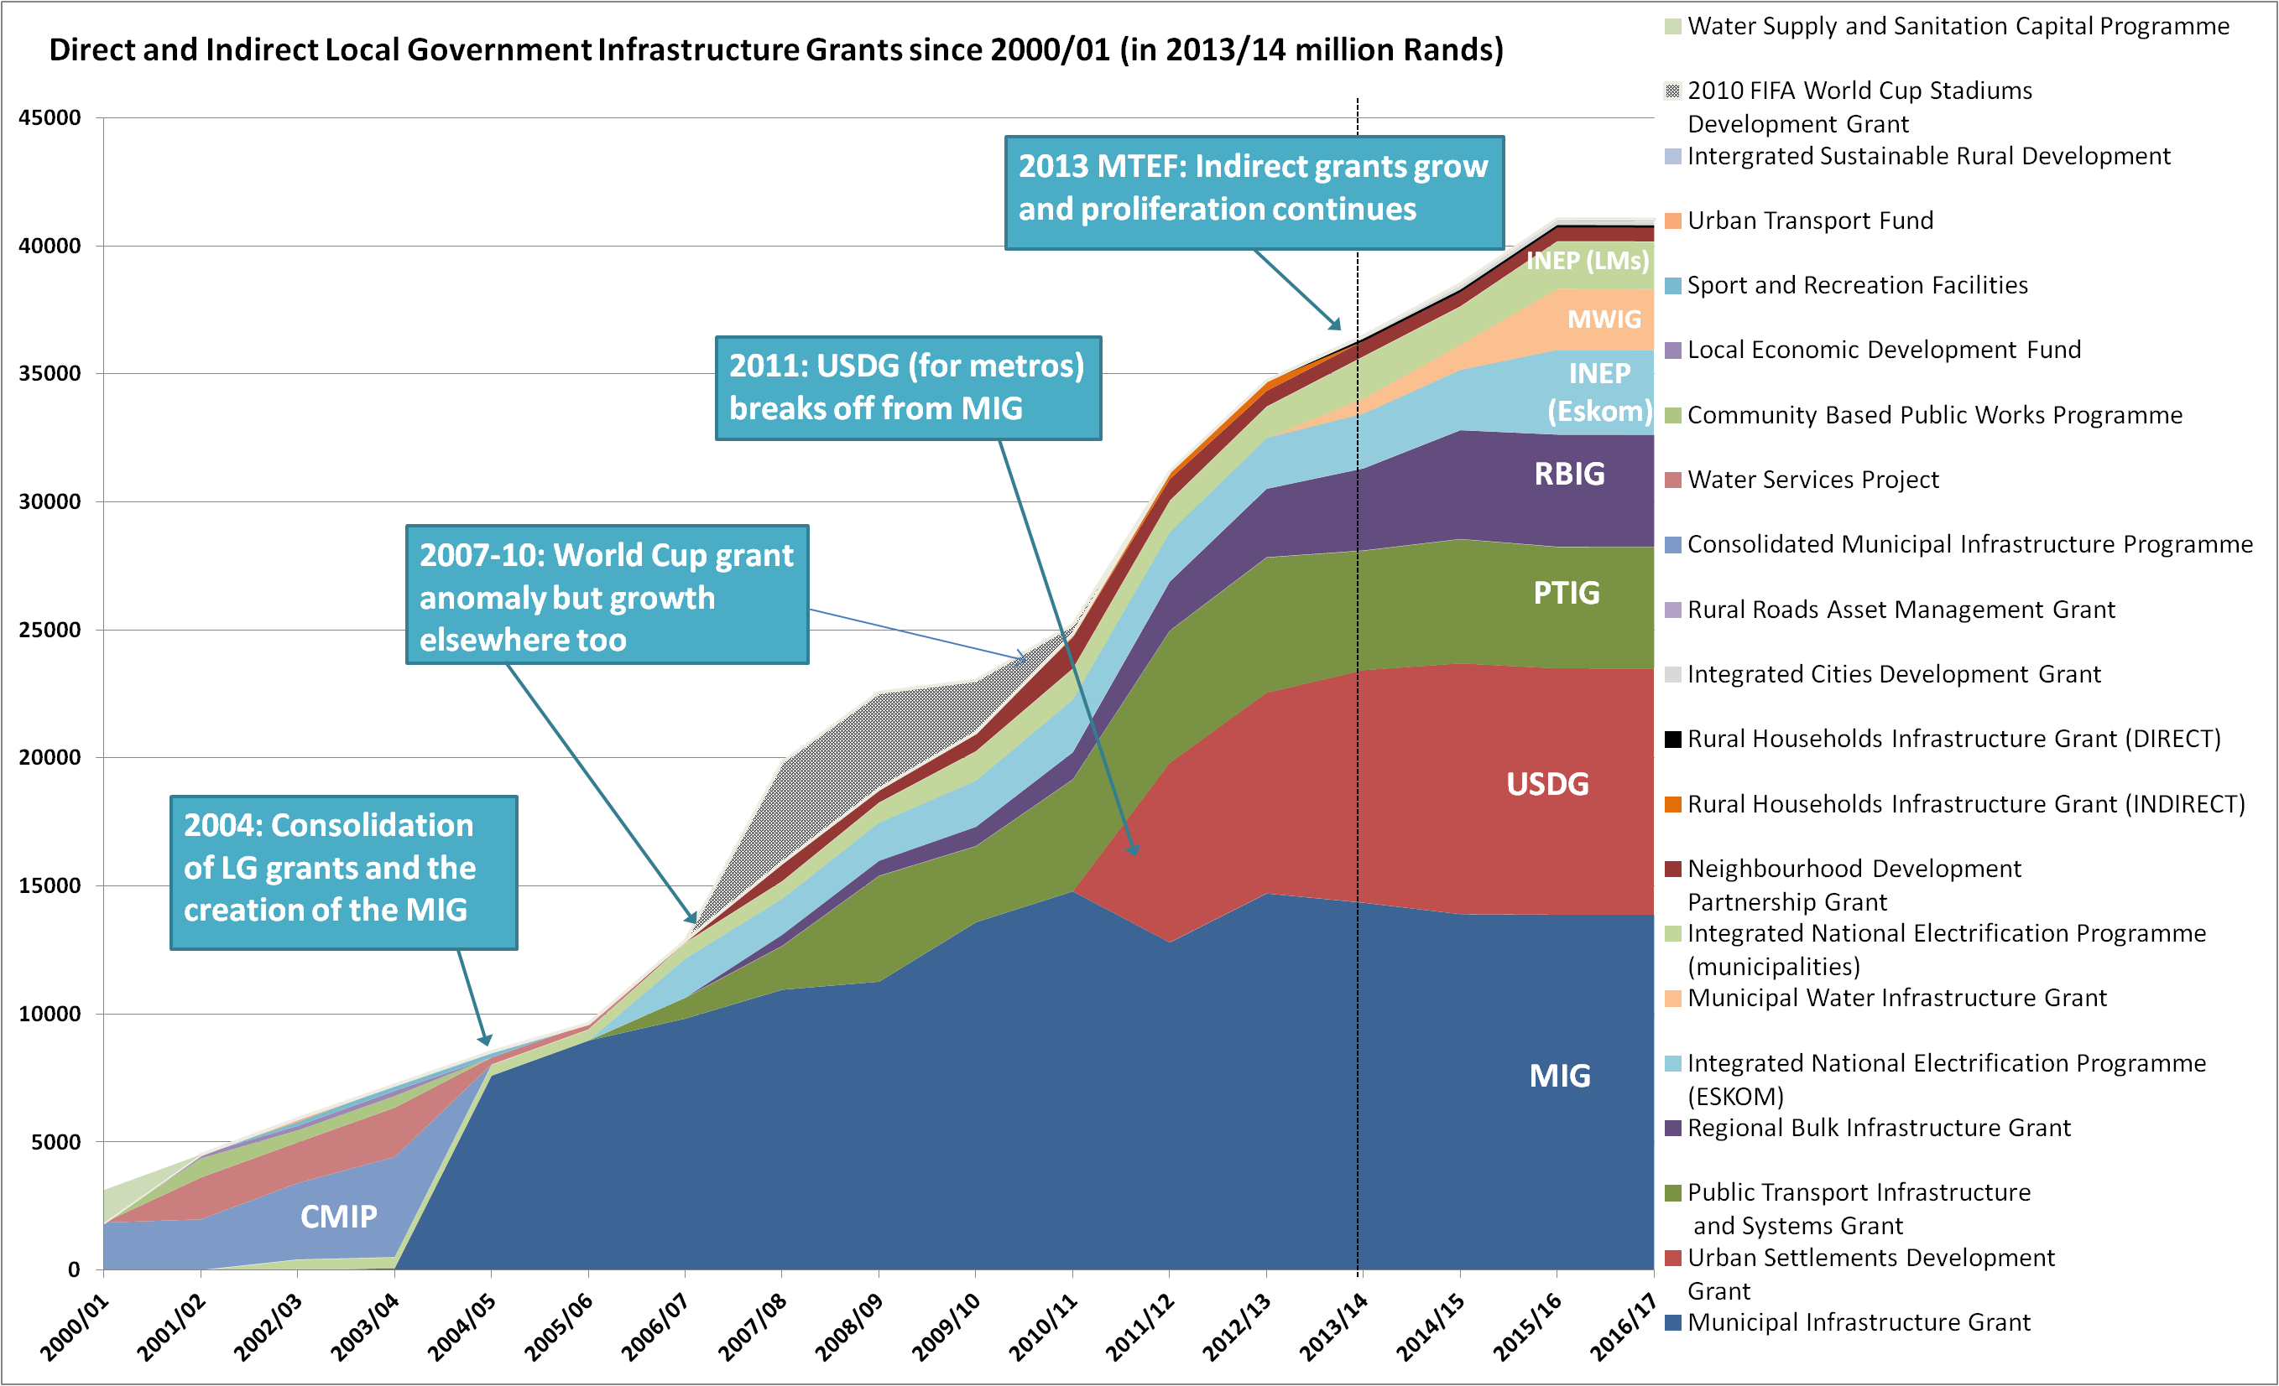
Local government also receives billions in conditional grants, mainly for infrastructure, but also for capacity building

Slide 8
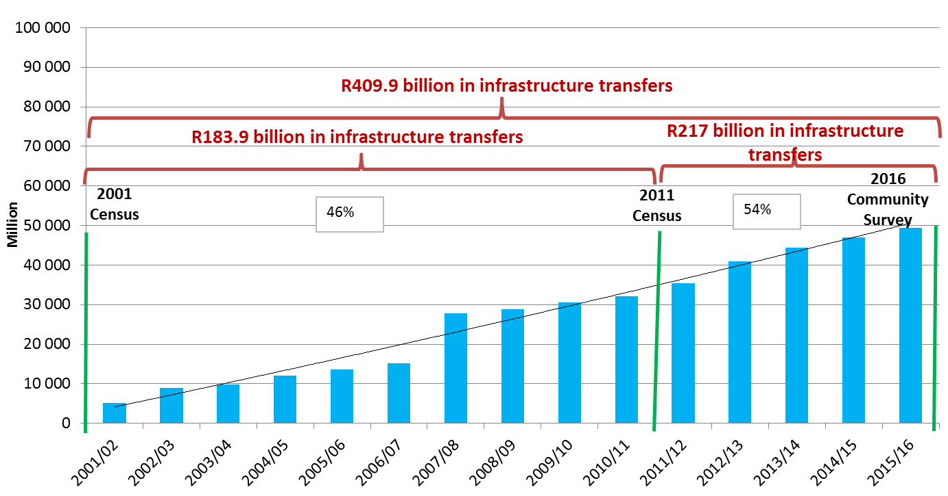
LG real infrastructure allocations (June 2016 = 100)
Between 2011 Census and 2016 CS, LG real infrastructure allocations increased by 8%
Growth in division of revenue to local government
Division of revenue to local government grow from 3% in 2000/01 to 9% in 2016/17

Slide 9
Impact of the new formula
Old formula - Allocation per poor household
New formula - Allocation per poor household
The old formula produced allocations per poor household that were lowest for municipalities with the least ability to raise their own revenue
The new formula corrects this with a much more redistributive structure
(figures presented here exclude the impact of the phase-in)

Slide 10
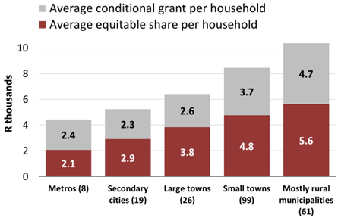
Redistribution to poorer resourced municipalities achieved through the Division of Revenue
The division of revenue achieves a substantial redistribution of revenues raised through taxes in relatively wealthy (mainly urban) areas to areas where demand for subsidised public services is highest
As a result, the most rural municipalities receive twice the allocation per household that is transferred to metros (although 70% of tax revenue is raised in metros)
Per household allocations to municipalities

Slide 11
Analysis of the top 20 municipalities owing Eskom
Audit outcomes 2014/15
Performance 2015/16
Budget 2016/17
Performance 2nd Q2 - 2016/17

Slide 12
Performance of top 20 municipalities- Audit 14/15
The audit opinions of these municipalities is evidence that financial management is in disarray

Slide 13
Performance of top 20 municipalities- financial distress municipalities in 2015/16
The fact that many municipalities are persistently distressed are concerning
At the end of the 2015/16 financial year the creditors amount far exceed cash – can be regarded as an overdraft as it consist of more than one month arrears
The acting positions contribute to the crisis they find themselves in

Slide 14
LGES allocation and households subsidised
The fact of the matter is that municipalities are more than sufficiently subsidised
Consequently, municipalities are in turn not providing as intended

Slide 15
Budget 2016/17 – electricity function
When municipalities bills and collects less than the bulk cost, the function becomes unsustainable - not taking secondary cost into consideration
Unfunded budgets contributes to the problem
If the trade creditors for the year exceed the cash then it is clear that the municipality does not have intention to pay

Slide 16
Asset management and losses in electricity – 2016/17 budget
Any renewal below 40% - is indicative that assets are not replaced at the required rate – infrastructure failure - losses
Depreciation is the rate at which assets are used. below – a % below is indicative that assets are used faster rate than replaced – infrastructure failure – losses
R&M 8% is risky
Evident in the distribution losses

Slide 17
S71 2nd Quarter ended December 2016 and Eskom arrears
In all municipalities creditors amount exceed the cash at the end of the second quarter
Municipalities that have deficit at this stage may have a serious cash flow problem
This suggest that they cannot pay creditors within the legal time frames
In some cases the Eskom arrears amount far exceeds the cash available
Apart from the Eskom debt the bigger problem is amounts owed to other creditors

Slide 18
Conclusion
The following general observations that relate to the municipalities’ failure to pay their creditors which emerged from the analysis:
Many municipalities were not aware of their consumption patterns for bulk services;
High operating costs – above normal staff costs which implies that a large part of the equitable share is being utilised to pay salaries and not directly towards service delivery. In addition many municipalities have bloated organisational structure;
Unfunded budgets – Past repayment arrangement were not affordable and realistic (not cash backed) and in many cases were signed merely for compliance;
Tariffs – electricity and water tariff setting are not cost reflective, municipalities bill for electricity and collect far less than they purchase – not sustainable;
Theft/losses of electricity equates to as much as 50 per cent of purchases in some cases;
Poor asset management that leads to infrastructure failure and increased losses;
Poor revenue management has meant that payments due to creditors far exceed revenue collected;
Even though municipalities have adopted cost containment measures in council the reality is that many are not practicing what is suggested. There are no evidence of reprioritisation budgets in terms of importance;
Municipalities are not utlising the LGES subsidisation for the poor households as intended;
Poor leadership and weak financial management led to mismanagement of finances, as reflected by poor audit outcomes, which in turn allowed the debt to escalate; and
Lack effective internal controls, have poor cash flow management.

Slide 19
Thank You

