Slide 1
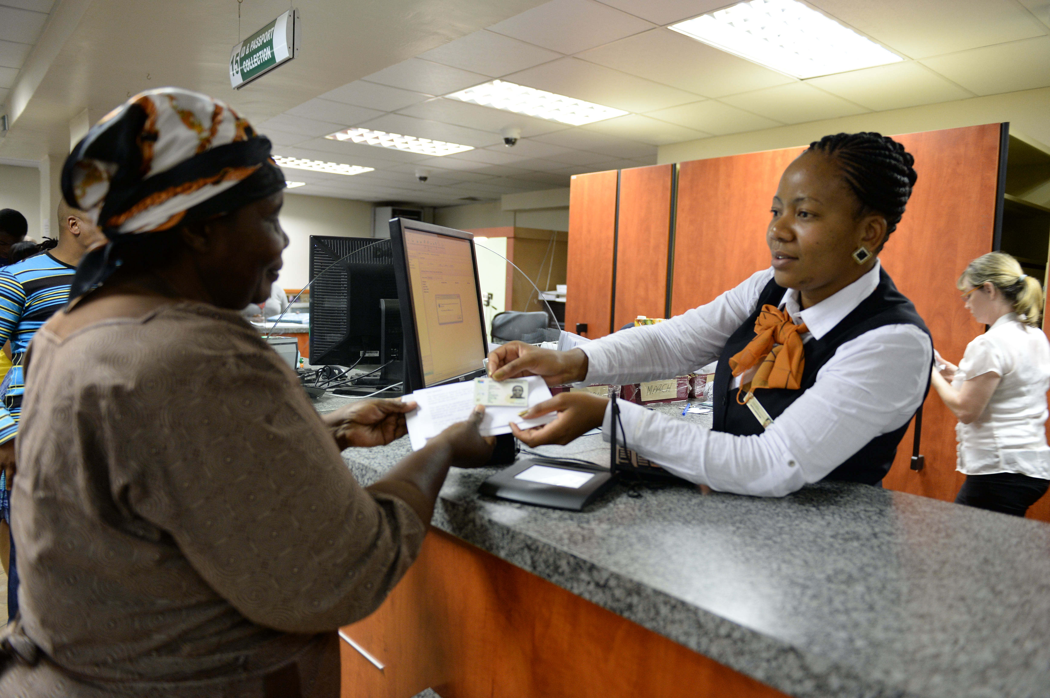
Presentation to the Select Committee on Social Services
Annual Performance Report of the Department of Home Affairs for 2015/2016

Slide 2
VISION, MISSION AND VALUES
VALUES
MISSION
Value Statement
The Department of Home Affairs is committed to being:
People-centred and caring;
Patriotic;
Professional and having integrity;
Corruption free and ethical;
Efficient and innovative;
Disciplined and security conscious.
VISION
The efficient determination and safeguarding of the identity and status of citizens and the regulation of immigration to ensure security, promote development and fulfill our international obligations.
A safe, secure South Africa where all of its people are proud of, and value, their identity and citizenship.

Slide 3
SUPPORTING GOVERNMENT PRIORITIES
The DHA contributes directly to four of the 14 Outcomes of Government:
Quality basic education.
A long and healthy life for all.
All people in South Africa are and feel safe.
Decent employment through inclusive economic growth.
Skilled and capable workforce to support an inclusive growth path.
An efficient competitive and responsive economic infrastructure network.
Vibrant equitable sustainable rural communities contributing to food security for all.
Sustainable human settlements and improved quality of household life.
Responsive accountable effective and efficient local government system.
Protect and enhance our environmental assets and natural resources.
Create a better South Africa a better Africa and a better world.
An efficient effective and development oriented public service.
Social protection.
Nation building and social cohesion.

Slide 4
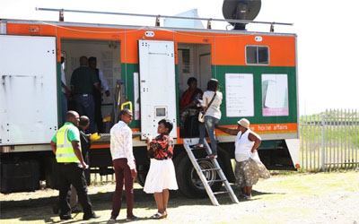
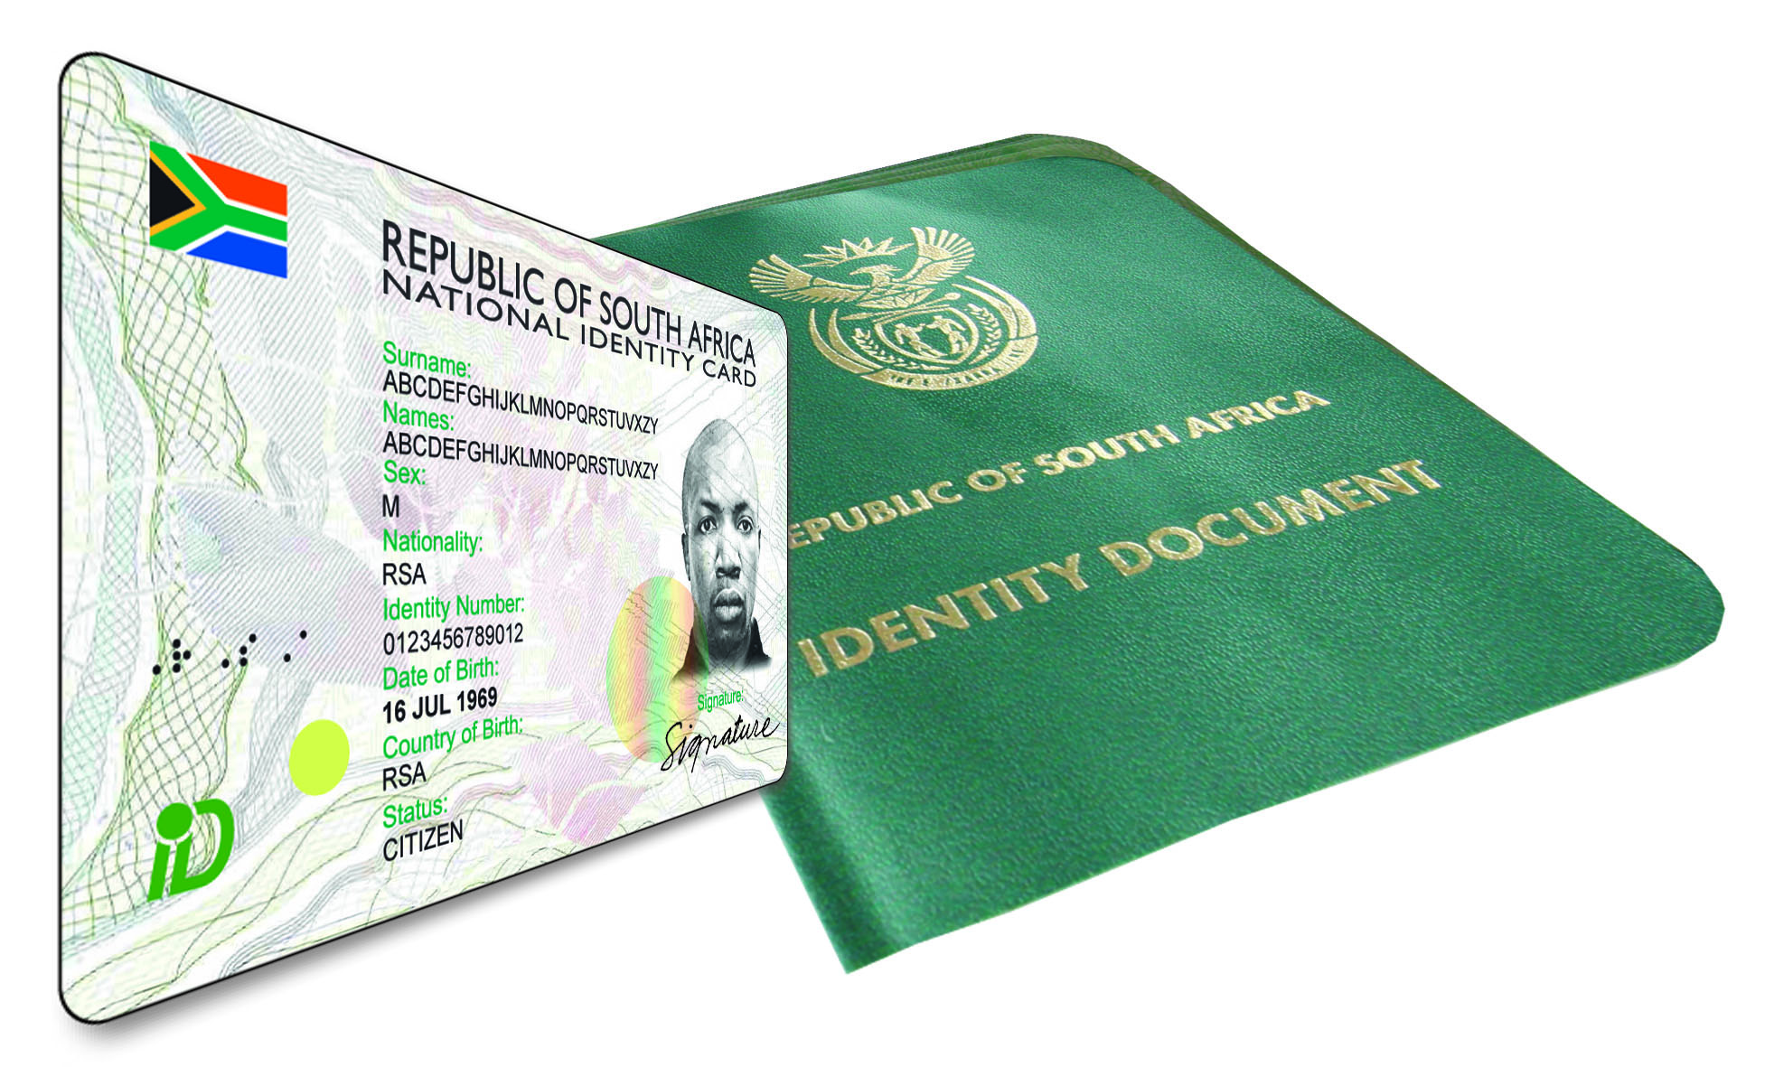
DHA OUTCOMES AND STRATEGIC OBJECTIVES
^{Outcome 3:}
Services to citizens and other clients that are accessible and efficient.
^{Strategic Objectives:}
Secure, effective, efficient and accessible service delivery to citizens and immigrants.
Good governance and administration.
Ethical conduct and zero tolerance approach to crime, fraud and corruption.
Collaboration with stakeholders in support of enhanced service delivery and core business objectives.
^{Outcome 1:}
Secured South African citizenship and identity.
^{Strategic Objectives:}
All eligible citizens are issued with enabling documents relating to identity and status.
An integrated and digitised National Identity System (NIS) that is secure and contains biometric details of every person recorded on the system.
^{Outcome 2:}
Secured and responsive immigration system.
^{Strategic Objectives:}
Refugees and asylum seekers are managed and documented efficiently.
Movement of persons in and out of the country regulated according to a risk based approach.
Enabling documents issued to foreigners efficiently and securely.

Slide 5
MTSF Priorities & DHA Commitments in support of MTSF 2014 to 2019
MTSF Priorities Based on Electoral Mandate
DHA Contribution to 14 outcomes
DHA Commitments in support of MTSF outcomes
BMA established and operational by April 2017
Integrated Border Management Strategy developed and implemented to defend, protect, secure and ensure well-managed borders (2018/19)
74% or 810 000 of all births captured within 30 days by 18/19
National Identity System (NIS) operational (18/19)
100% of all designated ports of entry equipped with biometric systems by 2018/19
Immigration and Refugees Bills submitted to Parliament for approval by 2018/19
Decent work and sustainable livelihoods
Education
Health
Rural development, food security and land reform
Fight against crime and corruption
3. All people in South Africa are and feel safe
4. Decent employment through inclusive economic growth
3 DHA Premium Visa & Permit Service Centres for Corporate Account clients and their families opened
85% of critical skills visas adjudicated within 4 weeks for applications processed within the RSA
12. An efficient effective and development oriented public service
Establishment of the DHA Contact Centre (2015/16)
No DHA commitment in MTSF
DHA contributes through enabling documents (citizens, vulnerable groups, refugees) and access to systems (e.g. DSD)
13. Social Cohesion and (14) Nation building and social cohesion
Notes:
Following the adoption of the NDP, the NPC Secretariat and DPME were requested by Minister Manuel to prepare a proposal on the implementation of the National Development Plan .
Significance – a shared long-term strategic framework within which more detailed planning can take place.
Key is that the 2014-2019 MTSF be situated within the context of the long-term agenda set by the NDP

Slide 6
OVERVIEW OF ORGANISATIONAL PERFORMANCE (2015–16)
The Department had a total of 36 targets planned for 2015/16 financial year. A total of 29 targets were achieved representing 81% achievement rate, 7 (19%) targets were not achieved .
Significant improvement in organisational performance has been realised over the last 3 financial years

Slide 7
OVERVIEW OF ORGANISATIONAL PERFORMANCE (2015–16)
The main reasons for the improvement in organizational performance over the last 3 financial years can be attributed to:
Improved governance, planning, implementation and monitoring practices:
Cascading of the DHA strategy throughout the organisation.
Planning is focused on those critical priorities which will ensure maximum impact.
Development of clear planning and M&E guidelines, tools and capacity building in this regard.
Improved governance practices such as the formation of a Key Performance Indicator Panel to quality assure technical indicator description sheets, compliance with prescripts such as SMART principles, improved design of reporting templates upfront and ensuring that all set targets are funded
Increasing realization of the importance of integrated planning to identify and address key dependencies and risks.
One-on-one feedback/consultation sessions with branches on performance information / bottom up approach to planning.
Intensified monitoring of progress on set targets.
Improved internal controls around management practices.
The participation of Internal Audit in the strategic management process and evaluation of achieved targets per quarter
Improved governance arrangement, e.g. Audit Action Plan and Quarterly Reviews.
Application of lessons learned from audits in previous financial years.
Improved analysis of past and current departmental and branch performance to inform institutional planning

Slide 8
OVERVIEW OF ORGANISATIONAL PERFORMANCE (2015–16)
REASONS FOR IMPROVEMENT: FY 2015/16
The Moetapele (leadership) programme launched in May 2015 challenged the staff to be client-centred and innovative with several model offices being opened to increase the efficiency in DHA offices.
Partnership with 4 (four) major banks (ABSA, FNB, Nedbank and Standard Bank); assisted in increasing the footprint of DHA.
Service Charter outlining service standards was developed. The service charters are currently being displayed in all DHA offices.
Front Office Toolkit was developed and implemented in all DHA services, with targeted facilities were optimized in respect of staff, equipment, connectivity and signage.
Revised HR structure to streamline the functions and the competencies in the Department including implementation of revised working hours.
Improved governance and accountability fora and approval of governance documents i.e. compliance in terms of National Treasury regulations and DPME directives, approved SOPs in several business units.

Slide 9
OVERVIEW OF ORGANISATIONAL PERFORMANCE (2015–16)
REASONS FOR IMPROVEMENT: FY 2015/16
Live capture was rolled out to 7 DHA offices and 9 bank branches during the reporting period; and 31 additional offices were completed by April 2016.
The Learning Academy strengthened its working relationship with the Inspectorate unit to ensure execution of the training of new Inspectorate officers.
System enhancements and expansion of live capture functionality to banks and additional offices contributed to the increased volume of cards produced.
Upgrades to the power supply at the Central ID Production Facility during 2014/15 created a stable environment conducive for increased production.
Permitting and visa issuance has also benefited from investment into improved systems and business processes.
The maturity of business standards and business processes in partnership with VFS Global, has contributed to the achievement of significantly improved turnaround times for applications that are categorised as high priority in particular for corporate accounts, highly skilled labour, work, business and study.
Movement control system has been enhanced with Biometrics functionality and rolled out to 4 International Airports (ORTIA, Cape Town IA, King Shaka IA and Lanseria) to address issues related to the Immigration Regulations, 2014.

Slide 10
OVERALL PERFORMANCE AND ACHIEVEMENT OF TARGETS PER PROGRAMME
Programme | Number of Targets | Achieved | Not Achieved
Administration (1) | 19 | 18 (95%) | 1(5%)
Civic Services (2) | 5 | 4 (80%) | 1 (20%)
Immigration Services (3) | 12 | 7 (58%) | 5 (42%)
TOTAL | 36 | 29 (81%) | 7 (19%)

Slide 11
HIGHLIGHTS: 2015 – 2016: CIVIC SERVICES
Since the launch of the Smart ID Card on 18 July 2013, the number of permanent Home Affairs offices with live capture technology has increased to 178.
The department has signed the MOU with four banks: ABSA, FNB, Nedbank and Standard Bank to provide office space for DHA to process Smart ID Cards and Passport through the Live Capture system.
Twelve (12) branches also went operational and were digitised for the application and collection of Smart ID cards and passport.
A total of 2 320 972 smart ID cards issued against the target of 2.2 million.
275 699 IDs (First Issue) were issued in 54 working days which is equal to 93.9% against the target of 90% and 17 731 above.
208 422 IDs (Re-issues) were issued in 47 working days which is equal to 92.4% against the target of 90% and 4 507 above.
Significant decline of LRB cases: An internal analysis was conducted of the 297,973 births registered of children between 31 days and 14 years and it was determined that approximately 27% of these registrations that took place are for the category 31 to 60 days which essentially reflects that the core message of birth registration is filtering through to the citizens to some extent.

Slide 12
HIGHLIGHTS: 2015 – 2016 : IMMIGRATION SERVICES
During the 2015/16 financial year, the Refugee Amendment Bill of 2015 was gazetted for public comment. Improvements have been implemented at Marabastad RRO and the launch will be done early next year
The DHA has improved the current Enhanced Movement Control System (EMCS) with biometrics capability that was rolled out to four international air ports; i.e.. OR Tambo, Lanseria, Cape Town and King Shaka.
Permitting has migrated from a manual to electronic adjudication process in so far as the key targets are concerned, namely, Temporary Residence Visas and Permanent Residence Permits.
The Lesotho Special Dispensation Permit (LSP) was approved by Cabinet in October 2015 and shortly thereafter the process was initiated in cooperation with the Lesotho Government now closing in December 2016
The ZSP project has been closed with great achievement. This programme comprised 197959 accredited applications of which 85 were rejected due to non-compliance with the ZSP application criteria. The ZSP Project Team concluded within its targeted timeframe, delivering a success rate of 99.8% against its target.

Slide 13
HIGHLIGHTS: 2015 – 2016: IMMIGRATION SERVICES
Feasibility study on the implementation of biometrics in 3 missions, namely: Harare, Munich and Colombo was conducted.
Another notable achievement is the implementation of a verification process for permanent residents who lodge Identity Document applications wherein the original is issued with a verified copy attached thereon.
Strategy for local integration, repatriation and resettlement of refugees submitted and approved by the Minister.
Borderline community survey conducted.
Green Paper on International Migration approved by Minister.
Participation in Operation Fiela.

Slide 14
IMS: CHALLENGES AND TRANSFORMATION STRATEGY
The Department continues to experience capacity constraints in the area of Appeals and we intend to establish a dedicated unit for Appeals within the Chief Directorate Permits.
Budget constraints remain a serious challenge and have the potential to seriously hamper operations and service delivery. Key cost drivers are the Advance Passenger Processing system and peak period operations
The budget for the deportation of foreign nationals was exhausted before the end of the financial year, resulting in challenges relating to transfers of deportees to the Lindela Holding Facility and deportations from Lindela to the countries of origin.

Slide 15
Road Map into addressing some of the challenges: Ministerial Priorities (2014 to 2019)
PRIORITY | MAIN 2019 DELIVERABLES
Complete the Modernisation Programme | Integrated digital systems and re-engineered processes (NIS, immigration and related) managed and protected by the required compliment of effective professionals.
2. Establish an effective BMA | Founding legislation, model and basic structures, people, processes and systems in place.
3. Upgrade key ports of entry (6) | New model piloted and implemented in 6 POEs with significant improvements in respect of infrastructure, processes and leadership.
4. Comprehensive review of Immigration Policy | Green Paper and White Paper approved and new comprehensive legislation drafted.
5. Improved client experience through leadership (Moetapele) | Officials at all levels responding to client needs by demonstrating leadership through improving front and back office culture, processes and systems.

Slide 16
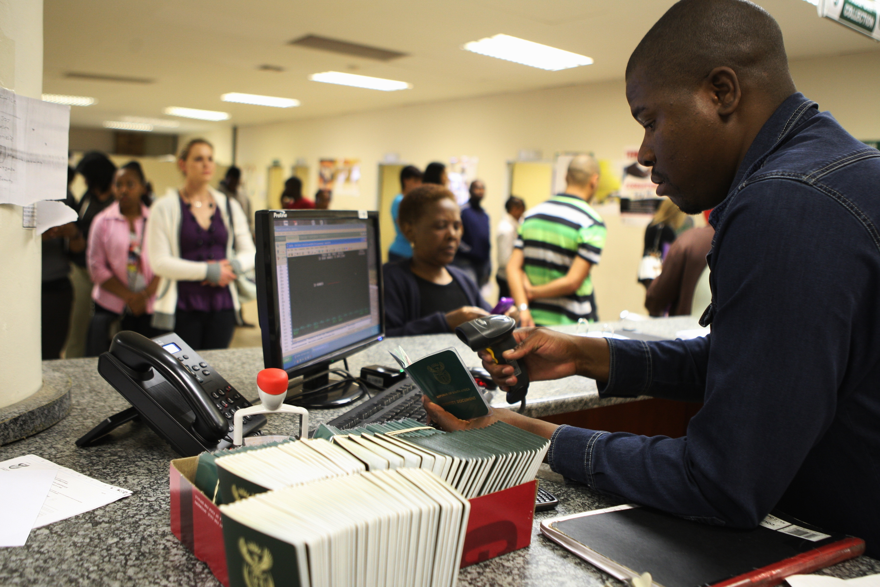
Strategic priorities linked to Medium Term Strategic Framework (MTSF 2014 - 2019)
Establishing an integrated Border Management Authority (BMA);
Developing an over-arching strategy and sub-strategies to defend, protect, secure and ensure well-managed borders;
Ensuring that registration at birth is the only entry point for SA to the new national identity system (NIS);
National Identity System (NIS) designed and operational;
Ensuring that systems are in place to enable the capturing of biometric data of all travellers who enter or exit SA legally;
Immigration Policy developed and approved by Cabinet;
Reducing the time required for importing critical skills needed for the economy; and
Improving feedback opportunities for citizens and other service users through the establishing of a DHA contact centre.

Slide 17
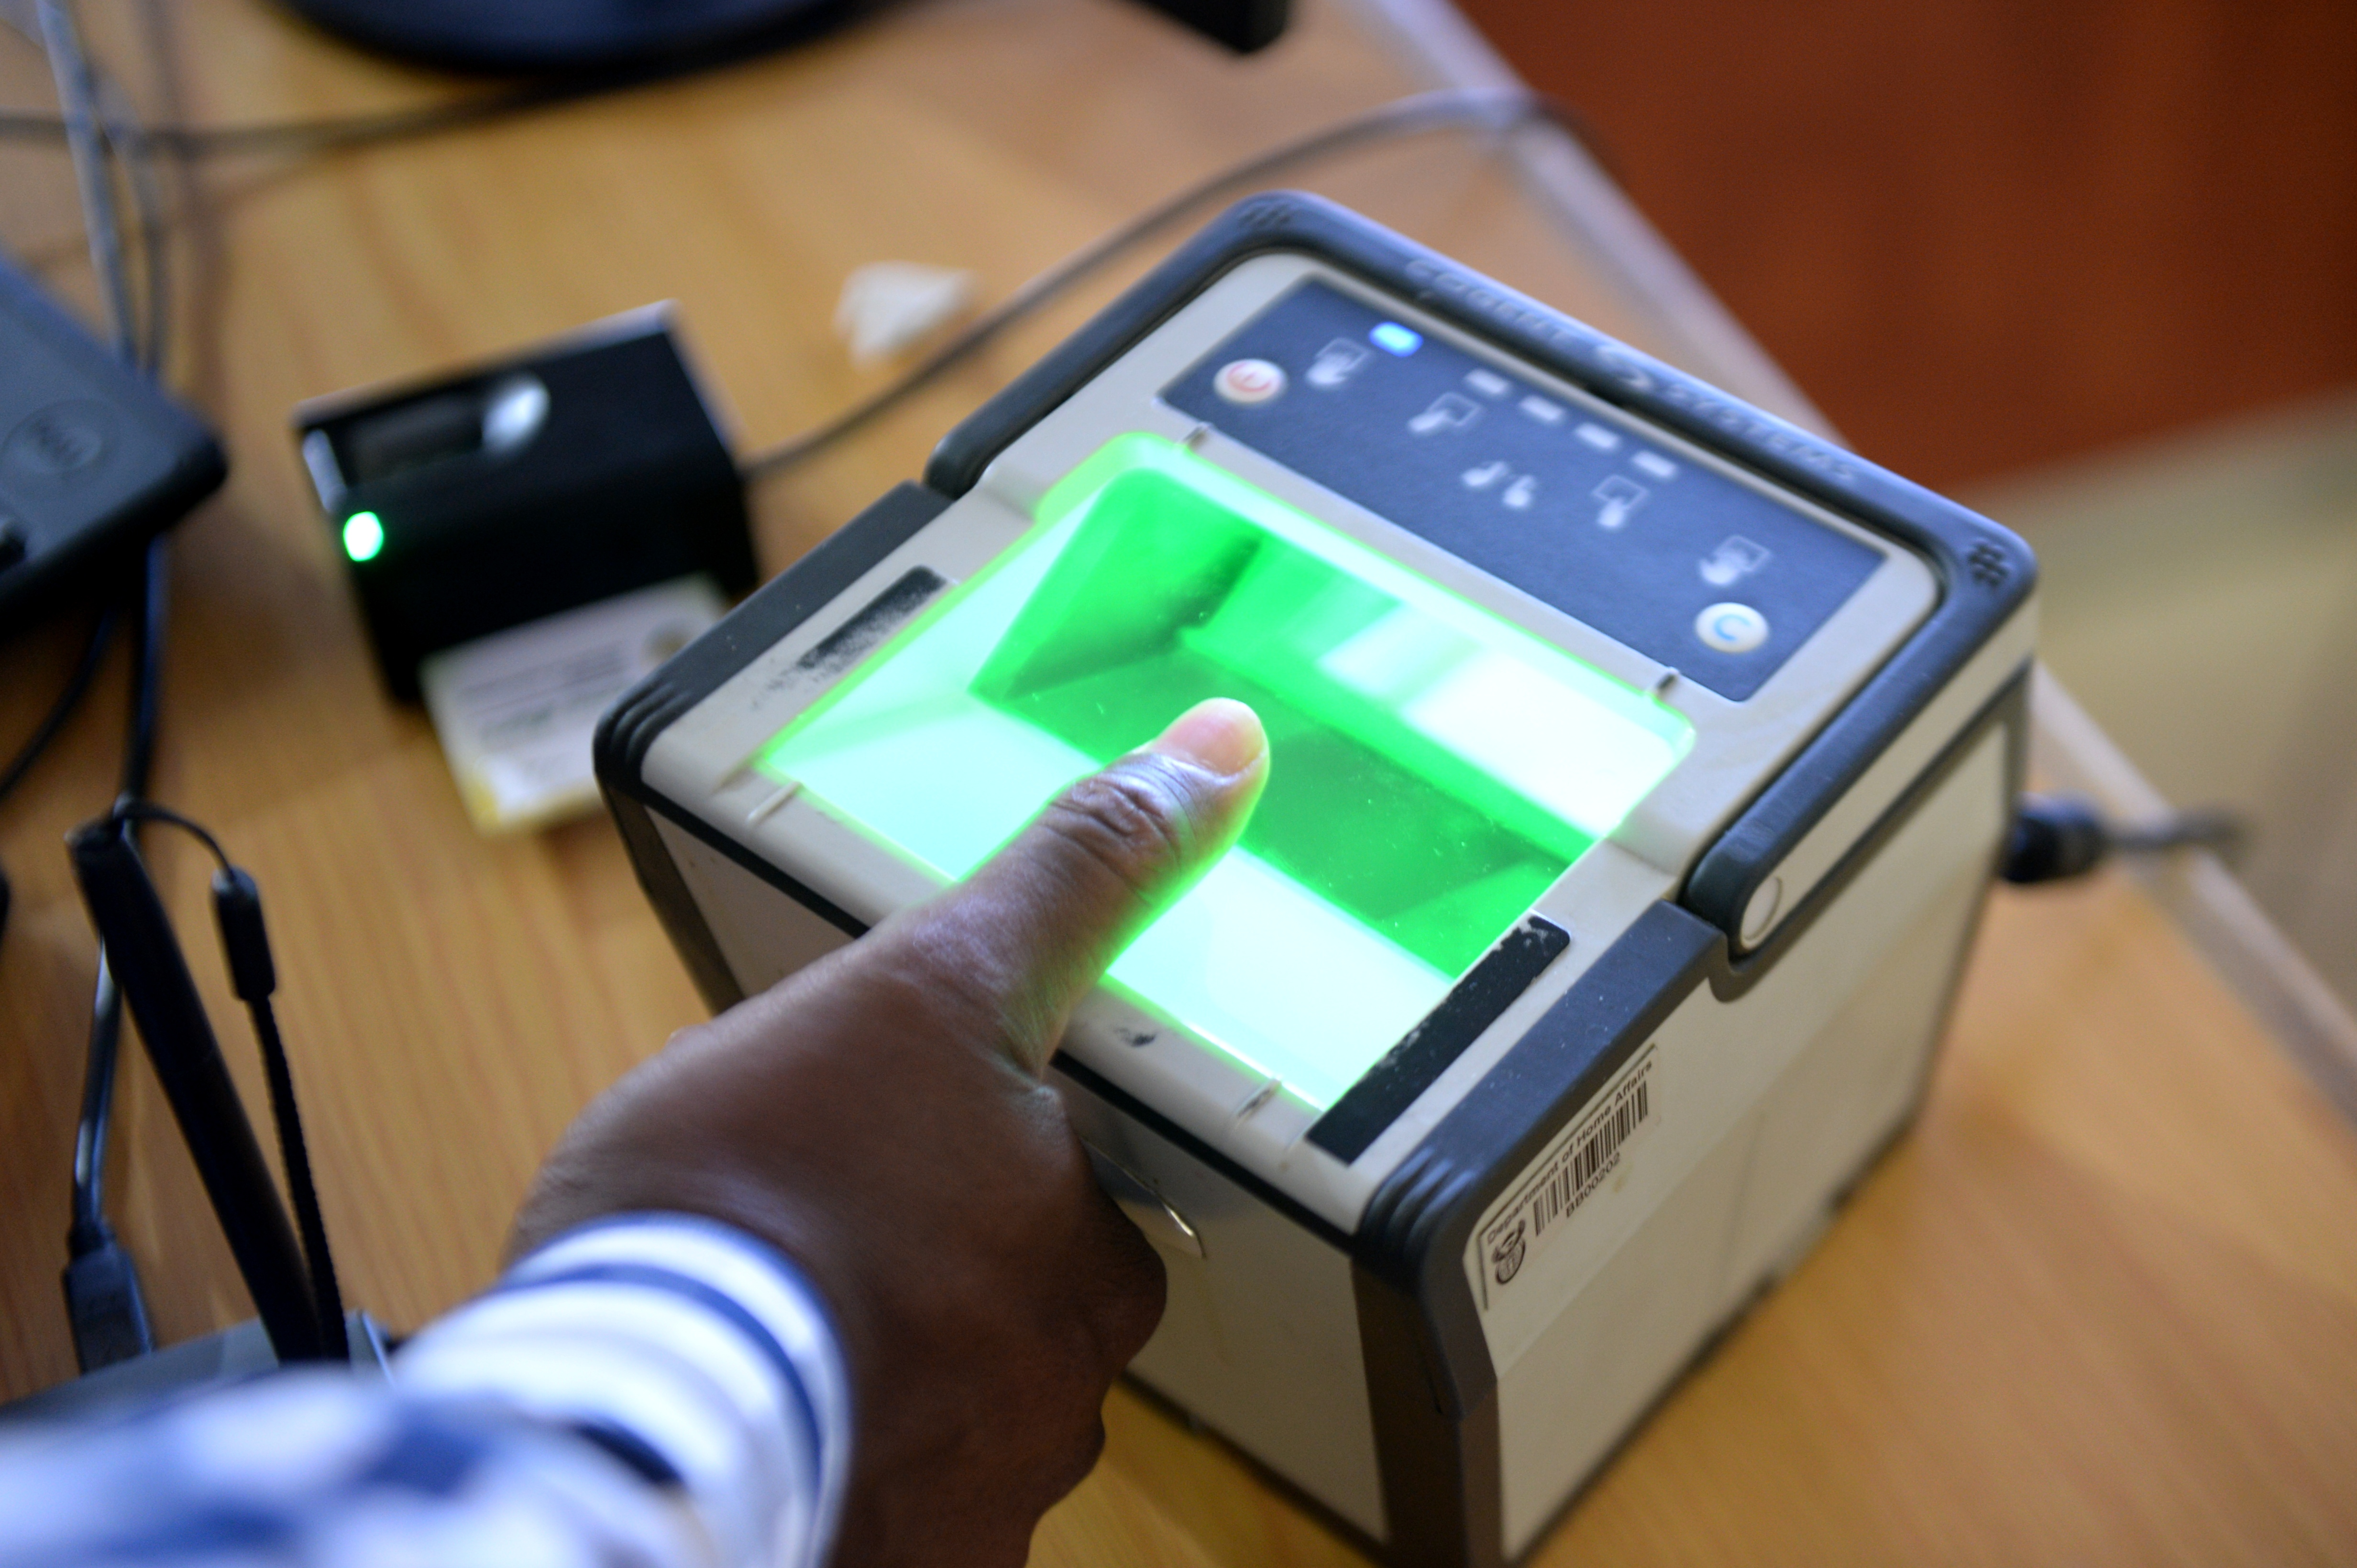
PROGRAMME 1: ADMINISTRATION

Slide 18
PROGRAMME 1: ADMINISTRATION
Strategic objectives supported by the targets | Strategic Objective 1.2: An integrated and digitised National Identity System (NIS) that is secure and contains biometric details of every person recorded on the system.
 | 1.2.1 Procurement of hardware for new Automated Fingerprint Identification System (AFIS) concluded (2015/16)
 | 1.2.2 Implementation of phase 2 of EMCS in line with new Immigration Regulations 2015/16)

Slide 19
PROGRAMME 1: ADMINISTRATION
Strategic objectives supported by the targets | Strategic Objective 3.1: Secure, effective, efficient and accessible service delivery to citizens and immigrants
 | 3.1.1 Number of officials trained on DHA National Certificate: Home Affairs Services (skills programmes within the Certificate) to improve performance
 | 3.1.2 Training of 80 Cadets on identified number of unit standards from the National Certificate: Home Affairs Services (2015/16 to 2017/18)
 | 3.1.3 Number of managers (junior, middle and senior) trained in leadership and management development programmes to improve performance
 | 3.1.4 Number of officials in identified front offices and ports of entry trained on Client Relations Improvement and Professionalising Programme
 | 3.1.5 Implementation of Contact Centre solution in line with DHA modernization strategy (2015/16)

Slide 20
PROGRAMME 1: ADMINISTRATION
Strategic objectives Supported by the targets | Strategic Objective 3.2 Good governance and administration
 | 3.2.1 Compliance with set deadline for submission of annual financial statements to the Auditor-General by 31 May annually
 | 3.2.2 Compliance with set deadline for submission of In-Year Monitoring reports to National Treasury in respect of required format and accurate information
 | 3.2.3 Compliance with set deadline for tabling of Annual Report in Parliament as per PFMA
 | 3.2.4 Quarterly performance reports verified and approved by EXCO and signed by the DG within 60 days after each quarter
 | 3.2.5 Phased implementation of business case (2015/16). • Ministerial approved Cabinet Memorandum on the repositioning of DHA as a security department
 | 3.2.6 Vacancy rate maintained at a set percentage or lower

Slide 21
PROGRAMME 1: ADMINISTRATION
Strategic objectives supported by the targets | Strategic Objective 3.3 Ethical conduct and zero tolerance approach to crime, fraud and corruption
 | 3.3.1 Number of awareness initiatives on ethics, fraud prevention and counter corruption conducted
 | 3.3.2 Percentage of reported cases investigated and finalised within 90 working days
 | 3.3.3 Number of reviews on processes conducted and reports signed off by DG to identify possible vulnerabilities in business processes
 | 3.3.4 Number of Threats and Risk Assessments (TRAs) conducted in accordance with the requirements of Minimum Information- (MISS) and /or Physical Security Standards (MPSS)
 | 3.3.5 Number of vetting fieldwork investigations finalised and submitted to State Security Agency (SSA)

Slide 22
PROGRAMME 1: ADMINISTRATION
Strategic objectives Supported by the targets | Strategic Objective 3.4: Collaboration with stakeholders in support of enhanced service delivery and core business objectives
 | 3.4.1 Implementation of communication strategy and action plan in respect of: Corporate Communication Services, Media Relations and Public Awareness and Engagement

Slide 23
PROGRAMME 1: ADMINISTRATION
Strategic Objective 1.2: An integrated and digitised National Identity System (NIS) that is secure and contains biometric details of every person recorded on the system
PERFORMANCE INDICATOR | ANNUAL TARGET (2015/16) | ACTUAL (2015/16)
Procurement of hardware for new Automated Fingerprint Identification System (AFIS) concluded (2015/16) | Hardware for the development of new Automated Fingerprint Identification System (AFIS) procured in preparation for National Identity System (NIS) | Not achieved AFIS tender specifications were finalised. The tender process commenced in April with the publication of the Request for Accreditation (RFA)
Implementation of phase 2 of EMCS in line with new Immigration Regulations (2015/16) | Phase 2 of EMCS implemented in line with new Immigration Regulations | Achieved Undesirable hits management solution implemented in line with new Immigration regulations Learning Academy trainers trained on new changes to EMCS

Slide 24
PROGRAMME 1: ADMINISTRATION
Strategic Objective 3.1: Secure, effective, efficient and accessible service delivery to citizens and immigrants
PERFORMANCE INDICATOR | ANNUAL TARGET (2015/16) | ACTUAL (2015/16)
Number of officials trained on DHA National Certificate: Home Affairs Services (skills programmes within the Certificate) to improve performance | 350 officials trained on DHA National Certificate: Home Affairs Services (skills programmes within the Certificate) to improve performance | Achieved 407 Officials countrywide were trained on Skills Programmes of the National Certificate Home Affairs Services 117% Achievement.
Training of 80 Cadets on identified number of unit standards from the National Certificate: Home Affairs Services | 80 Cadets trained on 18 unit standards for the National Certificate: Home Affairs Services | Achieved 80 Cadets were trained on 18 unit standards for the National Certificate: Home Affairs Services
Number of managers (junior, middle and senior) enrolled and trained in leadership and management development programmes to improve performance | 250 managers (junior, middle and senior) enrolled and trained in leadership and management development programmes to improve performance | Achieved A total of 779 managers, 460 junior, 268 middle and 51 senior were trained in leadership and management development Programmes. The over-achievement of 212% is due to the demand created by the new Moetapele Initiative by the Office of the Director-General which was additional to the planned programmes

Slide 25
PROGRAMME 1: ADMINISTRATION
Strategic Objective 3.1: Secure, effective, efficient and accessible service delivery to citizens and immigrants
PERFORMANCE INDICATOR | ANNUAL TARGET (2015/16) | ACTUAL (2015/16)
Number of officials in identified front offices and ports of entry trained on Client Relations Improvement and Professionalising Programme | 200 officials in identified front offices and ports of entry trained on Client Relations Improvement and Professionalising Programme | Achieved 212 officials in identified front offices and ports of entry trained on Client Relations Improvement and Professionalising Programme
Implementation of Contact Centre solution in line with DHA modernization strategy (2015/16) | DHA contact centre solution Implemented as per project plan | Achieved • Contract with service provider signed • Statement of work developed • All solutions implemented as per project plan/ statement of work

Slide 26
PROGRAMME 1: ADMINISTRATION
Strategic Objective 3.2: Good governance and administration
PERFORMANCE INDICATOR | ANNUAL TARGET (2015/16) | ACTUAL (2015/16)
Compliance with set deadline for Submission of annual financial statements to the Auditor-General by 31 May annually | Annual financial statements submitted to the Auditor-General by 31 May annually | Achieved Accurate and completed financial statements submitted to Auditor General by 31 May.
Compliance with set deadline for submission of In-Year Monitoring reports to National Treasury in respect of required format and accurate information | In-Year Monitoring reports submitted to National Treasury by the 15th of each month | Achieved The reports for all quarters were submitted by the due date.
Compliance with set deadline for tabling of Annual Report in Parliament as per PFMA | Annual Report tabled in Parliament by 30 September annually | Achieved Annual Report tabled in Parliament by 30 September 2016
Quarterly performance reports verified and approved by EXCO and signed by the DG within60 days after each quarter | 3 DHA 2015/16 and 1 DHA 2014/15 Quarterly performance reports verified and approved by EXCO and signed by the DG within 60 days after each quarter | Achieved 3 DHA 2015/16 and 1 DHA 2014/15 Quarterly Performance Reports verified and approved by EXCO and signed by the DG within 60 days after each Quarter

Slide 27
PROGRAMME 1: ADMINISTRATION
Strategic Objective 3.2: Good governance and administration
PERFORMANCE INDICATOR | ANNUAL TARGET (2015/16) | ACTUAL (2015/16)
Phased implementation of business case (2015/16) Ministerial approved Cabinet Memorandum on the repositioning of DHA as a Security department | First phase of business case implemented: Cabinet Memorandum on the repositioning of DHA as a security department approved by the Minister | Achieved Cabinet agreed to principles and Project charter approved by EXCO and the Minister
Vacancy rate maintained at a set percentage or lower | Vacancy rate maintained at 10% or below by 31 March 2016 | Achieved Throughout the 2015/16 Financial year, a vacancy rate of below 10% was maintained at all times Vacancy rate was at 2.1% as at 31 March 2016

Slide 28
PROGRAMME 1: ADMINISTRATION
Strategic Objective 3.3: Ethical conduct and zero tolerance approach to crime, fraud and corruption
PERFORMANCE INDICATOR | ANNUAL TARGET (2015/16) | ACTUAL (2015/16)
Number of awareness initiatives on ethics, fraud prevention and counter corruption conducted | 20 awareness initiatives on ethics, fraud prevention and counter corruption conducted | Achieved 44 Awareness interventions conducted. The huge success was due to close collaborations with the Learning Academy.
Percentage of reported cases investigated and finalised within 90 working days | 62% reported cases investigated and finalised within 90 working days | Achieved 69% of reported cases investigated and finalised within 90 days
Number of reviews on processes conducted and reports signed off by the DG to identify possible vulnerabilities in business processes | 2 reviews on processes conducted and reports signed off by the DG to identify possible vulnerabilities in business processes | Achieved 2 reviews on processes conducted to identify possible vulnerabilities in business processes

Slide 29
PROGRAMME 1: ADMINISTRATION
Strategic Objective 3.3: Ethical conduct and zero tolerance approach to crime, fraud and corruption
PERFORMANCE INDICATOR | ANNUAL TARGET (2015/16) | ACTUAL (2015/16)
Number of Threats and Risk Assessments (TRAs) conducted in accordance with the requirements of Minimum Information (MISS) and / or Physical Security Standards (MPSS) | 80 (60 MPSS, 20 MISS) | Achieved 88 (67/21) Threat and Risk Assessments(TRAs) conducted in accordance with the requirements of Minimum Information (MISS) and/or Physical Security Standards (MPSS)
Number of vetting fieldwork Investigations finalised and referred to State Security Agency (SSA) | 980 vetting fieldwork Investigations finalised and referred to State Security Agency (SSA) | Achieved 1143 Vetting fieldwork investigations finalised and submitted to State Security Agency (SSA) for Evaluation

Slide 30
PROGRAMME 1: ADMINISTRATION
Strategic Objective 3.4: Collaboration with stakeholders in support of enhanced service delivery and core business objectives
PERFORMANCE INDICATOR | ANNUAL TARGET (2015/16) | ACTUAL (2015/16)
Implementation of communication strategy and action plan with a focus on internal and external communications (actual progress against planned activities) | Communication strategy and action plan developed and implemented in respect of: Corporate Communication Services, Media Relations Public Awareness Engagement | Achieved 13 publications of Ministerial Home Affairs Today produced 8 publications of Notes from the DG’s Desk produced 4 publications of Ikhaya (internal newsletter – printed) produced 22 Media briefings were conducted 20 Ministerial / departmental izimbizo conducted Budget Vote exhibition participated in 1 exhibition participated in

Slide 31
PROGRAMME 2: CITIZEN AFFAIRS

Slide 32
PROGRAMME 2: CITIZEN AFFAIRS
Strategic objectives Supported by the targets | Strategic Objective 1.1: All eligible citizens are issued with enabling documents relating to identity and status.
 | 1.1.1 Number of births registered within 30 calendar days
 | 1.1.2 Number of smart ID cards issued to citizens 16 years of age and above
 | 1.1.3 Percentage (%) of IDs (First issues) issued within 54 working days for applications collected and processed within the RSA (from date of receipt of application until ID is scanned at office of application)
 | 1.1.4 Percentage (%) of IDs (Re-issues) issued within 47 working days for applications collected and processed within the RSA (from date of receipt of application until ID is scanned at office of application)
 | 1.1.5 Percentage (%) of machine readable passports (new live capture system) issued within 13 working days for applications collected and processed within the RSA (from date of receipt of application until passport is scanned at office of application)

Slide 33
PROGRAMME 2: CITIZEN AFFAIRS
Strategic Objective 1.1: All eligible citizens are issued with enabling documents relating to identity and status
PERFORMANCE INDICATOR | ANNUAL TARGET (2015/16) | ACTUAL (2015/16)
Number of births registered within 30 calendar days of birth | 750 000 births registered within 30 calendar days of birth | Not Achieved 703 765 births were registered within 30 days of birth during the review period

Slide 34
Provincial contribution to DHA Annual Target : 750 000 births registered within 30 calendar days of birth
703,765 births registered within 30 calendar days of the birth event.
NOT ACHIEVED
Province | Annual Target 2015/16 | Target Q1 | Actual Performance Q 1 | Target Q2 | Actual Performance Q2 | Target Q3 | Actual Performance Q3 | Target Q4 | Actual Performance Q4 | Total Annual Performance | Annual %
EC | 94,725 | 22,722 | 20,735 | 24,534 | 21,102 | 21,818 | 19,924 | 25,651 | 22,210 | 83,971 | 89%
FS | 45,517 | 11,105 | 10,551 | 11,704 | 10,973 | 10,555 | 10,071 | 12,707 | 10,301 | 41,896 | 92%
GP | 174,084 | 41,958 | 41,218 | 44,723 | 40,542 | 41,735 | 39,537 | 45,668 | 42,033 | 163,330 | 94%
KZN | 127,708 | 29,905 | 30,132 | 32,176 | 30,113 | 30,504 | 28,505 | 35,123 | 31,197 | 119,947 | 94%
LP | 94,767 | 21,708 | 22,669 | 24,604 | 22,836 | 22 369 | 21,495 | 26,086 | 25,517 | 92,517 | 98%
MP | 57,173 | 13,624 | 13,636 | 14,602 | 14,087 | 13,437 | 12,928 | 15,510 | 15,081 | 55,732 | 97%
NC | 22,988 | 5,410 | 5,439 | 6,101 | 5,301 | 5,320 | 5,047 | 6,156 | 5,349 | 21,136 | 92%
NW | 47,261 | 10,959 | 11,400 | 12,336 | 11,229 | 11,078 | 10,584 | 12,888 | 11,908 | 45,121 | 95%
WC | 85,776 | 20,833 | 19,954 | 21,484 | 19,571 | 20,671 | 20,043 | 22,788 | 20,547 | 80,115 | 93%
TOTAL | 750,000 | 178,223 | 175,734 | 192,264 | 175,754 | 177 487 | 168,134 | 202,577 | 184,143 | 703,765 | 94%

Slide 35
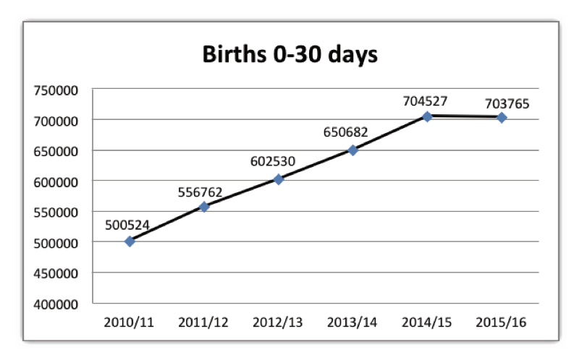
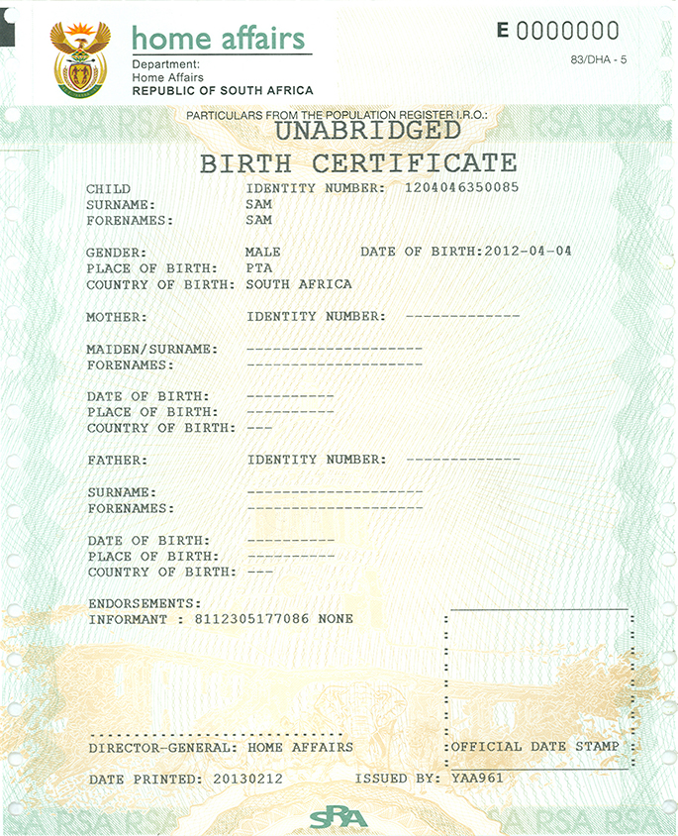
PROGRAMME 2: CITIZEN AFFAIRS

Slide 36
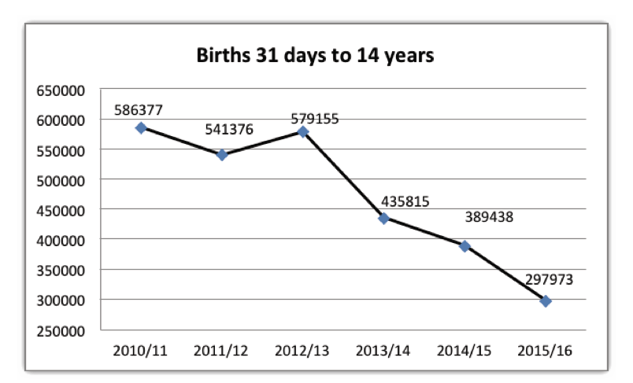
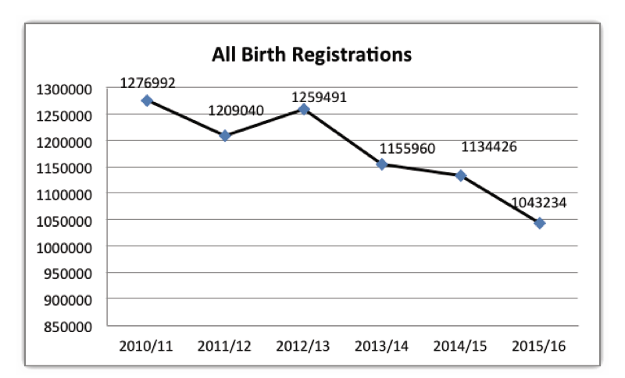
PROGRAMME 2: CITIZEN AFFAIRS

Slide 37
PROGRAMME 2: CITIZEN AFFAIRS
Strategic Objective 1.1: All eligible citizens are issued with enabling documents relating to identity and status
PERFORMANCE INDICATOR | ANNUAL TARGET (2015/16) | ACTUAL (2015/16)
Number of smart ID cards issued to citizens 16 years of age and above | 2.2 million smart ID cards issued to citizens 16 years of age and above | Achieved 2 320 972 ID smart cards were issued to citizens
Percentage (%) of IDs (First issues) issued within 54 working days for applications collected and processed within the RSA (from date of receipt of application until ID is scanned at office of application) | 90%of IDs (First issues) issued within 54 working days for applications collected and processed within the RSA (from date of receipt of application until ID is scanned at office of application) | Achieved 93.9% of IDs (first issues) were issued within 54 working days (RSA applications only) 275 699 IDs (First Issue) were issued in 54 working days and 17 731 above. The total number of IDs (First Issues) issued during the review period was 293 430

Slide 38
Provincial contribution to DHA Annual Target : 2,200,000 Smart ID Card issued to citizens 16 years and above. Smart ID Cards issued (ready for collection)
Achieved
Province | Provincial contribution to the APP target | Target Q 1 | Actual Performance Q 1 | Target Q2 | Actual Performance Q 2 | Target Q3 | Actual Performance Q3 | Target Q4 | Actual performance Q4 | Annual Performance | Year %
EC | 261,499 | 55,866 | 52,167 | 68,941 | 53,432 | 71318 | 67863 | 65375 | 82434 | 255,896 | 98%
FS | 113,695 | 24,289 | 30,362 | 29,974 | 31,141 | 31008 | 33301 | 28,424 | 34905 | 129,709 | 114%
GP | 659,432 | 140,879 | 128,265 | 173,850 | 138,819 | 179845 | 143976 | 164858 | 167603 | 578,663 | 88%
KZN | 301,292 | 64,367 | 80,307 | 79,432 | 90,662 | 82171 | 100907 | 75323 | 112402 | 384,278 | 128%
LP | 204,651 | 43,721 | 63,286 | 53,953 | 61,406 | 55814 | 68696 | 51163 | 76198 | 269,586 | 132%
MP | 187,597 | 40,078 | 40,466 | 49,457 | 41,563 | 51163 | 45723 | 46899 | 46595 | 174,347 | 93%
NC | 96,641 | 20,646 | 15,642 | 25,478 | 18,146 | 26357 | 19884 | 24160 | 20939 | 74,611 | 77%
NW | 176,227 | 37,649 | 34,756 | 46,460 | 39,463 | 48062 | 42527 | 44057 | 49382 | 166,128 | 94%
WC | 198,966 | 42,506 | 53,002 | 52,455 | 63,387 | 54264 | 72175 | 49742 | 84923 | 273,487 | 137%
GP Banks | NA | NA | NA | Pilot | 1,921 | - | 4197 | - | 8149 | 14,267
TOTAL | 2,200,000 | 470,000 | 498,253 | 580,000 | 539,940 | 600002 | 599249 | 550001 | 683530 | 2,320,972 | 105%

Slide 39
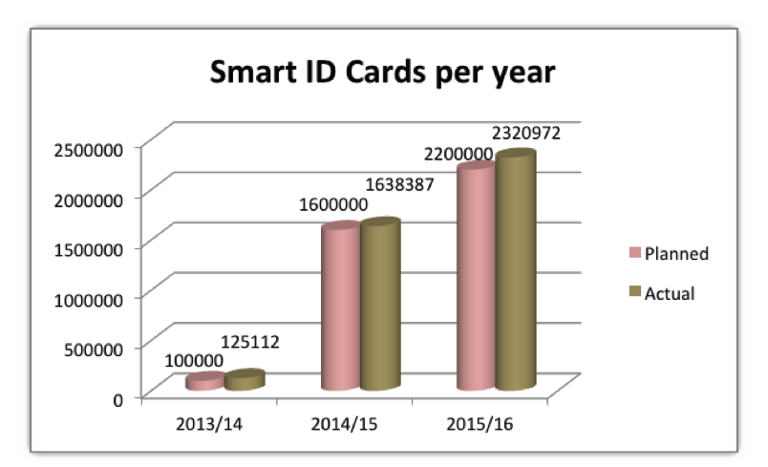
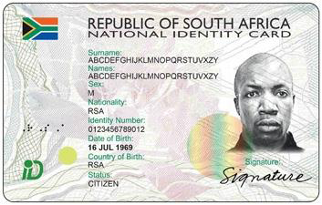
PROGRAMME 2: CITIZEN AFFAIRS

Slide 40
PROGRAMME 2: CITIZEN AFFAIRS
Strategic Objective 1.1: All eligible citizens are issued with enabling documents relating to identity and status
PERFORMANCE INDICATOR | ANNUAL TARGET (2015/16) | ACTUAL (2015/16)
Percentage (%) of IDs (Re-issues) issued within 47 working days for applications collected and processed within the RSA (from date of receipt of application until ID is scanned at office of application) | 95%of IDs (Re-issues) issued within 47 working days for applications collected and processed within the RSA (from date of receipt of application until ID is scanned at office of application | Achieved 97.9% of IDs (Re-issues) were issued within 47 working days (RSA applications only) 208 422 IDs (Re-issues) were issued in 47 working days and 4 507 above. The total number of IDs (Re-issues) issued during the review period was 212 929

Slide 41
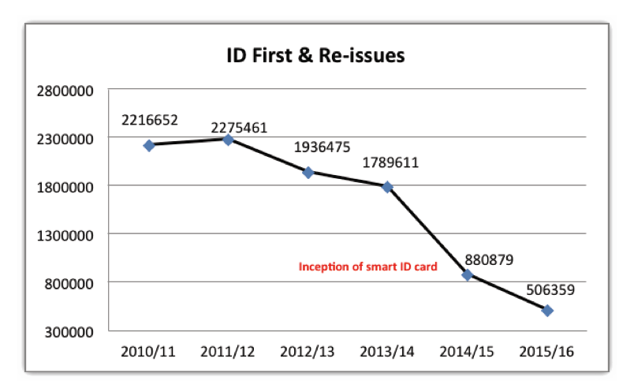
PROGRAMME 2: CITIZEN AFFAIRS

Slide 42
PROGRAMME 2: CITIZEN AFFAIRS
Strategic Objective 1.1: All eligible citizens are issued with enabling documents relating to identity and status
PERFORMANCE INDICATOR | ANNUAL TARGET (2015/16) | ACTUAL (2015/16)
Percentage (%) of machine readable passports (manual process) issued within 24 working days for applications collected and processed within the RSA (from date of receipt of application until passport is scanned at office of application | 90% of machine readable passports (manual process) issued within 24 working days for applications collected and processed within the RSA (from date of receipt of application until passport is scanned at office of application) | Achieved 92.4% of machine readable passports (MRP) (live capture process) were issued within 13 working days (RSA applications only) 563 475 MRPs (live capture process) were issued in 13 working days and 46 273 above. The total number of MRPs (live capture process) issued during the review period was 609 748

Slide 43
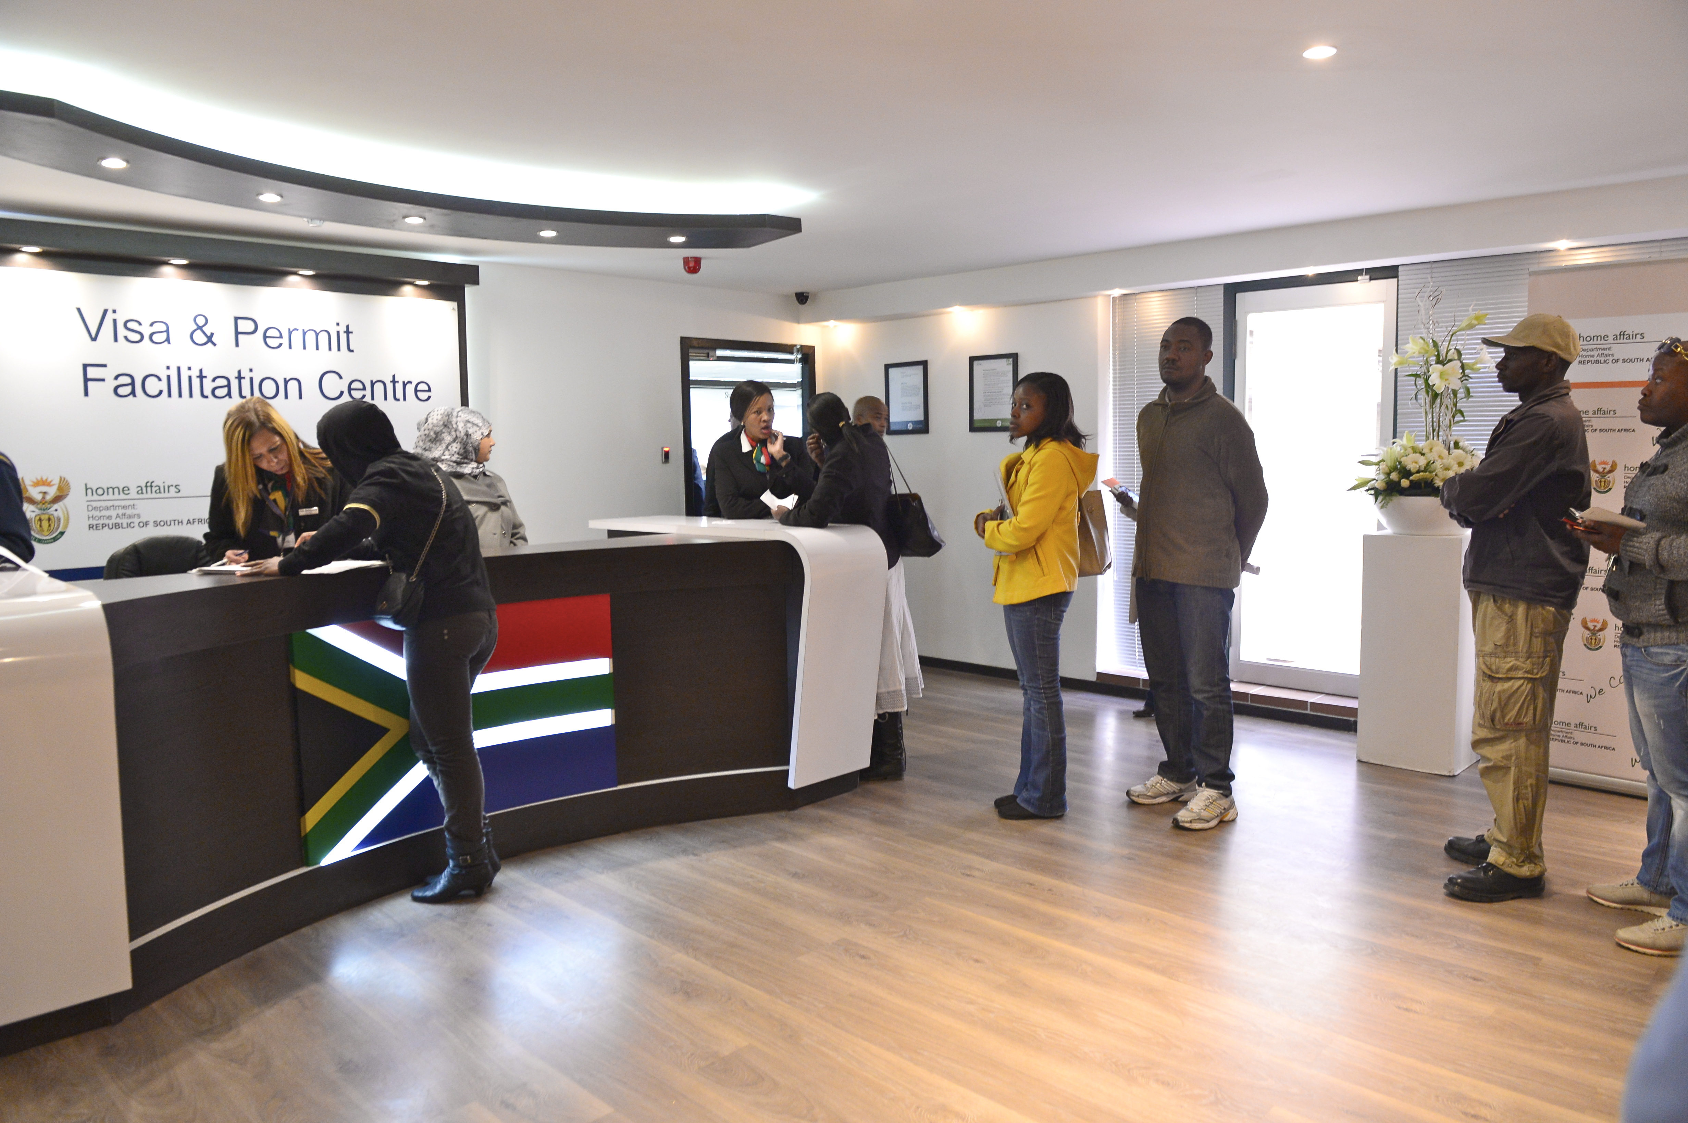
PROGRAMME 3: IMMIGRATION AFFAIRS

Slide 44
PROGRAMME 3: IMMIGRATION AFFAIRS
Strategic objectives supported by the targets | Strategic Objective 2.1: Refugees and asylum seekers are managed and documented efficiently
 | 2.1.1 Percentage (%) of refugee IDs (first issue) issued within 90 working days (from the date of application at refugee reception offices until document is ready at office of application)
 | 2.1.2 Percentage (%) of refugee travel documents issued within 90 working days (from the date of application at refugee reception offices until travel document is ready at office of application)
 | 2.1.3 Submission to Minister for approval of strategy for local integration, repatriation and resettlement of refugees (2015/16)

Slide 45
PROGRAMME 3: IMMIGRATION AFFAIRS
Strategic objectives supported by the targets | Strategic Objective 2.2: Movement of persons in and out of the country managed according to a risk based approach
 | 2.2.1 Promulgation of BMA legislation (2015/16)
 | 2.2.2 Approval of over-arching strategy to defend, protect, secure and ensure well-managed borders by DHA (2015/16)
 | 2.2.3 Number of priority ports of entry (POE’s) to which Port Control Strategy and Operational Framework have been rolled out (2015/16 and 2016/17)
 | 2.2.4 Number of surveys of borderline communities conducted
 | 2.2.5 Submission of final draft of Green Paper on International Migration to Minister for approval (2015/16)
 | 2.2.6 Approval of report on feasibility study conducted at 3 foreign missions for installation of biometric system by DDG:IMS (2015/16)

Slide 46
PROGRAMME 3: IMMIGRATION AFFAIRS
Strategic objectives supported by the targets | Strategic Objective 2.3 Enabling documents issued to foreigners efficiently and securely
 | 2.3.1 Percentage (%) of permanent residence applications adjudicated within 8 months for applications collected within the RSA (from date of receipt of application until outcome is received at the office of application) (Above applications refer to: critical skills (s27b), general work (s26a) and business (s27c) only)
 | 2.3.2 Percentage (%) of business and general work visas adjudicated within 8 weeks for applications processed within the RSA (from date of receipt of application until outcome is received at the office of application)
 | 2.3.3 Percentage (%) of critical skills visas adjudicated within 4 weeks for applications processed within the RSA (from date of receipt of application until outcome is received at the office of application)

Slide 47
PROGRAMME 3: IMMIGRATION AFFAIRS
Strategic Objective 2.1: Refugees and asylum seekers are managed and documented efficiently
PERFORMANCE INDICATOR | ANNUAL TARGET (2015/16) | ACTUAL (2015/16)
Percentage (%) of refugee IDs issued within 90 calendar days (from the date of application at refugee reception offices until document is ready at office of application) | 50% of refugee IDs issued within 90 calendar days (from the date of application at refugee reception offices until document is ready at office of application) | Achieved Total applications over the annual reporting period are: 7,754. Refugee IDs produced and dispatched back to RROs within turnaround time: 3,977. Performance translates to 51% achievement. Total figure of applications disqualified: 506
Percentage (%) of refugee travel documents issued within 90 calendar days (from the date of application at refugee reception offices until travel document is ready at office of application) to citizens 16 years of age and above | 80% of refugee travel documents issued within 90 calendar days (from the date of application at refugee reception offices until travel document is ready at office of application) to citizens 16 years of age and above | Not Achieved Out of 5,585 applications received from RROs during the reporting period 2015/16, 1241 were produced within the stipulated turnaround time. Annual performance translates to 22% achievement

Slide 48
PROGRAMME 3: IMMIGRATION AFFAIRS
Strategic Objective 2.1: Refugees and asylum seekers are managed and documented efficiently
PERFORMANCE INDICATOR | ANNUAL TARGET (2015/16) | ACTUAL (2015/16)
Submission to the Minister for approval of strategy for local integration, repatriation and resettlement of refugees (2015/16) | Strategy for local integration, repatriation and resettlement of refugees submitted to the Minister for approval | Achieved The Strategy for local integration, repatriation and resettlement of refugees was presented to EXCO on 07 March 2016 and final draft was processed for the Minister’s consideration and approval on 25 March 2016

Slide 49
PROGRAMME 3: IMMIGRATION AFFAIRS
Strategic Objective 2.2: Movement of persons in and out of the country regulated according to a risk based approach
PERFORMANCE INDICATOR | ANNUAL TARGET (2015/16) | ACTUAL (2015/16)
Promulgation of BMA legislation (2015/16) Launch of BMA | BMA legislation promulgated | Not Achieved The first draft BMA Bill was finalised in June 2015 and gazetted in August 2015 for public comments Cabinet approved the introduction of the Bill into Parliament in September 2015, thereafter the Bill was submitted to Parliament in October 2015 Considering the socioeconomic implications of the BMA, engagements on the Bill were initiated with NEDLAC in November 2015. As a consequence, Parliamentary deliberations on the Bill could not commence Engagements with NEDLAC progressed well and finalised in May 2016, the BMA Bill was formally introduced to Parliament and currently under discussion at Portfolio Committee on Home Affairs

Slide 50
PROGRAMME 3: IMMIGRATION AFFAIRS
Strategic Objective 2.2: Movement of persons in and out of the country regulated according to a risk based approach
PERFORMANCE INDICATOR | ANNUAL TARGET (2015/16) | ACTUAL (2015/16)
Approval of overarching strategy to defend, protect, secure and ensure well-managed borders by DHA (2015/16) | Over-arching strategy developed and approved by the Minister | Not Achieved The BMA Project Management Office prepared a Terms of Reference for the appointment of a Service Provider to undertake the drafting of the Integrated Border Management Strategy (IBMS) however, a Service Provider could not be appointed As a result the BMA Project Management Office plans to draft the Strategy with support from the BMA Policy and Legal Task Team which is constituted by various stakeholders A draft IBMS outline was prepared in this regard

Slide 51
PROGRAMME 3: IMMIGRATION AFFAIRS
Strategic Objective 2.2: Movement of persons in and out of the country regulated according to a risk based approach
PERFORMANCE INDICATOR | ANNUAL TARGET (2015/16) | ACTUAL (2015/16)
Number of priority ports of entry to which Port Control Strategy and Operational Framework have been rolled out (2015/16 and 2016/17) | Roll-out of Port Control Strategy and Operational Framework to 5 priority ports of entry | Not Achieved
Number of surveys of borderline Communities conducted | 1 survey of borderline communities conducted | Achieved A survey of borderline communities was conducted
Submission of final draft of Green Paper on International Migration to the Minister for approval (2015/16) | Final draft of Green Paper on International Migration submitted to the Minister for approval | Achieved Final draft of Green Paper on International Migration approved by the Minister on29 March 2016

Slide 52
PROGRAMME 3: IMMIGRATION AFFAIRS
Strategic Objective 2.2: Movement of persons in and out of the country regulated according to a risk based approach
PERFORMANCE INDICATOR | ANNUAL TARGET (2015/16) | ACTUAL (2015/16)
Approval of report on feasibility study conducted at 3 foreign missions for Installation of biometric system by DDG:IMS (2015/16) | Approval of report on feasibility study conducted at 3 foreign missions for Installation of biometric system by DDG:IMS (2015/16) | Achieved Feasibility study conducted at 3 foreign missions (Munich, Colombo and Harare) and report approved by DDG: IMS
Percentage (%) of permanent Residence applications adjudicated within 8 months for applications collected within the RSA (from date of receipt of application until outcome is known) | 70% of permanent Residence applications adjudicated within 8 months for applications collected within the RSA (from date of receipt of application until outcome is known | Not Achieved From a population of 5,227 applications, a total of 2,754 were adjudicated within the turnaround time, thus yielding a 53% achievement for the year

Slide 53
PROGRAMME 3: IMMIGRATION AFFAIRS
Strategic Objective 2.2: Movement of persons in and out of the country regulated according to a risk based approach
PERFORMANCE INDICATOR | ANNUAL TARGET (2015/16) | ACTUAL (2015/16)
Percentage (%) of business, critical skills, and general work permits adjudicated within 8 weeks for applications processed within the RSA (from date of receipt of application until outcome is known) | 70% of business, critical skills and general work permits adjudicated within 8 weeks for applications processed within the RSA | Achieved Out of 6,805 applications 5,764 were adjudicated within the 8 weeks turnaround time thus yielding an 84.7% achievement for the year under review

Slide 54
PROVINCIAL ANNUAL PERFORMANCE REPORT

Slide 55
Provincial target :9 outreach campaigns conducted in provinces to support the Late Registration of Birth final mop up campaign. Achieved
Achieved
Province | Annual target | Target Q1 | Actual performance Q1 | Additional information on LRB hot spot areas visited Q1 | Target Q2 | Actual performance Q2 | Additional information on LRB hot spot areas visited Q2 | Target Q3 | Actual performance Q3 | Additional information on LRB hot spot areas visited Q3 | Target Q4 | Actual performance Q4 | Annual Performance
EC | 1 | - | - | - | 1 | 1 | 211 | - | - | - | - | - | 1
FS | 1 | 1 | 2 | 42 | - | - | - | - | - | - | - | - | 2
GP | 1 | - | - | - | 1 | 1 | 153 | - | - | - | - | - | 1
KZN | 1 | 1 | 1 | 176 | - | - | - | - | - | - | - | - | 1
LP | 1 | 1 | 1 | 144 | - | - | - | - | - | - | - | - | 1
MP | 1 | - | - | - | 1 | 1 | 100 | - | - | - | - | - | 1
NC | 1 | - | - | - | - | - | - | 1 | 1 | 55 | - | - | 1
NW | 1 | - | - | - | - | - | - | 1 | 1 | 99 | - | - | 1
WC | 1 | - | - | - | - | - | - | 1 | 1 | 110 | - | - | 1
TOTALS | 9 | 3 | 4 | 362 | 3 | 3 | 464 | 3 | 3 | 264 | - | - | 10

Slide 56
Provincial target : Number of employers charged for contravening section 38 (4)(a) of the Immigration Act
NOT ACHIEVED
Province | Annual target | Target Q1 | Actual performance Q 1 | % Actual Performance Q1 | Target Q2 | Actual performance Q 2 | % Actual Performance Q2 | Target Q3 | Actual performance Q 3 | % Actual Performance Q3 | Target Q4 | Actual performance Q 4 | % Actual Performance Q4 | Financial year Performance | % Financial year Performance to date
EC | 54 | 13 | 9 | 69% | 15 | 9 | 60% | 16 | 20 | 125% | 10 | 11 | 110% | 49 | 91%
FS | 40 | 10 | 15 | 150% | 10 | 5 | 50% | 10 | 11 | 110% | 10 | 16 | 160% | 47 | 118%
GP | 291 | 92 | 27 | 29% | 67 | 27 | 40% | 67 | 34 | 51% | 67 | 4 | 0.5% | 92 | 31%
KZN | 42 | 8 | 10 | 125% | 13 | 11 | 85% | 7 | 7 | 100% | 14 | 12 | 86% | 40 | 95%
LP | 159 | 40 | 12 | 30% | 39 | 24 | 54% | 40 | 9 | 23% | 40 | 51 | 127% | 96 | 60%
MP | 58 | 8 | 8 | 100% | 18 | 11 | 61% | 14 | 10 | 71% | 18 | 2 | 67% | 41 | 71%
NC | 51 | 14 | 10 | 71% | 13 | 28 | 223% | 12 | 4 | 33% | 12 | 4 | 33% | 46 | 90%
NW | 40 | 10 | 26 | 260% | 10 | 11 | 110% | 10 | 19 | 190% | 10 | 12 | 120% | 68 | 170%
WC | 45 | 14 | 10 | 71% | 10 | 19 | 190% | 10 | 1 | 10% | 11 | 16 | 145% | 46 | 102%
TOTALS | 780 | 209 | 127 | 61% | 195 | 145 | 74% | 186 | 115 | 62% | 192 | 128 | 67% | 525 | 67%

Slide 57
Provincial Target Number of Transgressors of departmental legislation charged in terms of section 49 of the Immigration Acts
ACHIEVED
Province | Annual target | Target Q1 | Actual performance Q1 | % Actual Performance Q1 | Target Q2 | Actual performance Q2 | % Actual Performance Q2 | Target Q3 | Actual performance Q3 | % Actual Performance Q3 | Target Q4 | Actual performance Q4 | % Actual Performance Q4 | Financial year Performance | % Financial year Performance
EC | 1595 | 391 | 433 | 111% | 416 | 423 | 102% | 395 | 460 | 116% | 393 | 394 | 101% | 1710 | 107%
FS | 614 | 153 | 941 | 615% | 154 | 605 | 392% | 154 | 660 | 233% | 153 | 695 | 454% | 2901 | 472%
GP | 8176 | 2044 | 5020 | 246% | 2044 | 1615 | 79% | 2044 | 1535 | 75% | 2044 | 1324 | 65% | 9494 | 116%
KZN | 1538 | 376 | 876 | 233% | 538 | 570 | 106% | 343 | 360 | 105% | 281 | 279 | 99% | 2085 | 135%
LP | 4156 | 936 | 1013 | 108% | 911 | 1081 | 119% | 1307 | 1181 | 90% | 1002 | 1393 | 139% | 4668 | 112%
MP | 415 | 112 | 298 | 266% | 105 | 565 | 538% | 99 | 351 | 355% | 99 | 252 | 255% | 1466 | 353%
NC | 1118 | 280 | 409 | 146% | 280 | 461 | 165% | 278 | 186 | 70% | 280 | 49 | 18% | 1105 | 99%
NW | 624 | 156 | 843 | 540% | 156 | 574 | 368% | 153 | 501 | 327% | 159 | 323 | 203% | 2241 | 359%
WC | 800 | 199 | 387 | 194% | 199 | 556 | 279% | 199 | 240 | 135% | 203 | 267 | 132% | 1450 | 181%
TOTALS | 19036 | 4647 | 10220 | 220% | 4803 | 6450 | 134% | 4972 | 5474 | 110% | 4614 | 4976 | 108% | 27120 | 142%

Slide 58
Provincial Target : 100% of Detected undocumented foreigners deported directly within 30 Calendar days.
ACHIEVED
Province | Annual target | Target Q1 | Actual performance Q1 | Target Q2 | Actual performance Q2 | Target Q3 | Actual performance Q3 | Target Q4 | Actual performance Q4 | Financial year Performance to date
EC | 100% | 100% | 65/65 (100%) | 100% | 44/44 (100%) | 100% | 19/19 (100%) | 100% | 4/4 (100%) | 172/172 (100%)
FS | 100% | 100% | 1465/1465 (100%) | 100% | 1269/1269 (100%) | 100% | 1079/1079 (100%) | 100% | 844/844 (100%) | 4657/4657 (100%)
GP | 100% | 100% | 454/454 (100%) | 100% | 72/72 (100%) | 100% | 427/427 (100%) | 100% | 880/880 (100%) | 1833/1833 (100%)
KZN | 100% | 100% | 655/655 (100%) | 100% | 189/189 (100%) | 100% | 148/148 (100%) | 100% | 207/207 (100% | 1199/1199 (100%)
LP | 100% | 100% | 679/679 (100%) | 100% | 1433/1433 (100%) | 100% | 1198/1198 (100%) | 100% | 1089/1089 (100%) | 4399/4399 (100%)
MP | 100% | 100% | 259/259 (100%) | 100% | 674/674 (100%) | 100% | 606/606 (100%) | 100% | 2049/2049 (100%) | 3588/3588 (100%)
NC | 100% | 100% | 35/35 (100%) | 100% | 31/31 (100%) | 100% | 36/36 (100%) | 100% | 20/20 (100%) | 122/122 (100%)
NW | 100% | 100% | 32/32 (100%) | 100% | 69/69 (100%) | 100% | 48/48 (100%) | 100% | 28/28 (100%) | 177/177 (100%)
WC | 100% | 100% | 21/21 (100%) | 100% | 2/2 (100%) | 100% | 0 | 100% | 0 | 23/23(100%)
TOTALS | 100% | 100% | 3665/3665 (100%) | 100% | 3783/3783 (100%) | 100% | 3561/3561 (100%) | 100% | 5121/5121| (100%) | 16147/16147 (100%)

Slide 59
Provincial Target : 100% of Detected undocumented foreigners transferred to Lindela within 20 calendar days
ACHIEVED
Province | Annual target | Target Q1 | Actual performance Q1 | Target Q2 | Actual performance Q2 | Target Q3 | Actual performance Q3 | Target Q4 | Actual performance Q4 | Financial year End
EC | 100% | 100% | 37/51 (73%) | 100% | 7/7 ( 100%) | 100% | 72/72 (100%) | 100% | 94/94 ( 100%) | 210/224 (94%)
FS | 100% | 100% | 583/583 (100%) | 100% | 192/192 (100%) | 100% | 213/213 (100%) | 100% | 149/149 (100%) | 1137/1137 (100%)
GP | 100% | 100% | 4512/4691 (96%) | 100% | 3639/3722 (98%) | 100% | 2386/2386 (100%) | 100% | 2633/2633 (100%) | 13170/13432 (98%)
KZN | 100% | 100% | 186/186 (100%) | 100% | 303/303 (100%) | 100% | 84/84 (100%) | 100% | 134/134 (100%) | 707/707 (100%)
LP | 100% | 100% | 20/20 (100%) | 100% | 34/34 (100%) | 100% | 95/95 (100%) | 100% | 58/58 % (100%) | 207/207 (100%)
MP | 100% | 100% | 93/93 (100%) | 100% | 105/105 (100%) | 100% | 117/117 (100%) | 100% | 44/44 (100%) | 359/359 (100%)
NC | 100% | 100% | 375/375 (100%) | 100% | 337/337 (100%) | 100% | 291/291 (100%) | 100% | 75/75 (100%) | 1078/1078 (100%)
NW | 100% | 100% | 853/853 (100%) | 100% | 421/421 (100%) | 100% | 328/328 (100%) | 100% | 320/320 (100%) | 1922/1922 (100%)
WC | 100% | 100% | 138/138 (100%) | 100% | 228/228 (100%) | 100% | 93/93 (100%) | 100% | 40/40(100%) | 499/499 (100%)
TOTALS | 100% | 100% | 6797 / 6990 (97%) | 100% | 5266/5349 (98%) | 100% | 3679/3679 (100%) | 100% | 3547/3547 (100%) | 19289/19565 (99%)

Slide 60
Provincial Target : 100% of Cases of fraudulent marriages finalized
ACHIEVED
Province | Annual target | Target Q1 | Actual performance Q1 | Target Q2 | Actual performance Q2 | Target Q3 | Actual performance Q3 | Target Q4 | Actual performance Q4 | Financial year end
EC | 100% | 100% | (6/6) (100%) | 100% | No reported cases | 100% | No reported cases | 100% | No reported cases | 6/6 (100%)
FS | 100% | 100% | (5/5) (100%) | 100% | 1/1 (100%) | 100% | 3/3 (100%) | 100% | No reported cases | 9/9 (100%)
GP | 100% | 100% | (27/27) (100%) | 100% | 17/17 (100%) | 100% | 27/27 (100%) | 100% | 3/3(100%) | 74/74 (100%)
KZN | 100% | 100% | (84/84) (100%) | 100% | 4/4 (100%) | 100% | 25/25 (100%) | 100% | 3/3 (100%) | 116/116 (100%)
LP | 100% | 100% | (1/1) (100%) | 100% | 2/2 (100%) | 100% | 1/1(100%) | 100% | 3/3(100%) | 7/7 (100%)
MP | 100% | 100% | (20/20) (100%) | 100% | 19/19 (100%) | 100% | 1/1(100%) | 100% | 29/29 (100%) | 69/69 (100%)
NC | 100% | 100% | (3/3) (100%) | 100% | 1/1 (100%) | 100% | No reported cases | 100% | No reported cases | 4/4 (100%)
NW | 100% | 100% | (1/1) 100% | 100% | 1/1 (100%) | 100% | 2/2 (100%) | 100% | No reported cases | 4/4 (100%)
WC | 100% | 100% | (2/2) (100%) | 100% | No reported cases | 100% | 4/4 (100%) | 100% | No reported cases | 6/6 (100%)
TOTALS | 100% | 100% | (149 / 149) (100%) | 100% | 45/45 (100%) | 100% | 63/63 (100%) | 100% | 38/38(100%) | 295/295 (100%)

Slide 61
GLOBAL DHA CHALLENGES AND POSSIBLE SOLUTIONS
DHA Challenges | Strategic Responses
Effective and efficient management of the asylum seeker and refugee environment, including the relocation of refugee centers closer to borderlines and management of economic migrants. | Develop and implement new policy and legislation (e.g. Zimbabwean and Lesotho dispensations); Improve areas such as appeals, Marabastad and deportations Finalise the development of White Paper on International Migration as there is a chapter which deals with overall management of asylum seekers and refugees
Overhaul of the border management environment and provision of acceptable port infrastructure. | Establish a Border Management Agency; Transform the permitting environment to support national interests; Finalise the infrastructure development of the 6 ports of entry; and Capacitating the inspectorate function.
Historical under-funding and resourcing of the DHA. | Developing and advocating a business case to reposition the DHA; including new funding and organisational options; and Phased implementation of agreed intervention strategies (e.g. working with banks).
Dependency on the Departments of Public Works and SITA for timeous service delivery. | Find strategic way to work with these entities including the approach of DHA being exempted. .
Non-integration of IT systems across the DHA. | Invest in the modernisation of the DHA in terms of capacity to drive the process: specialists and programme office.
Lack of efficient records management in support of key civic and immigration services to clients. | Phased digitisation of records using earmarked funds received from Treasury to start process through partnerships with appropriate organisations (e.g. StatsSA and employment creation funds).

Slide 62
GLOBAL DHA CHALLENGES AND POSSIBLE SOLUTIONS
DHA Challenges | Possible Strategic Responses
Lack of capacity in critical areas such as Inspectorate, Legal Services, Risk Management, Information Services, Counter Corruption and Security Services & Financial Management. | Phased in implementation of the restructuring of the organisational structure as per proposals submitted to DPSA so as to increase the proportion of specialists. This must be aligned with the new technology and partnership model as well as recommendations to be made in Business Case
Fight against unlawful activities. | Shift resources and start building security systems around high-risk areas and processes.
Improvement of governance and administration practices. | Eradicate poor service delivery and promote good governance and administration which includes putting in place necessary controls, processes and systems, establishing sound leadership and management practices, adequate delegation of powers, building a strong monitoring and evaluation function and a programme office supported by reliable management information and ensuring a conducive working environment for clients and staff. Intensify the implementation of Moetapele programme
Ensuring staff are appropriately trained, professional and caring with the required leadership and management capabilities. | The professionalisation of the DHA through developing officials that are ethical, patriotic and professional. Training programmes and the development of leadership and management capabilities will be a key success factor.
Organisational structure and operating model not fully in support of mandate. | This will be developed with other business case options, with input from the process of the recently commissioned restructuring of organisational model.
People, processes and organisation are not secure. | Build a security system to protect the DHA. This will include process and system security such as the design and implementation of a national identity system with biometric capability; as well as cadre formation, vetting, counter intelligence and cyber security.

Slide 63
Financial Information

Slide 64
AUDIT OUTCOMES: 2013/14 FY, 2014/15 FY and 2015/16FY
2013/14 FY – Disclaimer | 2014/15 FY – Qualification | 2015/16 FY – Qualification
Departmental Revenue (Foreign Revenue and Fines) | Departmental Revenue (Foreign Revenue and Fines) | Departmental Revenue (Foreign Revenue)
Accruals and payables not recognised | Accruals and payables not recognised | Accruals and payables not recognised
Movable tangible capital assets | - | -
Intangible assets | Intangible assets | -
Immovable assets | - | -
Commitments | - | -

Slide 65
Legacy issues - Foreign revenue
Amendments to the Immigration Act
The Immigration Act was amended on the 26th of May 2014 which had the following financial implications:
Repeal of section 50(1)
No longer charging administrative fine to overstaying travellers
Declare a continuous over-stayers as undesirable
Do away with a requirement for a repatriation deposit
No longer collecting repatriation deposits
Require traveller to present return flight ticket
Immigration Control Account (ICA) accounted for separately from the VOTE
Implications on the AFS
Any fine recovered through eMCS to be accounted as revenue and receivable balance to be written off
Government Gazette issued informing Repatriation deposit holders to claim all unclaimed deposits by 28 February 2015 else it will be forfeited
Unclaimed repatriation deposits to be regarded as revenue, Immigration Control Account to be closed and balance transferred to NRF

Slide 66
Legacy issues - Foreign revenue (cont…)
Departures Granted by NT prior to 2013/14 FY required DHA to:
Recognise revenue upon receipt of documentation and payment from DIRCO
Documentation on hand, not paid – accounted for as Accrued Departmental Revenue
Departures granted 2013/14 FY to 2014/15 FY
Recognise revenue upon receipt of documentation and payment from DIRCO, matching the payment to the voucher
Any payment made against a voucher not on hand to be accounted for as an overpayment (Payable to DIRCO)
All outstanding documentation accounted for as a contingent asset
Documentation on hand, not paid by DIRCO recognised as a Receivable
All departures granted were revoked at the end of the 2014/15 FY
2015/16 FY – full compliance with Modified Cash Standard (MCS)
Account for revenue on Agent/Principal basis meaning revenue is recognised when the transaction is taking place in the mission (at source)
The source document is the mission cashbook (debit and credit list)
Any errors and omissions found in foreign revenue will impact on the audit opinion of DHA

Slide 67
Implications to the financial statements 2015/16 FY
DIRECTIVES | DATE | ACTION
Directive 1: | 26 May 2016 | Received approval from National Treasury to account for the revenue as follows: 2014/15 FY and older = Account for outstanding vouchers under the suspense account 2015/16 FY = Apply Agent/Principal accounting policy by including a narrative note with the revenue collections done through DIRCO AG agreed with the above proposal
 | 31 May 2016 | AFS submitted complying with the Directive
 | 10 June 2016 | AG raise audit query informing the Department that: The agent/principle has been incorrectly accounted for as the revenue is not shown in the AFS (Statement of Financial Performance) The AFS has two accounting policy treatments for revenue
 | June | NT (Office of the Accountant General) and AG Technical teams meet to discuss appropriate accounting treatment

Slide 68
Implications to the financial statements 2015/16 FY (cont…)
DIRECTIVE | DATE | ACTION
DIRECTIVE 2: | 18 July 2016 | DHA receives confirmation from NT that they have come to a common understanding with AG and propose the new accounting treatment which will meet the requirements of the Modified Cash Standard (MCS): DHA to reflect the revenue collect by DIRCO in the Statement of Financial Performance The amount of revenue not paid over to NRF by DIRCO to be shown as a Receivable from DIRCO
 | 20 July 2016 | DHA appoints a technical consultant through NT to detail the requirements for revenue relating to the legacy transactions (2204/05 FY to 2014/15 FY)
 | 28 July 2016 | Report of the technical consultant was shared with AG
 | 29 July 2016 | DHA writes to AG requesting an extension of the audit based on the letter from NT to ensure compliance with MCS
 | 31 Aug 2016 | DHA submits revised AFS compliant with the Directive

Slide 69
Implications to the financial statements 2015/16 FY (cont…)
DIRECTIVE | DATE | ACTION
DIRECTIVE 3: | 24 Oct 2016 | AG raises query with management that the Immigration Control Account (ICA) is not included in the AFS DHA obtained approval from NT to account for the ICA separately, on its own
 | 14 Nov 2016 | DHA resubmit AFS with ICA included
 | 30 Nov 2016 | DHA received the final audit opinion from AG

Slide 70
Legacy issues – Expenditure for employees posted abroad
Accruals and payables
Legacy issues (2010/11 FY to 2014/15 FY)
DIRCO pays expenditure on behalf of employees posted abroad on a cost recoverable basis
Documentation (vouchers) on hand, not paid: recorded as confirmed - balance forms part of Payables to DIRCO
Outstanding documentation recorded as unconfirmed – balance shown under Accruals
2015/16 FY and going forward
Transfer of baseline amount to DIRCO to cover expenditure of posted officials
No expenditure for posted officials reflects in the AFS of DHA
Audit finding: Classification issue between confirmed and unconfirmed balances

Slide 71
Budget versus Actual: 2015/16 FY Audited
Programme | Budget | Actual | (over) / under spending | % spent
1: Administration | 1 758 739 | 1 757 204 | 1 535 | 100%
2: Citizen Affairs | 4 858 580 | 4 856 418 | 2 162 | 100%
3: Immigration Affairs | 731 406 | 729 756 | 1 650 | 100%
TOTAL | 7 348 725 | 7 343 378 | 5 347 | 100%
The Department spent 100% of its allocated budget

Slide 72
Budget versus Actual: 2015/16 FY Audited
Economic Classification | Budget | Actual | (over) / under spending | % spent
Compensation of Employees | 2 846 673 | 2 845 327 | 1 346 | 100%
Goods and Services | 2 619 199 | 2 615 214 | 3 985 | 100%
Transfers and subsidies | 1 666 150 | 1 666 143 | 7 | 100%
Payment for capital assets | 216 703 | 216 694 | 9 | 100%
TOTAL | 7 348 725 | 7 343 378 | 5 347 | 100%

Slide 73
EXPENDITURE AS AT 31/03/2016 - PROVINCES
PROVINCES | BUDGET | EXPENDITURE | AVAILABLE BUDGET | % SPENT
 | R'000 | R'000 | R'000 | %
 | 2 078 400 | 2 078 316 | 84 | 100.0%
EASTERN CAPE | 238 623 | 238 621 | 2 | 100.0%
FREE STATE | 157 233 | 157 231 | 2 | 100.0%
GAUTENG | 425 174 | 425 170 | 4 | 100.0%
KWAZULU-NATAL | 239 214 | 239 211 | 3 | 100.0%
LIMPOPO | 274 657 | 274 650 | 7 | 100.0%
MPUMALANGA | 221 415 | 221 400 | 15 | 100.0%
NORTH WEST | 183 527 | 183 519 | 8 | 100.0%
NORTHERN CAPE | 109 378 | 109 358 | 20 | 100.0%
WESTERN CAPE | 229 179 | 229 156 | 23 | 100.0%

Slide 74
WAY FORWARD AND AREAS OF IMPROVEMENT
Way Forward – Medium Term Priorities
Complete the modernisation programme with specific emphasis on the National Identity System.
Establish the BMA and operationalisation thereof in a phased in approach.
Finalise the policy on international migration.
Develop and implement the business case to reposition the DHA as a highly secure and modern department.
Continue with the implementation of Moetapele Initiative.
Optimisation of DHA contact centre.
Continuous improvement of governance and administration practices.
Work towards the discontinuation of the Green ID Book.
Continue fight against fraud and corruption.

Slide 75
WAY FORWARD AND AREAS OF IMPROVEMENT (cont…)
Legacy issues
DHA to work with DIRCO in clearing transactions in this regard
Conclude the closure of Immigration Control Account and pay balance to National Revenue Fund
Reconcile transactions and prepare MCS compliant AFS for 2016-17
Prepare process for the Presidential proclamation for DIRCO to collect and report on foreign missions transactions

Slide 76
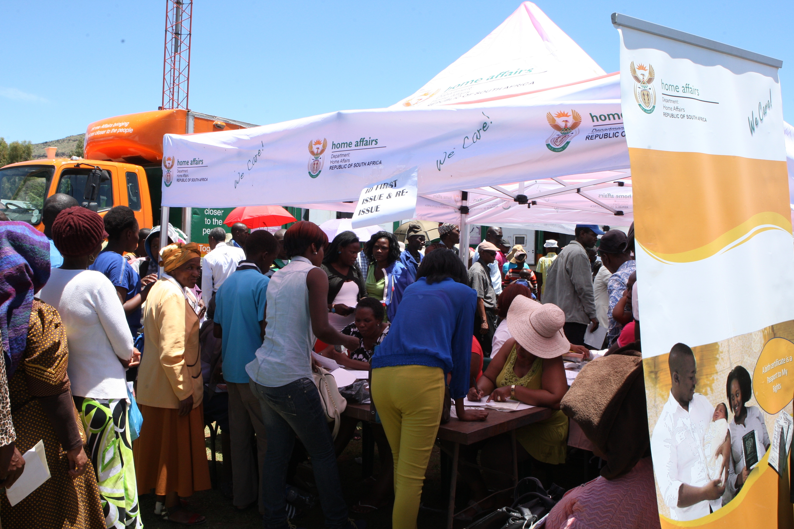
DHA would like to thank the Committee for their support and guidance.

