Slide 1
Department of
Higher Education and Training
Progress Report on the Action Plan in Addressing Issues Identified during the Oversight Visit at South West Gauteng TVET College
Portfolio Committee on Higher Education and Training
15 February 2017

Slide 2
Presentation Outline
1. Background
2. Pending results and exam irregularities
3. KM radius coverage not adequately catered by bursary policy
4. Curriculum of TVET Colleges out-dated
5. Labour relations issues
6. Human resources issues
7. Concluding remarks and way forward

Slide 3
Background
On 22 September 2016 the Portfolio Committee on Higher Education and Training conducted an oversight visit to South West Gauteng Technical and Vocational Education and Training (TVET) College, Head Office at Molapo. Several stakeholders at the College were invited to a meeting with the Portfolio Committee wherein a number of concerns were raised.
Due to a disruption of the meeting by union representatives, the meeting could not conclude, and the Portfolio Committee could not get adequate responses from both the Department and the College.

Slide 4
Background
The Department and the College were requested to provide feedback to the Portfolio Committee on actions that will be undertaken to resolve the issues raised mainly by organised labour and students.
On 07 October 2016 DDG: TVET convened a meeting of all stakeholders at the College to discuss the issues and to develop the Action Plan.

Slide 5
Background
This meeting was attended by officials from Head Office, Regional Office and College Management. Various stakeholders at the College were also invited to the meeting and they included representatives from the SRC, NAPTOSA, NEHAWU and PSA, Concerns raised by the various stakeholders at the College were discussed and actions to be undertaken to resolve these issues were agreed upon by the DHET, College Management, organised labour and the SRC.
On 10 October 2016, a report with the Action Plan was submitted to the Portfolio Committee.
Progress update is provided for actions assigned to DHET.

Slide 6
DHET PROGRESS REPORT ON KEY ACTIONS FROM THE SWGC MEETING OF 07 OCTOBER 2016

Slide 7
Pending results and exam irregularities

Slide 8
Pending results and exam irregularities
Action: | Progress Update:
Provide a firm commitment as to when the results will be released and indicate what the challenge was. | A meeting was agreed upon between the College and the CD: NEA in December 2016. Unfortunately, the Deputy Principal: Academic fell ill and the meeting was postponed. This has now been overtaken by the developments as all matters related to outstanding results have been addressed with the College.
Conduct an investigation of irregularities within a specified period, which period should be communicated to students at college. | The irregularities at SWGC are processed along with those of all other centres per exam cycle. The college will have to provide specific details should any cases remain unresolved.

Slide 9
Pending results and exam irregularities

Slide 10
Pending results and exam irregularities
Action: | Progress Update:
Document all the current problems related to pending results and the changing of results and send a report to DDG: TVET. | All resulting queries have been resolved. The task team on examinations matters has been established and DDG: TVET is the convener. Weekly meetings are held where actions to resolve challenges are agreed upon and progress reports are provided to DDG: TVET.
Instruct the Chief Director: Examinations and officials to be sent to college to clarify the issues raised by the student. | No visit undertaken to date. Resulting issues raised have been resolved in the interim. The matter closed.

Slide 11
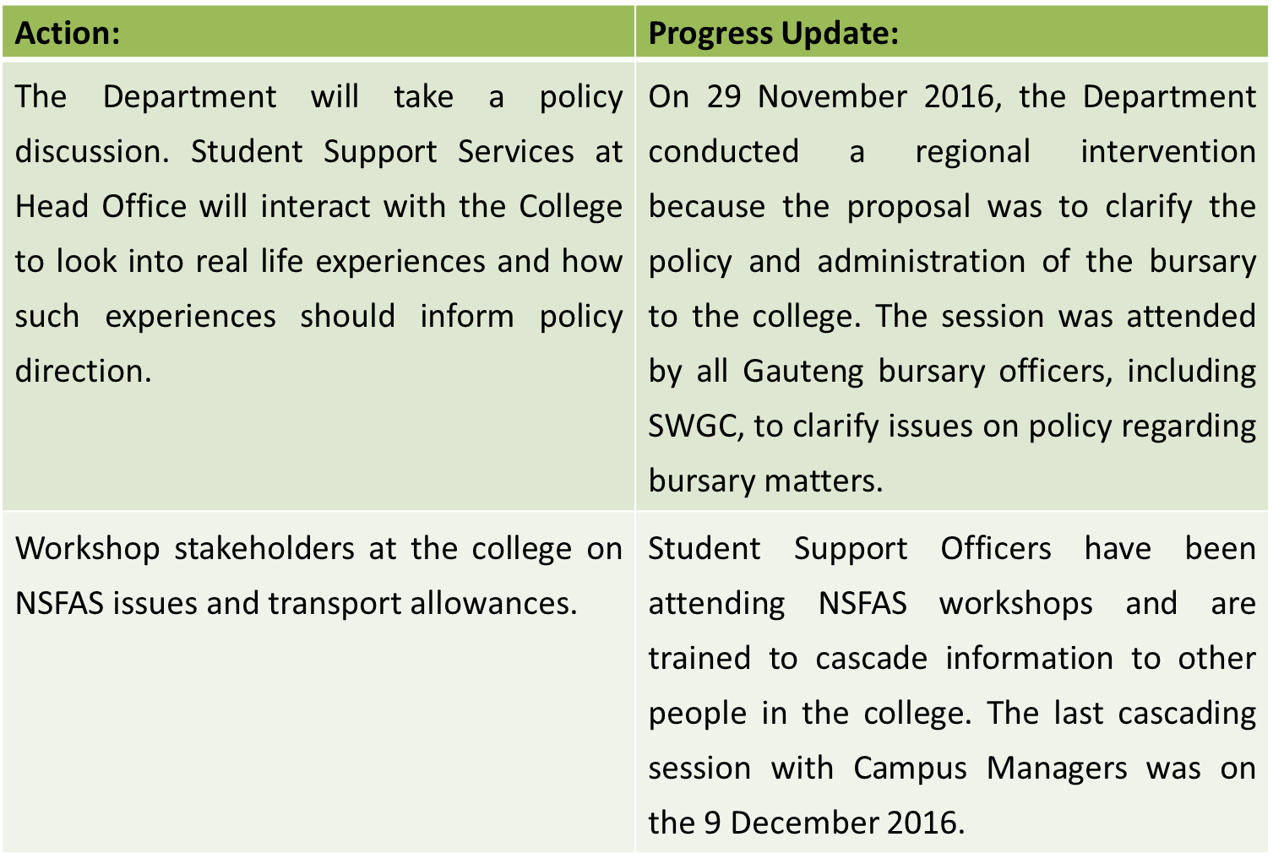
Km radius coverage not adequately catered by bursary policy

Slide 12
Km radius coverage not adequately catered by bursary policy
Action: | Progress Update:
Student Support Services Directorate will visit the College to explore what is possible within the NSFAS policy guidelines. | No specific visit has been conducted at the College. However, SWGC has been part of workshops on changes in the NSFAS policy.

Slide 13
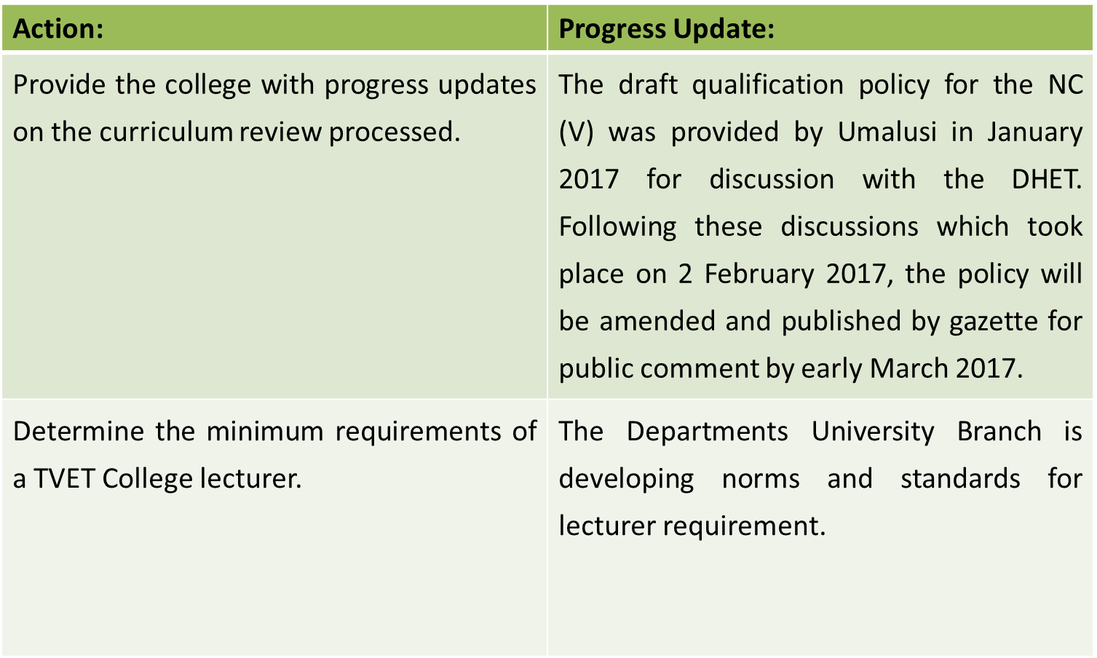
Curriculum of TVET Colleges out-dated

Slide 14
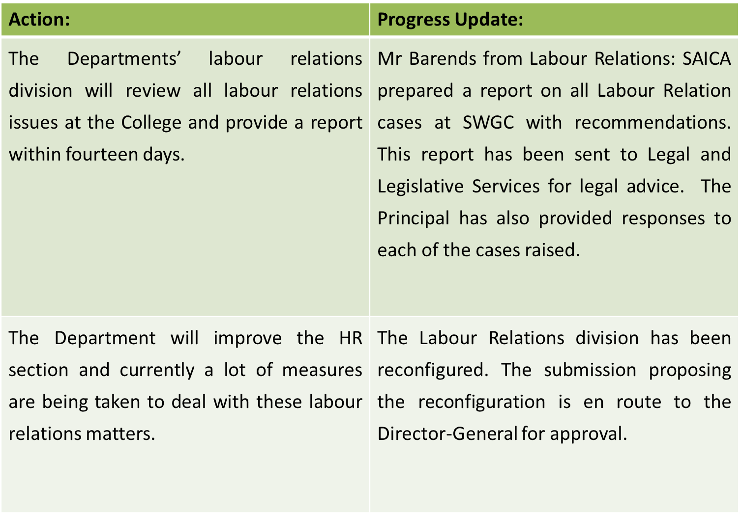
Labour relations issues

Slide 15
Labour relations issues
Action: | Progress Update:
The Department will ensure that there is only one contact point dealing with labour relations matters at Head Office. | An official from Head Office, Ms Julianne Avis has been appointed to deal with all labour relations matters related to SWGC.

Slide 16
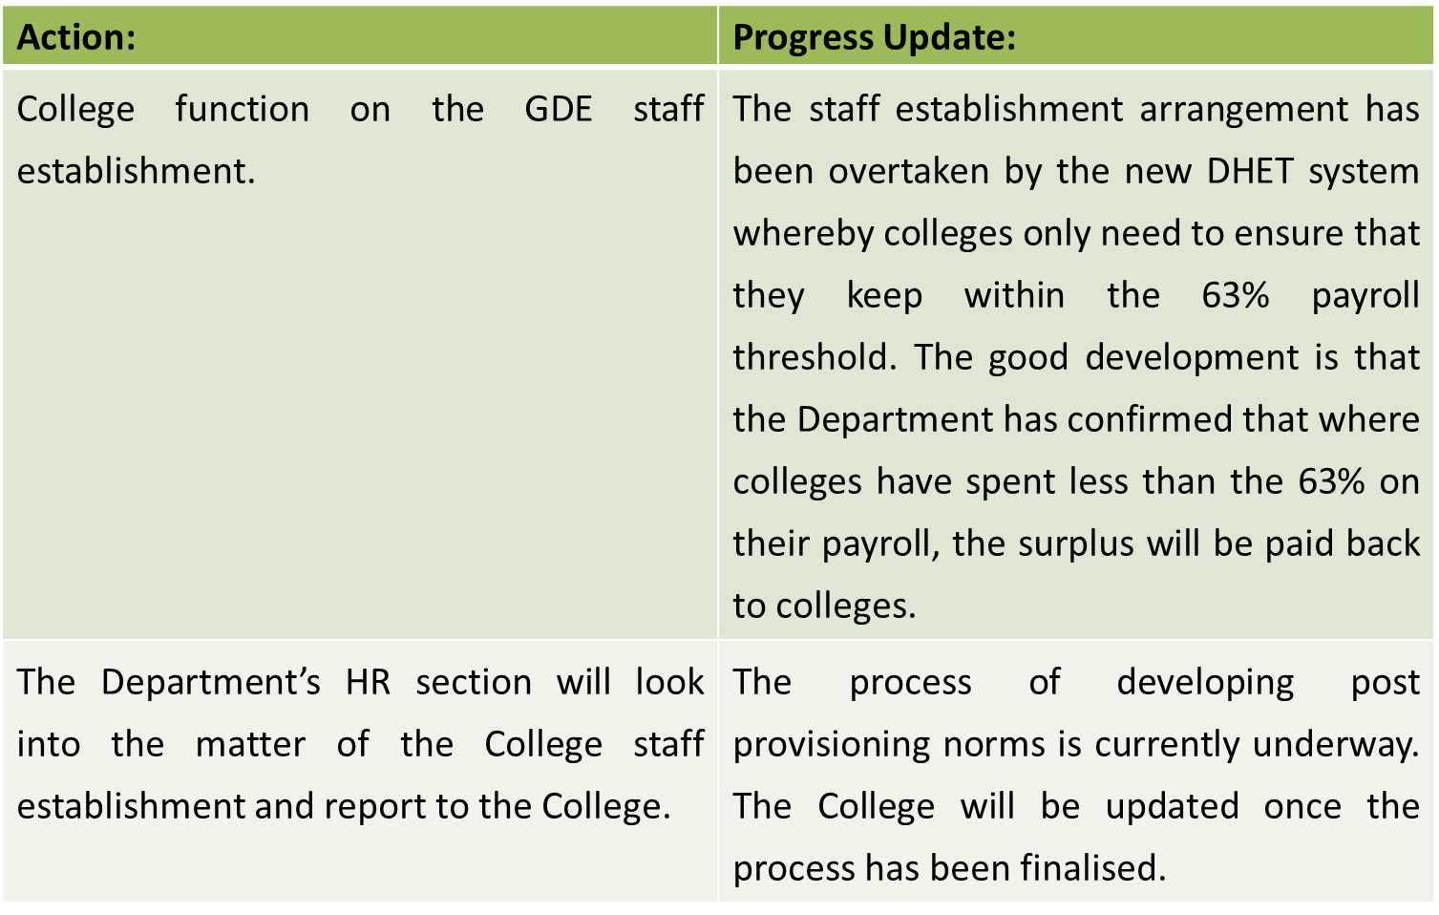
Human resources issues

Slide 17
Way forward
Action: | Progress Update:
The process report will be submitted to the Portfolio Committee listing all the issues and indicating what process will be undertaken to resolve these issues. | A report with an Action Plan was submitted to the Portfolio Committee on 10 October 2016.
The Regional Office will follow up with the college in regard to developing the broad plan with timeframes. The Regional Office should give priority to the issues in terms of the urgency required to resolve them. | Regional Office has been interacting with College and updating itself on progress being made, with latest engagement having taken place on 09 January 2017, with Acting Regional Manager, Mr. Friendly Thwala (DHET).

Slide 18
Thank You

